Slide 1
Before Data Weighting:
An ensemble model approach to fishery management advice
CAPAM Workshop on Data-Weighting
October 2015
Richard D. Methot
NOAA Fisheries Senior Scientist for Stock Assessments

Slide 2
Take Home Messages
Structural uncertainty dominates
Thru sensitivity analyses, decision tables, MCMCs, grid profiles and “stuck juries” we are close to ensemble modeling today
Multiple operating models in MSEs are ensembles
A few examples of explicit ensembles exist
Protocols for membership in ensembles need development
Communication of ensemble distribution, central tendency, decision analysis need development

Slide 3
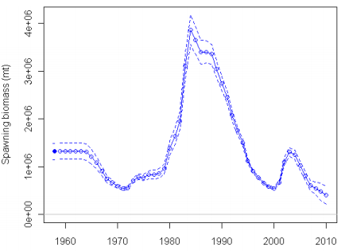
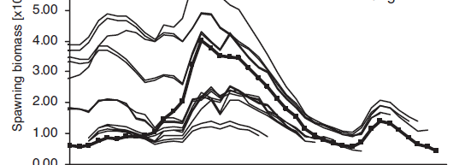
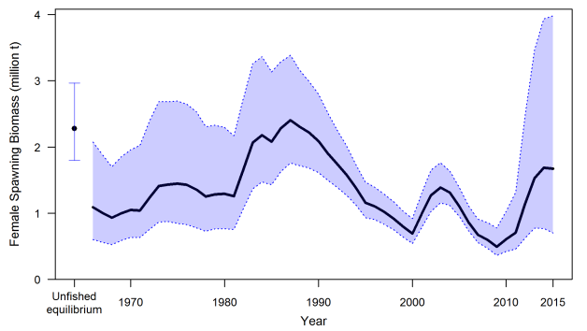
Structural Uncertainty Dominates – Pacific hake
2010
Ralston et al;
Meta-analysis
2015
M, h, q estimated

Slide 4
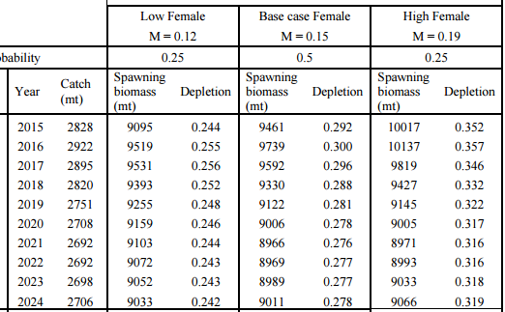
Decision Analysis – Petrale sole
States of nature were based on the likelihood profile of female M
Midpoints of the lower 25% probability and upper 25% probability regions

Slide 5
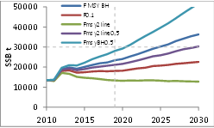
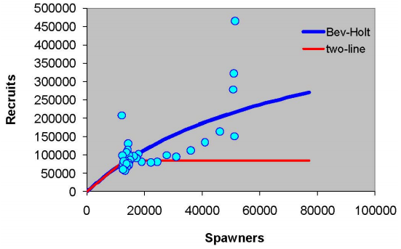
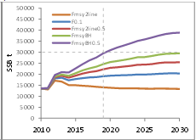
Decision Analysis for Atlantic Bluefin Tuna
Maximize the minimum gain vs.
Minimize the maximum loss
Rosenberg et al. 2012. Scientific Examination of Western Atlantic Bluefin Tuna Stock-Recruit Relationships
Notes:
MAXIMIN: A risk-averse approach used to select a decision that maximizes a minimum gain If high SSB is desired,for each decision d, calculate the min. SSB that would result from applying that decision across all states of nature. Then, select decision d that results in largest of these minima.
MINIMAX: A less risk-averse strategy, that selects the action that minimizes the maximum regret or realized benefit and what could have been obtained if the correct decision been made. If losses in yield are to be avoided: For each decision d, calculate the maximum yield loss across the possible states of nature. Then, select the decision d that results in the smallest of these losses

Slide 6
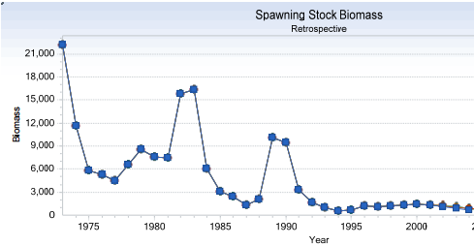
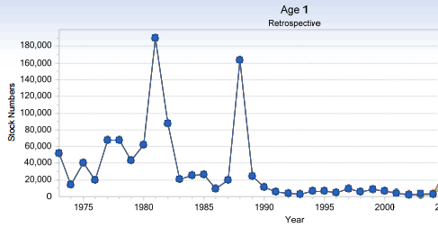
Southern New England Yellowtail Flounder
Same regime shift question as in Atlantic bluefin tuna
Close vote in SSC
Chose regime shift, so lowered rebuilding Bmsy, and lowered MSY
Regime Shift?

Slide 7
MSE for southern bluefin tuna
Define “operating models” to incorporate uncertainty about the stock, dynamics and sampling
  Level of productivity (steepness of SR)
  Level of natural mortality
  Interpretation of CPUE
  Currently an ensemble of 320 “models”
Use to test candidate HCR proposed by member scientists
Find HCR that is robust to uncertainties, achieves rebuilding objectives and maintains a viable industry

Slide 8
DLMTool – Carruthers et al
DLMtool uses Management Strategy Evaluation and parallel computing to make powerful diagnostics accessible
Includes over 55 MPs
  3 catch-based, static
  6 depletion-based, static; e.g. DBSRA
  2 catch-based, dynamic
  4 depletion-based, dynamic
  6 abundance-based, dynamic
Same MP functions that are tested by MSE can be applied to provide management recommendations from real data.
SUMMARY: Evaluation of model skill using MSE to guide selection for development for management advice

Slide 9
More pseudo-ensembles
MCMC | Grid Profile
likelihood based search across all parameter space | MPD estimate of free parameters given selected grid position
Key parameters (M, h, q) may have informative prior | Key parameters form the grid dimensions
Discontinuous structural decisions possible, but harder, to incorporate | Structural decisions can be a grid dimension
Structural uncertainty then could be represented in the LogL based uncertainty calculation | Moments of the grid can be unweighted, LogL weighted, weighted by another measure of model skill
Advice is the median of the posterior density function | Advice may not be prescriptive, instead can be the pdf of possible outcomes given possible management decisions

Slide 10
Approaches to Dealing with Structural Uncertainty
Turn into estimated parameter
Contrast in a decision analysis
Alternative operating models in MSE
Expand into an ensemble

Slide 11
Ensemble Model Approach in Other Fields
Burnham and Anderson, 2002. Model Selection and Multimodel Inference
Dietterich. 2000. Ensemble methods in machine learning. In Multiple classifier systems
Tebaldi and Knutti, 2007. The use of the multi-model ensemble in probabilistic climate projections.
Yun et al. 2005. A multi-model superensemble algorithm for seasonal climate prediction
Grueber, et al 2011. Multimodel inference in ecology and evolution: challenges and solutions.
Thomson et al. 2006. Malaria early warnings based on seasonal climate forecasts from multi-model ensembles

Slide 12
Super-Ensembles
Superensembles use the predictions from multiple models as covariates in a new statistical model
Trained against a set of known results
Includes correlations among models in the ensemble

Slide 13
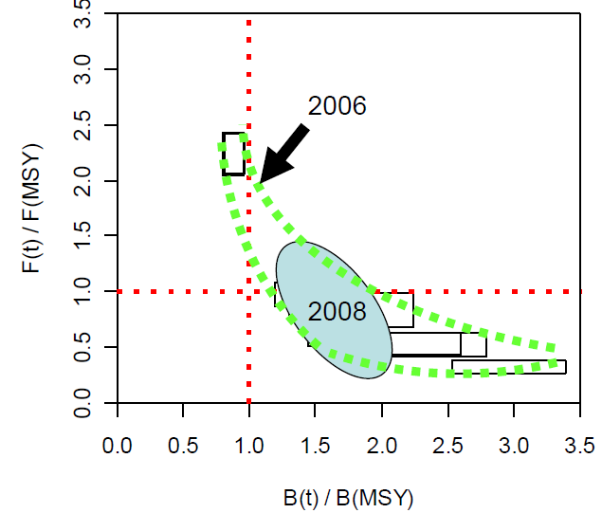
Western Pacific Swordfish Ensemble Model
Kolody et al 2008
Multifan-CL
192 models in Most Plausible Ensemble
  2 stock recruitment curve steepness priors
  2 diffusive mixing assumptions
  8 growth rate / maturity / mortality options
  2 recruitment deviation options
  2 sample size down-weighting options for catch-at-size likelihoods
  3 relative weighting options for CPUE
  2 selectivity constraint options
Data weighting is part of the ensemble structure
Parameter estimation error < above structural error

Slide 14
An aside on composition data
Biomass dynamics works by comparing observed ∆B to e(∆B) from catch and f(B)
Composition data improves on biomass dynamics:
  Explicit selectivity
  Information on recruitment deviations
Composition data competes with biomass dynamics:
  Direct information on Z rather than on ∆B
  But now conditional on M, selectivity, and R trend

Slide 15
Structural Choices / Potential Ensemble Axes
FACTOR | OPTIONS
Q – fishery CPUE | constant, trend, random walk
Q - survey | Uniform, or informed prior
M | fixed, or estimated with prior
Growth | Set, estimated, time-varying
Selectivity | asymptotic, or domed; parametric or non
Selectivity | time-invariant, or not
Selectivity | Size based, age-based, both
Spawner-recruitment shape | Bev-Holt, Ricker, Shepard, none, regime-shifted
Spawner-recruitment steepness | fixed, =1.0, estimated, with prior, inferred
Recruitment deviations | Random, env-linked, dev from SRR, auto-correlated
Data-weighting | Emphasize trend info vs. composition
A few more…………

Slide 16
Ensemble Proposal
Define a set of model configurations that is always in the ensemble
Allow for at least one stock specific ensemble factor
Run all with internal tuning to the extent implemented
Classify into tiers of plausibility? Based on?
Get catch advice and status projection from each according to standard harvest policy
Get status projection from each, given median catch advice from all
Report distribution and median as the consensus advice (by plausibility tier?)

Slide 17
Questions
How can we support status determinations and ACL setting from an ensemble of possible results?
Ensembles by model configuration within package?, by alternative but similar software?, by different degrees of model complexity?
Un-weighted, logL-weighted, other skill weighted, or super-ensemble?
How much tuning, data-weighting, random effects estimation should occur within each ensemble member?
Can we focus attention on the big picture and avoid getting lost in weeds of ensemble members?

Slide 18
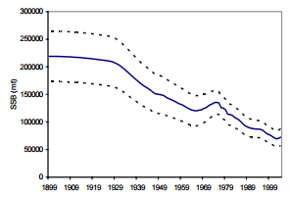
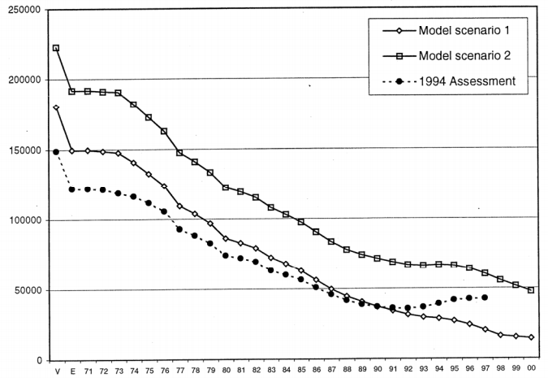
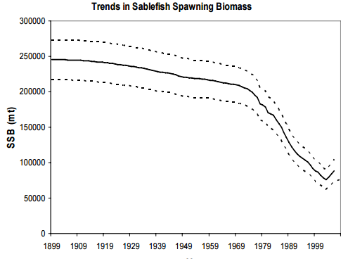
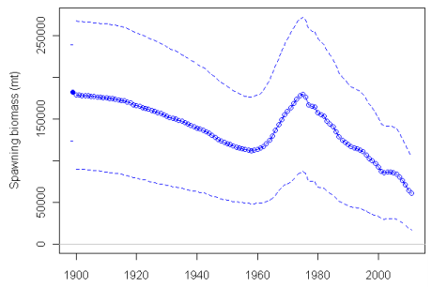
Sablefish
1998
2005
2011
2007

