Slide 1
Modeling biological-composition time series in integrated stock assessments:
data weighting considerations and impact on estimates of stock status
Fishery 1
Fishery 2
P. R. Crone
Southwest Fisheries Science Center (NOAA)
Center for the Advancement of Population Assessment Methodology (CAPAM)
8901 La Jolla Shores Dr., La Jolla, CA 92037, USA

Slide 2
Presentation outline
Study description
Results
Conclusions
Further work

Slide 3
Study description
Motivation and expectations
  Better understanding of impact that data weighting considerations in typical assessments have on baseline management statistics …
  contribute to good practices for stock assessment development
  Meta-analysis is based on a limited pool of assessments …
  is able to provide quantitative results for particular statistical comparisons, is not a substitute for simulation-based tests

Slide 4
Study description
General
Assessment archive
  Pool of recently conducted fish stock (species) assessments used for management
  Assessments for small pelagic (3), large pelagic (7), and groundfish (19) species
  Assessments based on the Stock Synthesis model
  Majority of assessments conducted in 2015, some 2011-14
Biological-composition time series
  Length (‘marginal’, e.g., no./pct. by length bin and time step)
  Age (marginal)
  Conditional age-at-length (‘random at length’, age-length key format)
  Size (marginal, e.g., weight, biological compositions based on different bin structure)
  Weight (unfitted empirical weight-at-age data)
  Various ways of using/combining biological-composition time series in assessments

Slide 5
Study description
General (continued)
Data weighting of biological compositions ‘outside’ the model
  Initial (input) sample sizes for biological compositions are assessment/analyst-specific
  Sometimes based on actual number of fish (e.g., sport fishery compositions, CAAL)
  More often based on number of boat trips, hauls, sets, wells, sample adjustment formula, etc.
  Can be based generally on variance estimates determined from sample/survey programs
  Can be based generally on variance estimates from simulation analysis (e.g., bootstrap methods)
  Often caps (thresholds) are used for input sample sizes (e.g., 100-200)
  Input sample size determination was not addressed in this evaluation

Slide 6
Study description
General (continued)
Data weighting of biological compositions ‘inside’ the model
  Variability of biological-composition time series is based initially on input sample size … subsequently, adjusted internally based on comparing observed and expected values from fits to the time series
  Various data weighting approaches for composition time series in integrated assessment models … McCallister and Ianelli (1997) and Francis (2011) methods often considered in practice
  ‘Effective’ sample size in Stock Synthesis model (McCallister and Ianelli methods) reflects number of random samples (drawn from multinomial distribution) needed to produce fit as precise as model’s predicted fit
  Actual weighting values (scalars) for composition data reflect various mean estimates calculated from ratios of effective to input sample sizes (multiplicative based)
  Francis method basis is variation of mean length/age of the composition time series, accounts for correlation among length or age groups, results in greater variation surrounding composition time series
  In practice, ad hoc caps (thresholds) are implemented for estimated scalars >1
  Internally implemented data weighting methods for composition time series were addressed in this evaluation

Slide 7
Study description
Assessment models Data weighting methods
Baseline (Final)
  Assessment model for advising management
Unweighted (UW)
  Final model that includes no (internally) weighted composition time series
  All scalars (‘weighting values, variance adjustments, lambdas’) = 1
McCallister-Ianelli (AM)
  Scalar estimate reflects arithmetic mean from model fits to composition time series (based on ratios of effective sample size to input sample sizes)
McCallister-Ianelli (HM)
  Scalar estimate reflects harmonic mean from model fits to composition time series (based on ratios of effective sample size to input sample sizes)
Francis (F0)
  Assessments that included only length- and/or age-composition time series and no CAAL time series (based on FA)
Francis-Method A (FA)
  Assessments that included CAAL time series along with length and/or age-composition time series (mean estimates indexed by year)
Francis-Method B (FB)
  Assessments that included CAAL time series along with length and/or age-composition time series (mean estimates indexed by year/length bin)

Slide 8
Study description
General (continued)
Model development/estimation
  For each species, final assessment model re-configured according to recommended scalars from respective data weighting method (cap=100 and single iteration)
  For a species, from 3-5 alternative models were developed for overall study, depending on the biological compositions, SS version, convergence issues
  Data weighting addressed only biological compositions included in the model, i.e., no weighting applicable to other input data (e.g., index of abundance time series) or parameter assumptions (e.g., σ_{R} of stock-recruit relationship)
  Data weighting methods described in McCallister and Ianelli (1997), Francis (2011), Methot and Wetzel (2013), Punt (in press)
Output
  Management quantities of interest: MSY, F_{MSY}, B_{current}, Depletion (SSB_{current} / SSB₀)
  Comparisons based on means/CVs and medians/REs

Slide 9
Data weighting methods – Example (SS effective sample size)

Slide 10
Data weighting methods – Example (FA/FB/F0 diagnostic plot)
Mean length (cm)
5
Year

Slide 11
Study description
Analysis flow chart
Species
Assessment model
(Final)
Assessment model
(Data weighting method)
Output
(Management quantities)
Unweighted (All scalars=1)
UW
MSY, F_{MSY}, B_{current}, DEP
McCallister/Ianelli (Arithmetic mean) AM
MSY, F_{MSY}, B_{current}, DEP
P. sardine
Baseline
Final
McCallister/Ianelli (Harmonic mean)
HM
MSY, F_{MSY}, B_{current}, DEP
.
.
.
.
.
.
.
N = 29 species
Francis (No CAAL)
F0
MSY, F_{MSY}, B_{current}, DEP
Francis (CAAL, Method A)
FA
MSY, F_{MSY}, B_{current}, DEP
Francis (CAAL, Method B)
FB
MSY, F_{MSY}, B_{current}, DEP

Slide 12
Results

Slide 13
Data Weighting Methods
Scalar Ranges by Biological Data Type

Slide 14
Assessment (species) examples
Mean and CV
Mean and CV

Slide 15
Data Weighting Methods
‘Within Assessment’ Variability
MSY

Slide 16
Data Weighting Methods
‘Within Assessment’ Variability
F_{MSY}

Slide 17
Data Weighting Methods
‘Within Assessment’ Variability
B_{current}

Slide 18
Data Weighting Methods
‘Within Assessment’ Variability
Depletion

Slide 19
Data Weighting Methods
‘Between Management Quantity’ Variability
MSY
F_{MSY}
B_{current}
Depletion

Slide 20
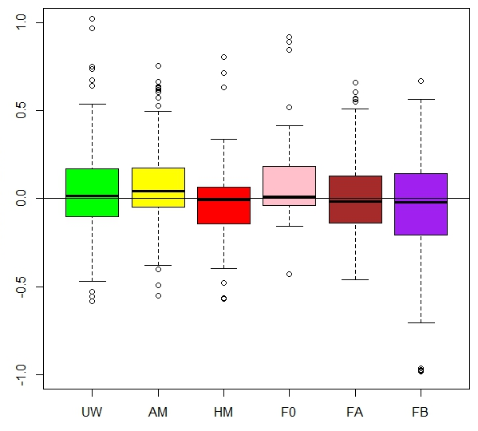
‘Within Assessment’ Variability (Relative to Data Weighting Method)
MSY
Relative error
Data weighting method
Species (no. of assessments) | 29 | 27 | 29 | 11 | 15 | 15
Models (no. of replicates) | 126 | 119 | 126 | 43 | 74 | 74
Sample size limit implemented (no. of species) | 0 | 2 | 0 | 0 | 1 | 1
Convergence issues (no. of species) | 0 | 2 | 0 | 0 | 0 | 0
Unplotted models (pct. extreme positive outliers) | 4% | 2% | 2% | 2% | 4% | 1%

Slide 21
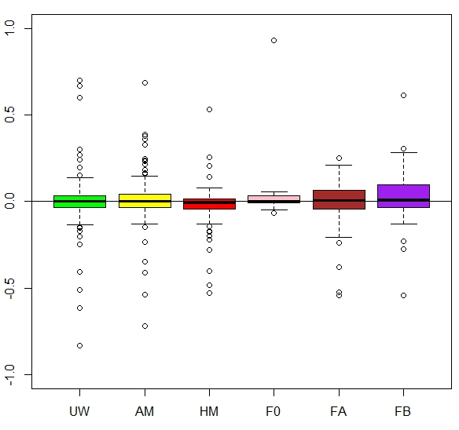
‘Within Assessment’ Variability (Relative to Data Weighting Method)
F_{MSY}
Relative error
Data weighting method
Species (no. of assessments) | 29 | 27 | 29 | 11 | 15 | 15
Models (no. of replicates) | 126 | 119 | 126 | 43 | 74 | 74
Sample size limit implemented (no. of species) | 0 | 2 | 0 | 0 | 1 | 1
Convergence issues (no. of species) | 0 | 2 | 0 | 0 | 0 | 0
Unplotted models (pct. extreme positive outliers) | 1% | 0% | 2% | 7% | 0% | 0%

Slide 22
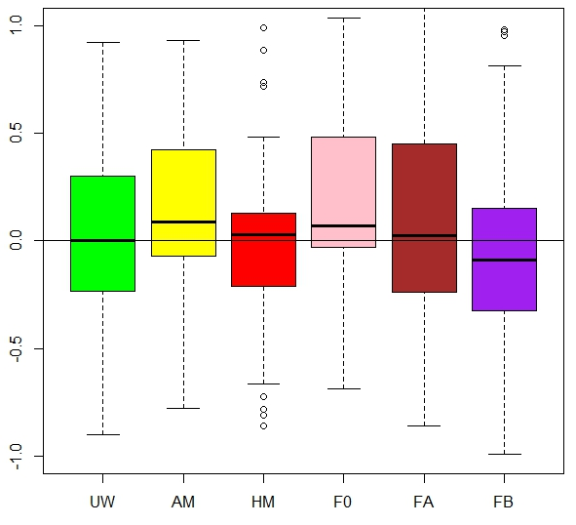
‘Within Assessment’ Variability (Relative to Data Weighting Method)
B_{current}
Relative error
Data weighting method
Species (no. of assessments) | 29 | 27 | 29 | 11 | 15 | 15
Models (no. of replicates) | 126 | 119 | 126 | 43 | 74 | 74
Sample size limit implemented (no. of species) | 0 | 2 | 0 | 0 | 1 | 1
Convergence issues (no. of species) | 0 | 2 | 0 | 0 | 0 | 0
Unplotted models (pct. extreme positive outliers) | 6% | 11% | 4% | 12% | 9% | 5%

Slide 23
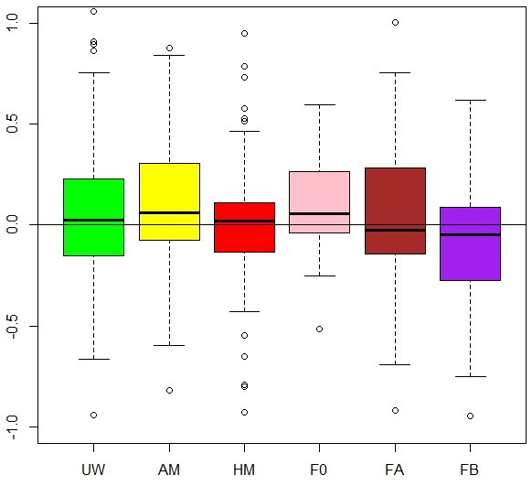
‘Within Assessment’ Variability (Relative to Data Weighting Method)
Depletion
Relative error
Data weighting method
Species (no. of assessments) | 29 | 27 | 29 | 11 | 15 | 15
Models (no. of replicates) | 126 | 119 | 126 | 43 | 74 | 74
Sample size limit implemented (no. of species) | 0 | 2 | 0 | 0 | 1 | 1
Convergence issues (no. of species) | 0 | 2 | 0 | 0 | 0 | 0
Unplotted models (pct. extreme positive outliers) | 5% | 10% | 2% | 12% | 1% | 3%

Slide 24
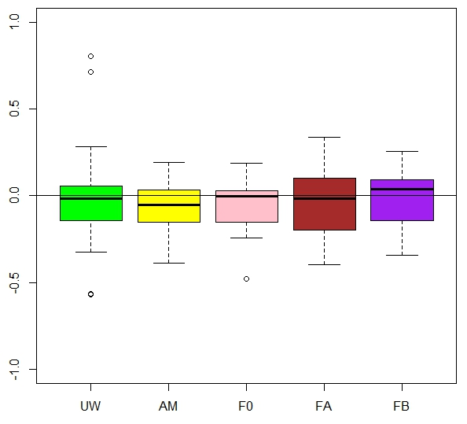
Data Weighting Methods
Relative to HM (‘correctly specified’ model)
MSY
Relative error
Data weighting method
Species (no. of assessments) | 29 | 27 | 11 | 15 | 15
Models (no. of replicates) | 29 | 27 | 11 | 15 | 15
Sample size limit implemented (no. of species) | 0 | 2 | 0 | 1 | 1
Convergence issues (no. of species) | 0 | 2 | 0 | 0 | 0
Unplotted models (pct. extreme positive outliers) | 0% | 0% | 0% | 0% | 13%

Slide 25
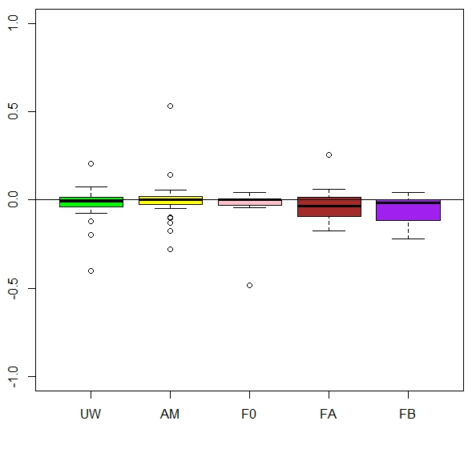
Data Weighting Methods
Relative to HM (‘correctly specified’ model)
F_{MSY}
Relative error
Data weighting method
Species (no. of assessments) | 29 | 27 | 11 | 15 | 15
Models (no. of replicates) | 29 | 27 | 11 | 15 | 15
Sample size limit implemented (no. of species) | 0 | 2 | 0 | 1 | 1
Convergence issues (no. of species) | 0 | 2 | 0 | 0 | 0
Unplotted models (pct. extreme positive outliers) | 3% | 0% | 0% | 0% | 0%

Slide 26
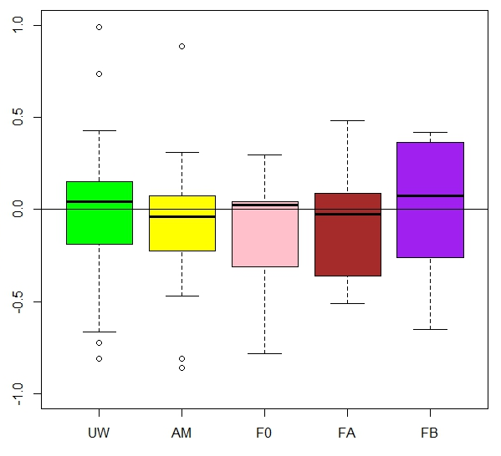
Data Weighting Methods
Relative to HM (‘correctly specified’ model)
B_{current}
Relative error
Data weighting method
Species (no. of assessments) | 29 | 27 | 11 | 15 | 15
Models (no. of replicates) | 29 | 27 | 11 | 15 | 15
Sample size limit implemented (no. of species) | 0 | 2 | 0 | 1 | 1
Convergence issues (no. of species) | 0 | 2 | 0 | 0 | 0
Unplotted models (pct. extreme positive outliers) | 3% | 0% | 0% | 0% | 13%

Slide 27
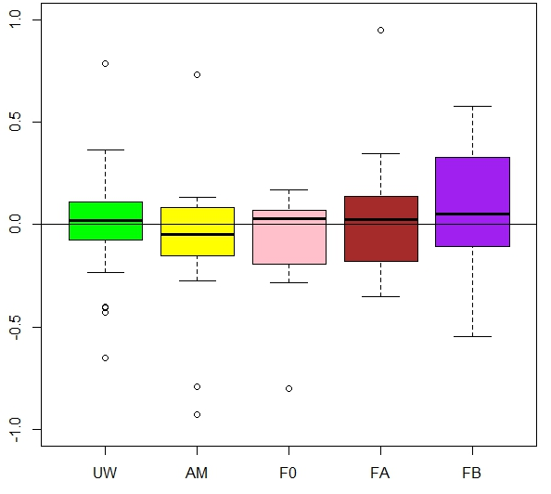
Data Weighting Methods
Relative to HM (‘correctly specified’ model)
Depletion
Relative error
Data weighting method
Species (no. of assessments) | 29 | 27 | 11 | 15 | 15
Models (no. of replicates) | 29 | 27 | 11 | 15 | 15
Sample size limit implemented (no. of species) | 0 | 2 | 0 | 1 | 1
Convergence issues (no. of species) | 0 | 2 | 0 | 0 | 0
Unplotted models (pct. extreme positive outliers) | 0% | 0% | 0% | 0% | 7%

Slide 28
Conclusions
Data weighting methods impact on management quantities
  Terminal biomass estimates most uncertain in most cases (mean CV=35%), depletion and MSY less so (20%), and F_{MSY} most precise (<10%)
  Positively-skewed, median-unbiased relative error distributions
  The harmonic mean-based McCallister-Ianelli method (HM) resulted in precise and unbiased estimates in most cases, but …
  Unweighted method (UW) also relatively precise and robust in many comparisons
  Frances methods (F0, FA, FB) produced generally unbiased estimates, but typically less precise than HM; more similar for MSY-related quantities
  FA less bias (equally precise) than FB in many comparisons
  For correctly-specified assessment based on HM, better off not weighting (UW) than implementing an alternative data weighting method

Slide 29
Study benefits and further work
Replicates (assessments) in meta-analysis are realistic
  Replicates associated with typical simulations are unrealistic, i.e., much too similar to one another … increase number/variety of assessments
  However, study (experimental) population based on real assessments provides limited cause-and-effect information, given the many data/parameter inconsistencies across replicates
Meta-analysis provides baseline information for more focused simulation studies
  Contrast between quality of derived management metrics
  Fold into MSEs addressing small pelagic species’ fisheries on the USA Pacific coast for basing (much needed) new and improved harvest control rules
Information useful for analysts charged with developing ongoing assessments for management purposes
  Data weighting approaches in actual assessments are evolving presently, research needed to inform good practices

Slide 30
References
Crone, P.R., D.B. Sampson. 1998. Evaluation of assumed error structure in stock assessment models that use sample estimates of age composition. Pages 355-370 in Fishery Stock Assessment Models. Alaska Sea Grant College Program Report No. AK-SG-98-01, University of Alaska, Fairbanks, Alaska.
Fournier, D., C.P. Archibald. 1982. A general theory for analyzing catch at age data. Can. J. Fish. Aquat. Sci. 39:1195-1207.
Francis, R.I.C.C. 2011. Data weighting in statistical fisheries stock assessment models. Can. J. Fish. Aquat. Sci. 68:1124-1138.
McAllister, M.K., J.N. Ianelli. 1997. Bayesian stock assessment using catch-age data and the sampling-importance resampling algorithm. Can. J. Fish. Aquat. Sci. 54(2): 284–300.
Methot, R.D., C.R. Wetzel. 2013. Stock Synthesis: a biological and statistical frame-work for fish stock assessment and fishery management. Fish. Res. 142:86–99.
Pennington, M., L.-M. Burmeister, V. Hjellvik. 2002. Assessing the precision of frequency distributions estimated from trawl survey samples. Fish Bull. 100:74–80.
Punt, A.E. in press. Some insights into data weighting in integrated stock assessments. Fish. Res.
Stewart, I.J., O.S. Hamel. 2014. Boostrapping of sample sizes for length- or age-composition data used in stock assessments. Can. J. Fish. Aquat. Sci. 671:581-588.

