Slide 1
Data Weighting for Tagging Data in Integrated Size-Structured Models.
André E. Punt^{1,2}, Roy A. Deng², M.S.M. Siddeek³, Rik. C. Buckworth², and Vicki Vanek³
¹Uiniv. Washington ²CSIRO ³Alaska Department of Fish and Game
CSIRO Oceans & Atmosphere
11 April 2013

Slide 2
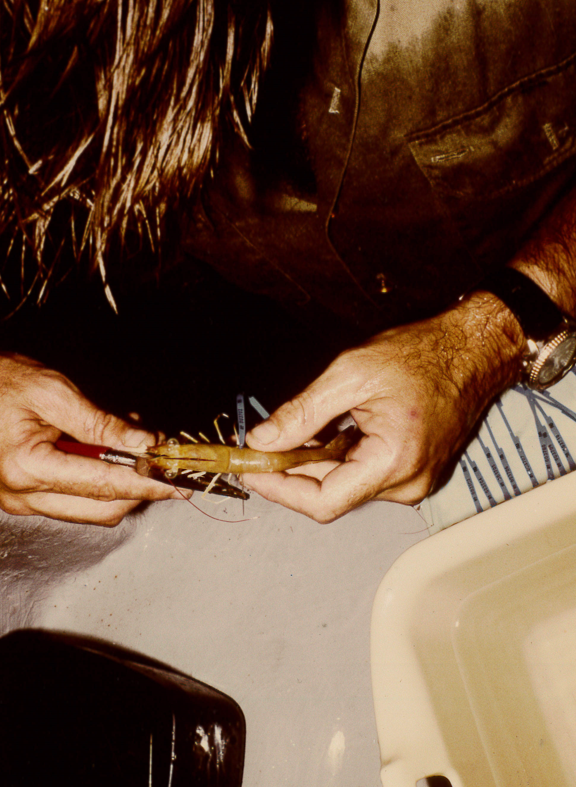
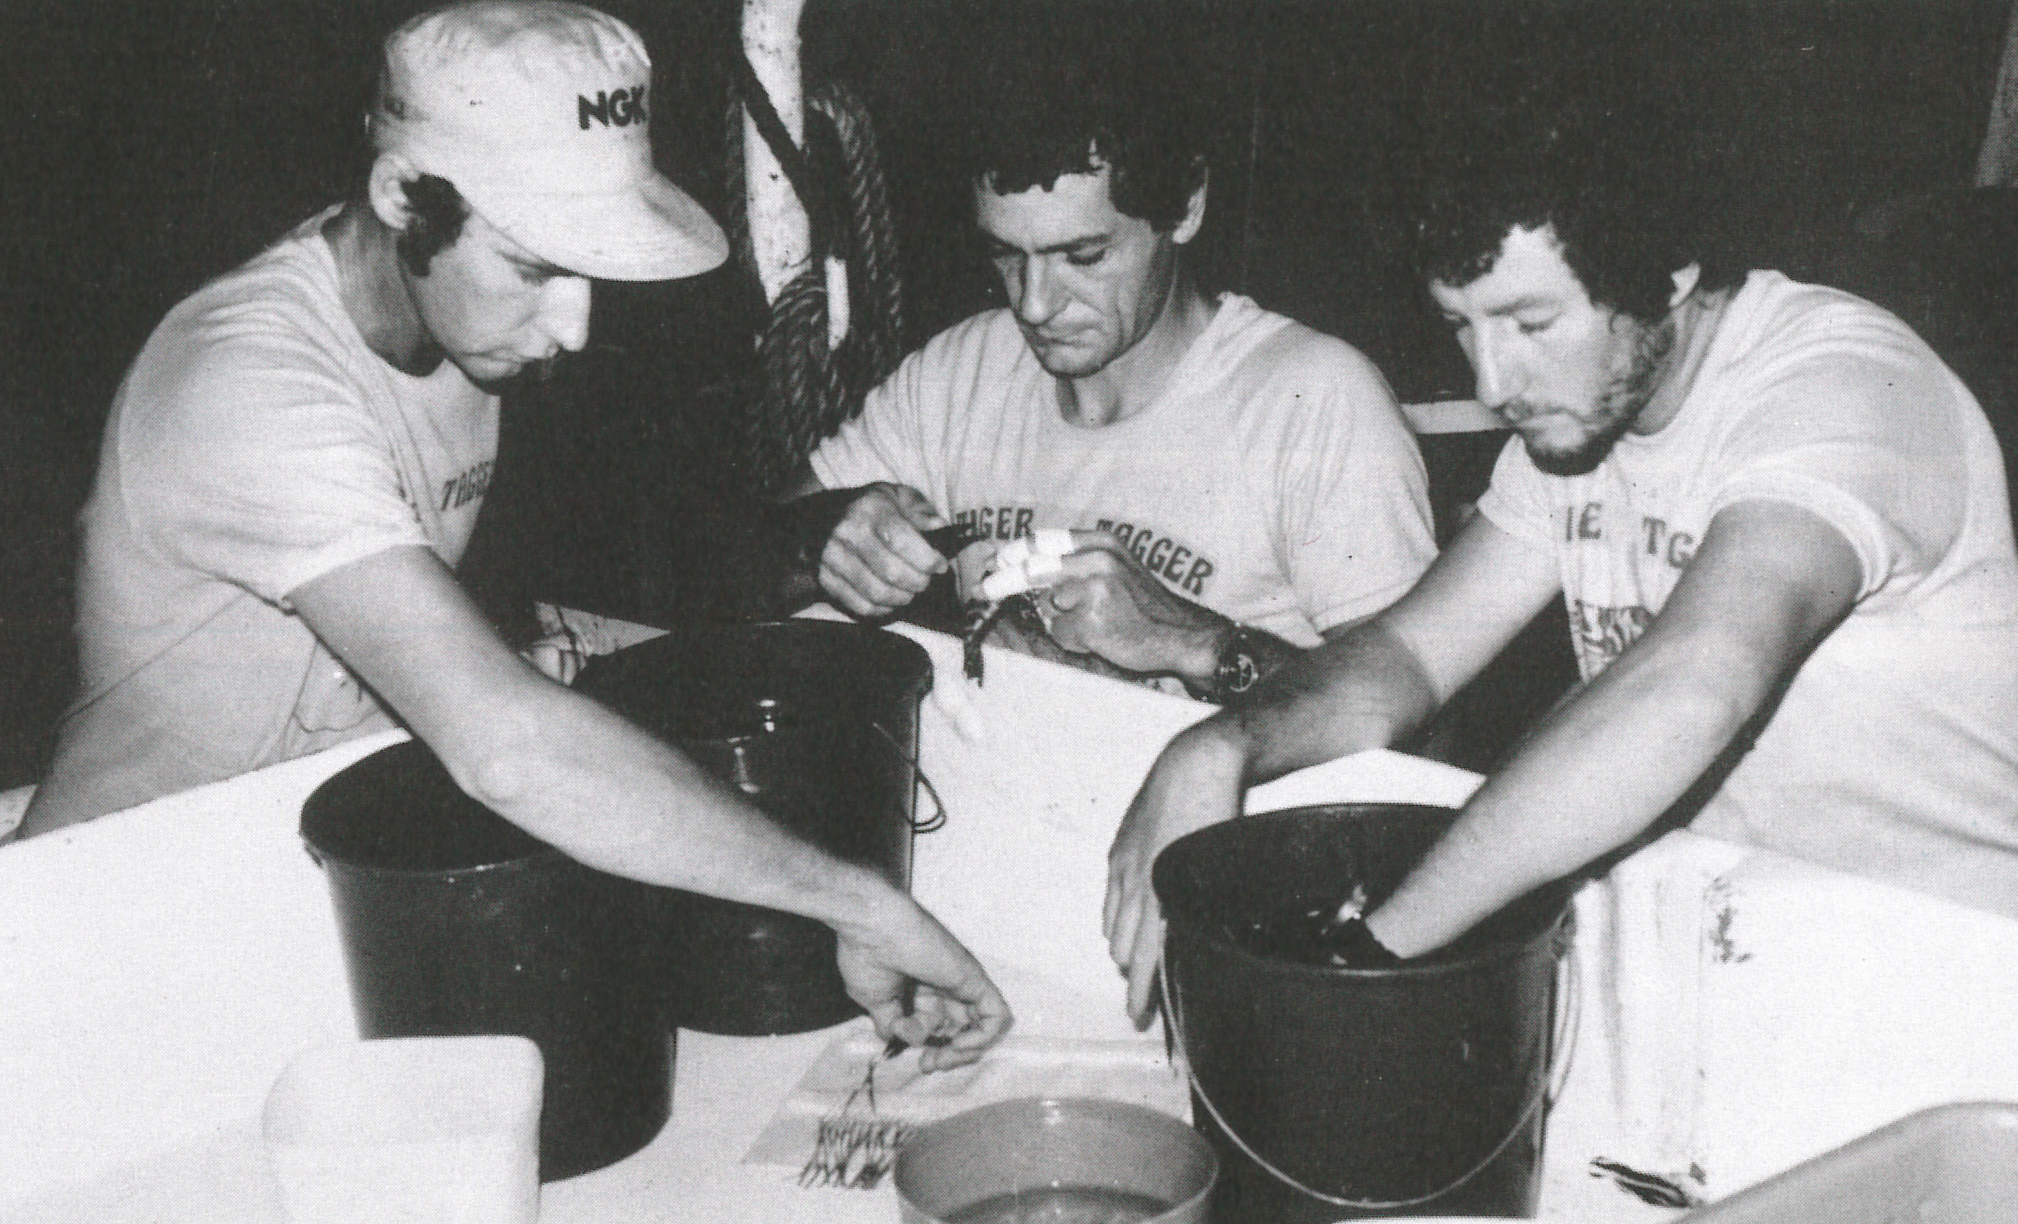
Preface
Back in the days of Ronald Reagan in the USA, and Bob Hawke in Australia . . .
–these young fellows were out collecting some of the data I am talking about today.
They would be delighted to see that the way it is being used is still being improved

Slide 3
Overview
Aleutian Is. Golden King Crab and Northern Prawn Fishery Tiger Prawns: tagging growth data in integrated size-structured models : complex
How well do the integrated models fit the tagging information (potential sources of data conflict)?
- we offer new diagnostics
How should the tagging growth information be weighted relative to the other types of information?
- we offer a new method that accounts for overdispersion, analogous to “Francis weighting”
Assessments can be profoundly impacted by weighting

Slide 4
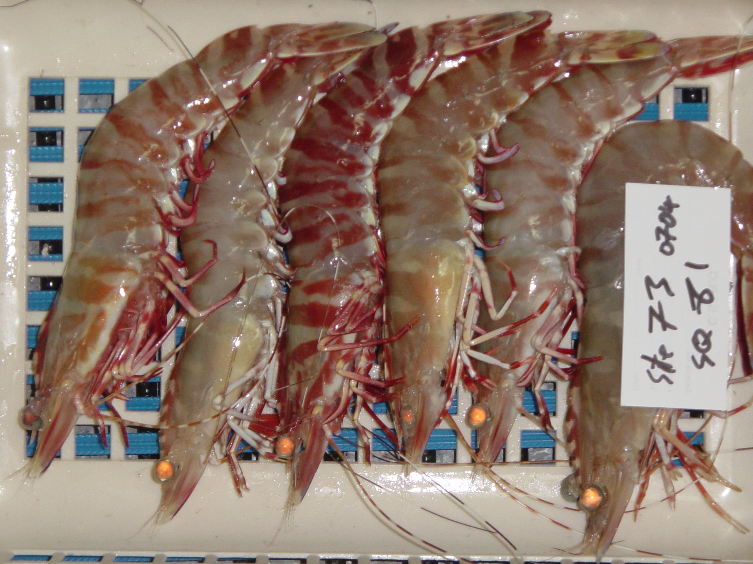
Some brief background on the fisheries - Tiger Prawns in Australia’s Northern Prawn Fishery
Tropical otter trawl fishery, 20-40 m
Input controls –ITEs, gear controls, extensive closures
Targets Grooved (Penaeus semisulcatus) and Brown (P. esculentus) Tiger prawns
A single (mostly) cohort fishery, targets large, valuable prawns
814-3285 t since 1996 (historically greater) ~ Aust $17-26 million
. P esculentus
. P semisulcatus
Notes:
There are several sub-models that contribute to this – length v weight, fishing, catch, growth
Growth is the NET number that enter that size class in that week
ditto recruitment

Slide 5
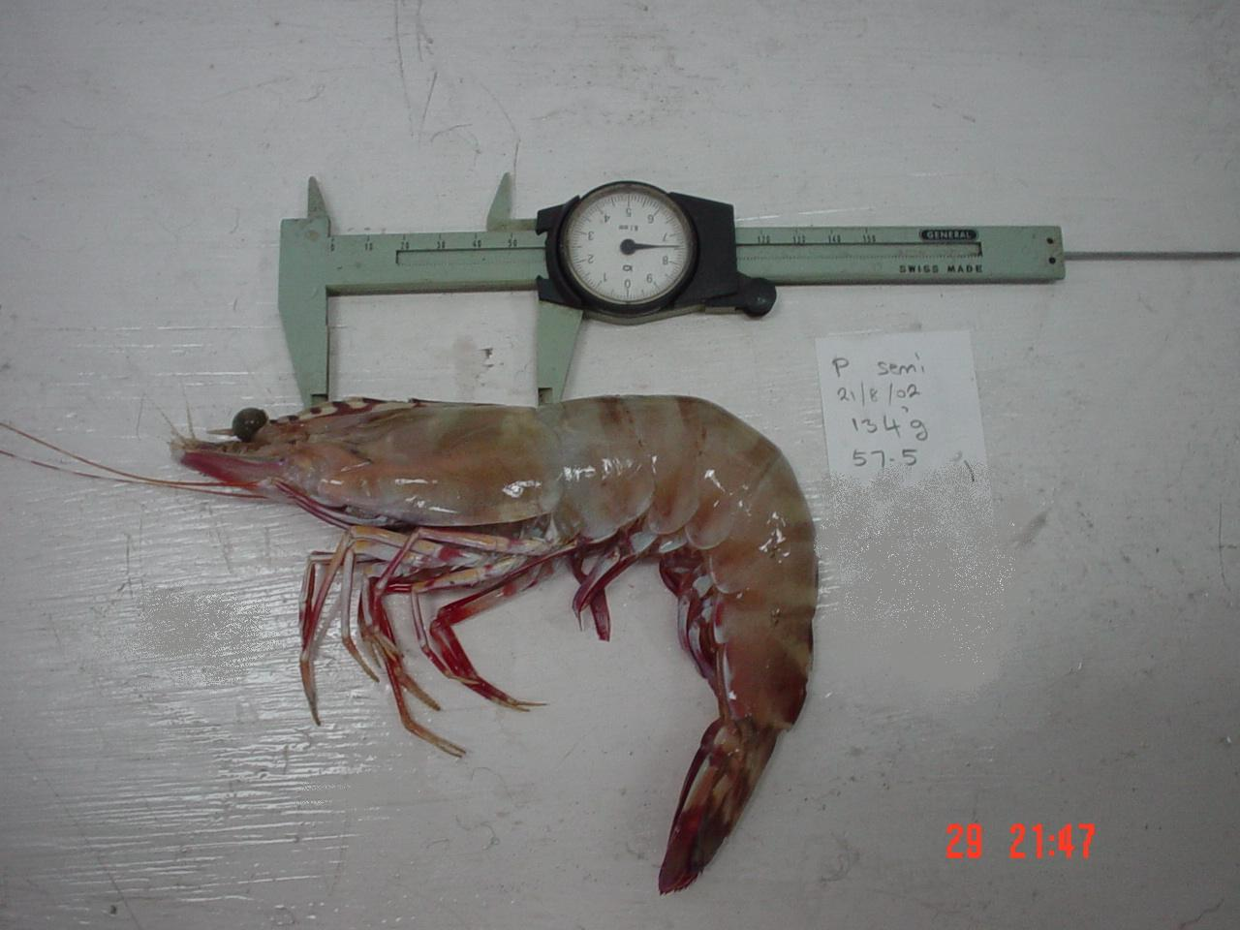
- Tiger Prawns in Australia’s Northern Prawn Fishery -more
Assessment via a sex- and length-structured, weekly time-step model using several different data types:
Catch and effort data, survey abundance index and size composition, commercial size composition, growth from tagging

Slide 6
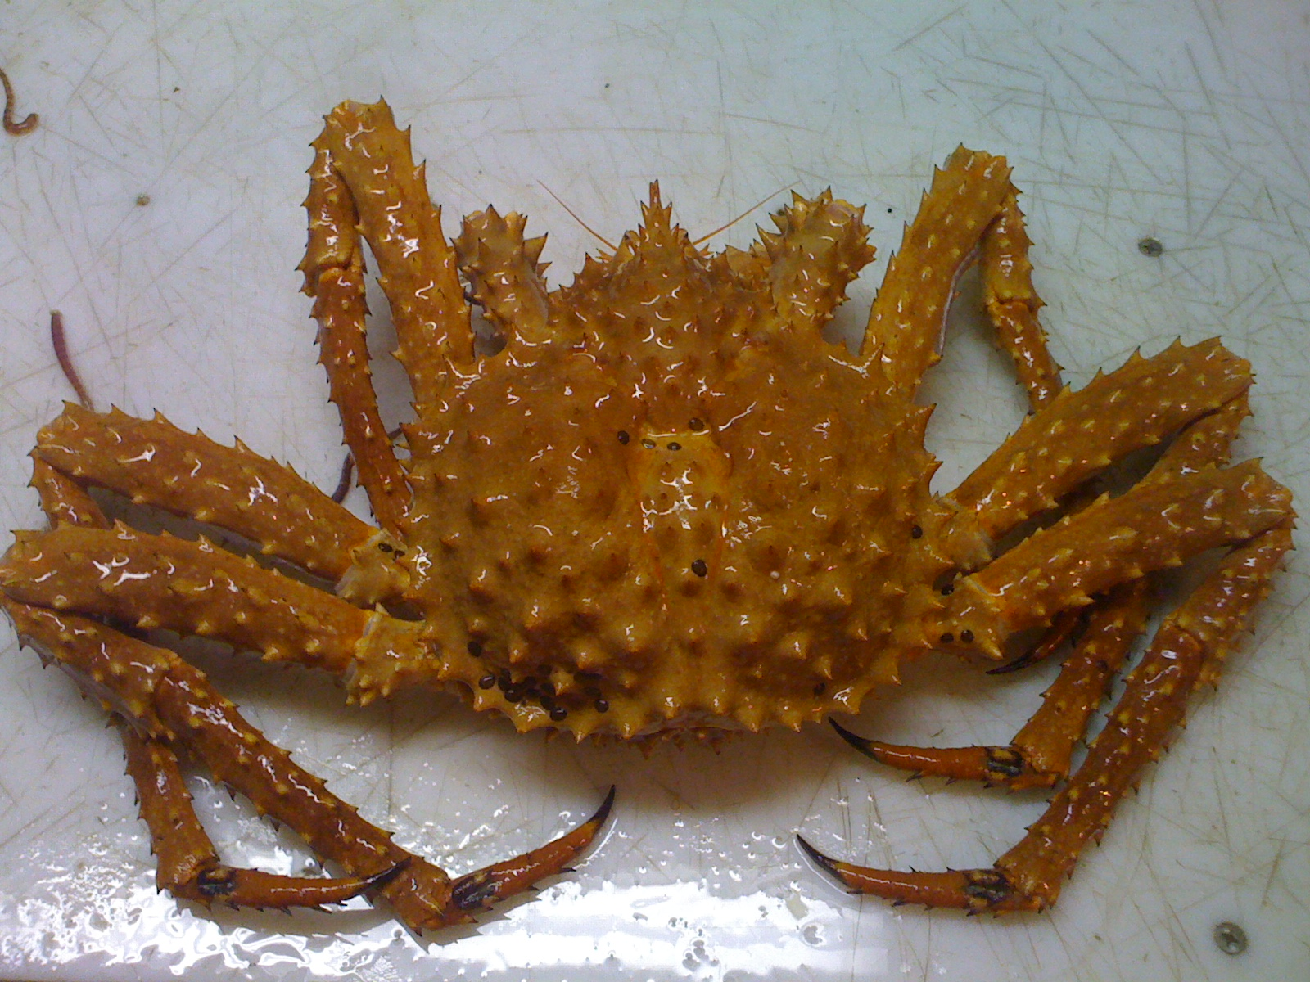
Some brief background on the fisheries - Golden King Crab in the West Aleutian Islands
Deep-water pot fishery for Lithodes aequispinus , west of 174º W.
Males only.
Lands 931-1140 t annually, valued US$2.6-$10.1 million( since 1996)
ITQ, with a limited fishing season (August to May)
ADFG

Slide 7
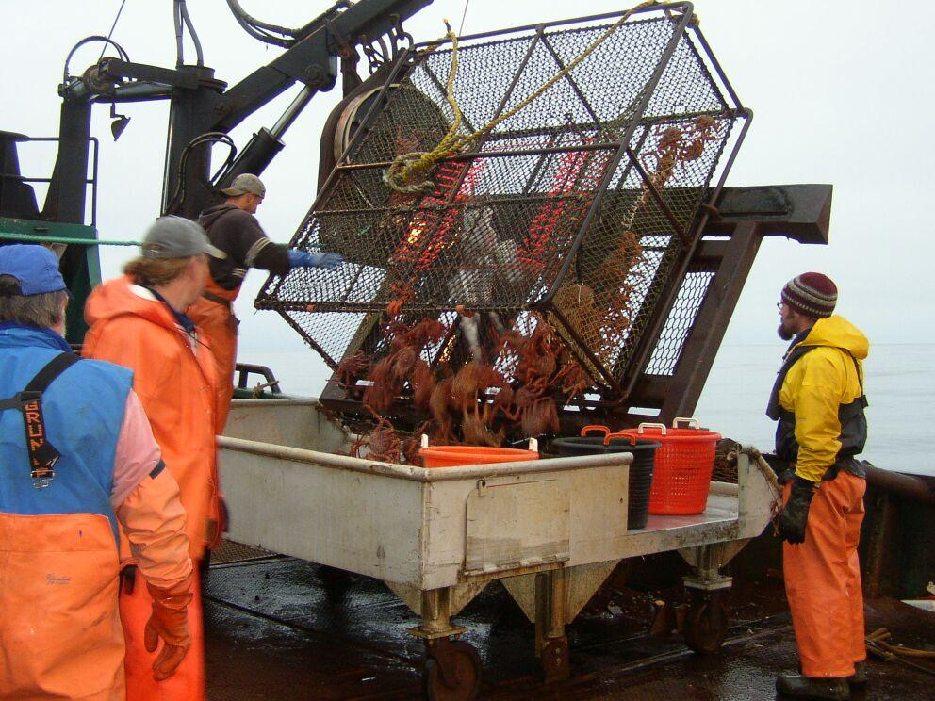
Some brief background on the fisheries - Golden King Crab in the west Aleutian Islands
Assessment models male biomass
Data sources include landings, size comp. of landings and catches, catch rate indices, tagging for growth, bycatch
NO annual stock abundance surveys.
ADFG

Slide 8
Modern fishery assessments can use multiple sources of data
Maximizing the likelihood (or minimizing –ve ln(likelihood)) is the main criterion for model “fit” –connecting the data and the model
The Log Likelihood for NPF tiger prawn assessments:
LL_{total} = w₁ LL_{Growth} + w₂ LL_{Cannual} + w₃ LL_{Cweek}
+ w₄ LL_{NspawnerIndex} + w₅ LL_{NrecruitIndex} +
+ w₆ LL_{SizeSurvey}
+ w₇ LL_{SizeComm}

Slide 9
The fit of the model to the data!
Do things work the way that you think that they should?
LL_{total} = w₁ LL_{Growth} + w₂ LL_{Cannual} + w₃ LL_{Cweek}
+ w₄ LL_{NspawnerIndex} + w₅ LL_{NrecruitIndex} +
+ w₆ LL_{SizeSurvey}
+ w₇ LL_{SizeComm}
Notes:
How the data ‘connect’ with the model is via the likleihood

Slide 10
The likelihood component for the tagging data is
The i subscript indicates the i th recapture, T_{i} is the time-at –liberty, C_{i} is the size class at recapture, R_{i} is the size class at release, X is the size transition matrix,
S_{j} is the selectivity of an animal in size-class j.
Notes:
L is the product of the probabilities of capture size given release size and times at liberty, across the i recaptures

Slide 11
Diagnostics 1
Plot: observed v expected frequencies of recapture size by release size class
is the expected number of recaptures in size class j
the probability of the ith animal in size class k at release, being recaptured in size class j

Slide 12
Diagnostics 1
Plot: observed v expected recapture size by release size class
No problems apparent with king crab or brown tiger prawn –
Problem with grooved tiger prawns

Slide 13
Diagnostics 2
Plot observed mean recapture size
by release size class,
along with the expected (mean) size at recapture
and ±S.E.
by time at liberty

Slide 14
Diagnostics 2
Plot observed mean recapture size v release size class, along with the expected (mean) size at recapture (±S.E.), by time at liberty
No problems with King Crab or Brown Tiger Prawn growth data fit
Bias: Grooved Tigers (Females shown)

Slide 15
Integrating the data with other data types -weighting
What should the relative contribution of the data sources be?
LL_{total} = w₁ LL_{Growth} + w₂ LL_{Cannual} + w₃ LL_{Cweek}
+ w₄ LL_{NspawnerIndex} + w₅ LL_{NrecruitIndex} +
+ w₆ LL_{SizeSurvey}
+ w₇ LL_{SizeComm}

Slide 16
Compensate for known mis-specification: Growth data from tagging tend to be overdispersed
Northern Prawn Fishery (NPF) tiger prawns and Aleutian Islands golden king crab assessment models: tagging data is used to estimate growth parameters.
Model: each recapture is a Bernoulli trial (binomial)
BUT pseudoreplicates due to release/ recapture clustering (not independent), thus should account for overdispersion: downweight
Hitherto, no objective methods of weighting or for exploring mis-specification for growth model
Notes:
overdispersion - there is greater variability in the data set than would be expected based on a given statistical model.
A Bernoulli trial (or binomial trial) is a random experiment with exactly two possible outcomes, "success" and "failure", in which the probability of success is the same every time the experiment is conducted.
Animals released together are not spatially independent - may move together, even if they don’t they may remain spatially close together. Probability of recapturing an animal is not independent of the recapture of others

Slide 17
Weighting . . .
The inverse of the variance of the standardized residuals for the mean size at recapture, in each size class
observed (mean) size-at-recapture, release size L
expected (mean) size-at-recapture, release size L
mid point of length class j, N_{L} number of releases in L
Principle: weight is related to deviation between data and expected value. Analogue to Francis weighting
(
*by time-at-liberty interval and sex
.
Notes:
Need to ensure that meaning of the parameters is clearly explained or add detail to the slide

Slide 18
Weighting . . .
For both Tiger Prawn species, weighting factors for all months and sexes were about 1 (so, no further analysis)
Western Aleutian Islands Golden King Crab:
Weighting factors of 0.5, 0.2, and 0.35 for times-at-liberty of 1, 2 and 3 years. Later years calculated ≥ 1 (set at 1)
.
Notes:
The calculated are approximately 1.

Slide 19
Big impact on assessment for W. Aleutian Is. Golden King Crab
Conflict between growth data from tagging and other data sources
.
Notes:
Trends similar, but the estimated biomass for the series with the new weighting was ½ that of the uwneighted series for much of the time period of the assessment
Suggests that there is a conflict between the tagging data and some of the other data sources included in the assessment.

Slide 20
Conclusions
We developed diagnostic plots to evaluate fits to growth data from tagging; there appear to be some issues with the fit of the model for grooved tiger prawns. Brown tiger prawns and W. golden King Crabs were fine.
The diagnostics potentially indicate sources of data conflict
Tagging data are overdispersed, so should be downweighted
We have provided a method of weighting likelihoods for use with growth data from tagging (extended “Francis weighting”)
Assessments can be quite sensitive to data weighting –as shown by the W. Aleutians Golden King Crab case study

Slide 21
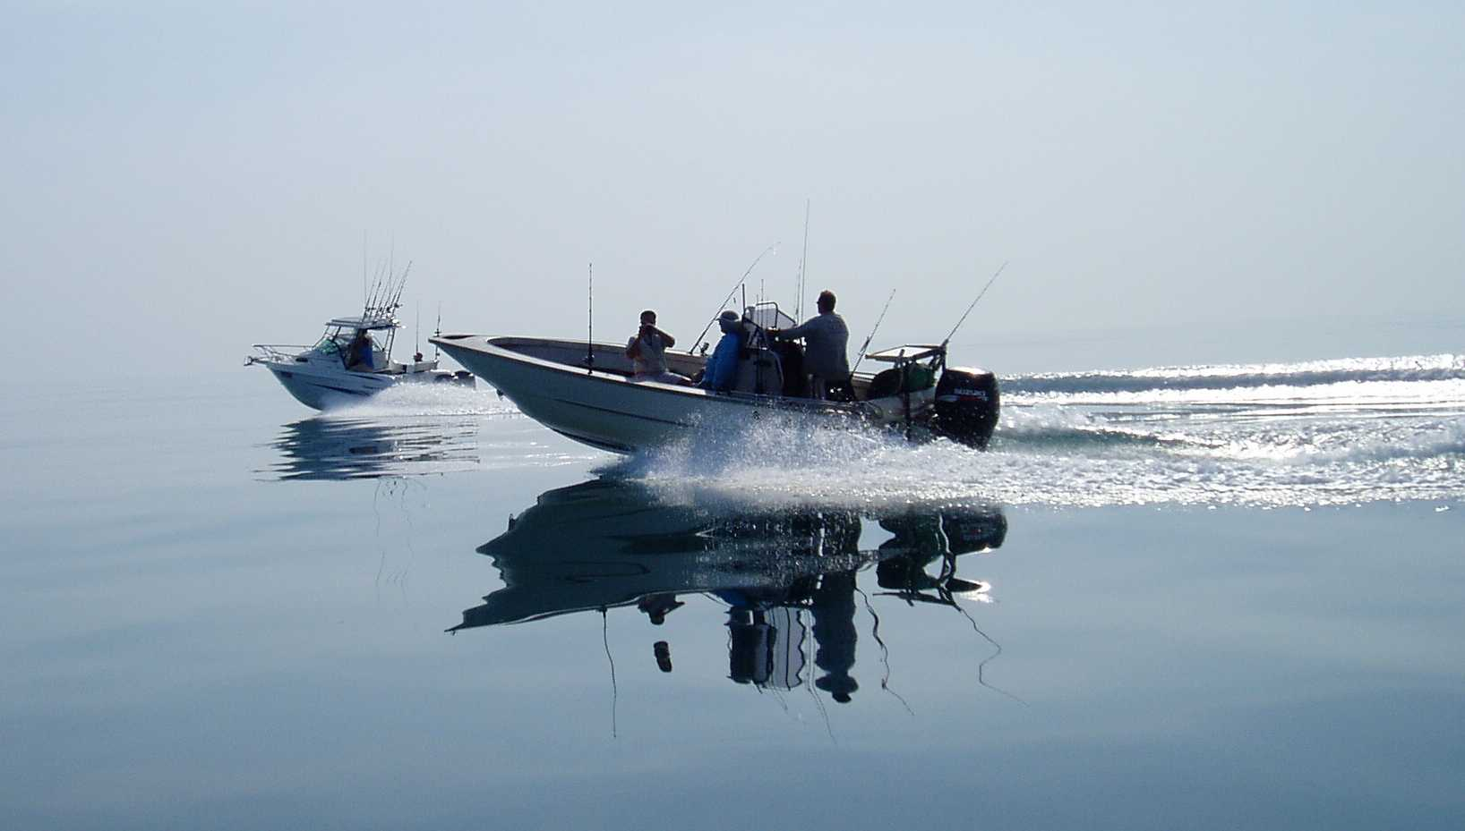
Acknowledgements and Questions
NT DPIF
This work was partially funded by NOAA Award NA14NMF4370119, Australian Fisheries Management Authority (AFMA) project RR2015/0811 and the Joint Institute for the NOAA Ocean Acidification Program through the Joint Institute of the Study of the Atmosphere and Ocean (JISAO) under NOAA Cooperative agreement No. NA10OAR4320148., as well as CSIRO.
NT DPIF

Slide 22
Thank you
Dr Rik Buckworth Oceans & Atmosphere
Principal Research Scientist
t +61 8 89448484
e rik.buckworth@csiro.au
w www.csiro.au

Slide 23
Why weight data?
LL_{total} = w₁ LL_{growth} + w₂ L_{Cannual} + w₃ LL_{Cweek}
+ w₄ LL_{NspawnerIndex} + w₅ LL_{NrecruitIndex} + w₆ LL_{SizeSurvey}
+ w₇ LL_{SizeComm}
Each component likelihood (LL) represents a sub-model describing sampling from that data source.
A ‘consensus’? – weights (w_{i}) for each component likelihood depend on the type and amount of that data, in principle relates to deviations between observed and expected values
Objective weightings are not always straightforward – ours is a new method for growth data used in this context
Notes:
Mis-specification is expected to some extent - Models are a simplification of reality
Data conflict arises where different parameter estimates are evolved if data sets are used individually

Slide 24
What drives data conflict? Why test model fit?
LL_{total} = w₁ LL_{growth} + w₂ L_{Cannual} + w₃ LL_{Cweek}
+ w₄ LL_{Nspawner} + w₅ LL_{Nrecruit} + w₆ LL_{SizeSurvey}
+ w₇ LL_{SizeComm}
Data conflict? Different parameter estimates are evolved if data sets are used individually
Data are true – hence conflict implies model mis-specification. Test?
Compensate for known mis-specification
Notes:
Mis-specification is expected to some extent - Models are a simplification of reality

Slide 25
The pressure is always on to improve assessments – but you should ask a couple of questions!
Do things work the way that you think that they should – the fit of the model to the data?
Integrating the data with other data types

