Slide 1



Is down weighting composition data adequate to deal with model misspecification or do we need to fix the model?
Sheng-Ping Wang, Mark N. Maunder
National Taiwan Ocean University
Inter-American Tropical Tuna Commission
Center for the Advancement of Population Assessment Methodology

Slide 2
Data weighting is a common issue that arises when developing stock assessment models.
Previous studies indicated that diverse stock assessment conclusions may result from different data weightings.
The appropriate weighting of data sets in stock assessment models is an important component of model development.

Slide 3
In this study, we develop a simple age-structured population dynamics model for summer flounder in the U.S. mid-Atlantic to explore the influence of data weightings on model estimation using a simulation approach.
A simulation analysis based on this model is conducted to examine whether data weighting can deal with misspecified steepness, natural mortality and selectivity.

Slide 4
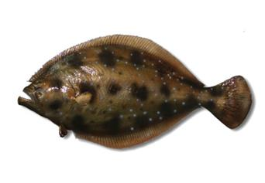
Summer flounder fishery
Summer flounder (Paralichthys dentatus) is one of the most important commercial and recreational species on the U.S. Atlantic coast.
Total landings declined substantially during the late 1980s by 1990 and then has been relatively constant since the early 1990s.

Slide 5
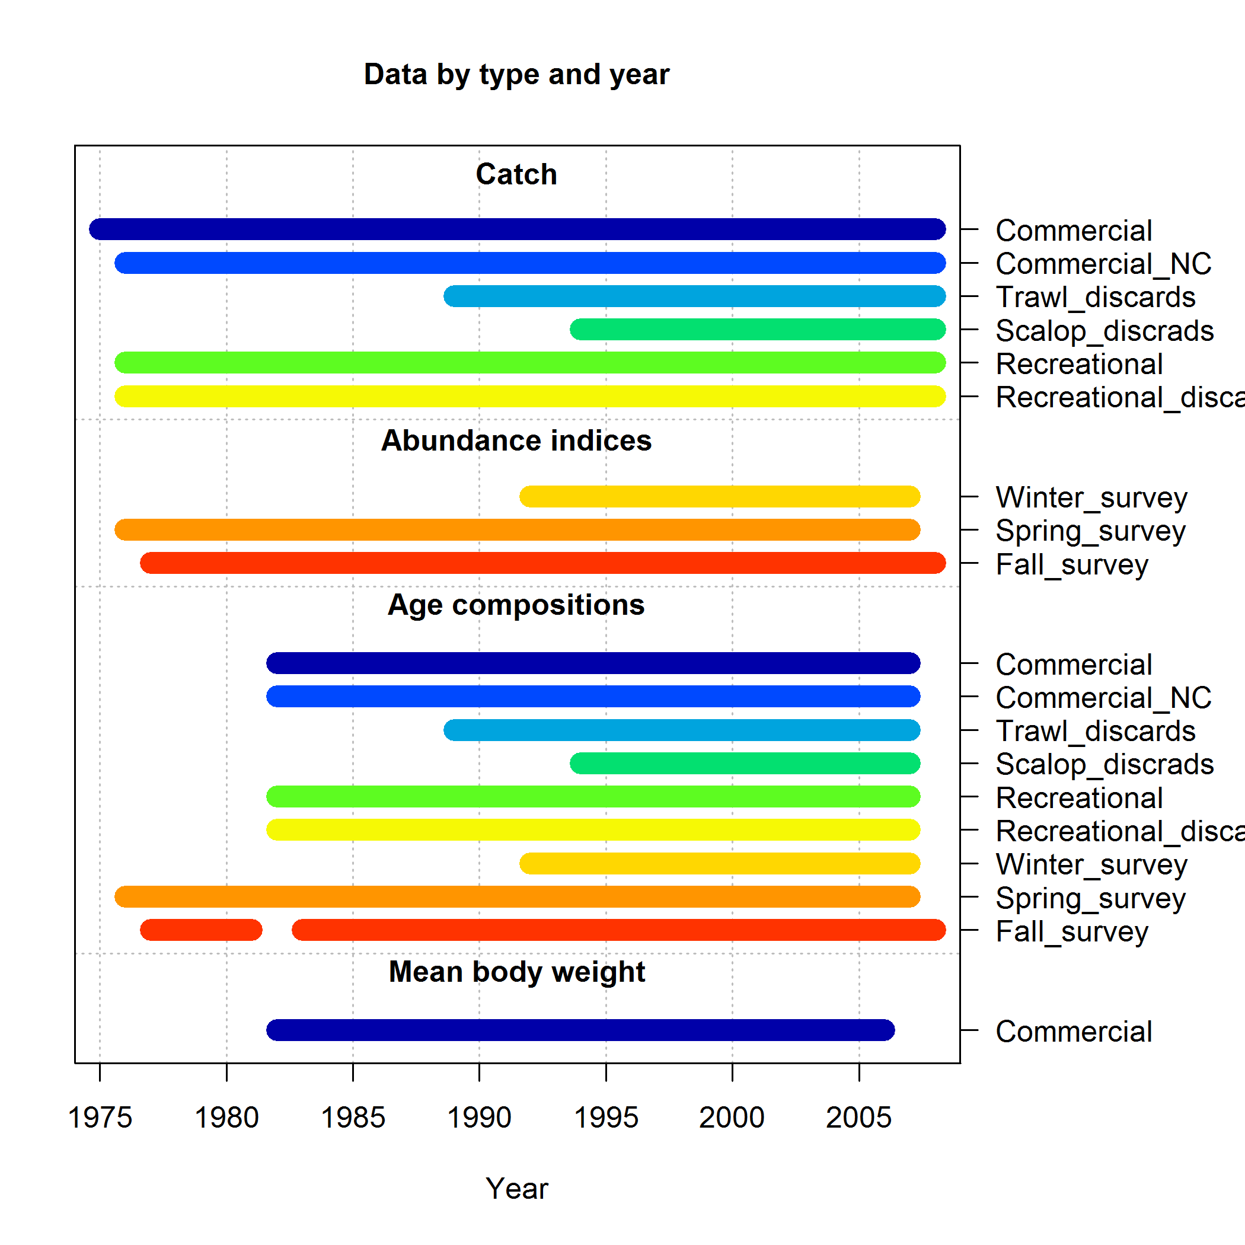
Previous stock assessment
Data used in previous assessments consists of
  Catches for 6 fisheries
  Indices for 3 surveys
  Age-compositions for 6 fisheries and 3 surveys
  Mean body weight for 1 fishery

Slide 6
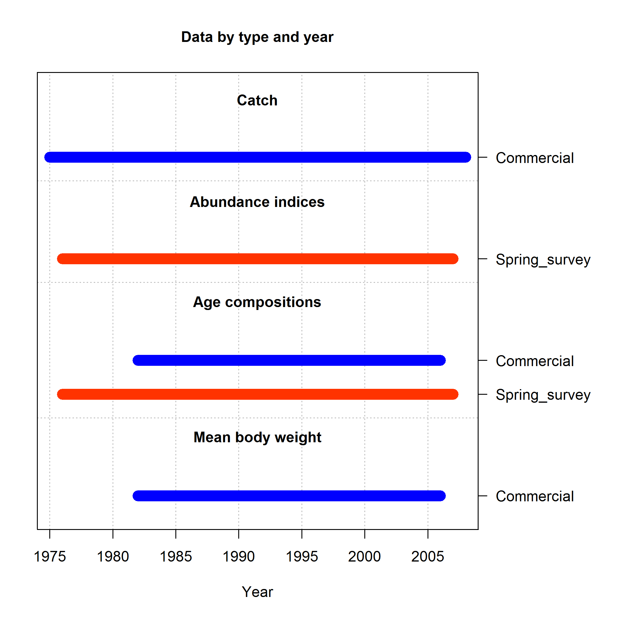
Model used in this study
To explore the influence of data weighting on model estimation, we develop a simple model, which includes data of
  Catch for 1 fisheries (total catch)
  Index for 1 surveys
  Age-compositions for 1 fisheries and 1 surveys
  Mean body weight for 1 fishery

Slide 7
Model used in this study
We also change the sex-specific model into single sex model.
Life history parameters:
Life history parameter | Value
Steepness (h) | 0.85
Natural mortality (M) | 0.20
Length at maximum age (Linf) | 62.12
Growth coefficient (K) | 0.20
Coefficient of length-weight relationsip (a) | 2.44E-06
Exponent of length-weight relationsip (b) | 3.35
Length at 50% maturity (L₅₀) | 28.10
Slope of maturity ogive | -0.25
Recruitment deviation (σ_{R}) | 0.60

Slide 8
Simulation procedure
The model is developed using Stock Synthesis.
  Fit actual data to the model to obtain estimates of parameters.
  Generate simulated data based on SS bootstrap data by fixing parameters obtained from step 1), and also replacing recruitment deviation by random values.
  Fit simulated data to the model without any misspecification to obtain the “true” estimates.
  Fit simulated data to the model with assumed misspecification to obtain the estimates under model misspecification.
  Repeat steps 2) to 4) for 100 times.

Slide 9
Scenarios
We conduct 9 scenarios to explore the influence of misspecifications of model estimations.
Case | M | h | Selectivity for fishery
True | 0.2 | 0.85 | Dome-shaped and time-variant
1 | 0.2 | 0.85 | Dome-shaped and time-variant
2 |  | 1
3 | 0.15
4 | 0.3
5 |  |  | Asymptoic and time-variant
6 | Estimate
7 | Estimate | 1
8 | Estimate |  | Asymptoic and time-variant
9 |  |  | Dome-shaped and time-invariant

Slide 10
Scenarios
We also conduct 5 weightings for age composition data to explore the influence of data weighting of model estimations.
Case | Fishery | Survey
1-F&S | 1 | 1
0.1-F&S | 0.1 | 0.1
10-F&S | 10 | 10
0.1-F | 0.1 | 1
10-F | 10 | 1

Slide 11
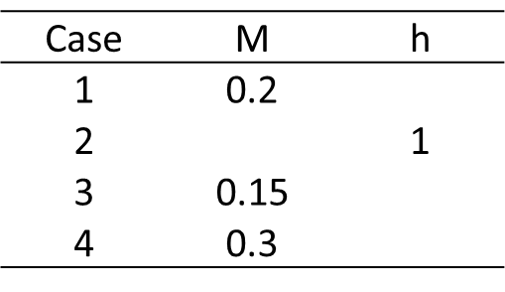
Results -
Misspecification for life history parameter
Misspecification of life history parameters generally leads to biased estimates.
Biased estimates occurs when down or up weighting , even without any misspecification (case1).
Down weighting could not significantly improve model estimates.
Up weighting leads to obviously imprecise estimations.

Slide 12
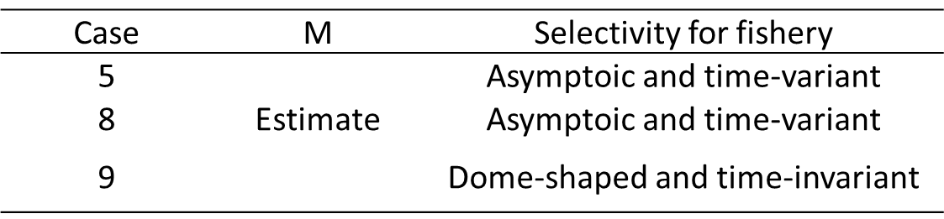
Results -
Misspecification for selectivity
Down or up weighting leads to biased estimates when selectivity is misspecified.
Up weighting may somehow improve accuracy of estimates but substantially deteriorates the precision of estimates for most quantities.

Slide 13
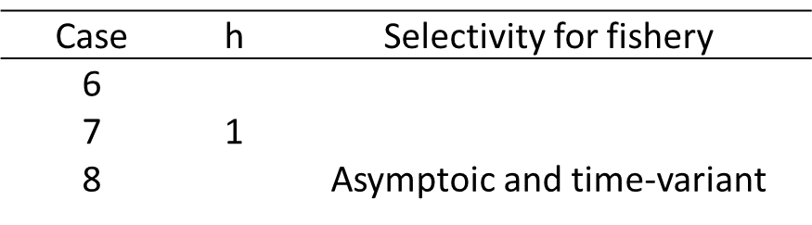
Results -
Estimating natural mortality
Although misspecification of h leads to systematically biased estimates, estimating M makes estimates more consistent whenever down or up weighting, even though selectivity is misspecified.
Up weighting deteriorates the precision of estimates .

Slide 14
Results -
Influence of weighting on estimate of M
Estimate of M are not influenced when down or up weighting.
Up weighting slightly deteriorates the precision of estimates.

Slide 15
Results -
Influence of weighting on selectivity
Parameters of selectivity are less influenced when misspecifiying life history parameters or estimating M (most REs within 10%).
Estimates of selectivity are less relevant to data weighting .
Misspecifiying selectivity as time-invariant leads to systematically biased estimates of selectivity.

Slide 16
Results -
Mean relative error
Quantity | Case | 1-F&S | 0.1-F&S | 10-F&S | 0.1-F | 10-F
R₀ | 1 | 0.00 | 6.69 | -2.00 | 1.12 | -1.47
 | 2 | -46.94 | -45.70 | -46.15 | -46.20 | -46.52
 | 3 | 32.74 | 45.43 | 30.18 | 34.44 | 29.78
 | 4 | -3.87 | 0.77 | -5.95 | -3.05 | -4.56
 | 5 | 0.05 | 12.54 | -7.04 | 1.03 | -1.88
 | 6 | 0.14 | 6.26 | 2.09 | 1.88 | -1.92
 | 7 | -47.38 | -47.43 | -45.71 | -48.17 | -45.92
 | 8 | -2.66 | 8.46 | -6.08 | -0.21 | -5.07
 | 9 | 5.79 | 12.32 | -4.14 | 7.69 | 8.19
SB_{cur}/SB₀ | 1 | 0.00 | -5.40 | -1.16 | -2.40 | 0.08
 | 2 | 70.30 | 63.00 | 67.69 | 65.63 | 67.43
 | 3 | -49.81 | -53.99 | -48.96 | -51.29 | -49.12
 | 4 | 83.39 | 85.36 | 74.20 | 80.32 | 79.43
 | 5 | -1.23 | -11.26 | -7.75 | -0.55 | -8.67
 | 6 | 7.63 | 7.99 | 4.24 | 3.27 | 13.44
 | 7 | 63.64 | 49.64 | 64.81 | 51.39 | 69.24
 | 8 | 25.75 | 17.62 | 17.51 | 15.09 | 31.68
 | 9 | -9.92 | -8.47 | -40.37 | -8.15 | -13.70

Slide 17
Results -
Mean relative error
Quantity | Case | 1-F&S | 0.1-F&S | 10-F&S | 0.1-F | 10-F
MSY | 1 | 0.00 | 3.40 | -1.57 | 0.67 | -1.61
 | 2 | -37.34 | -36.62 | -36.33 | -36.64 | -36.86
 | 3 | 61.72 | 69.50 | 59.66 | 62.83 | 57.92
 | 4 | -30.45 | -29.22 | -31.70 | -30.06 | -31.05
 | 5 | 4.73 | 12.67 | -1.68 | 5.26 | 3.53
 | 6 | -2.11 | -1.35 | 2.39 | -0.05 | -5.89
 | 7 | -35.98 | -34.31 | -35.10 | -34.28 | -36.82
 | 8 | -8.50 | -2.89 | -9.64 | -2.04 | -15.13
 | 9 | -2.25 | 3.38 | -11.17 | 0.55 | -9.81
SB_{cur}/SB_{MSY} | 1 | 0.00 | -4.82 | -1.47 | -1.99 | 0.72
 | 2 | 114.84 | 108.78 | 110.83 | 109.93 | 112.97
 | 3 | -49.15 | -52.94 | -48.43 | -50.41 | -48.08
 | 4 | 73.26 | 77.85 | 64.27 | 70.77 | 70.30
 | 5 | -14.48 | -23.71 | -19.91 | -13.96 | -20.81
 | 6 | 6.95 | 7.66 | 2.64 | 3.07 | 12.59
 | 7 | 106.98 | 92.72 | 104.88 | 94.24 | 111.18
 | 8 | 9.09 | 1.87 | 2.12 | -0.27 | 14.31
 | 9 | -12.09 | -10.02 | -41.78 | -12.55 | -7.34

Slide 18
Results -
Root-Mean-Square Error (RMSE)
Quantity | Case | 1-F&S | 0.1-F&S | 10-F&S | 0.1-F | 10-F
R₀ | 1 | 0.00 | 3.35 | 5.89 | 1.43 | 2.00
 | 2 | 4.25 | 4.60 | 4.34 | 4.25 | 4.39
 | 3 | 6.26 | 10.15 | 13.97 | 7.14 | 6.28
 | 4 | 3.47 | 4.78 | 5.07 | 3.41 | 3.93
 | 5 | 2.31 | 4.35 | 7.49 | 2.65 | 3.01
 | 6 | 5.85 | 6.97 | 14.52 | 6.50 | 6.38
 | 7 | 6.49 | 8.56 | 8.05 | 6.85 | 8.18
 | 8 | 4.71 | 7.72 | 9.76 | 5.61 | 4.96
 | 9 | 2.11 | 4.46 | 7.39 | 2.77 | 5.20
SB_{cur}/SB₀ | 1 | 0.00 | 4.39 | 15.48 | 1.81 | 4.29
 | 2 | 8.75 | 10.12 | 28.01 | 8.78 | 10.25
 | 3 | 2.49 | 3.54 | 9.12 | 2.87 | 3.54
 | 4 | 8.02 | 11.50 | 31.43 | 8.00 | 9.72
 | 5 | 2.74 | 4.57 | 17.77 | 3.23 | 5.40
 | 6 | 21.25 | 25.82 | 38.72 | 21.83 | 28.36
 | 7 | 32.28 | 39.39 | 42.88 | 35.90 | 37.85
 | 8 | 26.46 | 31.43 | 39.67 | 24.18 | 31.91
 | 9 | 2.66 | 4.46 | 16.10 | 2.66 | 12.71

Slide 19
Results -
Root-Mean-Square Error (RMSE)
Quantity | Case | 1-F&S | 0.1-F&S | 10-F&S | 0.1-F | 10-F
MSY | 1 | 0.00 | 3.37 | 5.89 | 1.19 | 1.63
 | 2 | 4.95 | 5.16 | 5.10 | 4.92 | 5.02
 | 3 | 7.58 | 11.14 | 17.16 | 8.52 | 7.53
 | 4 | 2.47 | 3.36 | 3.58 | 2.47 | 2.73
 | 5 | 2.68 | 4.28 | 7.76 | 2.76 | 3.26
 | 6 | 13.39 | 14.88 | 27.71 | 14.30 | 14.86
 | 7 | 6.29 | 7.54 | 7.15 | 6.99 | 6.32
 | 8 | 14.39 | 18.90 | 23.32 | 15.45 | 14.29
 | 9 | 1.22 | 4.02 | 6.22 | 1.89 | 3.59
SB_{cur}/SB_{MSY} | 1 | 0.00 | 4.73 | 15.37 | 1.87 | 5.07
 | 2 | 11.72 | 13.16 | 35.16 | 11.98 | 16.19
 | 3 | 2.55 | 3.80 | 9.13 | 3.01 | 3.80
 | 4 | 7.94 | 10.93 | 29.72 | 7.88 | 9.89
 | 5 | 2.66 | 4.01 | 15.64 | 3.01 | 5.03
 | 6 | 20.10 | 24.43 | 36.37 | 20.53 | 26.58
 | 7 | 30.20 | 41.46 | 44.11 | 35.46 | 34.60
 | 8 | 23.35 | 28.08 | 34.79 | 21.32 | 28.07
 | 9 | 2.70 | 4.82 | 15.92 | 2.94 | 13.63

Slide 20
Summary
Biased estimates are generally obtained when misspecification occurs for either life history parameters or assumption of selectivity.
Downing weighting composition data may lead to biased estimates for most quantities.
Up weighting composition data may somewhat improve model estimates, but substantially deteriorates the precisions of model estimates.

Slide 21
Summary
Either down or up weighting composition data leads to biased estimates when selectivity is misspecified.
Estimates of M are not influenced by weighting for composition data.
Estimates of Selectivity are also not influenced by weighting for composition data, except for misspecifying time-varying selectivity.

Slide 22
Future work
Conduct simulation analysis by incorporating length-composition data.
  Evaluate the impact of weighting to length-composition data on model estimates and growth.
Evaluate the impact of data weightings on the results of full stock assessment model.

Slide 23

Thank you

