Slide 1
Population scale and M: likelihood profiles and production model diagnostics
Tim Sippel¹, Steve Teo¹, Kevin Piner¹, Hui Hua Lee¹
1. Southwest Fisheries Science Center

Slide 2
Background
Abundance & yield are related to M (higher M leads to lower yield & abundance)
Global parameters (M and R₀) can be influenced by information sources not thought related to abundance (eg. composition data)
Comp. data both improves and competes with biomass dynamics (Methot, this meeting)
Improves by providing explicit info on selectivity and rec. devs
Competes by providing info on Z rather than ∆ B,
Is conditional on M, selectivity, and R trend
M can be estimated from:
Catch curve to derive Z = F + M
Production relationship
Fitting to model noise

Slide 3
Background
Age-structured Production Model (ASPM) diagnostic proposed by Maunder and Piner (2015) to help identify production relationship
How well does catch explain abundance?
Likelihood profiling across global scaling parameters (R₀, B₀) proposed by Lee et al 2014
Explore information content of data components

Slide 4
Objectives & Approach
Objectives:
Explore if production relationship corresponds with ability to estimate M well (Lee et al 2011)
ASPM: selectivity fixed at MLE, recruitment devs turned off, ignore size comps, estimate scale parameters (R0, initial F)
Investigate information content and influence of data components
R₀: Fixed at range above and below MLE

Slide 5
Assessments
Same suite of 12 assessments used in Lee et al (2011) for simulation testing M estimation
US West Coast Groundfish completed in 2006/2007
Focus on 4 assessments from M study today
2 where M was estimable
Chillipepper rockfish (Field 2007)
Darkblotched rockfish (Hamel 2007)
2 where M was not estimable
Northern black rockfish (Wallace, Cheng, Tsou 2006)
Southern black rockfish (Sampson 2007)
Used SS2

Slide 6
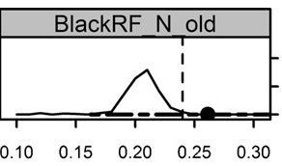
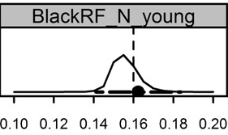
Simulating M in Lee et al 2011
Lee et al 2011. Estimating M simulation study
Data generated from original model using same rec dev variance
Distribution of M, where black dot is from original assessment, vertical line estimated from simulation
This study on age aggregated
Natural mortality (M)

Slide 7
Assessment Info
Chillipepper RF
Catch 1892-2006; 2 tuning indices: trawl logbook, Rec Obs.
Darkblotched RF
1928-2006; 1 tuning index: triennial shelf survey
N. black RF
1938-2006; 2 tuning indices: tag CPUE, tag abun.
S. black RF
1915-2006; 2 tuning indices: Rec CPUE, CPFV

Slide 8
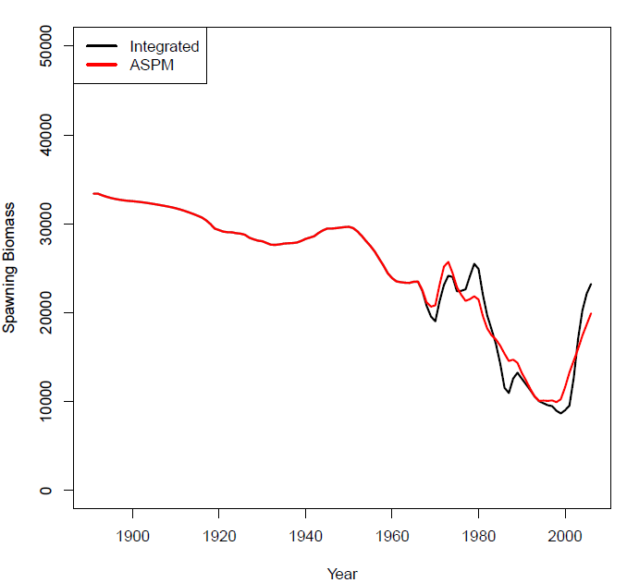
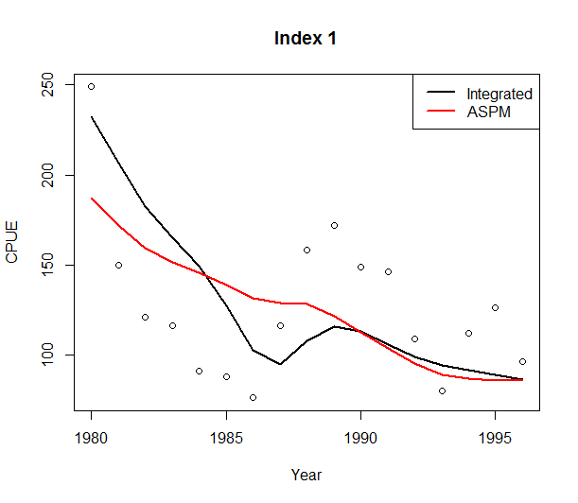
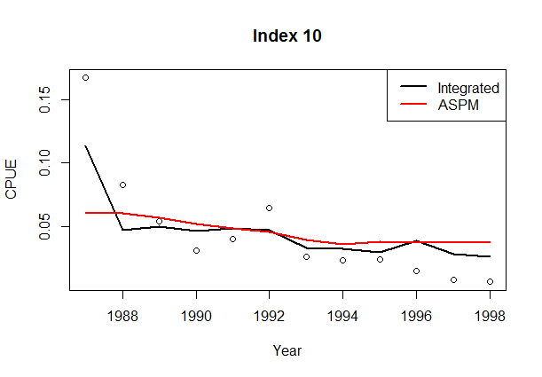
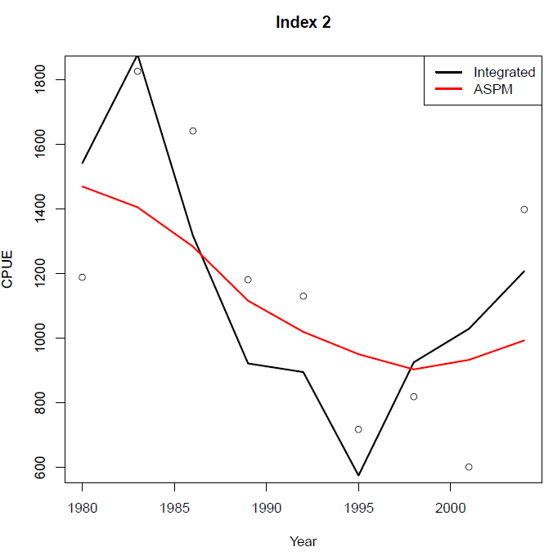
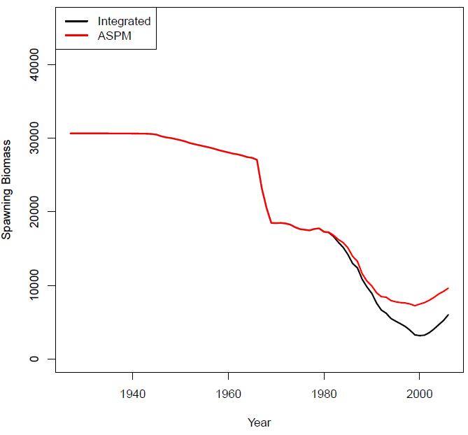
Chillipepper RF
(trawl logbook)
(rec. observers)
Darkblotched RF
(NMFS triennial shelf survey)
Notes:
Production relationship is evident in both assessments (high initial F, change in abundance).
Good fit to indices
Abundance trends comparable between Integrated and ASPM

Slide 9
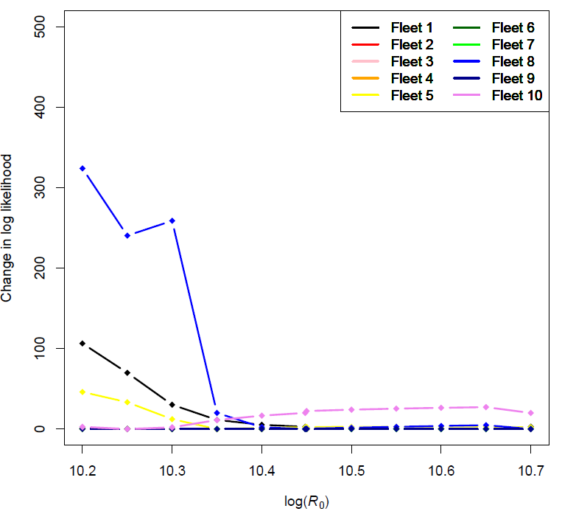
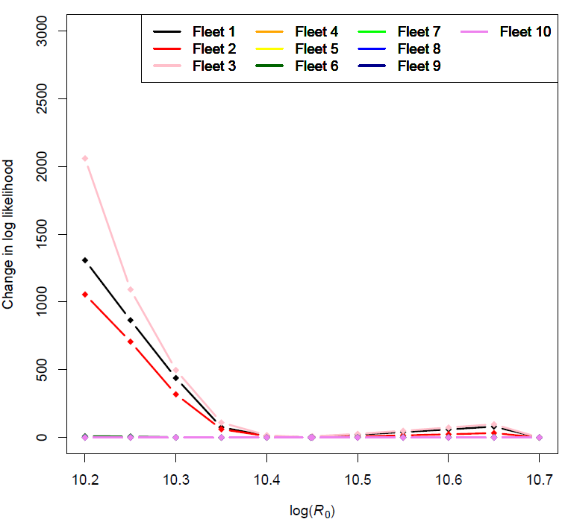
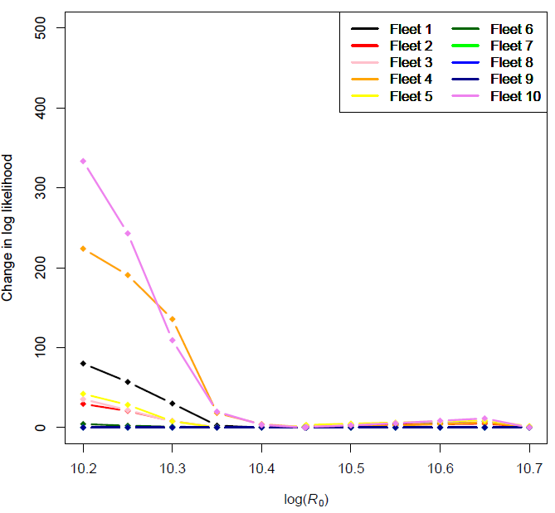
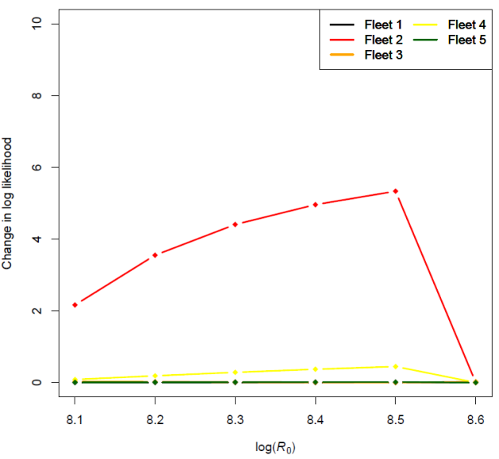
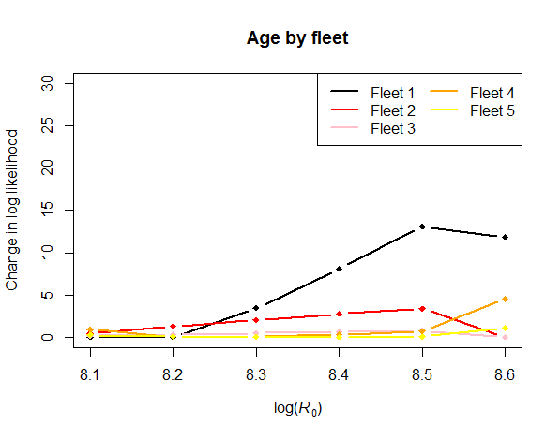
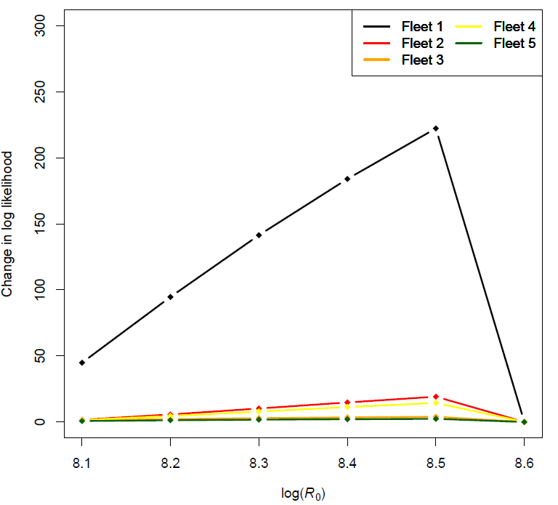
Chillipepper RF
Indices by fleet
Age by fleet
Length by fleet
MLE
Darkblotched RF
Indices by fleet
Age by fleet
Length by fleet
MLE
Notes:
Size comps (age/length) providing most information.
Surveys relatively less informative
Darkblotched model only ran at MLE and higher, population crashed below MLE

Slide 10
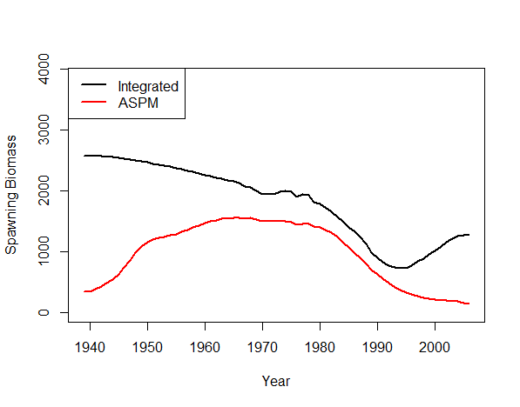
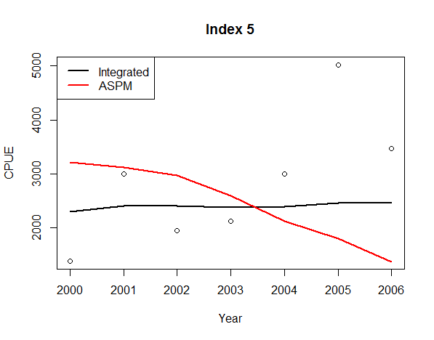
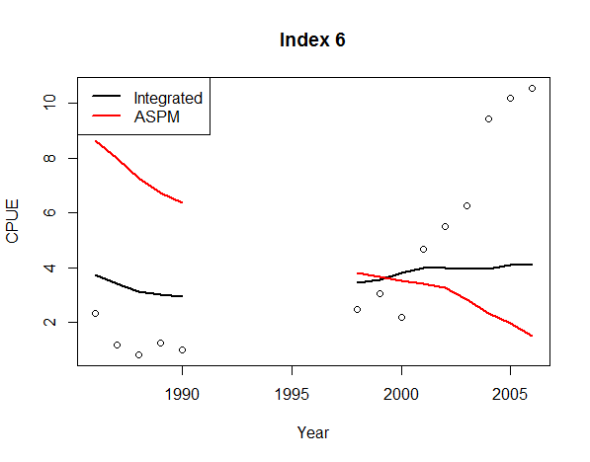
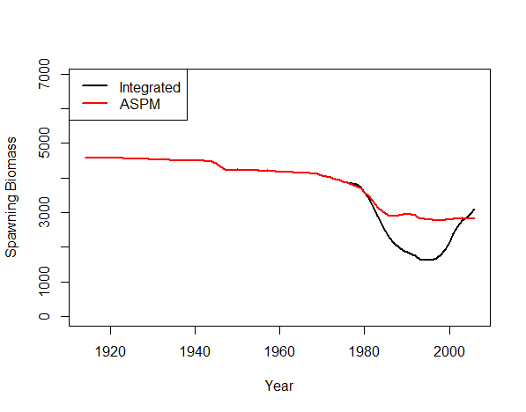
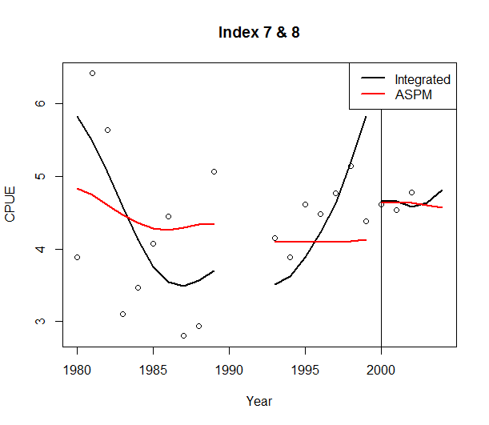
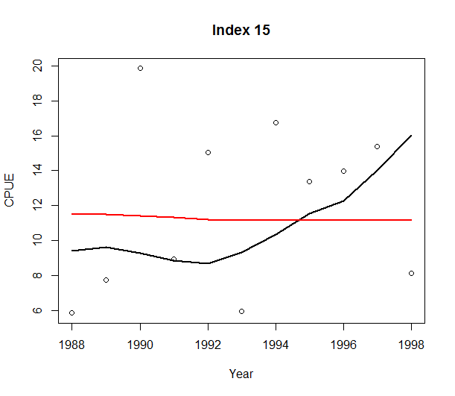
N. Black RF
(tag abund. index)
(tagging CPUE)
S. Black RF
(RecFin OR.)
(CPFV CA.)
Notes:
Weak production function
ASPM poor fit to index
Trends not comparable

Slide 11
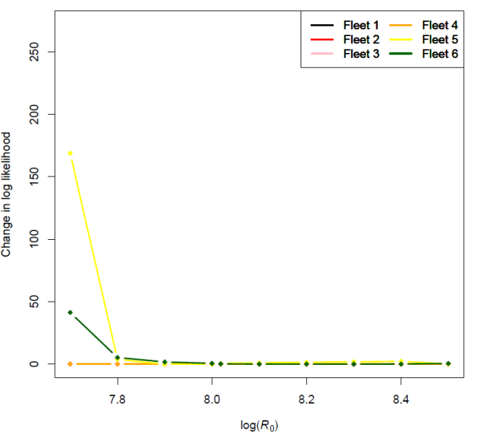
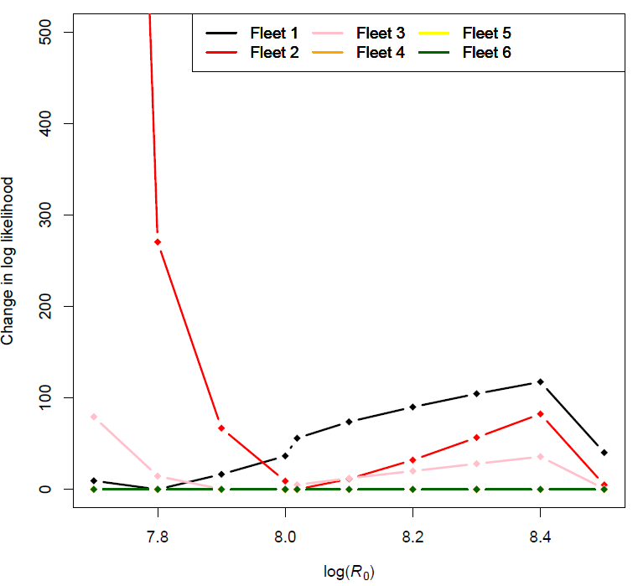
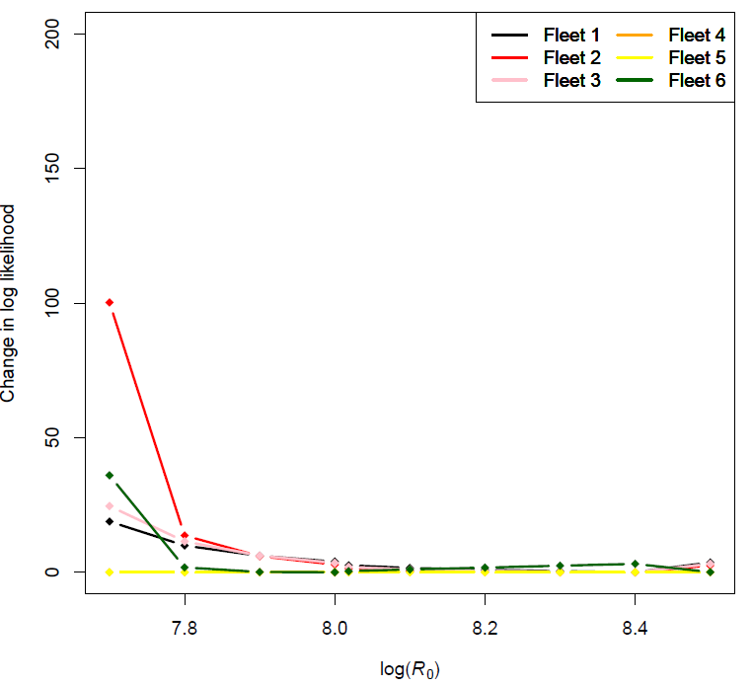
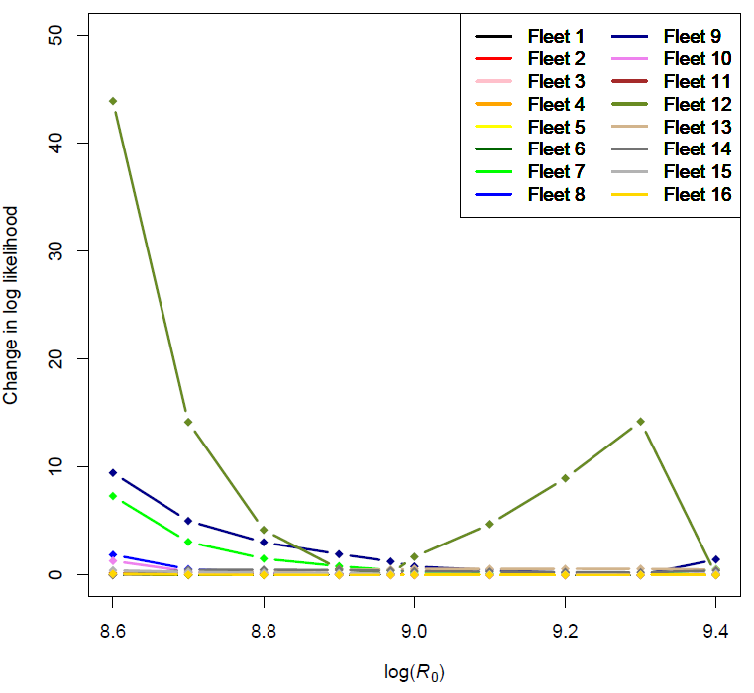
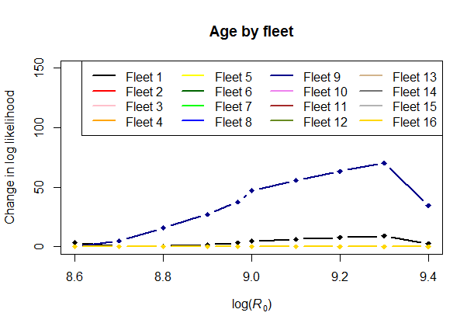
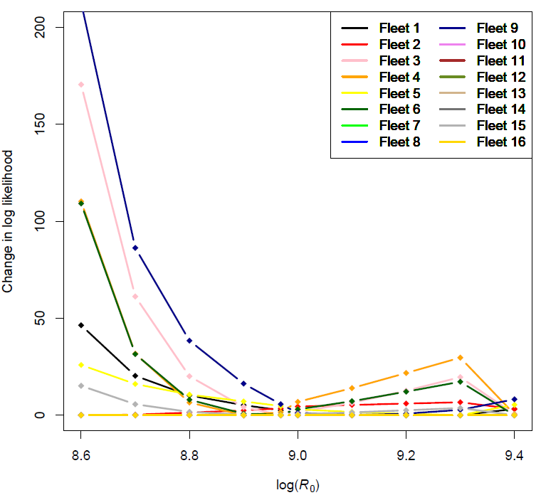
N. Black RF
Indices by fleet
Age by fleet
Length by fleet
MLE
S. Black RF
Indices by fleet
Age by fleet
Length by fleet
MLE
Notes:
Size comps (age/length) providing most information.
Surveys relatively less informative

Slide 12
Discussion
Strong production function evident when catch does explain an abundance index with good contrast
Chillipepper & Darkblotched showed strong production functions; N. Black RF and S. Black RF did not.
Assessments with estimable M also had good production curves
Biased M also showed poor production relationship
8 more assessments to investigate though….
Reasons for poor production function could include the abundance trend being recruitment driven, indices not indicative of relative abundance, or models misspecified (Maunder & Piner 2015)

Slide 13
Conclusions
Look for production relationship before deciding to estimate M.
Be explicit about how M is estimated
Catch curves
Production relationship
Fitting to noise

