Slide 1




Comparison of weighting methods for size composition data: A case study for the
North Pacific striped marlin stock assessment
Yi-Jay Chang, Brian Langseth, Jon Brodziak
NOAA Fisheries, National Marine Fisheries Service,
Pacific Islands Fisheries Science Center,
1845 Wasp Blvd., Honolulu, HI, 96818
Data weighting workshop
La Jolla 2015

Slide 2
Outline
Introduction
  Data weighting
  Correlation in size data
  Weighting methods for multinomial size composition
  Objectives of this study
Methods and materials
  ISC WCNPO striped marlin assessment data & model
  Various model diagnostics
Results
Discussion
Conclusions

Slide 3
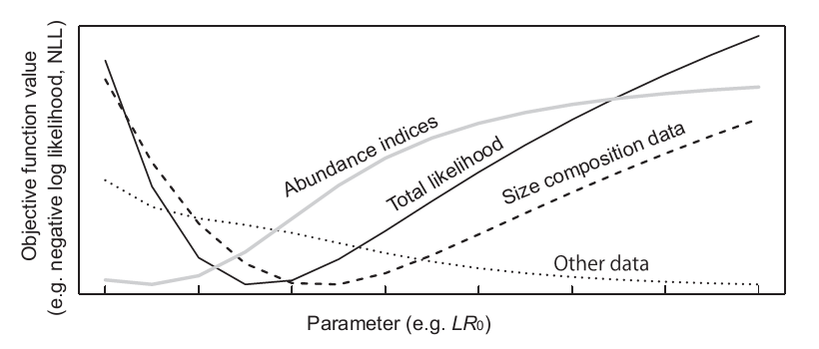

Introduction
Modern stock assessments use multiple data sets. One of the issues is how much weight to assign to each data set (NRC, 1998; Francis, 2011).
The estimated status of the stock can be dependent, possibly strongly, on these weights.
?
Ichinokawa et al. (2014)

Slide 4
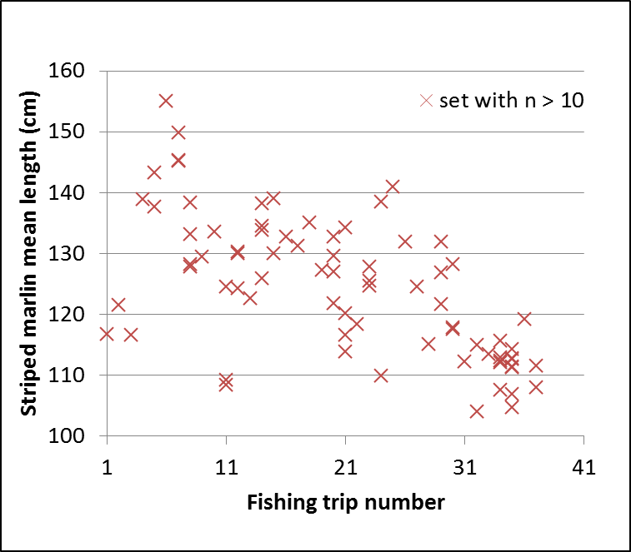

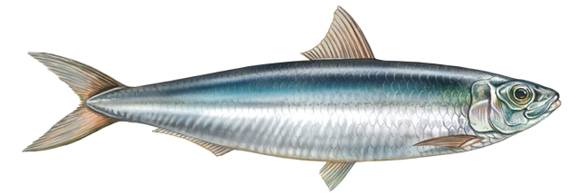


Introduction
Source: Hawaii longline observer program
Francis (2011) suggested three guiding principles
  (ii) when weighting age or length composition data, allow for correlations;
Correlations in length composition data (intra-haul correlation) would reduce the amount of information of the data (Pennington and Vølstad, 1994)
One of the solutions: to reduce the multinomial sample size to compensate for the correlations
(e.g., Francis (2011)’s TA1.8 method)
Intra-haul correlation
Notes:
Fish in the same catch (e.g., from the same tow of a trawl net, or the same set of a long-line) tend to be more similar to each other in length or age than are fish from different catches

Slide 5
Weighting methods for multinomial size composition
Variance ratio method (McAllister and Ianelli, 1997)
  N = Ratio of the theoretical variance of the multinomial to the estimated variance;
Francis (2011) TA1.8 method
  The effective sample size is based on how well the model mimics the mean lengths (i.e., the standard deviation of the normalized residuals close to one)
Others: Paul’s talk A4

Slide 6

Objectives of this study
To conduct a stock assessment update for the WCNPO striped marlin through 2013 (ISC BILLFISH WORKING GROUP)
“Update” with minor improvement (i.e., best scientific information available)
  To include an alternative weighting method
  for the size composition
To compare two weighting methods for size composition data based on various model diagnostics and model outputs
  Variance ratio method v.s. Francis (2011) TA1.8 method
New weighting!
?
!
?
!

Slide 7

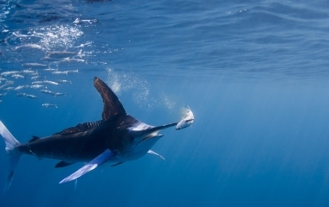

Slide 8
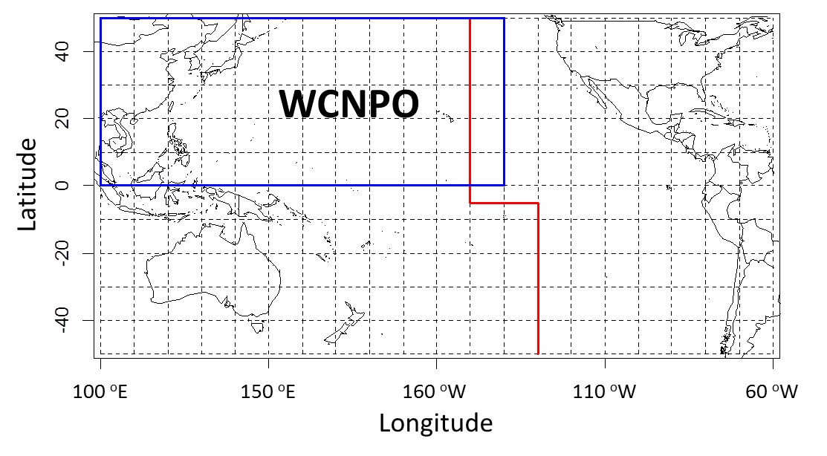
Stock structure
Western and Central North Pacific Ocean Stock
140ºW
WCPFC Area
Notes:
Add WCPFC and IATTC areas

Slide 9
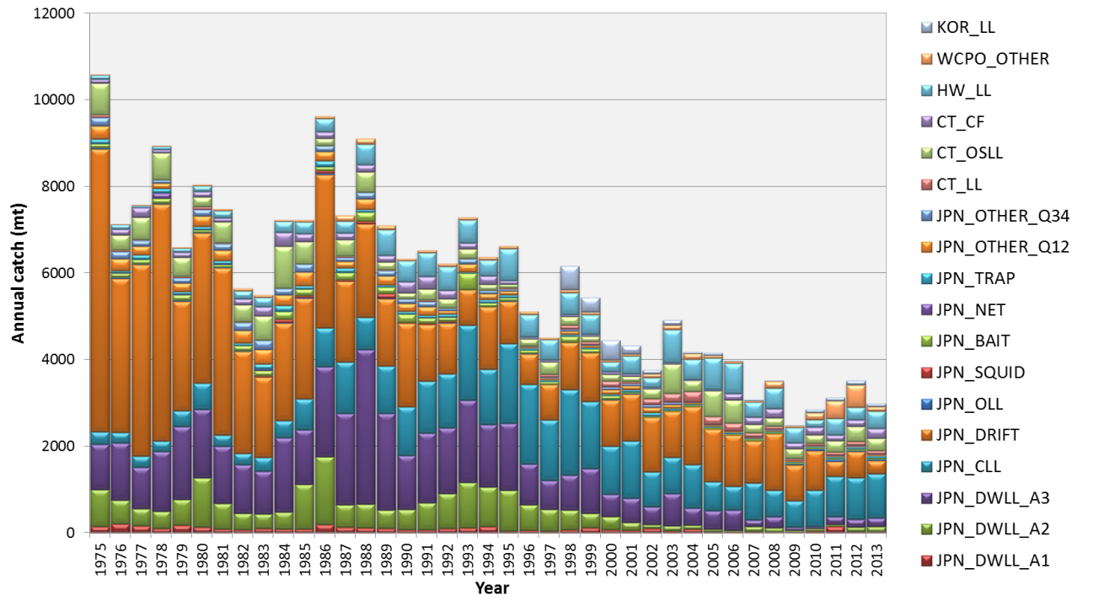


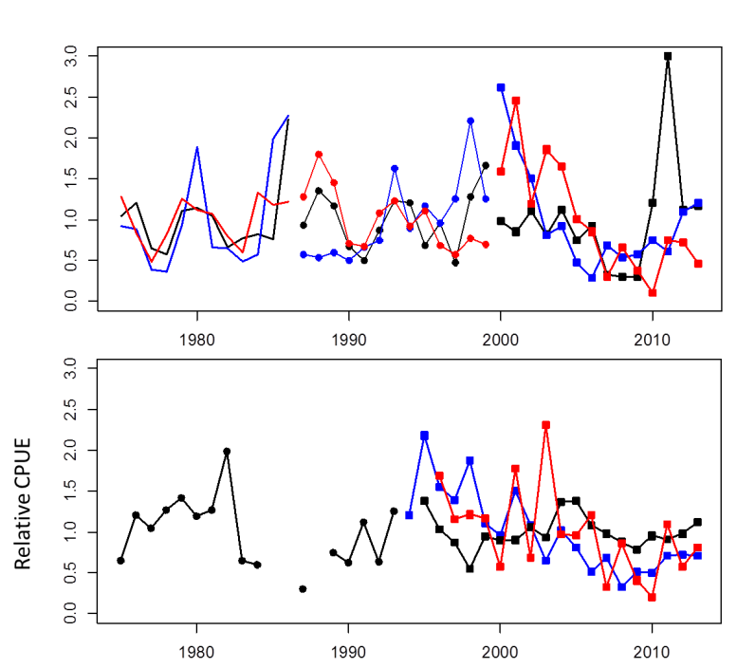
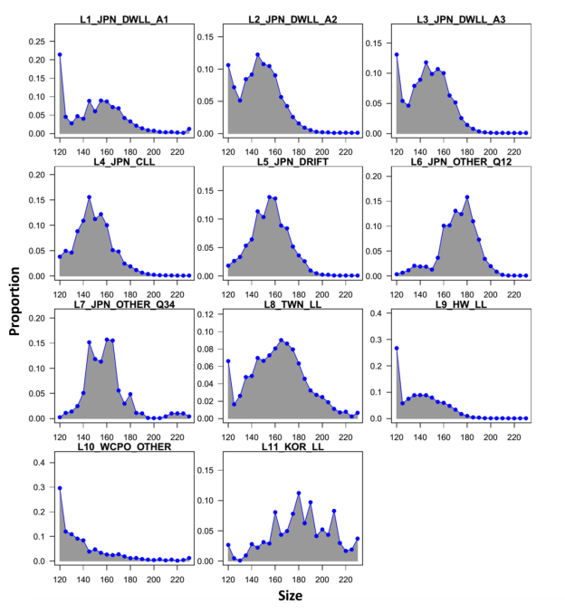
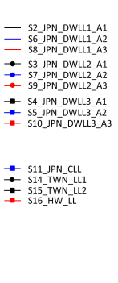
WCNPO Striped marlin
Source:
Previous assessments
ISC (2011)
SS3
Data used (1975–2013):
18 Catch fleets
15 abundance indices
11 composition series

Slide 10
Stock assessment model
Model: Stock Synthesis 3 (ver 3.24f)
Starts in 1975 (seasonal)
Life histories
  Fixed, age-specific natural mortality; growth; and steepness
Selectivity
  Flexible -> double normal (15 fleets), logistic (3 fleets)
  Time blocks (1975-1986; 1987-1999; 2000-2013)
Estimated parameters (n = 93):
  R₀, initial F, Selectivity, recruitment dev.

Slide 11

Model diagnostics
Visual examination of goodness-of-fits
Statistical test of residuals
  Standard deviation of normalized residual (SDNR) of CPUE (Chi-square)
  Runs test of residuals (CPUE and Francis TA1.8 residuals)
Relative likelihood profile (log(R₀))
Retrospective analysis (Mohn’s ρ value)
Visual examination of the model outputs
  Selectivity, SSB, recruitment, fishing mortality

Slide 12
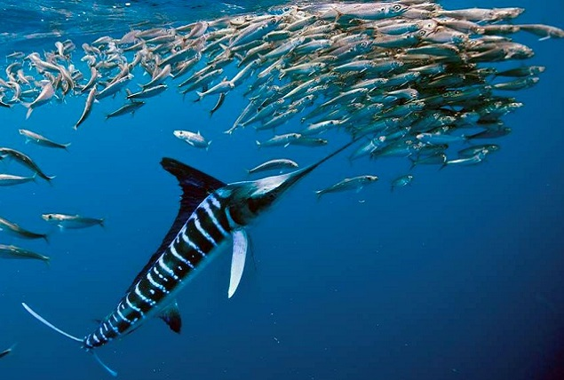


Slide 13
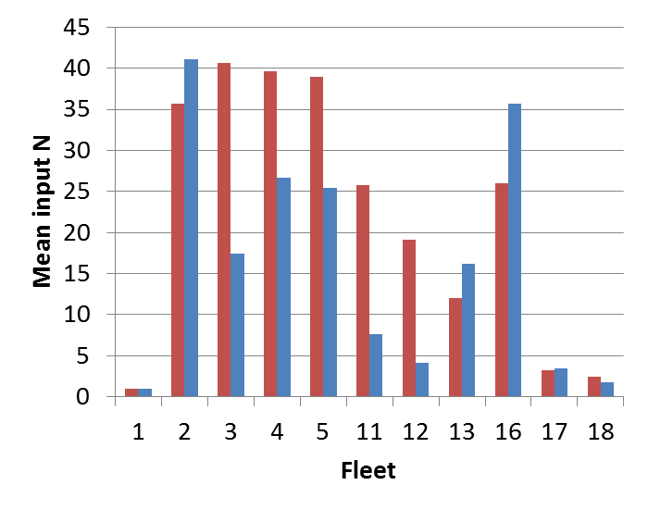
Estimation of effective sample size
Model M
(McAllister and
Ianelli, 1997)
Model F
(Francis, 2011
TA1.8)
Effective sample sizes are generally higher in Model M,
but not in F2, 13, 16

Slide 14
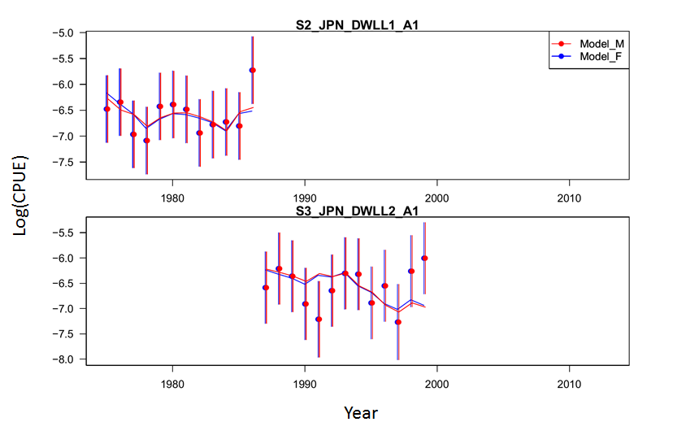
Visual examination of goodness-of-fits (CPUE)
Detail look
Notes:
Slightly differences in

Slide 15
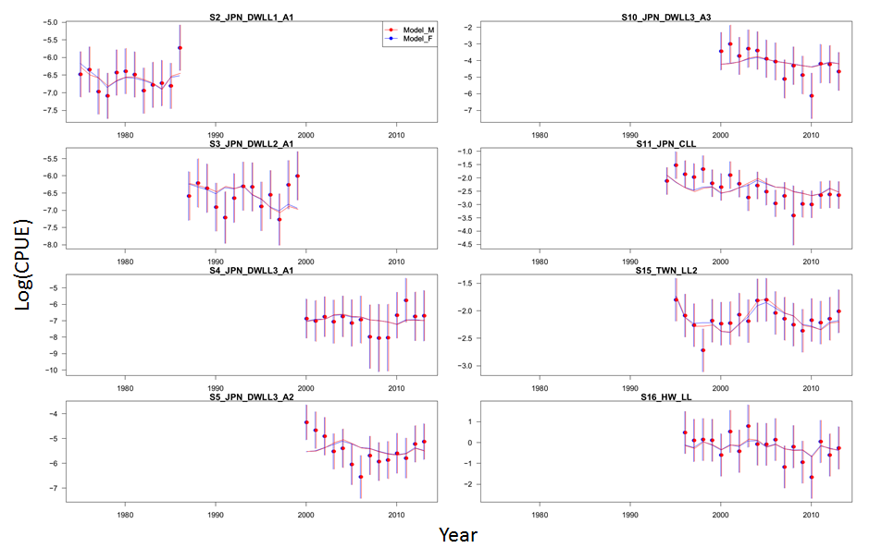
Visual examination of goodness-of-fits (CPUE)
Overall look
Notes:
Slightly differences in

Slide 16
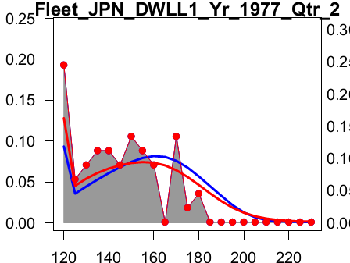
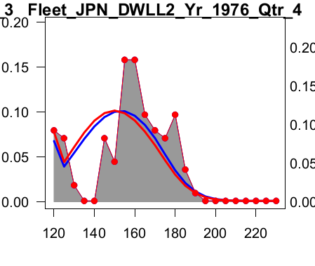
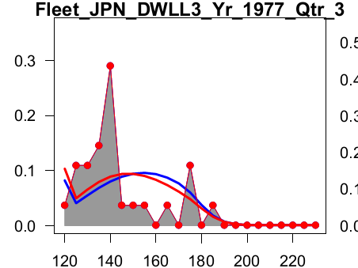
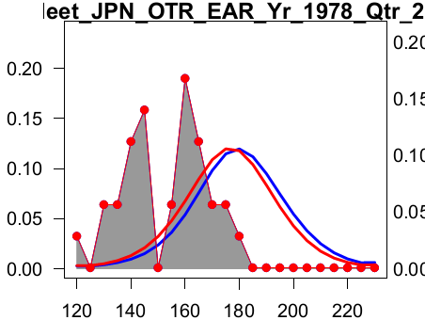
Visual examination of goodness-of-fits (size)
Detail look
Model M
Model F
Proportion
Size
Year and season specific

Slide 17
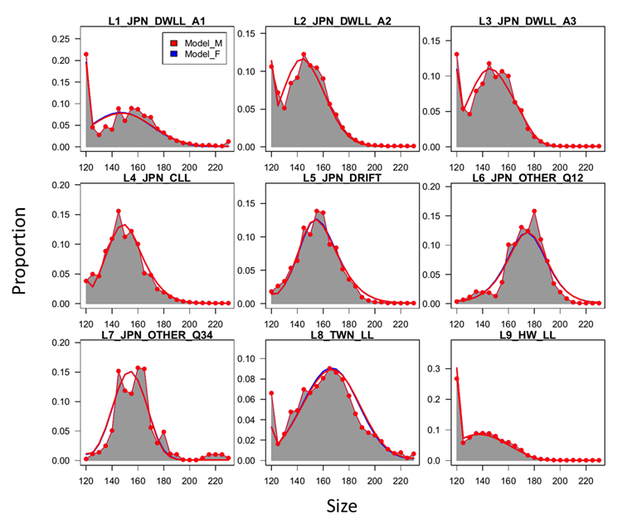
Visual examination of goodness-of-fits (size)
Overall look
Aggregated

Slide 18
SDNR
Index | n | SDNR |  |  | χ²
 |  | Model M |  | Model F
Svey2_JPN_DWLL1 | 12 | 0.95 |  | 1.01 | 1.34
Svey3_JPN_DWLL1 | 13 | 1.32 |  | 1.26 | 1.32
Svey4_JPN_DWLL1 | 14 | 0.73 |  | 0.72 | 1.31
Svey5_JPN_DWLL2 | 14 | 1.58 |  | 1.57 | 1.31
Svey6_JPN_DWLL2 | 12 | 0.91 |  | 0.93 | 1.34
Svey7_JPN_DWLL2 | 13 | 2.49 |  | 2.38 | 1.32
Svey8_JPN_DWLL3 | 12 | 1.08 |  | 1.12 | 1.34
Svey9_JPN_DWLL3 | 13 | 1.07 |  | 1.04 | 1.32
Svey10_JPN_DWLL3 | 14 | 1.17 |  | 1.19 | 1.31
Svey11_JPN_CLL | 20 | 1.62 |  | 1.57 | 1.26
Svey12_JPN_DFT | 17 | 2.09 |  | 2.27 | 1.28
Svey13_JPN_DFT | 11 | 1.39 |  | 1.31 | 1.35
Svey14_TWN_EARLY | 16 | 0.87 |  | 0.97 | 1.29
Svey15_TWN_LATE | 19 | 0.78 |  | 0.81 | 1.27
Svey16_HWLL | 18 | 0.92 |  | 0.93 | 1.27
In Survey 3, Model F is better than Model M

Slide 19
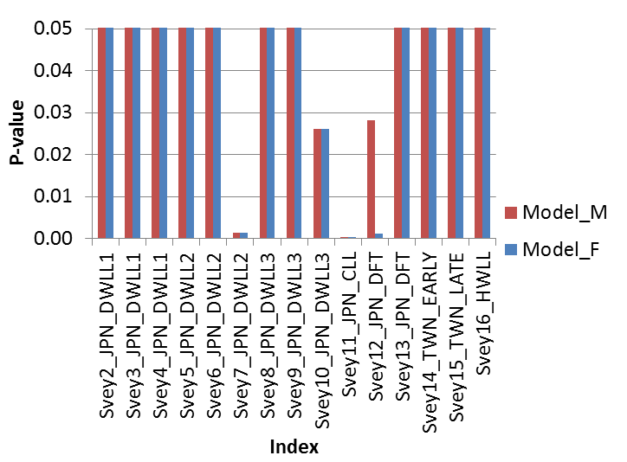
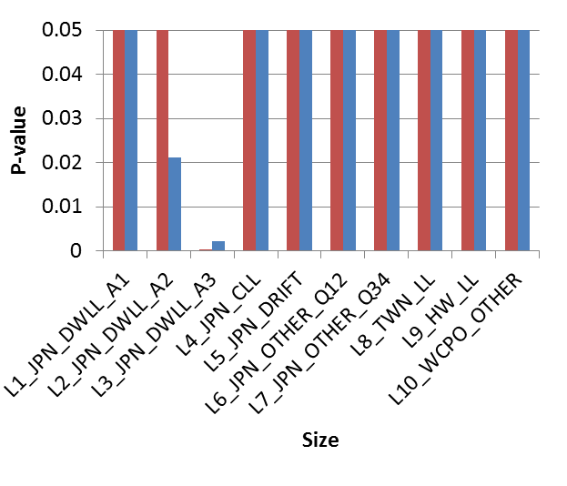
Runs test
α = 0.05
α = 0.05
Two models are the same
based on α = 0.05
L2 is different between
two models
(Model F didn’t pass the test)

Slide 20
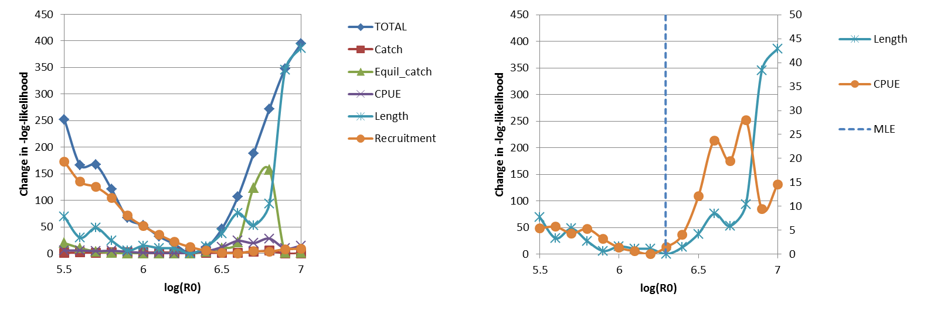
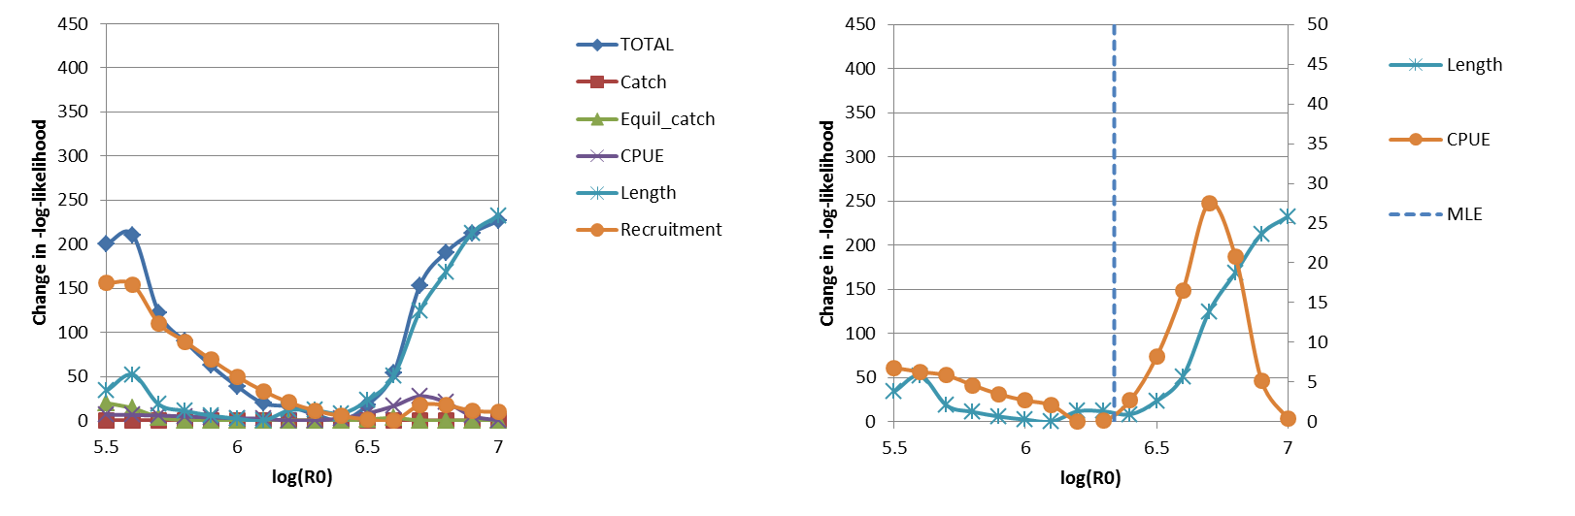
Relative Likelihood Profile, log(R₀)
Model M
(Left axis)
(Right axis)
Model F
(Left axis)
(Right axis)
MLE is consistent with CPUE

Slide 21
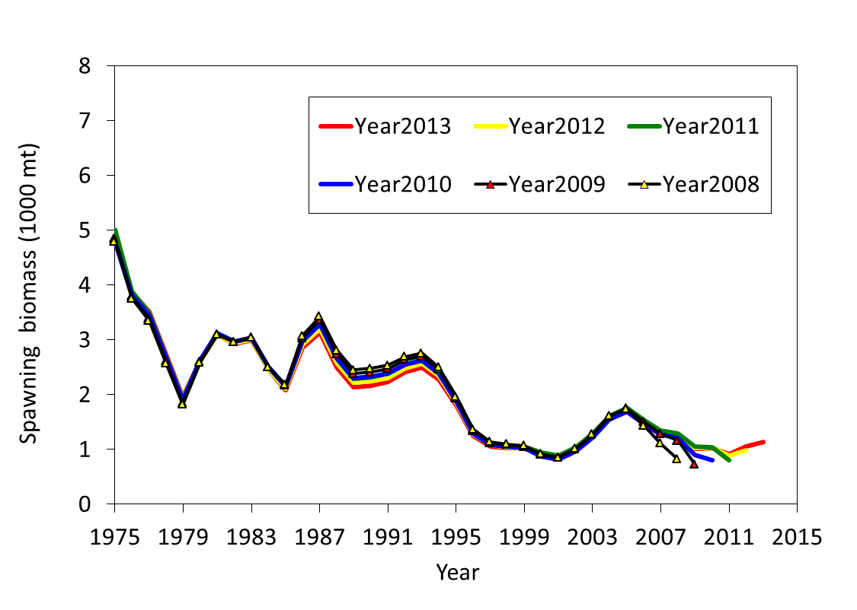
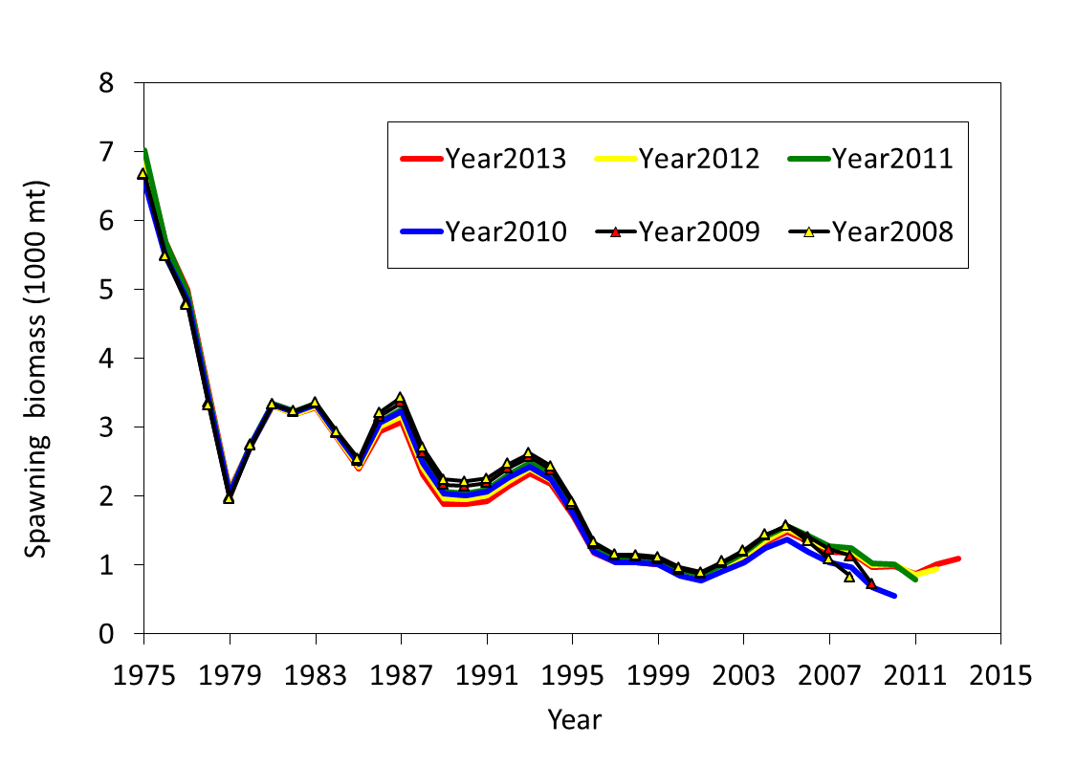
Retrospective analysis
Model M
Model F
Mohn’s ρ = -1.04
Mohn’s ρ = -1.17

Slide 22
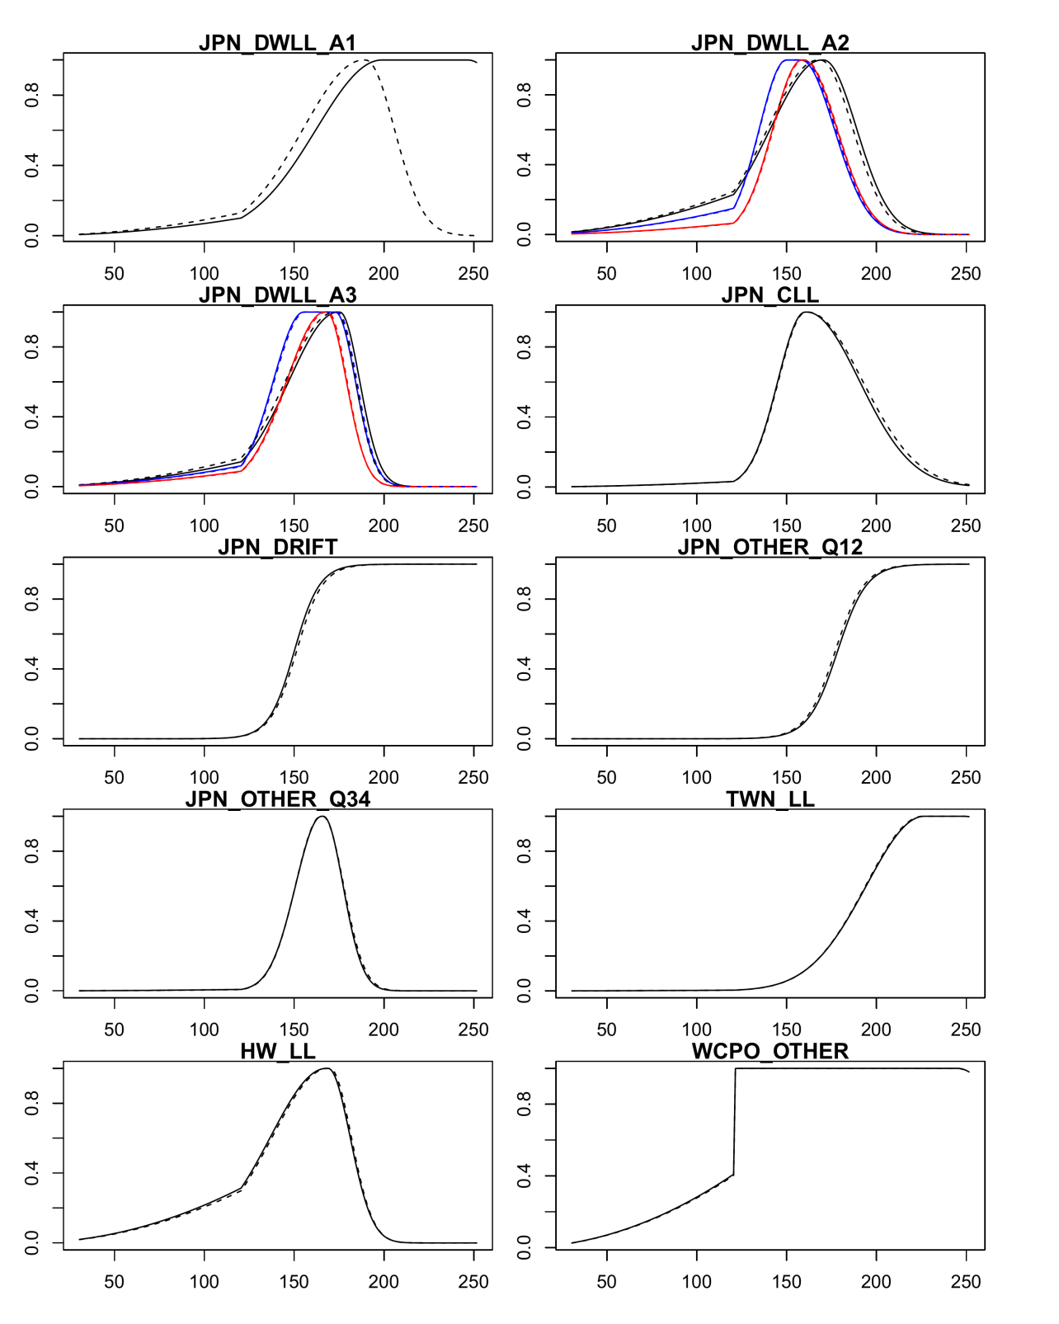
Estimation of
selectivity
Model M
1975-1986;
1987-1999;
2000-2013
Model F
1975-1986;
1987-1999;
2000-2013
Proportion
Solid line = Model M
Dotted line = Model F
Size

Slide 23
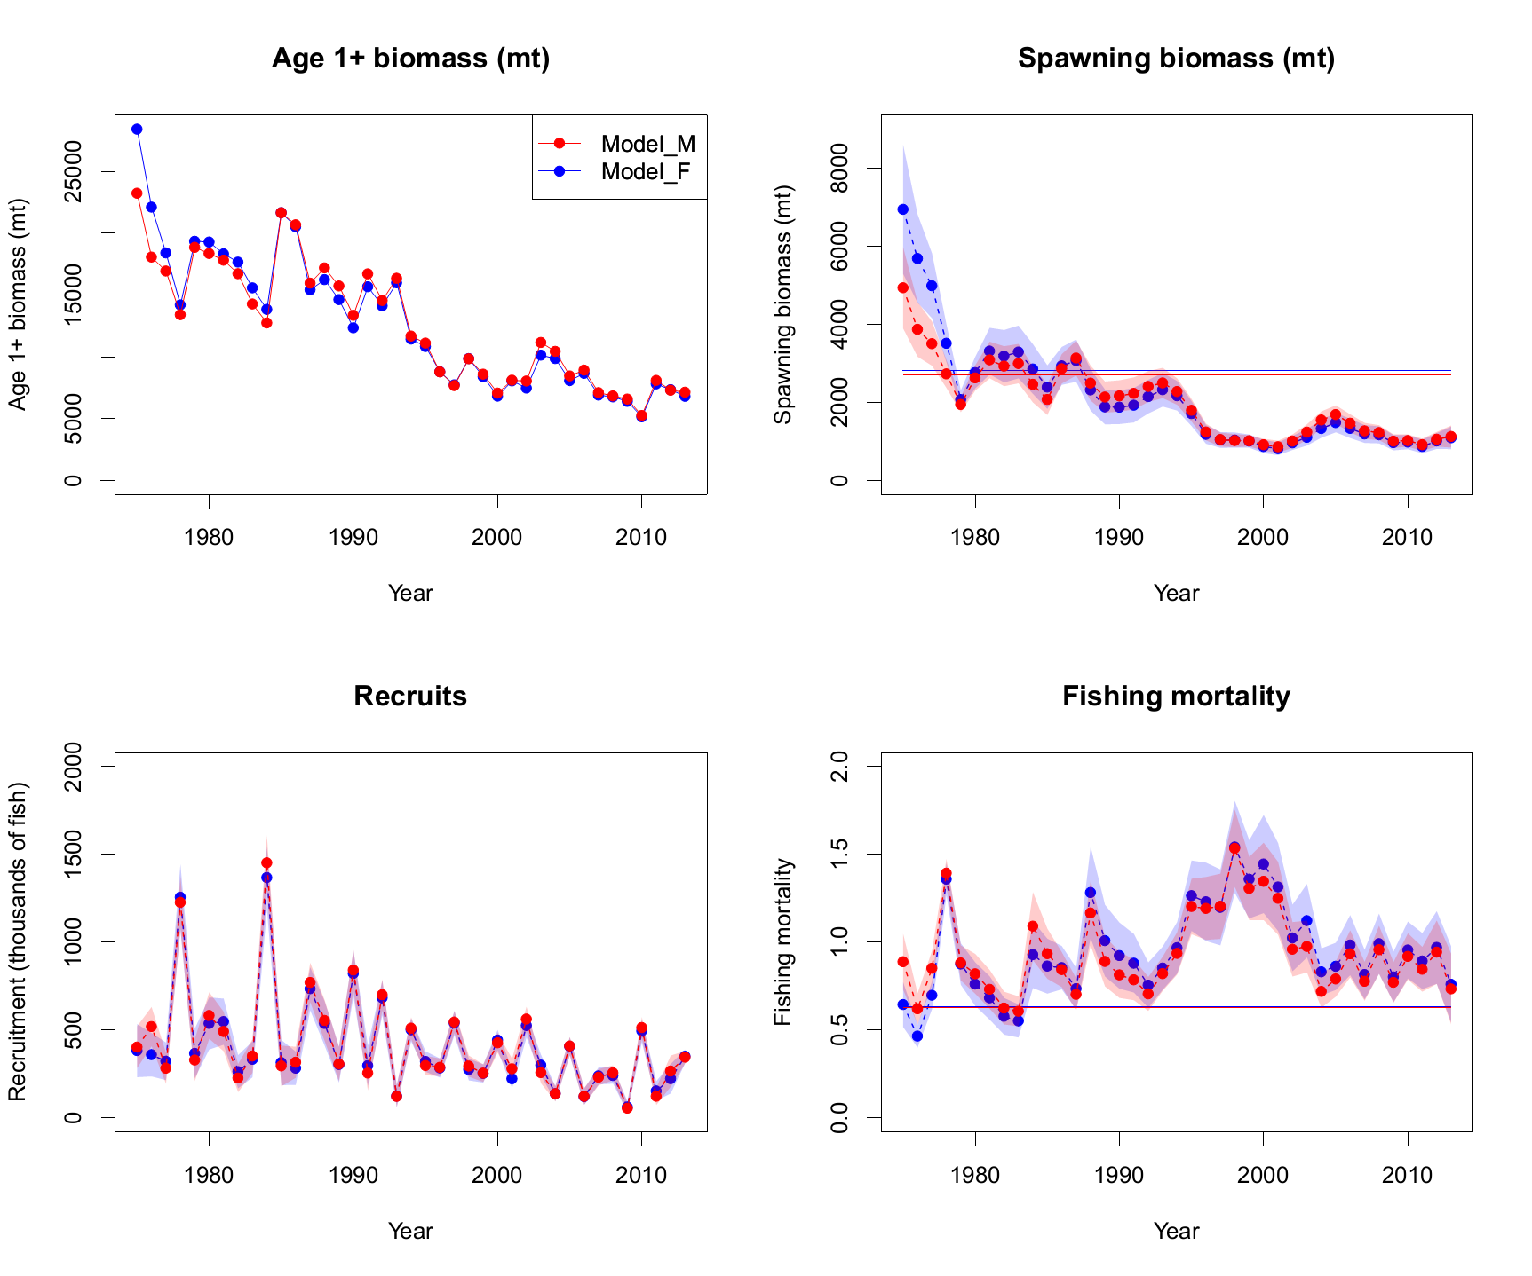
Model Outputs

Slide 24
Discussion
Our study suggests the results between two weighting methods are very similar
  SDNR in Survey 3_JPN_index (Model F is better)
  Runs test in L2_JPN_size (Model M is better)
  Relative abundance indices was prioritized in Model F
  Finally, we chose Model F as the base-case model
Data weighting may affect the estimation of selectivity!
  ->Biomass, SSB, F have slightly changed
  Why? The weight for this fleet (F1) is relative small. Selectivity of F1 can be either Dome or asymptotic.

Slide 25
Conclusions
In our case, the stock assessment result is very robust to the data weighting method
We recommended other studies should include the weighting methods as a sensitivity analysis.
We also suggested the diagnostics analysis used in this study is a useful tool for model selection (Felipe’s D4).
Next step: Evaluation of various weighting methods by using our IBM simulator

Slide 26




Acknowledgements
Questions?
ISC BILLWG chairman Jon Brodziak
Hiroaki Okamoto, Kotaro Yokawa, Seiji Oshimo, Mikihiko Kai, Minoru Kanaiwa, Darryl Tagami, Russell Ito, Chi-Lu Sun, Nan-Jay Su, and Su-Zan Yeh (ISC BILLWG)
Peter Williams (WCPFC) and Michael Hinton (IATTC)
Hui-hua Lee (NOAA Fisheries, Southwest Fisheries Science Center), Ian Taylor (NOAA Fisheries, Northwest Fisheries Science Center), and Rick Methot (NOAA Science Advisor for Stock Assessments)

