Slide 1


Model Misspecification and Diagnostics and
the quest for internal consistency
Kevin Piner and Hui Hua Lee
NOAA Fisheries, SWFSC
Mark Maunder
IATTC
Disclaimer
This presentation reflects solely the views
of it authors, but Not necessarily those of
NOAA, IATTC or rational thoughtful folks.
Listener beware.

Slide 2
Definitions
Error- the difference between Observation and the Prediction
Sampling error -random error due when data not a census
Process error- a result of model misspecification of the observation or systems model
3. Observation model- processes linking dynamics and data (e.g. q, selectivity)
4. Systems model- governs the population dynamics (e.g. recruitment, M)
5. Observation error- data error included in the model (sampling error + process error)
sampling
process

Slide 3
What is a correctly specified model?
1. “A model where only sampling error leads to non-zero residuals”
2. “It is a model we can trust—one that is unbiased
(i.e., predicts well for all components) and
includes all the key structure that explain the phenomenon you are interested in”

Slide 4




Part I. The high lords edict:
Maunder’s law of conflicting data
Axiom
Data is true
Implication
Conflicting data implies model misspecification
Caveat
Data conflict needs to be interpreted in the context of random sampling error
Significance
Down weighting or dropping conflicting data is not necessarily appropriate because it may not resolve the model misspecification
Conflict is bad

Slide 5









Slide 6


Slide 9
Model Misspecification in inevitable
Result of incorrect (often simplifying) assumptions:
Some types of model misspecification
1. Missing important model processes
2. Using an incorrect model structure
3. Incorrect specification of a model parameter
Making an incorrect statistical assumption
Naively estimating processes

Slide 10
Toy Problem
Systems model
Fixed time invariant growth, mortality
S/R (BH sigma R=0.6)
Movement is random (age to age)
Observation model
Time invariant asymptotic selection
Constant catchability
True
juvenile
length
selection
Data:
Juvenile: catch and lengths
Adult: catch, lengths and CPUE
age based movement
length
adults

Slide 11
Missing Process
Spatial dynamics and movement (systems model)
199 parameters
70 parameters
True/correct
Area as fleets
juvenile
juvenile
length
length
length
length
age based movement
adults
adults

Slide 12
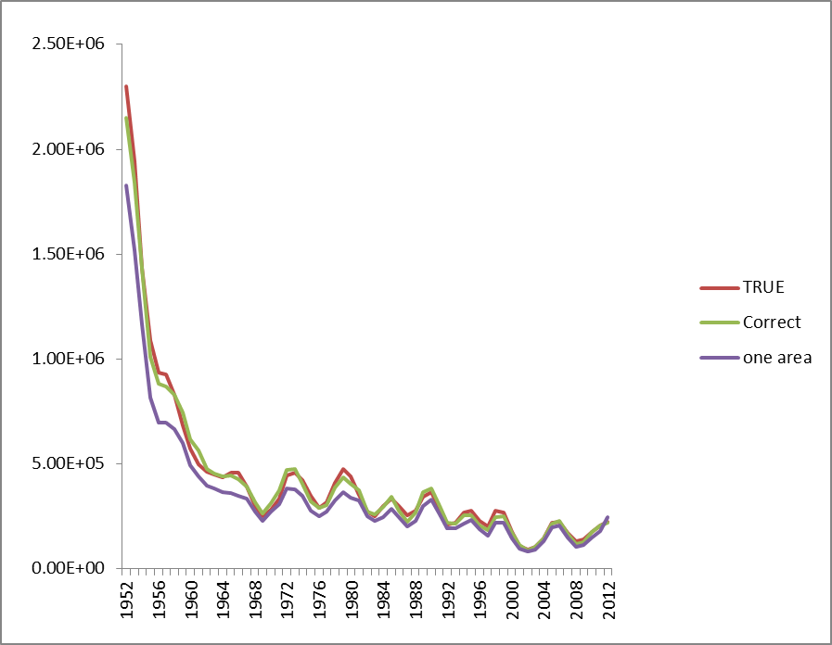
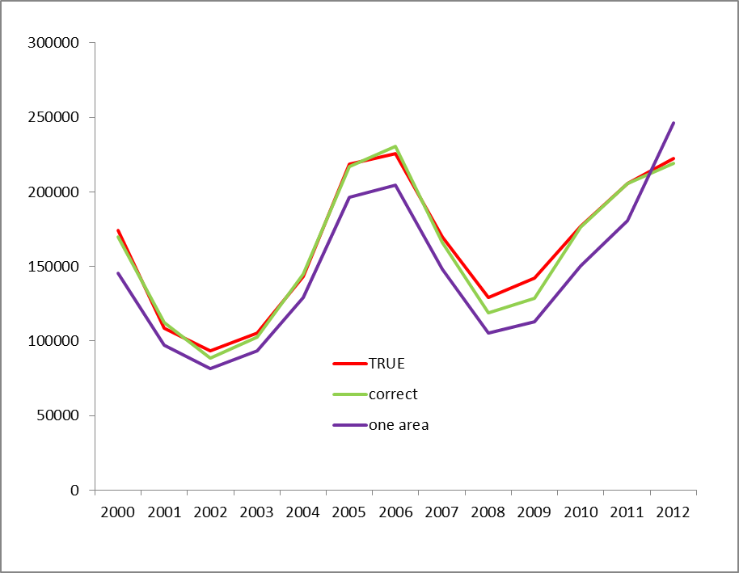
Missing Process
Spatial dynamics and movement (systems model)
Spawning biomass
True Model Correct Model (includes sampling error) One area Model
juvenile
juvenile
length
length
length
length
age based movement
adults
adults

Slide 13
Incorrect Model Structure- age based selection
True Model /correct age based selection
juvenile
juvenile
length
age
age based movement
length
age based movement
age
adults
adults

Slide 14
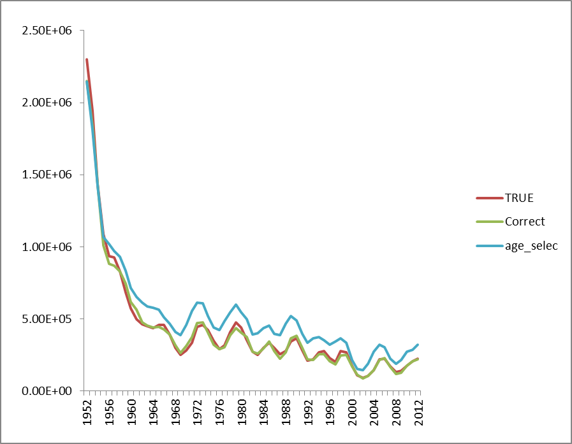
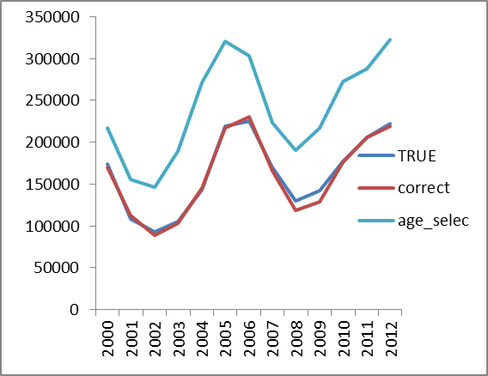
Incorrect Model Structure-
Spawning biomass
True Model Correct Model (includes sampling error) One area Model
juvenile
juvenile
length
age
age based movement
length
age based movement
age
adults
adults

Slide 15
Incorrect Parameter Specification- Linf fixed at 270cm
True Model/Correct Model Linf 8% bigger
juvenile
juvenile
length
length
age based movement
length
age based movement
length
adults
adults

Slide 16
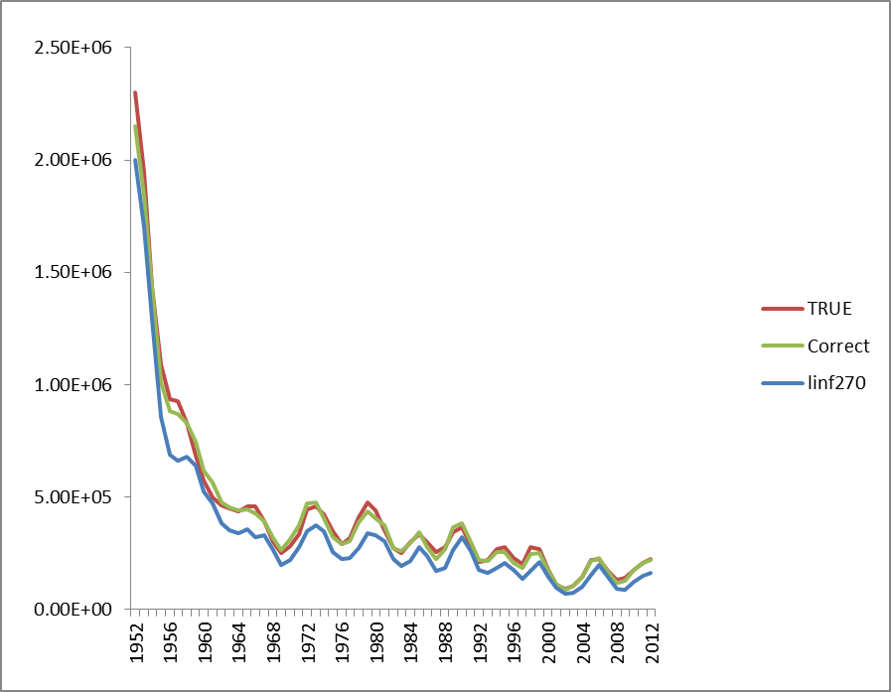
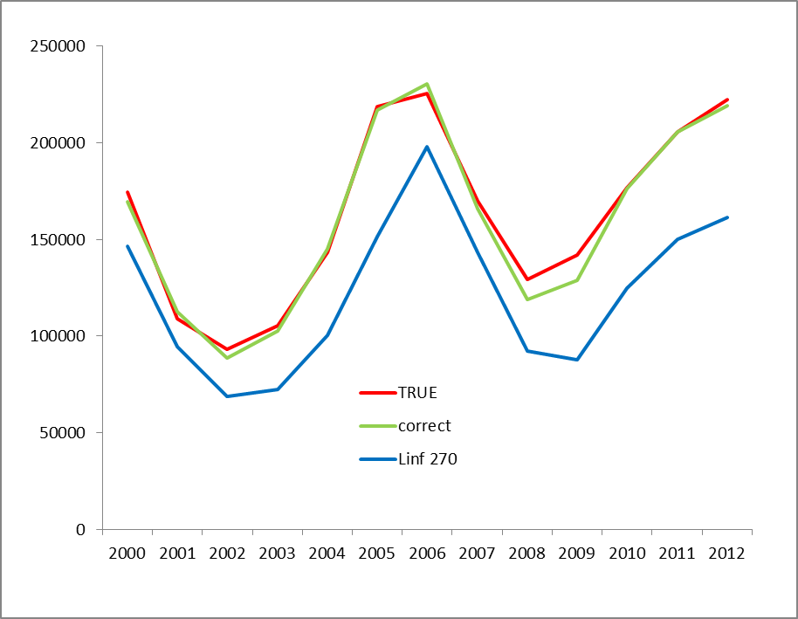
Incorrect Parameter Specification- Linf fixed at 270cm
True Model Correct Model (includes sampling error) Linf 270cm
juvenile
juvenile
length
length
age based movement
length
age based movement
length
adults
adults

Slide 17
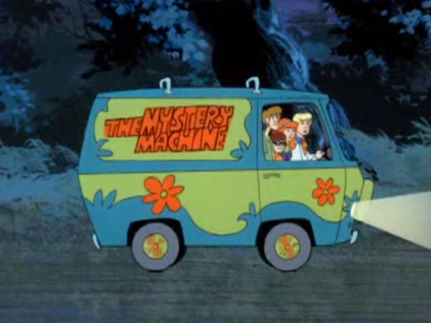
Part II. Scooby Doo where are you?
Model Diagnostics
Diagnostic methods deal with misfit
Goodness of fit
Effects of residual misfit (Conflict)

Slide 18
Goodness of fit
SD = 2
magnitude
pattern

Slide 19
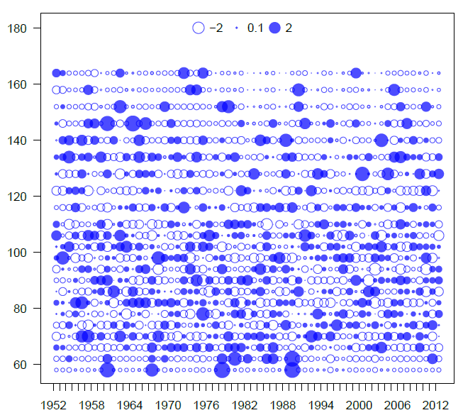
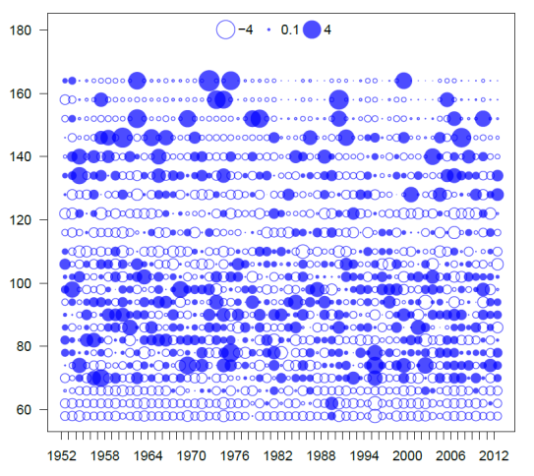
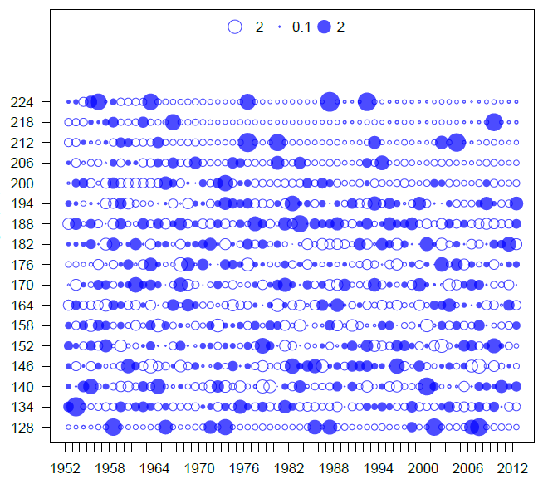
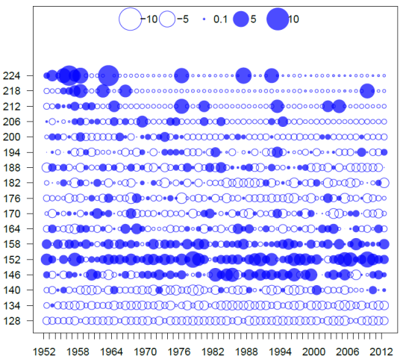
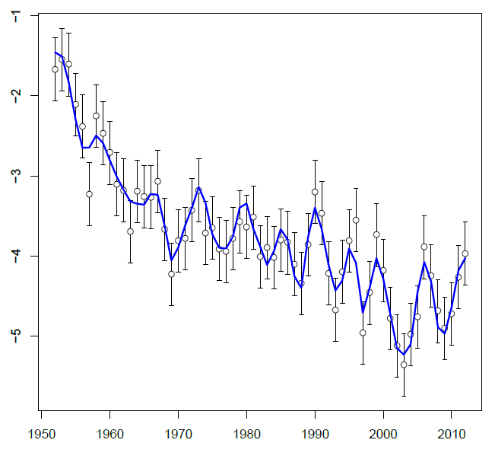
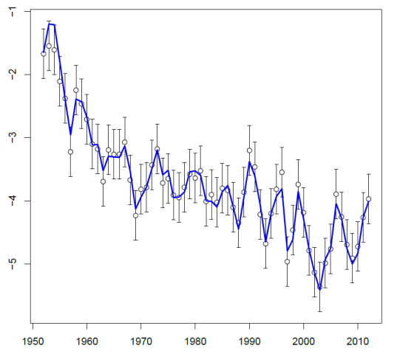
correct
Age selectivity
Juvenile lengths
Adult lengths
Adult CPUE

Slide 20

Effects of misfit (Conflict)
Retrospective
Profiling

Slide 21
Conflict between data sources given model structure
worse
No conflict
My models
Length comps
survey
Some measure of relative goodness of fit
better
Fixed values of something
Fixed values of something

Slide 22
Conflict between data sources given model structure
worse
No conflict
My models
Length comps
survey
Some measure of relative goodness of fit
total
better
Fixed values of something
Fixed values of something

Slide 23
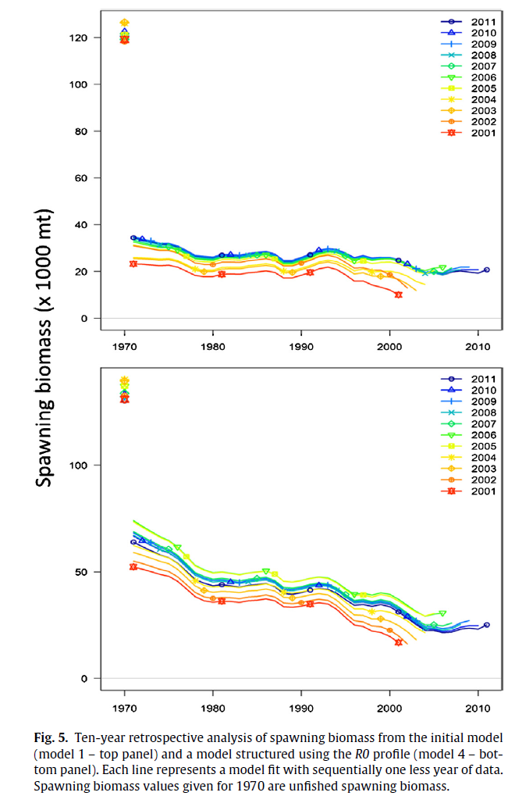
Lee et al. use profiling over unfished stock
size to structure the assessment model
Used more flexible selection and time-varying
selection along with re-weighting to reduce conflict
and down-weight components not prioritized
Lee et al. 2014 Use of likelihood profiling over a global scaling parameter to structure the population dynamics model: an example using blue marlin in the Pacific Ocean. Fish Res

Slide 24
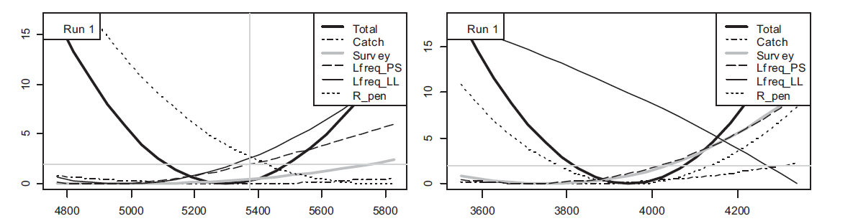
Correctly specified
Incorrectly specified selectivity PS
True value
Likelihood gradient
Unfished stock size
Diagnostics tools good at identifying misspecification but not
the underlying cause.
Wang et al. (2014). Evaluation of virgin recruitment profiling as a diagnostic for selectivity curve structure in integrated stock assessment models. Fish Res. 158:158-164.
Conflict/bias can show up even with correctly specified models
Hurtado-Ferro et al. 2015 Looking in the rear-view mirror: bias and retrospective patterns in integrated, age-structured stock assessment models ICES 72(1):99-110

Slide 25
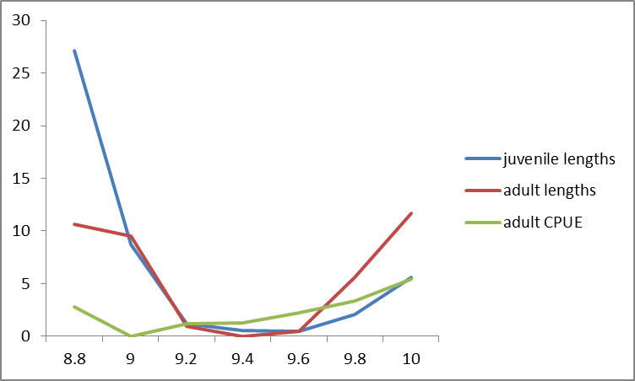
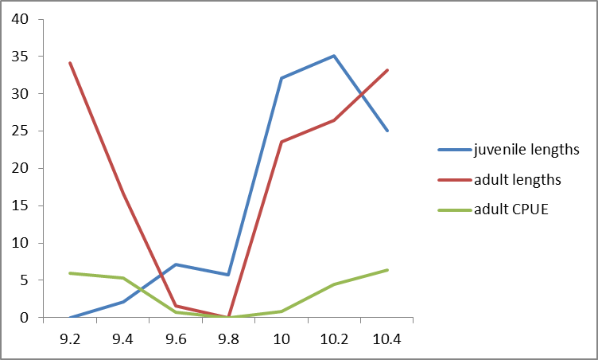
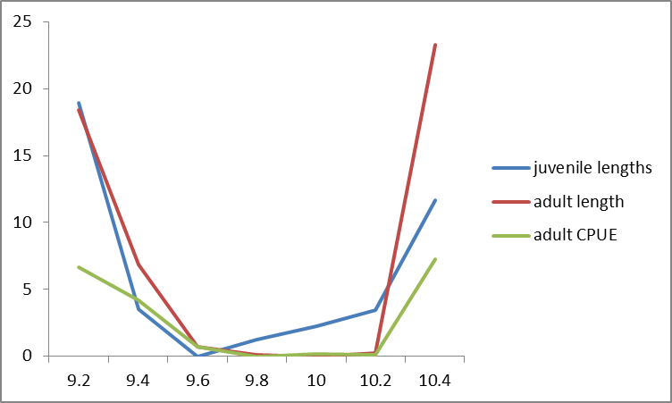
Can you find the correctly specified model?
#1
information gradient
R0
#2
#3

Slide 26
Estimating some parameters cure all ills
#1
Correct model
Information gradient
true
estimated
R0
#2
Misspecified Linf
#3
Misspecified Linf and estimate M
Can create internally consistent models that are wrong, especially when
important system dynamic processes are estimated (e.g. M)
Piner et al. (2011). A simulation-based method to determine model misspecificaton: Examples using natural mortality and population dynamics models. Mar. Coast. Fish.3:336-343.

Slide 27
Part III. Follow the yellow brick road
If the model is most likely misspecified?
and,
diagnostics can’t identify the actual misspecification?
How to proceed?
Condition the model to represent this prioritized data
Assume some data are “the best” sources of information on dynamics
Create internally consistent models
prioritized
Information load

Slide 28
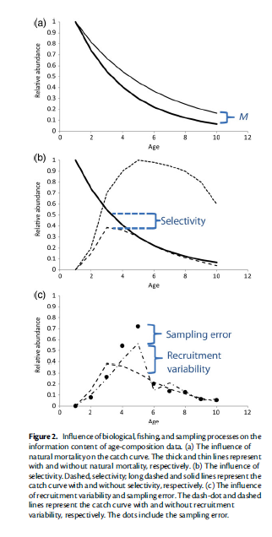
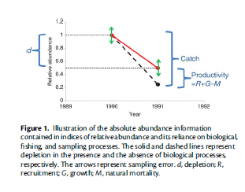
Composition and scale
index and scale
Maunder, M.N. and K. R. Piner (2015).Contemporary Fisheries Stock Assessment: many issues still remain. ICES J. Mar. Sci.72(1):1-6

Slide 29
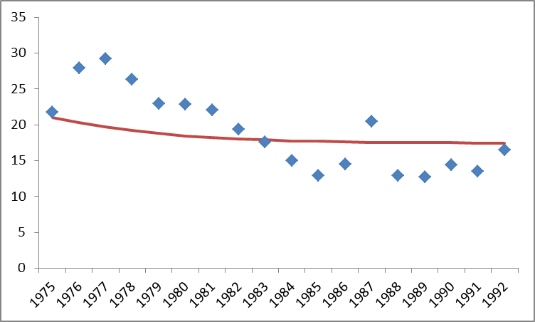
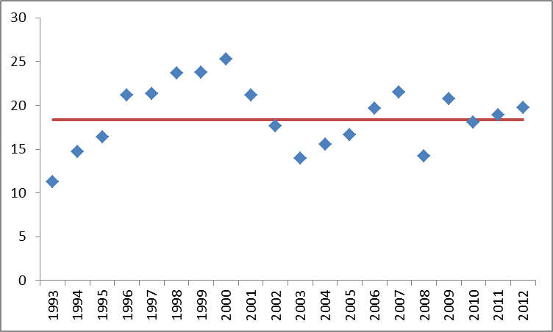
Age structured production diagnostic
Fix selectivity parameters, remove composition, estimate scale parms(R0, q etc).
Deterministic recruitment (S/R)
Pacific Bluefin Tuna
The production function and catch explains trends
Albacore:
Recruitment variability explains the trend

Slide 30

Part IV. A box of wrenches when what I really need is a hammer
impractical
ideal
Information load
doable
Not so ideal

Slide 31
Include the Relevant Processes
Optimal but not be practical
Deals with both observation and system processes
Probably doesn’t require prioritizing of data
Hard to identify what are relevant processes
Data intensive- not all processes have directed information

Slide 32
Use substitute processes (controlled misspecification)
Typically time varying processes or more flexible structure- selectivity?
The estimates of the alternative process may be biased if contaminated by
other misspecifications.
Appropriate for prioritizing data
Does tend to increase the complexity of the model maybe beyond
that of the full model

Slide 33
Missing Process
Spatial dynamics and movement (systems model)
Truth
Our Model
199 parameters
200+ parameters
juvenile
juvenile
length
length
length
age
length
age based movement
age
adults
adults

Slide 34
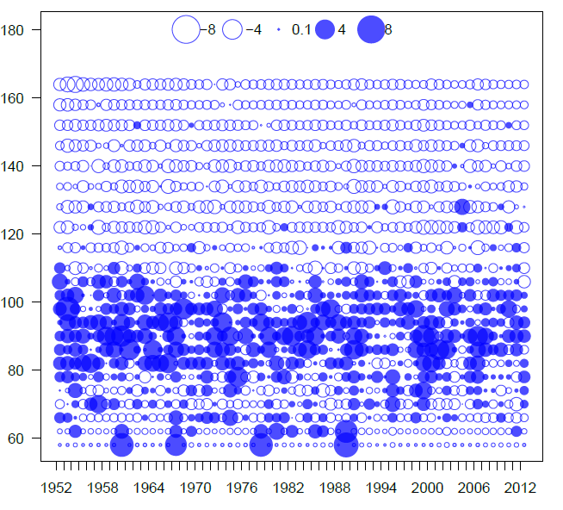
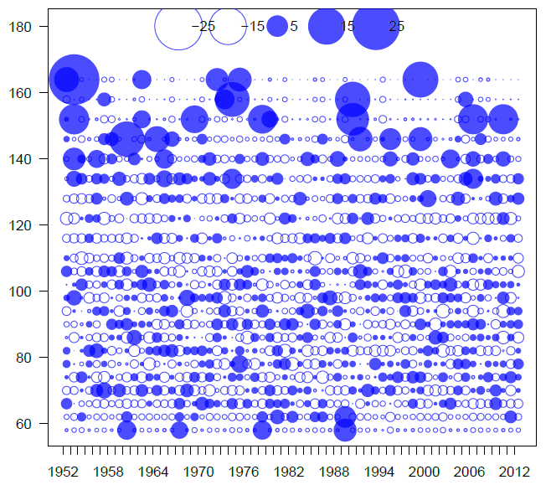
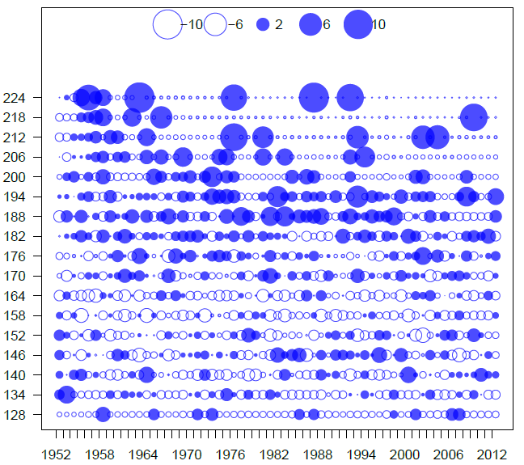
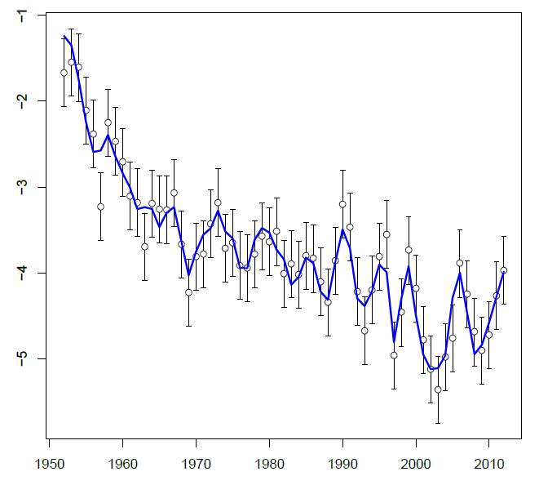
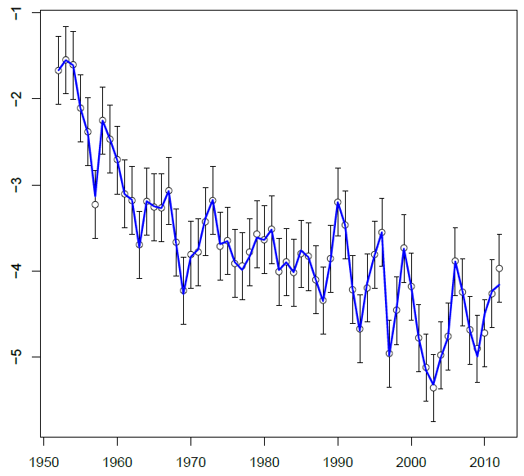
correct
Area as fleet
Time varying age selection
over fitting?

Slide 35
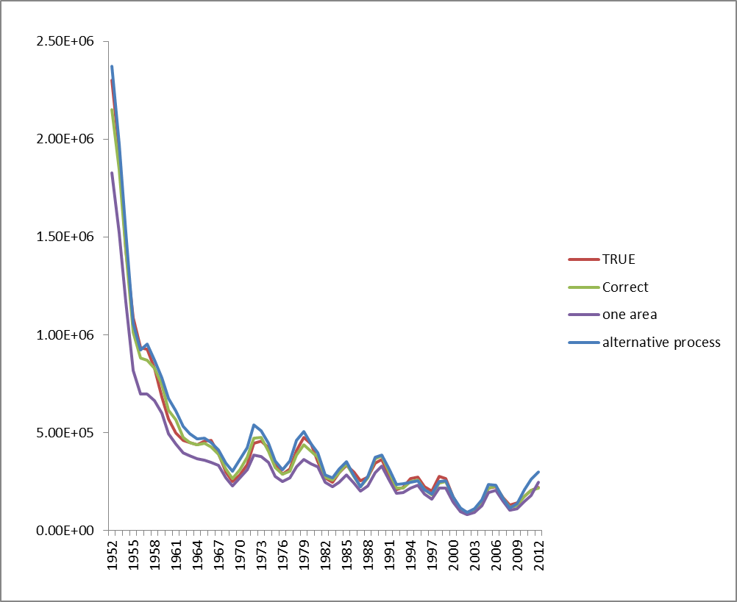
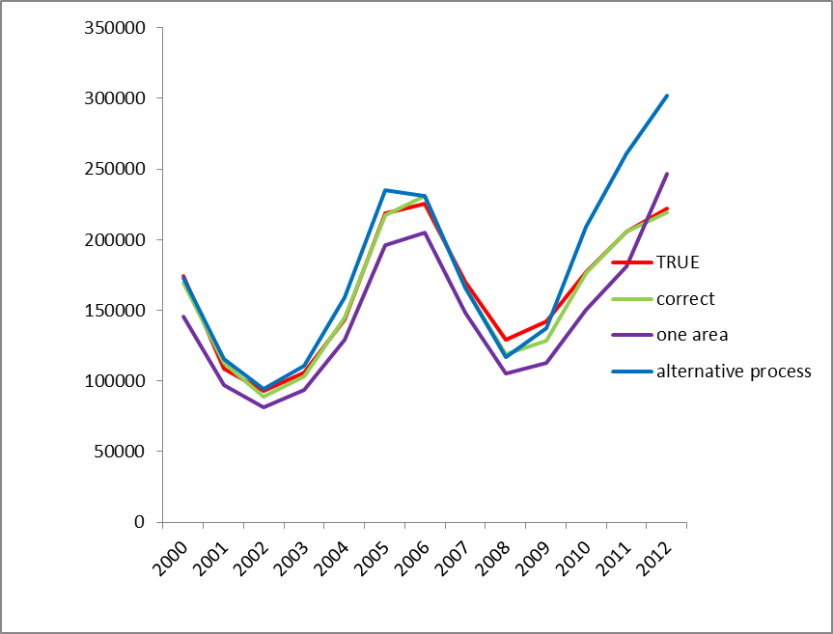
Insert figures of Misfit to one area

Slide 36
Increase the observation error to account for process error
Doesn’t address the underlying problem, especially systems model misspecification
May lead to unacceptable fits to the down weighted component
Requires prioritizing data
However, it is a simple approach that doesn’t lead to increasing model
complexity
Francis RICC (2011) Data weighting in statistical fisheries stock assessment models. Can J Fish Aquat Sci 68:1124–1138

Slide 37
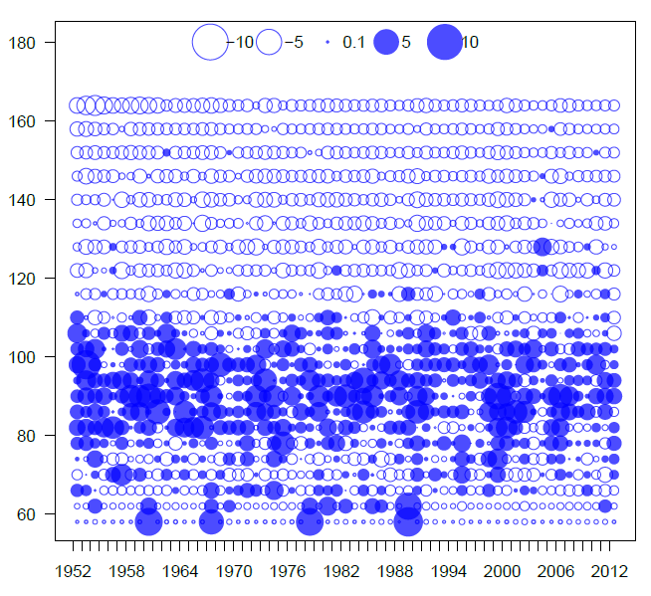
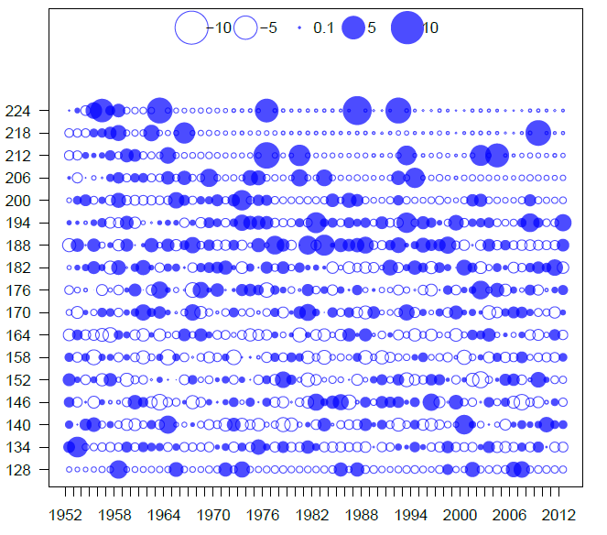
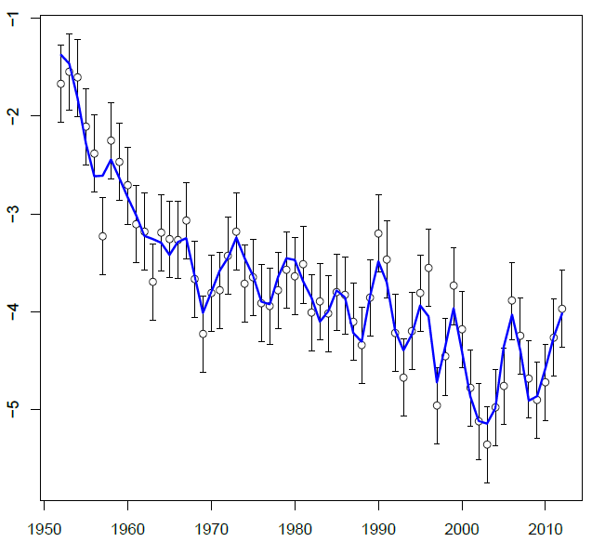
correct
Area as fleet
Down-weight juvenile fleet
Juvenile lengths
Pattern same
Magnitude is worse
Adult lengths
Small improvement
Adult CPUE

Slide 38
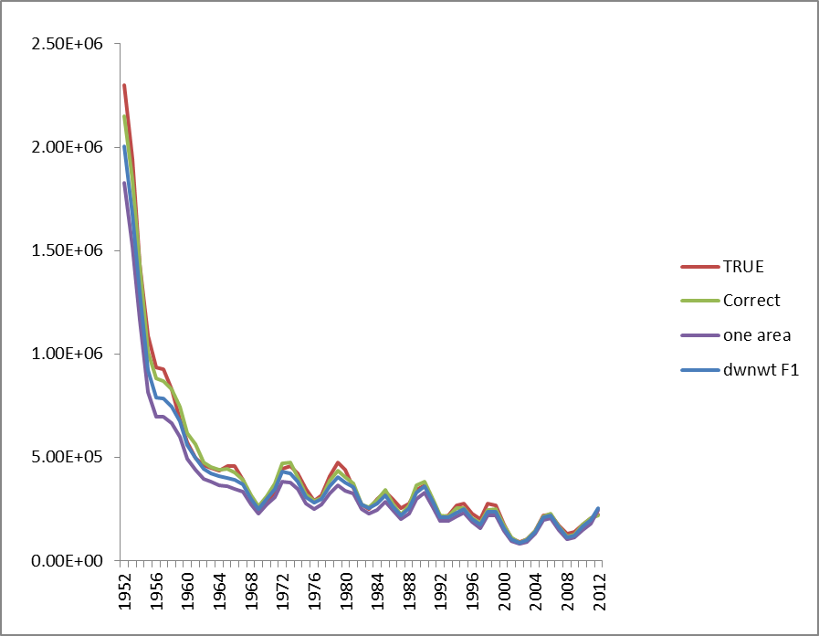
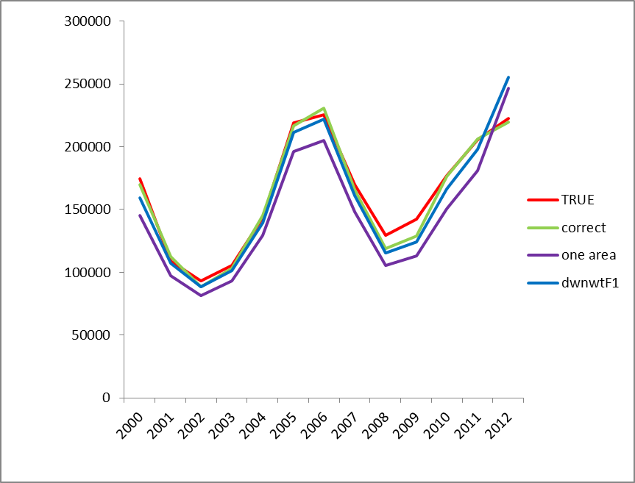
Insert figures of Misfit to one area

Slide 39
?
Compile the data to reduce the importance/difficulty of the problematic process(s)
May lead to a nearly correctly specified model
Appropriate for prioritizing data
May add complexity to model
MacCall, A.D. and S.L.H. Teo. 2013. A hybrid stock synthesis—Virtual population analysis model of Pacific bluefin tuna . Fish. Res. 142: 22-26.

Slide 40
Part V. What we are trying to do
Pre-modeling
Be clear in what you want to estimate- (e.g. are you really interested in MSY?)
Create a hypothesis or multiple hypotheses
Estimate the sampling error outside the model- you will need this to assess quality of fit
Carefully select the data = Don’t throw everything into the model (maybe prioritize)
Create the initial model based on understanding hypothesis with original sampling error
Determine if you have elucidated a production function
Apply model diagnostics
Model additional process as appropriate
Re-weight the data as needed
Use sensitivity analyses to understand effects of hard to estimate processes
Use simulation studies to help choose modeling approach

Slide 41
Our Approach
Be clear in what you want to estimate
Carefully select the data = Don’t throw everything into the model
Estimate the sampling error outside the model- you will need this to assess quality of fit and
  to prioritize the data
Create the initial model based on the hypothesis and the important data
Apply model diagnostics
Determine what data has information on trends and scale (maybe adjust prioritization)
Modify or add additional process as appropriate (diagnostics again)
Right-weight the data last (diagnostics again again….)
Use sensitivity analyses to understand effects of hard to estimate processes
Use simulation studies to help choose modeling approach
Model Development

Slide 42
Our Approach
Be clear in what you want to estimate
Carefully select the data = Don’t throw everything into the model
Estimate the sampling error outside the model- you will need this to assess quality of fit and
  to prioritize the data
Create the initial model based on understanding hypothesis with original sampling error
Determine if you have elucidated a production function
Apply model diagnostics
Model additional process as appropriate
Re-weight the data as needed
Potentially add in other data as long as it doesn’t change things too much (abundance)
Use sensitivity analyses to understand effects of simplifying assumptions/processes
Create alternative models which is not the same as sensitivity analyses
Use simulation studies to help choose modeling approach
Post Model Development

Slide 43
Our Approach
Be clear in what you want to estimate
Carefully select the data = Don’t throw everything into the model
Estimate the sampling error outside the model- you will need this to assess quality of fit and
  to prioritize the data
Create the initial model based on understanding hypothesis with original sampling error
Determine if you have elucidated a production function
Apply model diagnostics
Model additional process as appropriate
Re-weight the data as needed
Use sensitivity analyses to understand effects of hard to estimate processes
Use simulation studies to help choose modeling approach
To improve subsequent assessments

Slide 44

The Last Slide

Slide 45

Conflict is inevitable
‘There are things we know that we know. There are known unknowns. That is to say there are things that we now know we don't know. But there are also unknown unknowns. There are things we do not know we don't know’

Slide 46
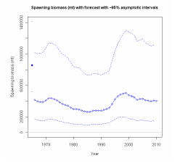
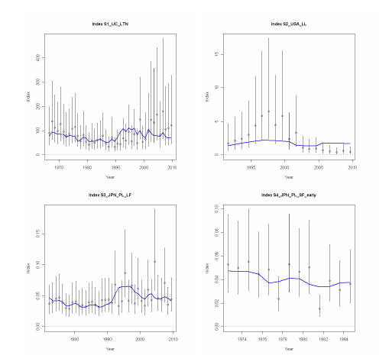
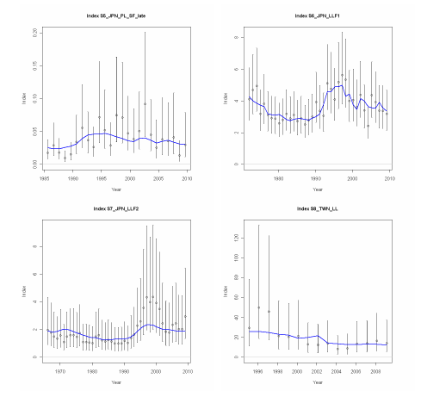
Simplify your data
Old Assessment
New Assessment

