Slide 1
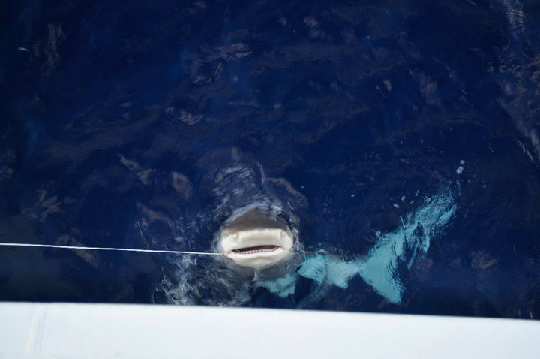


Use of dynamic factor analysis to estimate trends in abundance of upper trophic level species
Michael Scott Sherburne
Cassidy D Peterson
Robert J Latour

Slide 2
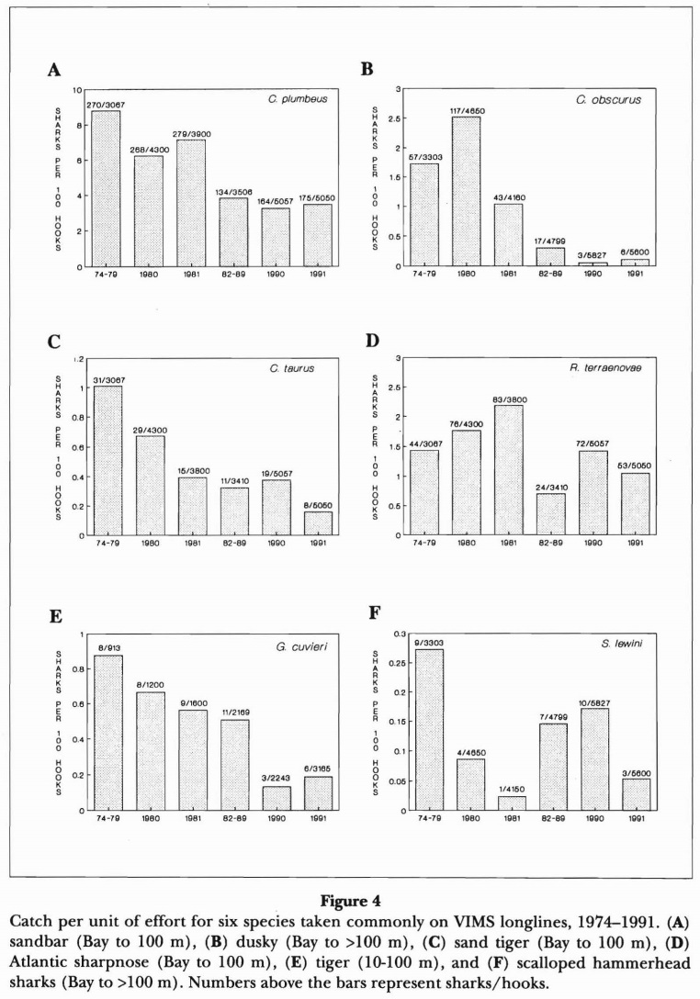
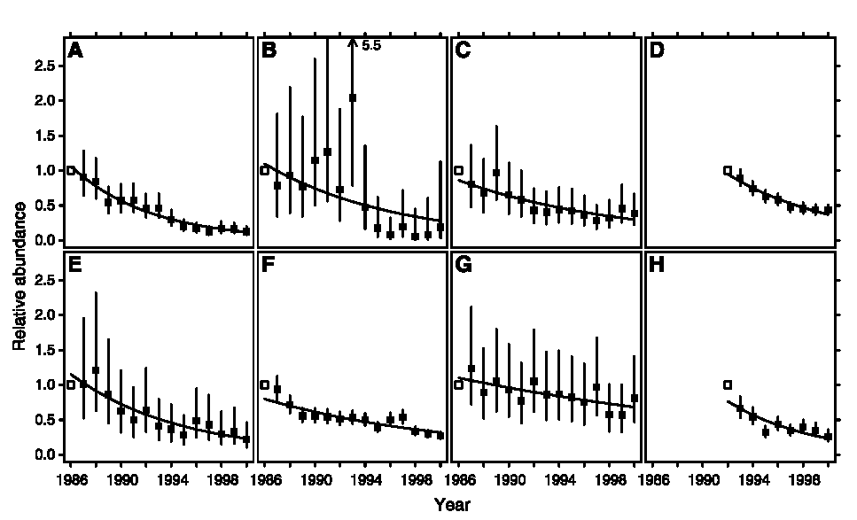
Background
Musick et al. 1993
Shark population declines (1970s – 1990s)
  Increased commercial and recreational fishery
  K-selected life history
Shark Fishery Management Plan (NMFS 1993)
Baum et al. 2003

Slide 3
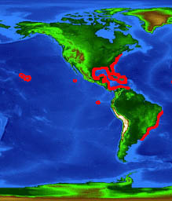
Motivation
Conservative management
Shark stock assessments require catch-based indices of abundance
  Problems:
    Species ranges are large
    Sharks are migratory with sex- and size-specific movements
    Surveys are localized
Sandbar
flmnh.ufl.edu

Slide 4
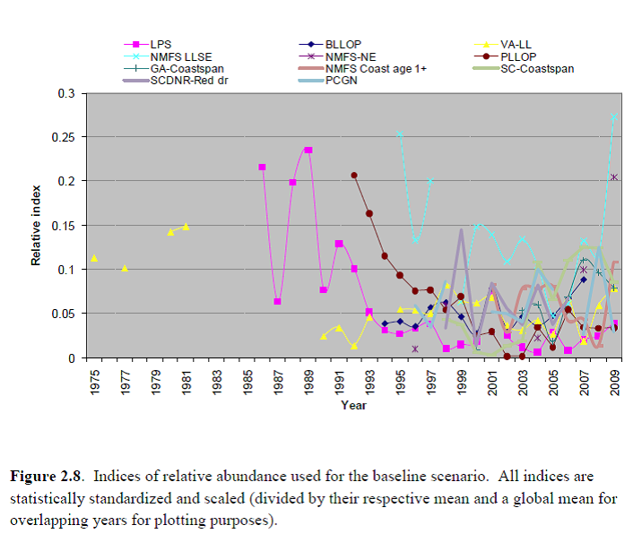
Motivation: Sandbar Stock Assessment
SEDAR 21 2011

Slide 5
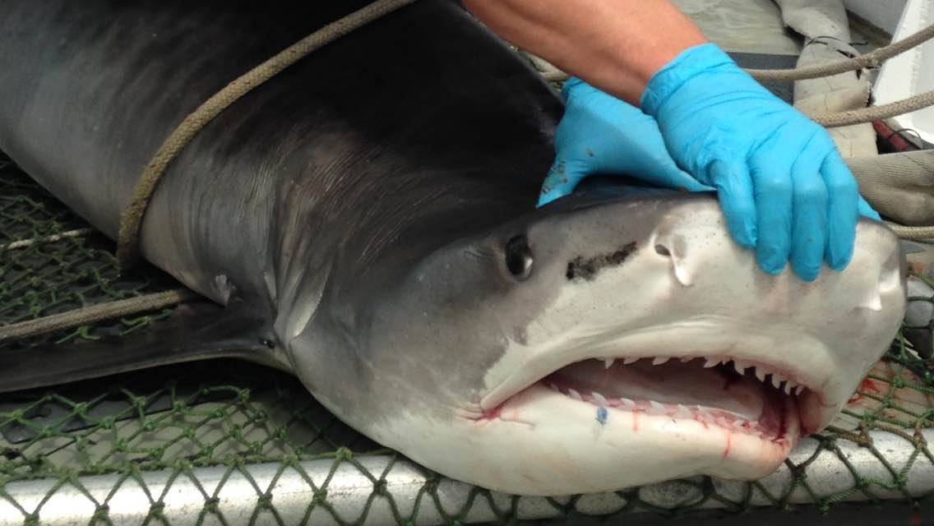
Motivating QUESTIONs:
Can we compile these conflicting indices of abundance into a representative trend of abundance over the sampled distribution?
Do broad-scale covariates affect these abundances?

Slide 6
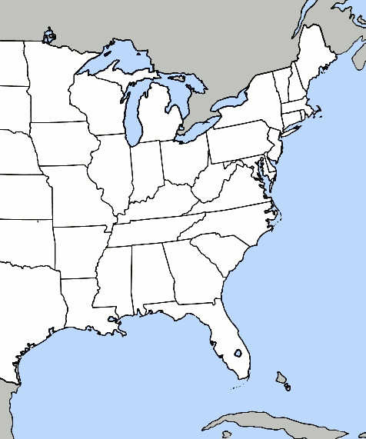
Data Sources
VIMS LL
SEAMAP trawl
SC LL
GA LL
SEFSC LL
GULFSPAN GN

Slide 7
Female Life History Parameters |  |  |  |  | von Bertalanffy parameters
Species | A_{50%} | A_{MAX} | Repro. Cycle | Fecundity | L∞ | K
LARGE COASTAL SHARKS
Sandbar | 14 yrs¹ | 27 yrs² | 2.5 yrs¹ | 8 pups¹ | 165 cm PCL³ | 0.086 / yr³
Blacktip: Atl. | 7 yrs⁴ | 22 yrs⁴ | 2 yrs⁵ | 4 pups⁵ | 159 cm FL⁴ | 0.16 / yr⁴
Blacktip: GOM | 6 yrs⁴ | 17 yrs⁴ | 2 yrs⁵ | 4 pups⁵ | 142 cm FL⁴ | 0.24 / yr⁴
Spinner | 7-8 yrs⁶ | 20 yrs⁶ | 2 yrs⁷* | 6-8 pups⁸ | 226 cm FL⁹ | 0.08 / yr⁹
Tiger | 10 yrs¹⁰ | 29 yrs¹⁰ | 2 yrs⁸ | 41 pups⁸ | 347 cm FL¹⁰ | 0.12 / yr¹⁰
SMALL COASTAL SHARKS
Finetooth | 6.3 yrs^{11†} | 18.2 yrs^{11†} | 2 yrs¹² | 4 pups¹⁰ | 131.3 cm FL^{11†} | 0.19 / yr^{11†}
Blacknose: Atl. | 4.5 yrs¹³ | 17-19yrs^{13,16} | 2 yrs¹³ | 5 pups⁸ | 113.6 cm FL¹⁴ | 0.18 / yr¹⁴
Blacknose: GOM | NA | 16 yrs¹⁵ | 1 yr¹⁶ | 3 pups¹⁶ | 113.7–124.1 cmFL¹⁵ | 0.24–0.35 / yr¹⁵
Bonnethead: Atl. | 6.7 yrs¹⁷ | 19 yrs¹⁷ | 1 yr¹⁸ | 9 pups¹⁸ | 103.6 cm FL¹⁷ | 0.18 / yr¹⁷
Bonnethead: GOM | 3-4 yrs¹⁹ | 12 yrs²⁰ | 1 yr¹⁹ | 10 pups²¹ | 122.6 cm TL²⁰ | 0.25 / yr²⁰
Atlantic Sharpnose | 3 yrs²² | 23 yrs²³ | 1 yr²² | 4-5 pups²² | 94 cm TL²⁴ | 0.73 / yr²⁴
¹ Baremore and Hale 2012
² SEDAR 2011
³ Sminkey and Musick 1995
⁴ Carlson et al. 2006
⁵ Castro 1996
⁶ Branstetter 1987
⁷ Joung et al. 2005
⁸ Castro 2011
⁹ Carlson and Baremore 2005
¹⁰ Kneebone et al. 2008
¹¹ Drymon et al. 2006
¹² Castro 1993
¹³ Driggers et al. 2004b
¹⁴ Driggers et al. 2004a
¹⁵ Carlson et al. 1999
¹⁶ Sulikowski et al. 2007
¹⁷ Frazier et al. 2014
¹⁸ Frazier et al. 2013
¹⁹ Manire et al. 1995
²⁰ Carlson and Parsons 1997
²¹ Lombardi-Carlson et al. 2003
²² Castro 2009
²³ Frazier et al. 2015
²⁴ Carlson and Baremore 2003
* Note that samples for this study were taken in waters off of Taiwan; study that estimated the reproductive cycle of spinner sharks within American waters.
† Finetooth life history parameters estimated from fish within the Gulf of Mexico indicate slightly smaller, faster maturing fish (Carlson et al. 2003).

Slide 8
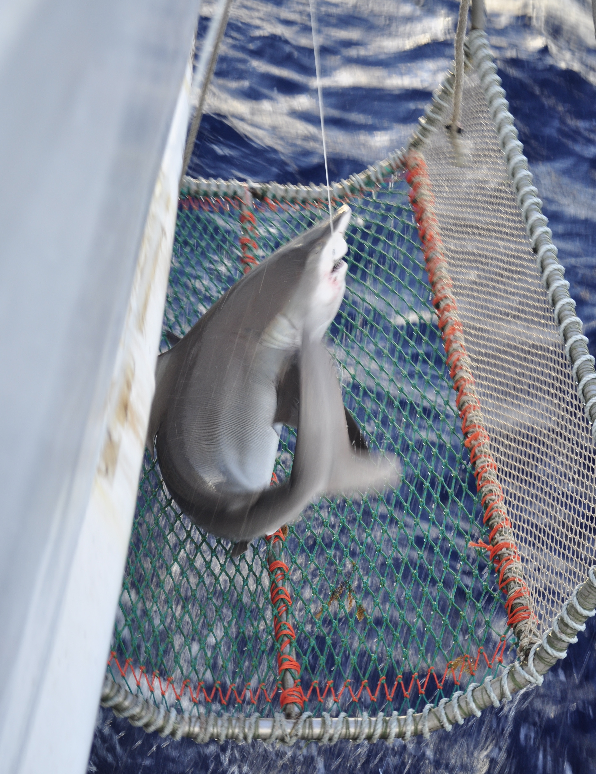
1. Indices of abundance
Standardize CPUE for changes in catchability via generalized linear models (GLMs)
Zero inflation
Models fit:
  Delta-lognormal
  Hurdle Poisson / negative
  binomial
  Zero-inflated Poisson /
  negative binomial
Michael Scott Sherburne

Slide 9
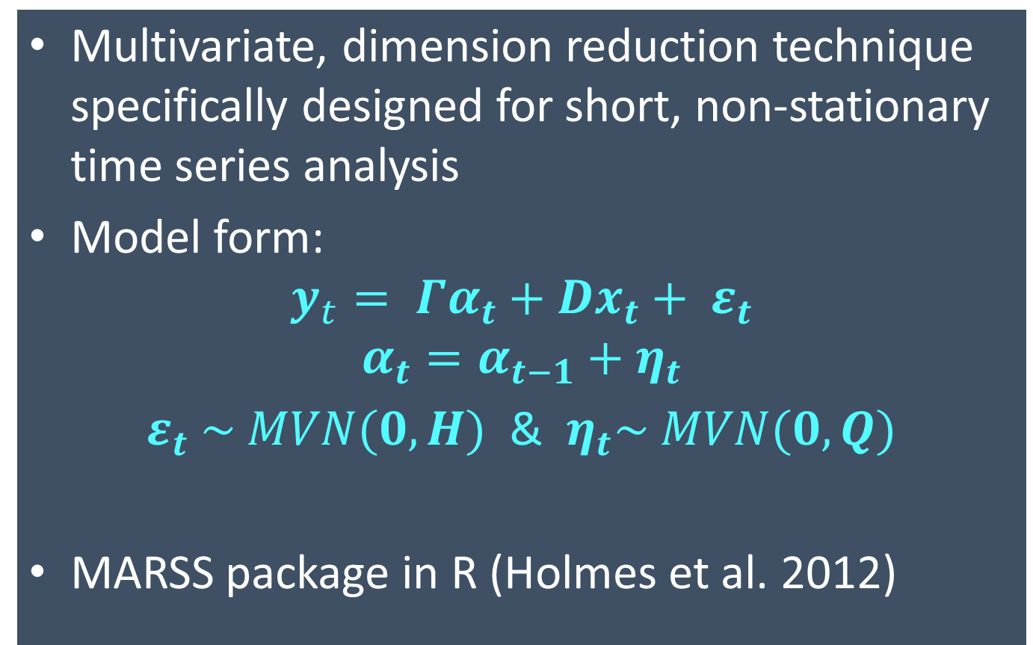
2. Dynamic Factor Analysis
Multivariate, dimension reduction technique specifically designed for short, non-stationary time series analysis
Model form:
$$y_{t}= Γα_{t}+Dx_{t}+ ε_{t}$$
$$α_{t}=α_{t−1}+η_{t}$$
$ε_{t} \sim MVN(0, H)$ & $η_{t}\sim MVN(0, Q)$
MARSS package in R (Holmes et al. 2012)
Factor loadings
Design matrix
Covariates
Observation Error
Relative
abundance (from each survey)
Process
Error
Common trends
(Factors)

Slide 10
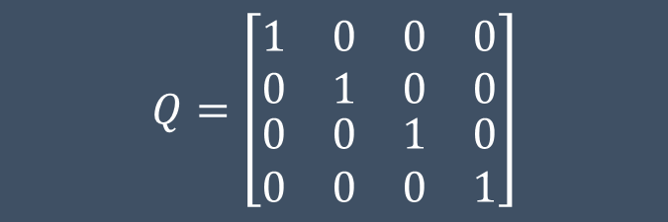
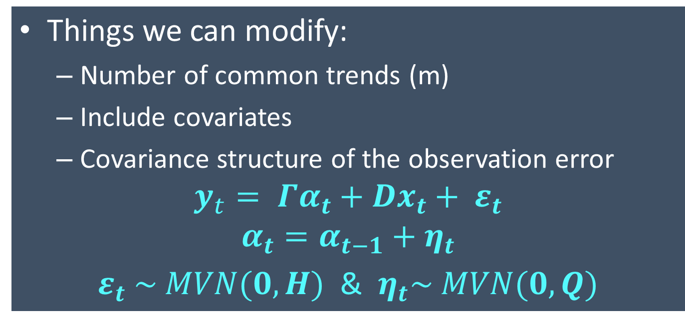
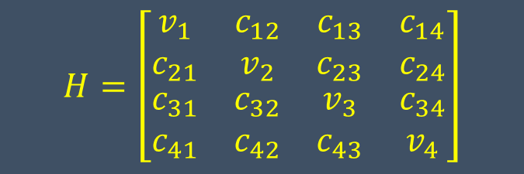
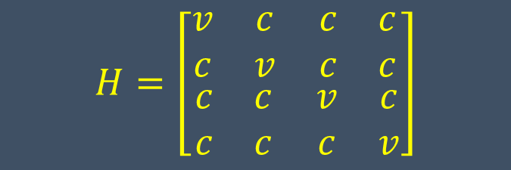
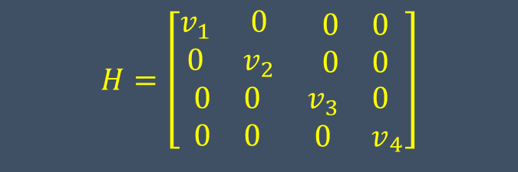
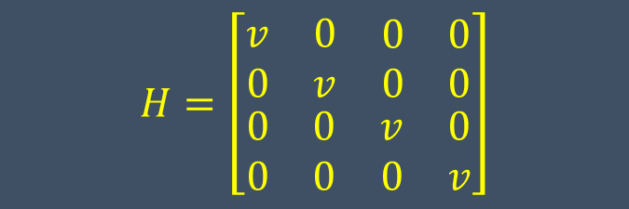
2. Dynamic Factor Analysis
Things we can modify:
  Number of common trends (m)
  Include covariates
  Covariance structure of the observation error
$$y_{t}= Γα_{t}+Dx_{t}+ ε_{t}$$
$$α_{t}=α_{t−1}+η_{t}$$
$ε_{t} \sim MVN(0, H)$ & $η_{t}\sim MVN(0, Q)$
$$H=\left[\begin{matrix}\begin{matrix}v & 0 \\ 0 & v\end{matrix} & \begin{matrix}0 & 0 \\ 0 & 0\end{matrix} \\ \begin{matrix}0 & 0 \\ 0 & 0\end{matrix} & \begin{matrix}v & 0 \\ 0 & v\end{matrix}\end{matrix}\right]$$
$$H=\left[\begin{matrix}\begin{matrix}v_{1} & 0 \\ 0 & v_{2}\end{matrix} & \begin{matrix}0 & 0 \\ 0 & 0\end{matrix} \\ \begin{matrix}0 & 0 \\ 0 & 0\end{matrix} & {\begin{matrix}v_{3} & 0 \\ 0 & v\end{matrix}}_{4}\end{matrix}\right]$$
$$H=\left[\begin{matrix}\begin{matrix}v & c \\ c & v\end{matrix} & \begin{matrix}c & c \\ c & c\end{matrix} \\ \begin{matrix}c & c \\ c & c\end{matrix} & \begin{matrix}v & c \\ c & v\end{matrix}\end{matrix}\right]$$
$$H=\left[\begin{matrix}\begin{matrix}v_{1} & c_{12} \\ c_{21} & v_{2}\end{matrix} & \begin{matrix}c_{13} & c_{14} \\ c_{23} & c_{24}\end{matrix} \\ \begin{matrix}c_{31} & c_{32} \\ c_{41} & c_{42}\end{matrix} & \begin{matrix}v_{3} & c_{34} \\ c_{43} & v_{4}\end{matrix}\end{matrix}\right]$$
$$Q=\left[\begin{matrix}\begin{matrix}1 & 0 \\ 0 & 1\end{matrix} & \begin{matrix}0 & 0 \\ 0 & 0\end{matrix} \\ \begin{matrix}0 & 0 \\ 0 & 0\end{matrix} & \begin{matrix}1 & 0 \\ 0 & 1\end{matrix}\end{matrix}\right]$$

Slide 11
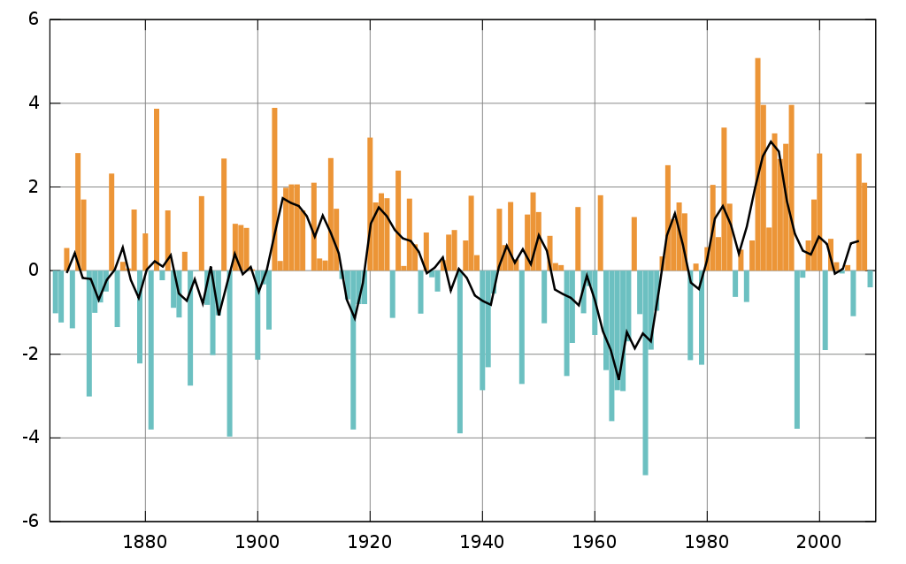
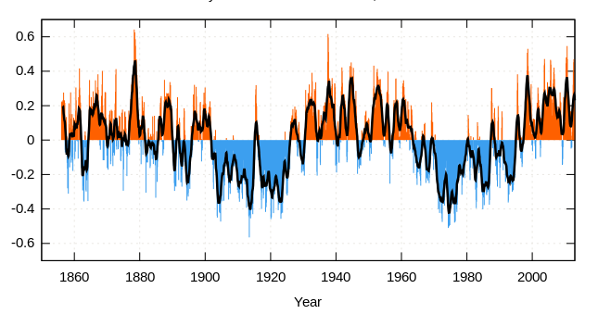
Potential DFA Covariates:
North Atlantic Oscillation (NAO)
Atlantic Multidecadal Oscillation (AMO)
Annual Sea Surface Temperature (SST)
Species landings*
Data provided by NOAA/OAR/Earth System Research Laboratory Physical Sciences Division, Boulder, Colorado, USA, from their Web site at http://www.esrl.noaa.gov/psd/
“NAO timeseries 1856-present" by Rosentod, Marsupilami http://commons.wikimedia.org/wiki/File:Winter-NAO-Index.svg Licensed under Public Domain via Wikimedia; "AMO timeseries 1856-present" by Rosentod, Marsupilami http://www.cdc.noaa.gov/Correlation/amon.us.long.data. Licensed under Public Domain via Wikimedia

Slide 12
Potential DFA Covariates:
North Atlantic Oscillation (NAO)
Atlantic Multidecadal Oscillation (AMO)
Annual Sea Surface Temperature (SST)
Species landings*
Data provided by NOAA/OAR/Earth System Research Laboratory Physical Sciences Division, Boulder, Colorado, USA, from their Web site at http://www.esrl.noaa.gov/psd/
“NAO timeseries 1856-present" by Rosentod, Marsupilami http://commons.wikimedia.org/wiki/File:Winter-NAO-Index.svg Licensed under Public Domain via Wikimedia; "AMO timeseries 1856-present" by Rosentod, Marsupilami http://www.cdc.noaa.gov/Correlation/amon.us.long.data. Licensed under Public Domain via Wikimedia

Slide 13
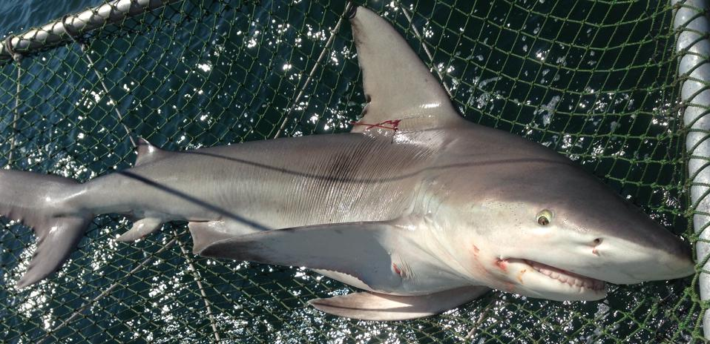
Results:
Sandbar shark
CJ Sweetman

Slide 14
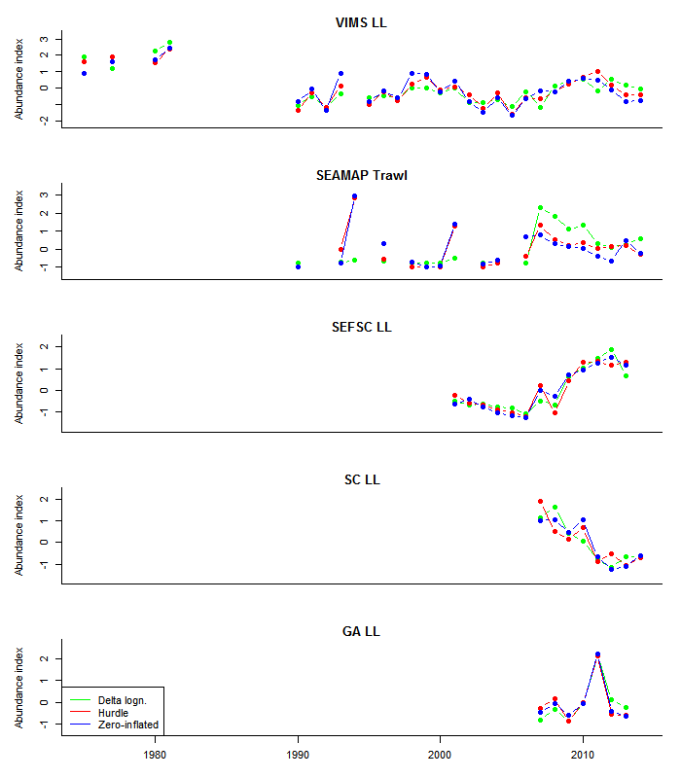
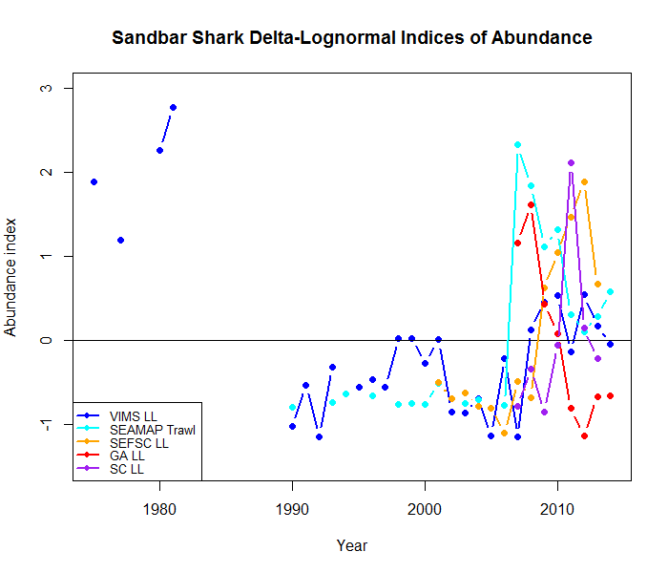
Sandbar Shark: Indices of Abundance

Slide 15
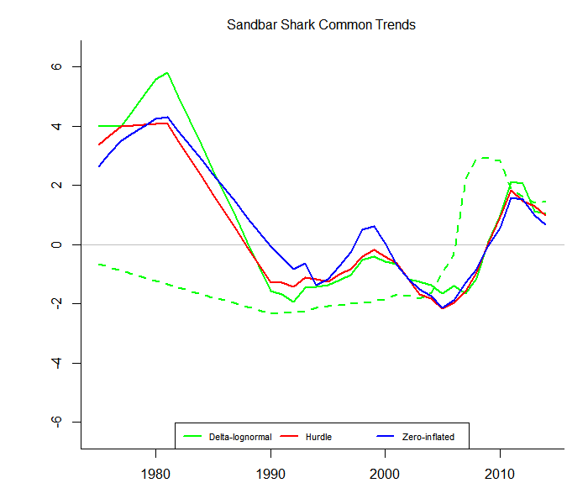
Index Type | Covariance Structure | Common Trends | Covariate
Delta-Lognormal | diagonal and equal | 2 | None
Hurdle | diagonal and equal | 1 | None
Zero Inflated | diagonal and unequal | 1 | None

Slide 16
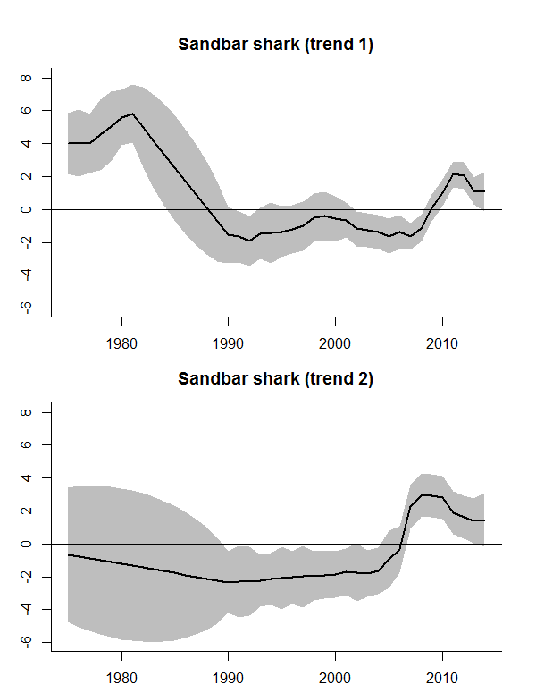
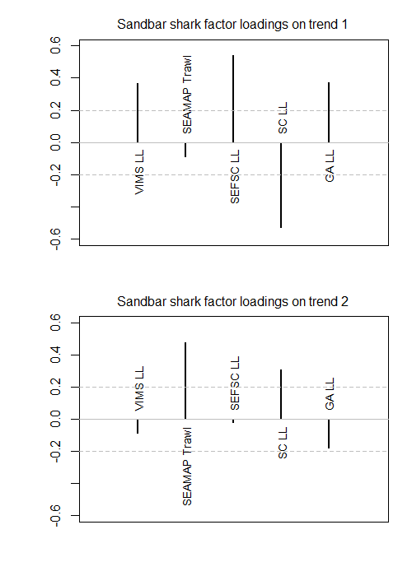
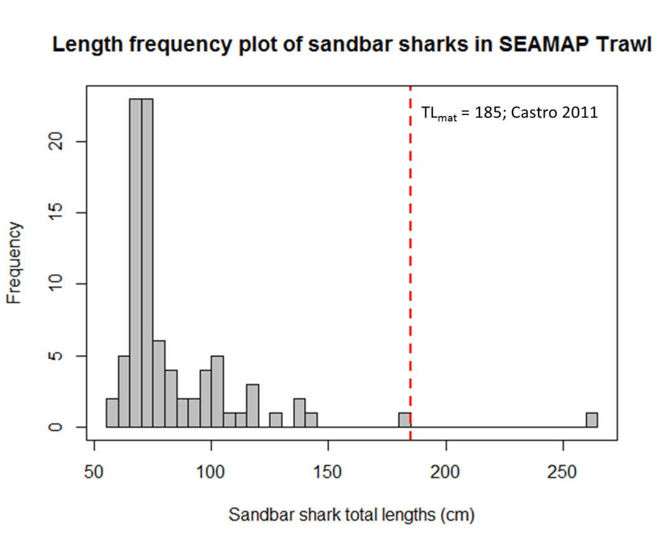

Slide 17
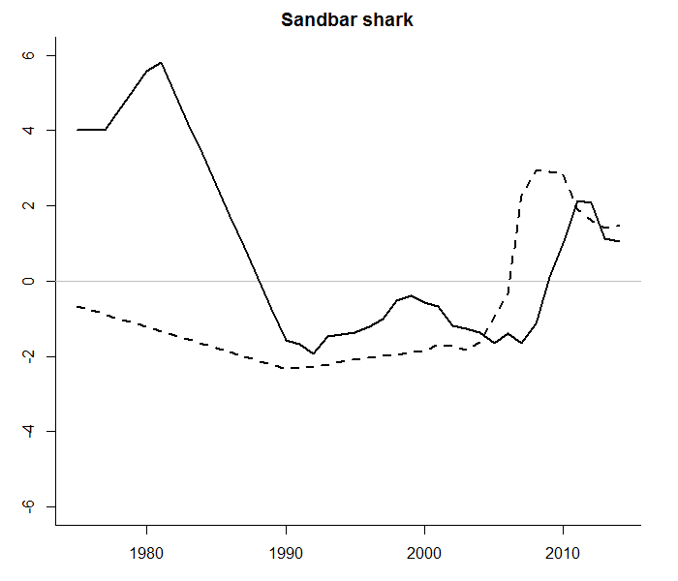
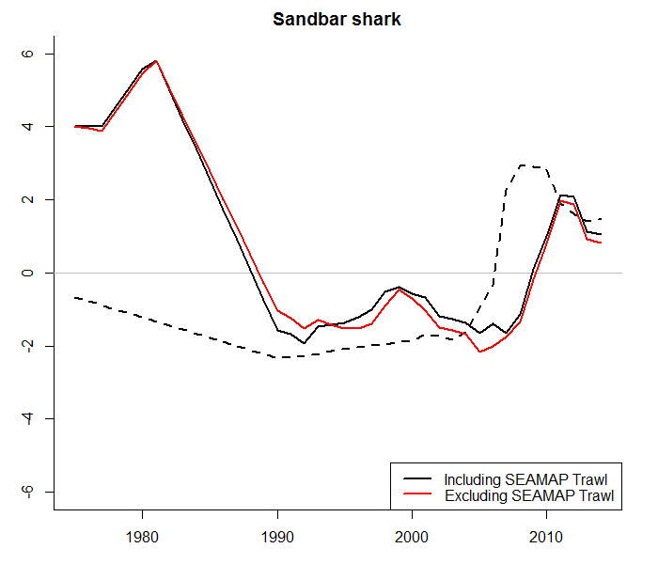

Slide 18
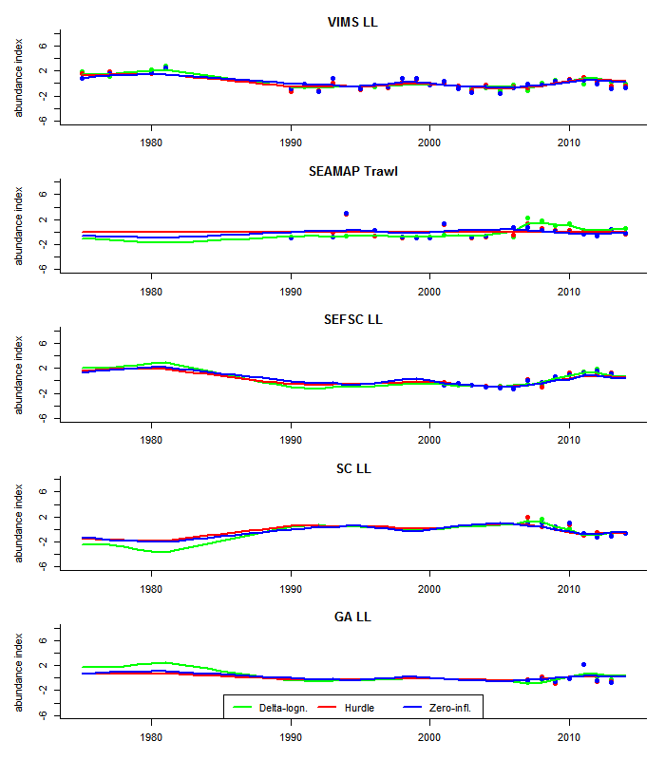
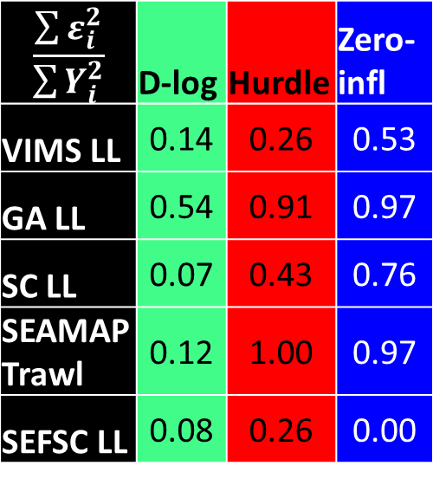
Sandbar Shark:
Fitted trends
$$\frac{\sum{ε_{i}^{2}}}{\sum{Y_{i}^{2}}}$$ | D-log | Hurdle | Zero-infl
VIMS LL | 0.14 | 0.26 | 0.53
GA LL | 0.54 | 0.91 | 0.97
SC LL | 0.07 | 0.43 | 0.76
SEAMAP Trawl | 0.12 | 1.00 | 0.97
SEFSC LL | 0.08 | 0.26 | 0.00

Slide 19
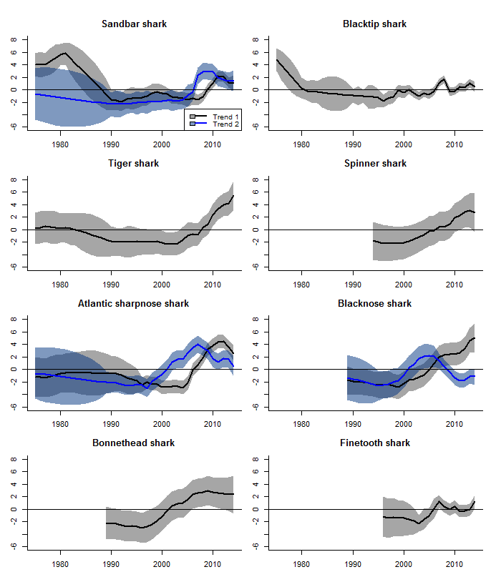
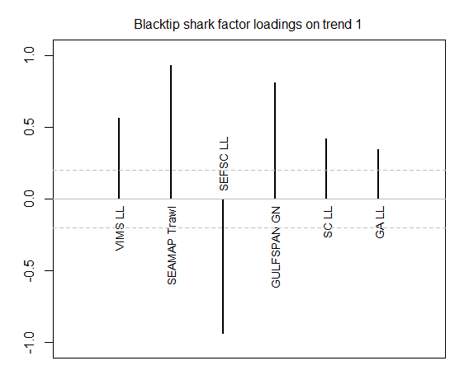
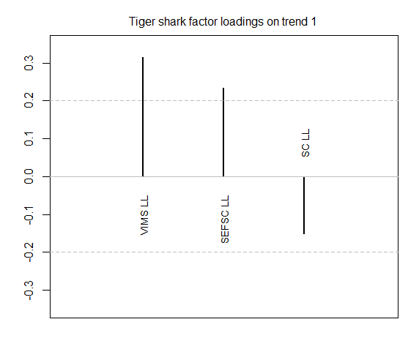
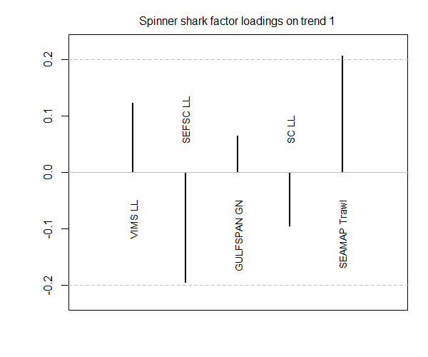
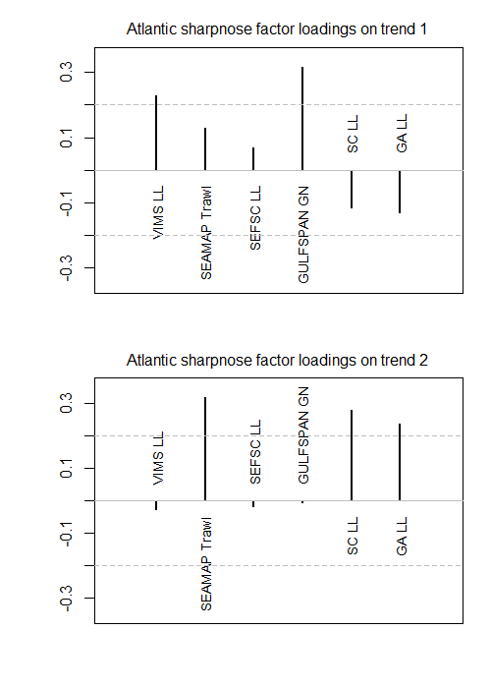
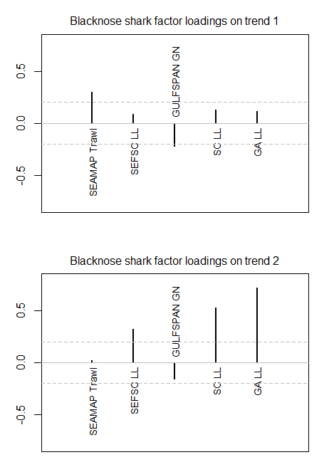
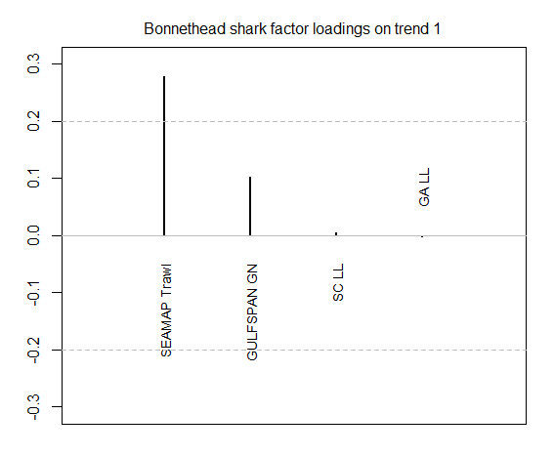
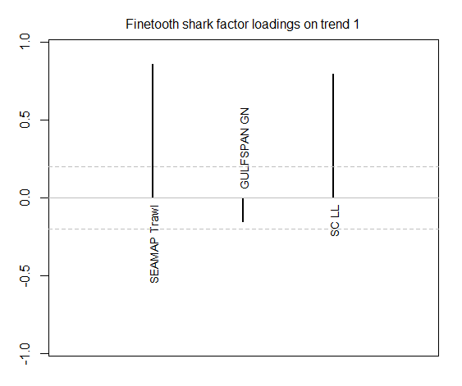

Slide 20
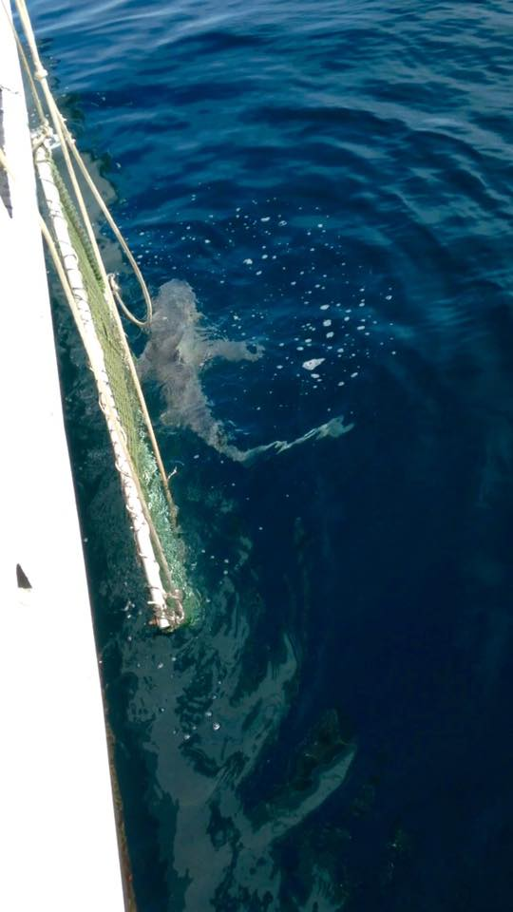
Conclusions
Choice of CPUE standardization method doesn’t change resulting common trend
Climatic indices don’t seem to significantly influence shark population trends
Shark populations are recovering; management seems to be effective
Following Azevedo et al. (2008), could we use common trends as inputs in stock assessment in place of conflicting indices of abundance?

Slide 21
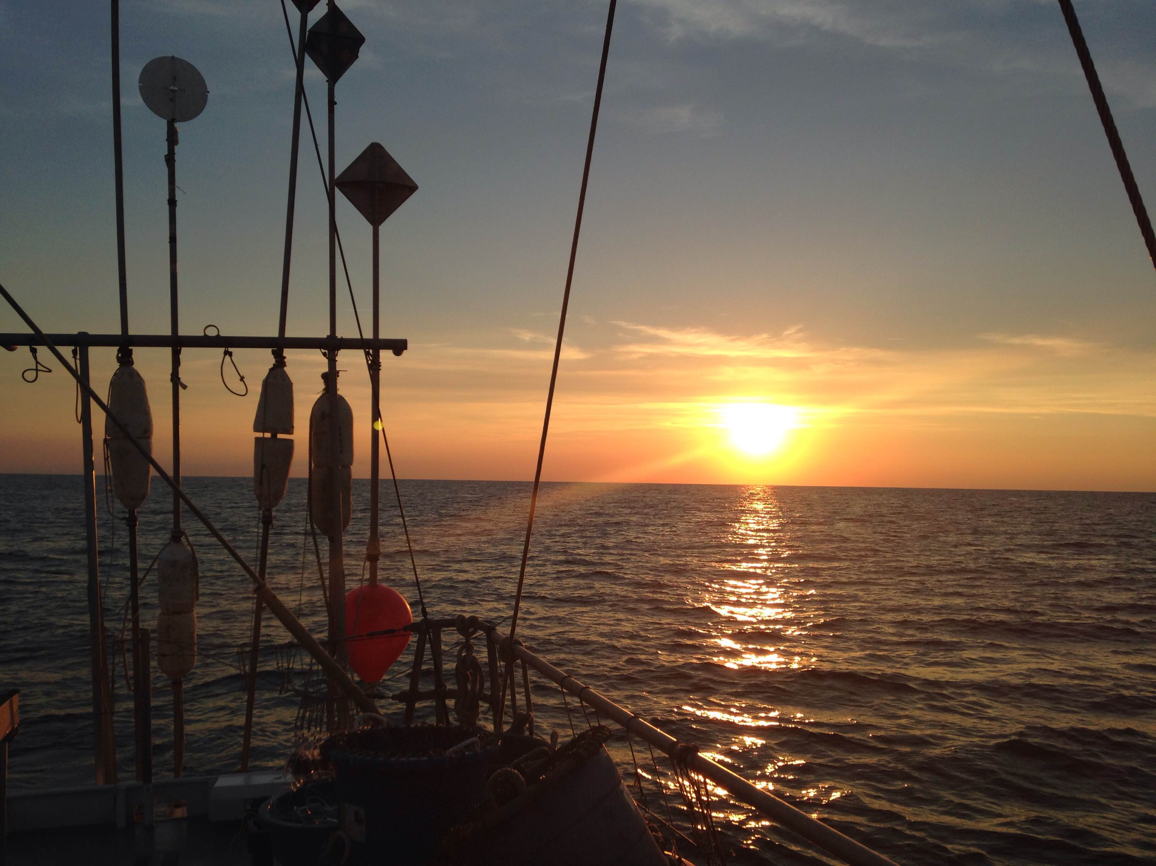
Acknowledgements
SEFSC LL: Trey Driggers
GULFSPAN GN: Dana Bethea
GA Red Drum LL: Carolyn Belcher
SC Red Drum LL: Erin Levesque; Bryan Frazier
SEAMAP Trawl:
  Data for GA LL, SC LL, & SEAMAP Trawl from Southeast Area Monitoring and Assessment Program (SEAMAP.org)

Slide 22
Questions & Comments
cpeterson@vims.edu

Slide 23
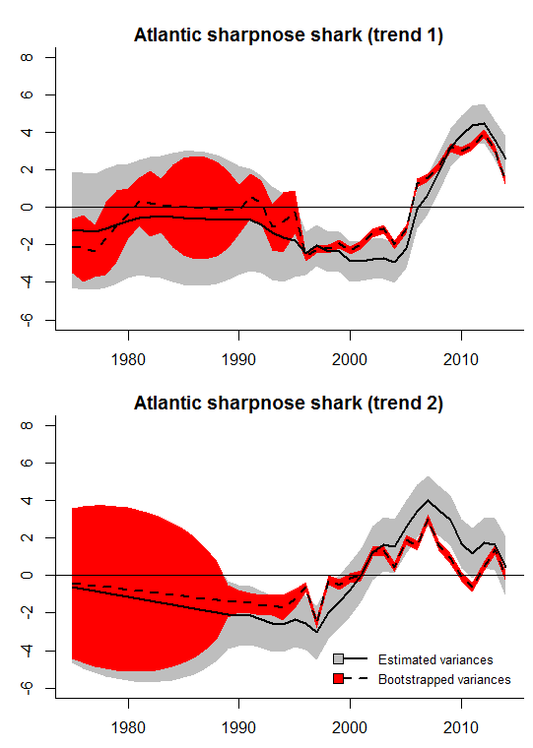
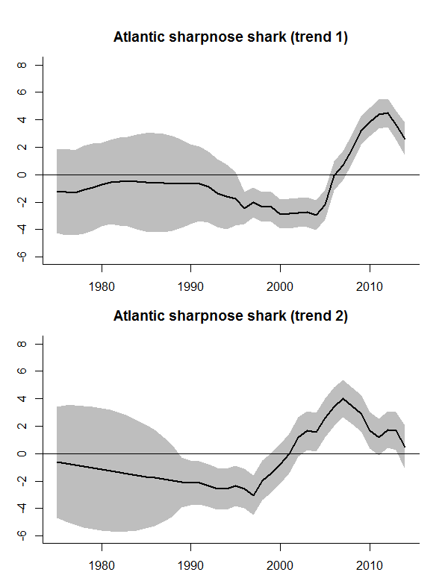

Slide 24
