Slide 1

Can diagnostic tests help identify what model structure is misspecified?
Data weighting workshop – La Jolla, October 2015
Felipe Carvalho¹, Mark N. Maunder^{2,3}, Yi-Jay Chang¹, Kevin R. Piner⁴, Andre E. Punt⁵
¹PIFSC - Pacific Islands Fisheries Science Center
²Inter-American Tropical Tuna Commission
³Center for the Advancement of Population Assessment Methodology
⁴SWFSC – Southwest Fisheries Science Center
⁵University of Washington

Slide 2
Outline
Introduction
  Data conflict
  Model misspecification
  Diagnostics
  Objectives
  Methods
    Study case – Western Central Pacific Ocean striped marlin stock assessment
    Simulation approach
    Estimation models misspecification
    Model diagnostics
    Preliminary results
    Conclusions and further research

Slide 3
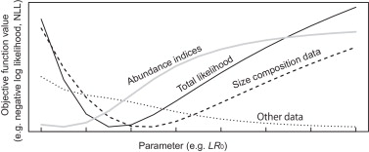
Introduction
Data conflicts
Data conflicts occur when the objective function components from different data sources achieve minima at different values for a given parameter
M. Ichinokawa et al.(2014)

Slide 4
Introduction
Model misspecification
Apparent data conflicts in integrated stock assessment models can occur for three main reasons:
1) random sampling error,
2) misspecification of the observation model, and
3) misspecification of the system dynamics model.

Slide 5



Introduction
SS3
Hospital
Determine when a model needs additional or alternative structure to eliminate model misspecification and conflict between components

Slide 6
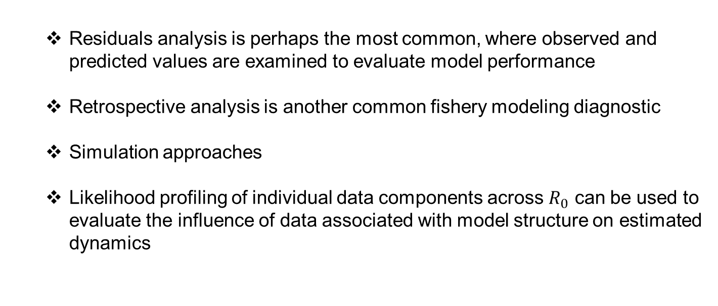
Introduction
Model diagnostic
  Residuals analysis is perhaps the most common, where observed and predicted values are examined to evaluate model performance
  Retrospective analysis is another common fishery modeling diagnostic
  Simulation approaches
  Likelihood profiling of individual data components across $R_{0}$ can be used to evaluate the influence of data associated with model structure on estimated dynamics
However, still important to develop a standard set of diagnostics for stock assessment models that will improve their performance and acceptance.

Slide 7


Introduction
Can model diagnostics really help identify when a model is misspecified?
What model structure is misspecified?

Slide 8
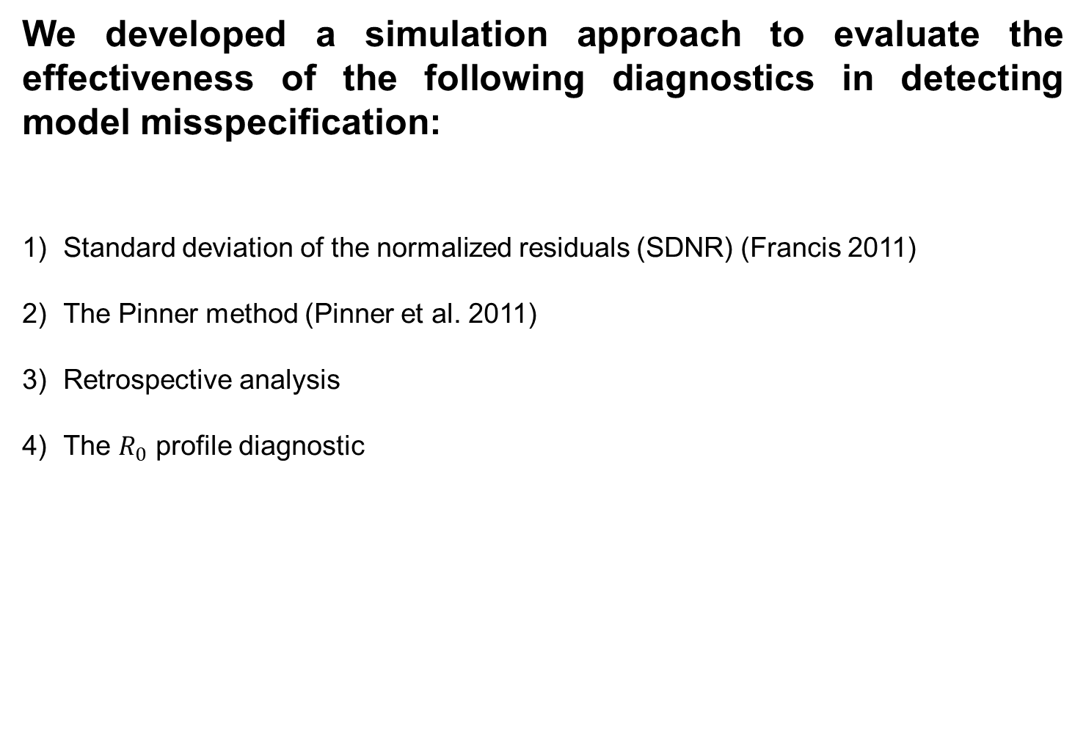
Objectives
We developed a simulation approach to evaluate the effectiveness of the following diagnostics in detecting model misspecification:
Standard deviation of the normalized residuals (SDNR) (Francis 2011)
The Pinner method (Pinner et al. 2011)
Retrospective analysis
The $R_{0}$ profile diagnostic
So what we want to show on this study is what the diagnostics from a correct specified model looks like compared to diagnostics from an uncorrected misspecified model.

Slide 9

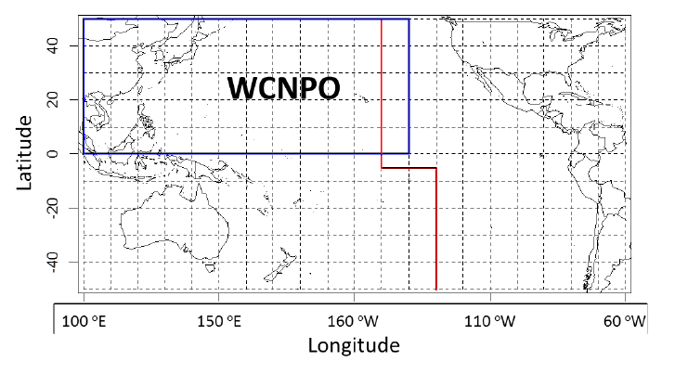
Methods: study case
Stock assessment for striped marlin (kajikia audax) in the western and central north pacific ocean through 2013.

Slide 10
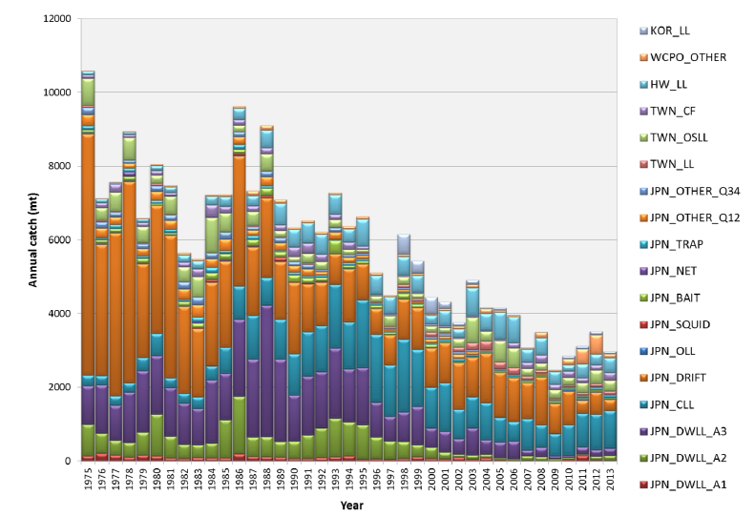
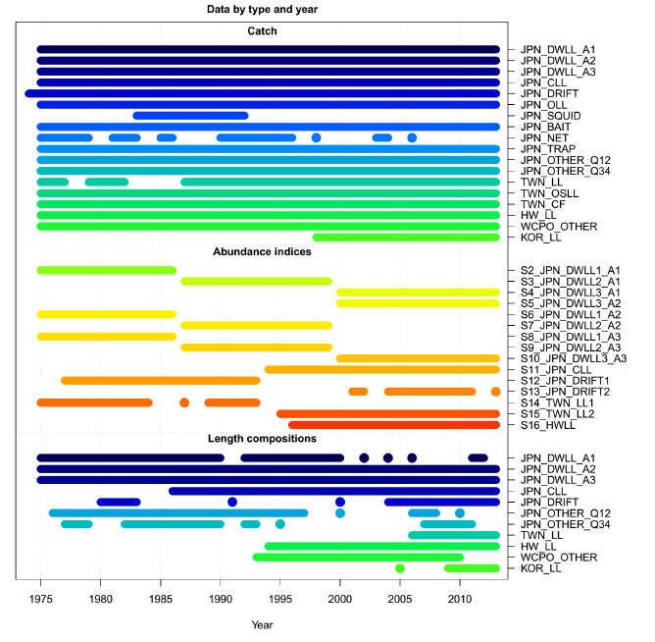
Methods: study case
Stock assessment for striped marlin (kajikia audax) in the western and central north pacific ocean through 2013.

Slide 11
Methods: study case
Parameter (units) | Value
Natural mortality (yr⁻¹) | 0.54 (age 0) 0.47 (age 1) 0.43 (age 2) 0.40 (age 3) 0.38 (age 4-15)
Spawner-recruit relationship | Beverton-Holt
Spawner-recruit steepness (h) | 0.87 (Fixed)
Selectivity | Logistic and Double-normal (time-varying)

Slide 12
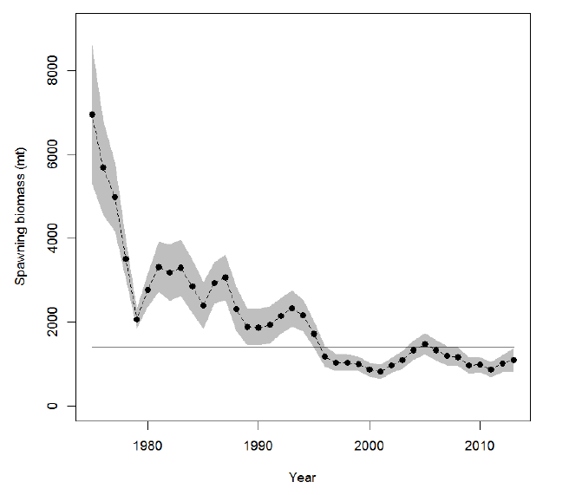
Methods: Data used
Stock assessment for striped marlin (kajikia audax) in the western and central north pacific ocean through 2013.

Slide 13
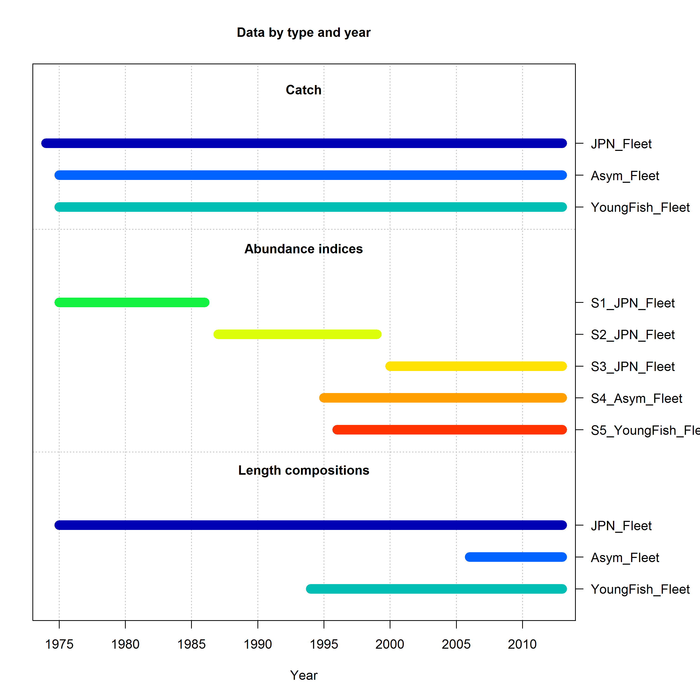
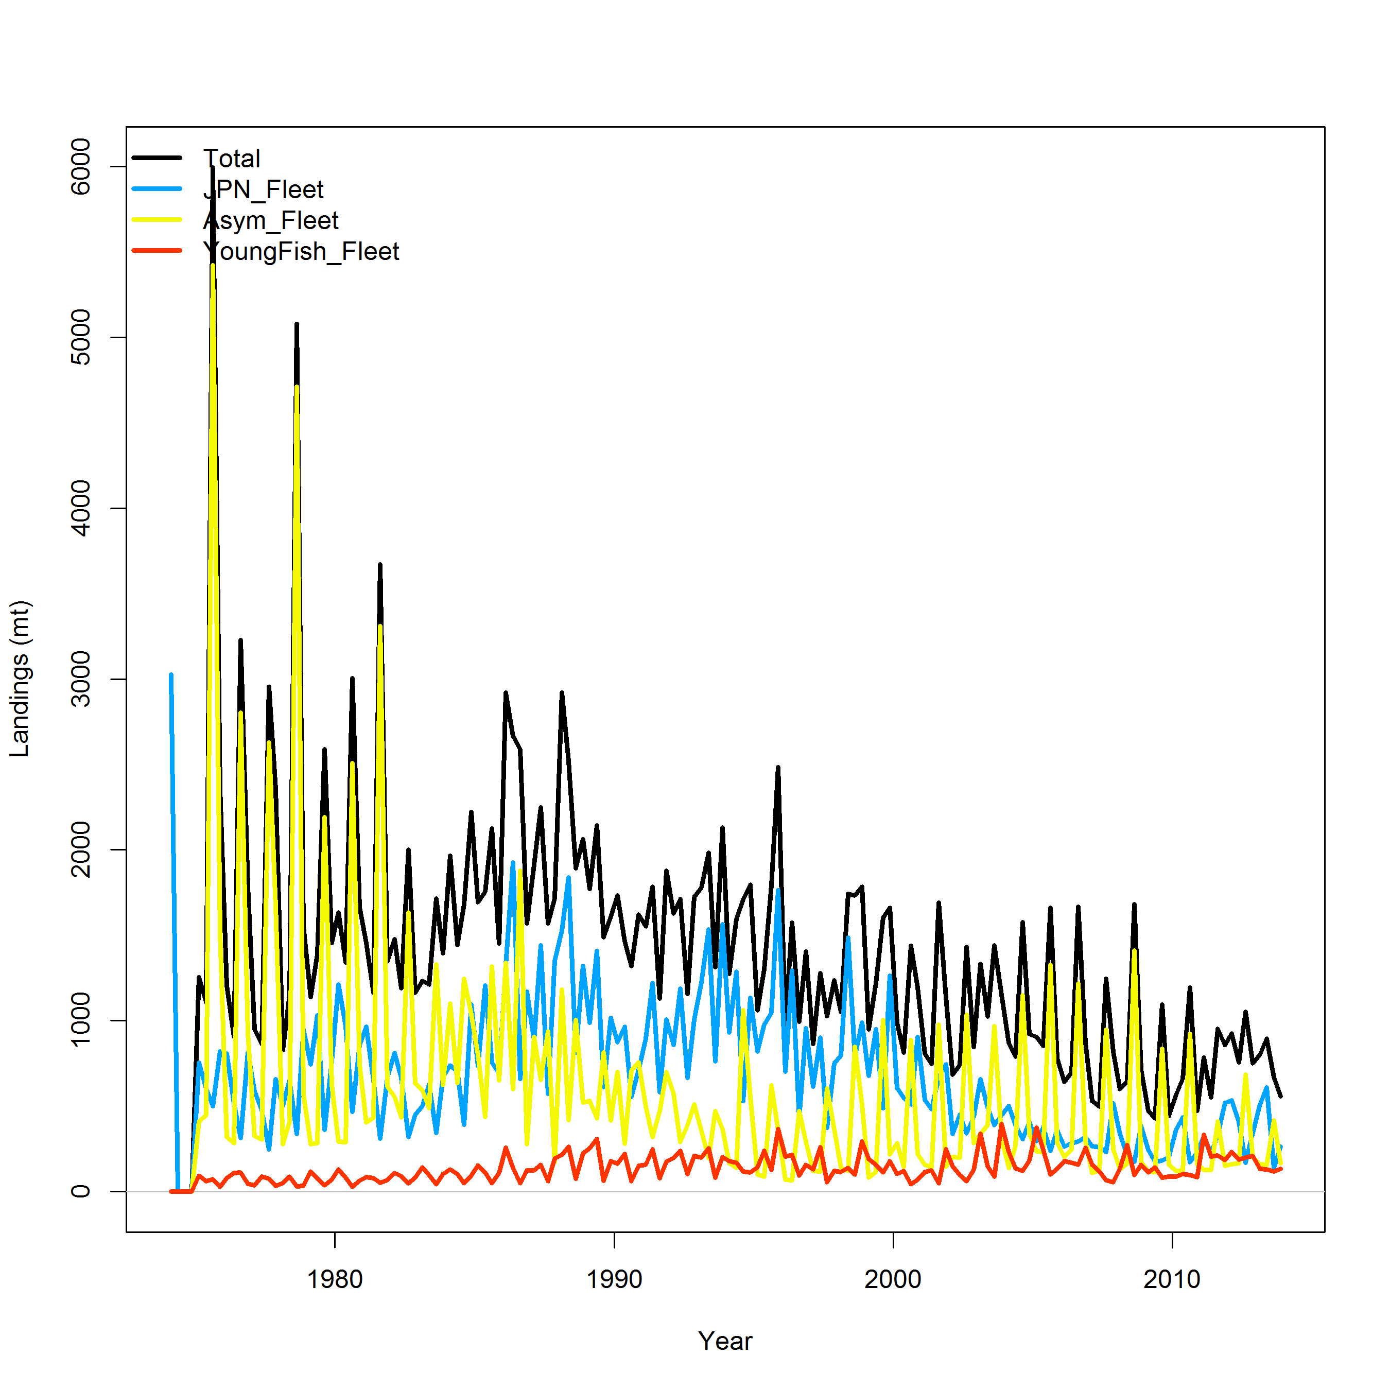
Methods: Data used
Stock assessment for striped marlin (kajikia audax) in the western and central north pacific ocean through 2013 (SIMPLIFIED)

Slide 14
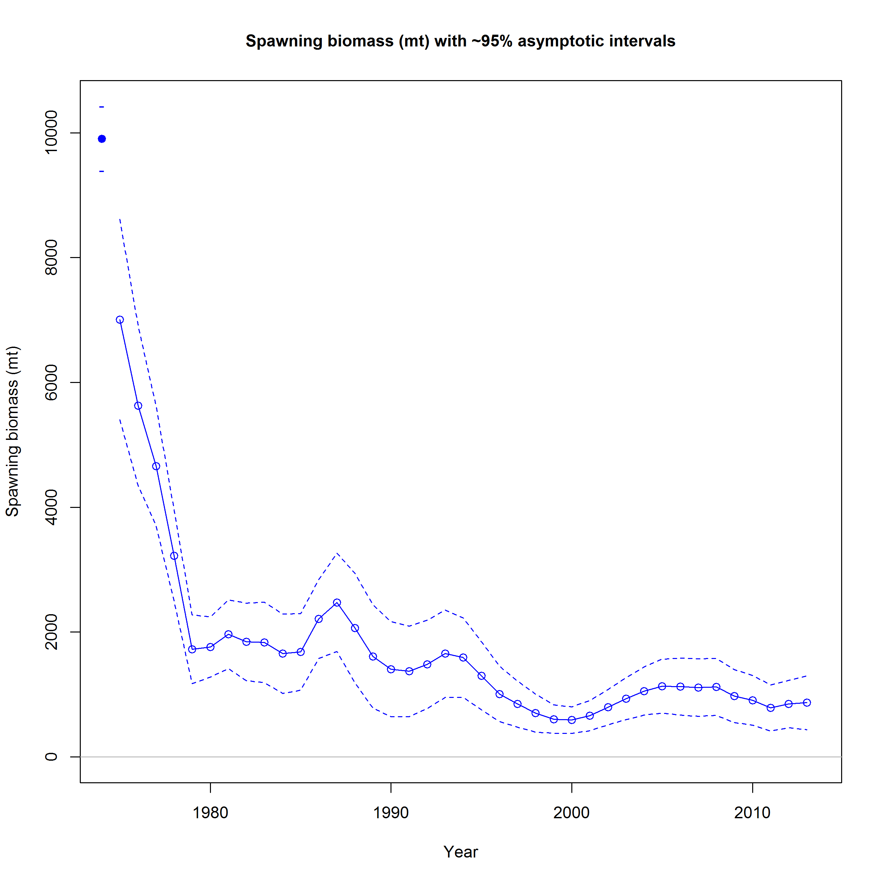
Methods: Data used
Stock assessment for striped marlin (kajikia audax) in the western and central north pacific ocean through 2013 (SIMPLIFIED)

Slide 15
Methods: Simulation
Generating data from “True” assessment using SS3
Dat file
Operating model
data.ss_new
Ctl file
Boot n^{th}
Bootstrap
Starter
file
Par file
Estimation model
(e.g., recruitment dev.)
Batch file script
Ctl file

Slide 16
Methods: Simulation
Scenarios
Parameter (units) | Value (“True”) | Value (EM_01) | Value (EM_02) | Value (EM_03)
Natural mortality (yr⁻¹) | 0.54 (age 0) 0.47 (age 1) 0.43 (age 2) 0.40 (age 3) 0.38 (age 4-15) | 0.54 (age 0) 0.47 (age 1) 0.43 (age 2) 0.40 (age 3) 0.38 (age 4-15) | 0.54 (age 0) 0.47 (age 1) 0.43 (age 2) 0.40 (age 3) 0.38 (age 4-15) | 0.38 (All ages)
Spawner-recruit relationship | Beverton-Holt | Beverton-Holt | Beverton-Holt | Beverton-Holt
Spawner-recruit steepness (h) | 0.87 (Fixed) | 0.87 (Fixed) | 0.70 (Fixed) | 0.87 (Fixed)
Selectivity (Fleet 1) | Double-normal | Double-normal | Double-normal | Double-normal
Selectivity (Fleet 2) | Double-normal | Asymptotic | Double-normal | Double-normal
Selectivity (Fleet 3) | Double-normal | Double-normal | Double-normal | Double-normal

Slide 17
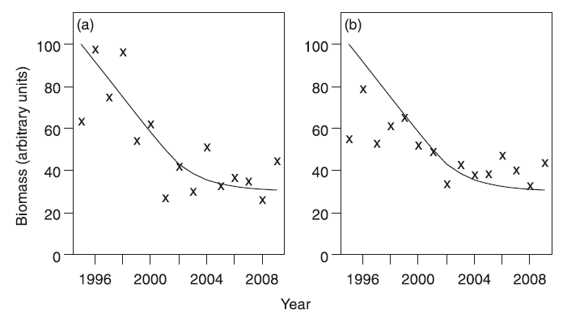
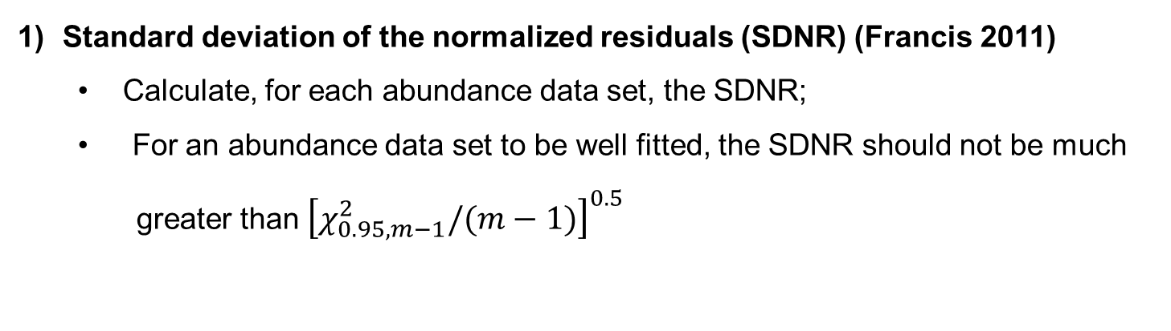
Methods: Diagnostics
Standard deviation of the normalized residuals (SDNR) (Francis 2011)
  Calculate, for each abundance data set, the SDNR;
  For an abundance data set to be well fitted, the SDNR should not be much
  greater than ${\left[χ_{0.95,m−1}^{2}/(m−1)\right]}^{0.5}$
Fig 5.
The SDNR by itself is not a godd measure of goodness of fit.
The SNDR is exactly the same in both panels but the residual patterns indicate a good fit in panel (a), and a poor fit in panel (b).

Slide 18
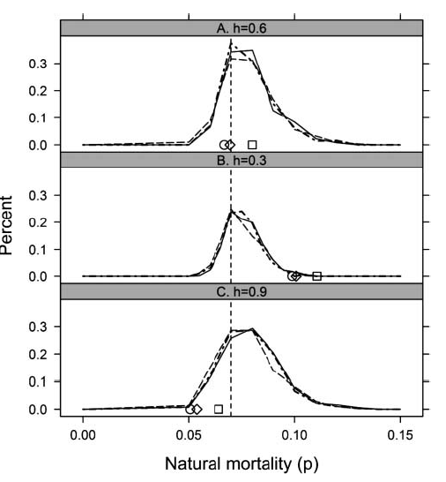
Methods: Diagnostics
2) The Pinner method (Pinner et al. 2011)
  Diagnostic technique based on simulation analysis;
  Evaluate if an estimated parameter is outside the bounds of a simulated distribution (two-sided test)
Fig 3.

Slide 19
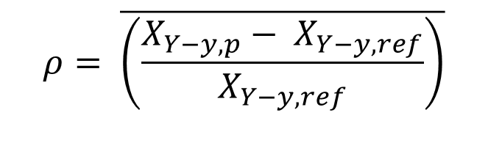
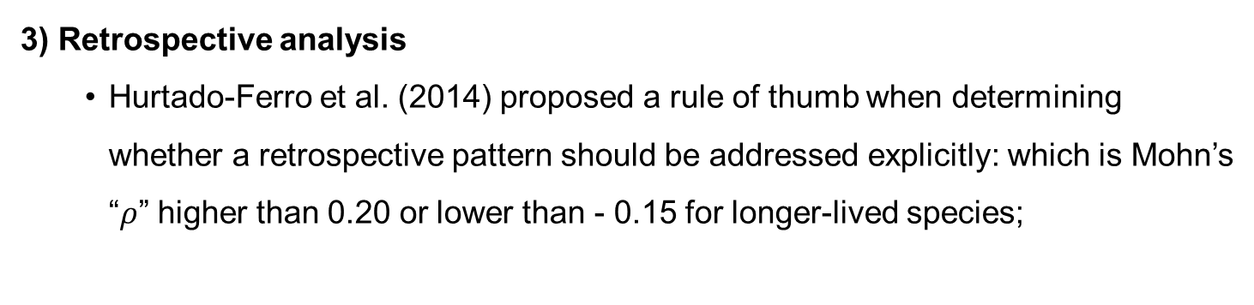
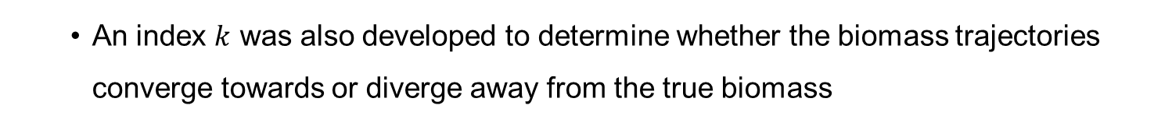
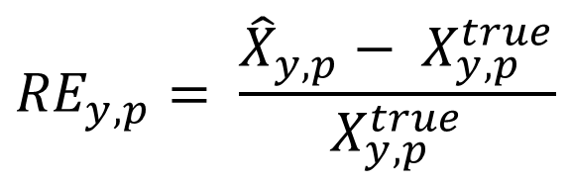
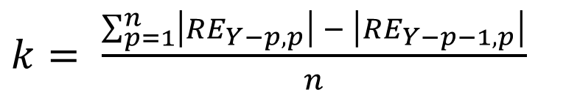
Methods: Diagnostics
3) Retrospective analysis
  Hurtado-Ferro et al. (2014) proposed a rule of thumb when determining whether a retrospective pattern should be addressed explicitly: which is Mohn’s “$ρ$” higher than 0.20 or lower than - 0.15 for longer-lived species;
$$ρ= \overline{\left(\frac{X_{Y−y,p}− X_{Y−y,ref}}{X_{Y−y,ref}}\right)}$$
  An index $k$ was also developed to determine whether the biomass trajectories converge towards or diverge away from the true biomass
$${RE}_{y,p}= \frac{{\hat{X}}_{y,p}− X_{y,p}^{true}}{X_{y,p}^{true}}$$
$k= \frac{\sum_{p=1}^{n}{\left|{RE}_{Y−p,p}\right| − \left|{RE}_{Y−p−1,p}\right|}}{n}$
where

Slide 20
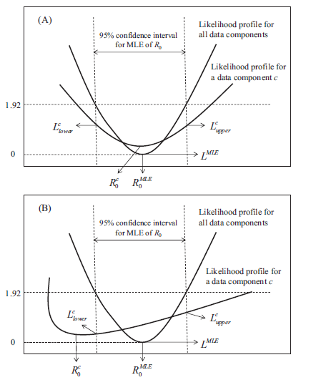
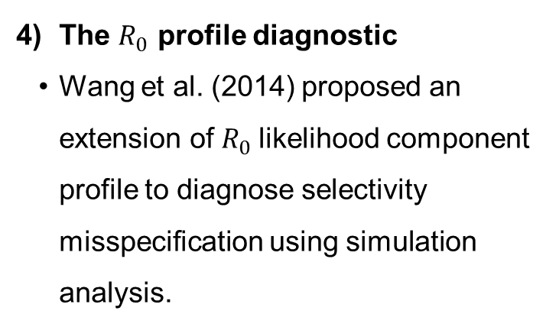
Methods: Diagnostics
The $R_{0}$ profile diagnostic
  Wang et al. (2014) proposed an extension of $R_{0}$likelihood component profile to diagnose selectivity misspecification using simulation analysis.

Slide 21
Results
1) Standard deviation of the normalized residuals (SDNR)
The SDNR diagnostic indicated that all misspecified estimation models did fit the indices well;

Slide 22
Results
2) The Piner diagnostic
Distributions of SPB_last year estimated from three replicate models for each EM
Estimate of SPB_last year based on a misspecification of $h$ = 0.7, was located near the tails of the distribution of in all three replicates.

Slide 23
Results
2) The Piner diagnostic
Misspecification of h reflecting a less resilient stock (h = 0.7) had significant impact on the population dynamics.
The true value of spawning biomass (based on h = 0.85) always lay below the average simulated estimates.

Slide 24
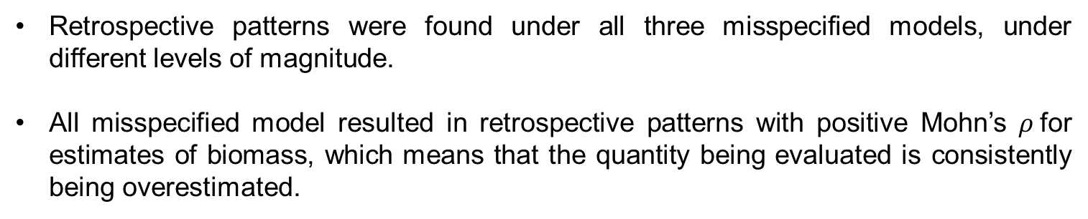
Results
4) Retrospective patterns
Retrospective patterns were found under all three misspecified models, under different levels of magnitude.
All misspecified model resulted in retrospective patterns with positive Mohn’s $ρ$for estimates of biomass, which means that the quantity being evaluated is consistently being overestimated.

Slide 25
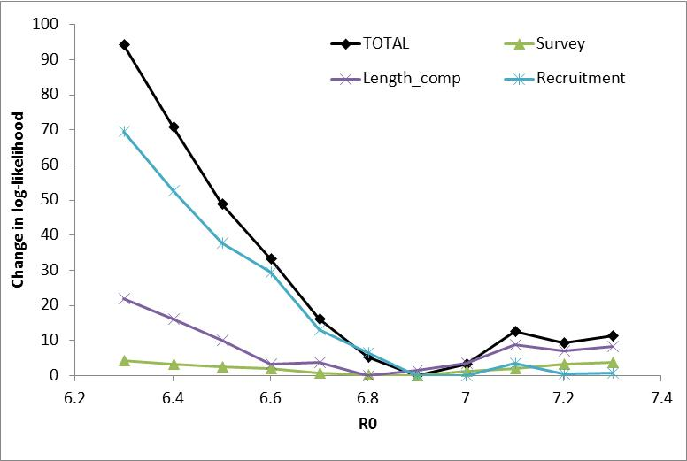
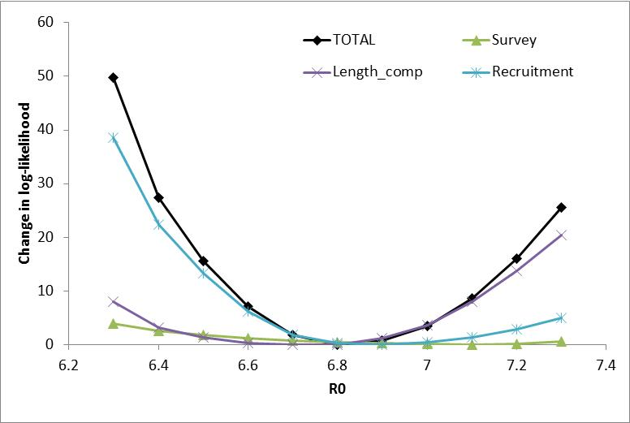
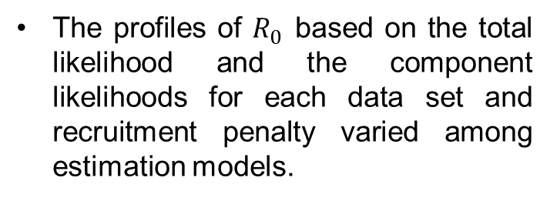

Results
4) The $R_{0}$ profile diagnostic
The profiles of $R_{0}$ based on the total likelihood and the component likelihoods for each data set and recruitment penalty varied among estimation models.
EM_02
EM_01

Slide 26
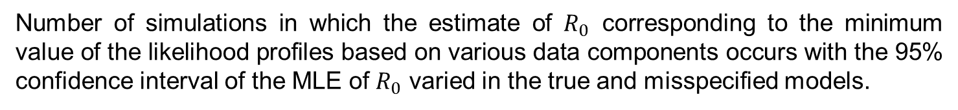

Results
4) The $R_{0}$ profile diagnostic
Number of simulations in which the estimate of $R_{0}$ corresponding to the minimum value of the likelihood profiles based on various data components occurs with the 95% confidence interval of the MLE of $R_{0}$ varied in the true and misspecified models.
Source | True | EM_01 | EM_02 | EM_03
Catch | 7 | 8 | 6 | 8
Survey | 9 | 6 | 7 | 6
Length comp | 8 | 8 | 6 | 9
R-pen | 10 | 10 | 10 | 10

Slide 27
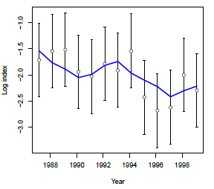
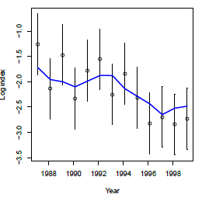
Conclusions and further research
The diagnostics tested were not able to correctly identify misspecification on selectivity and mortality.
The Pinner method and retrospective analysis were able to identify misspecification on h
Some misspecifications did not greatly influenced the population dynamics (e.g. CPUE trends and length comp are almost identical to the true model).
EM_01
EM_03

Slide 28
Conclusions and further research
Increasing the effect of the misspecification on model results, might also increase the chances of proposed diagnostics to detect the misspecification.
Some diagnostics might not be useful under certain circumstances. For example for the $R_{0}$ profile as well as for the SDNR a visual inspection is also suggested.
Next step….
Increase the number of model misspecification scenarios to address common issues in integrated stock assessment (e.g. time varying catchability, time varying growth)
Increase the number of diagnostics
    Age-structured production model
    Calibrated simulation
    …and others
Apply this diagnostics simulation testing in stock assessment of species with other life-history types (e.g. slow growth)

Slide 29

Mahalo!

