Slide 1
Recommended modeling approach
Version 2.0

Slide 2
The law of conflicting data
Axiom
Data is true
Implication
Conflicting data implies model misspecification
Caveat
Data conflict needs to be interpreted in the context of random sampling error
Significance
Down weighting or dropping conflicting data is not necessarily appropriate because it may not resolve the model misspecification

Slide 3
Preventing data conflict
Only use the main data that is representative
Estimate random sampling variance outside the stock assessment model
Use likelihood functions based on the sampling design to represent the fit to the data
Account for correlations in the data
Model annual recruitment variation with a distributional penalty. Estimate the variance of the penalty if possible.
Divide data into fleets so that selectivity is relatively constant over time within a fleet
Model fishery selectivity using a flexible and time varying method
Ensure that surveys/fisheries used for developing indices of relative abundance have time invariant selectivity
Use robust MVN with
covariance from
data (realistic
estimates)
Use Anders’ S-S
Model with more
Fishery structure
A problem
Identify what quantities are of interest and which can be estimated

Slide 4
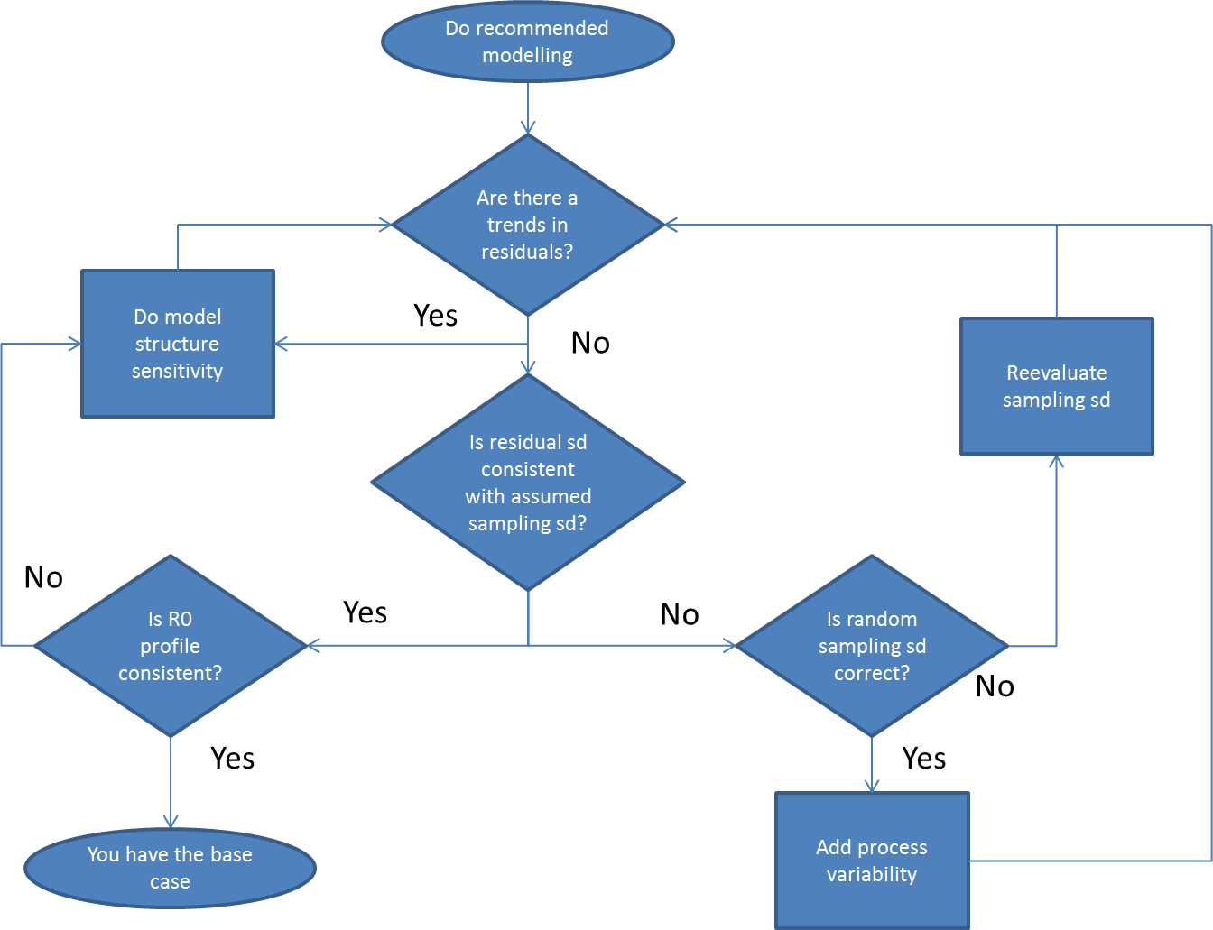
Present alternative model
structures that eliminate
Inconsistencies and consider
eliminating conflicting (index) data
and have alternative data runs
If the index does not provide absolute
abundance information, give up and go home
Look at correlations
In residuals
Or account for
Process error
In the likelihood
(estimate sd in MVN)
Consider adding other data

Slide 6
Preventing data conflict
Estimate random sampling variance outside the stock assessment model
Use likelihood functions based on the sampling design to represent the fit to the data
Account for correlations in the data
Model annual recruitment variation with a distributional penalty. Estimate the variance of the penalty if possible.
Divide data into fleets so that selectivity is relatively constant over time within a fleet
Model fishery selectivity using a flexible and time varying method
Ensure that surveys/fisheries used for developing indices of relative abundance have time invariant selectivity

