Slide 1
Using distributions of likelihoods to diagnose parameter misspecification of integrated stock assessment models
CAPAM workshop on Data conflict and weighting, likelihood functions, and process error
La Jolla, CA, USA, October 19-23, 2015
Jiangfeng Zhu*
Shanghai Ocean University, Shanghai 201306, China
Mark N. Maunder, Alexandre M. Aires-da-Silva
Inter-American Tropical Tuna Commission, La Jolla, CA 92037, USA
*E-mail: jfzhu@shou.edu.cn

Slide 2
Outline
Background (motivation).
Model and data.
Preliminary results.
Discussion and future improvements .

Slide 3
Background
Commonly used method to diagnose model misspecification:
— Analysis of residuals;
— Retrospective analysis;
— Likelihood profiling;
— Goodness of fit;
Potential to use simulation method (e.g., Piner et al. 2011);

Slide 4
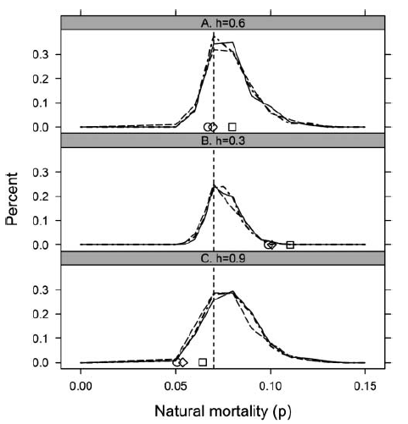
Previous study detecting model misspecification using simulation:
Figure from Piner et al. (2011) *
*Piner, K., H-H. Lee, M. Maunder and R. Methot. 2011. A simulation-based method to determine model misspecification: examples using natural mortality and population dynamics models. Mar. Coast. Fish. 3, 336–343

Slide 5
Idea for this study
We argue that a misspecified parameter might lead the original likelihood value (derived from fitting to original data) to lie out of the range (e.g., 90% percentiles) of the distribution of likelihood derived from the simulated data if the data are informative about the parameter.

Slide 6
Method
Develop and evaluate a simulation-based diagnostics using distributions of likelihood components to detect model (par)misspecification.
Two key parameters, the steepness (h) of Beverton-Holt S-R relationship and the average length of the oldest individuals (L2), are selected to represent the model misspecification.

Slide 7
Model and data
Simple SS3 Bigeye tuna in the eastern Pacific Ocean;
Two fisheries: purse seine and longline (1975 through 2011);
Selectivity: Asymptotic for purse seine (PS) and dome-shaped for longline (LL);
The Beverton–Holt S–R relationship.

Slide 8
Model and data
The model is conditioned on historical data by fitting to:
Indices of relative abundance of PS (1995-2011) and LL (1975-2010), log-transformed S.D. = 0.4 and 0.15; and
Length-composition data of PS (1994-2011, average sample size 16, fixed) and LL (1975-2008; average sample size 8, fixed).
Pars fixed: VBGF growth (mean and variation), age-specific M, h, maturity and weight-length curves;
Pars estimated: B0, rec_devs, fishing mortalities, parameters for selectivity curves, and q.

Slide 9
Simulation - controlled experiment for h (same for L2)
1) Assuming a true h=0.9 for the model, and fit to the original data set (D₀) to get the model pars;
2) Run bootstrap to create a single data set (D). The data set D is considered to be free of model misspecification;
3) Refit the data set D by specifying h=0.9 (correctly specified), h = 0.8 (under-specified), and h=1.0 (over-specified);
4) Using pars for each h in (3) to create multiple (e.g. 100) data sets, and fit the data sets by fixing corresponding h to get distribution of likelihood component; and
5) Check the distribution of likelihood component and the likelihood from fitting to D in (3), and determine if the misspecification of h can be detected.

Slide 10
Simulation
SS3 model
Fit to original data set (D0), assuming true h
Bootstrapping
Repeat from this step, with Db, Dc
Single bootstrap data set (Da)
Fit to Da by assuming:
Lower h
True h
Higher h
Mis model
Perfect model
Mis model
Likelihood (Like_Da)
Bootstrapping
Likelihood distribution
BOOT_{i}
BOOT_{i}
BOOT_{i}
Fit to
Random recruitment deviations added (process error)

Slide 11
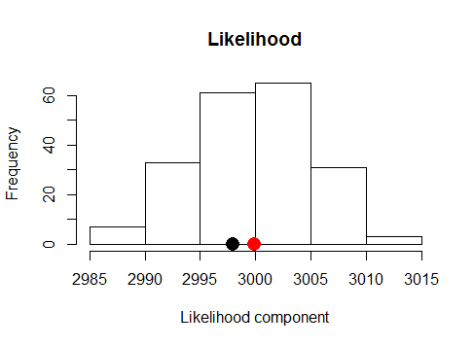
What we expect might like
(between 5th~95th percentile)
Median likelihood
Like_Da, If par wrong
Like_Da, If par correct
Like_Da, If par wrong
(e.g. length comp.)

Slide 12
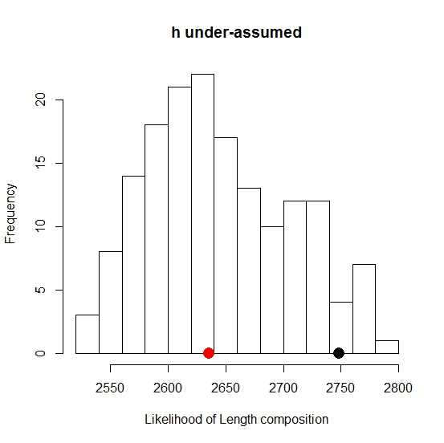
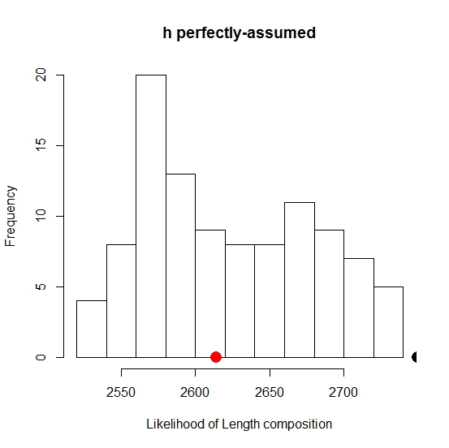
Test parameter h, base on data set: Da
Preliminary results of simulation
Low convergence rate for h over-assumed

Slide 13
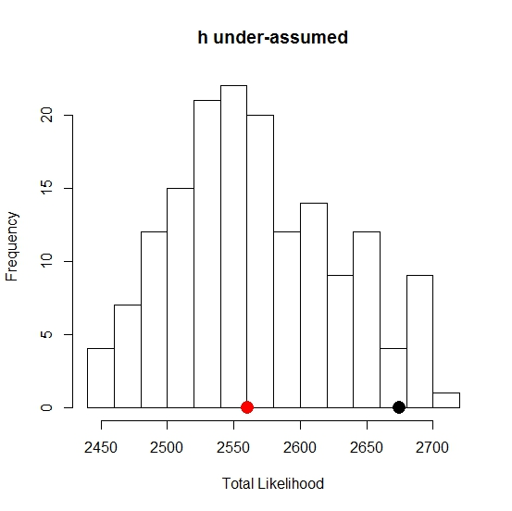
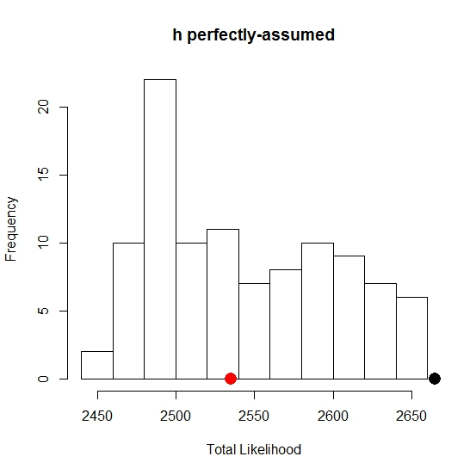
Test parameter h, base on data set: Da
Preliminary results
Low convergence rate for h over-assumed

Slide 14
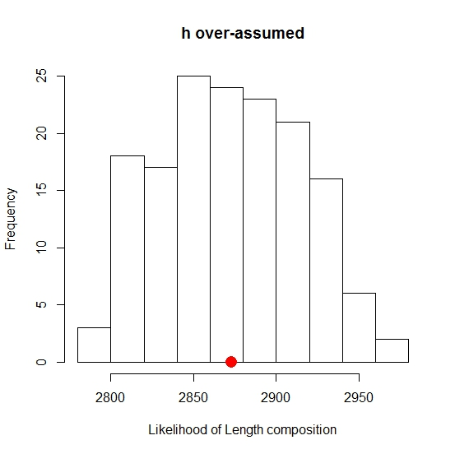
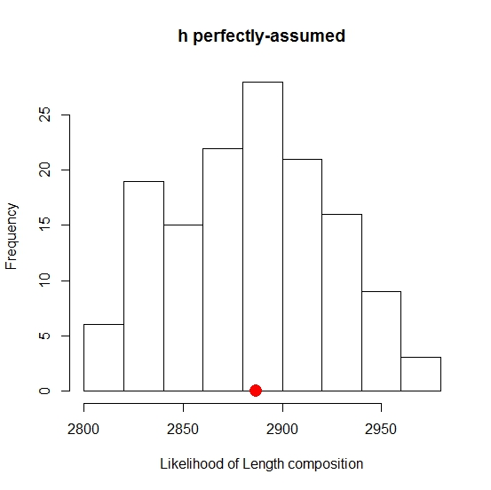
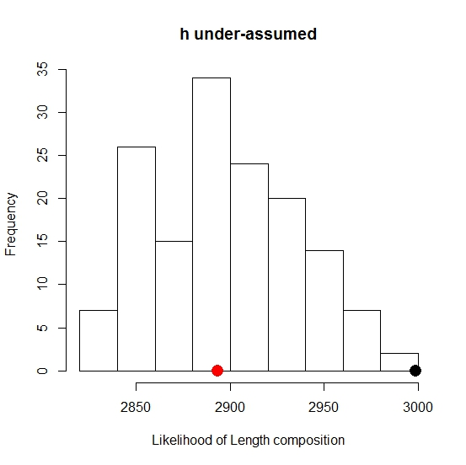
Test parameter h, base on data set: Db
Preliminary results

Slide 15
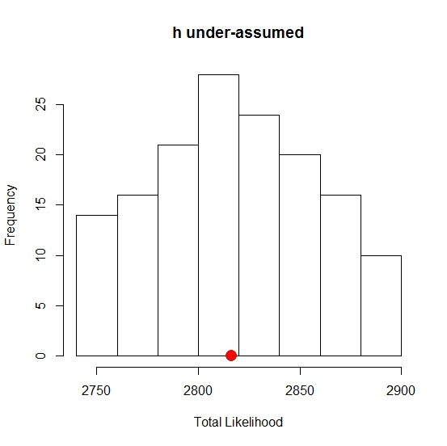
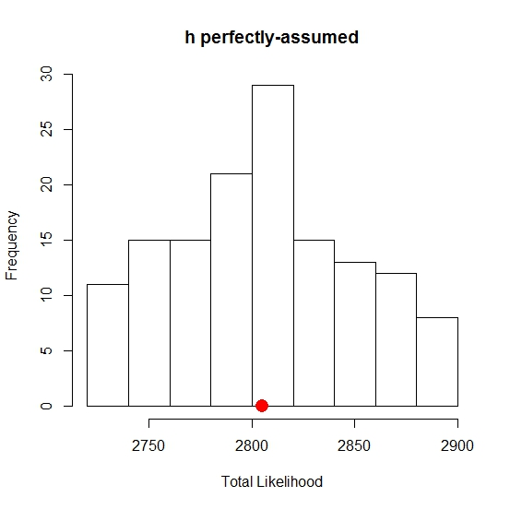
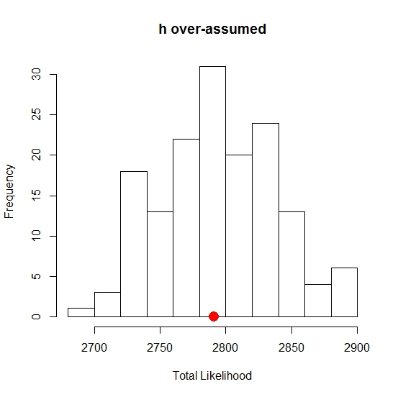
Test parameter h, base on data set: Db
Preliminary results

Slide 16
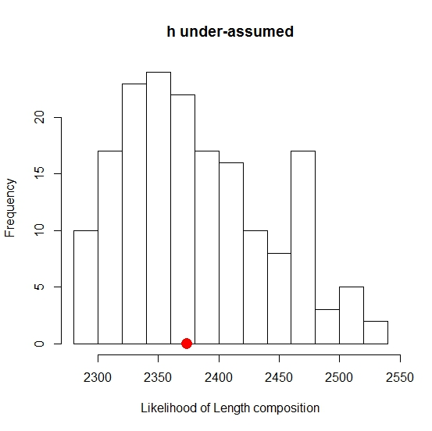
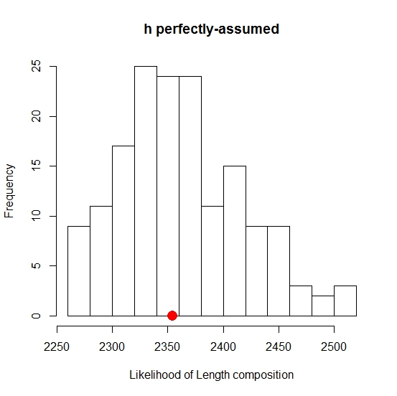
Test parameter h, base on data set: Dc
Preliminary results
Low convergence rate for h over-assumed

Slide 17
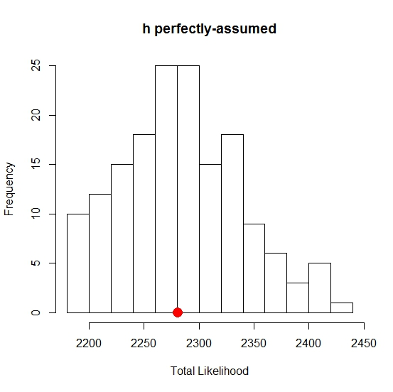
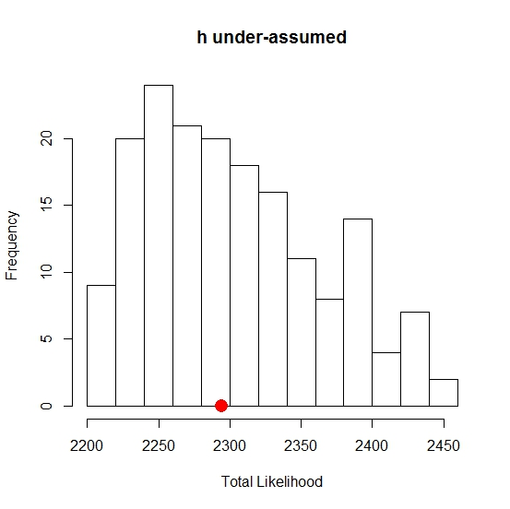
Test parameter h, base on data set: Dc
Preliminary results
Low convergence rate for h over-assumed

Slide 18
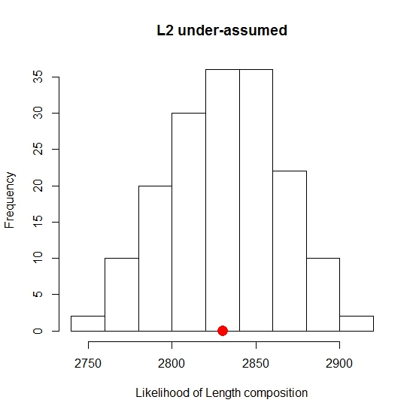
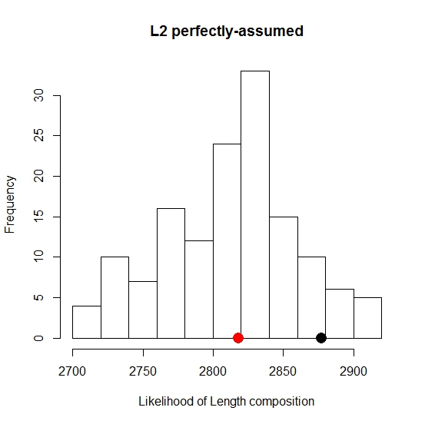
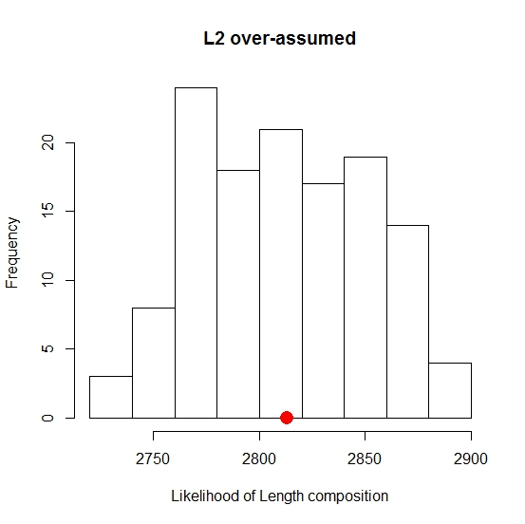
Test parameter L2, base on data set: Da
Preliminary results

Slide 19
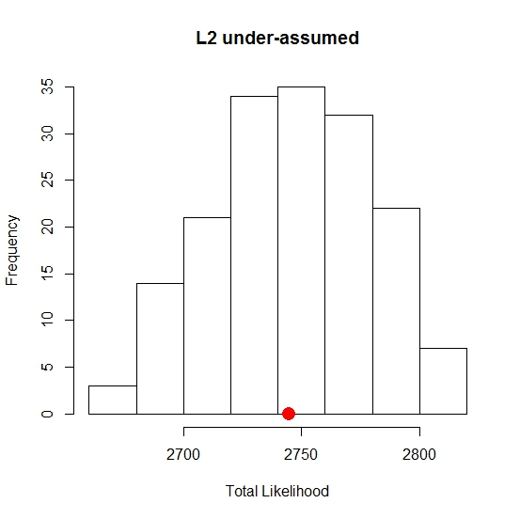
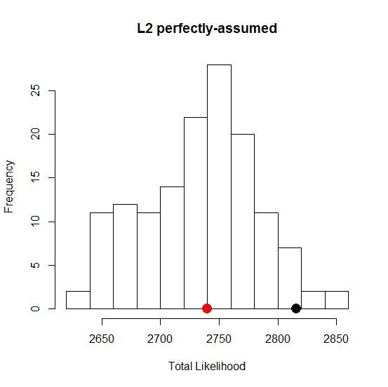
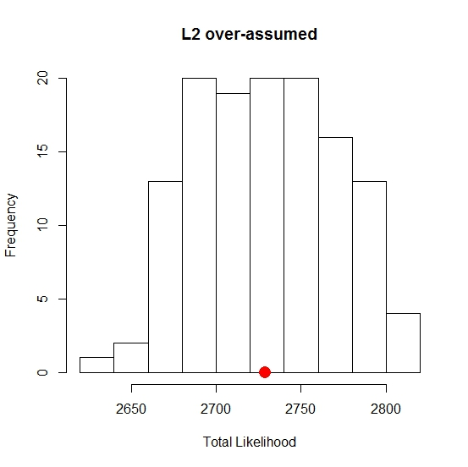
Test parameter L2, base on data set: Da
Preliminary results

Slide 20
Test parameter L2, base on data set: Db
Preliminary results

Slide 21
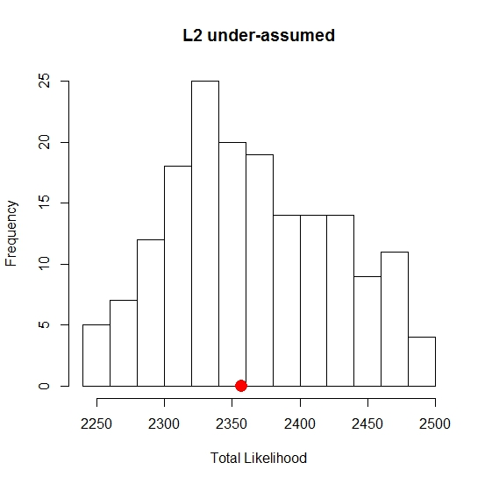
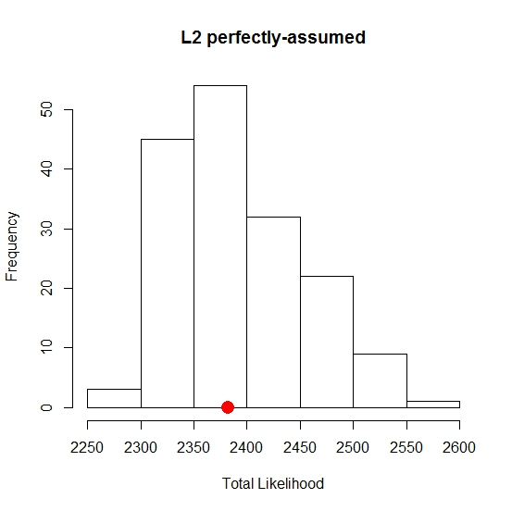
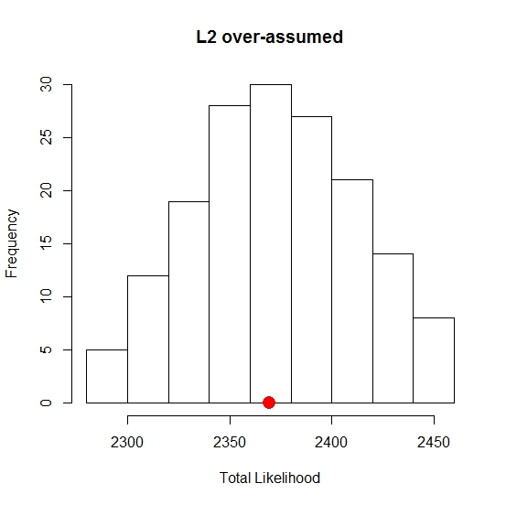
Test parameter L2, base on data set: Db
Preliminary results

Slide 22
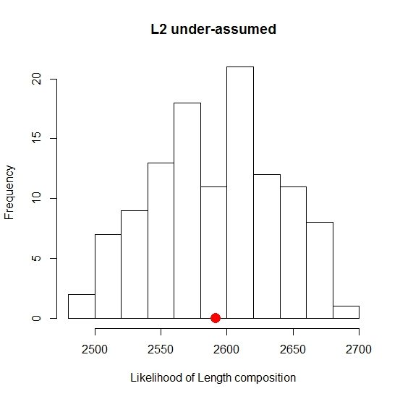
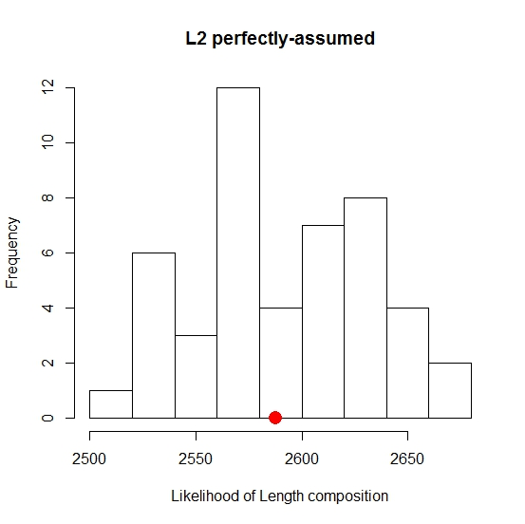
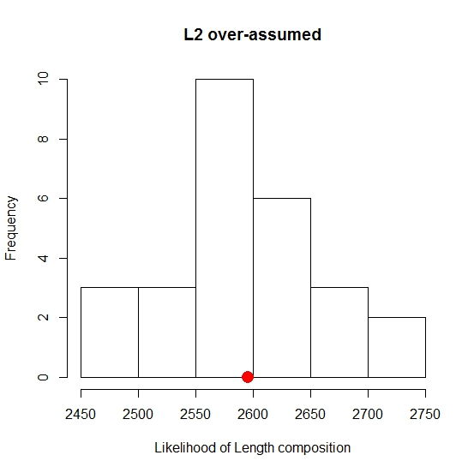
Test parameter L2, base on data set: Dc
Preliminary results

Slide 23
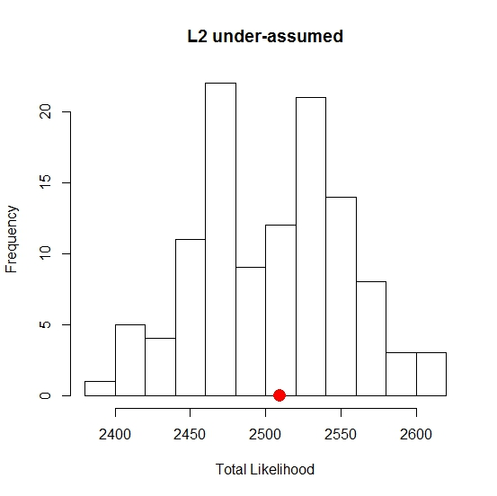
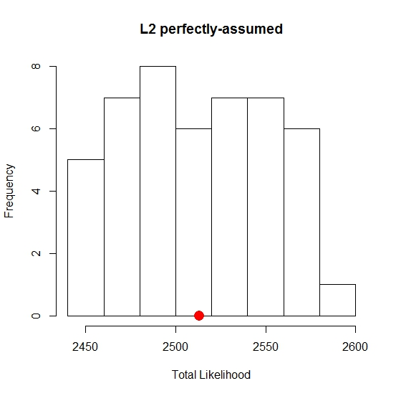
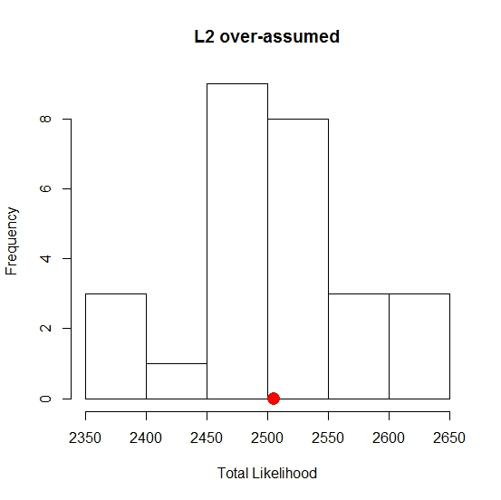
Test parameter L2, base on data set: Dc
Preliminary results

Slide 24
Discussion
How do deal with non-converged runs? Is it indicative to misspecification ?
The preliminary results are not what we expected, probably due to:
Uncertainties seem not sufficiently covered when simulating data sets for the L2, as previous study indicated that the data is informative for L2;

Slide 25
Discussion
Possible way to improve this work:
Use calibrated simulation introduced by Besbeas and Morgan(2014), i.e., sample from pars distributions when simulating data.

Slide 26
Discussion
If the par misspecification can be detected, implying the data is informative, then we can turn to estimate that parameter within the model;
Even if we may not be able to precisely determine the correct par values, we can reduce the uncertainty (e.g. narrower plausible range) by the diagnostics;
How to deal with multiple misspecifications (e.g. growth, selectivity, and q) using the simulation test? One by one ?

Slide 27
Thanks.
Comments and suggestions ...
Questions.

