Slide 1
A short course on data weighting and process error in
Stock Synthesis
Allan Hicks
CAPAM workshop
October 19, 2015

Slide 2
Working definitions
Process error
  Variability of a process (time-varying)
    e.g., recruitment or selectivity
Data weighting
  Balancing data sources such that the expected variability matches input variability
    SE on indices of abundance
    Input vs. effective sample sizes on composition data
  Allowing some data sources to influence results more than others

Slide 3
A brief introduction to SS
Four required input files
  Starter.ss
  Forecast.ss
  Data file
  Control file
A possible 5th file
  wtatage.ss
Executable
  Ss3.exe

Slide 4
SS I/O & Associated Tools
any text
editor
Excel
Sheets
Output for debugging
warning.sso
echoinput.sso
ParmTrace.sso
Input files
starter.ss
MyControlFile.ss
MyDataFile.ss
forecast.ss
R4SS
SS3
Output with results
Report.sso
CompReport.sso
covar.sso
Forecast-report.sso
to get comments
or simulated data
Excel
Viewer
Output that mirrors input
starter.ss_new
control.ss_new
data.ss_new
forecast.ss_new
R4SS
any text
editor

Slide 5
Starter and forecast files
Starter file
  Define names of data and control files
  Other definitions for minimization, output, and more
Forecast file
  Set up benchmarks and forecast settings

Slide 6
Data File sections (in order)
Model dimensions
Catches
Abundance index
Discards
Mean weight
Length compositions
Age compositions
Mean size-at-age
Environmental observations
Size frequencies
Tag data
Morph compositions

Slide 7
Data weighting methods in SS
Data file
Indices of abundance
  Typically a lognormal likelihood
  Input SE(log space)
    Higher values give less weight
    Allows for year-specific weighting
Compositions
  Multinomial likelihood
  Input sample sizes
    Lower values give less weight
    Allows for year-specific weighting

Slide 8
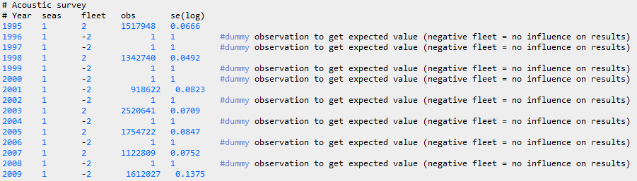
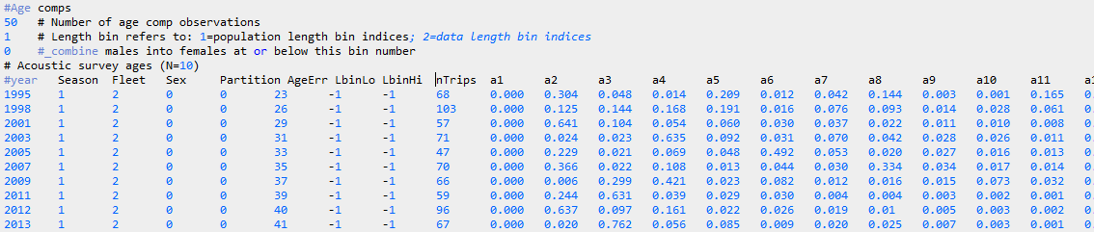
Pacific Hake Example
Index of abundance
Age compositions

Slide 9
Control file sections (in order)
Biological and time-block setup
Biological parameters
Stock-recruitment parameters and setup
Fishing mortality
Catchability
Selectivity
Tag-recapture
Variance adjustments
Lambdas (multipliers to likelihood)
Extra standard deviation reporting

Slide 10
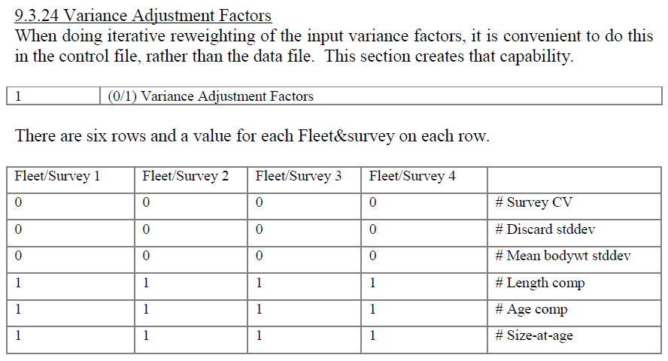
Data weighting methods in SS
Variance adjustment factors

Slide 11

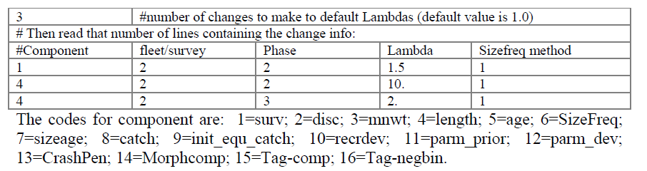
Data weighting methods in SS
Lambdas

Slide 12
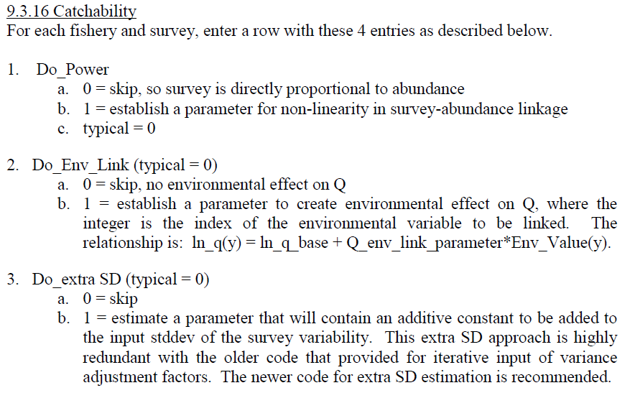
Data weighting methods
Extra SD on indices of abundance

Slide 13
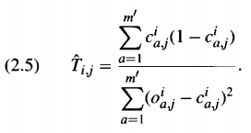

Data weighting guidance
Estimate additive SD for indices
Two concepts for weighting length and age data
  Effective N
    Commonly referred to as McAllister & Ianelli (1997)
    Multiply input N’s by a factor so that harmonic mean of effective N matches the mean of the input N
    By eye, fit a line through the scatterplot of the effective N vs. the input N
  Adjust input N so that variation around the mean contains the observed mean (Francis weighting)

Slide 14
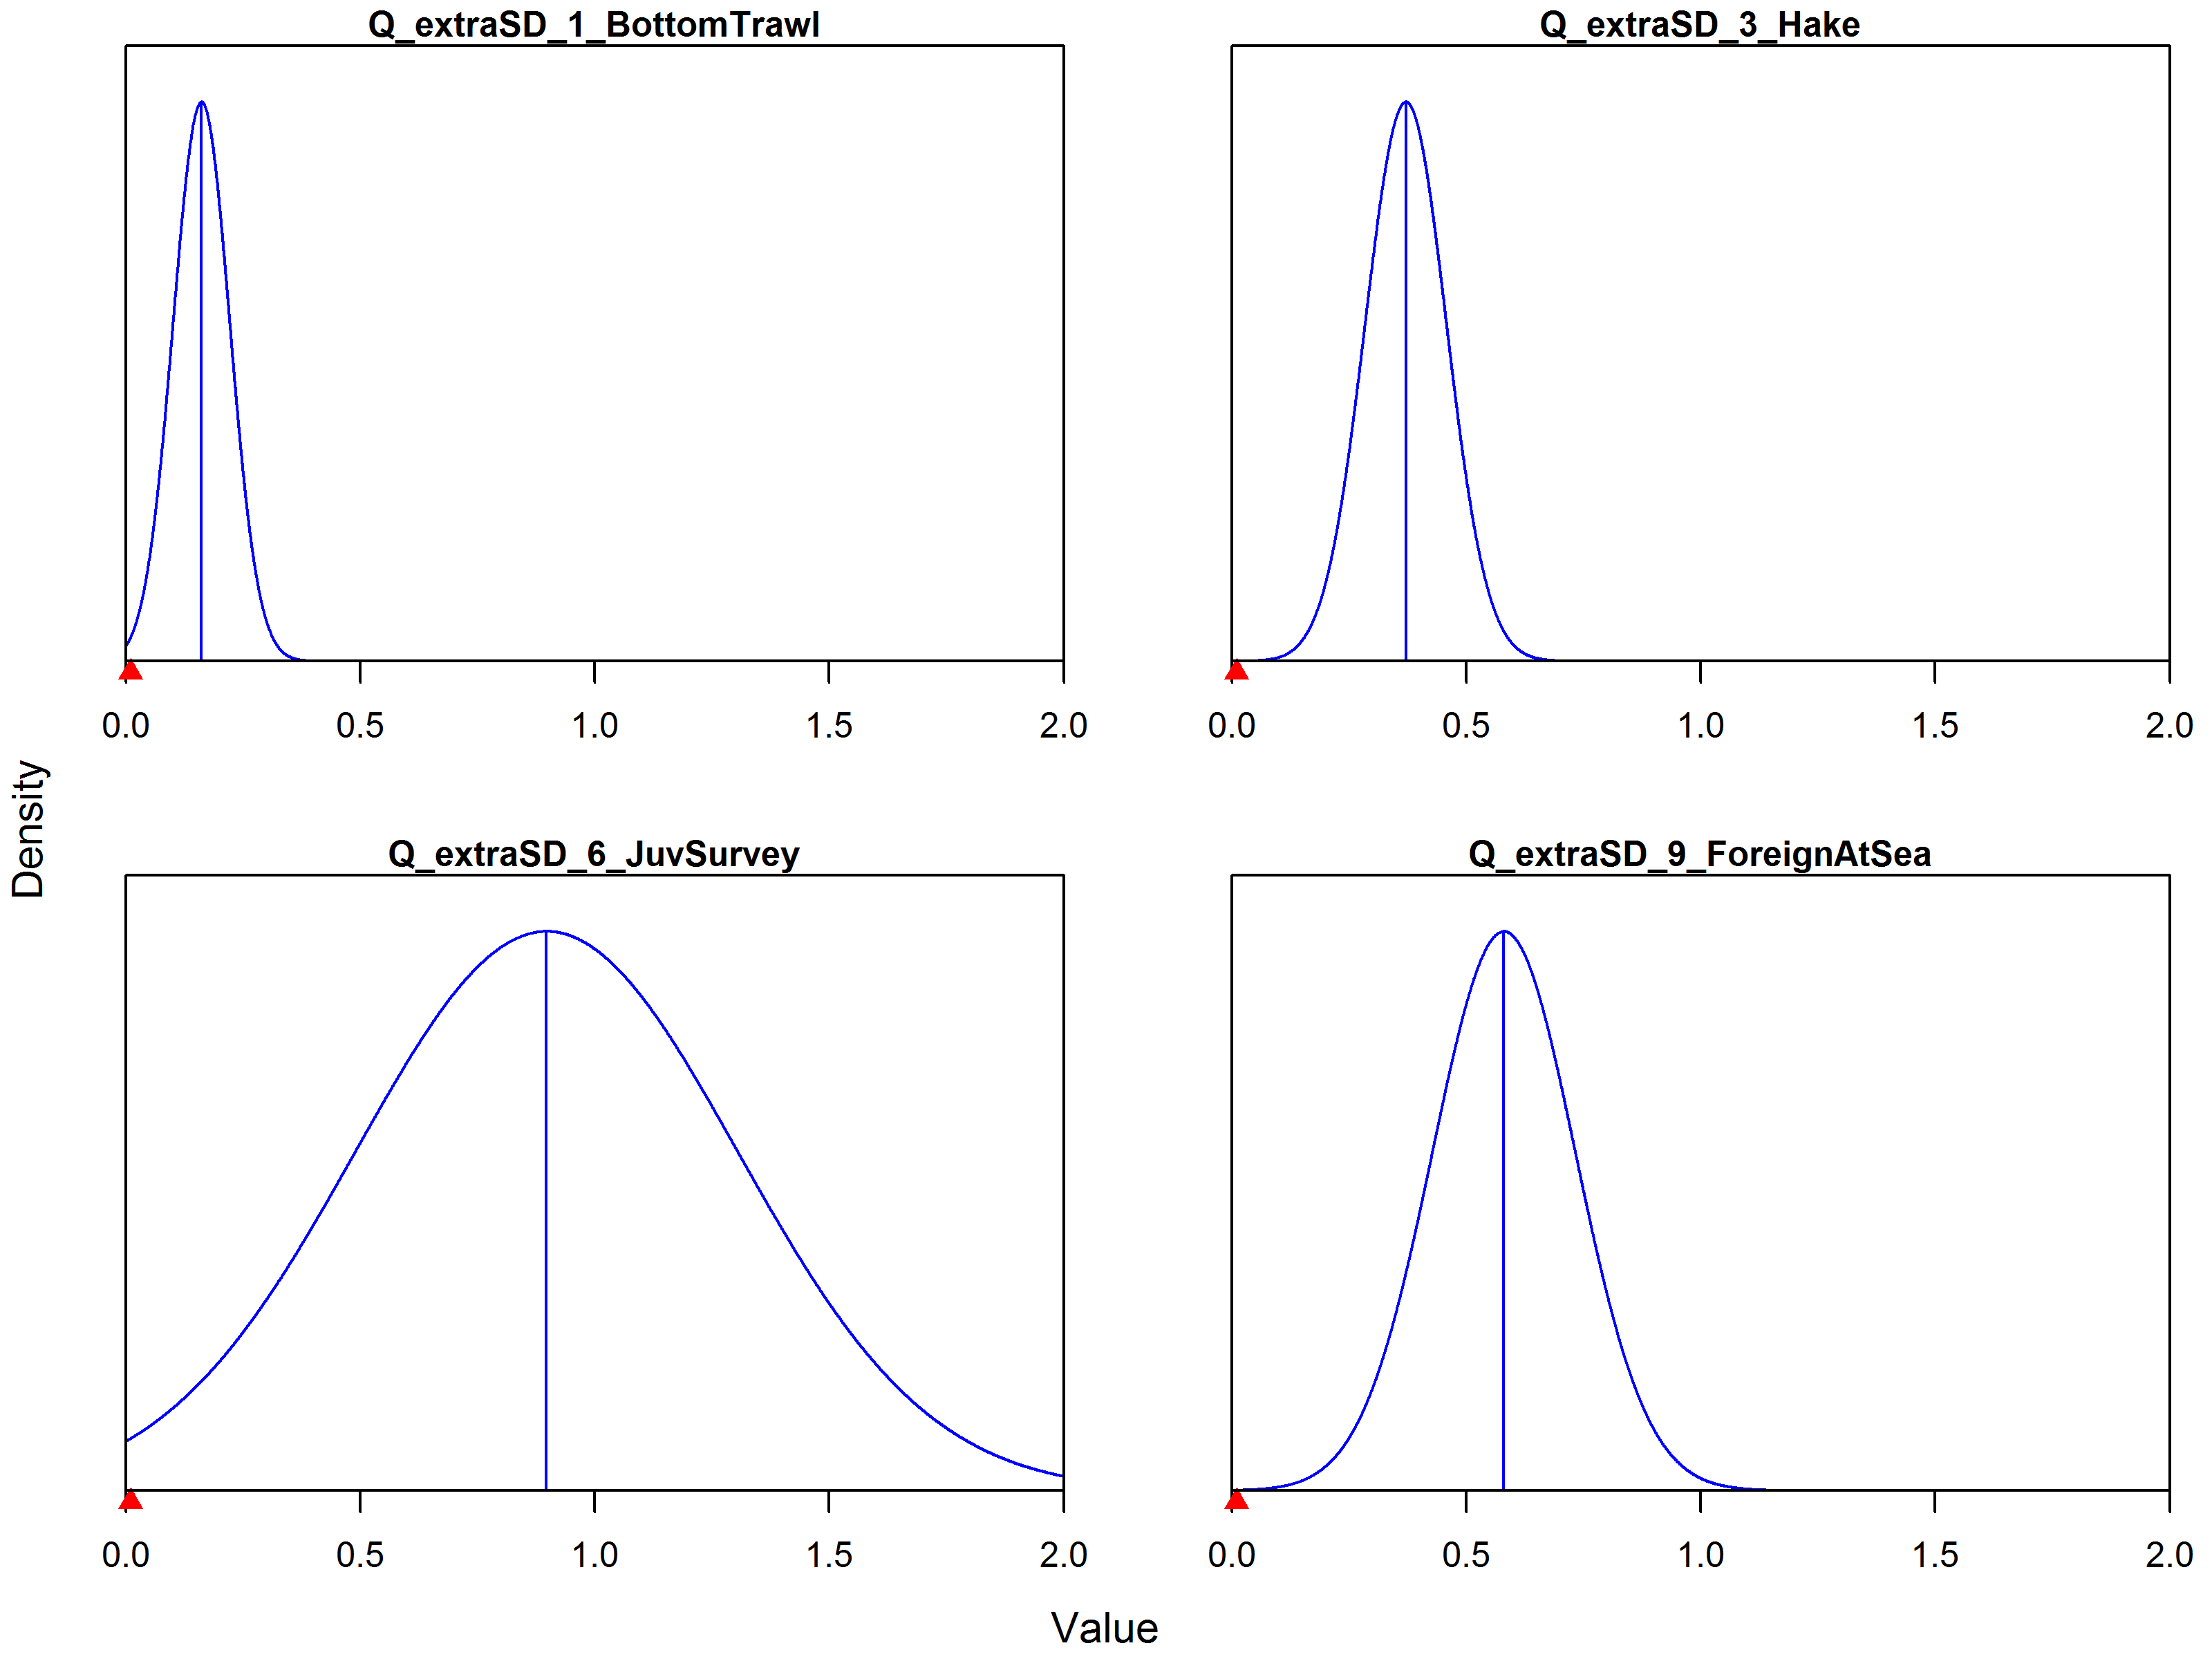
Extra SD for indices (Widow Rockfish)

Slide 15
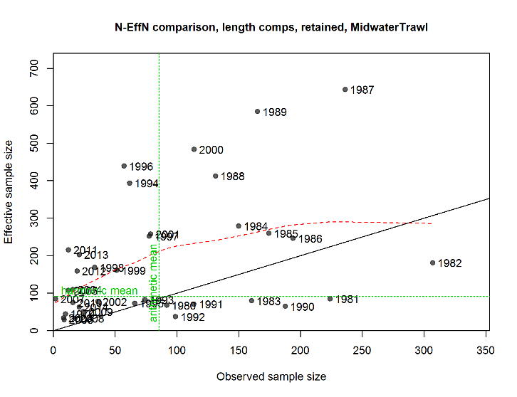
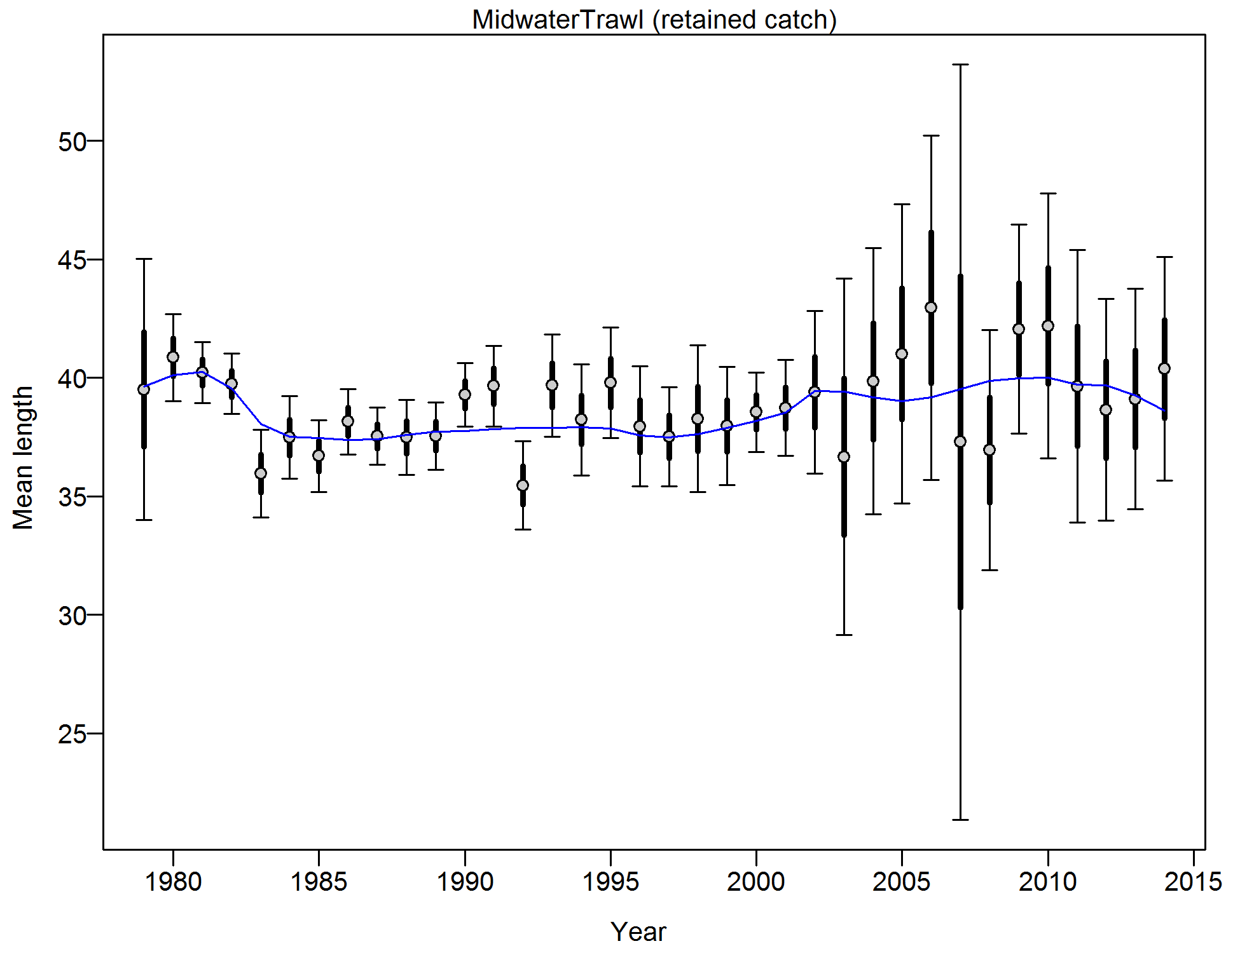
Length composition weighting
Widow Rockfish Midwater Trawl
Adj | mean (inputN*Adj) | meanEffN | HarMean (effN)
0.25 | 85.35 | 183.36 | 90.53
MeaneffN/ MeaninputN | HarMeanEffN/ MeanInputN | Francis
2.15 | 1.06 | 0.19 (0.1-0.4)

Slide 16
Fits to composition data

Slide 17
Process error
Recruitment
  Estimate recruitment as deviations with a defined variance (σ_{R})
  Define “eras”: early, main, forecast
  Main era is the most informed
  Tune the variance such that the RMSE (variability) of the deviates in the main era is slightly greater than σ_{R}

Slide 18
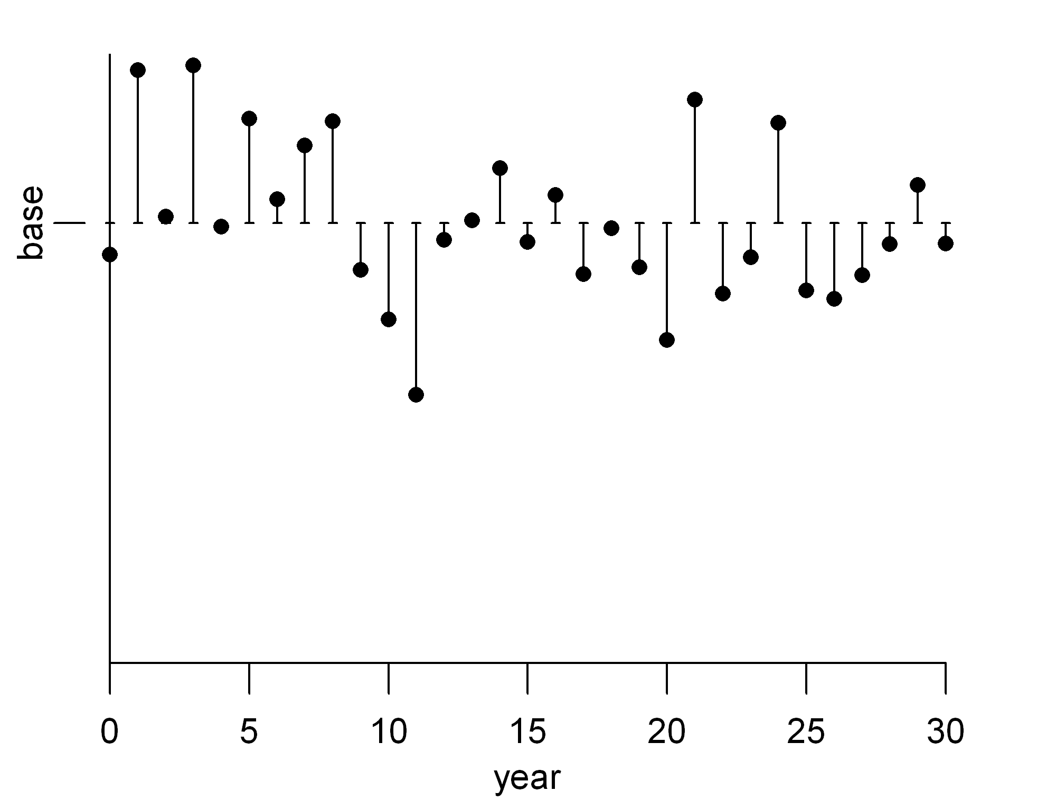
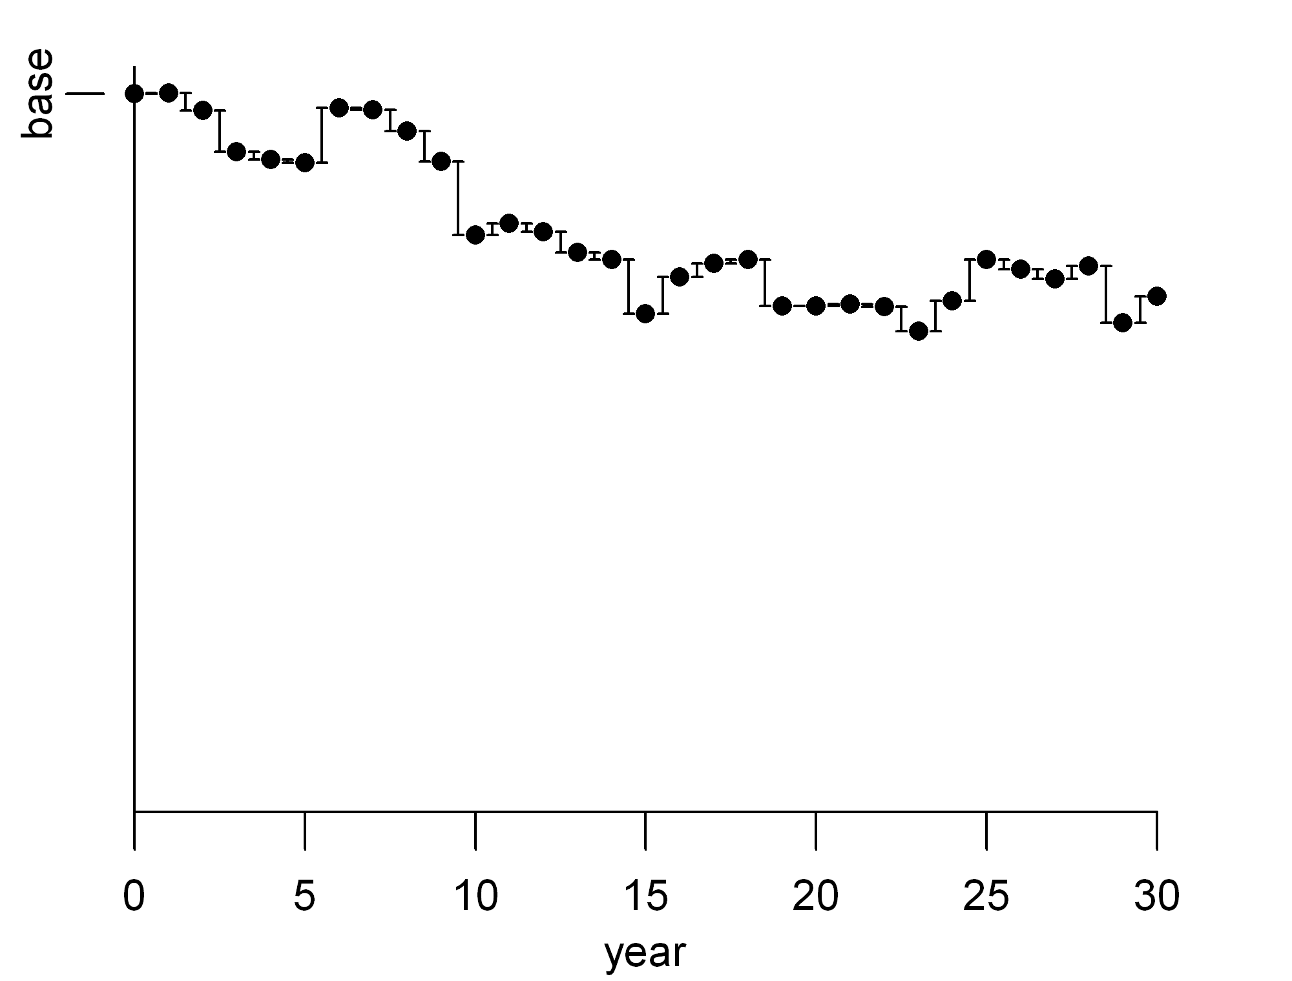
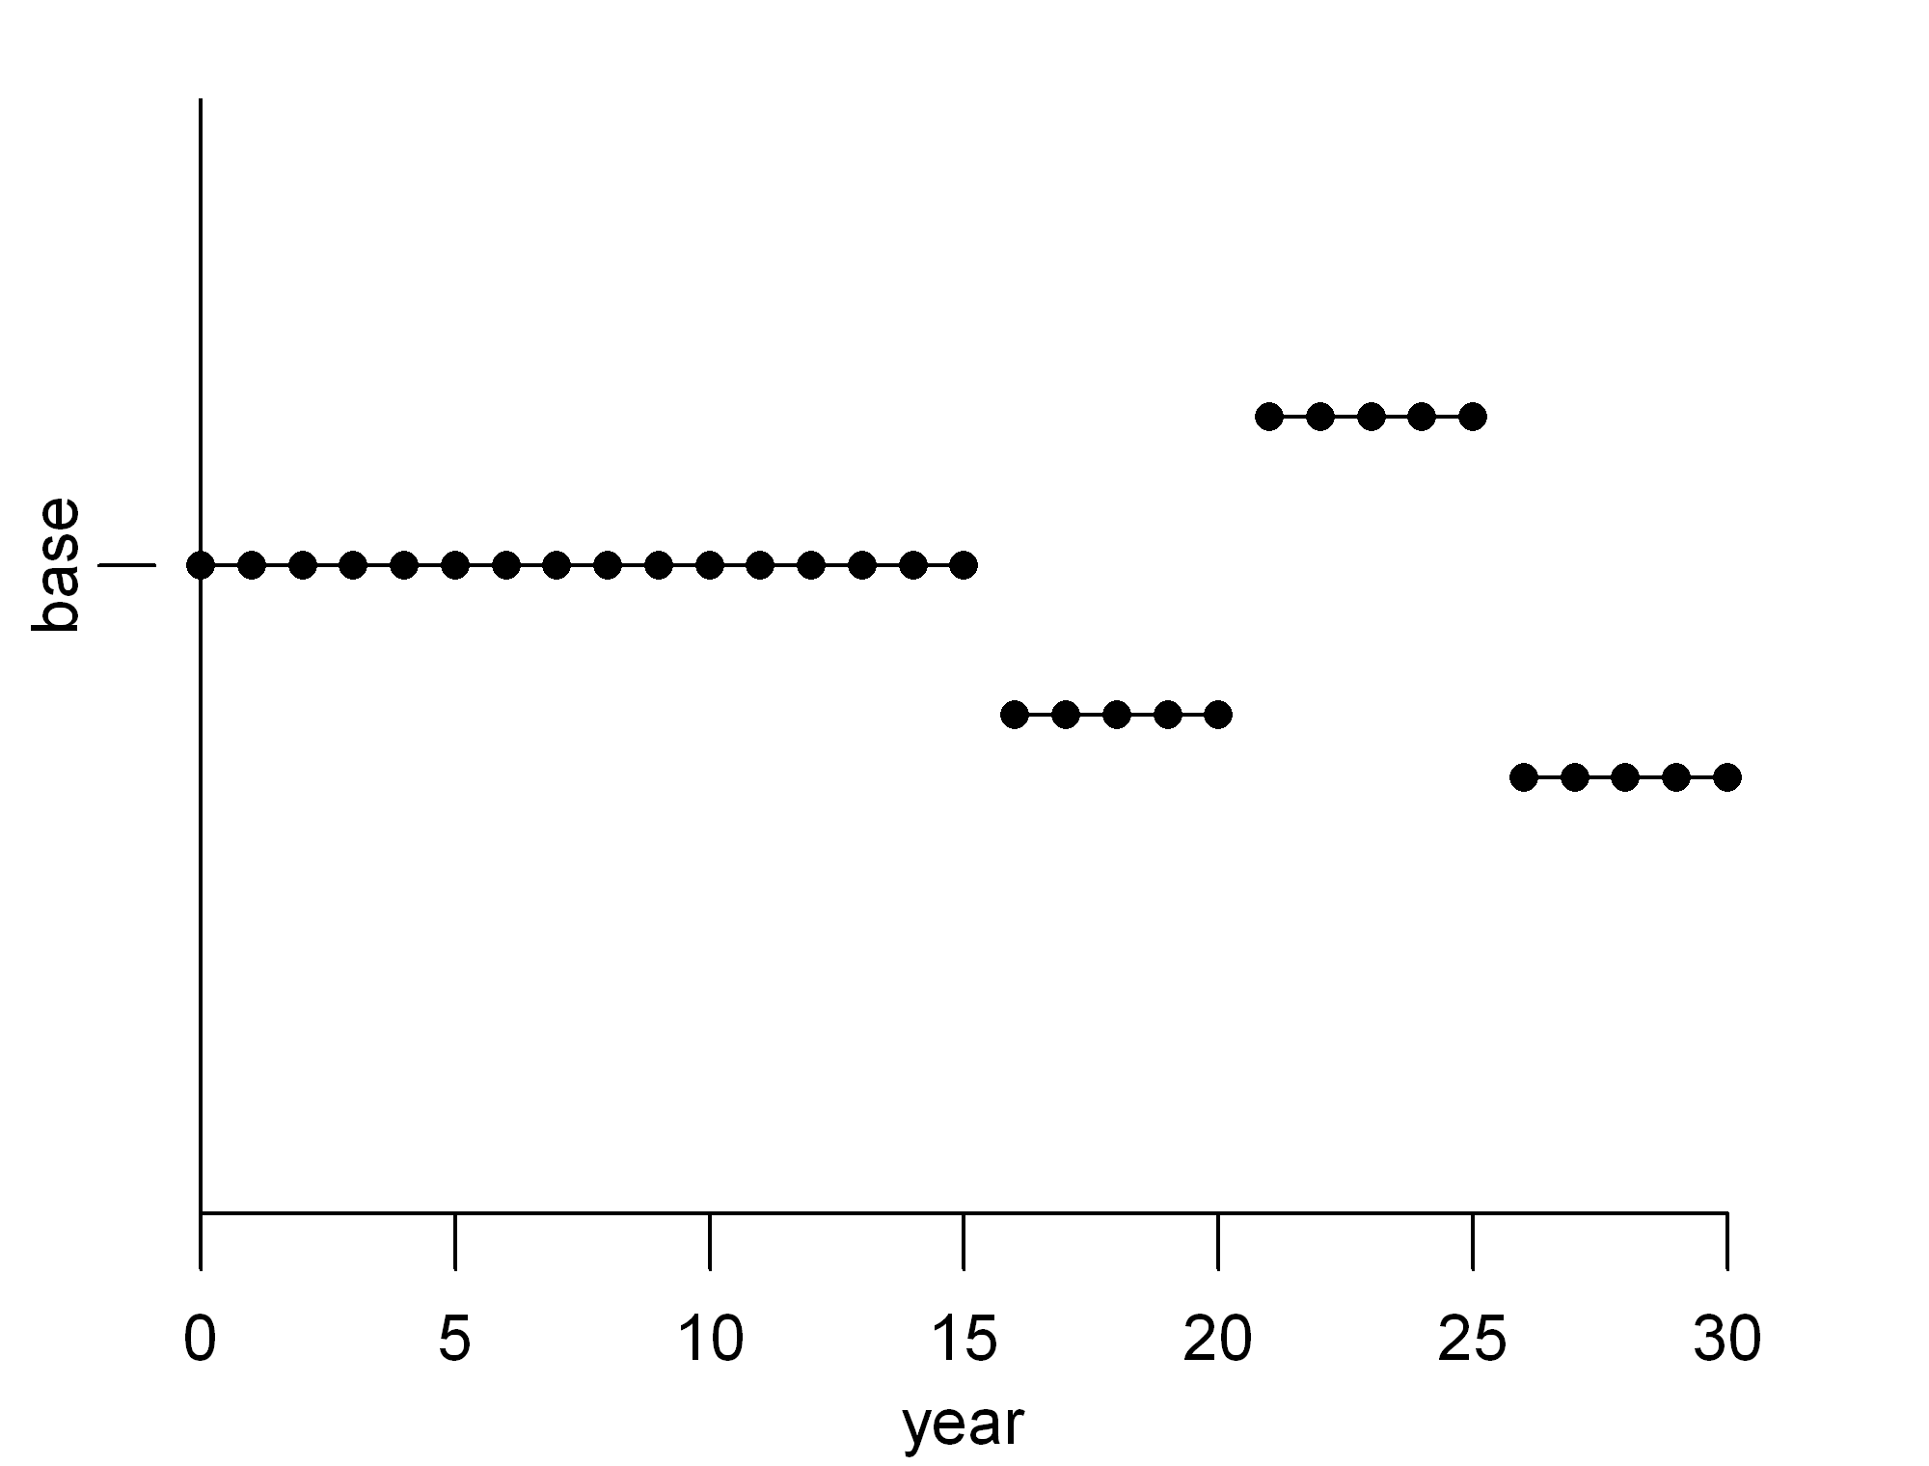
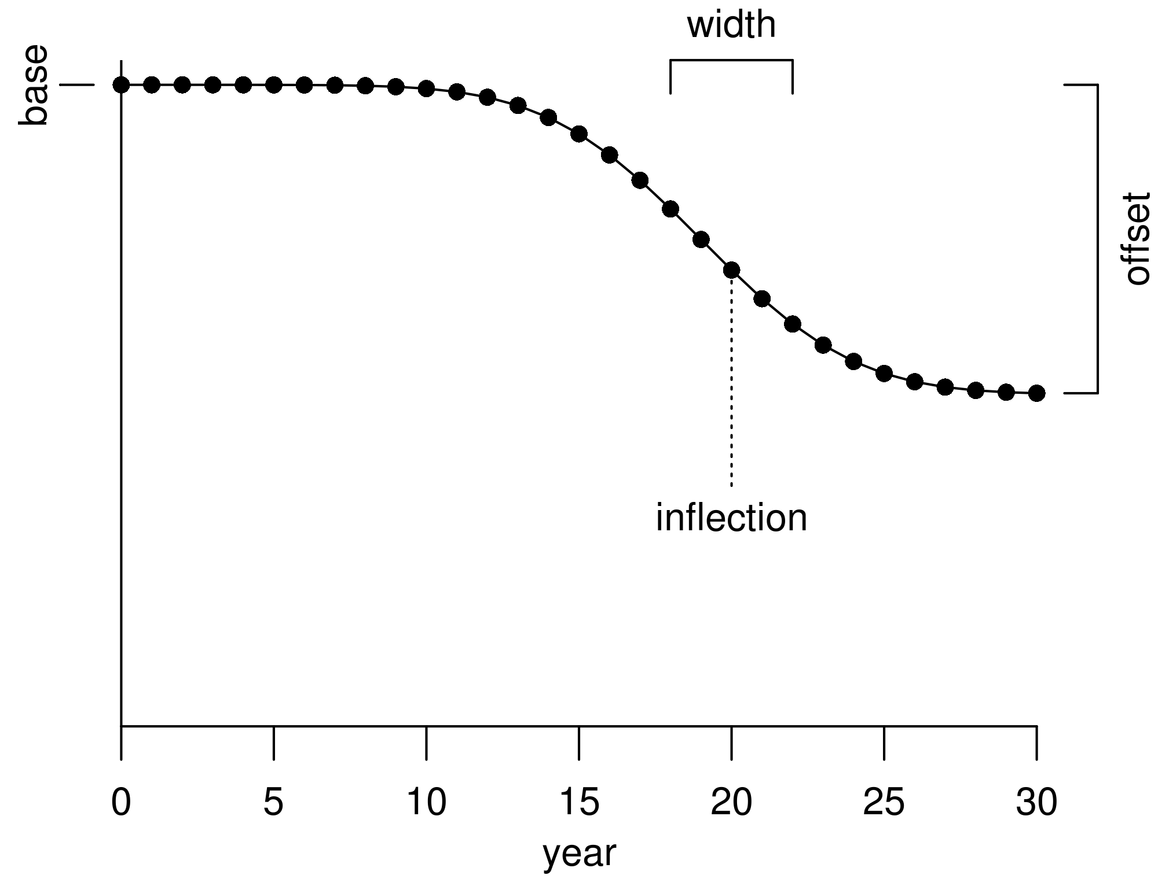
Process error
Deviations (N std. dev. pars.)
Time-varying quantities
  For example, growth and selectivity
  Link to an environmental variable
  Deviations
  Random walk
  Blocks
  Trend
Random walk (N -1 std. dev. pars.)
Blocks (1 par. per block)
Trend (3 pars.)

Slide 19
Parameter elements
Short parameter lines (7 elements)
#_Spawner-Recruitment Parameters
#_LO HI INIT PRIOR PR_type SD PHASE
5 20 10 9 -1 10 1 #Ln(R0)
Bounds
Initial value
Prior
Estimating phase
Optional comment
Full parameter lines (14 elements)
#Natural Mortality
#LO HI INIT PRIOR PR_type SD PHASE env-var use_dev dev_minyr dev_maxyr dev_stddev Block Block_Fxn
0.01 0.50 0.15 -1.8 3 0.3 6 0 0 0 0 0 0 0 #M
Bounds
Initial value
Prior
Estimating phase
Time-varying properties
Optional comment

Slide 20
Final thoughts
Data weighting is an art
It is basically trying to make the residuals (or lack of fit) consistent
  Don’t want standardized residuals much greater than 2 standard deviations
  Can look at residuals plots to see this
These values do not need to be exact
You may want to down-weight (or up-weight) some data sources based on your belief
  Not related to the guidance above
Process error can interact/confound data weighting

Slide 21
Example
Let’s first look at Pacific Hake
  Annual deviations on selectivity
  Estimates of extra SE on indices of abundance
  Recruitment and σ_{R}
  Age composition weighting
If we have time, let’s look at Widow Rockfish
  Block setup for time-varying factors
  Output for guidance on σ_{R} and composition weights
  R4SS output for effective N and Francis weighting

