Slide 1
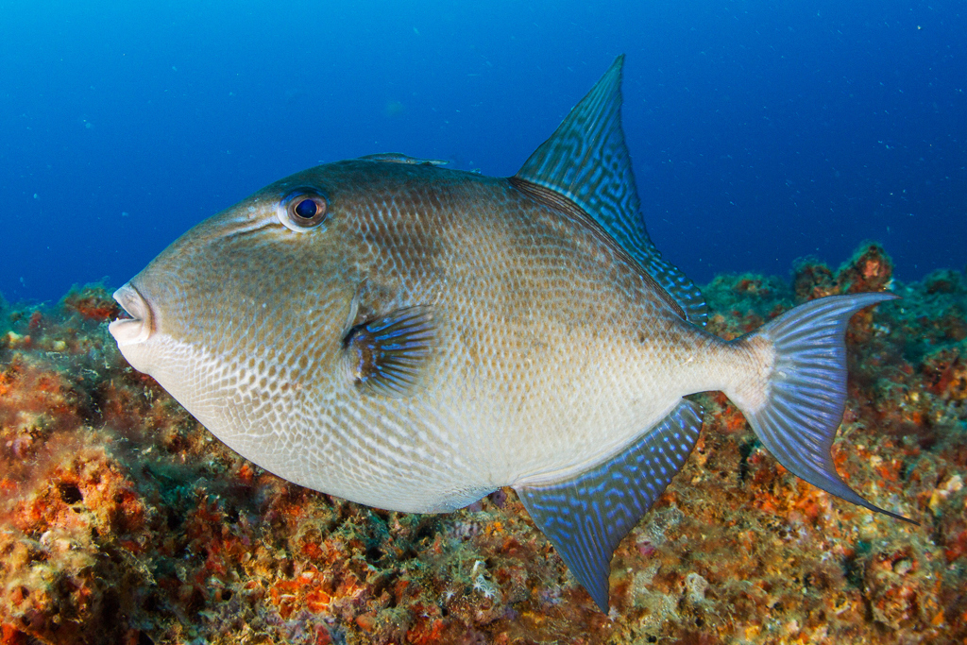
Effects of Catch-at-Age Sample Size on Gulf of Mexico Gray Triggerfish Spawning Stock Biomass Estimates
Jeff Isely
SEFSC Miami

Slide 2
Data Inputs
  Homogeneous stock structure
  Landings and indices calculated for eastern and western regions, but one population model constructed for entire Gulf of Mexico
  Lorenzen mortality
  Fixed growth curve
  Estimated discards
  Catch-at-age composition
    Annual age-length keys
    Estimated external to the model
  SS3

Slide 3
Data Inputs: Life History
Age and Growth
Gray Triggerfish
SEDAR 43 Growth Curve

Slide 4
Data Inputs: Life History
Age and Growth
  Large size at Age 0
    Few observations of small fish
  Grow rapidly
  Achieve maximum size at a young age
  Little “recruitment signal” in length data
  No fecundity – age relationship
    Used length-based fecundity curve

Slide 5
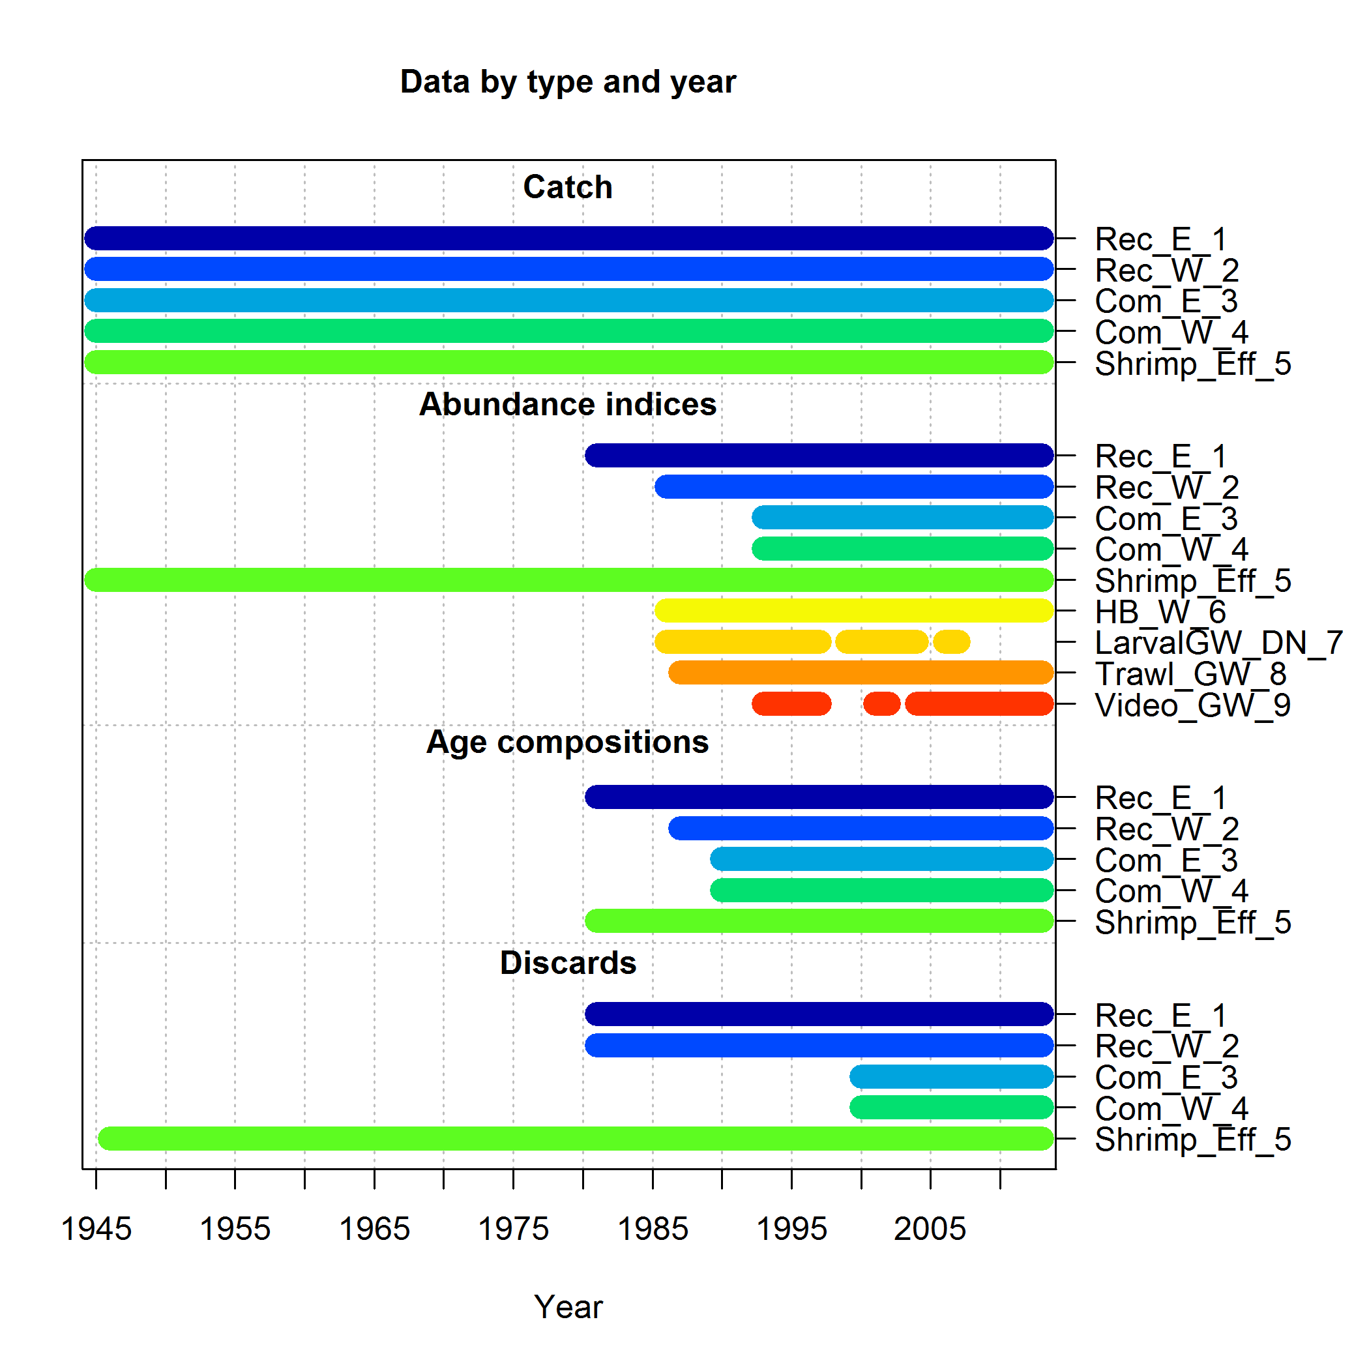
Model Configuration

Slide 6
Data Inputs: Landings
Recreational

Slide 7
Data Inputs: Landings
Commercial

Slide 8
Data Inputs: Discards
Commercial

Slide 9
Data Inputs: Discards
Recreational

Slide 10
Data Inputs: Discards
Recreational

Slide 11
Data Inputs: Discards
Recreational

Slide 12
Data Inputs: Indices of Abundance
Fishery Dependent
Recreational indices used guild approach to select trips that caught reef fish (as in SEDAR 9 Update).

Slide 13
Data Inputs: Indices of Abundance
Fishery Dependent
Commercial indices used guild approach to select trips that caught reef fish (as in SEDAR 9 Update).
Indices were adjusted for circle hook effect of 2.14
Notes:
Guild approach selects trips based on the catch composition containing species that belong to the reef fish assemblage, as is now the accepted treatment for developing standardized CPUE indices for the recreational sectors.

Slide 14
Data Inputs: Indices of Abundance
Fishery Independent
Notes:
Same standardization
methodology was used
as applied during
SEDAR 9 Update

Slide 15
Age
Recreational vs. Commercial
Individuals

Slide 16
Age
Recreational vs. Commercial
Catches Sampled

Slide 17
Age
Commercial

Slide 18
Age
Recreational

Slide 19
Length
Recreational vs. Commercial
Individuals

Slide 20

Length
Recreational vs. Commercial
Samples

Slide 21
Length
Commercial

Slide 22
Length
Recreational

Slide 23
Sample Size categories
Number of individuals measured (Length)
Number of trips sampled (Length)
Number of individuals aged (age)
Number of trips sampled (age)
Number - weighted by catch
Iterative reweighting of samples based on effective sample size
Number of individuals measured caped at 200

Slide 24
Sample Size categories
Number of individuals measured (Length)
Number of trips sampled (Length)
Number of individuals aged (age)
Number of trips sampled (age)
Number - weighted by catch
Iterative reweighting of samples based on effective sample size
Number of individuals measured capped at 200

Slide 26
Recreational

Slide 27
Commercial

Slide 28
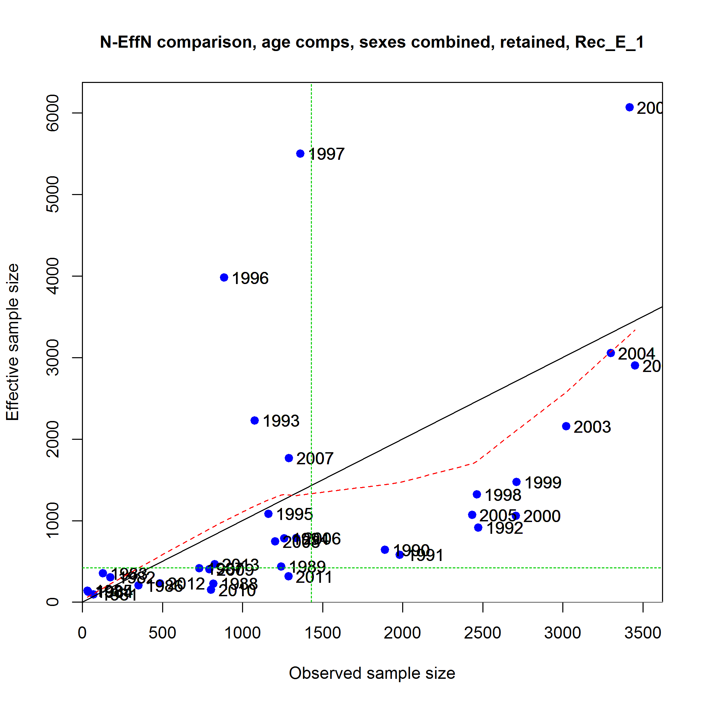
Length Numbers

Slide 29
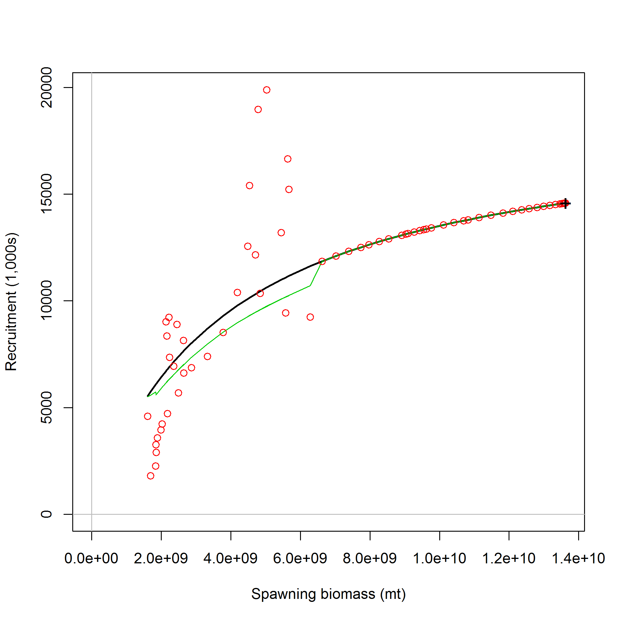
Length Numbers

Slide 30
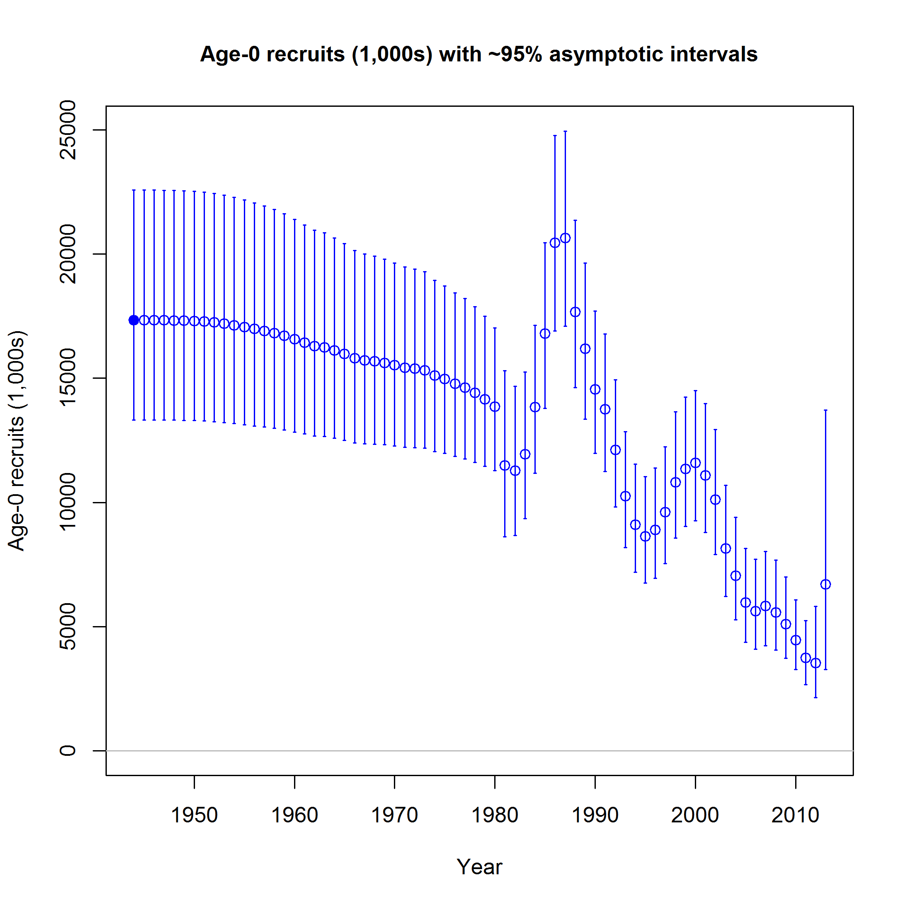
SSB and Recruitment

Slide 31
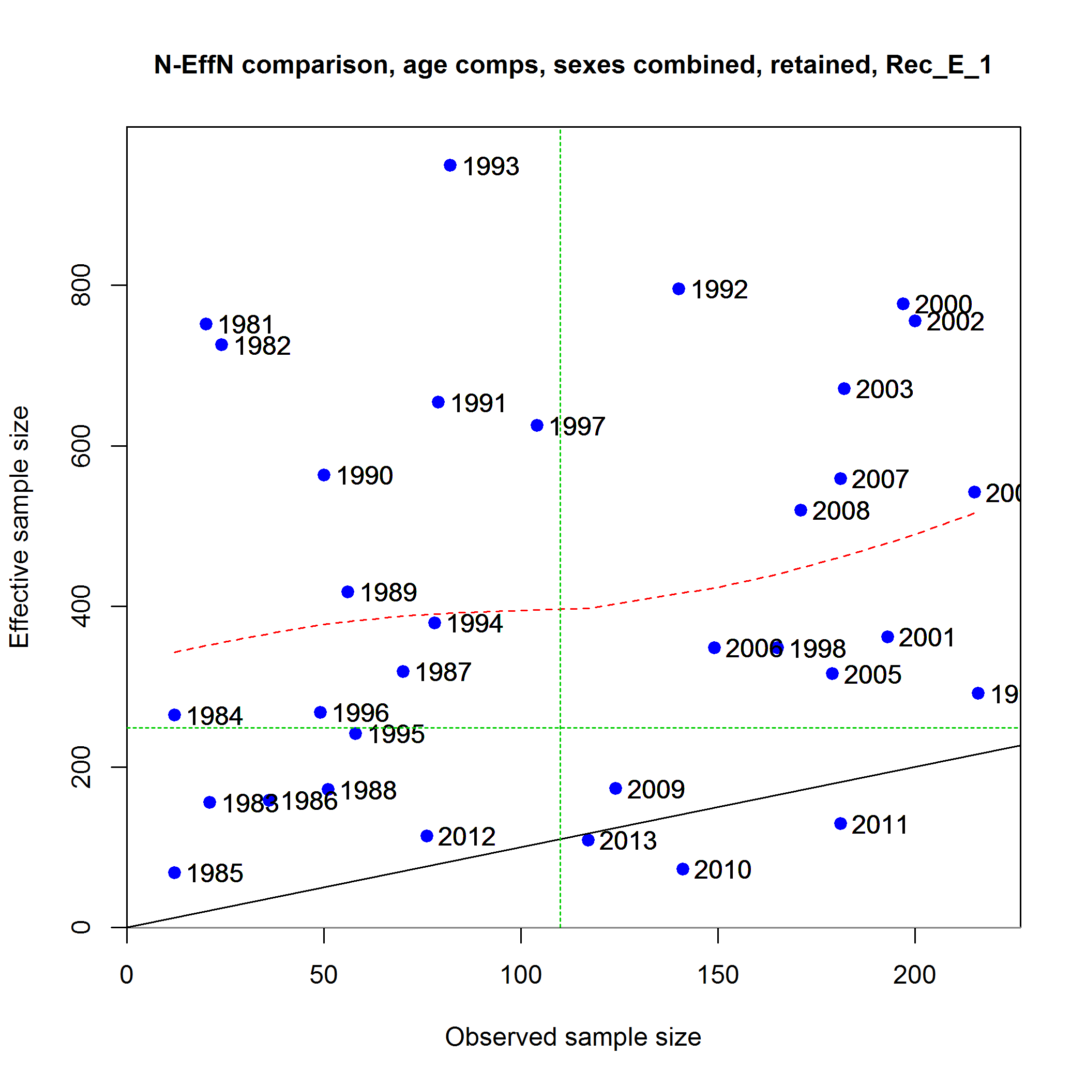
Length Samples

Slide 32
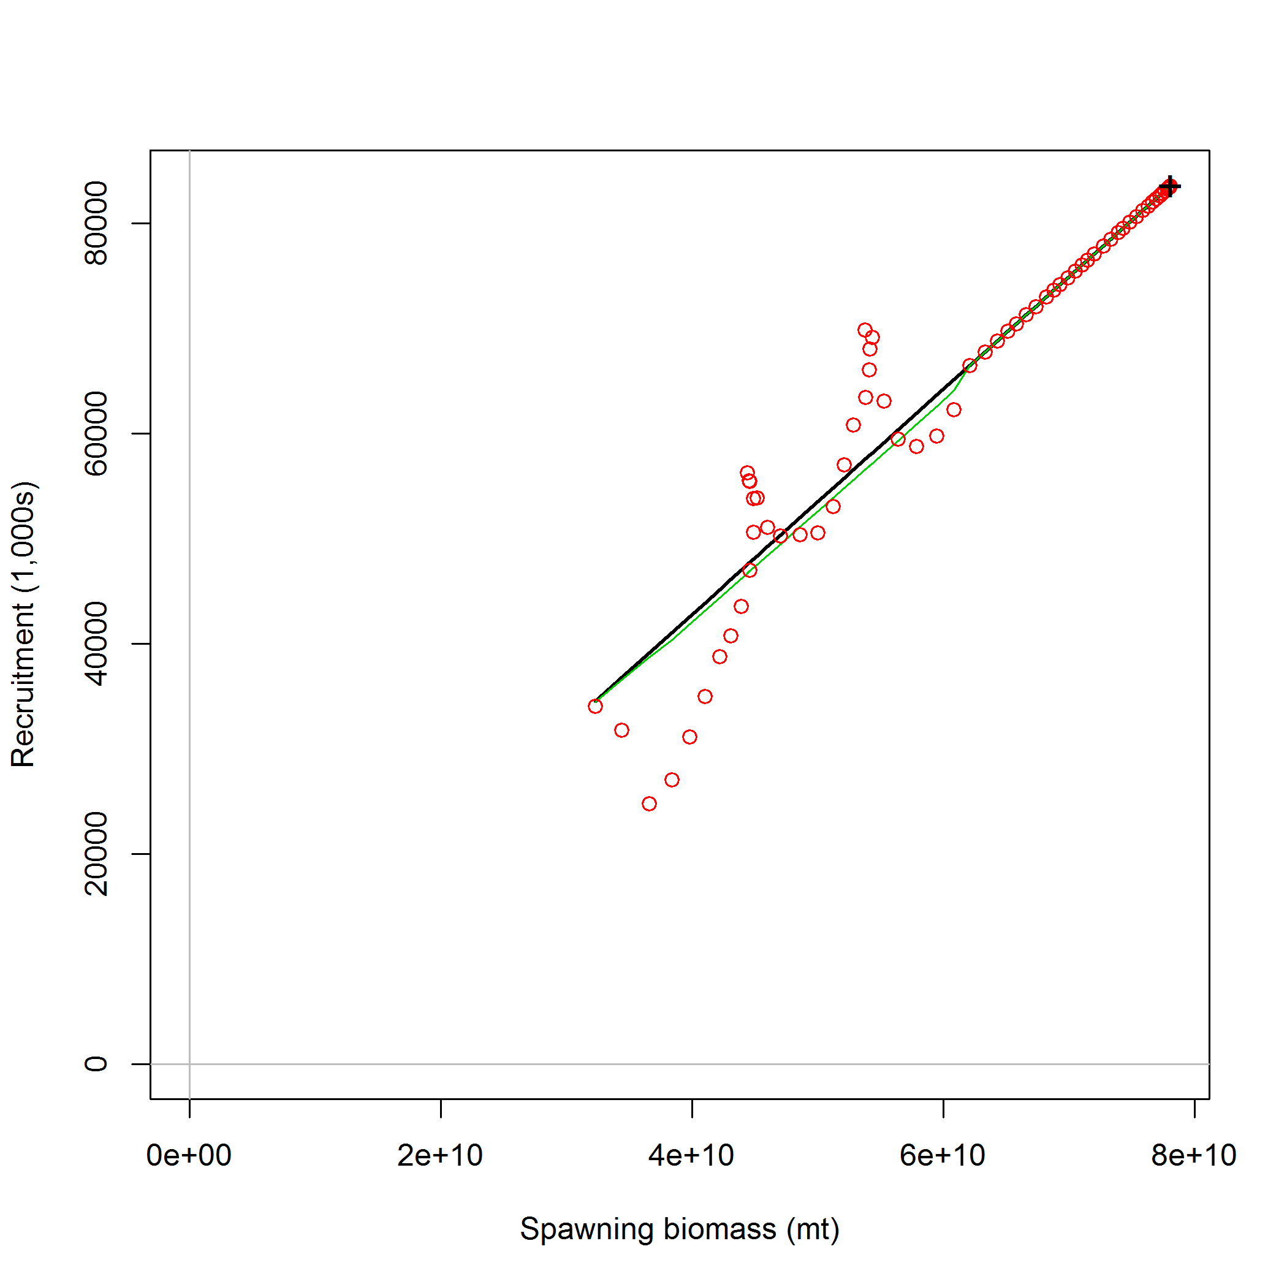
Length Samples

Slide 33
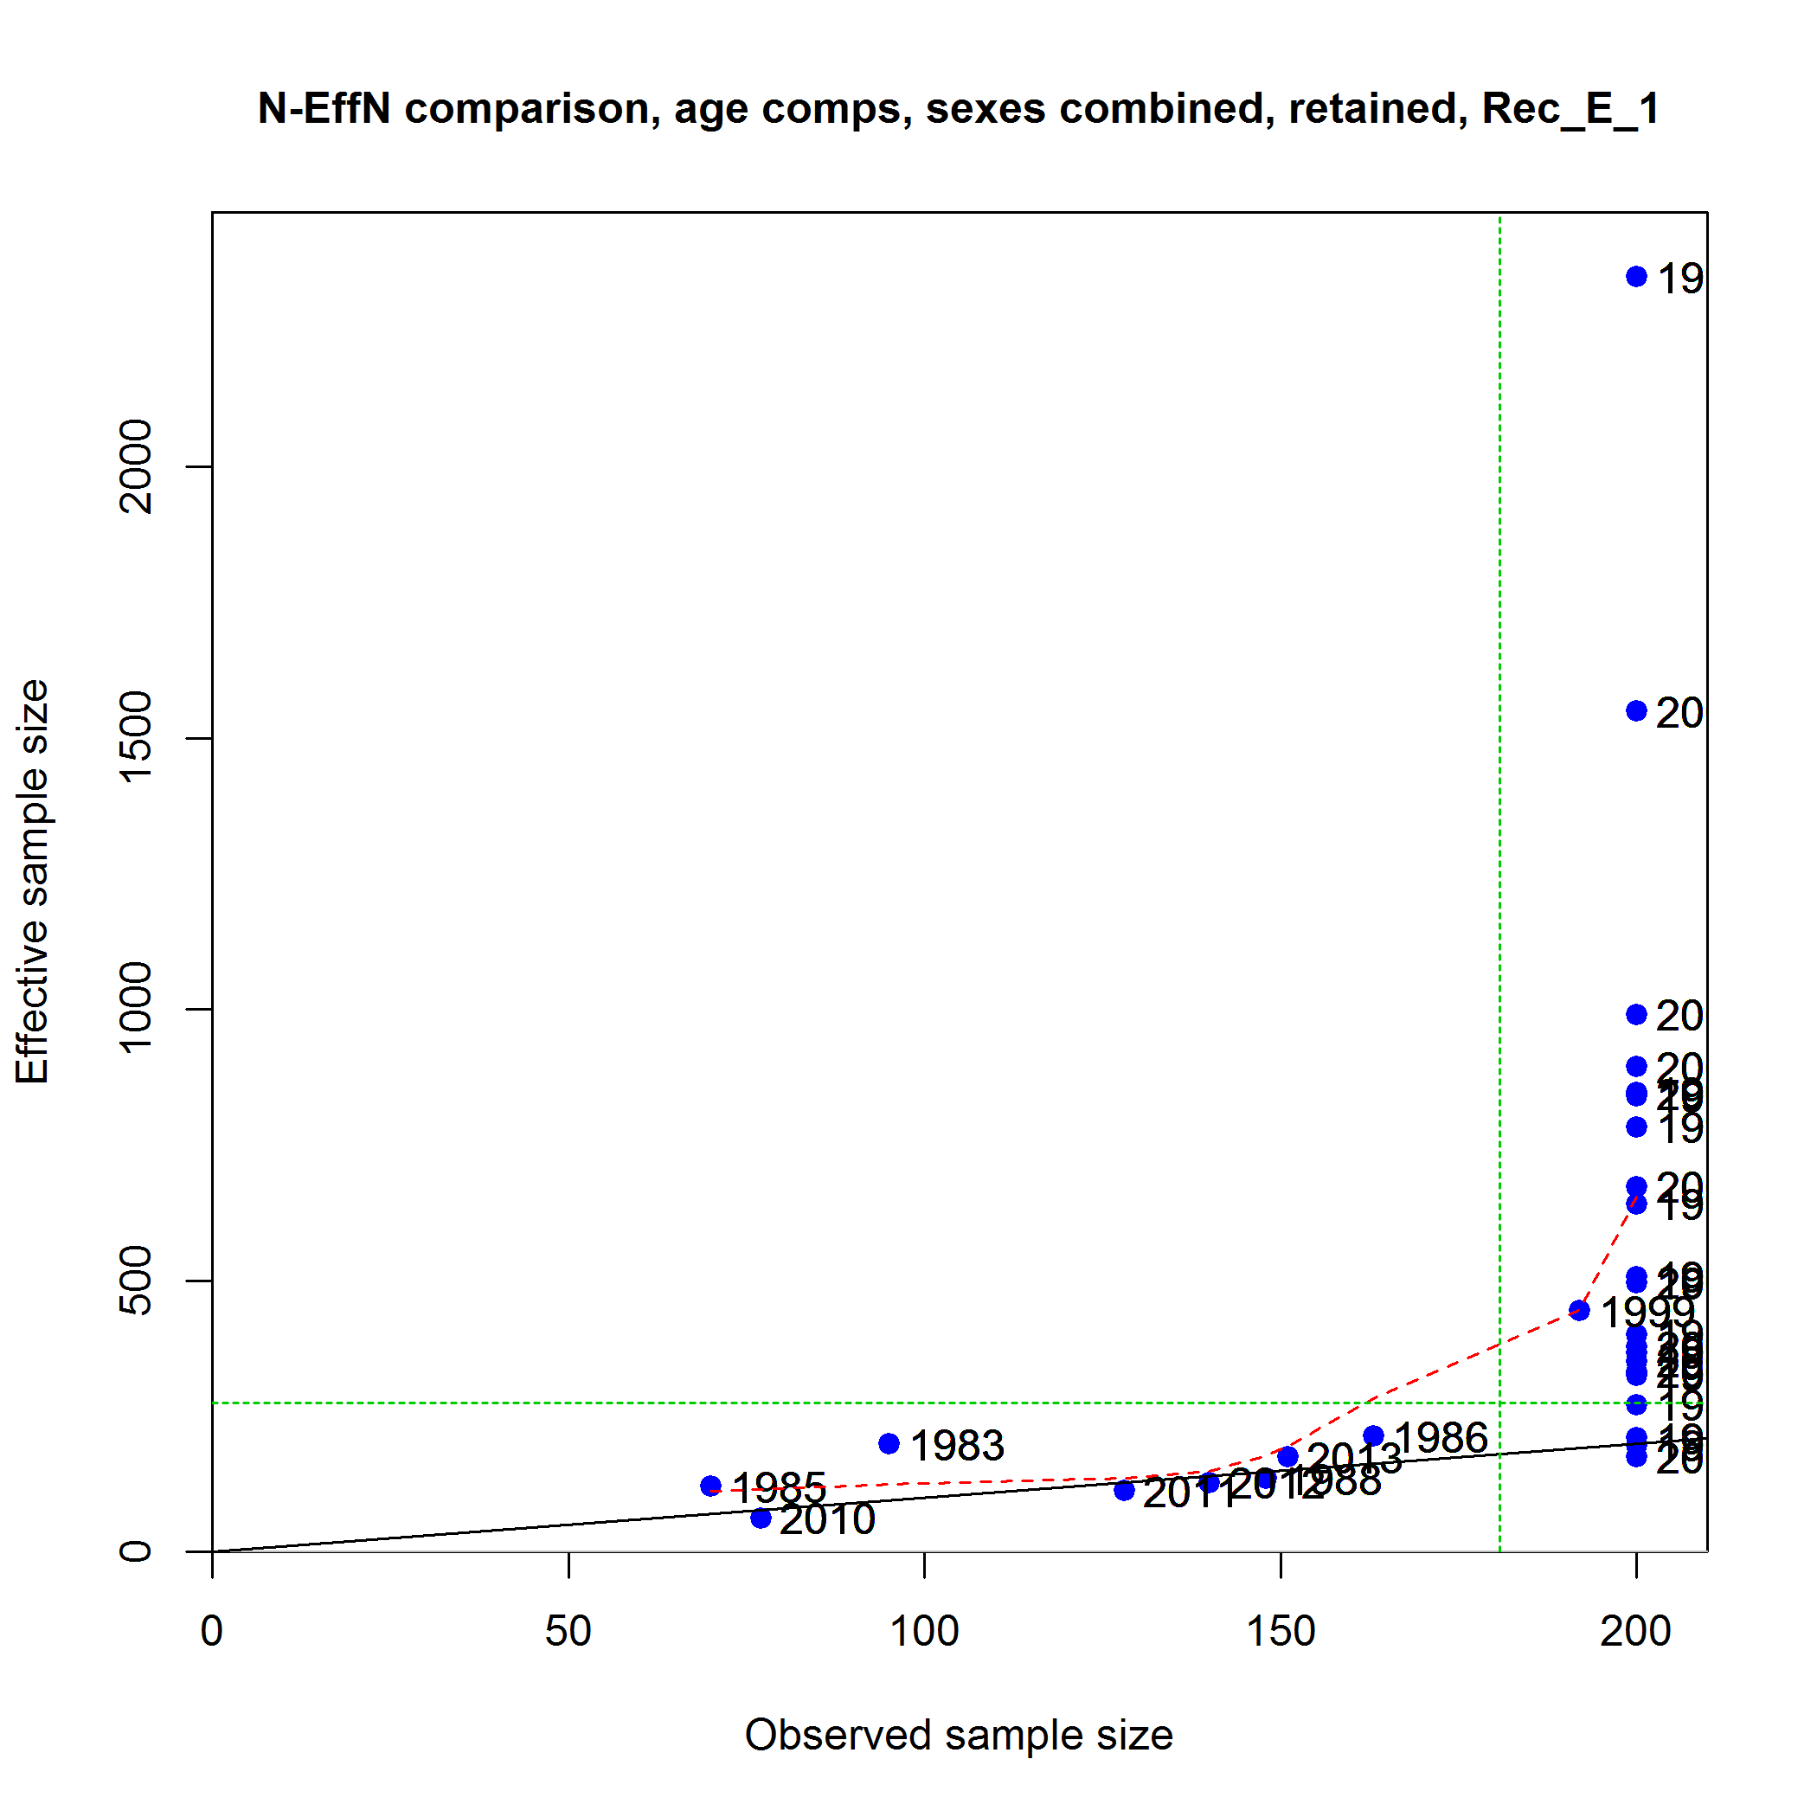
Capped Sample Size @ 200

Slide 34
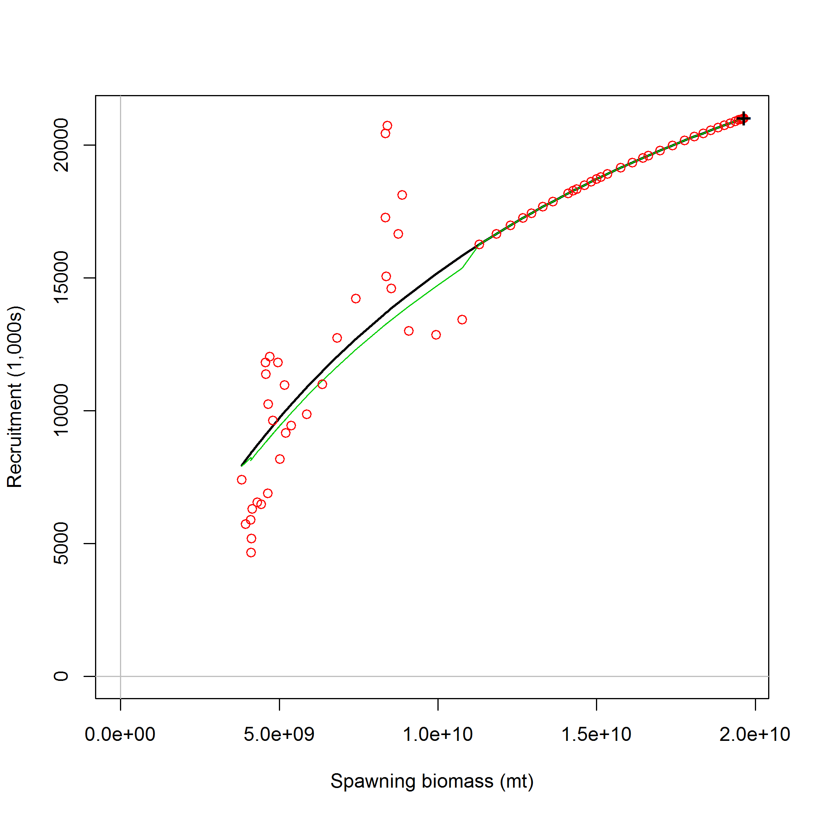
Capped Sample Size @ 200

Slide 35
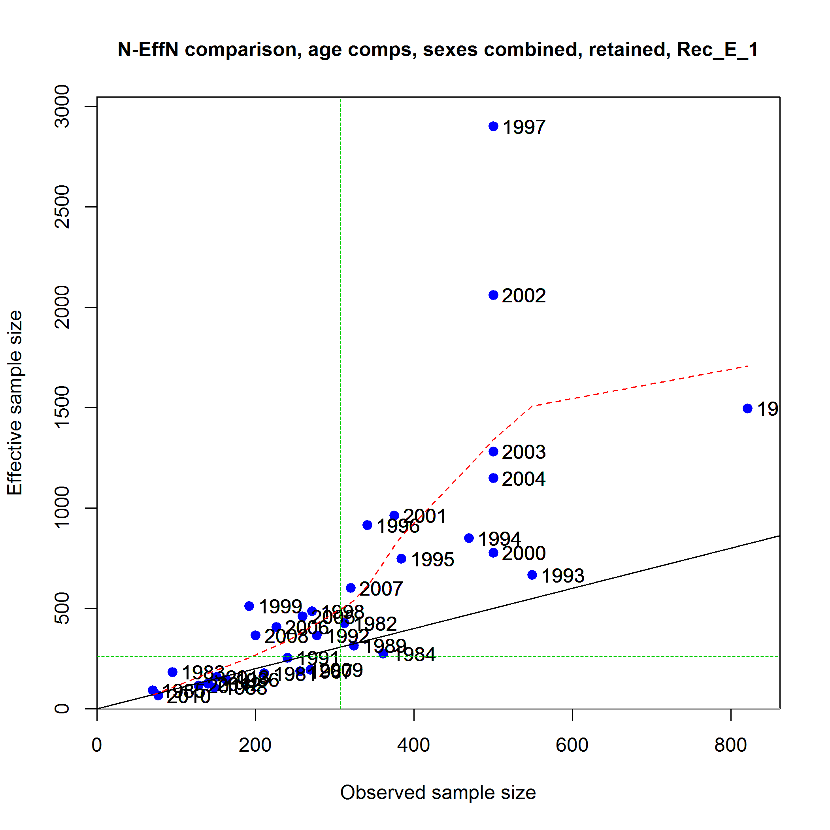
Catch Weighted

Slide 36
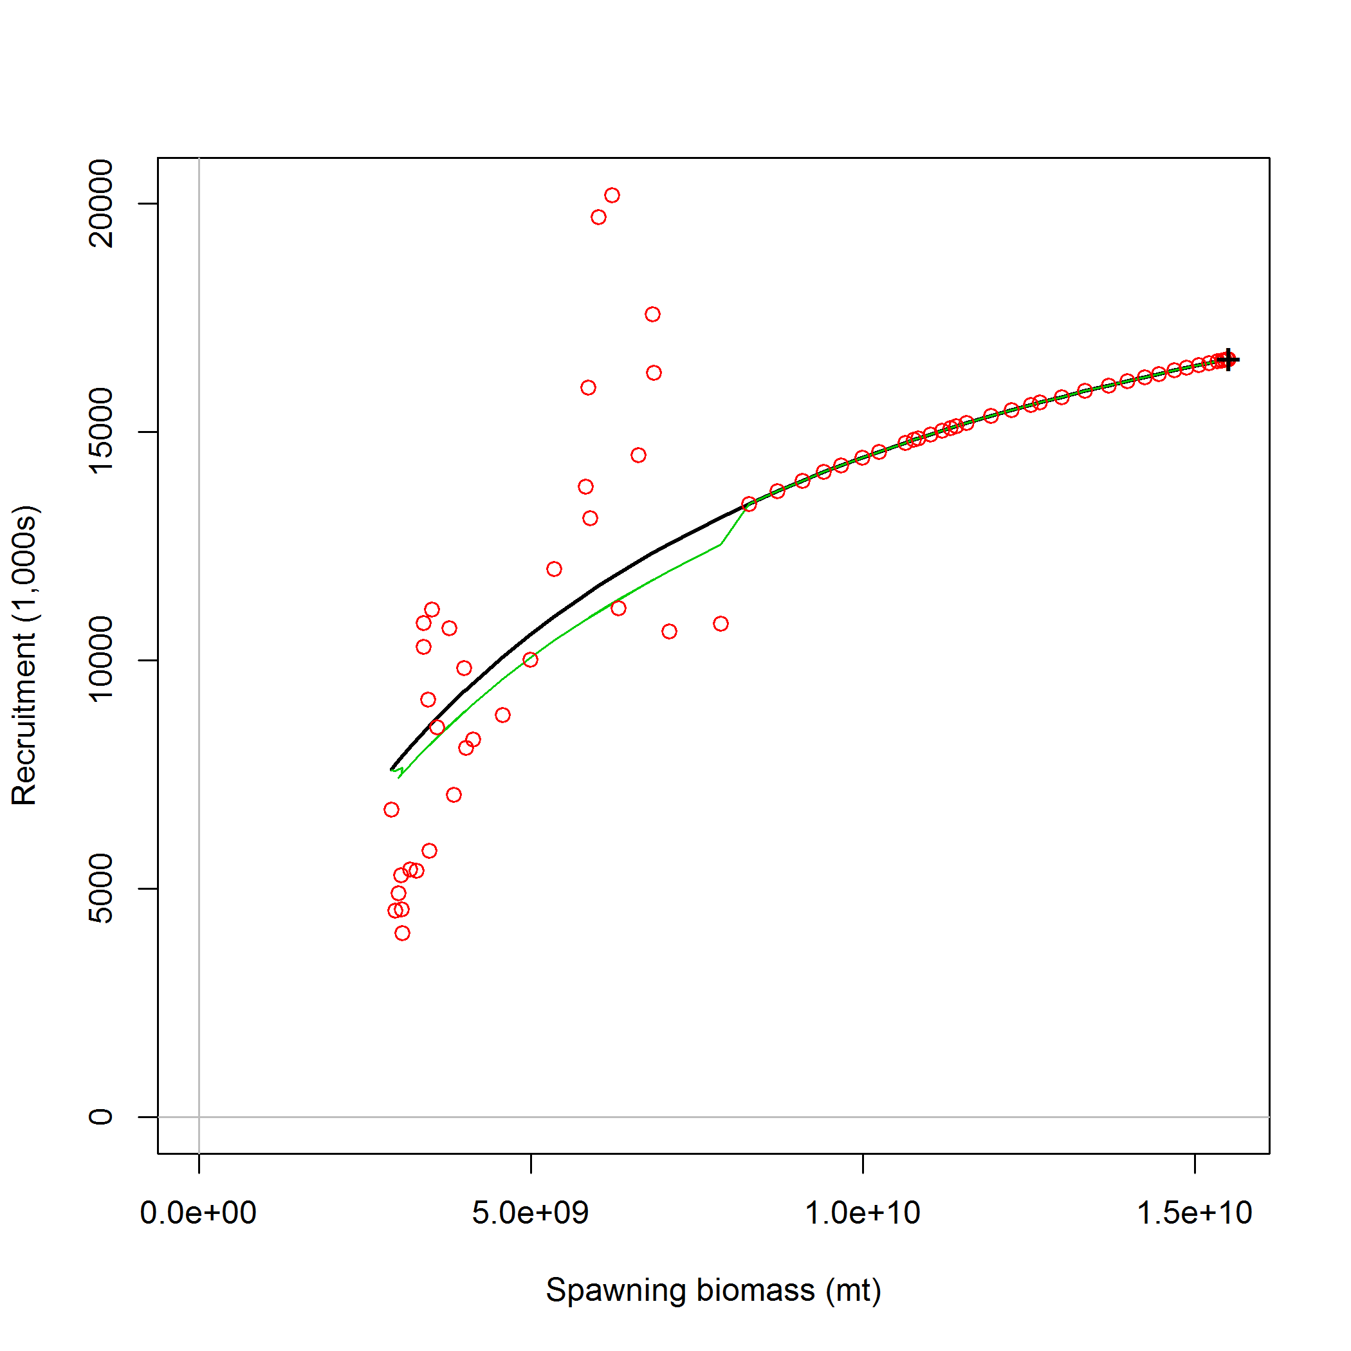
Catch Weighted

Slide 37
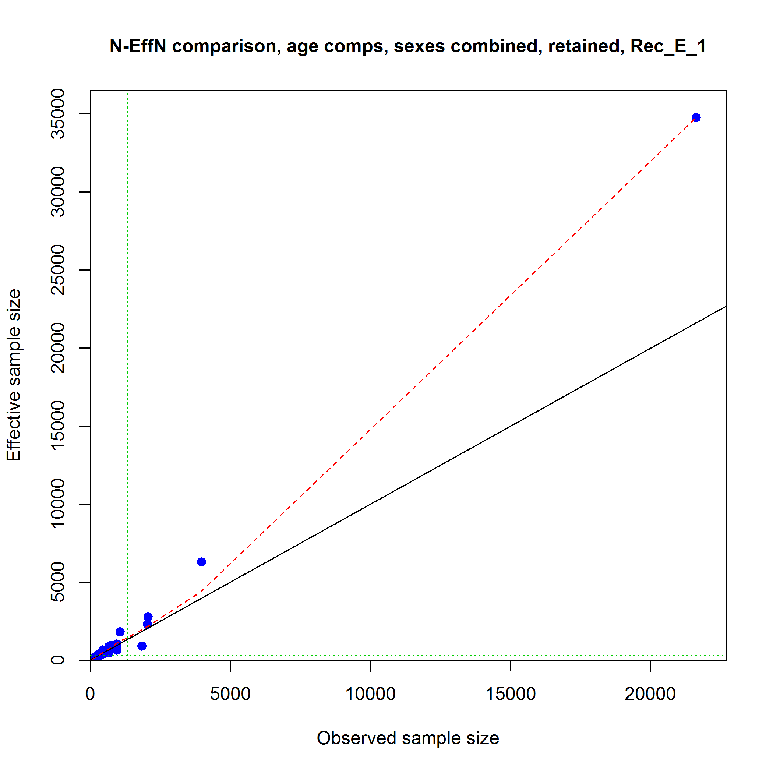
Iterative Reweighting

Slide 38
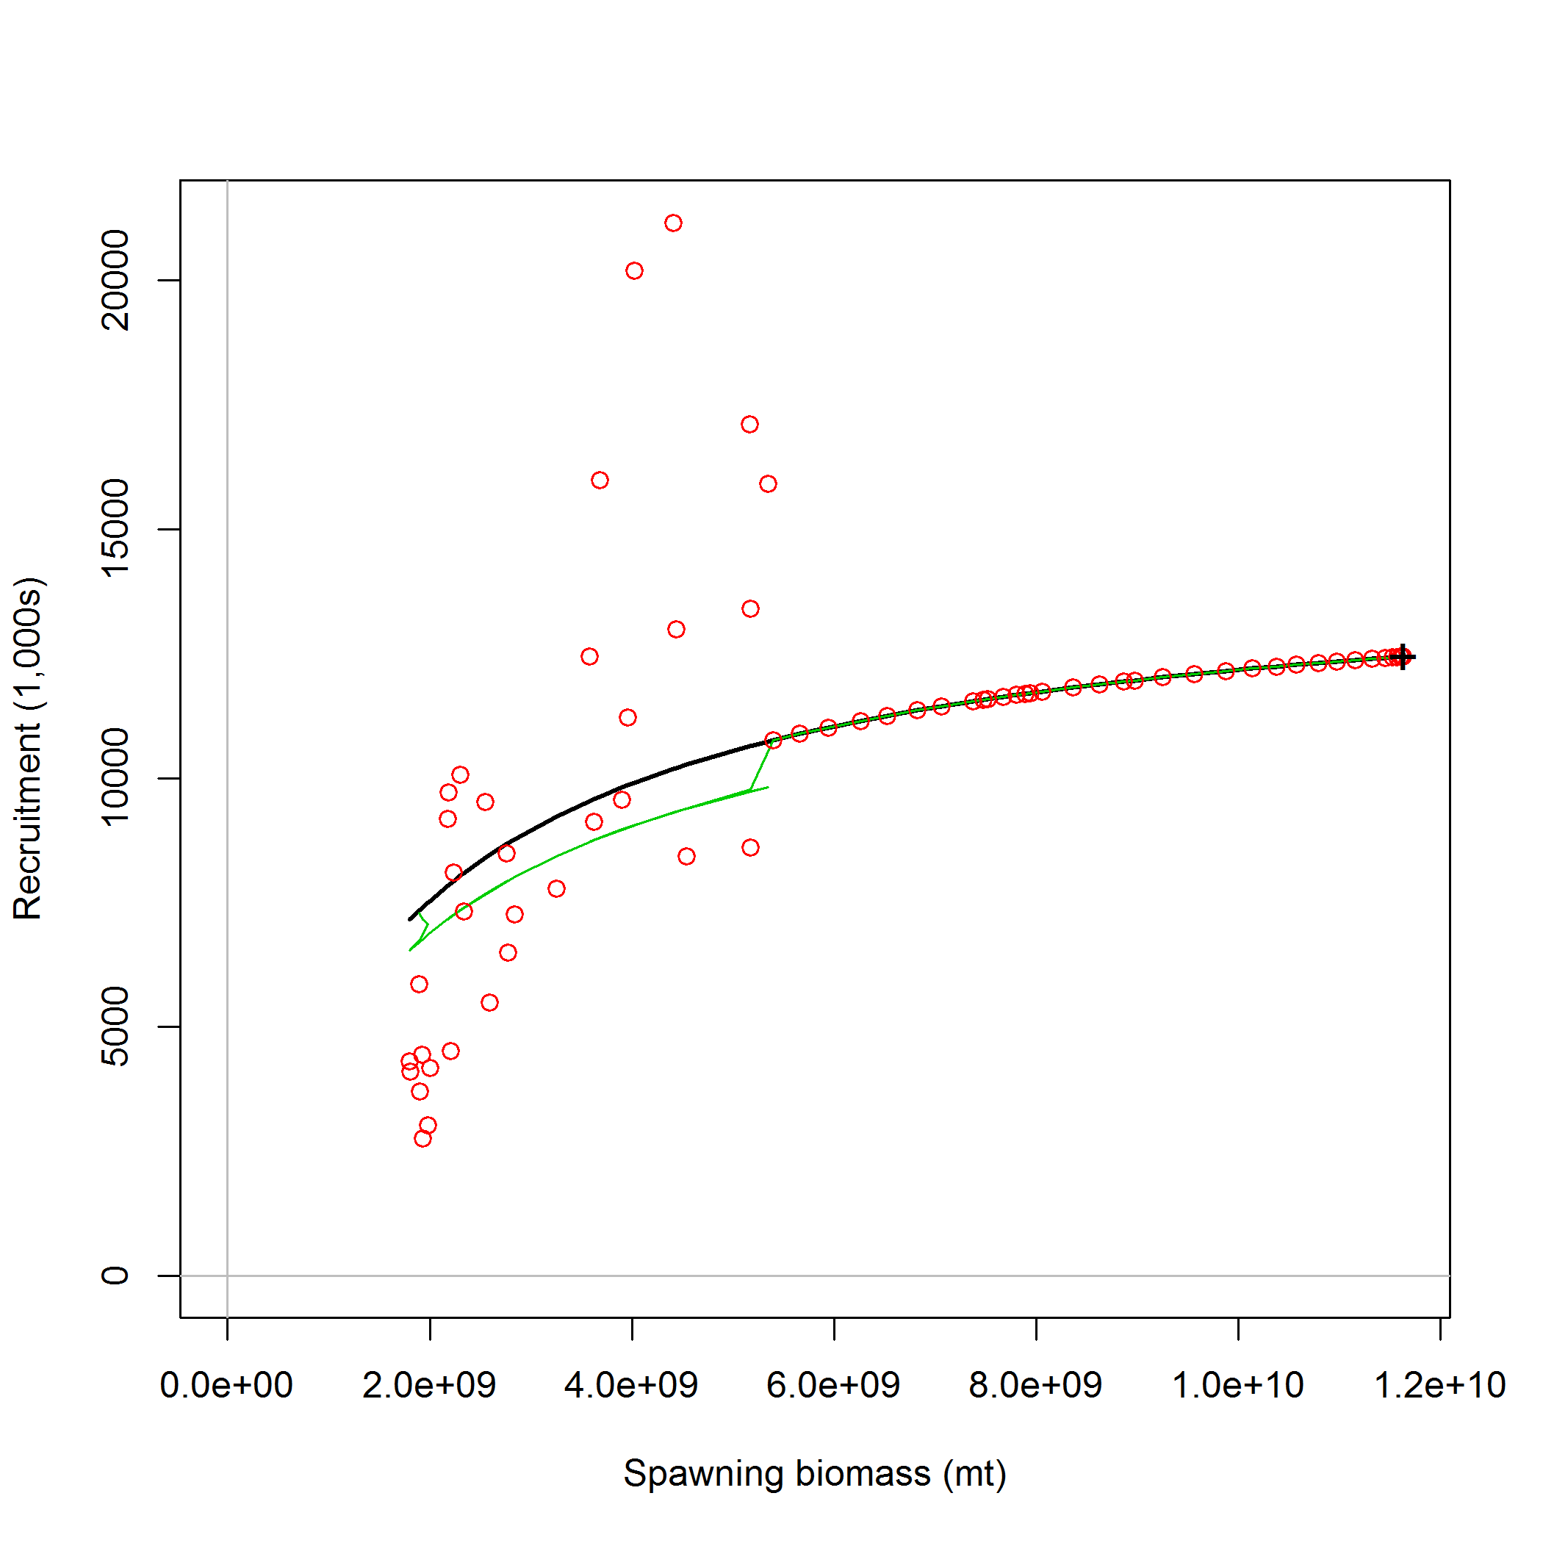
Iterative Reweighting

Slide 39
SSB/SSB0

Slide 40
SSBB/SSB0

Slide 41
SSB/SSB0

Slide 42
SSB/SSB0

Slide 43
Sample Size vs. Current SSB/SSB0

Slide 44
Results

Slide 45
Results

Slide 46
Results

Slide 47
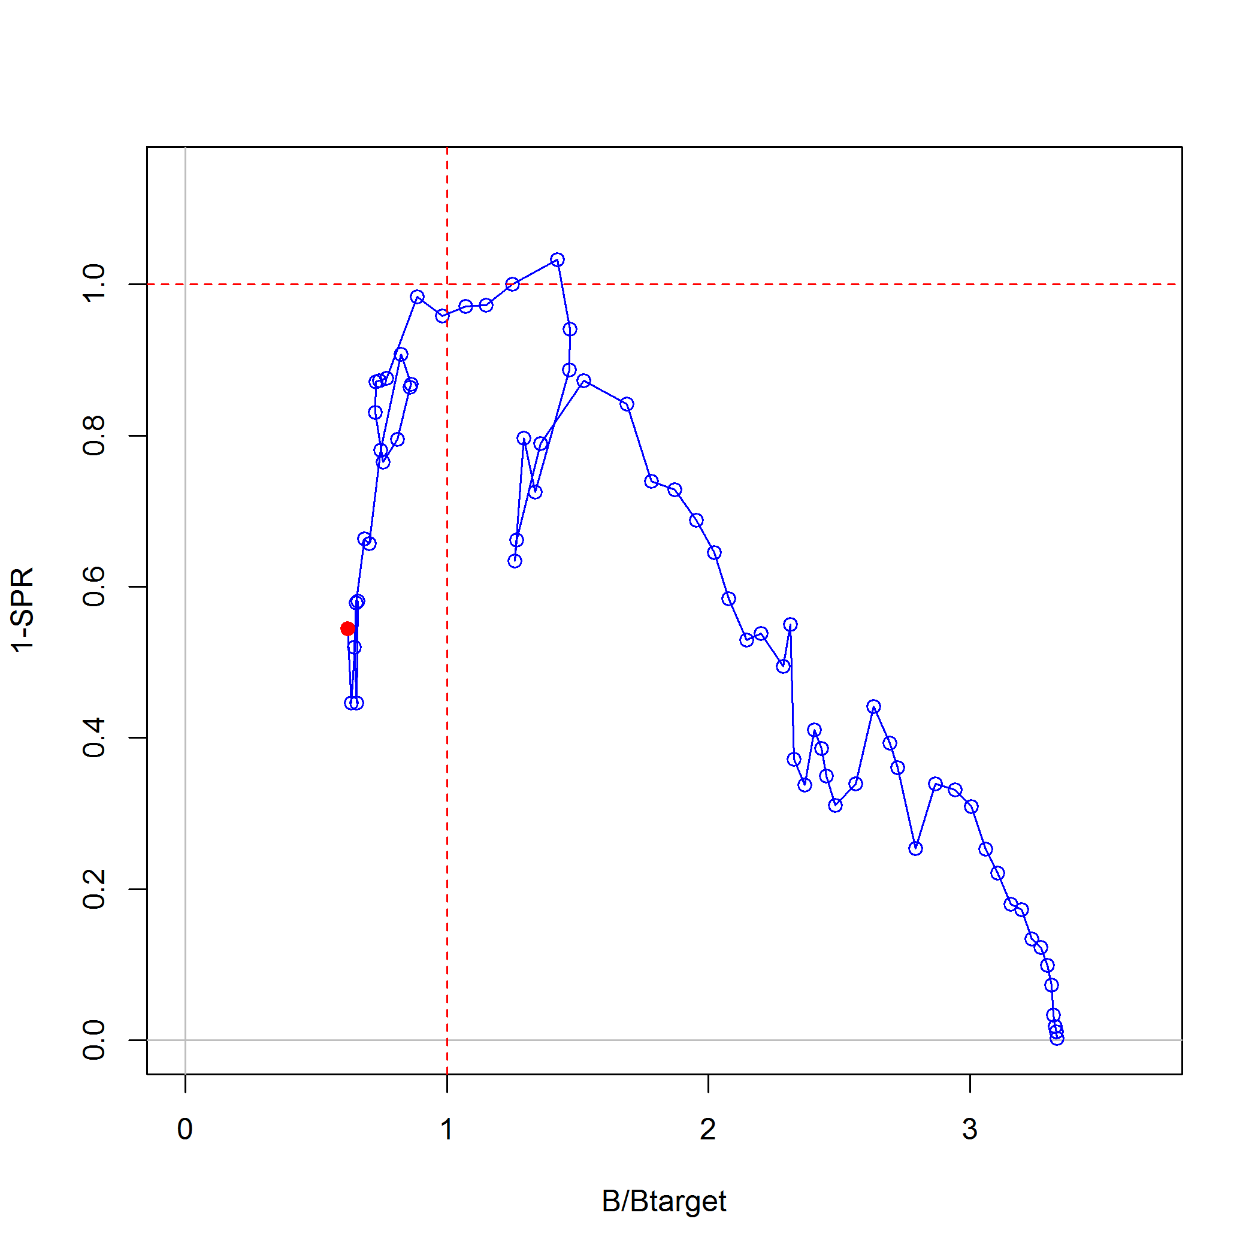
Catch Weighted

Slide 49
Catch Weighted

Slide 50
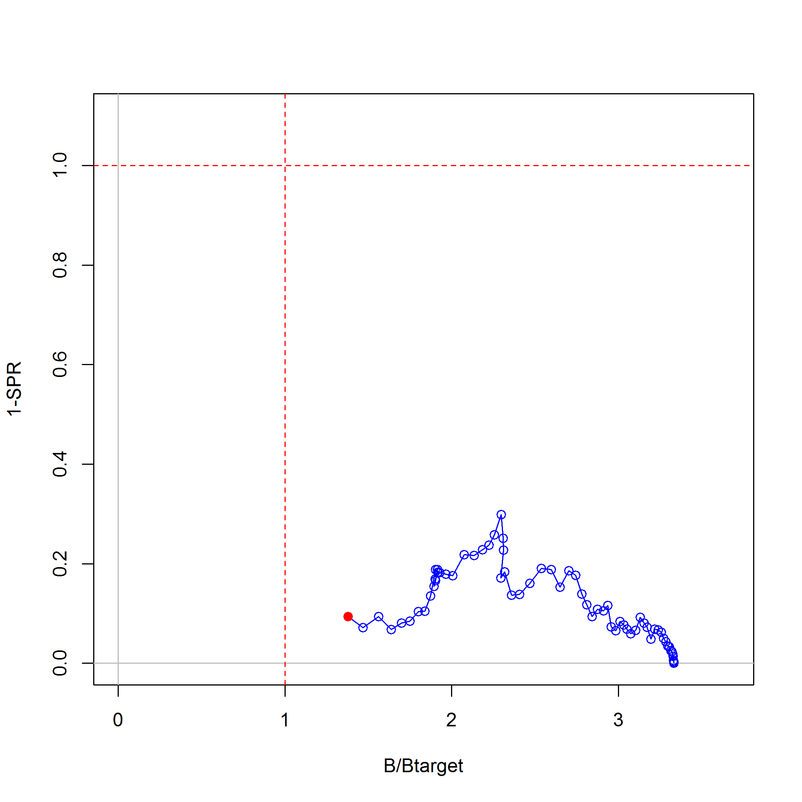
Length Samples

Slide 51
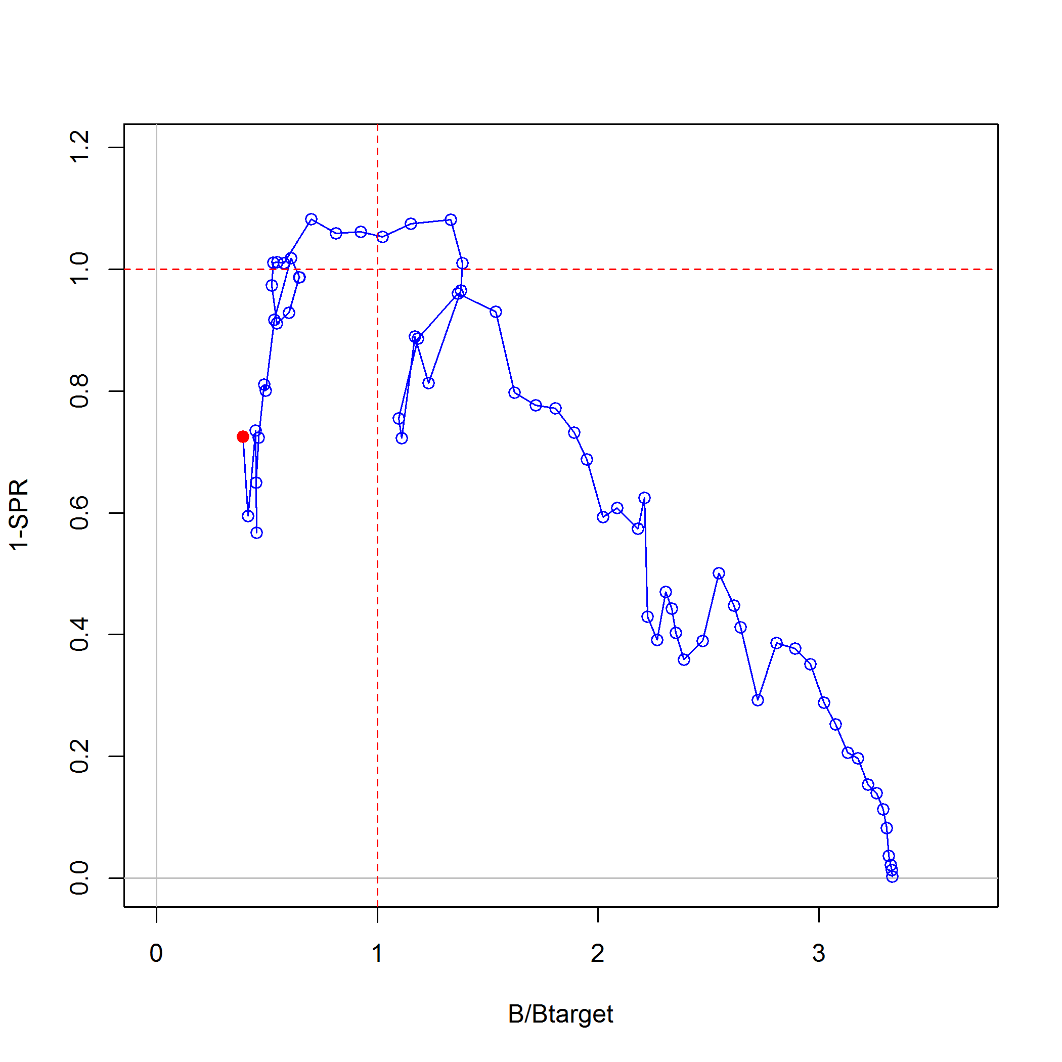
Length Numbers

Slide 52
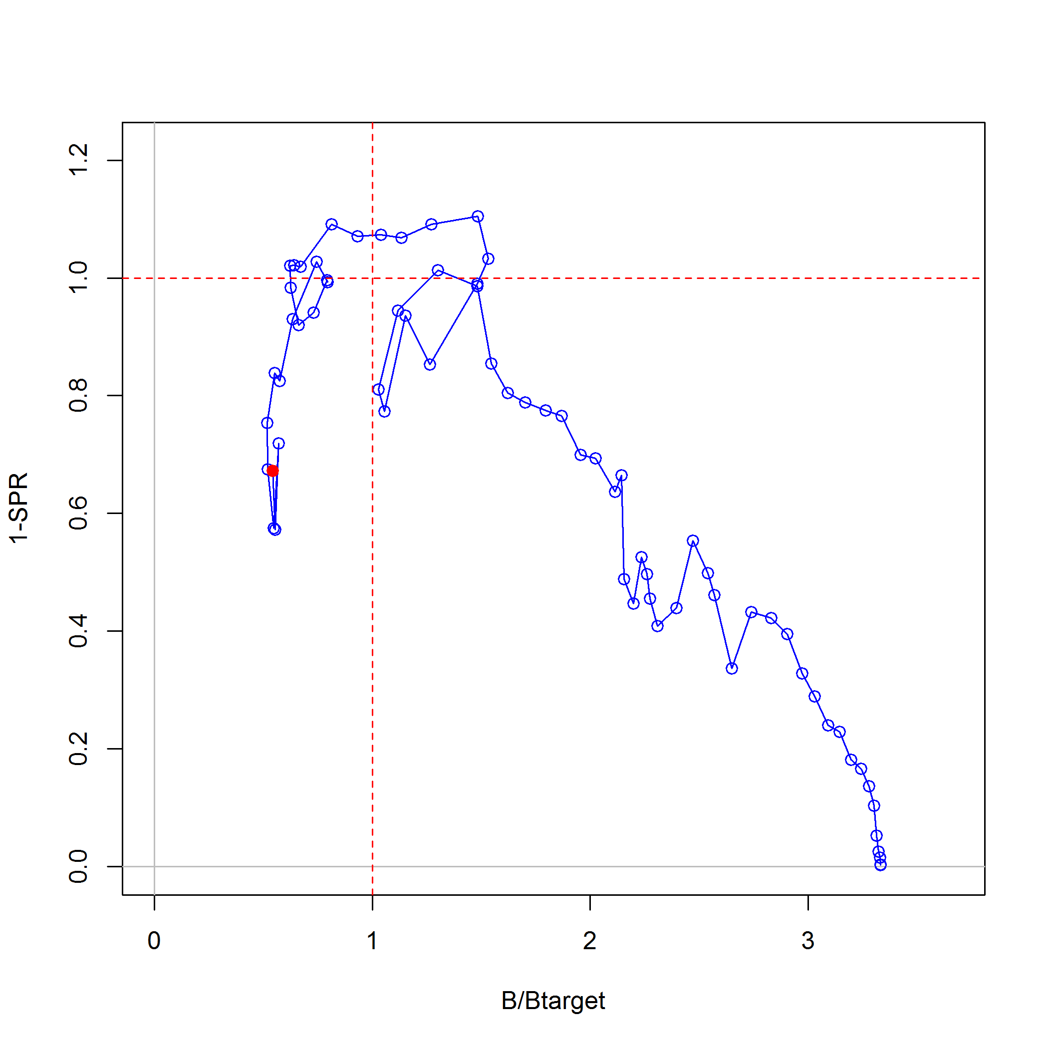
Iterative Reweighting

Slide 53
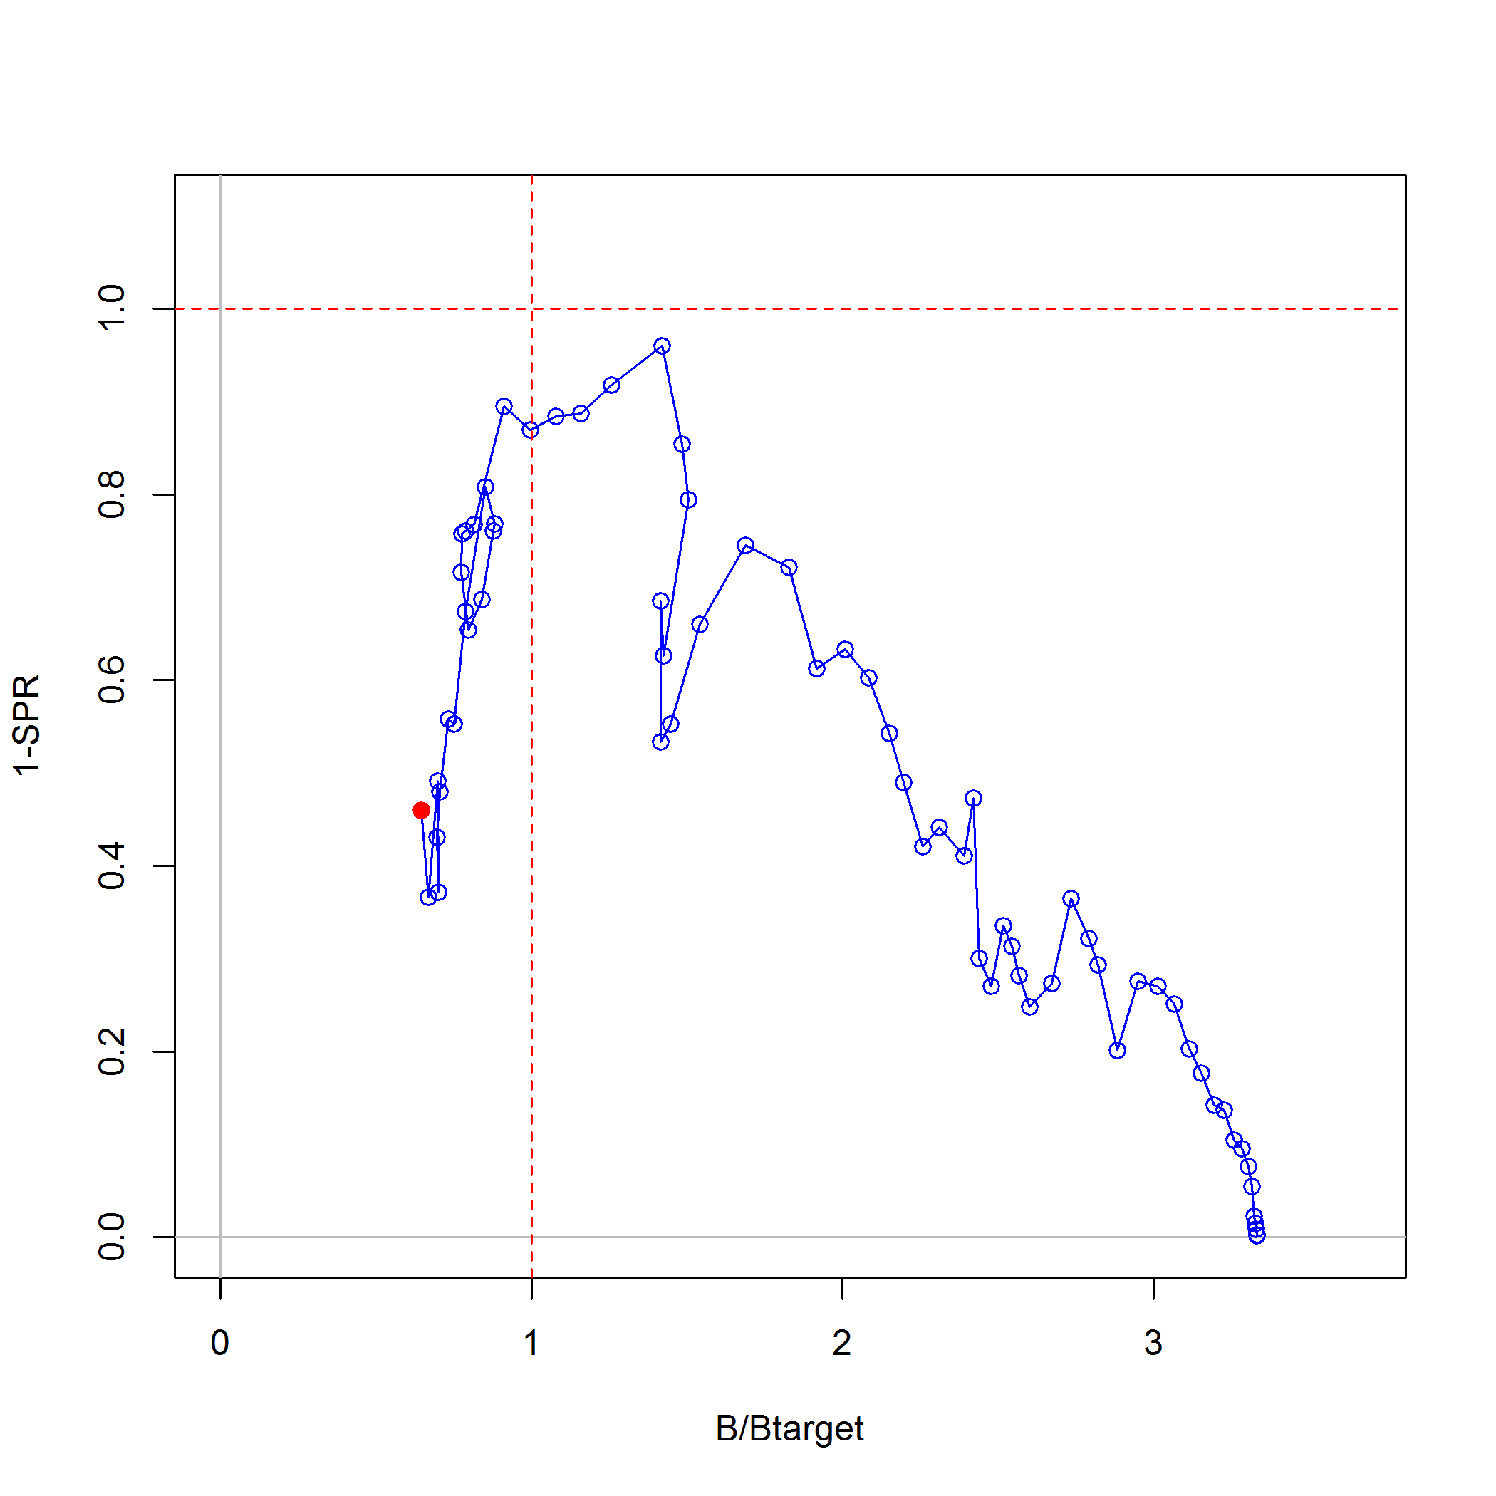
Capped @ 200

Slide 54
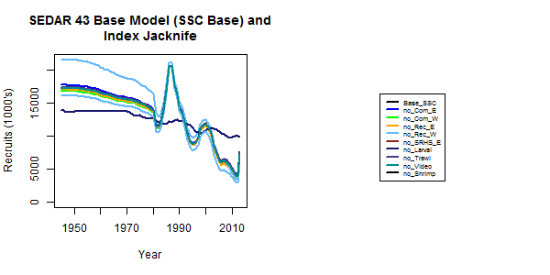

Results

Slide 55
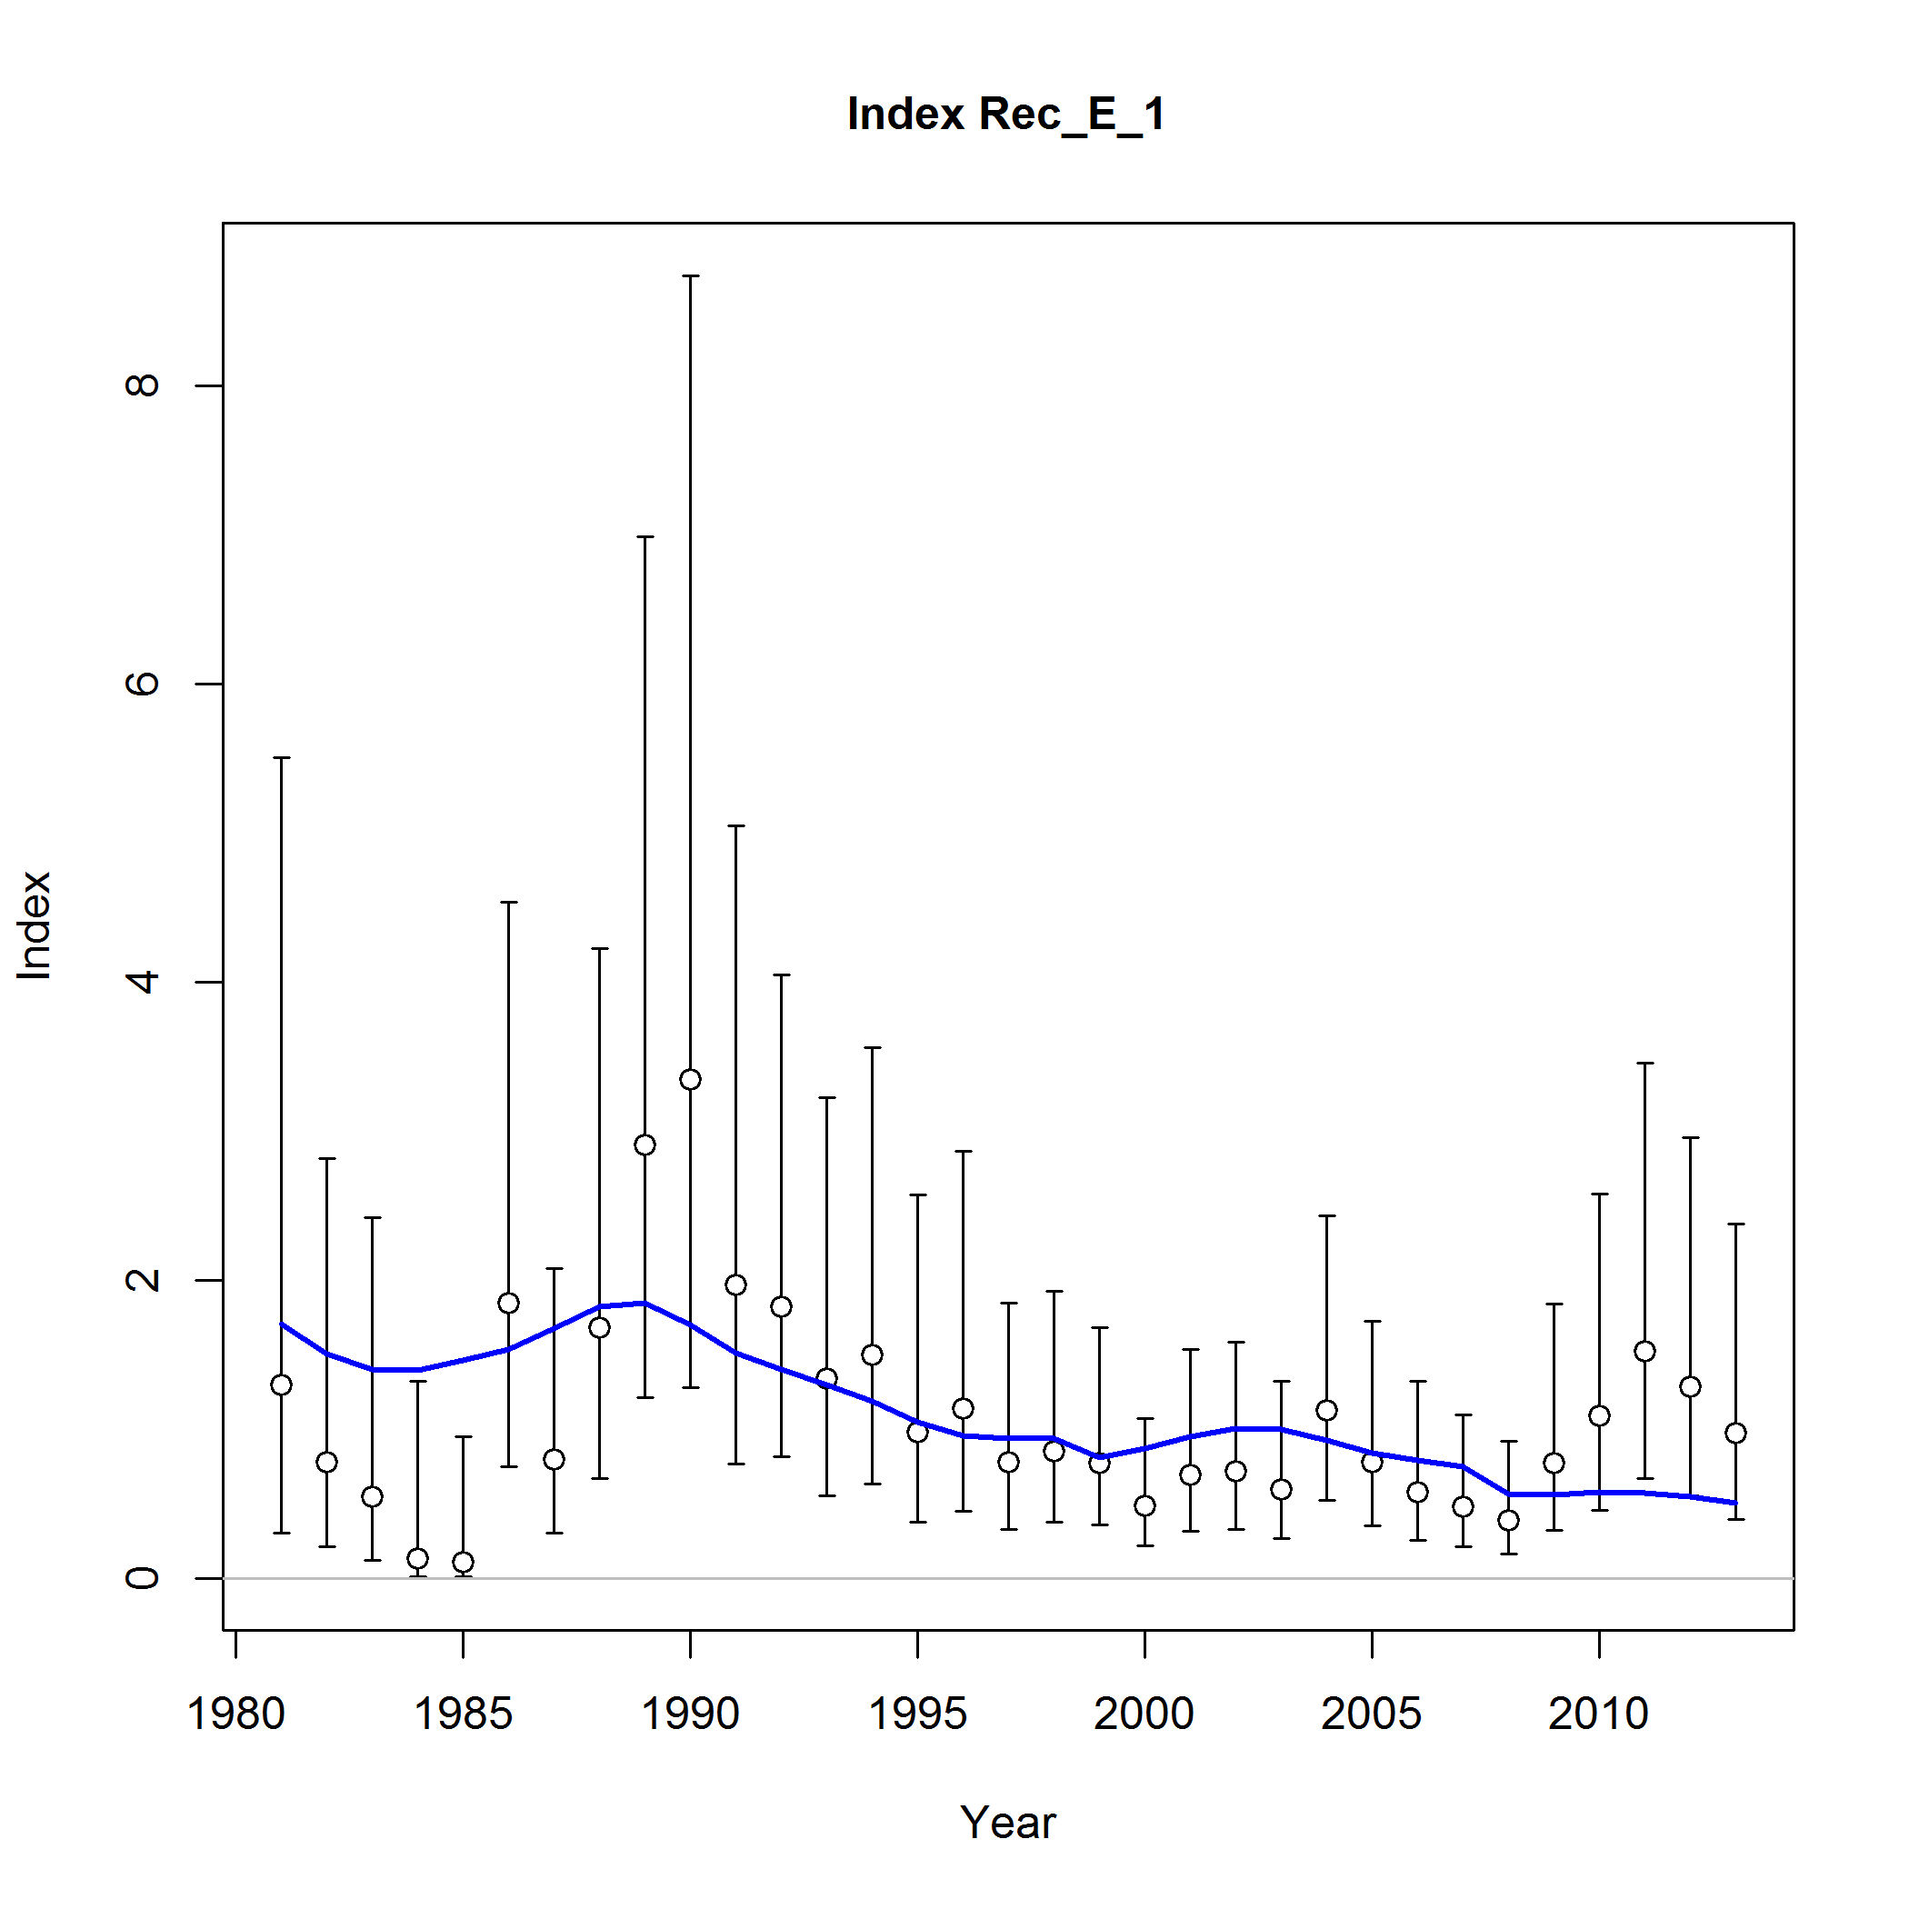
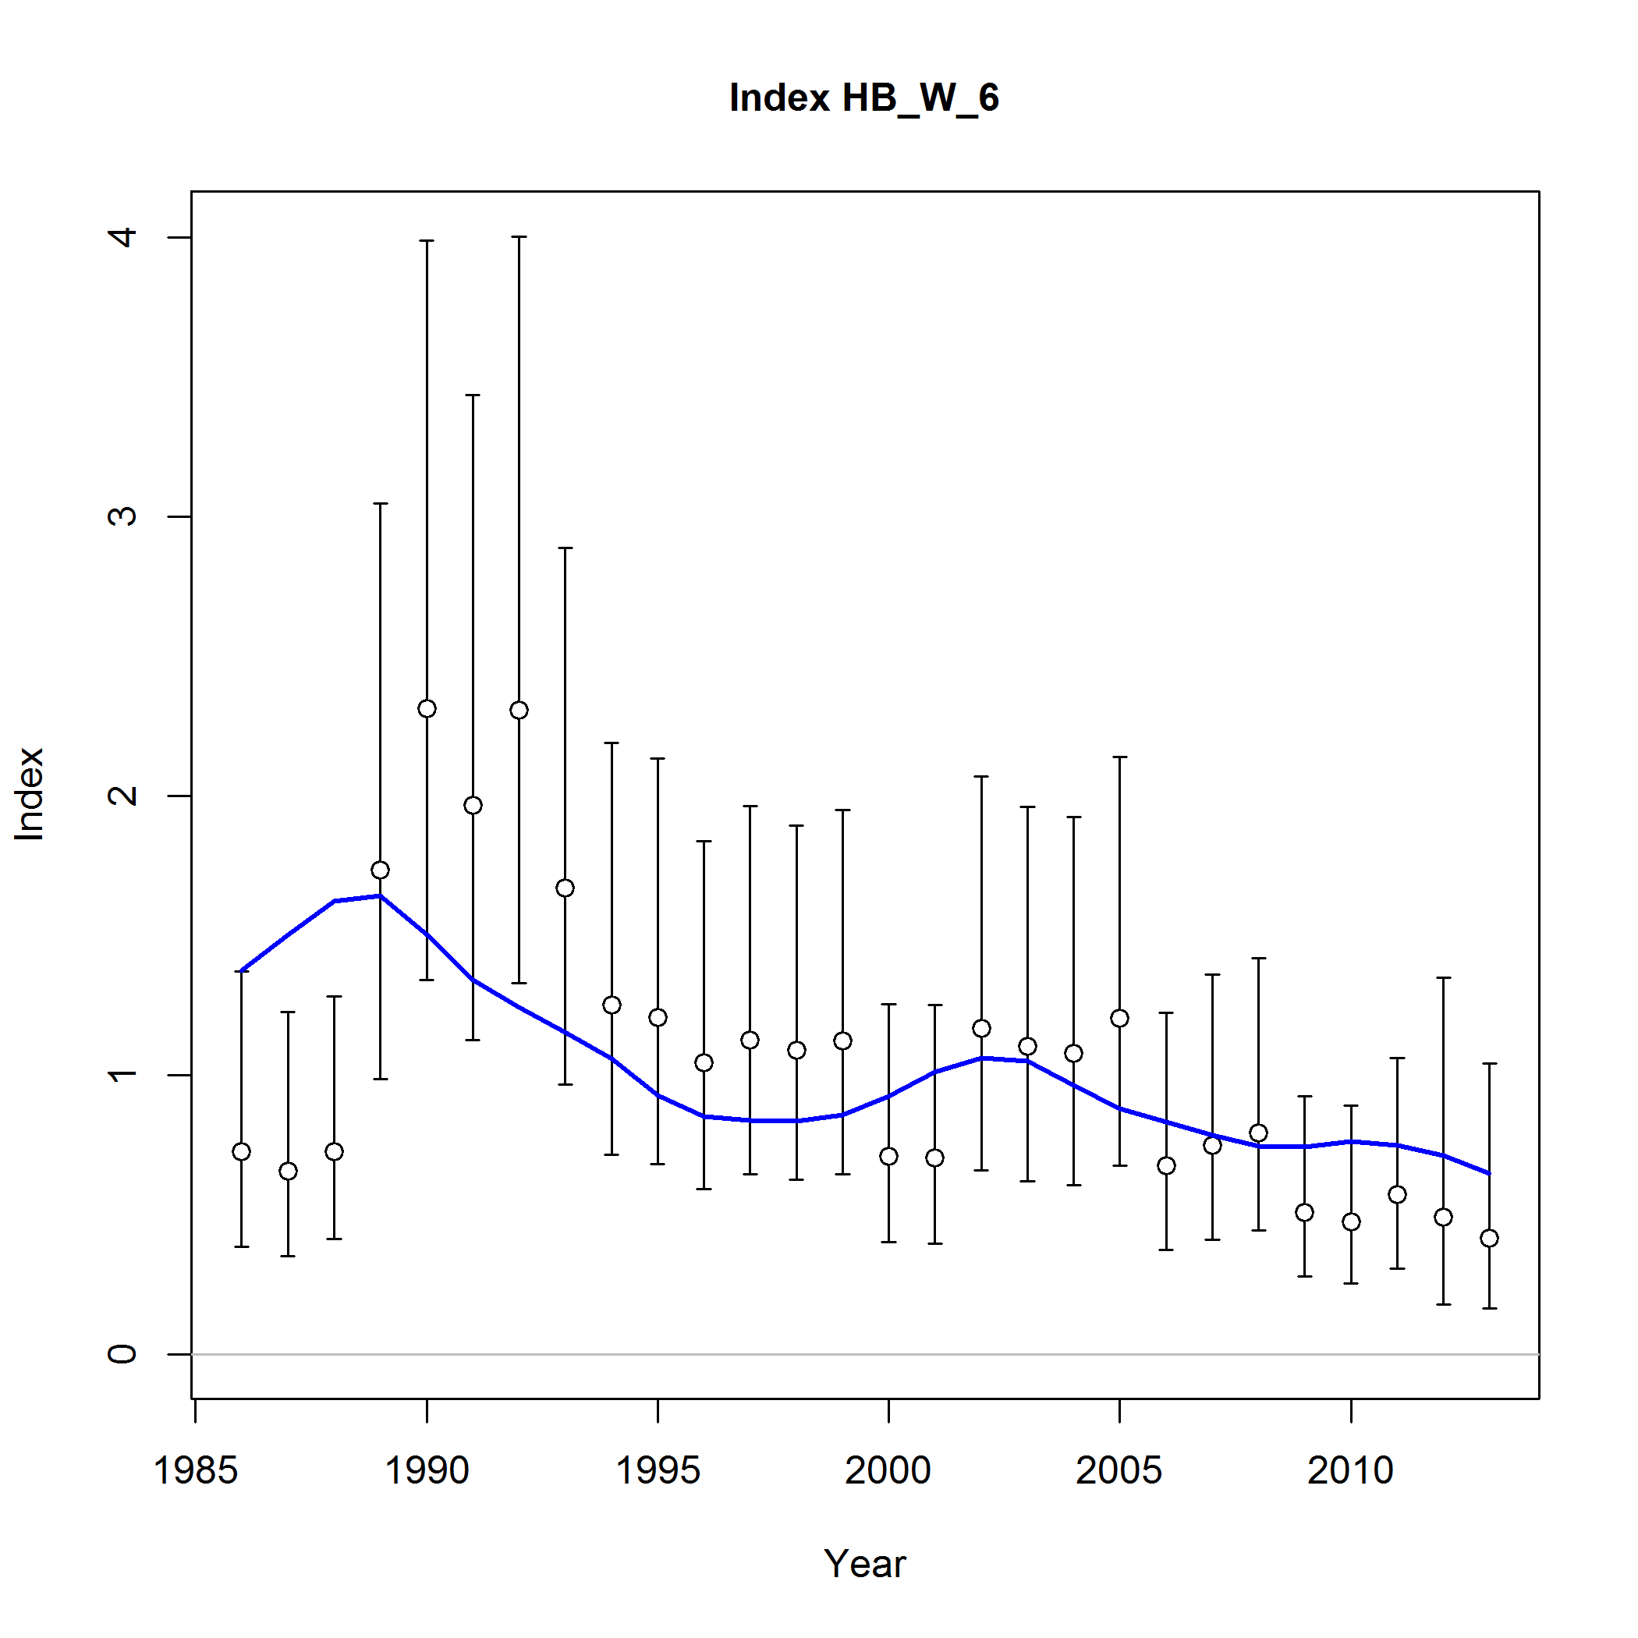
Fits to Rec-E Indices
Rec East
Headboat East

Slide 56
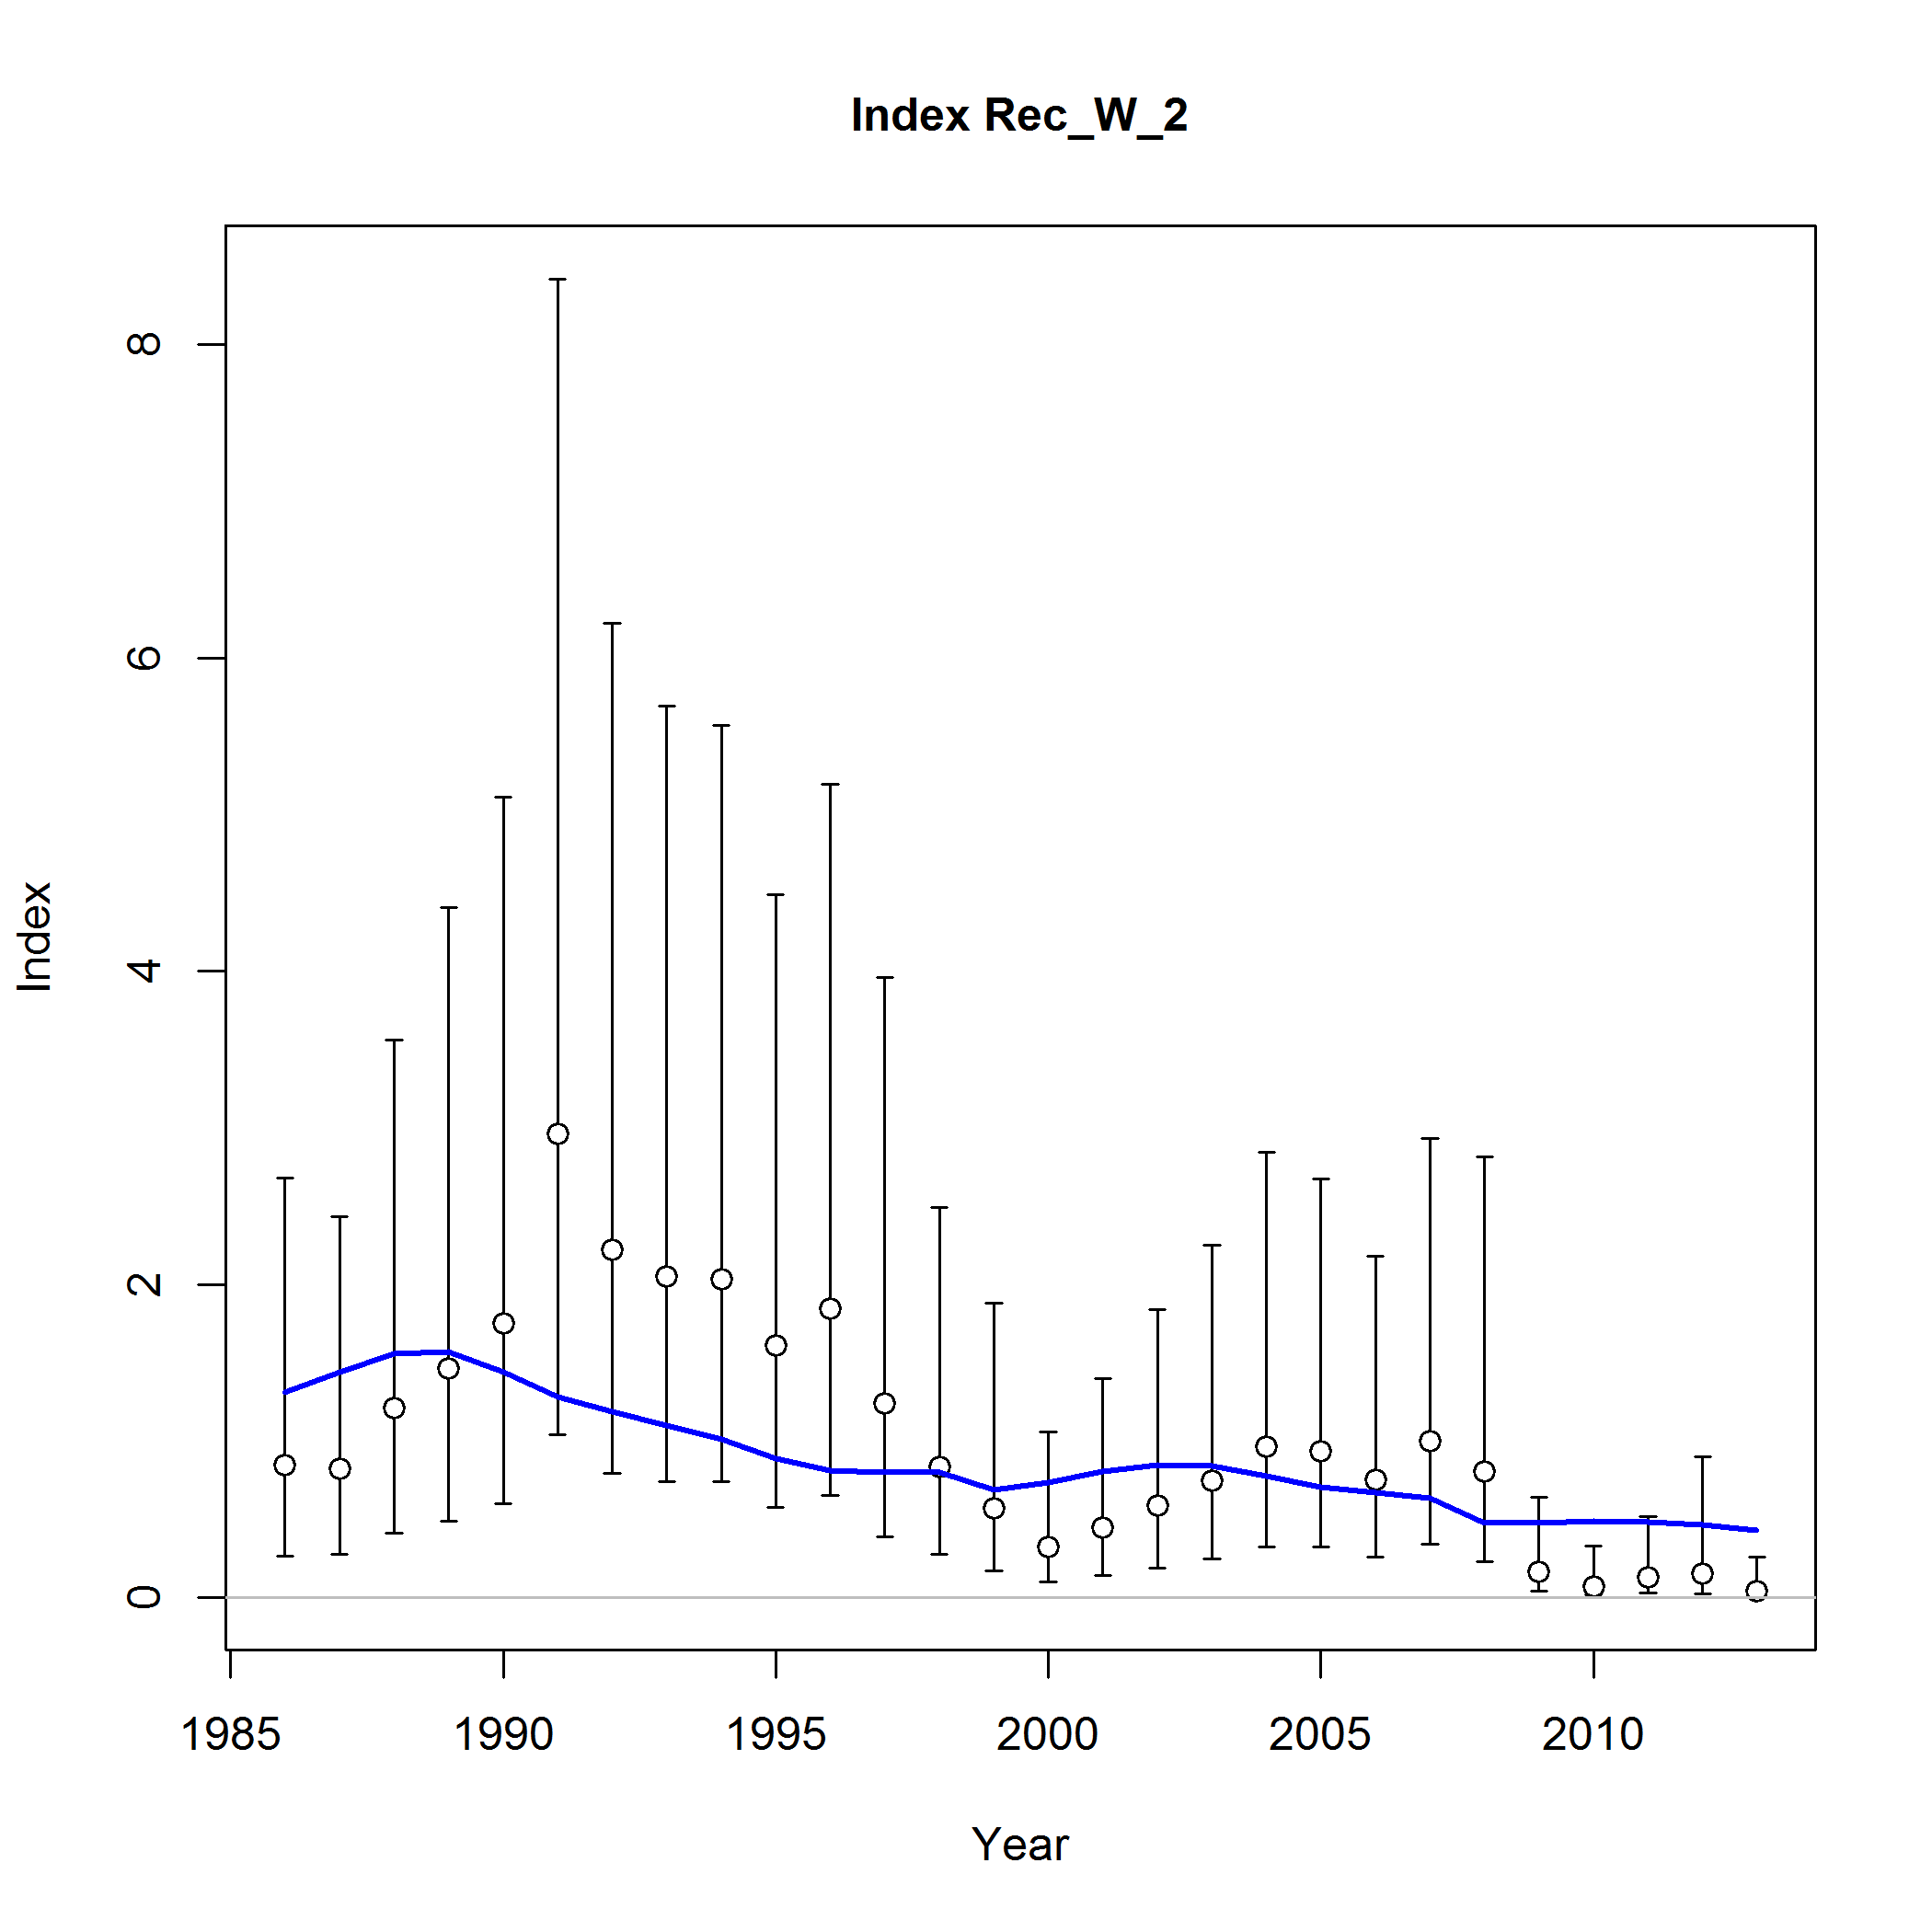
Fits to Rec-W Indices
Headboat West
Notes:
No Rec west. It was rejected in SEDAR 9 as too volatile.

Slide 57
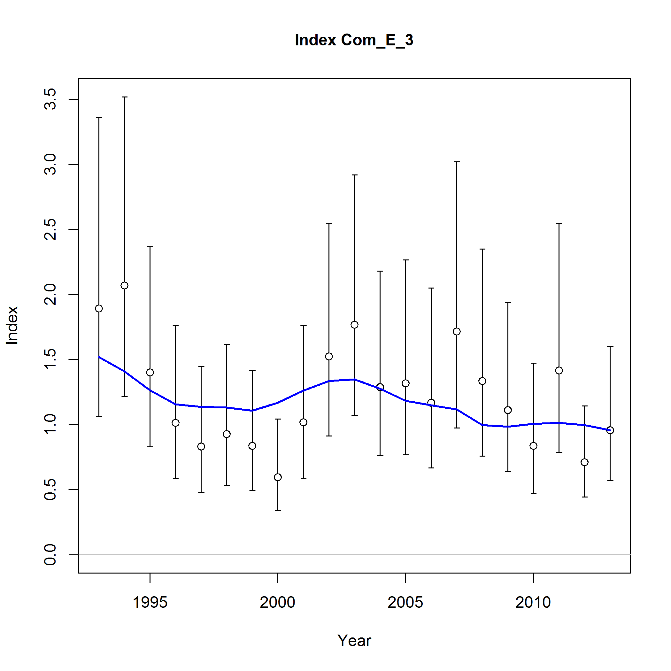
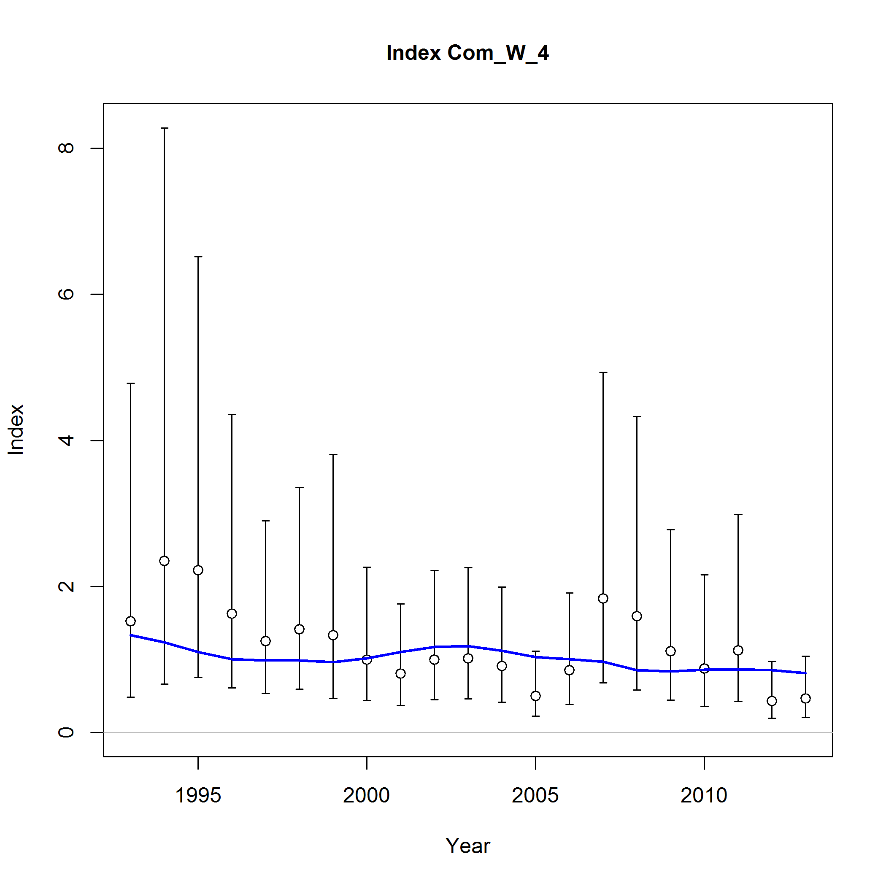
Fits to COM Indices

Slide 58
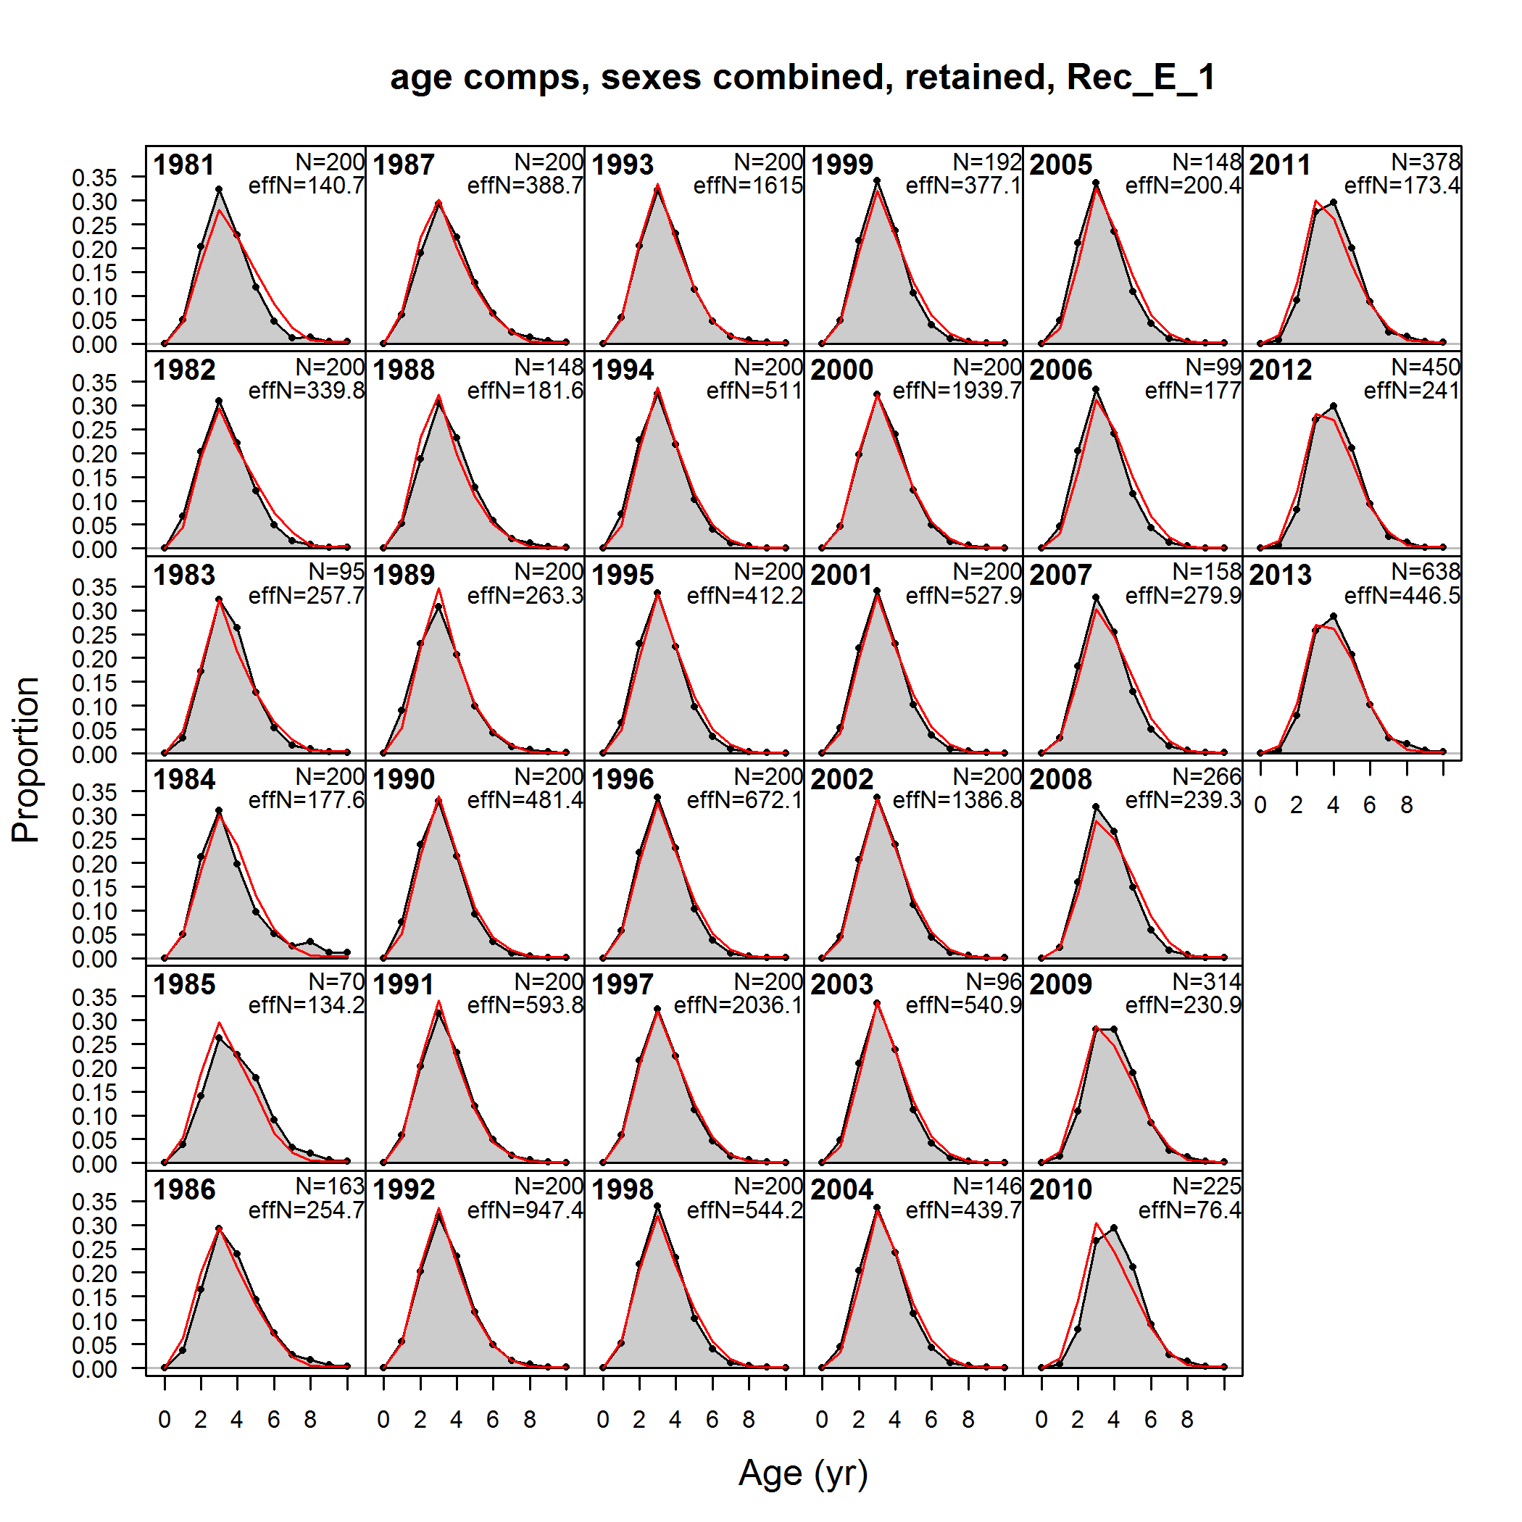
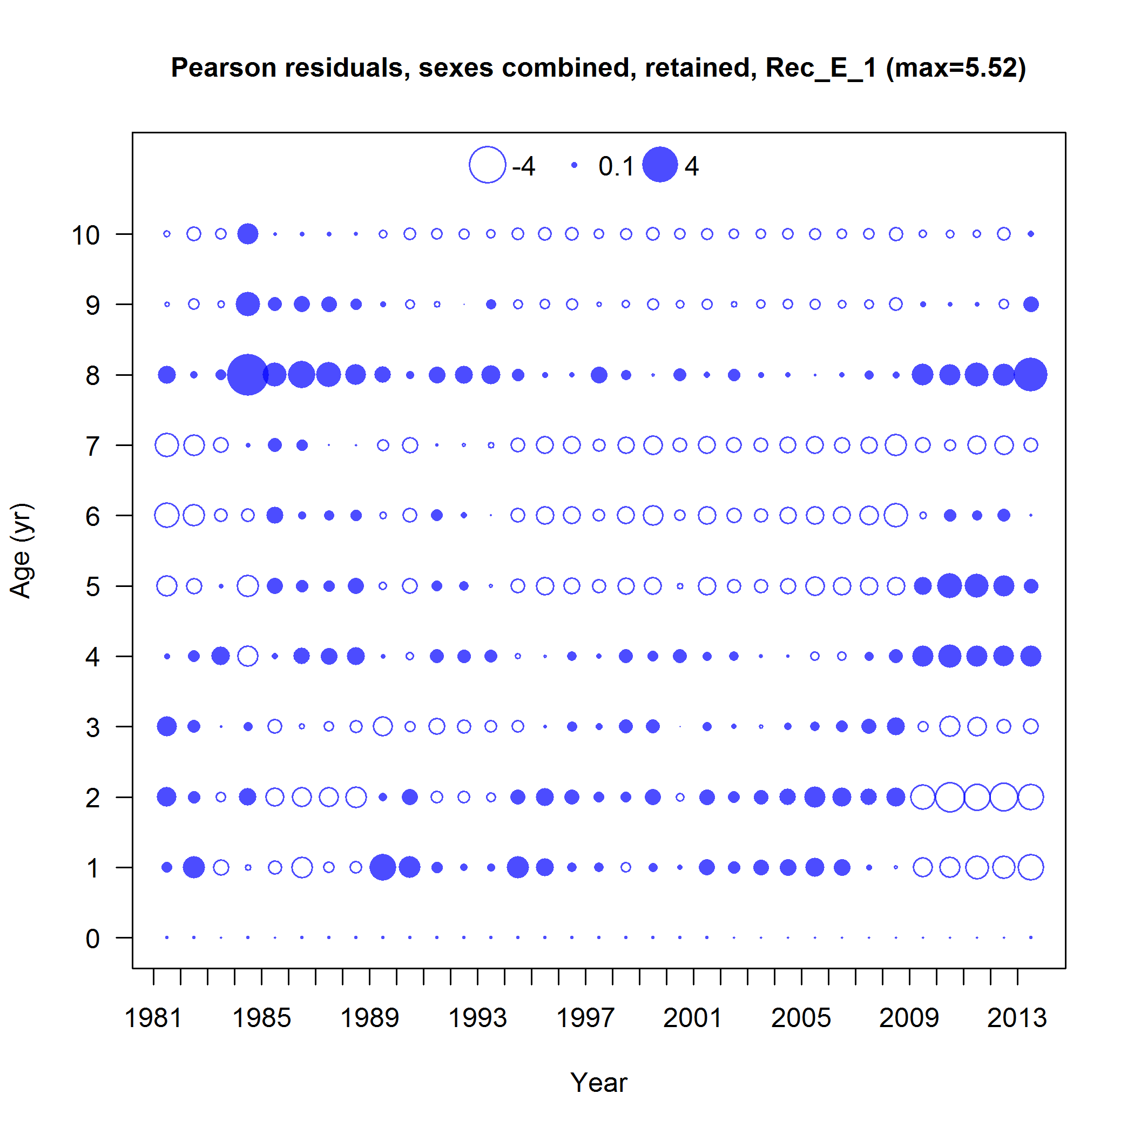
Fits to Age Comp: Rec East

Slide 59
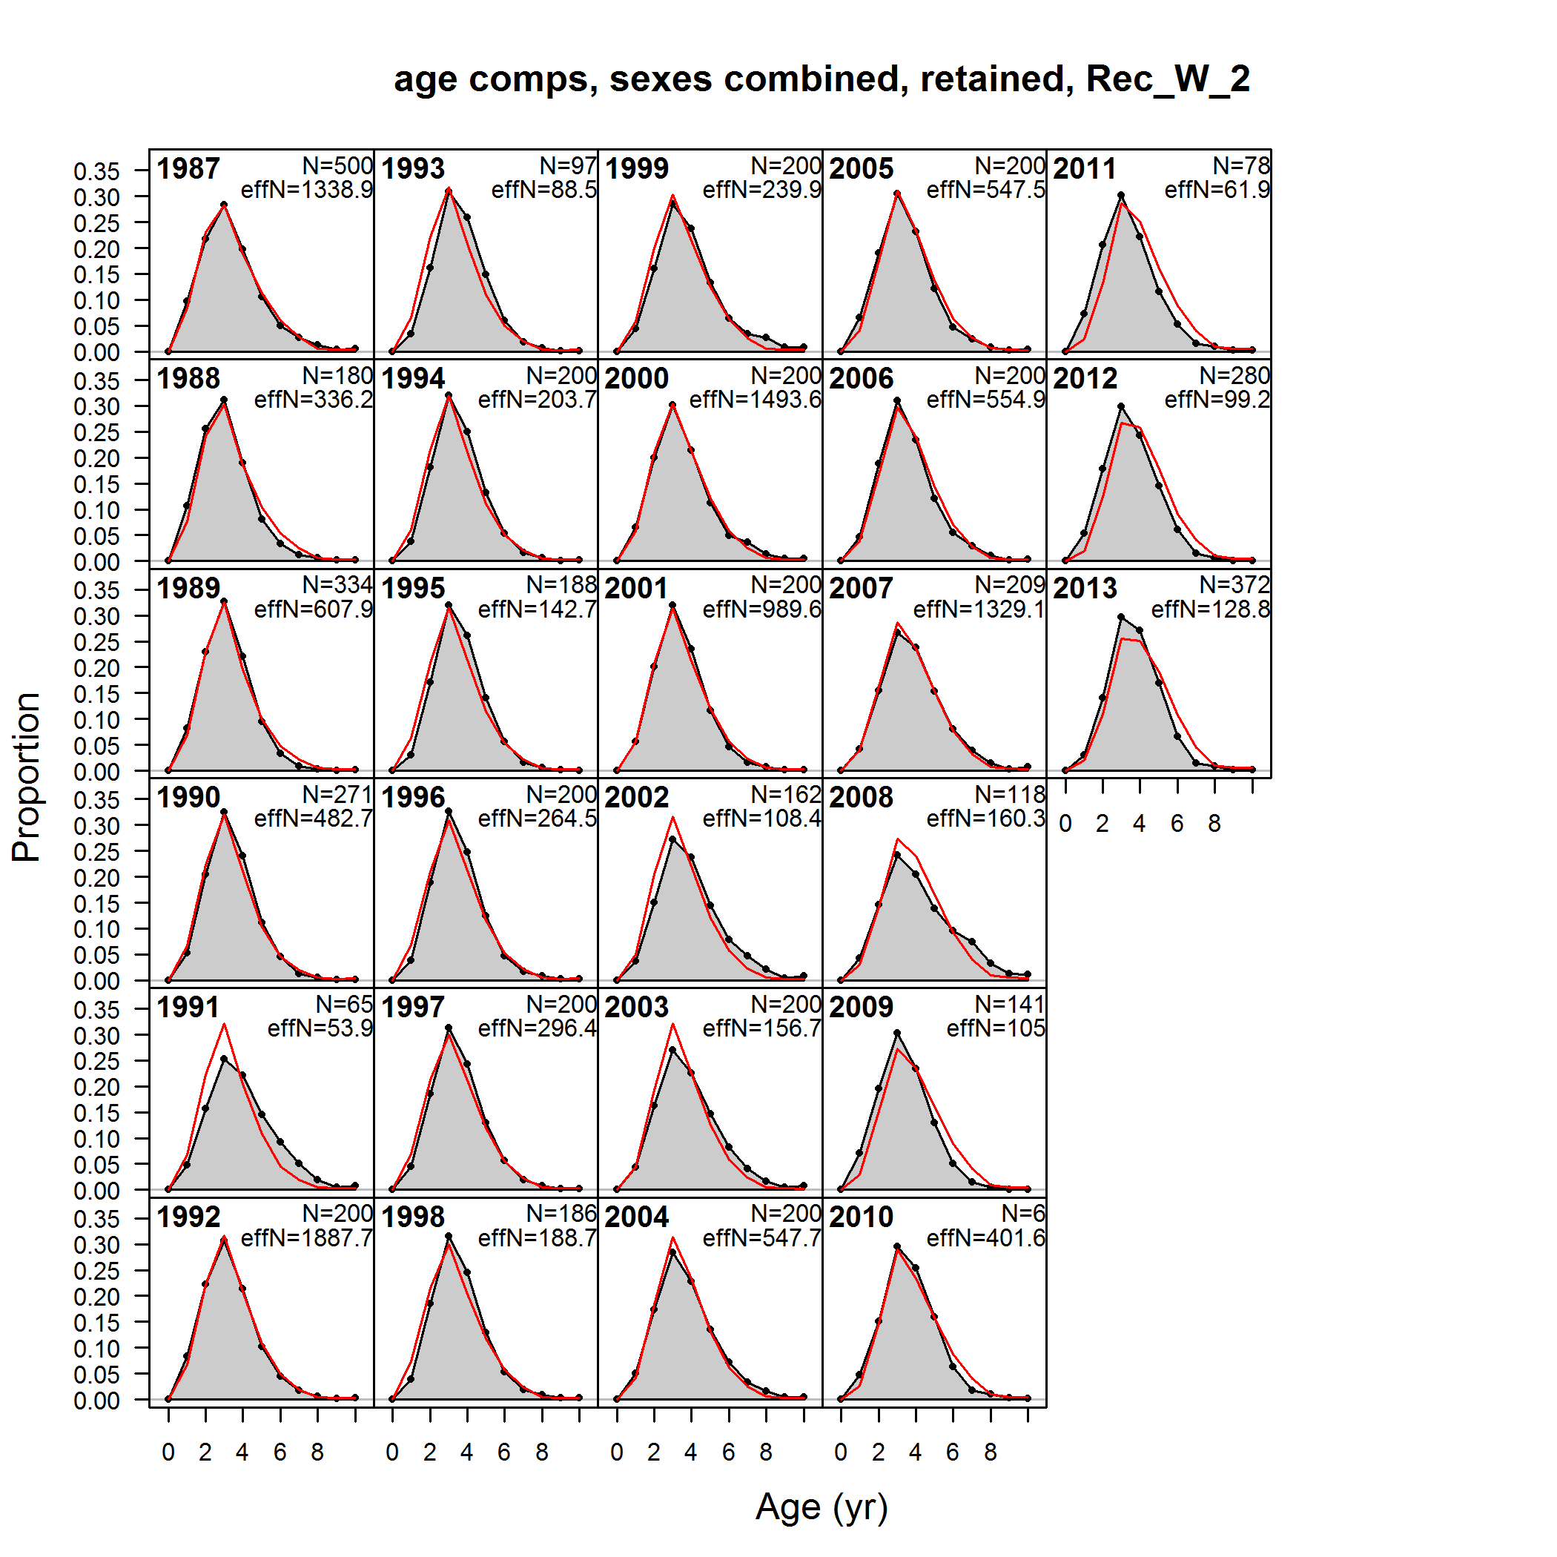
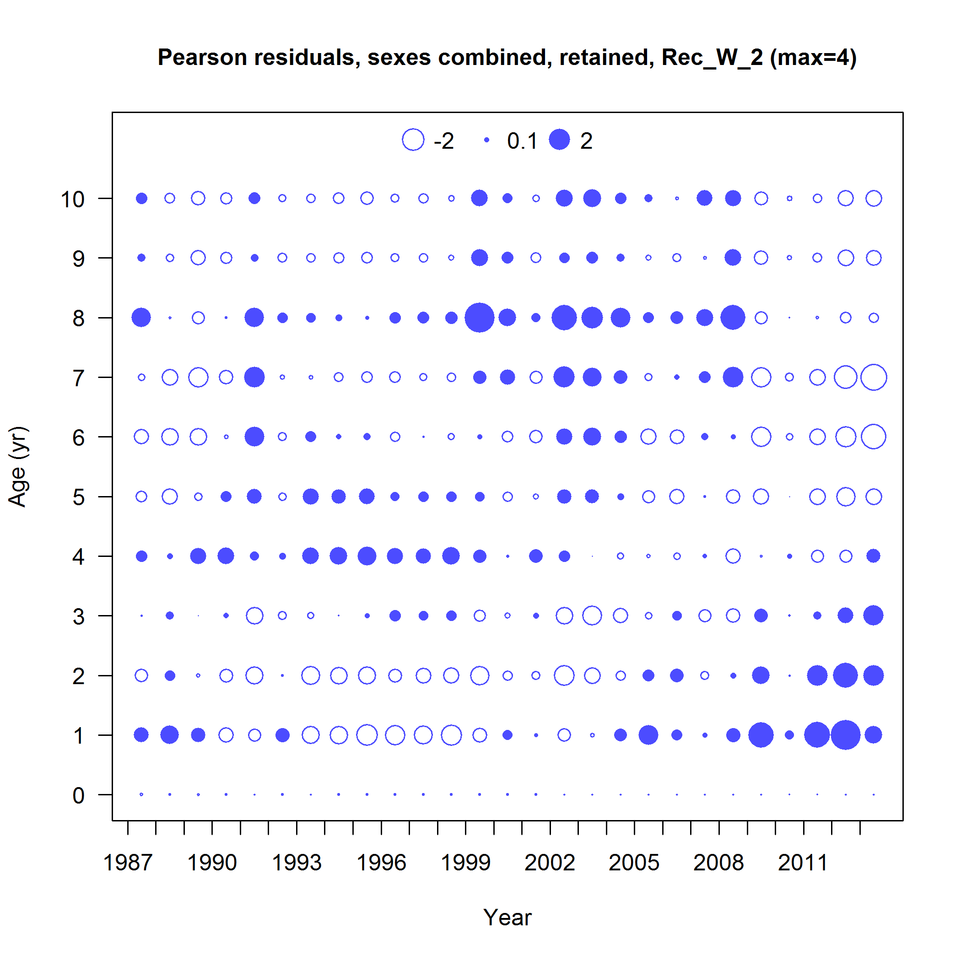
Fits to Age Comp Rec West

Slide 60
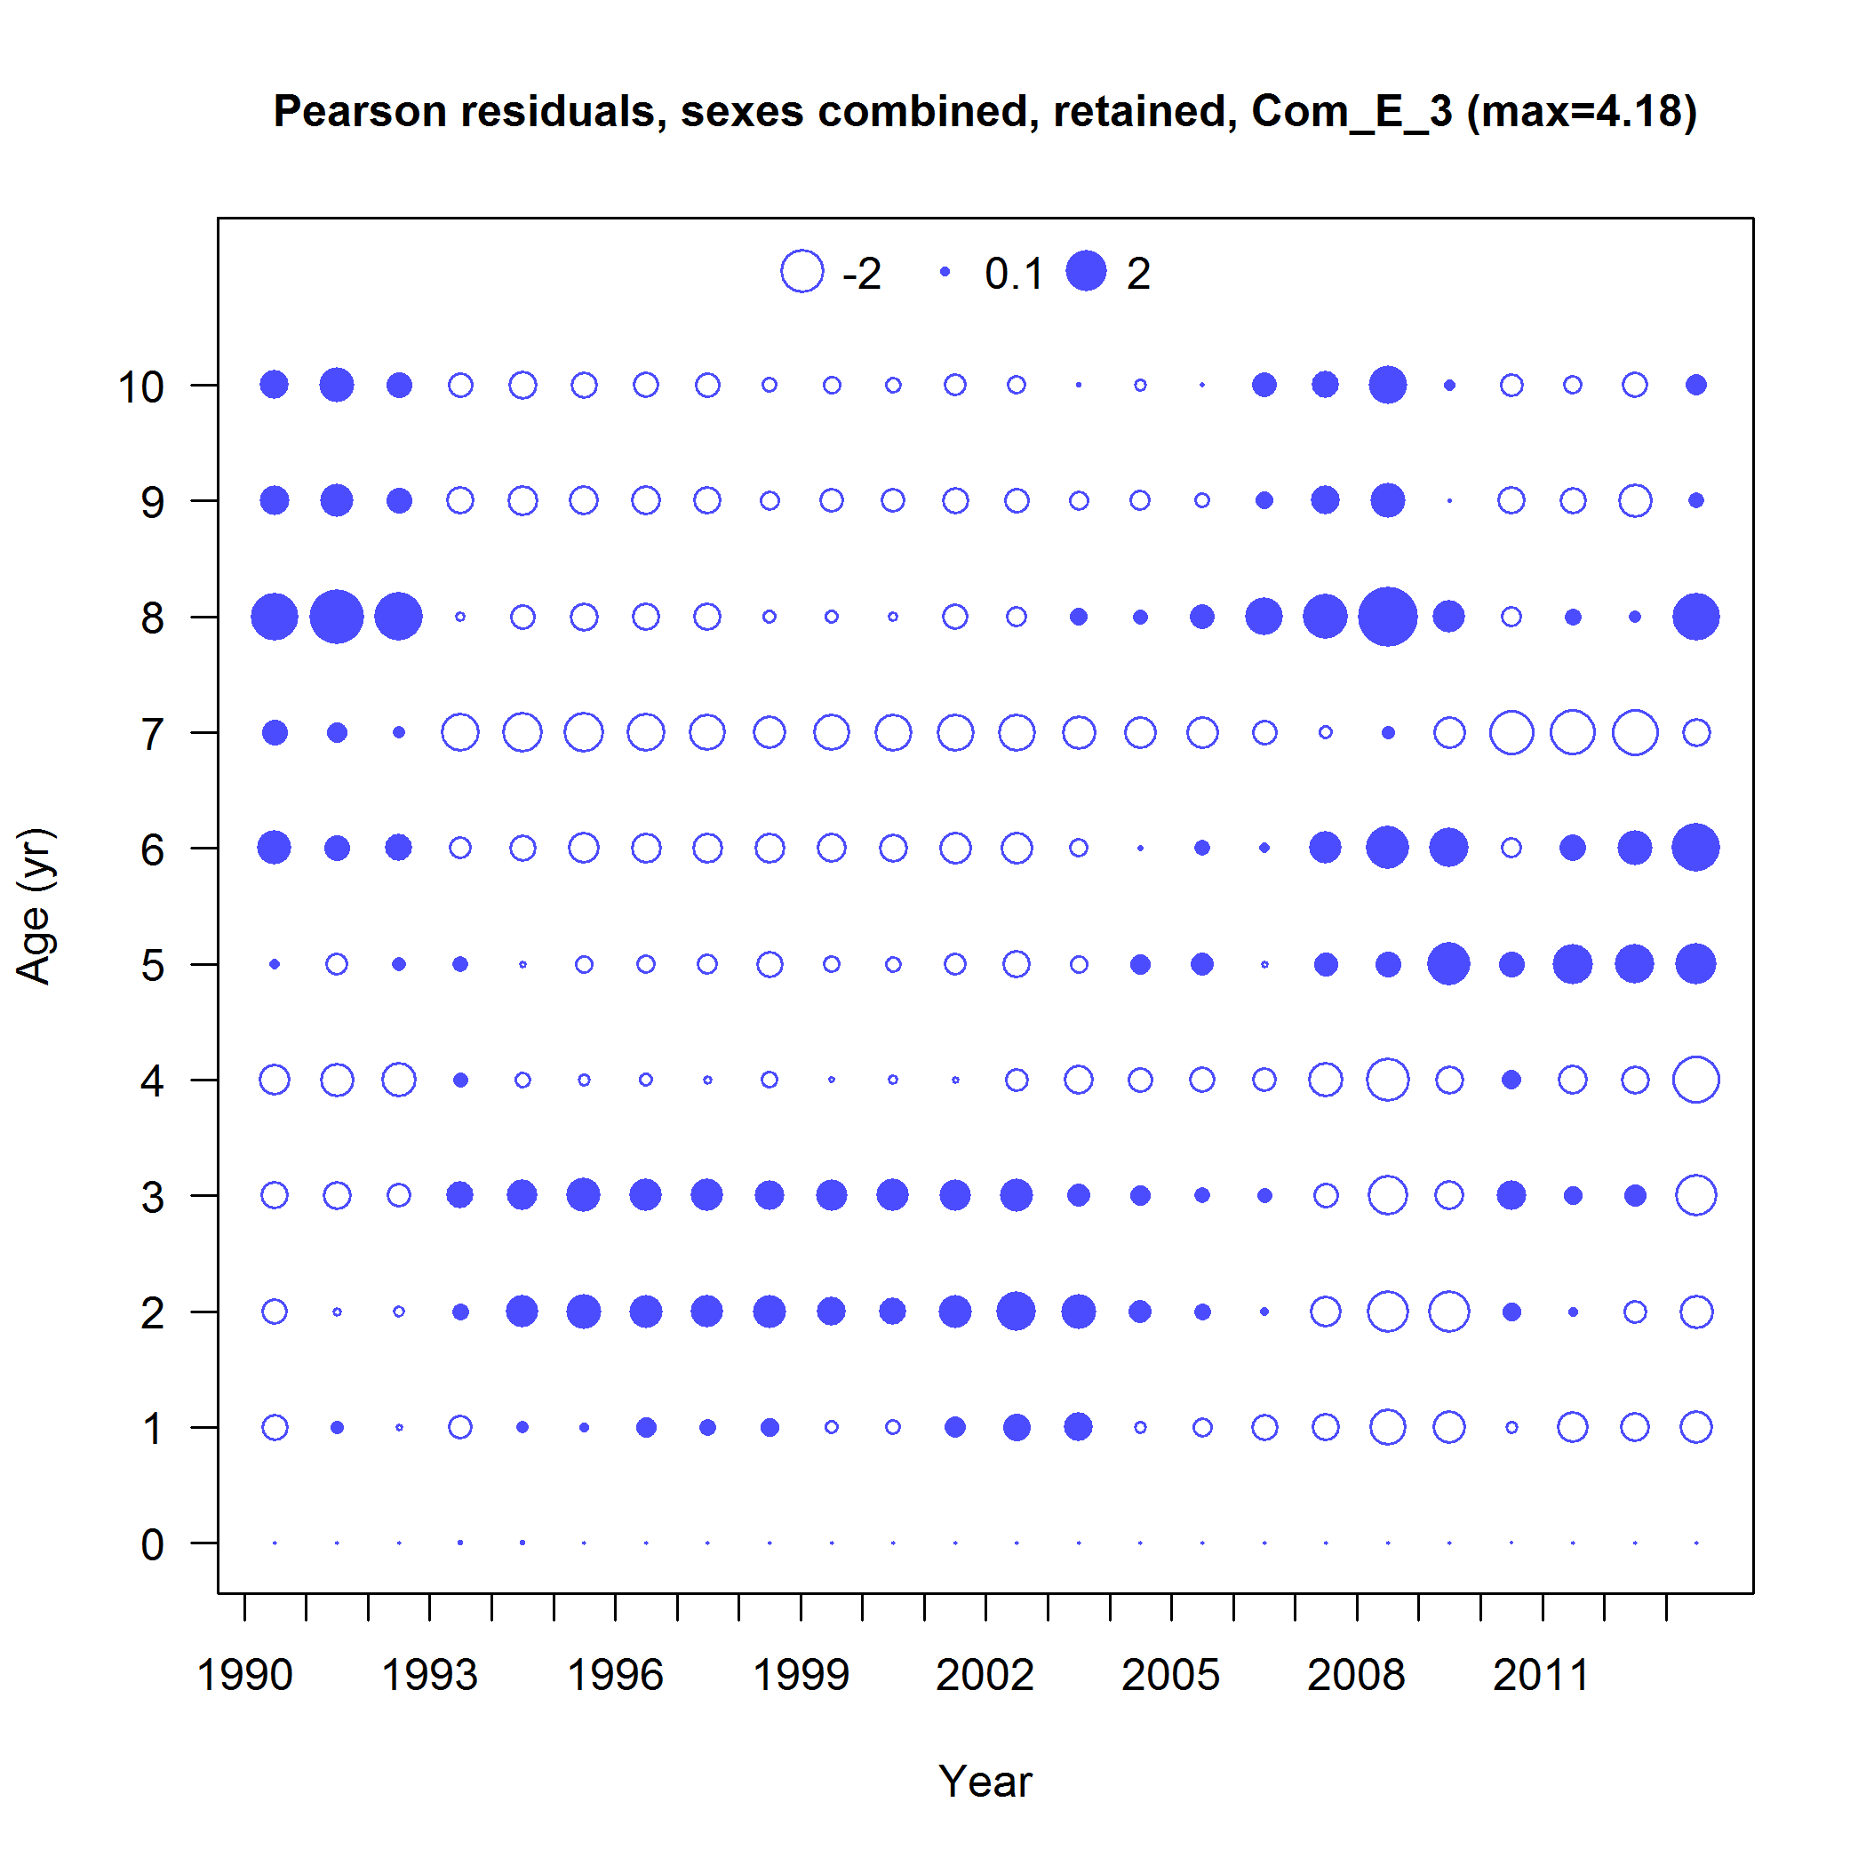
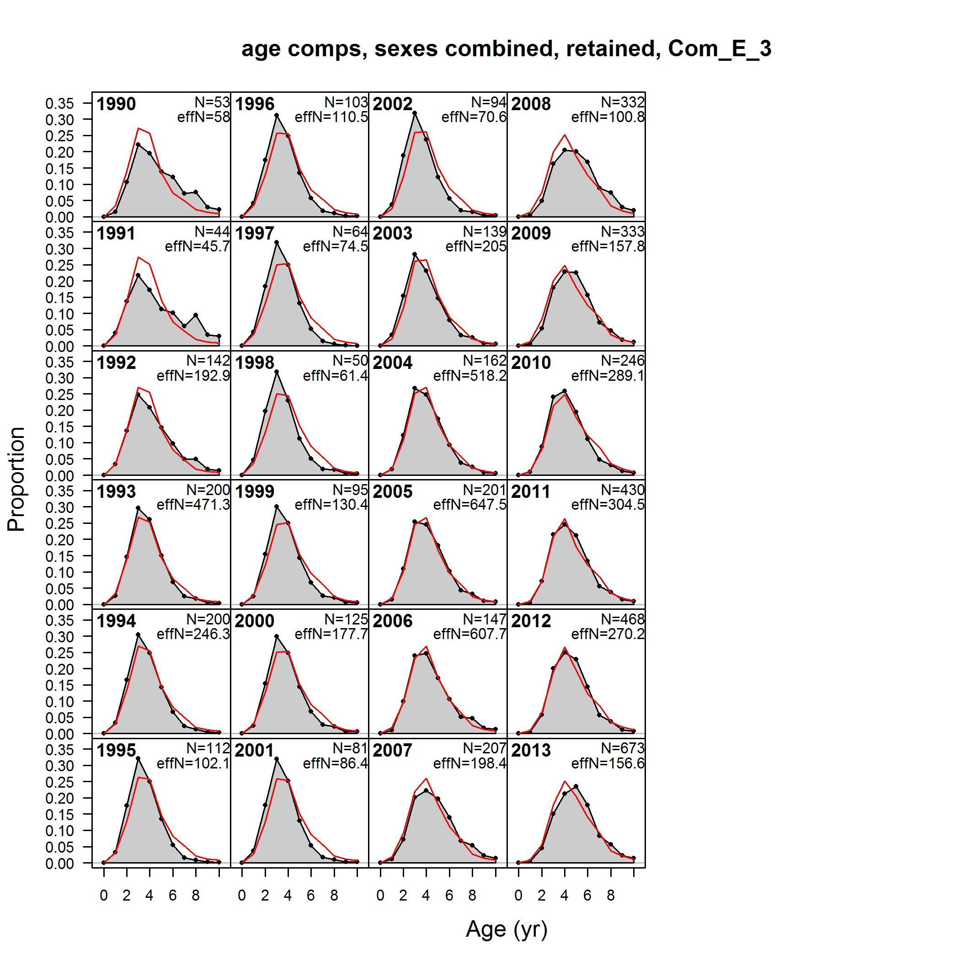
Fits to Age Comp: Com-East

Slide 61
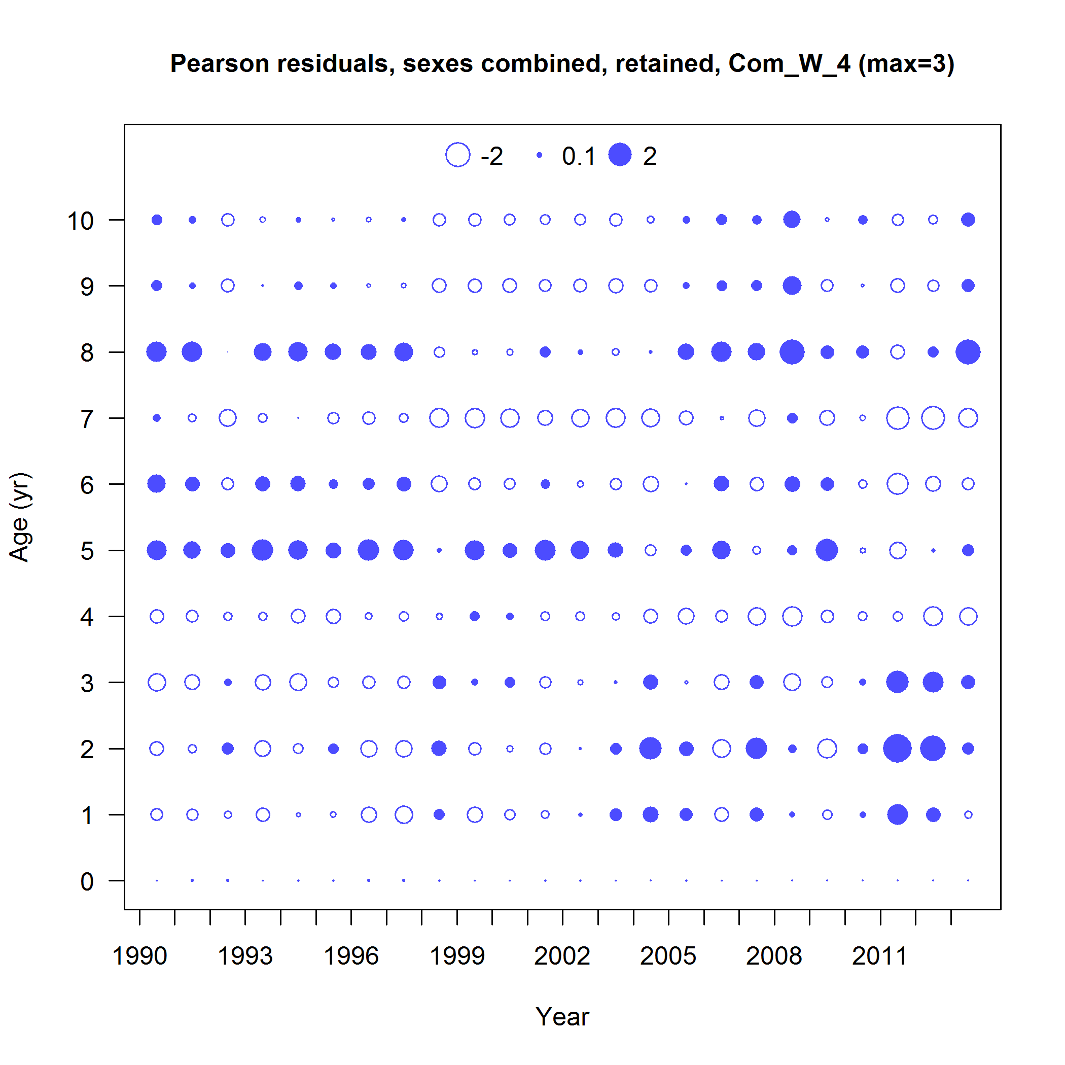
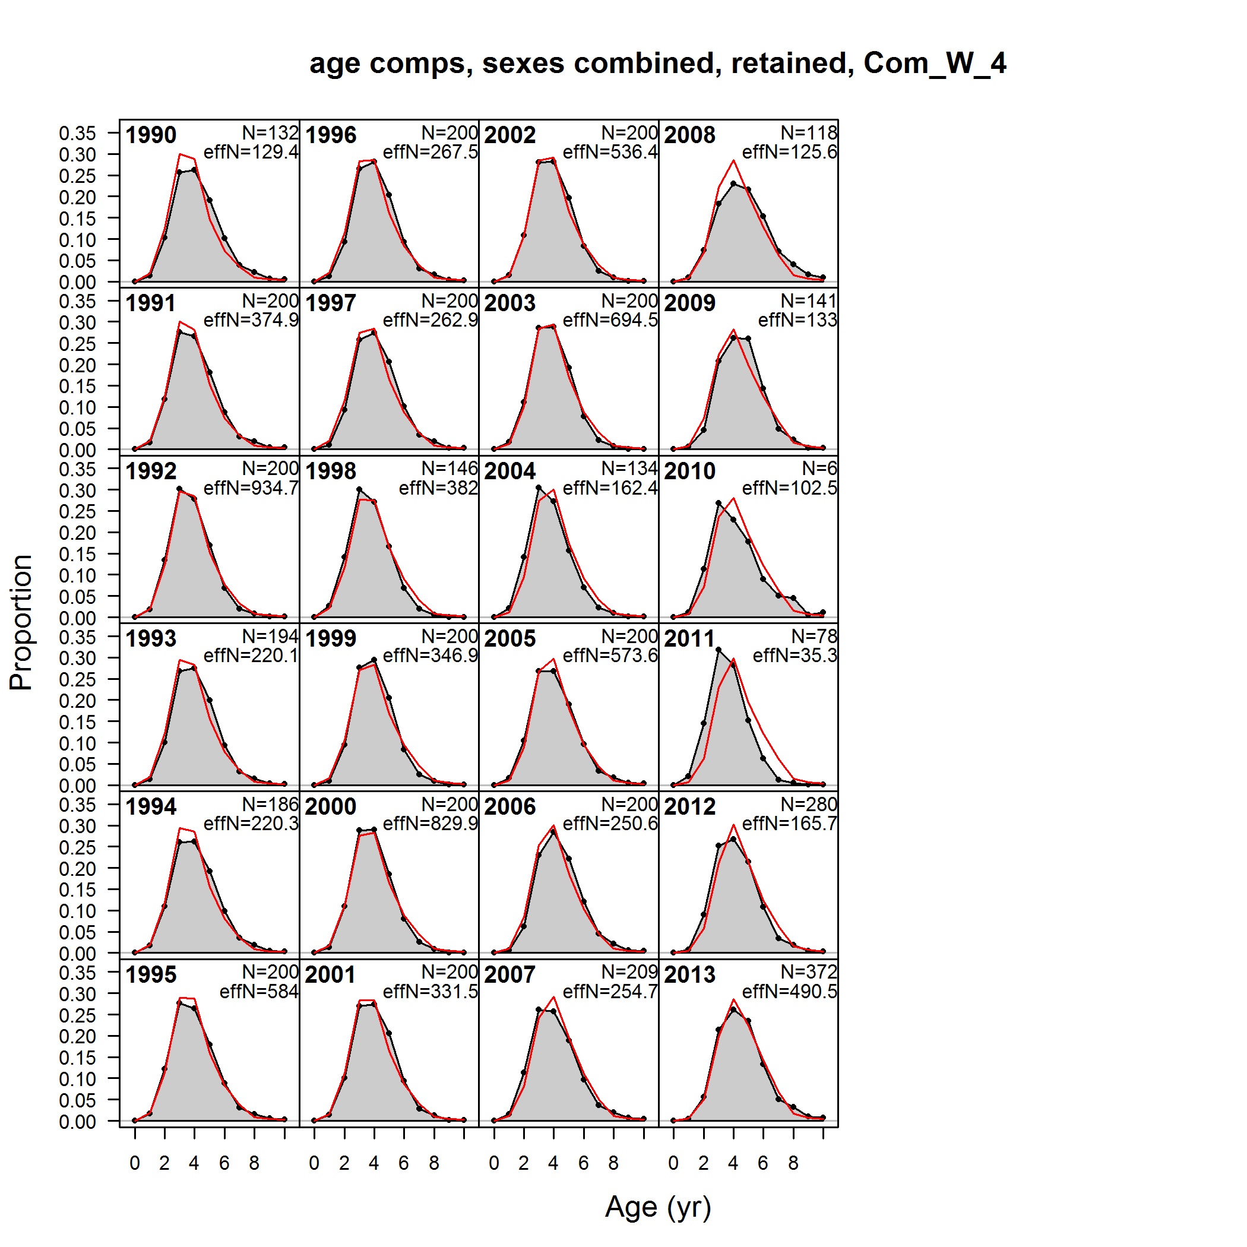
Fits to Age Comp: Com-West

Slide 62
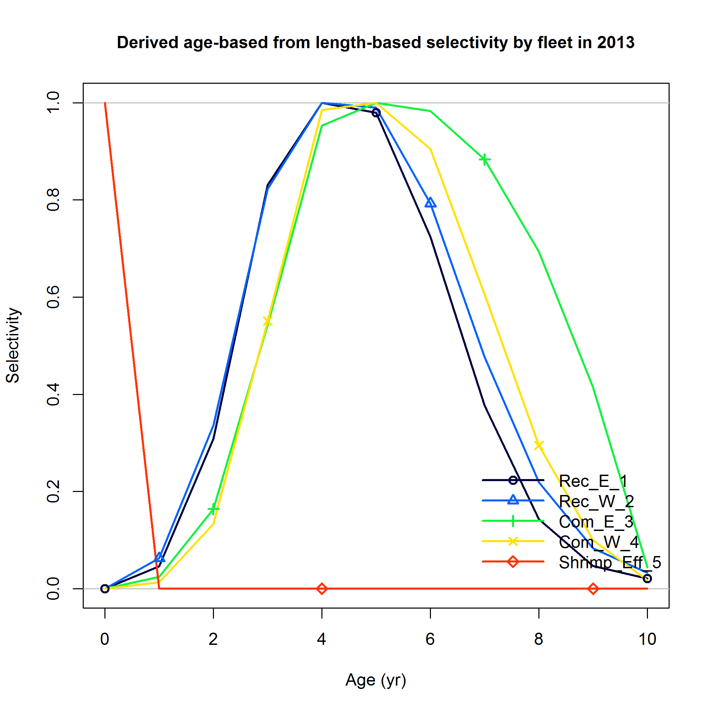
Fleet Selectivity

Slide 63
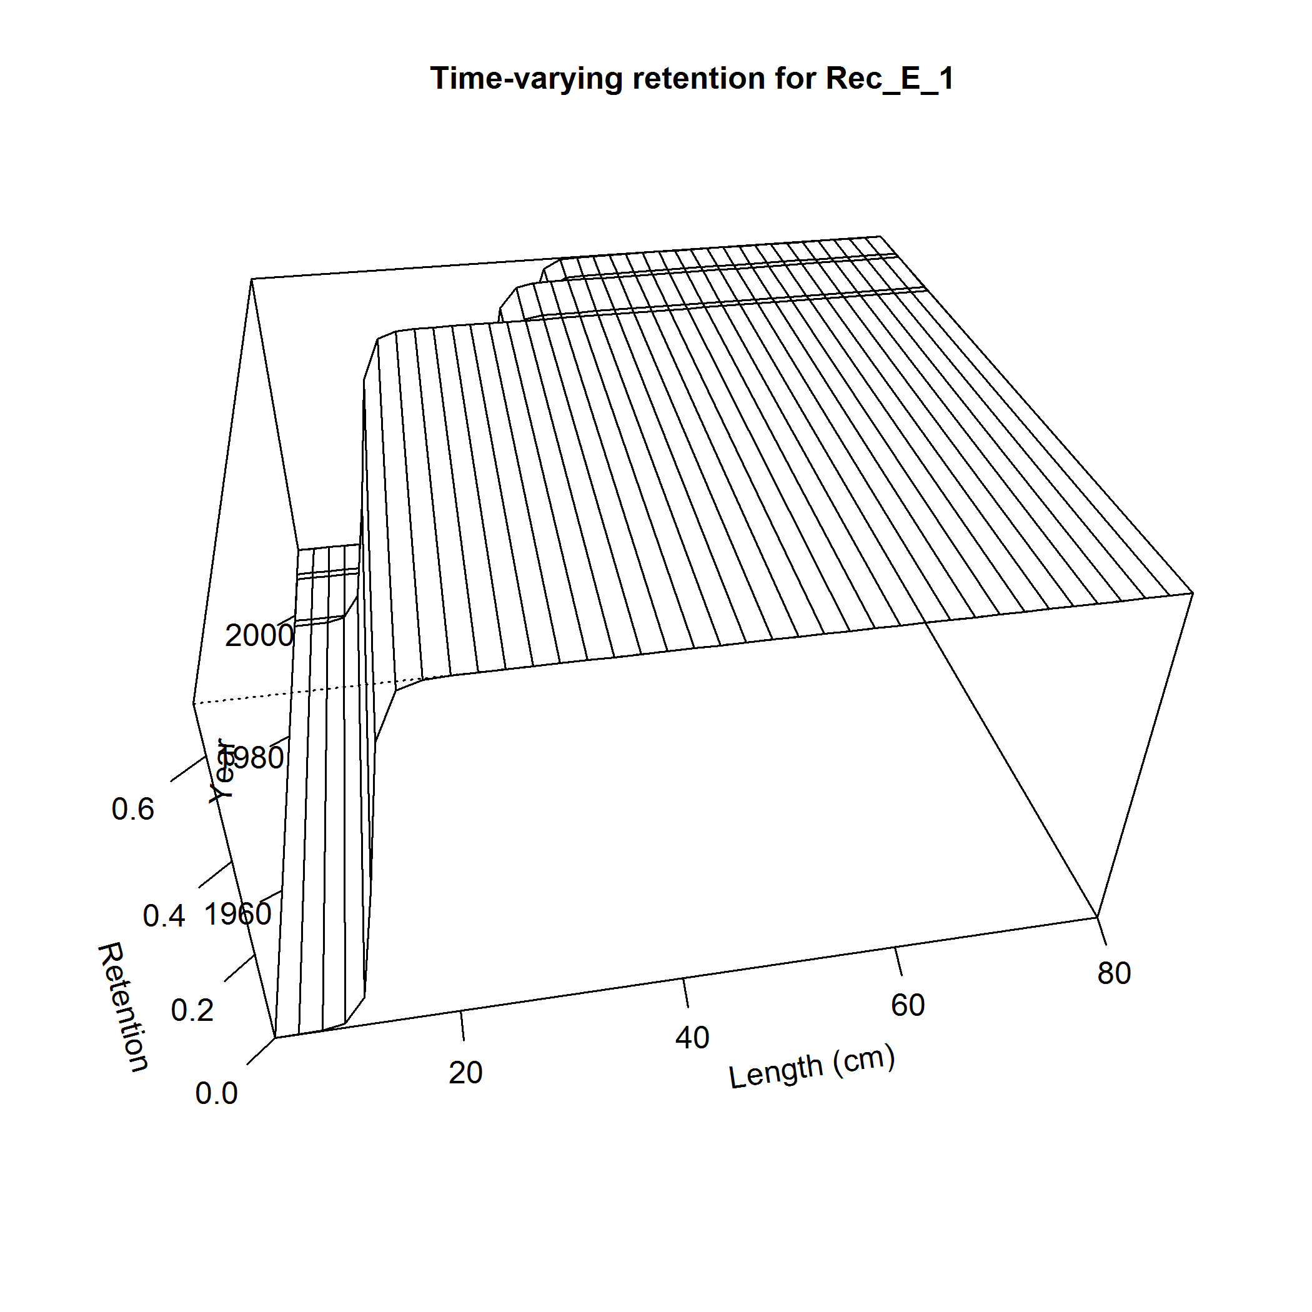
Retention Rec-E
Period 1: pre LL set at 6 inches
Period 2: 12 inch LL
Period 3: 14 inch LL
Assume “near” knife-edge selection

Slide 64
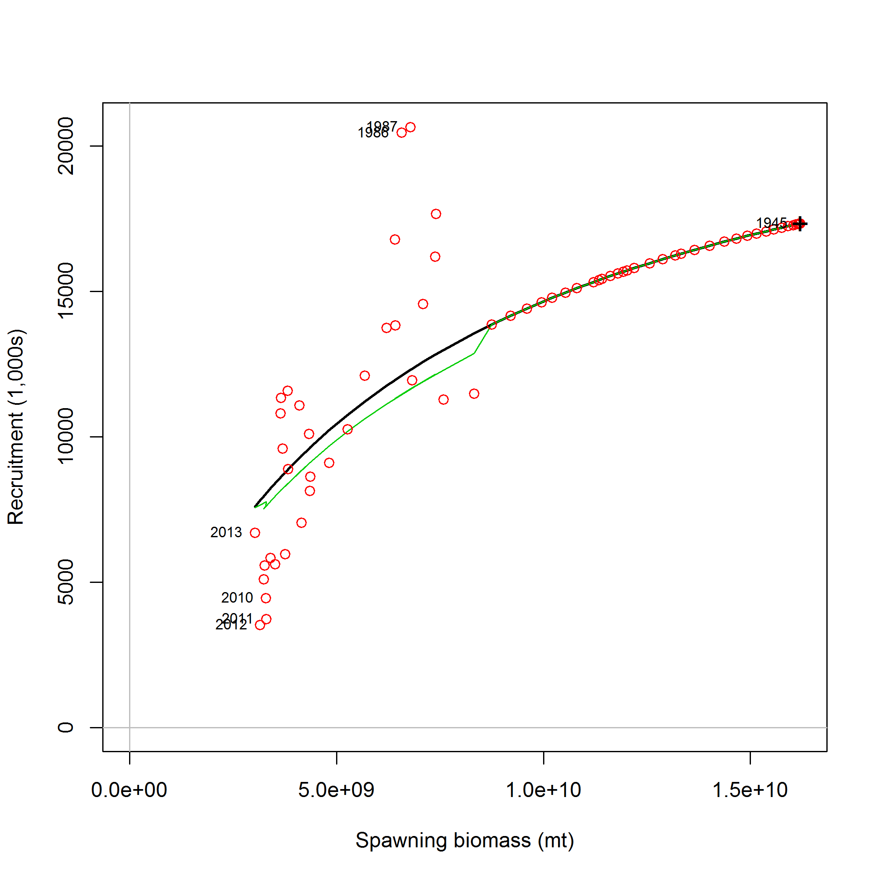
Spawner-Recruit Relationship
Open circles – Observed
Solid line – estimated
Green line – corrected

Slide 65
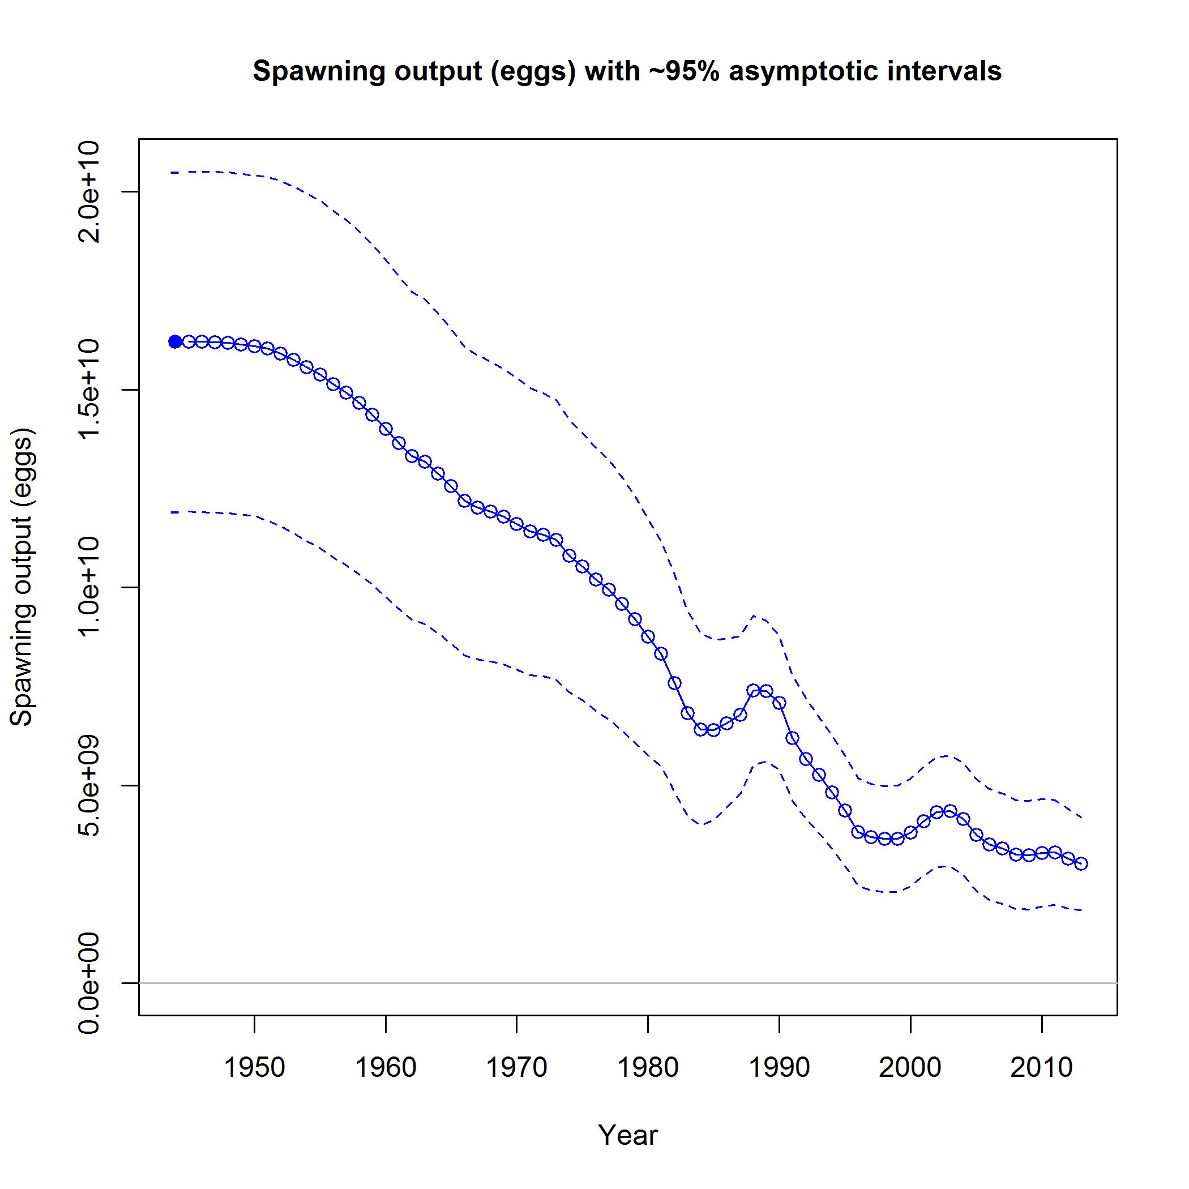
SSB and Recruitment

Slide 66
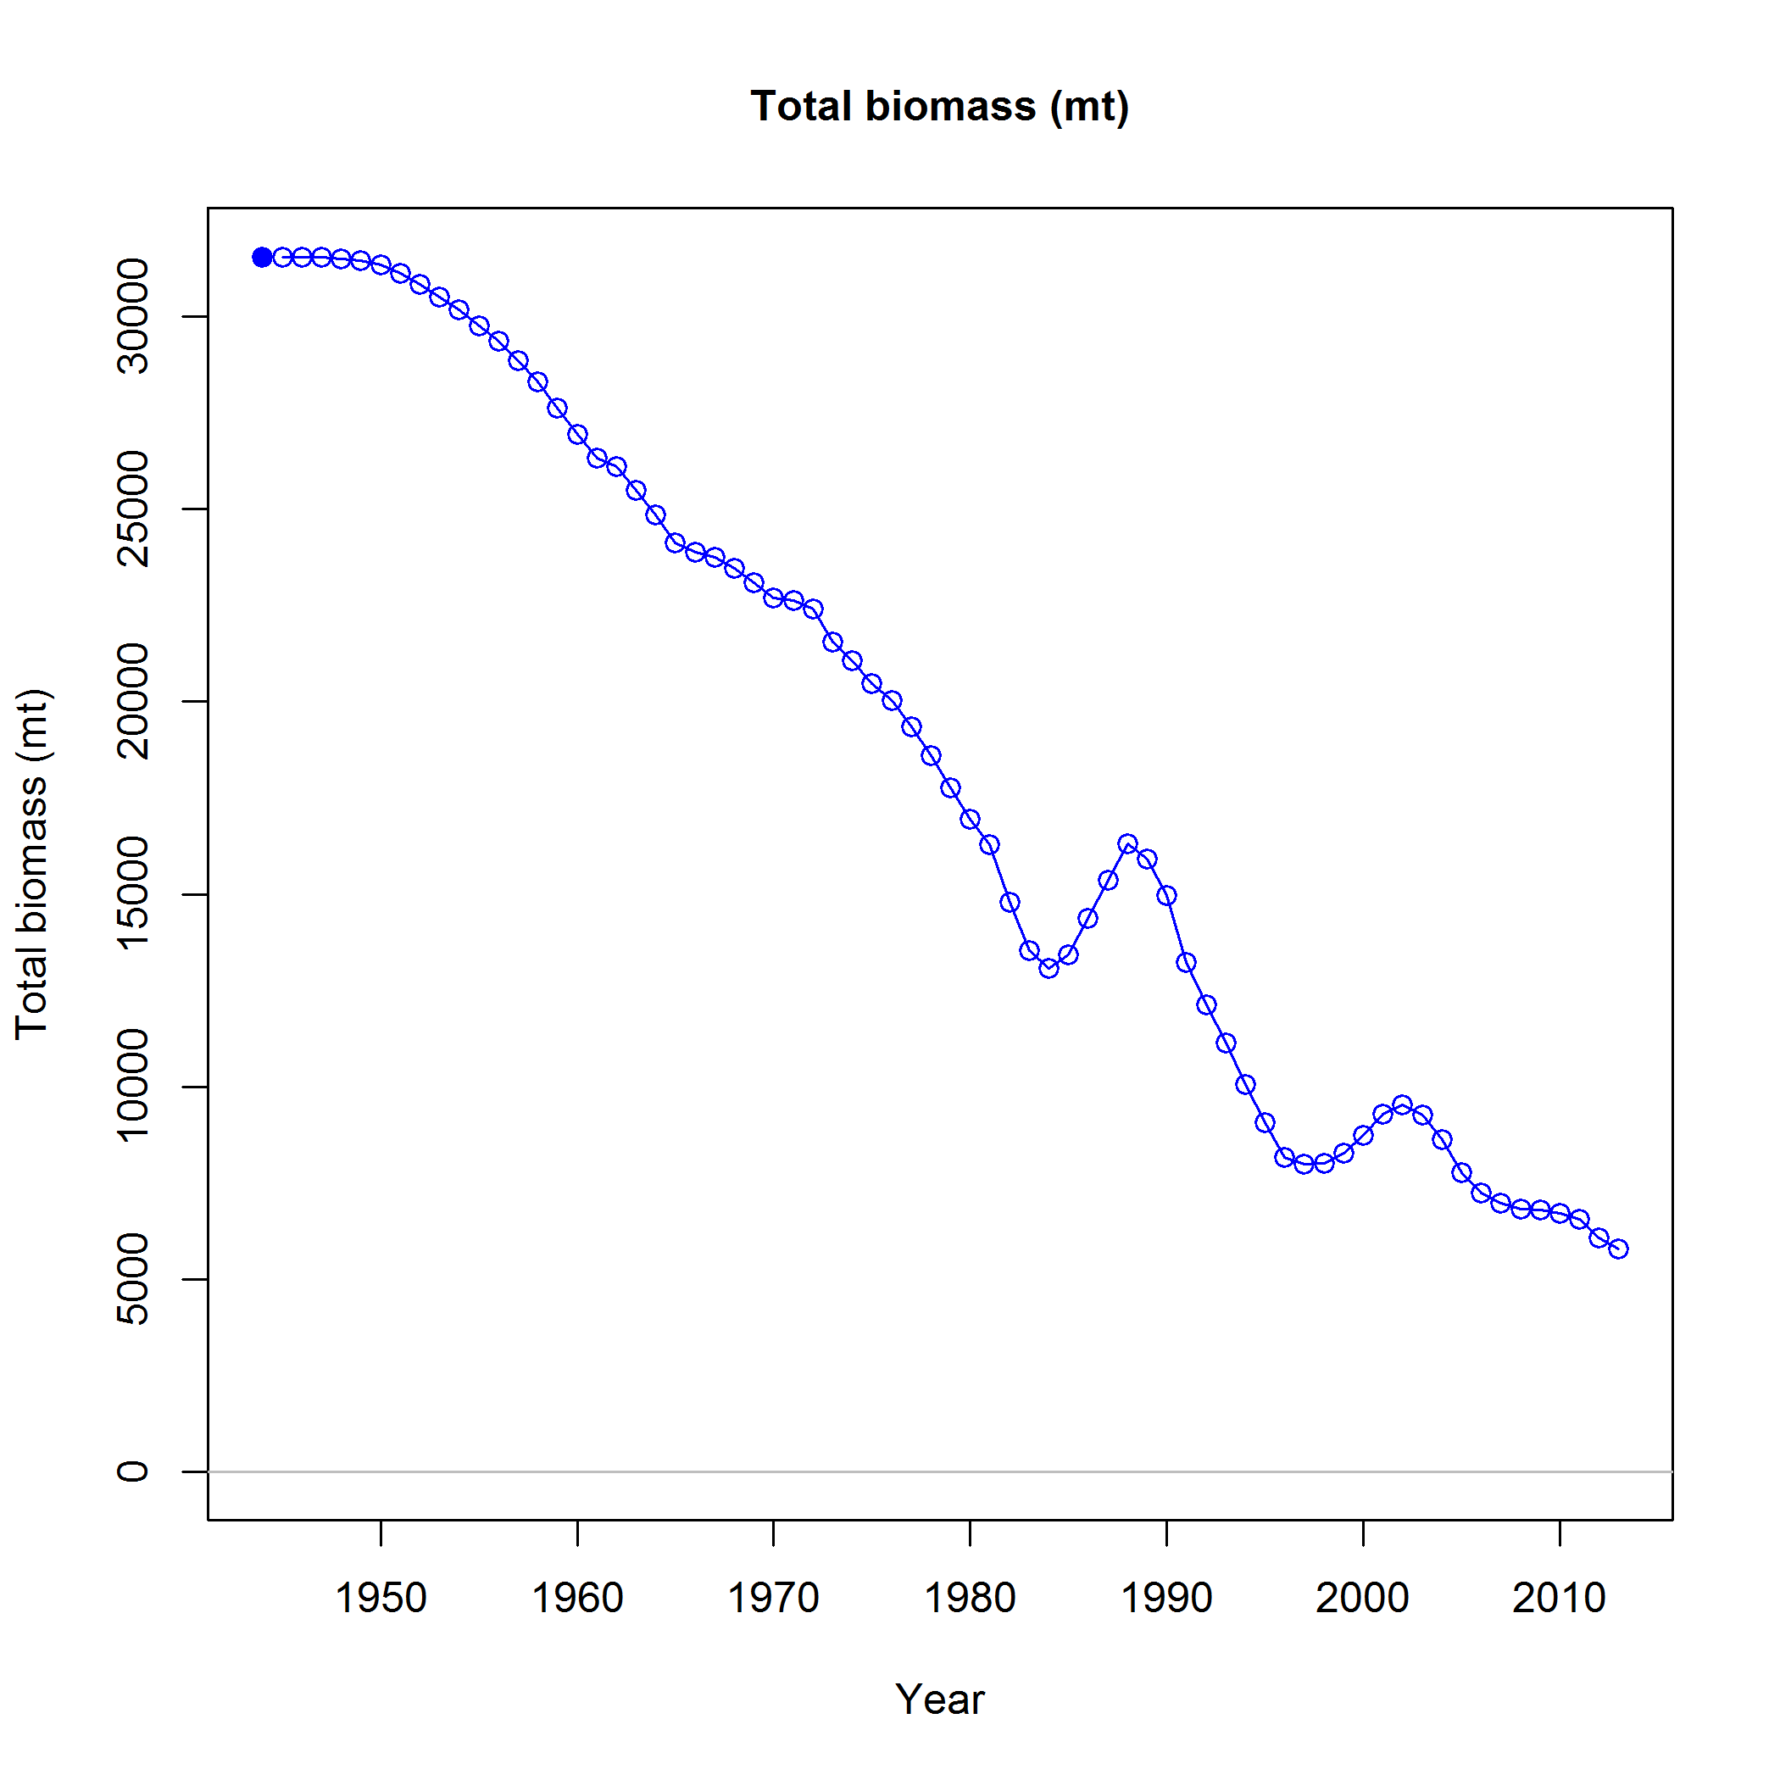
Results

Slide 67
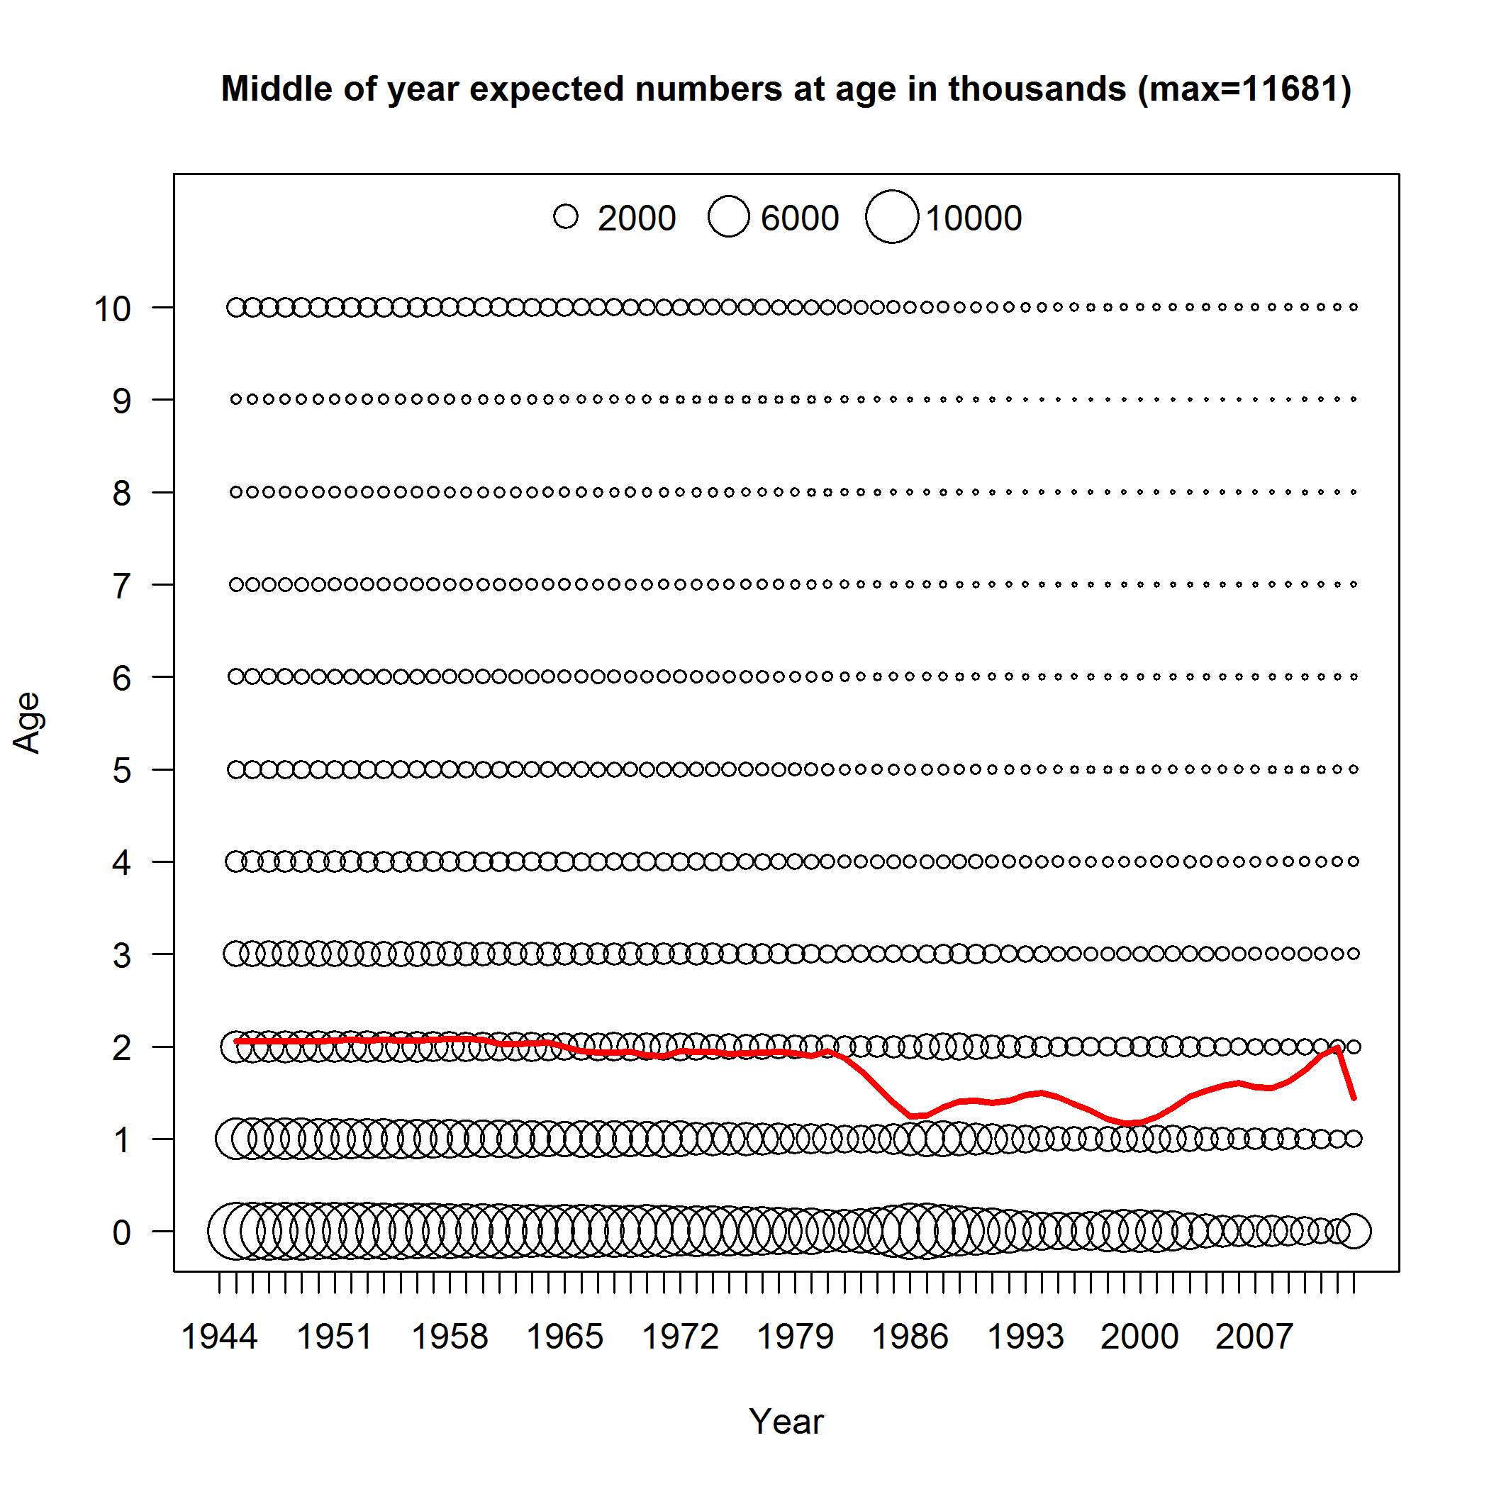
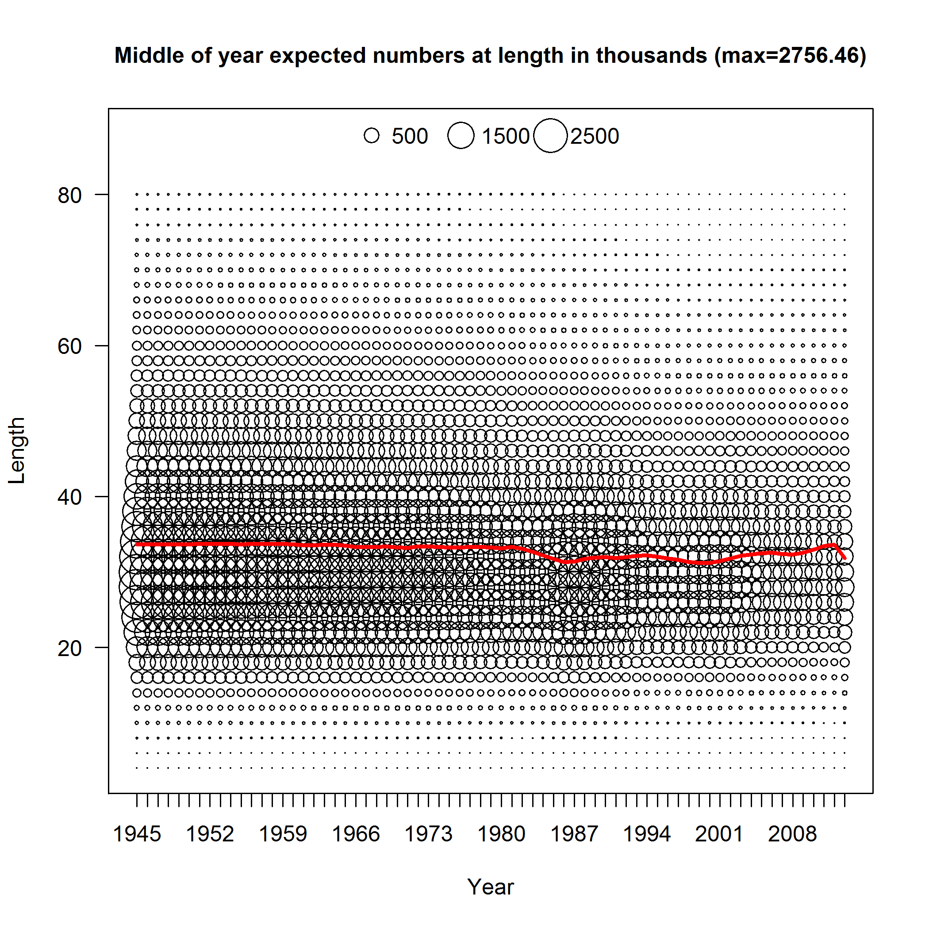
Average Age and Length

