Slide 1
Data weighting and data conflicts in fishery stock assessments
Chris Francis
Wellington, New Zealand
Francis (2011). Data weighting in statistical fisheries stock assessment models. CJFAS 68:1124-1138
Francis (2014). Replacing the multinomial in stock assessment models: A first step. Fish. Res. 151:70– 84
CAPAM workshop, “ Data conflict and weighting, likelihood functions, and process error” La Jolla, 19-23 October 2015

Slide 2
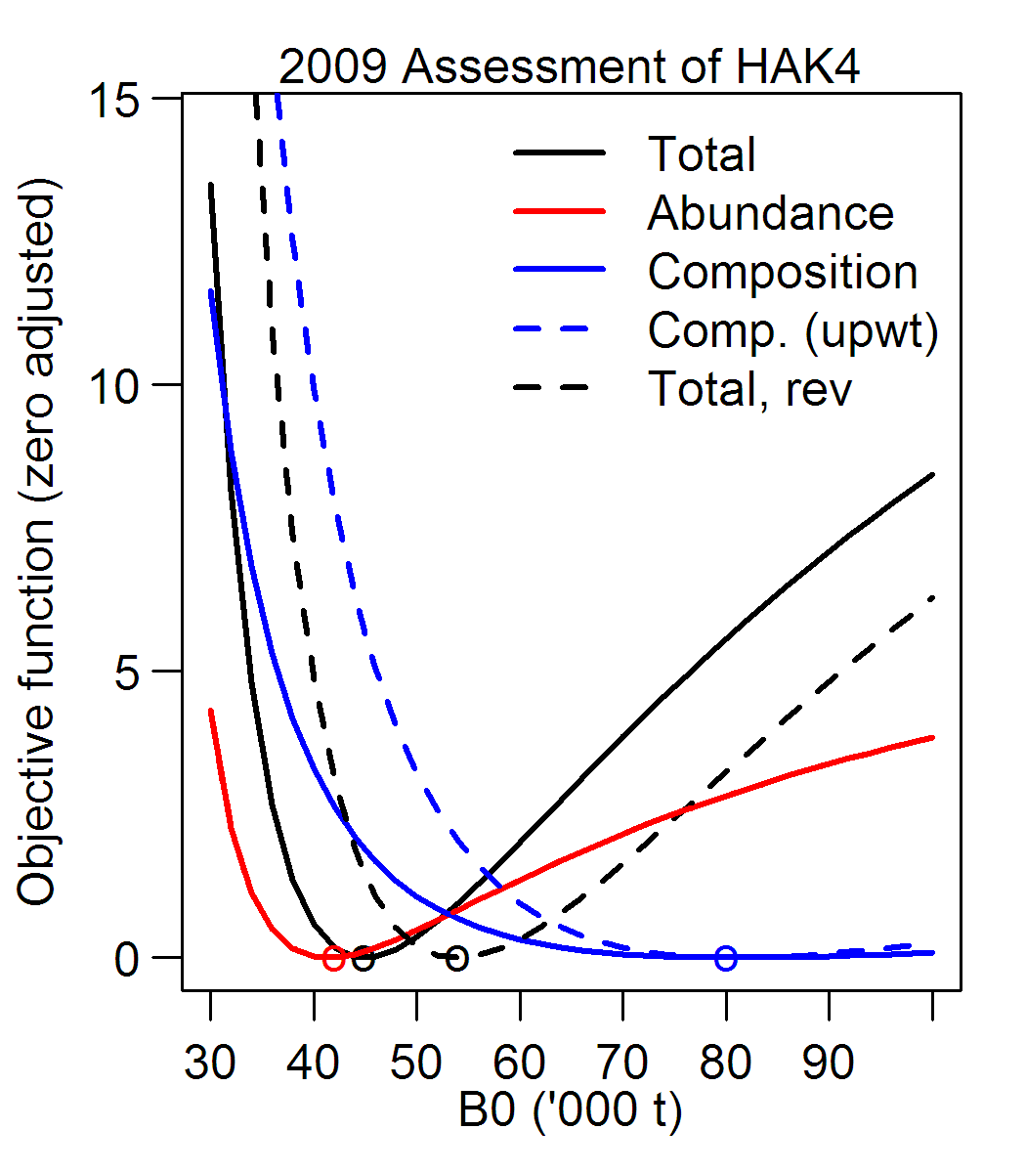
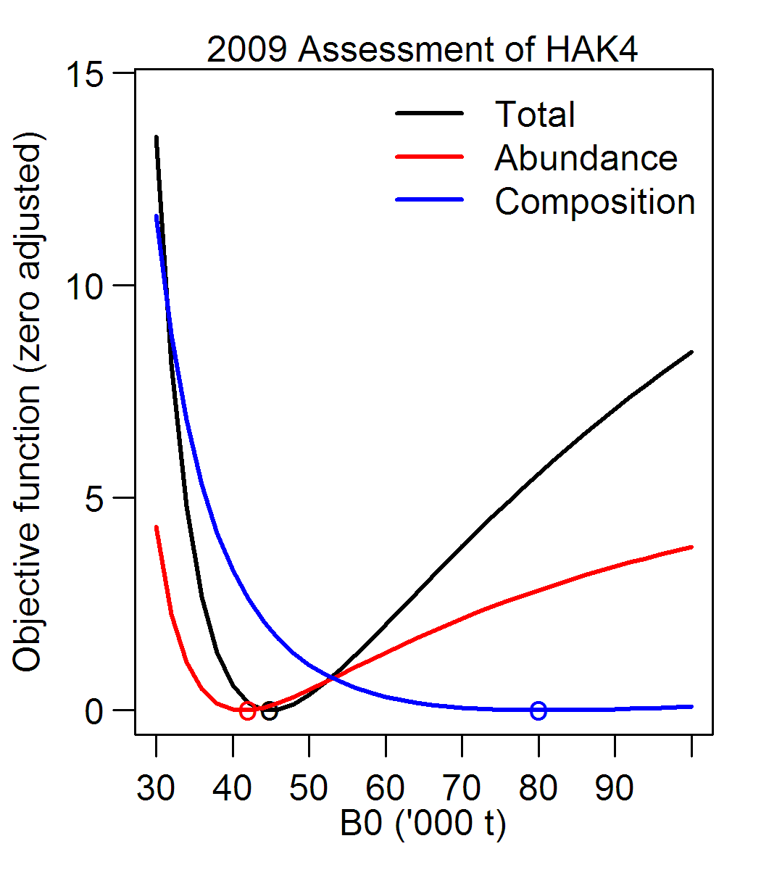
Why is data weighting important?
1. Can strongly affect stock status
2. All statistical inference assumes correct weighting
Increasing weightings tend to decrease estimated uncertainty (and vice versa)

Slide 3
Example of effect of reweighting on s.e.s
(Chilean ling)
Eff. sample sizes Standard errors
Model Age Length B₀(t) Depletion(%) F_{final}
Initial 100 50 339 2.16 0.016
Reweight 10 8 504 2.82 0.019
Change in s.e. +49% +31% +21%
Eff. sample sizes Standard errors
Model Age Length B₀(t) Depletion(%) F_{final}
Initial 100 50 339 2.16 0.016
Eff. sample sizes Standard errors
Model Age Length B₀(t) Depletion(%) F_{final}
Initial 100 50 339 2.16 0.016
Reweight 10 8

Slide 4
What is “correct” data weighting?
The weight given to each observation should describe the likely size of its error (and thus its information content)
Error
Model prediction
Observation
Observation error
Process error
Real world

Slide 5
How to set data weights?
Abundance data: outside the model (see Francis 2011); heteroscedastic if possible; no iterative reweighting
Composition data*: requires iterative reweighting because it’s not possible to quantify process error outside the model
Some causes of process error for composition data:
- misspecification of selectivity, M, and growth (for lengths)
*Including tagging: propns by age or length of recaptures

Slide 6
Iterative reweighting of compositions
Set initial data weights*
2. Run assessment model
3. Adjust weights using model residuals
[4. Repeat steps 2 & 3 as necessary]
* Usually sample sizes; could be c.v.s

Slide 7
Initial weighting of compositions
Two approaches:
1. To represent observation error
- from bootstrapping of data (e.g., Stewart & Hamel 2014)
2. Ad hoc: e.g., number of sets or landings sampled
Important: aim to capture year-to-year changes in reliability

Slide 8
Adjusting composition weightings
From analysis of composition residuals in model output
Most common method: McAllister & Ianelli (1998)
- included in Stock Synthesis outputs
- uses individual residuals
My recommendation: Method TA1.8 etc (Francis 2011)
- use residuals of mean age or mean length
- adapts approach of Pennington & Vølstad (1994)
- available in r4ss (SSMethod.TA1.8, SSMethod.Cond.TA1.8)

Slide 9
Chilean hake example (Francis 2011)
Sample sizes for compositions
Adjusted
Data set Initial McA&I TA1.8
Trawl fishery 150 258 15
Commercial longline 150 240 10
Artisanal longline 150 557 25
Survey 150 338 69

Slide 10
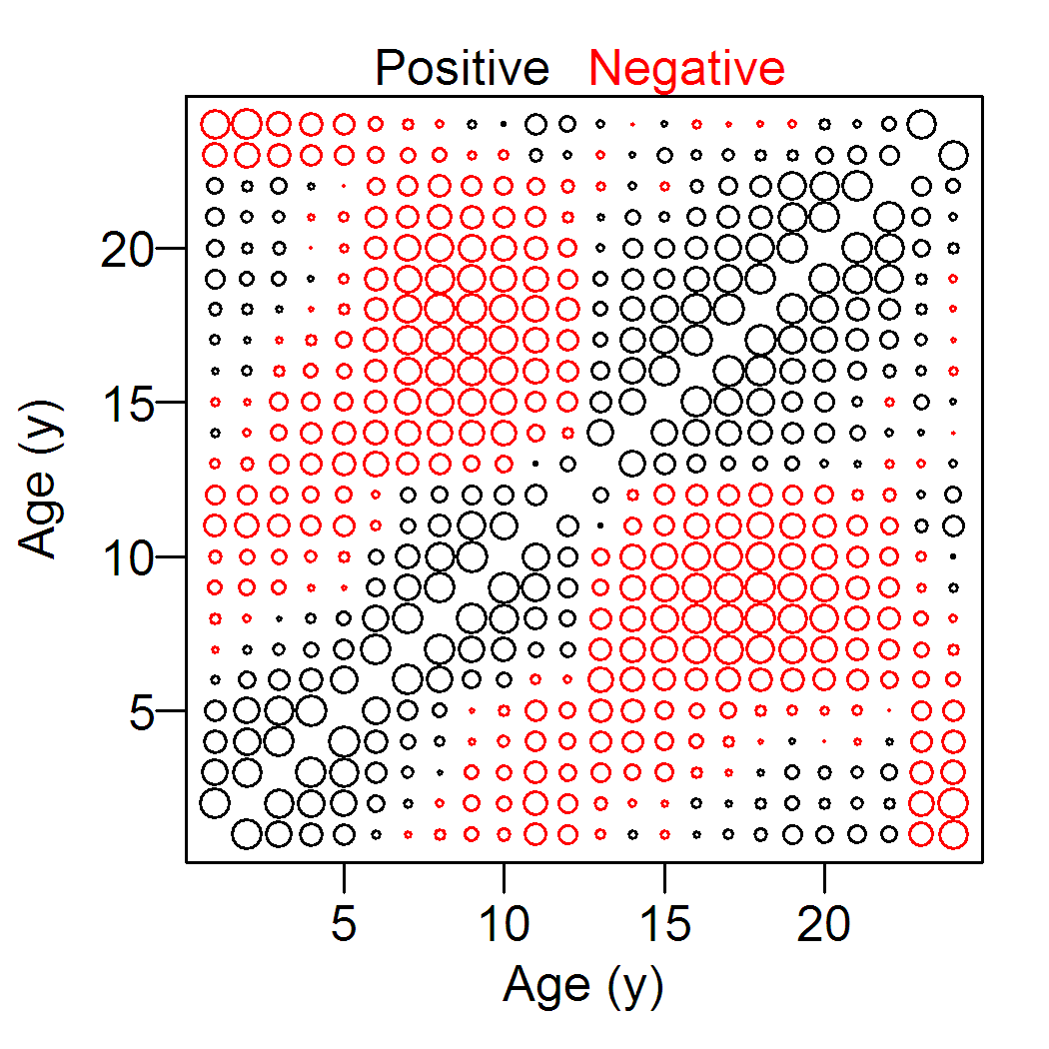
Correlations amongst individual composition residuals
Commercial trawl
McAllister & Ianelli approach overestimates sample sizes because it assumes residuals are uncorrelated

Slide 11
Main sources of composition correlations
Observation error:
- intra-haul correlation (Pennington & Vølstad 1994)
Process error:
- misspecification of selectivities, M, growth

Slide 12
Comparison of observation & total error for hoki age compositions
Actual sample sizes¹ Effective sample sizes¹
Data set Type Otoliths Lengths Obs. err. Total err.
HOKwc Fishery 753 53 061 937 20
HOKcs Fishery 763 10 527 261 69
HOKcr Survey 649 19 172 116 83
¹Median values over all years
Source: Table 1 of Francis (2014)

Slide 13
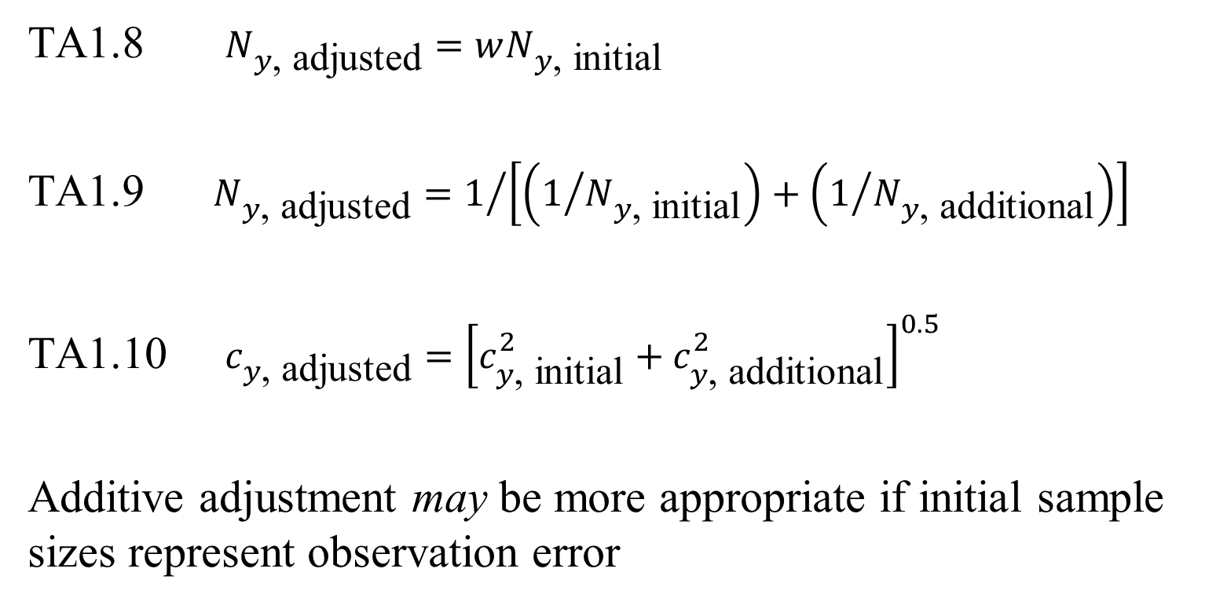
Research question: should adjustment be multiplicative or additive?
TA1.8 $N_{y\text{, }\text{adjusted}}=wN_{y\text{, }\text{initial}}$
TA1.9 $N_{y\text{, }\text{adjusted}}=1/{\left[\left(1/{N_{y\text{, }\text{initial}}}\right)+\left(1/{N_{y\text{, }\text{additional}}}\right)\right]}$
TA1.10 $c_{y\text{, }\text{adjusted}}={\left[c_{y\text{, }\text{initial}}^{2}+c_{y\text{, }\text{additional}}^{2}\right]}^{0.5}$
Additive adjustment may be more appropriate if initial sample sizes represent observation error

Slide 14
How many iterations?
Pragmatic approach:
- until there’s no visually significant change in fits & outputs (often, once is enough)
My experience:
- only large changes in N cause significant changes in the assessment

Slide 15
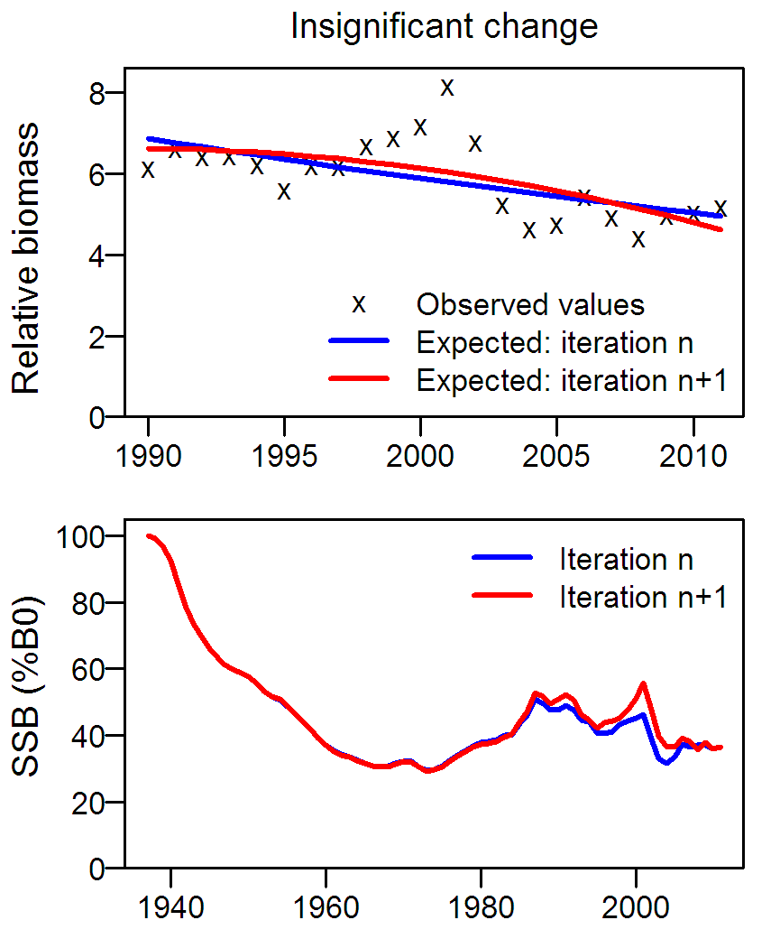
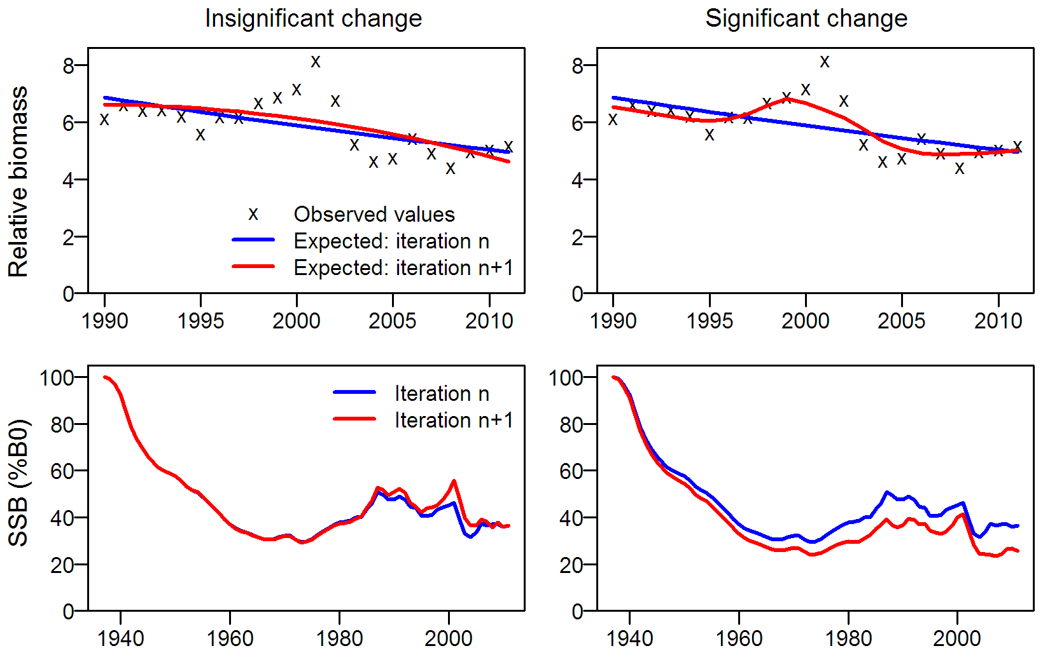
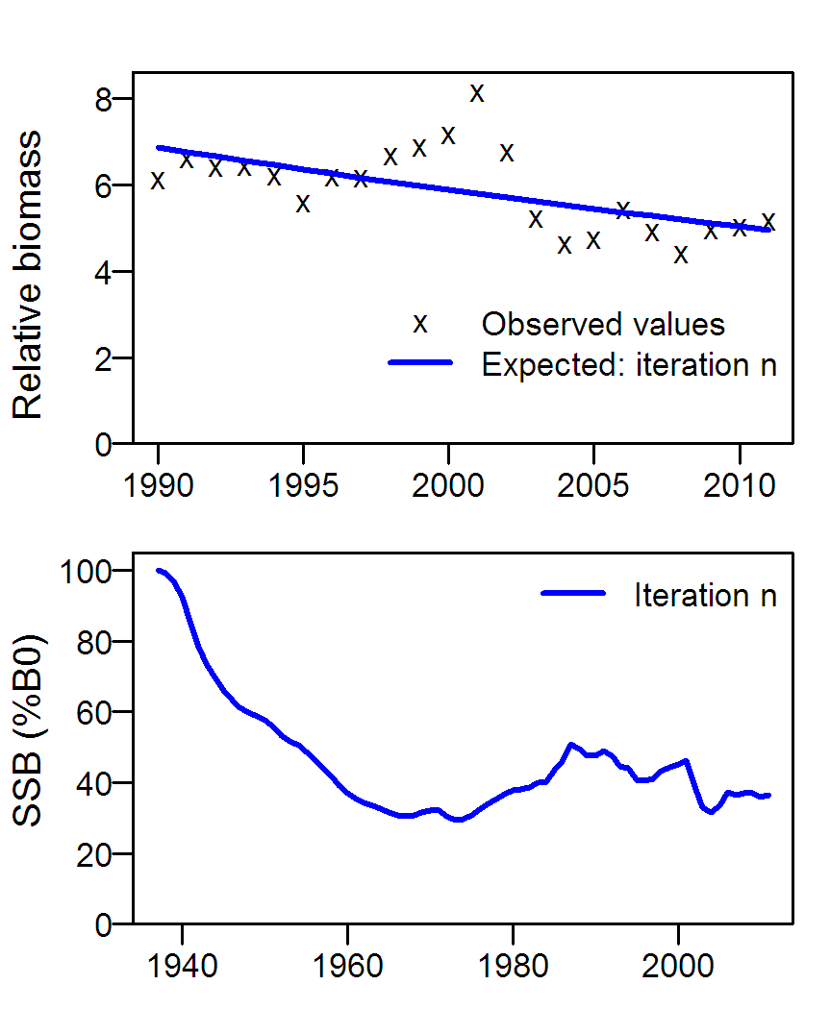
Significant & insignificant changes

Slide 16
An alternative to iterative reweighting
(Francis 2014)
Replace the multinomial with a likelihood that
- allows for realistic correlations
- is self-weighting
Possible replacement: logistic-normal

Slide 17
How to deal with abundance data that may be unrepresentative?
‘Unrepresentative’ = wrong trend
≠ imprecise or noisy
Common response: down-weight the data
Better response: either fit well or discard

Slide 18
Why prioritise abundance data?
Key stock assessment questions concern abundance
Composition data can tell us
- lots about recruitment variation
- something about selectivities and growth
- little about abundance (usually)
Inference from composition data can easily be compromised by misspecification

Slide 19
What is meant by “prioritise”?
Aim to achieve a good fit to all abundance data
(don’t let other data stop the model fitting abundance data well)
Weight abundance data outside the model
- no iterative reweighting
- no concentrated likelihoods

Slide 20
Right-weighting and down-weighting of composition data
Compositions should, ideally, be right-weighted
(i.e., consistent with residual sizes, as with TA1.8)
Right-weighting is important for valid statistical inference
Right-weighting of compositions depends on model structure
Apply further down-weighting only if necessary to achieve a satisfactory fit to abundance data (often not needed)

Slide 21
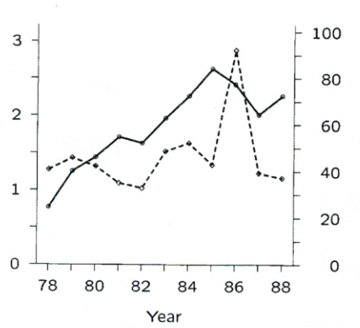
Conflict between two abundance series
Canadian 2J3KL cod stock
fig. 1 from Schnute & Hilborn 1993
Bad assumption: both series are correct.
Better assumption: one series is correct, but we don’t know which one.
CPUE
Survey

Slide 22
Conflict amongst multiple abundance series
1. Create two or more alternative models using different abundance series
2. Ensure that all abundance series in each model are well fitted
Differences between model outputs represent our uncertainty about which abundance series are representative

Slide 23
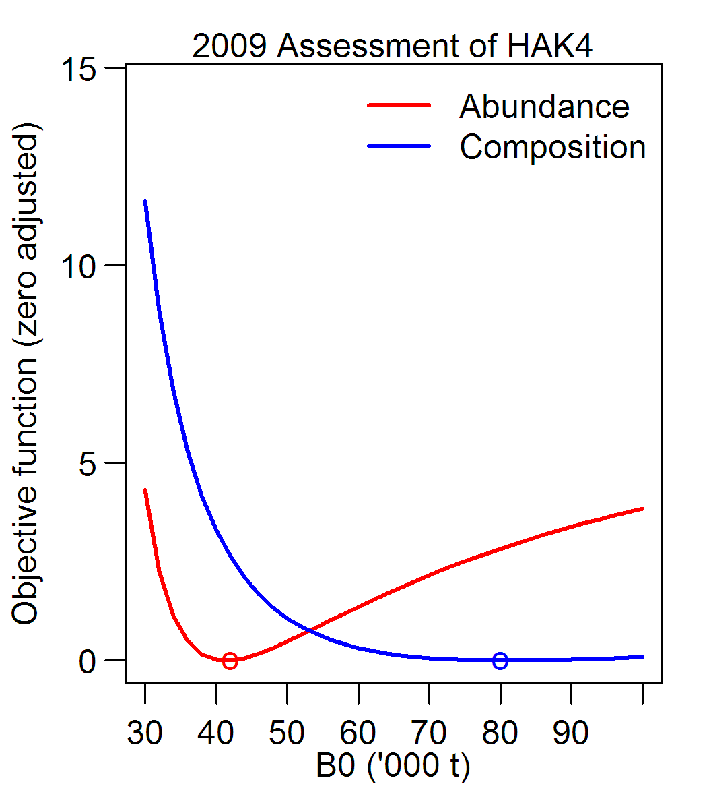
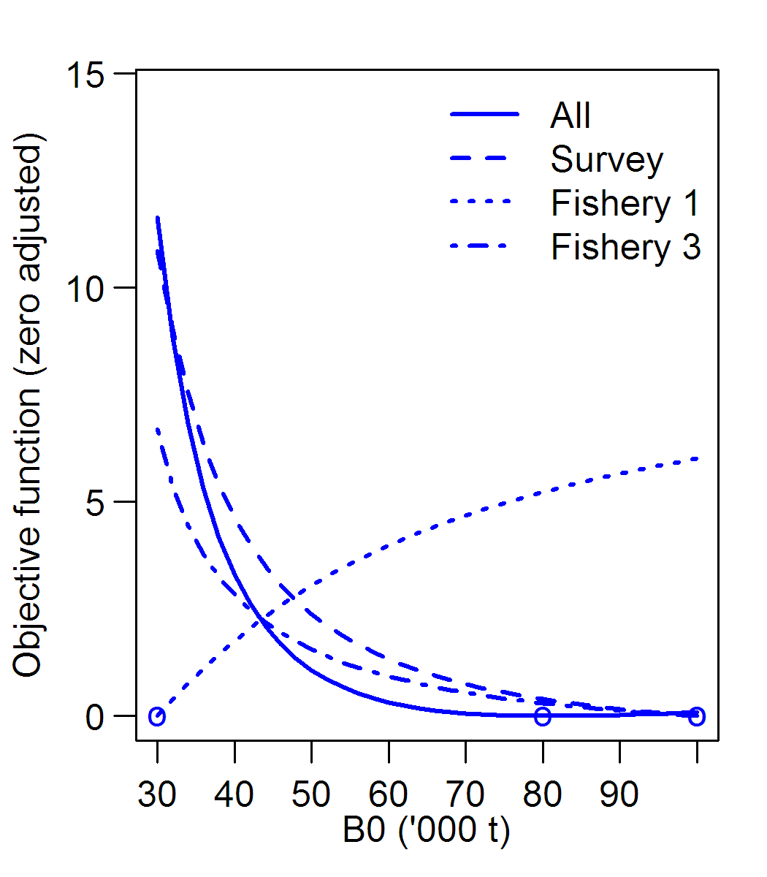
Conflicts involving compositions
Most likely cause: misspecification
Abundance vs compositions
Amongst compositions

Slide 24
Is restructuring an alternative to data weighting?
1. Profiles good for detecting misspecification causing data conflicts
2. Better to remove the misspecification/conflict, than to down-weight compositions
3. Without data conflict, data weighting is unimportant

Slide 25
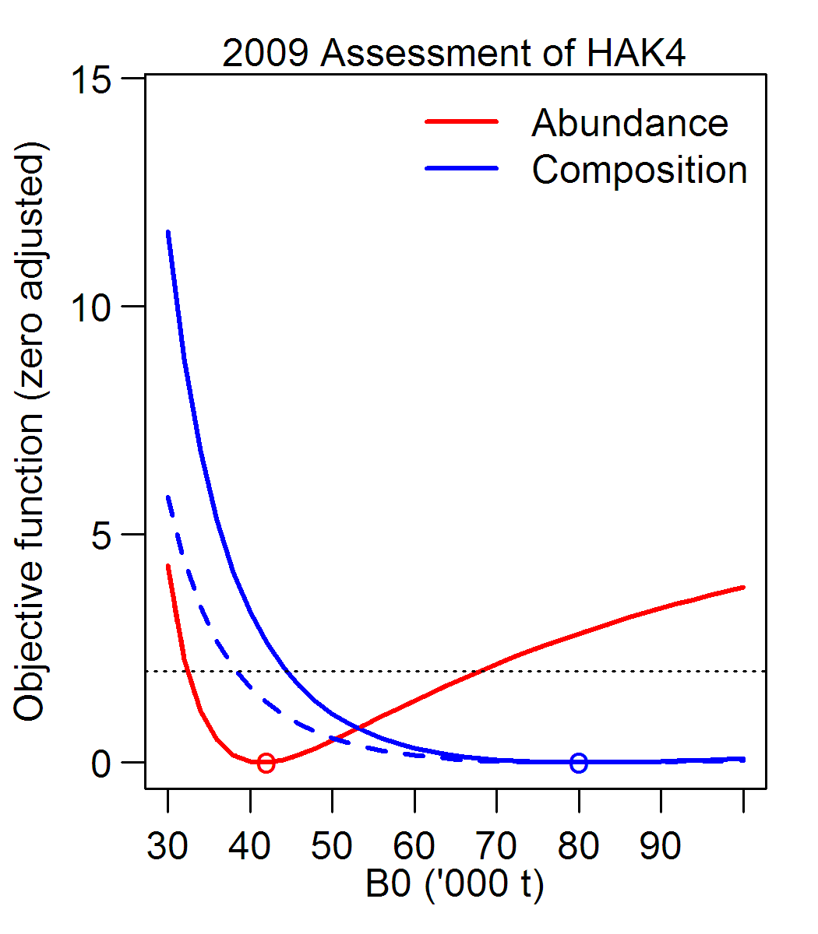
Some comments
1. Restructuring to reduce misspecification is good, and profiling is a useful tool
2. Why not restructure and reweight compositions?
3. If not, how to know if we have the right weights for our compositions?
4. The aim of reweighting
is right-weighting,
not down-weighting

Slide 26
Other comments on misspecification
1. George Box: “All models are wrong [= misspecified], but some are useful”
2. Don’t add model structure that’s not estimable
3. Possibility of over-fitting (e.g., time-varying selectivities)
4. The multinomial likelihood is a misspecification commonly overlooked (especially in simulation studies)
p. 424 in Empirical Model-Building and Response Surfaces (1987) by G.E.P. Box and Norman R. Draper

Slide 27
Summary 1: Three data-weighting principles
1. Prioritise abundance data (get good fits)
2. Don’t down-weight abundance data because they may be unrepresentative
3. For compositions:
- reweight iteratively, allowing for correlations
(the aim is right-weighting, not down-weighting)

Slide 28
Summary 2
Data conflict
1. Conflict amongst abundance data sets:
- consider alternative models
2. Conflict involving compositions:
- if possible, reduce misspecification (then reweight)
Simulation studies
- please simulate more realistic compositions

