Slide 1






A no BS guide to fishery stock assessment
Mark N Maunder
Inter-American Tropical Tuna Commission
Center for the Advancement of Population Assessment Methodology
?

Slide 2
?

Slide 3


Slide 4
Expert System
All the rage in the early 1990s
Basically, a decision tree
Need to estimate the decision probabilities
Did not have the automated learning (Machine learning)
Can we do it for stock assessment?
30 years later we are still working on it
Notes:
A doctor diagnosing a patient.
Expert system did not look like something a computer was going to be much use for unless there were a large number of possibilities. Why did it sound so complex.
But now I know with regression trees.
Steve munch is doing some research on automated assessment. So let’s see what happens.
We have to go back to working out the decision tree branch by branch.

Slide 5
Expert System

Slide 6

Expert System

Slide 7
Expert System

Slide 8
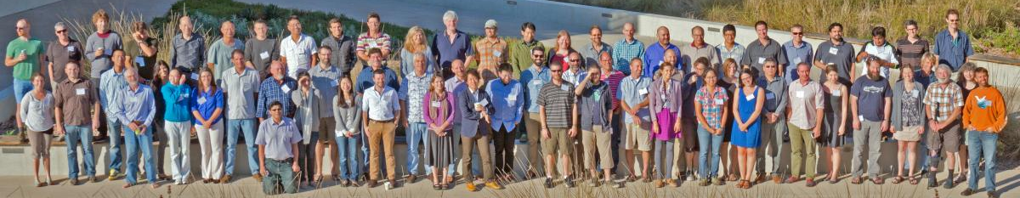
Expert System

Slide 9
CAPAM Stock Assessment Good Practices Workshop
Location: Rome (San Diego as a backup)
Date: Oct-Nov 2022 (date still tentative)
Special issue: Fisheries Research
More info: http://www.capamresearch.org/GPG-Workshop

Slide 10
Key notes
Intro: Avoiding Anarchy and Inflexibility: good practices for a research to operations approach in fisheries models - Rick Methot
Overview: Those who fail to learn from history are condemned to repeat it: Stock Assessment best practices and the consequences of not following them? - Andre Punt
Stock and fishery structure: Best practices for defining spatial boundaries and structure for stock assessment - Steve Cadrin
CPUE standardization: Good practices for standardizing fishery catch and effort data - Simon Hoyle
Growth: Good practices for modelling length-at-age in fisheries stock assessment - Kevin Piner and Hui-Hua Lee
Selectivity: Guidance for a comprehensive approach to modeling fishery and survey selectivity - Rick Methot
Natural mortality: Modelling natural mortality in fisheries stock assessment: approaches, estimation, complexity and uncertainty - Owen Hamel
Recruitment: Pragmatic approaches to the challenges of modeling recruitment in fisheries stock assessment - Liz Brooks
Data weighting: Data weighting: an iterative process linking data preparation and population models to evaluate model mis-specification - Jim Thorson
Random effects/state-space models: Good practices and necessity for random effects in fisheries stock assessment - Anders Nielsen
Spatial models: Spatial Awareness: Exploring the Continuum of Approaches for Addressing Spatial Population Structure and Connectivity Across the Assessment-Management Interface - Dan Goethel and Aaron Berger
Diagnostics: Model Diagnostics for Stock Assessment: A Comprehensive Review of the Current State-of-the-Art - Felipe Carvalho and Henning Winker
Integrated population models: Good practice guidelines for integrated population models - Michael Schaub
Data-limited methods: Data-limited stock assessments: The science of practical alchemy - Jason Cope

Slide 11
Why no BS?
Too many choices about ways to do things
Everyone does things differently
Need a Good Practices Guide
Too much uncoordinated and duplicated research
Must start the discussions somewhere
Here is a straw man
If you see any BS in the presentation, call it!

Slide 12

Questions
After each topic
Only time for a few
Main concept, not details
  Call the BS
  Why it is BS
  What to do instead
Time for more questions at the end

Slide 13
Outline
Topics
  (Stock structure)
  CPUE standardization
  Fishery structure
  Selectivity
  Growth
  Natural mortality
  Recruitment
  Data weighting
  Process variation (Random effects/state-space models)
  (Spatial models)
  Diagnostics
  (Data-limited methods)
Solution to the three Major Issues

Slide 14

Stock structure
Hard
Could be the reason behind many data conflicts
Assume we know it for this presentation
But see the end of the talk (Major Issue #1)

Slide 15
CPUE standardization
Predicted CPUE
Index of abundance needs to represent the whole (component of the) stock (or area in multi-area model)
Don’t use unrepresentative CPUE (e.g. limited spatial area)
Avoid basing indices on areas as fisheries
Use spatio-temporal models to fill in missing cells and do area weighting.
Create index by summing up areas
Maunder, M.N., et al. 2020. The need for spatio-temporal modeling to determine catch-per-unit-effort based indices of abundance and associated composition data for inclusion in stock assessment models. Fish. Res. 105594.

Slide 16
CPUE standardization
Predicted CPUE
Sampling can be unrepresentative
Effect of fishery expansion/contraction and preferential sampling
Effort
Maunder, M.N., et al. 2020. The need for spatio-temporal modeling to determine catch-per-unit-effort based indices of abundance and associated composition data for inclusion in stock assessment models. Fish. Res. 105594.

Slide 17
CPUE standardization: composition data
Standardize the composition data using spatio-temporal models along with the index
Index composition data should represent the abundance not the catch
Spatially weight the index composition data by CPUE and the fishery catch composition data by catch
Treat the index composition data separately from the catch composition data in the assessment model (but it is not independent)
Maunder, M.N., et al. 2020. The need for spatio-temporal modeling to determine catch-per-unit effort based indices of abundance and associated composition data for inclusion in stock assessment models. Fish. Res. 105594.

Slide 18
CPUE standardization: Call the BS?
Standardize CPUE and composition data using spatio-temporal models
Create index and composition data using area weighting
Weight index composition data using CPUE not catch
Treat index and catch composition separately in the assessment model

Slide 19
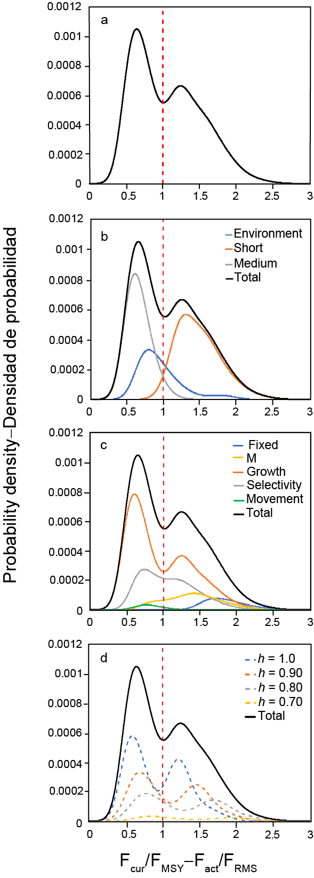
Fishery structure
To model fishery selectivity and fit composition data (not CPUE index)
(and other things e.g. management by gear type, management boundaries)
Remove fish at the right size
Three fishery (i.e. gear or area) example
Catch proportions changing over time
Selectivity
Length

Slide 20
Fishery structure
Define based on homogeneous length composition
Separate by fishing gear first
Tree based analysis on length comp data
Consider spatial, seasonal (year, country and sex)
When to stop (how many fisheries)
How to deal with growth and cohort strength (recruitment)
Lennert-Cody et al. 2010. Exploratory analysis of spatial-temporal patterns in length-frequency data: an example of distributional regression trees. Fisheries Research, 102(3): 323-326.

Slide 21
Fishery structure: Call the BS?
Separate by gear
Define fisheries based on regression tree analysis of composition data using area, season, and possibly year, country, and sex

Slide 22
Selectivity: Fishery vs index
Fishery
  Remove the fish at the correct age
  Smooth over sampling error
  Fill in missing years (gears)
  (can allow composition data to provide information on other quantities)
  Areas as fisheries (availability), flexible time varying selectivity curves
Index (including CPUE)
  Determines the ages represented by the index
  Smooth over sampling error
  (does not need to fill in missing years)
  Allow composition data to provide information on other quantities (F, M, annual recruitment, growth)
  Whole stock (contact), time invariant functional forms
  Design survey/CPUE analysis to make selectivity smooth, time invariant, and asymptotic if possible

Slide 23
Selectivity
Variation in composition data
  Sampling error - smooth with “functional” form
  Changes in contact selectivity – use time varying selectivity
  Spatial variation in age/size of fish – use fishery definitions (or spatial model)
  Often a combination of all three
How to know you are not modelling sampling error
  Estimation of smoothness parameter
  (see data weighting)
Age, length, or both
  Length for contact selectivity
  Age for availability

Slide 24
Fishery selectivity: Spatial variation
  Spatial structure causes dome shape and time varying selectivity
  Define fisheries to make selectivity as asymptotic and as constant over time as practical
  (Further evidence that weighting index composition data by CPUE is important)
Dome is expected
Waterhouse, L., Sampson, D. B., Maunder, M. Semmens, B. X. 2014. Using areas-as-fleets selectivity to model spatial fishing: Asymptotic curves are unlikely under equilibrium conditions. Fisheries Research, 158: 15-25.
Notes:
This also shows how if the index composition is weighted by catch you would get a done shape selectivity.

Slide 25
Fishery selectivity: Spatial variation
  Spatial structure causes dome shape and time varying selectivity
  Define fisheries to make selectivity as asymptotic and as constant over time as practical
  (Further evidence that weighting index composition data by CPUE is important)
Dome is expected
Waterhouse, L., Sampson, D. B., Maunder, M. Semmens, B. X. 2014. Using areas-as-fleets selectivity to model spatial fishing: Asymptotic curves are unlikely under equilibrium conditions. Fisheries Research, 158: 15-25.
Notes:
This also shows how if the index composition is weighted by catch you would get a done shape selectivity.

Slide 26
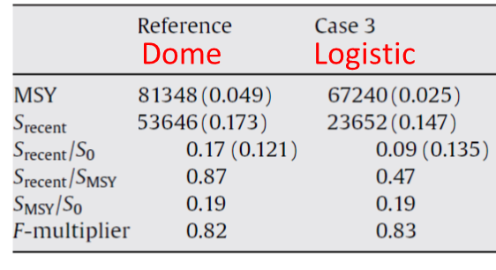
Selectivity
Assumptions are influential when fitting to length composition data
Wang et al. 2009. Implications of model and data assumptions: An illustration including data for the Taiwanese longline fishery into the eastern Pacific Ocean bigeye tuna (Thunnus obesus) stock assessment. Fisheries Research 97 (2009) 118–126.

Slide 27
Fishery selectivity: splines
Splines are flexible selectivity curves
Smoothness
  Smoothness parameters
  Number and location of knots (use empirical selective to find knots)
Oliveros-Ramos R (2020). Empirical selectivity diagnostics for r4ss. R package version 0.1.2. DOI:10.5281/zenodo.4599748.
Minte-Vera et al. 2020. Yellowfin tuna in the eastern Pacific Ocean, 2019: benchmark assessment. IATTC Document SAC-11-07 REV

Slide 28
Fishery selectivity
Weird selectivities/comp data
  Double modes
    Redefine fisheries by area, season, year, gear
    Time varying
  Long tails
    Not expected to be flatter than population composition
    Changes over time suggest fishery structure
  Jagged predictions vs smooth observations
    Cohorts
      Continuous recruitment
      Assumed variation of length at age too narrow
Xu et al. 2020. Bigeye tuna in the eastern Pacific Ocean, 2019: benchmark assessment. IATTC Document SAC-11-06 REV

Slide 29
Fishery selectivity: temporal variation
Time blocks
  Known changes
Random effects
  Parameters of functional forms
  Age-time Random effects
    Combining fisheries (e.g. Nielsen and Berg, 2014)
      Fewer parameters vs sharp changes in effort allocation among gears
  Length-time
    Too many parameters
  Estimating variance/smoothing parameters
  Computationally demanding
Nonparametric
  Splines
    Determining nodes in two dimensions
  Estimating nodes/smoothness penalties
Fitting to noise or removing fish at the right age/size
Nielsen, A., Berg. C. W. 2014. Estimation of time-varying selectivity in stock assessments using state-space models. Fisheries Research, 158: 96-101.

Slide 30
Fishery selectivity
Start
Use for information on F
No
Yes
Large difference in selectivity
Yes
No
Separate by gear and area
Separate by gear and area
Length selectivity needed
No
Yes
Use random walk in age
Use time varying spline
Use asymptotic time invariant functional form

Slide 31
Selectivity: Call the BS?
Fisheries
  Remove fish at the right age/size
  Use dome shape selectivities
  Use flexible selectivity curves (e.g. spline, random walk)
  Use time varying selectivities
  Refine fisheries to remove weird selectivities (e.g. bimodal)
Index
  Standardize CPUE and associated composition data using spatio-temporal models
  Use asymptotic time-invariant functional forms if possible

Slide 32
Growth
Often good information for most frequently caught fish and most abundant ages
  YPR
  ASPM
If length comp data are influential, then growth of all fish, particularly old, is important
Need to get growth right, including variation off length at age
Asymptotic length
Zhu et al.2016. Estimation of growth within Stock Synthesis models: Management implications when using length-composition data. Fisheries Research, 180: 87-91.

Slide 33
Growth
Estimate inside stock assessment to deal with age- (ontogenetic movement) or length-based (selectivity or length categories) sampling factors.
Piner et al. 2016. Evaluation of using random-at-length observations and an equilibrium approximation of the population age structure in fitting the von Bertalanffy growth function, 180: 128-137.

Slide 34
Growth
Functional form control estimates
Abundant young fish influence estimates of old fish
Need to use flexible growth curves
Maunder, M.N., Deriso, R.B., Schaefer, K.M., Fuller, D.W., Aires-da-Silva, A.M., Minte‑Vera, C.V., Campana, S.E. 2018. The growth cessation model: a growth model for species showing a near cessation in growth with application to bigeye tuna (Thunnus obesus). Marine Biology (2018) 165:76.

Slide 35
Growth
Use all data
  Otolith
  Tag growth increment
    Model age as a parameter
  Length frequency
    Estimate inside assessment
Aires-da-Silva, A.M., Maunder, M.N., Schaefer, K.M., Fuller, D.W., 2015. Improved growth estimates from integrated analysis of direct aging and tag–recapture data: an illustration with bigeye tuna (Thunnus obesus) of the eastern Pacific Ocean with implications for management. Fish. Res. 163, 119–126.

Slide 36
Growth: temporal variation
Empirical weight-at-age
  Needs catch-at-age data
  Sampling error
  Missing years/gears
  Model outside assessment to fill in gaps
Model time varying growth
  Functional form
    Parameters vary over time
    Growth increment approach
    Cohort or annual effects
  Non- or semi-parametric approach
  Estimating smoothness penalty
Density dependence
Needs lots of age-length data

Slide 37
Growth: spatial variation
Spatial differences in length compositions due to
  Sampling
    Make sure the differences are not due to an artifact of the sampling
      Time differences in the sample
      Differences in Length measurements or conversion factors
  Age
    Ontogenetic movement
      Spatial model
      Use age selectivity for availability and length-based contact selectivity (Lee et al. 2017)
    Differences in exploitation rates (spatial structured model)
  Growth
    Spatially structured model
    Assess areas separately
    Collect data to determine stock structure, movement, and growth
    Need to develop methods to model area specific growth curves in interacting sub-populations
  Selectivity
      Expected for different gears
      Why would it differ for the same gear?
Age data would help differentiate the cause of differences in length composition.
Lee, H-H., Piner, K.R., Maunder, M.N., Taylor, I.G., Methot Jr., R.D. 2017. Evaluation of alternative modelling approaches to account for spatial effects due to age-based movement. Canadian Journal of Fisheries and Aquatic Sciences, 2017, 74(11): 1832-1844

Slide 38
Growth: Call the BS?
Estimate growth within the stock assessment model
Use a flexible growth curve
Model time varying growth if there is adequate data
Deal with spatial variation by modeling separate populations (or in specific cases using age specific selectivity) until spatial structure and movement is understood.

Slide 39
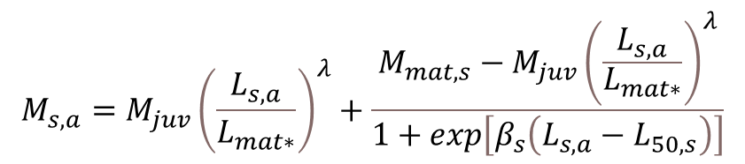
Natural mortality
Age and sex structured
Higher for young individuals, but independent of sex
Increase when they get older (e.g. mature) and differ between sexes
$$M_{s,a}=M_{juv}{\left(\frac{L_{s,a}}{L_{mat∗}}\right)}^{λ}+\frac{M_{mat,s}−M_{juv}{\left(\frac{L_{s,a}}{L_{mat∗}}\right)}^{λ}}{1+\exp\left[β_{s}\left(L_{s,a}−L_{50,s}\right)\right]}$$
Maunder et al. 2010. Preliminary estimation of age- and sex- specific natural mortality of bigeye tuna in the eastern Pacific Ocean by applying a cohort analysis with auxiliary information to tagging data. IATTC Stock Assessment Report, 10: 253-278.
Maunder et al. submitted. A review of estimation methods for natural mortality and their performance. Fish. Res.

Slide 40
Natural mortality
Proxies are imprecise
Estimate parameters inside stock assessment model
Some data can be integrated into the stock assessment
Dependent on composition data
Use proxies as priors
  Use prediction error
Major Issue #2
Lee et al. 2011. Estimating natural mortality within a fisheries stock assessment model. An evaluation using simulation analysis based on twelve stock assessments. Fisheries Research, 109: 89–94.
Maunder, M. N., and Wong, R. A. 2011. Approaches for estimating natural mortality: application to summer flounder (Paralichthys dentatus) in the U.S. mid-Atlantic. Fisheries Research, 111: 92–99.

Slide 41
Natural mortality: Call the BS?
Use age and sex-specific natural mortality
Estimate inside the stock assessment model
Use the proxies as priors with prediction uncertainty

Slide 42
Recruitment
Stock-recruitment relationship is unknown
Difficult to estimate within the stock assessment model
Maunder, M. N. 2012. Evaluating the stock-recruitment relationship and management reference points: application to summer flounder (Paralichthys dentatus) in the U.S. mid-Atlantic. Fisheries Research, 125–126: 20–26.
Lee et al. 2012. Can steepness of the stock-recruitment relationship be estimated in fishery stock assessment models? Fisheries Research, 125–126: 254–261.

Slide 43
Recruitment
Probably not important unless
  Low fecund species (focus on survival so number of pups can be used)
  Population at extreme low size so other things would be problematic (e.g. spatial extent of spawning, growth overfishing)
Taylor et al. 2013. A stock–recruitment relationship based on pre-recruit survival, illustrated with application to spiny dogfish shark. Fish. Res. 142, 15–21.

Slide 44
Recruitment
Assume independent of stock size
Is knowing Rsd approximately and using penalized likelihood adequate or do you need to estimate Rsd and use random effects?
Deal with bias correction and average for management quantities if using penalized likelihood
Special treatment if need to predict recruitment
  E.g. Catch quotas for short lived species
  Environmental covariates
  Autocorrelation
  Estimate Rsd

Slide 45
Recruitment: management
Treat management independent of assessment
Stock-recruitment Important for
  MSY based reference points
  Depletion level
Consider tradeoffs in MSE
Zhu et al. 2012. Implications of uncertainty in the spawner-recruitment relationship for fisheries management: an illustration using bigeye tuna (Thunnus obesus) in the eastern Pacific Ocean. Fisheries Research, 119–120: 89–93.

Slide 46
Recruitment: Call the BS?
Assume recruitment is independent of stock size except in specific situations (e.g. low fecund species, very low population size)
Use random effects if feasible
Otherwise
  Fix Rsd at a reasonable value and use penalized likelihood
  Adjust the bias correction appropriately
  Average the over the desired years for management quantities
Deal with management through MSE

Slide 47
Data weighting: objective
Don’t fit to sampling noise (i.e. don’t overweight or over parameterize)
  Stock assessment model is used to smooth over sampling error
Don’t account for model misspecification (fix it) and unmodeled process variation (model it) in the likelihood function
  (Important for estimating uncertainty or model averaging, might need to account for model misspecification and unmodelled process error in likelihood)

Slide 48
Data weighting: The Law of Conflicting Data
Maunder, M. N. and Piner, K. R. 2017. Dealing with data conflicts in statistical inference of population assessment models that integrate information from multiple diverse data sets. Fisheries Research. 192: 16-27.

Slide 49
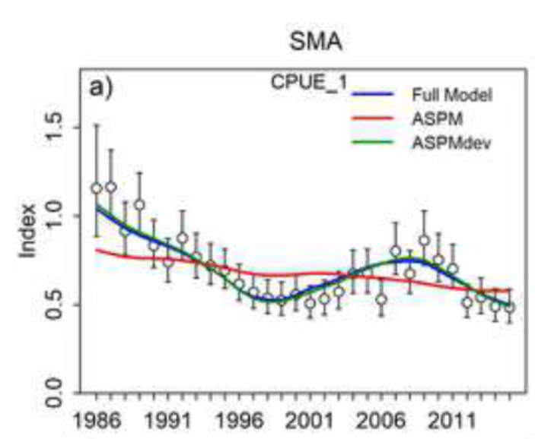
Data weighting
Specify sampling error
Model process variation
Fix model misspecification
Likelihood represents sampling error
  Estimate sampling variance using bootstrap for composition data
  Estimate index CV by fitting ASPM-Rdev
  (N too high and CV too low because can’t remove all model misspecification or model all process variation, but have to do what we can.)
Carvalho et al. in press. A Cookbook for Using Model Diagnostics in Integrated Stock Assessments. Fish. Res.
Maunder, M. N. and Piner, K. R. 2017. Dealing with data conflicts in statistical inference of population assessment models that integrate information from multiple diverse data sets. Fisheries Research. 192: 16-27.

Slide 50
Data weighting
Get N within half an order of magnitude, better than estimating it due to variance bias tradeoff
More evidence to fix sampling variance
Maunder, M. N. 2011. Review and evaluation of likelihood functions for composition data in stock-assessment models: estimating the effective sample size. Fisheries Research, 109: 311–319.

Slide 51
Data weighting
How to deal with Correlated residuals
  Francis sample size of fit to mean length/age
  Bootstrapping observations and represent correlations in multivariate (log)-normal likelihood
  Is it caused by model misspecification?
Maunder, M. N. 2011. Review and evaluation of likelihood functions for composition data in stock-assessment models: estimating the effective sample size. Fisheries Research, 109: 311–319.

Slide 52
Data weighting: Call the BS?
Assign effective sample size and CVs based on sampling error
  Bootstrap compositions
  Fit ASPM-Rdev for index
  Include correlations with a multivariate (log-) normal if needed
Model process variation
Fix model misspecification
Notes:
But the N and sd will probably be over weighted because of unmodeled temporal variation and model misspecification

Slide 53
Process variation
Model process variation when not present - some reduction in precision
Not model process variation when present - possible large bias
Important to model process variation when trends or regime shifts are present
May not need to model simple random variation

Slide 54
Process variation: Questions and issues
Should you model variation if there is little information in the data?
Will modeled variation incorrectly adjusts for other model misspecification?
Should you estimate the sd?
Model using state-space approach rather than random effects due to computational efficiencies, but harder to conceptualize and program.
Do you need to model autocorrelation? (prediction)
Is it practical to estimate (computational time, memory requirements, convergence issues)?

Slide 55
Process variation
What to model it in
  Recruitment - Yes
  Selectivity – Yes for fisheries
  Natural mortality – possibly
  Growth – Yes if have a time series of age-length data

Slide 56
Process variation: Call the BS?
Which processes
  Recruitment
  Selectivity (fisheries)
  Natural mortality (possibly)
  Growth (time series of age-length data)
Use random effects/state-space models if practical otherwise use penalized likelihood and fix sd
Only model autocorrelation if you need it for prediction/projection (e.g. catch quotas in short lived species)

Slide 57
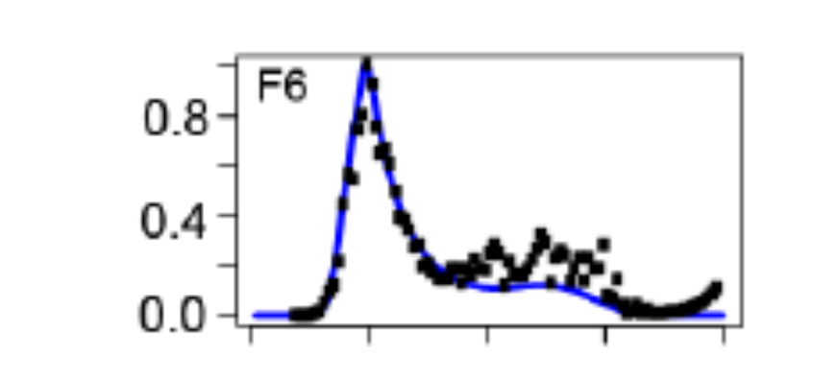
Diagnostics
What diagnostics
  Empirical selectivity
  Age-structured production model
  R0 profile
  Catch-curve diagnostic
  Retrospective analysis
  Hindcast cross validation
  Residual analysis
Carvalho et al. in press. A Cookbook for Using Model Diagnostics in Integrated Stock Assessments. Fish. Res.
Carvalho et al. 2017. Can diagnostic tests help identify model misspecification in integrated stock assessments? Fisheries Research. 192: 28-40.

Slide 58
Diagnostics for model construction
Need algorithm
  Start with good practices model
  Critical values for passing a diagnostic
  Identification of cause of failure
  Recommended solution
Automation
Do retained models have to pass every diagnostic?
Use all models that pass diagnostics
  If bad diagnostic, use all models that could fix problem
Maunder et al. 2020. Implementing reference point-based fishery harvest control rules within a probabilistic framework that considers multiple hypotheses. IATTC Document SAC-11 INF-F REV
Carvalho et al. submitted. A Cookbook for Using Model Diagnostics in Integrated Stock Assessments. Fish. Res.
Carvalho et al. 2017. Can diagnostic tests help identify model misspecification in integrated stock assessments? Fisheries Research. 192: 28-40.

Slide 59
Expert system to construct an ensemble of models for fisheries stock assessment
GPG default assumptions
Integrated assessment
Diagnostics
Pass
Model ensemble
Alternative assumptions to resolve issues
Fail

Slide 60
Diagnostics: Call the BS?
Start with good practices model
Use algorithm to eliminate model misspecification
All models must pass diagnostics

Slide 61
Data-limited methods
Implement them in an integrated model
Makes assumptions explicit
Better represents uncertainty
Can modify and add additional data
Use integrated model unless a comprehensive MSE says otherwise
Minte-Vera et al. 2020. Yellowfin tuna in the eastern Pacific Ocean, 2019: benchmark assessment. IATTC Document SAC-11-07 REV

Slide 62
Data-limited methods: Call the BS?
Use integrated model (unless MSE shows otherwise)
(skip this)

Slide 63
Major Issue #3: Estimating absolute abundance
The main task of stock assessment
Information
  Index of relative abundance: changes in index caused by catch
  Composition data: reduction in composition with age and F ≈ C/N
  Tagging
Initial conditions (not covered)
  Total catch history model
    Stock-recruitment relationship
    Historical catch error
    Regime shifts in recruitment
Most cases estimates are uncertain or biased
Maunder, M.N., Piner, K.R. 2015. Contemporary fisheries stock assessment: many issues still remain. ICES Journal of Marine Science. 72 (1): 7-18

Slide 64
The major issues
Stock structure
Natural mortality
Absolute biomass
(computationally efficient methods to estimate process variation)

Slide 65
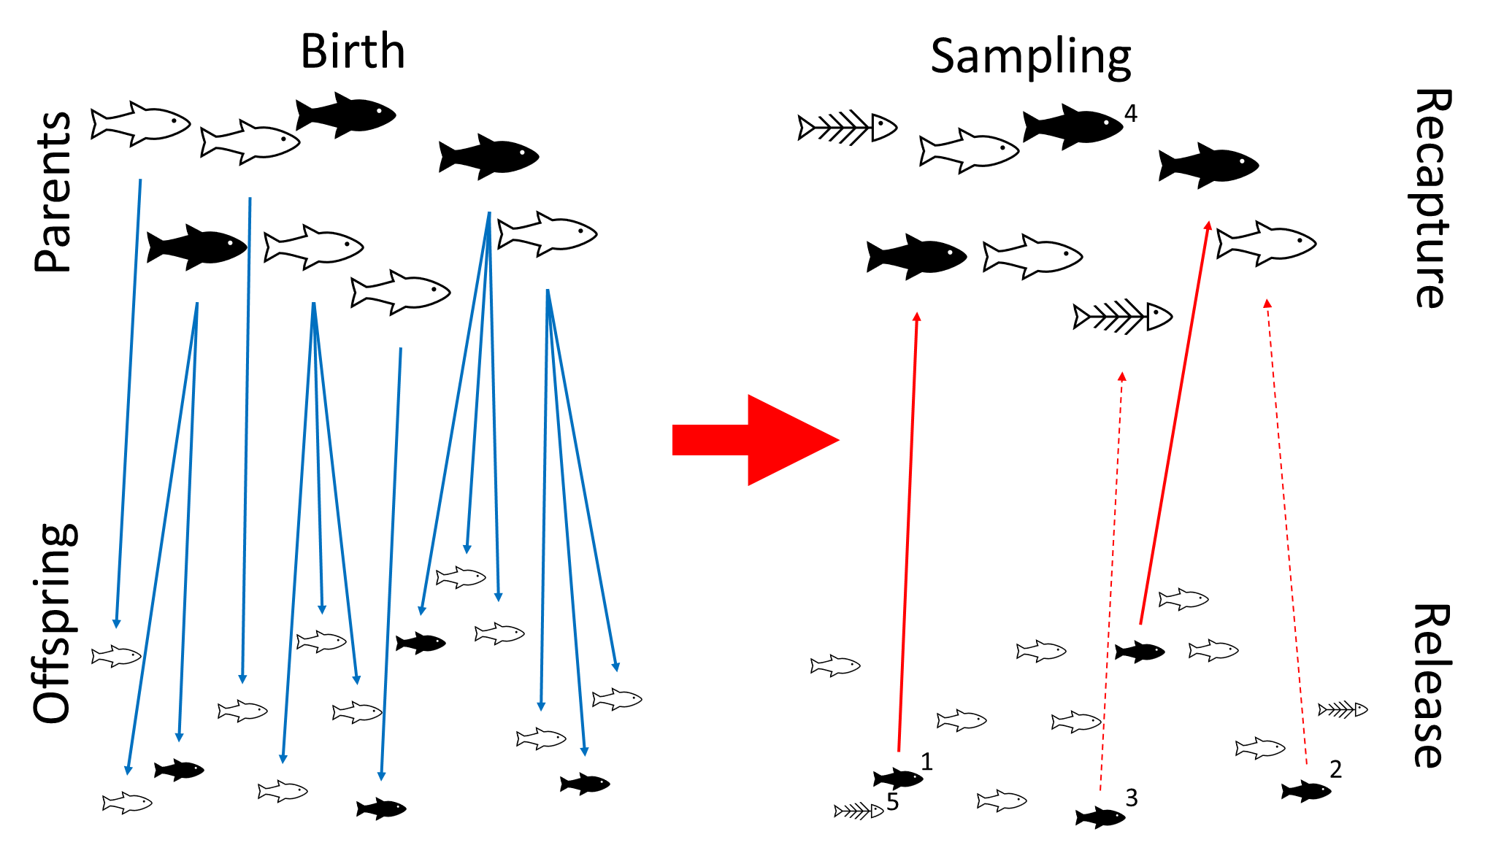
The solution: Close-Kin Mark-Recapture
Stock structure
Adult natural mortality (survival)
Absolute spawner biomass estimates
Still need to estimate
  Juvenile abundance
  Juvenile natural mortality
  Stock-recruitment relationship
Benefits
  Can use dead fish so wider sampling coverage
  No tag induced mortality
  No tag loss
  No miss reporting
  Larval and juvenile dispersal distributes the tags spatially
Bravington, Mark V., Peter M. Grewe, and Campbell R. Davies (2016). “Absolute abundance of southern bluefin tuna estimated by close-kin mark-recapture”. In: Nature Communications 7.
Skaug 2001. Allele-sharing methods for estimation of population size. Biometrics 57, 750-756.
Hillary et al. 2018. Genetic relatedness reveals total population size of white sharks in eastern Australia and New Zealand. Scientific reports 8, 2661-2661.
Bravington et al. 2016. Close-Kin Mark-Recapture. Statistical Science 31, 259-274.

Slide 66
Summary: No BS GPG
Fisheries
  Separate by gear
  Define fisheries based on regression tree analysis of composition data using area, season, and possibly year
CPUE
  Standardize CPUE and composition data using spatio-temporal models
  Create index and composition data using area weighting
  Weight index composition data using CPUE not catch
  Treat index and catch composition separately in the assessment model
Growth
  Estimate growth within the stock assessment model
  Use a flexible growth curve
  Model time varying growth if there is adequate data
  Deal with spatial variation by modeling separate populations (or in specific cases using age specific selectivity) until spatial structure and movement is understood.
Selectivity
  Fisheries
    Remove fish at the right age/size
    Use dome shape selectivities
    Use flexible selectivity curves (e.g. spline, random walk)
    Use time varying selectivities for fisheries
    Refine fisheries to remove weird selectivities (e.g. bimodal)
  Index
    Standardize CPUE and associated composition data using spatio-temporal models
    Use asymptotic time-invariant functional forms if possible
Natural mortality
  Use age and sex-specific natural mortality
  Estimate inside the stock assessment model
  Use the proxies as priors with prediction uncertainty
Recruitment
  Assume recruitment is independent of stock size except in specific situations (e.g. low fecund species, very low population size)
  Use random effects if feasible
  Otherwise
    Fix Rsd at a reasonable value and use penalized likelihood
    Adjust the bias correction appropriately
    Average the over the desired years for management quantities
Data weighting
  Assign effective sample size and CVs based on sampling error
    Bootstrap compositions
    Fit ASPM-Rdev for index
    Include correlations with a multivariate (log-)normal if needed
  Model process variation and fix model misspecification
Process variation
  Which processes
    Recruitment
    Selectivity (fisheries)
    Natural mortality (possibly)
    Growth (time series of age-length data)
  Use random effects/state-space models if practical otherwise use penalized likelihood and fix sd
  Only model autocorrelation if you need it for prediction/projection (e.g. catch quotas in short lived species)
Diagnostics
  Start with good practices model
  Use algorithm to eliminate model misspecification
  All models must pass diagnostics
Data limited
  Use integrated model (unless MSE shows otherwise)
Close-Kin Mark-Recapture
  Implement ASAP

Slide 67
Research questions
Stock structure
  Can spatial structure be modelled using areas as fleets + time varying flexible fishery selectivity + index and composition data for the whole stock?
Fishery definitions
  Should you use one fishery with time varying selectivity, areas as fisheries, or a hybrid approach?
  How to deal with growth and recruitment when using regression tress to define fishery structure?
  When should you stop splitting fisheries?
CPUE standardization
  How does spatial expansion/contraction of the fishery impact indices based on spatio-temporal modelling of CPUE?
  What likelihoods should be used if fishery data is used to create index composition and catch composition?
  Does using a core area for the spatio-temporal model work adequately when there is missing data for big spatial strata
  How can data from multiple gears with different catchability and/or selectivity and different areas be combined in a single spatio-temporal model to improve spatial coverage
Growth
  How to integrate tagging growth increment data into stock assessment models (is penalized or unpenalized likelihood adequate)?
  Need to develop methods to model area specific growth curves in interacting sub-populations
  How to deal with time varying growth?

Slide 68
Research questions
Selectivity
  What is the best time varying selectivity curve for fisheries and how do you estimate the smoothing parameter?
  Is cohort analysis appropriate for some stocks or some fisheries within an assessment model and can you smooth or fill-in data outside the model?
  Is age-time random effect fishery selectivity adequate even if selectivity is length based.
Natural mortality
Recruitment
  Is knowing Rsd approximately and using penalized likelihood adequate or do you need to estimate Rsd and use random effects?
Data weighting
  How can fishery composition data be used to inform annual recruitment (and selectivity), but not influence estimates of abundance?
Process variation
  Make random effect/state-space models practical to implement
  Can you and should you estimate autocorrelation and standard deviation for recruitment (or other process)?

