Slide 1


Simulation of methods to account for spatial effects in the stock assessment of Pacific bluefin tuna
Cast by:
Hui-hua Lee (NOAA Fisheries, SWFSC)
Kevin Piner (NOAA Fisheries, SWFSC)
Mark Maunder (IATTC)
Richard Methot (NOAA Fisheries)

Slide 2
STOCK STATUS (2015)
“… the current F average over 2009-2011 exceeds all target and limit biological reference points (BRPs) commonly used by fisheries managers except for Floss, and the ratio of SSB in 2012 relative to unfished SSB (depletion ratio) is less than 6%...”
F/Fmed
F/F_20%
SSB/SSBmed
SSB/SSB_20%

Slide 3
STOCK STATUS AND CONSERVATION ADVICE (2015)
Projections associated with the 2014 stock assessment examined a suite of recruitment hypotheses, including a low recruitment scenario which is consistent with the preliminary estimate of PBF recruitment in the WPO in 2014. Even with the low recruitment value resampled from the past low recruitment period, the projection results presented to the Plenary showed that the initial rebuilding goal adopted by WCPFC to recover to SSBmed by 2024 with a >60% probability can be achieved.
The catch in 2014 (17,076 t) was similar to that in 2011 (17,107 t), and increased from the 2012-2013 level (13,109 t in average), in most size classes on both sides of the Pacific Ocean. However, there was no indication of a significant increase in fishing effort, which may suggest an increase in the availability or catchability of fish. Although the catch in 2014 was consistent with the conservation measures adopted by RFMOs, the increase could affect the recovery. The impact of these increases is yet to be analyzed and will be assessed by the PBFWG in the next assessment.
Based on the above observations, the ISC provides the following conservation advice.
In relation to the projections requested by NC9, only Scenario 6, the strictest one, resulted in an increase in SSB even under a low recruitment scenario.
If the low recruitment of recent years continues, the risk of SSB falling below its historically lowest level observed would increase. This risk can be reduced with implementation of more conservative management measures.
If the specifications of the harvest control rules used in the projections were modified to include a definition of juveniles that is more consistent with the maturity ogive used in the stock assessment, projection results could be different; for example, rebuilding may be faster. The various harvest scenario projections defined “juvenile” based on weight, which is inconsistent with what the WG used (age). Any proposed reductions in juvenile catch should consider all non-mature individuals.
Given the low level of SSB, uncertainty in future recruitment, and importance of recruitment in influencing stock biomass, monitoring of recruitment and SSB should be strengthened to allow the trend of recruitment and SSB to be understood in a timely manner.
Stock status in bad shape!
Data are poorly fitted!

Slide 4
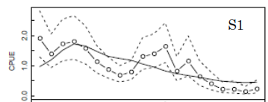
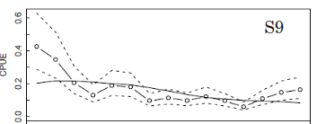

Poor fit to primary indices of adult fish

Slide 5
Poor fit to size compositions
6%
28%
2%
3%
% Catch in wt
F6: 6%
F13: 0.4%
F14: 2%
18%
10%
3%
24%
4%
3%
2%
R0 profile:
Influence of miss-fit

Slide 6
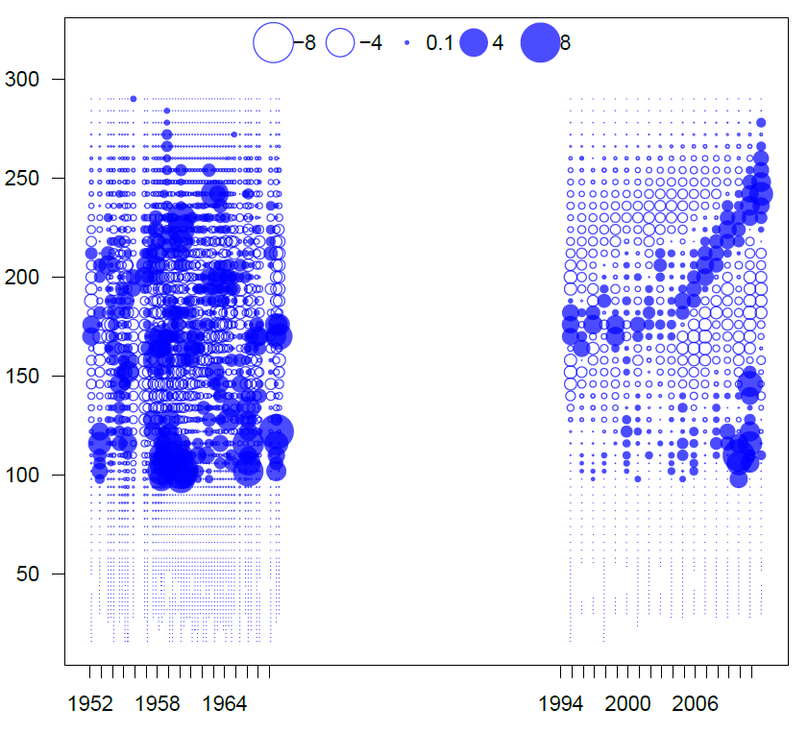
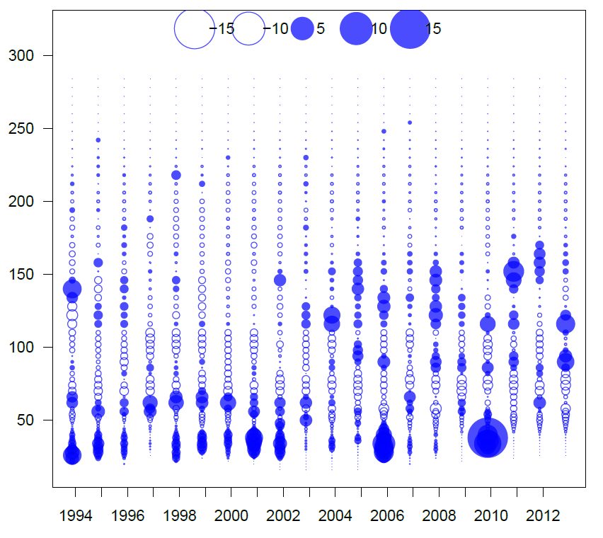
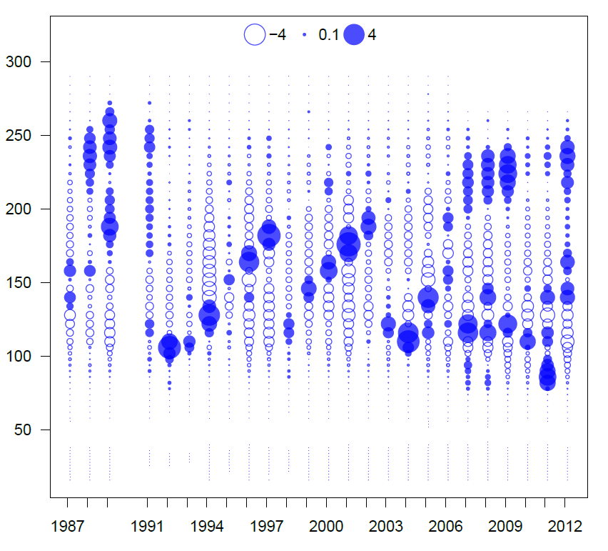
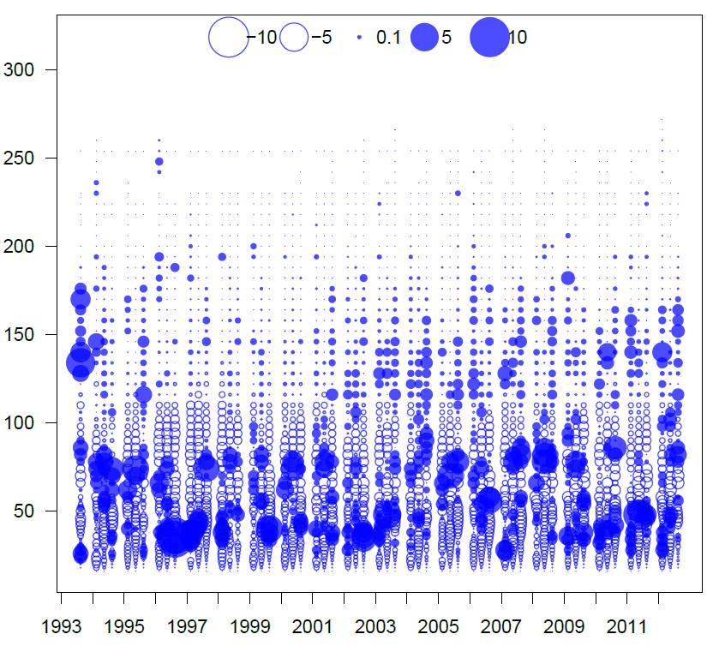
F1JPLL
F5JPTroll
F10JPSet
F3TunaPSJS
F9JPSet
F12EPOPS

Slide 7
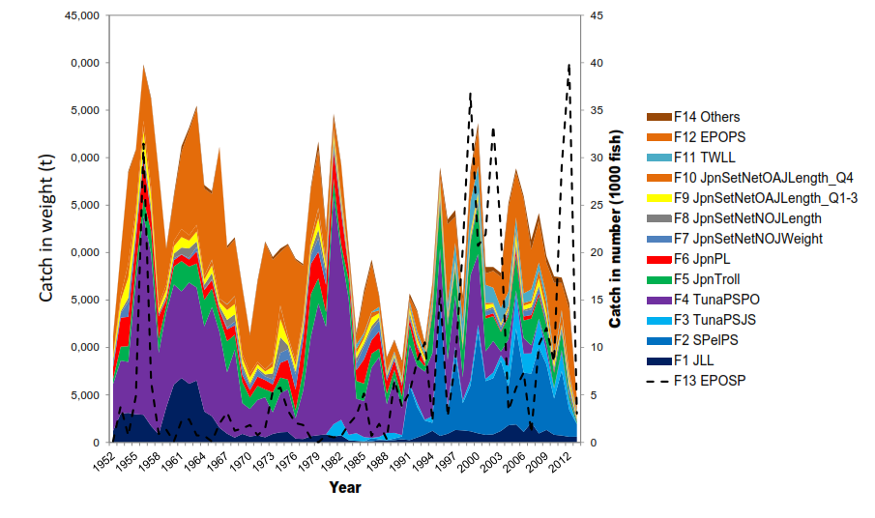
Two big Issues in the modelling
Numerous complex fisheries
11 out of 14 fleets has size comp
Missing modelled process
(Spatial movement and time-varying selectivity)

Slide 8
Migration
Purse seine:
1-5 yr
Longline: 5+ yr
WWF
Notes:
Spawning grounds are located southern (April to July) and northern (July to August).

Slide 9
Migration
Age 1
Setnet: 0-3
EPO fisheries: Age 1-3
Age 0-1
Troll: age 0
Age 3-4
Age 5+
WWF
Notes:
After they hatch from eggs, they travel along the coast of Japan looking for food. Some Bluefin travel across Pacific when they become one year old. Spent few years in EPO.

Slide 10
Earlier work on spatially explicit model
Estimate movement without direct observations (movement could absorb noise?)
Improve the fit of CPUE
Movement model provide similar dynamics to the base model

Slide 11

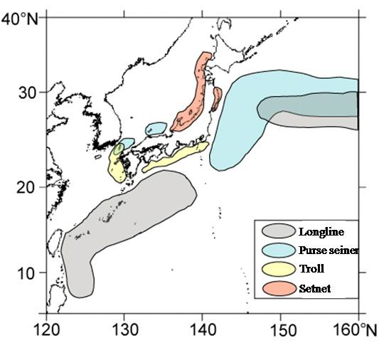
2014 assessment
It does not explicitly model movement process.
It assumes an instantaneously mixed population.
It incorporates region selection patterns and catchability coefficients to account for spatial effects (area-as-fleet).
Time-invariant selection process.
WWF

Slide 12
Objectives
Not attempt to solve the misfit in the assessment (although It is important!)
Evaluate the methods to account for spatial effect (structure of movement and approximations of process) and choose structure across scenarios and states of nature using simulation testing before next assessment in 2016

Slide 13
Operating models
Randomly select recruitment deviations, movement deviations and fishery attributes
Generate synthetic populations
Assume observation errors are precise
Estimation models
Various methods to structure spatial aspects
500 iterations
Performance measures
Compare to true derived quantities (Qest-Qtrue)/Qtrue

Slide 14
Operating models
Two areas with movement
Fleet component
Six fleets: one age-0 fleet, one adult fleet, four Age 1-5 fleets (one EPO, three WPO)
61 yrs dynamics with variety of fishing mortality trajectories for each fleet
Fixed selection patterns from the assessment (time-invariant)
Biology parameters
Fixed: growth; natural mortality; S-R relationship (steepness, sigmaR)
Random: rec_dev = normal(0, sigmaR); move_dev

Slide 15
Operating models - movement
WPO
EPO
Control the mean movement rate but trend could be in different states of nature
Notes:
Age 1 fish start move from WPO to EPO
Age 4 fish all move back to WPO from EPO

Slide 16
Operating models - movement
Time-varying trend
Uniform
low frequency variability (multi-decadal ~40-50 yrs; PDO)
Notes:
Age 1 fish start move from WPO to EPO
Age 4 fish all move back to WPO from EPO
1. uniform
2. low frequency variability (multi-decadal ~40-50 yrs; PDO)
3. high frequency variability (~4-5 yrs; El Nino)

Slide 17
Estimation models
EM1. Model the real process (spatial with movement, two areas)
EM2. Miss-specified movement (one area)
EM3. Model with substitute process (one area, time-varying selection)
EM4. Increase observation error to account for unmodeled process (one area)
EM5. Combined fleets structure with respect to spatial process (one area, flexible and time-varying selection)

Slide 18
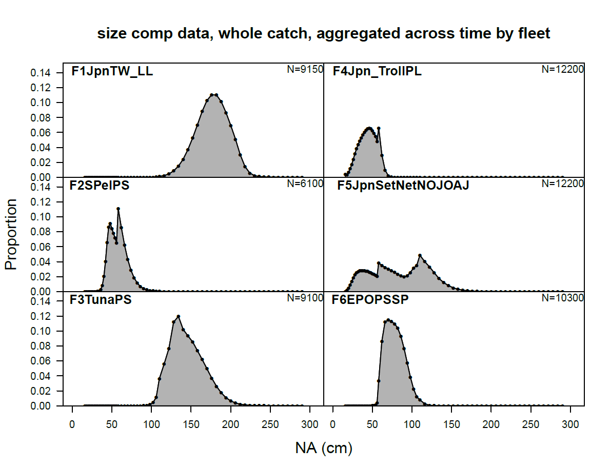
Estimation models
EM5. Combined fleets structure with respect to spatial process
 | Age-0 fleet | Adult fleet | Combined fleet
Age group | 0 | 7+ | 1-6
Indices | Yes | Yes | No
Size | Yes | Yes | Yes (catch weighted)
Selection | length-based & time-invariant | length-based & time-invariant | age-based & time-varying length-based & time-invariant
Example

Slide 19
Results
Summarize quantities of interest across states of nature
Present the results that are hessian invertible
Quantities of interest: management and terminal year

Slide 20
Ideal: Model the real process (movement)
In reality: no direct observations
Ignore the real process (one area)

Slide 21
# pars
164
102
# hessian
500
500
500
500

Slide 22
# pars
164
102
# hessian
500
500
500
500

Slide 23
Ideal: Model the real process (movement)
Ignore the real process (one area)
Model substitute process, time-varying length-based
selection (one area)

Slide 24
# pars
164
102
285
# hessian
500
500
325
500
500
179

Slide 25
# pars
164
102
285
# hessian
500
500
325
500
500
179

Slide 26
Ideal: Model the real process (movement)
Ignore the real process
Model substitute process, time-varying selection (one area)
Increase observation error to account for unmodeled process (one area)

Slide 27
# pars
164
102
285
102
# hessian
500
500
325
500
500
500
179
500

Slide 28
# pars
164
102
285
102
# hessian
500
500
325
500
500
500
179
500
Notes:
Get the same biases as M3. Perhaps get more process or downweight other problematic data components on top of M2 would help
Time-varying on one fishery have additional 122-183 estimated pars (61 yrs).. Have time-varying on more than one fisheries may cause most of model runs with invertible hessian

Slide 29
Ideal: Model the real process (movement)
Ignore the real process
Model substitute process, time-varying selection
Increase observation error to account for unmodeled process
Combined fleets structure with respect to spatial process in ways to eliminate the problematic model processes
- time-varying age-based + time invariant length-based selection

Slide 30
# pars
164
102
285
102
531
# hessian
500
500
325
500
205
500
500
179
500
211

Slide 31
# pars
164
102
285
102
531
# hessian
500
500
325
500
205
500
500
179
500
211

Slide 32
General conclusion
Management quantities (MSY related) unbiased across model structures and states of nature
Model the real process perform the best (unbiased & precise) across model structures and states of nature
Under the context of uniform movement process,
EM2 (ignore the process), EM3 (substitute process), EM4 (increase observation error), EM5 (combined fleets) perform similarly.
Under the context of PDO-like movement process,
Time-invariant models (EM2 & EM4) perform the worst with bimodal relative error.
Time-varying models (EM3 & EM5) perform marginal better but might lose ability to obtain invertible hessian. Solutions are to fine tuning the model or/and estimate time-varying parameters with penalty.

Slide 33
General conclusion
Under the context of PDO-like movement process,
The bimodal RE in time-invariant models (EM2 & EM4) appear to be shown in recent years

Slide 34
General conclusion
Under the context of PDO-like movement process,
The bimodal RE in time-invariant models (EM2 & EM4) appear to be shown in recent years
This bimodal RE might be associated with low stock biomass size.
This association is not clear and more work needs to be done.

Slide 35
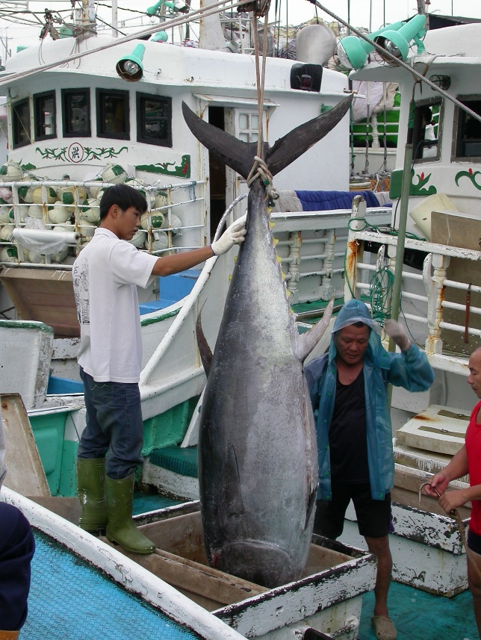
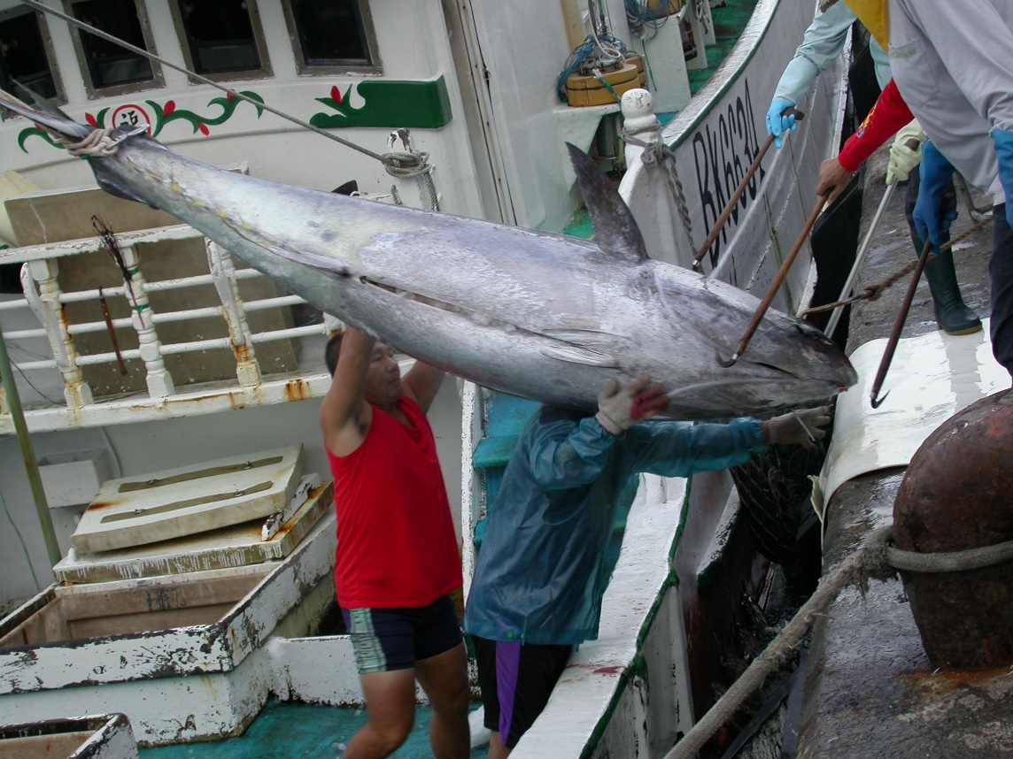
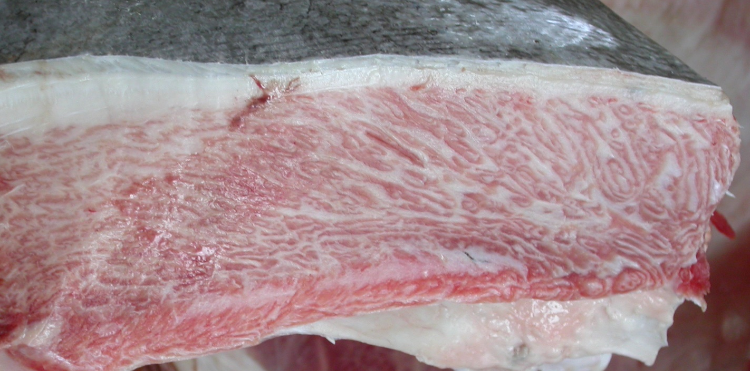
Thank you!
Comments?

Slide 37
EM3 (model substitute process, time-varying length-based selection)
Biased if all problematic data components are not modeled with substitute process
An example
EM2
EM3
TV on EPO
Not enough and still have problematic data components!
Notes:
Process on EPO is not enough. Still have problematic data components

Slide 38
Can we model as many time-varying processes as we want?
In the case of time-varying parameters are estimated independently
 | EM1 | EM2
# of estimated pars | 164 | 102
# of runs w/ invertible hessian out of 500 runs | 0 | 0
EM3 (time-varying len-based selex)
285 on EPO; 468 on EPO & Setnet; 834 on 4 fleets
175 on EPO; 228 on EPO & Setnet; 495 on 4 fleets

