Slide 1


Extending length-based models for data-limited fisheries into a state-space framework
Merrill B. Rudd* and James T. Thorson
*PhD Student, School of Aquatic and Fishery Sciences, University of Washington
CAPAM Workshop on Data Weighting
October 22, 2015

Slide 2
Length-based methods for data-limited fisheries
Easy and straightforward to take length measurements
Length-based spawning potential ratio (Hordyk et al. 2015)
Mean-length estimators of fishing mortality (Beverton and Holt 1957, Ault et al. 2005, Gedamke and Hoenig 2006, Nadon et al. 2015)
Assume equilibrium conditions or set breakpoints to represent changes in fishing mortality over time
Notes:
Length-based spawning potential ratio (LBSPR) and mean-length estimators of fishing mortality are increasingly used in assessments for data-limited species,
Especially for coral reef fish species in Hawaii, Florida, and the Caribbean
And LB-SPR is gaining momentum as a data-limited fisheries assessment methods for the marine stewardship council
However, these methods assume equilibrium conditions or set breakpoints a priori to represent changes in fishing mortality over time
Many of these assessments visually assess mean length data and see that it doesn’t change much over time to confirm that recruitment and fishing mortality are relatively constant, so they can rationalize using a set value for total mortality over time and assume constant recruitment in the population models.

Slide 3
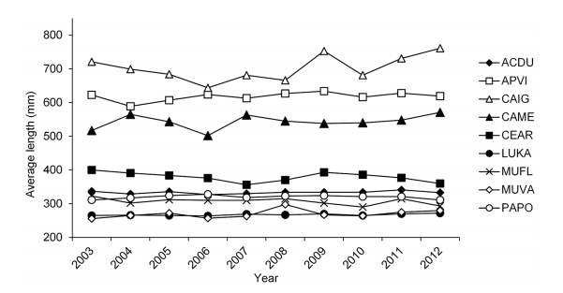
Coral reef fishery example 1: Hawaii
Nadon et al. 2015, PLoS ONE
Mean length reflects changes in fishing mortality
Data sources:
Life history information compiled from the literature
Diver surveys
Commercial fishery trip reports
Figure 3. Nadon et al. 2015
Time series of average lengths in the exploited phase of the population.

Slide 4
Coral reef fishery example 1: Hawaii
Nadon et al. 2015, PLoS ONE
Mean length reflects changes in fishing mortality
Data sources:
Life history information compiled from the literature
Diver surveys
Commercial fishery trip reports
Figure 3. Nadon et al. 2015
Time series of average lengths in the exploited phase of the population.
Notes:
Ault et al. 2005 demonstrated that estimates of mortality from mean length were robust to moderate levels of recruitment variation

Slide 5
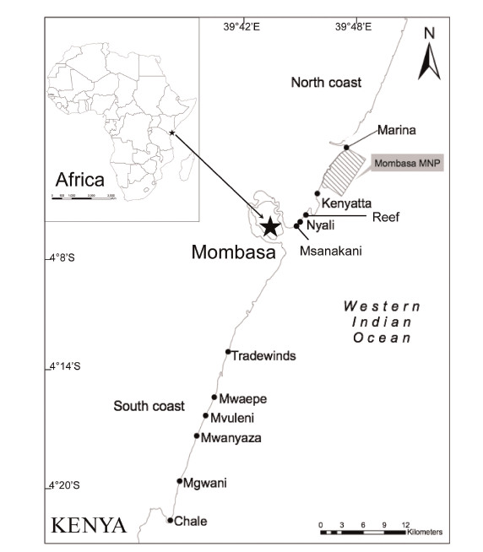
Coral reef fishery example 2: Kenya
Hicks and McClanahan 2012, PLoS ONE
Catch curve and Beverton-Holt mean length estimator will be sensitive to changes in recruitment
- Short lived fisheries and heavily exploited
Data sources:
Life history information compiled from literature
Port surveys of length composition and effort
Figure 1. From Hicks and McClanahan 2012 PLoS ONE

Slide 6
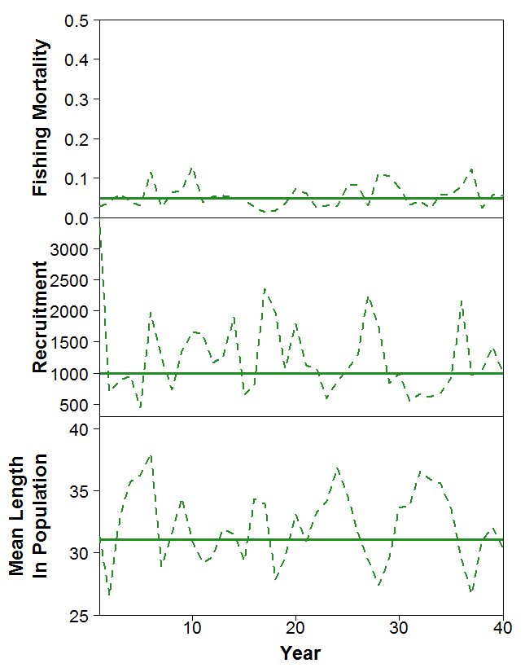
Potential need for direct consideration of recruitment variation
Changes in fishing mortality and recruitment are confounded
Notes:
However, the major issue for these assessment methods is that from the mean length or length composition, if there are many smaller fish, we don’t know if these are new recruits or if the larger fish have been harvested and the age structure has been truncated
Top – fishing mortality
Middle – recruitment
Bottom – mean length in population
Solid line is deterministic, dotted line is stochastic

Slide 7
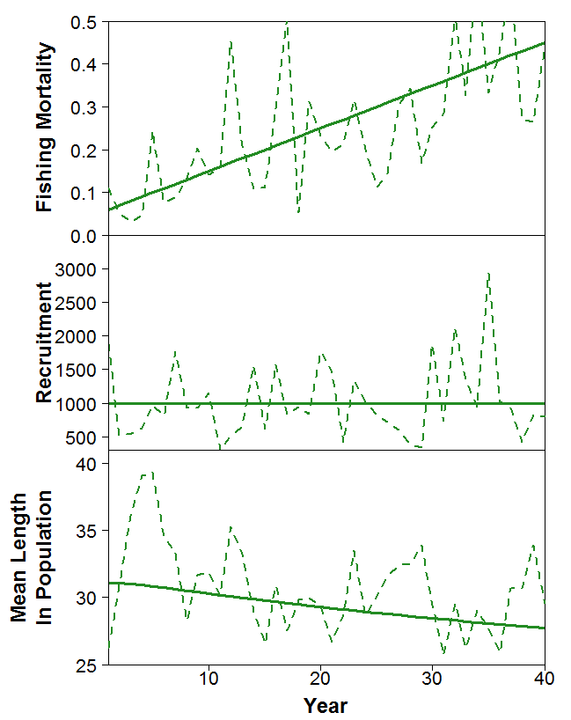
Potential need for direct consideration of recruitment variation
Changes in fishing mortality and recruitment are confounded
Notes:
As fishing mortality increases and recruitment remains constant, we expect mean length in population to decrease.
Can use this as an indicator that fishing mortality may need to be managed

Slide 8
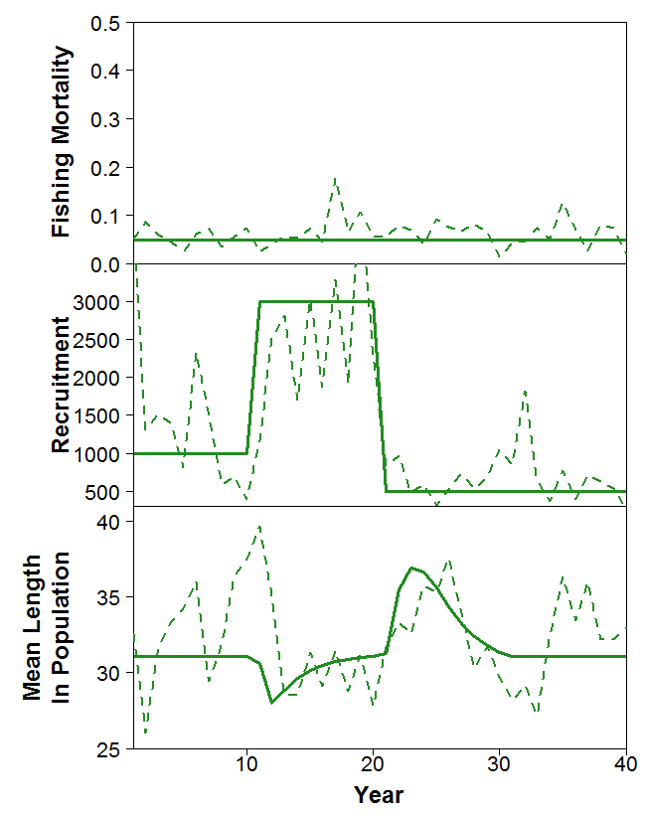
Potential need for direct consideration of recruitment variation
Changes in fishing mortality and recruitment are confounded
Notes:
However, when we have a pulse and/or drop in recruitment, but fishing mortality remains the same, we see that changes in recruitment comes with its own patterns in how mean length changes in the population
After a big recruitment pulse we expect to see a sharp decline in mean length, followed by an increase in mean length as those individuals grow.

Slide 9
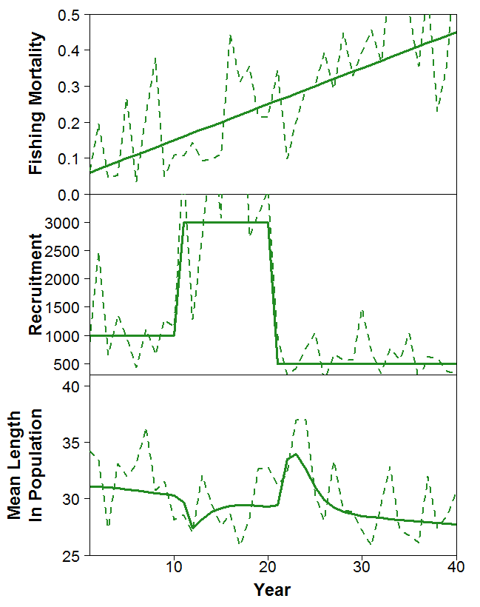
Potential need for direct consideration of recruitment variation
Changes in fishing mortality and recruitment are confounded
Notes:
When we have both an increase in fishing mortality and pulses in recruitment, along with process error and observation error, there is potentially no distinguishable change in mean length
This indicates it may be important to tease apart changes in fishing mortality and recruitment when using length composition or mean length as a primary data source.

Slide 10
Goal of this study
Alternative to equilibrium-based methods in data-poor situations mostly reliant on length composition data
Development
State-space model to account for recruitment variation
Tested under varying data availability scenarios
Notes:
Use this program to explore theoretical properties of the length composition data
And the requirements of the catch and abundance index in order to partition variation in the length composition into recruitment and fishing mortality
Flexible to be used in contexts with varying amounts of catch, index, and length composition data

Slide 11
Operating model
Age-converted to length-structured population dynamics
Abundance
(Hordyk et al. 2015)
Mortality
Notes:
Age-converted to length-structured underlying population dynamics
Where I assumed the maximum age was at 1% survivorship – this is just the same as the way Adrian Hordyk set up his LB-SPR method
Mortality is a function of a fixed natural mortality rate, age-structured selectivity, and the fishing mortality rate over time (which I will get to)
Catch follows the Baranov catch equation

Slide 12
Operating model
Age-converted to length-structured population dynamics
Abundance
Maturity
Growth
Slow-growing:
k = 0.1
L∞ = 60 cm
M = 0.184
Amax = 26
Fast-growing:
k = 0.2
L∞ = 30 cm
M = 0.37
Amax = 13
(Williams and Shertzer 2003)
(Hordyk et al. 2015)
Mortality
(Thorson and Cope 2015)

Slide 13
Operating model
Age-converted to length-structured population dynamics
Abundance
Maturity
Growth
Slow-growing:
k = 0.1
L∞ = 60 cm
M = 0.184
Amax = 26
Fast-growing:
k = 0.2
L∞ = 30 cm
M = 0.37
Amax = 13
(Williams and Shertzer 2003)
(Hordyk et al. 2015)
Mortality
Selectivity
(Thorson and Cope 2015)

Slide 14
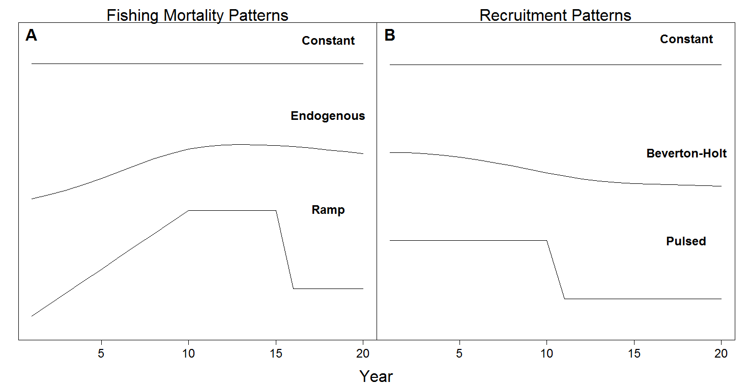
Operating model – fishing and recruitment dynamics
Notes:
Effort dynamics model from Thorson et al. 2013 that is based on biomass at equilibrium, acceleration rate, an initial fishing mortality – to generate stochastic realizations of fishery development with an equilibrium value around 25% of unfished biomass

Slide 15
Operating model – generating length composition
Probability of being in a length bin given age
Notes:
Check other notation

Slide 16
Operating model – generating length composition
Probability of being in a length bin given age
Probability of harvesting in a given length bin
Notes:
Check other notation

Slide 17
Operating model – generating length composition
Probability of being in a length bin given age
Probability of harvesting in a given length bin
Probability of sampling a given length bin
Notes:
Check other notation

Slide 18
Operating model – generating length composition
Probability of being in a length bin given age
Probability of harvesting in a given length bin
Probability of sampling a given length bin
Notes:
Check other notation

Slide 19
Operating model – data generation
Data Scenario | Catch | Index | Length Composition
Ultra-rich | Full catch known | Full effort known (CPUE index) | 10,000 samples annually
Rich | Full catch known | Full effort known (CPUE index) | 2,000 samples annually
Moderate | 20% of catch accounted for | 20% of effort accounted for (CPUE index) | 500 samples annually
Poor A | 20% of catch accounted for | 20% of effort accounted for (CPUE index) | 50 samples annually
Poor B | Catch not accounted for | Fishery-independent index | 500 samples in final year
Poor C | Catch not accounted for | No index | 2,000 samples in final year

Slide 20
Operating model – data generation
Data Scenario | Catch | Index | Length Composition
Ultra-rich | Full catch known | Full effort known (CPUE index) | 10,000 samples annually
Rich | Full catch known | Full effort known (CPUE index) | 2,000 samples annually
Moderate | 20% of catch accounted for | 20% of effort accounted for (CPUE index) | 500 samples annually
Poor A | 20% of catch accounted for | 20% of effort accounted for (CPUE index) | 50 samples annually
Poor B | Catch not accounted for | Fishery-independent index | 500 samples in final year
Poor C | Catch not accounted for | No index | 2,000 samples in final year

Slide 21
Operating model – data generation
Data Scenario | Catch | Index | Length Composition
Ultra-rich | Full catch known | Full effort known (CPUE index) | 10,000 samples annually
Rich | Full catch known | Full effort known (CPUE index) | 2,000 samples annually
Moderate | 20% of catch accounted for | 20% of effort accounted for (CPUE index) | 500 samples annually
Poor A | 20% of catch accounted for | 20% of effort accounted for (CPUE index) | 50 samples annually
Poor B | Catch not accounted for | Fishery-independent index | 500 samples in final year
Poor C | Catch not accounted for | No index | 2,000 samples in final year

Slide 22
Operating model – data generation
Data Scenario | Catch | Index | Length Composition
Ultra-rich | Full catch known | Full effort known (CPUE index) | 10,000 samples annually
Rich | Full catch known | Full effort known (CPUE index) | 2,000 samples annually
Moderate | 20% of catch accounted for | 20% of effort accounted for (CPUE index) | 500 samples annually
Poor A | 20% of catch accounted for | 20% of effort accounted for (CPUE index) | 50 samples annually
Poor B | Catch not accounted for | Fishery-independent index | 500 samples in final year
Poor C | Catch not accounted for | No index | 2,000 samples in final year

Slide 23
Operating model – data generation
Data Scenario | Catch | Index | Length Composition
Ultra-rich | Full catch known | Full effort known (CPUE index) | 10,000 samples annually
Rich | Full catch known | Full effort known (CPUE index) | 2,000 samples annually
Moderate | 20% of catch accounted for | 20% of effort accounted for (CPUE index) | 500 samples annually
Poor A | 20% of catch accounted for | 20% of effort accounted for (CPUE index) | 50 samples annually
Poor B | Catch not accounted for | Fishery-independent index | 500 samples in final year
Poor C | Catch not accounted for | No index | 2,000 samples in final year

Slide 24
Operating model – data generation
Data Scenario | Catch | Index | Length Composition
Ultra-rich | Full catch known | Full effort known (CPUE index) | 10,000 samples annually
Rich | Full catch known | Full effort known (CPUE index) | 2,000 samples annually
Moderate | 20% of catch accounted for | 20% of effort accounted for (CPUE index) | 500 samples annually
Poor A | 20% of catch accounted for | 20% of effort accounted for (CPUE index) | 50 samples annually
Poor B | Catch not accounted for | Fishery-independent index | 500 samples in final year
Poor C | Catch not accounted for | No index | 2,000 samples in final year

Slide 25
Reference point:
Spawning potential ratio (SPR)
Annual Biomass
Spawning Potential Ratio (SPR)
Unfished biomass
(Nadon et al. 2015, Ault et al. 2008)
Notes:
Other length-based methods work with SPR as a reference point
Calculate SPR based on equilibrium assumptions in snapshot years
In this model – can essentially calculate depletion in each year as a metric upon which to eventually compare to LBSPR method
So for this presentation, will assess the model’s ability to estimate depletion or SPR without bias.
Based on comparison of spawning biomass annually to the spawning biomass at the estimated global median recruitment in the unfished condition

Slide 26
Estimation model – implemented using Template Model Builder
Inputs
Fixed parameters
Von Bertalanffy Linf and k
Maturity curve
Natural mortality
CV for length-at-age
CV for observed catch and index
Data inputs
Length composition
Catch time series
Abundance index time series
Notes:
I assume I know the true values of Linf and k, the maturity curve, natural mortality rate, and CVs for the uncertainty in length-at-age and the observed catch and index
This is a giant laundry list of assumptions – and I plan to conduct more sensitivity analyses
However, these are the same assumptions made for the equilibrium-based methods currently in use
Data inputs – flexible! Requires at least 1 year of length composition data, just like the other length-based data-poor methods
But can also take some measure of catch
While I do not estimate catch, at least acts as a minimum harvested
Can also take an abundance index, whether that be fishery-dependent (CPUE) or independent

Slide 27
Estimation model – implemented using Template Model Builder
Inputs
Fixed parameters
Von Bertalanffy Linf and k
Maturity curve
Natural mortality
CV for length-at-age
CV for observed catch and index
Data inputs
Length composition
Catch time series
Abundance index time series
Outputs
Estimated
Annual fishing mortality (fixed effect)
Global mean recruitment
Random effects on annual recruitment
Recruitment variation (σ_{R})
Catchability coefficient
Logistic selectivity parameters
Performance measure
- SPR
Notes:
Options to estimate annual fishing mortality as a fixed effect – informed by catch data, length composition since it arises from the predicted catch
Recruitment as a random effect
Meaning it estimates global mean recruitment and then the random effects for the annual variability in recruitment
Also a standard deviation representing the recruitment variation
Gets information from length composition
Catchability coefficient when an index is available
And the parameters for a logistic selectivity curve
End goal – derive a value for spawning potential ratio
Looking for ability to detect depletion

Slide 28
Estimation model – age-converted to length-structured
Recruitment
(Methot and Taylor 2011)
Notes:
As we’ve gone over in the discussion of process error, the annual level of recruitment is estimated as a deviation from a global mean estimate of recruitment
Where this deviation is drawn from a distribution with mean 0 and standard deviation sigmaR
Run the whole estimation model 2 times, first to get an estimate of the standard error for the recruitment deviations
And then set the bias correction factor based on those estimates , re-run to get our final estimates of recruitment with the bias adjustment

Slide 29
Estimation model – age- converted to length-structured
Recruitment
Abundance
Mortality
(Methot and Taylor 2011)
Notes:
The abundance model is set up the same way as in the operating model, where the maximum age is assumed to be when 1% of the individuals would still be alive based on the fixed level of natural mortality

Slide 30
Estimation model – age- converted to length-structured
Recruitment
Abundance
Mortality
Selectivity
(Methot and Taylor 2011)
Notes:
The selectivity parameters are set up to be estimated, and then the mortality is based on the estimated fishing mortality and derived catch

Slide 31
Estimation model – maximum penalized likelihood
TMB

Slide 32
Estimation model – maximum penalized likelihood
TMB

Slide 33
Estimation model – maximum penalized likelihood
TMB

Slide 34
Estimation model – maximum penalized likelihood
TMB
Penalty on fishing mortality
Notes:
Penalty on fishing mortality was useful in the very data poor scenarios to keep the estimated fishing mortality from dropping to 0

Slide 35
Estimation model – maximum penalized likelihood
TMB
Penalty on fishing mortality
Penalty on depletion in initial year
Notes:
Penalty on fishing mortality was useful in the very data poor scenarios to keep the estimated fishing mortality from dropping to 0

Slide 36
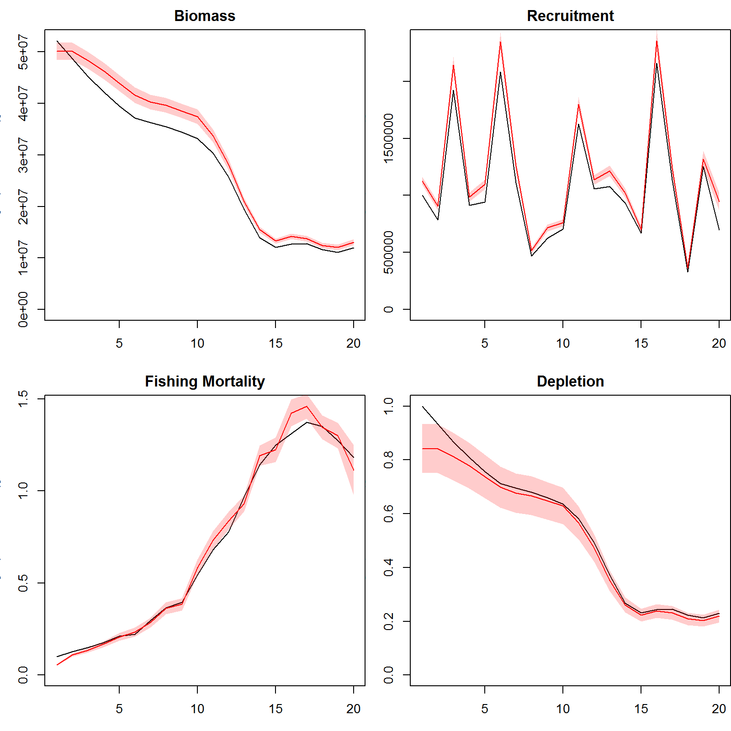
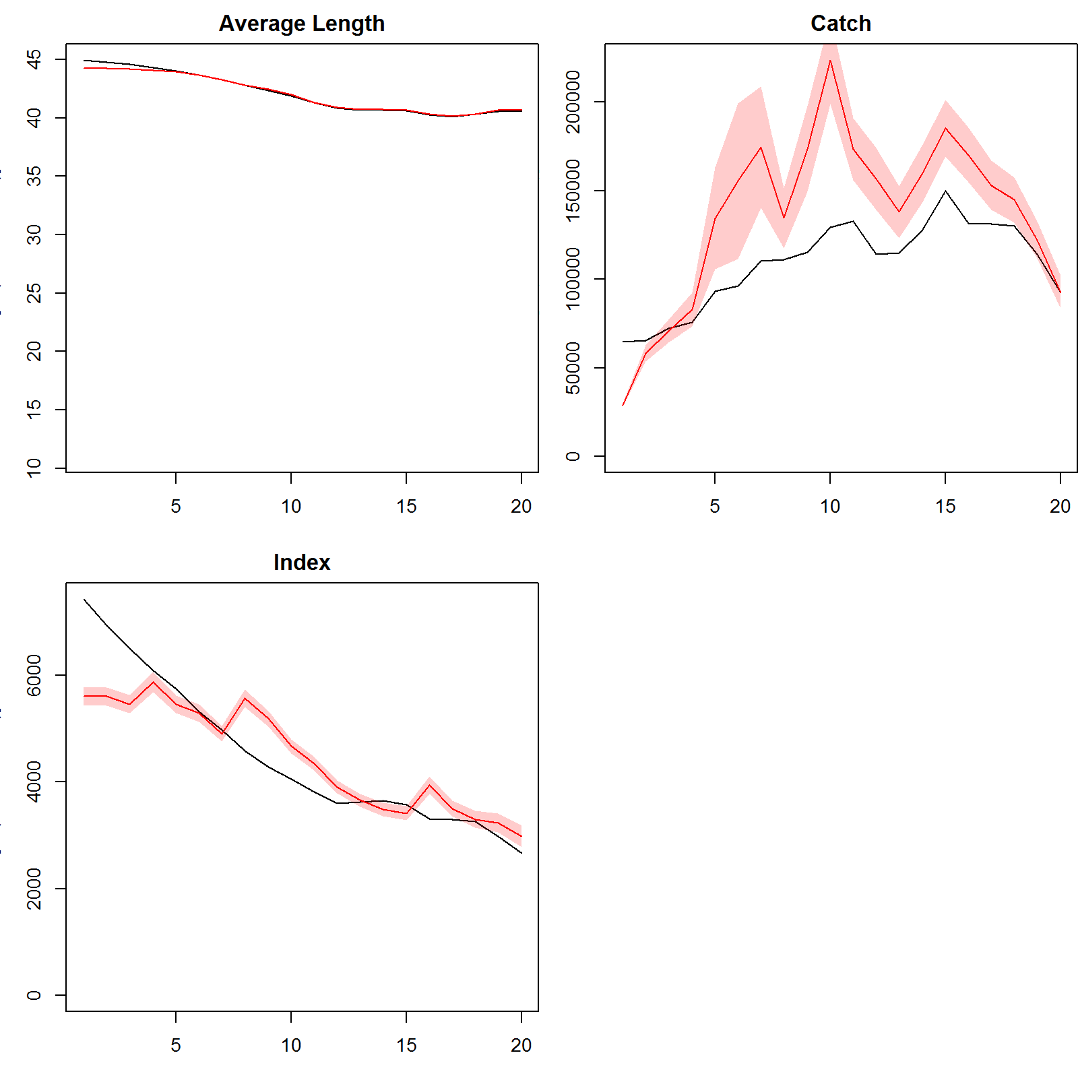
Model fits- Endogenous F, Constant R
Ultra-Rich Data Scenario
Biomass
Recruitment
Mean Length
Catch
Fishing mortality
Depletion
Index

Slide 37
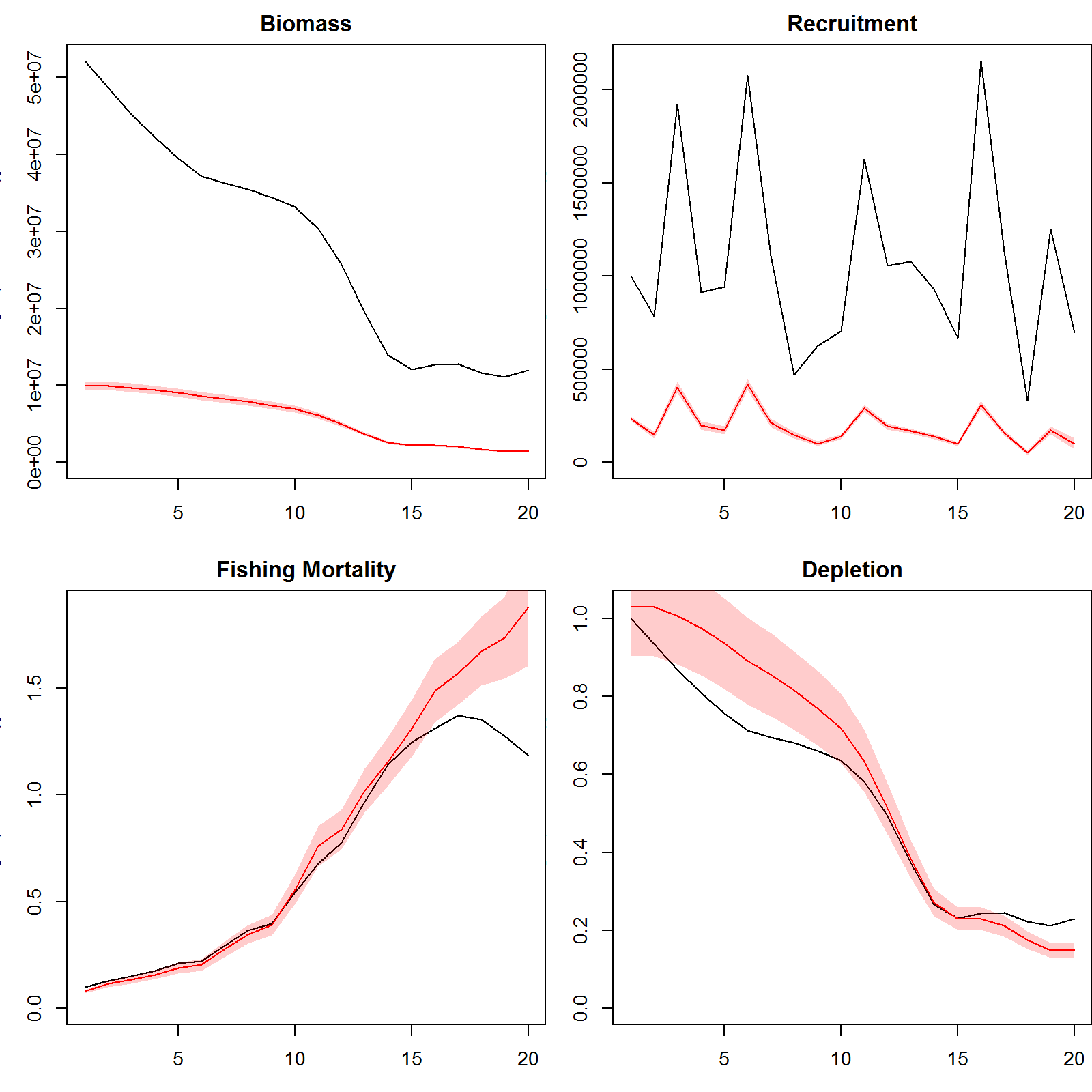
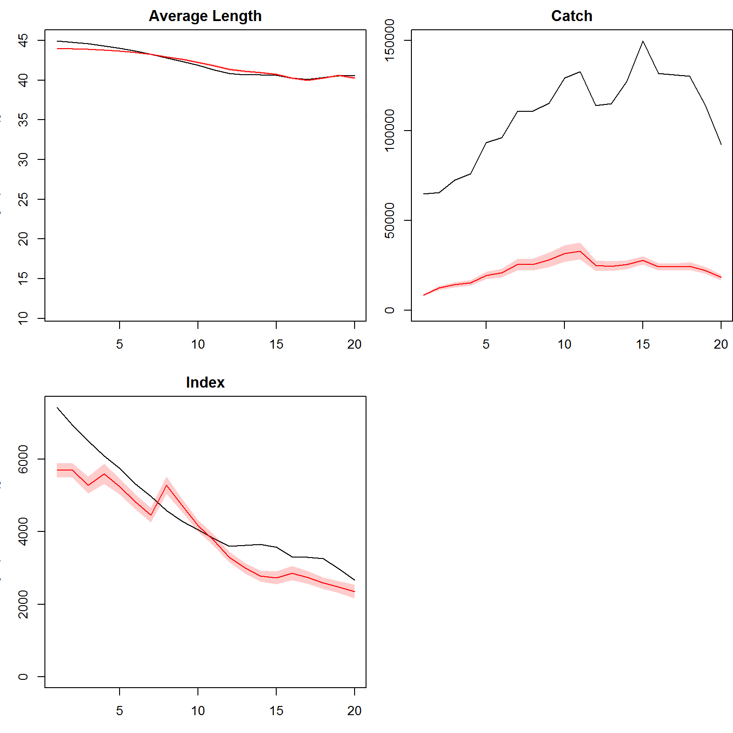
Model fits- Endogenous F, Constant R
Moderate Data Scenario
Biomass
Recruitment
Mean Length
Catch
Fishing mortality
Depletion
Index

Slide 38
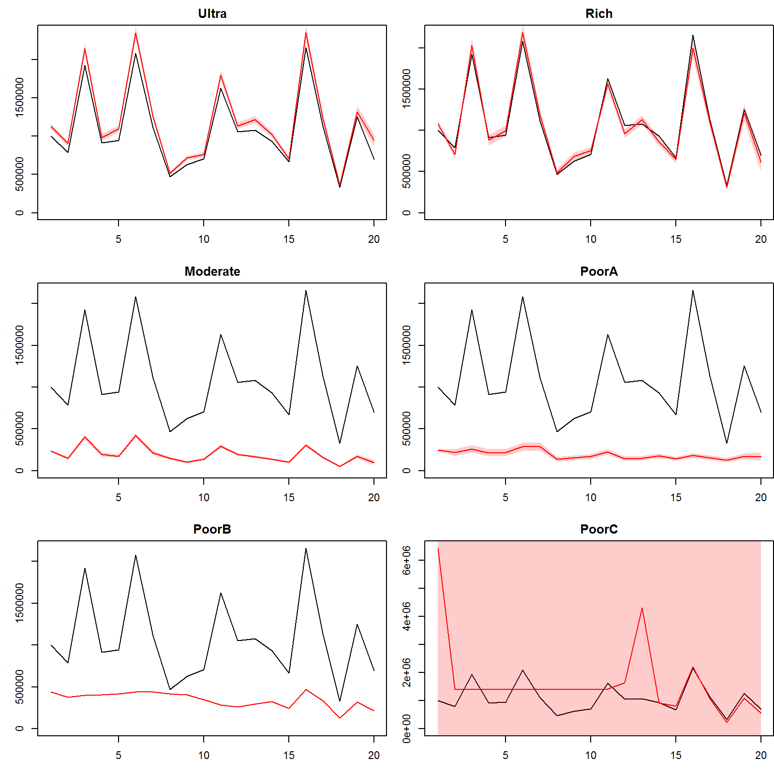
Model fits - Endogenous F, Constant R
Recruitment
Ultra
Rich
Moderate
Poor A
Poor B
Poor C

Slide 39
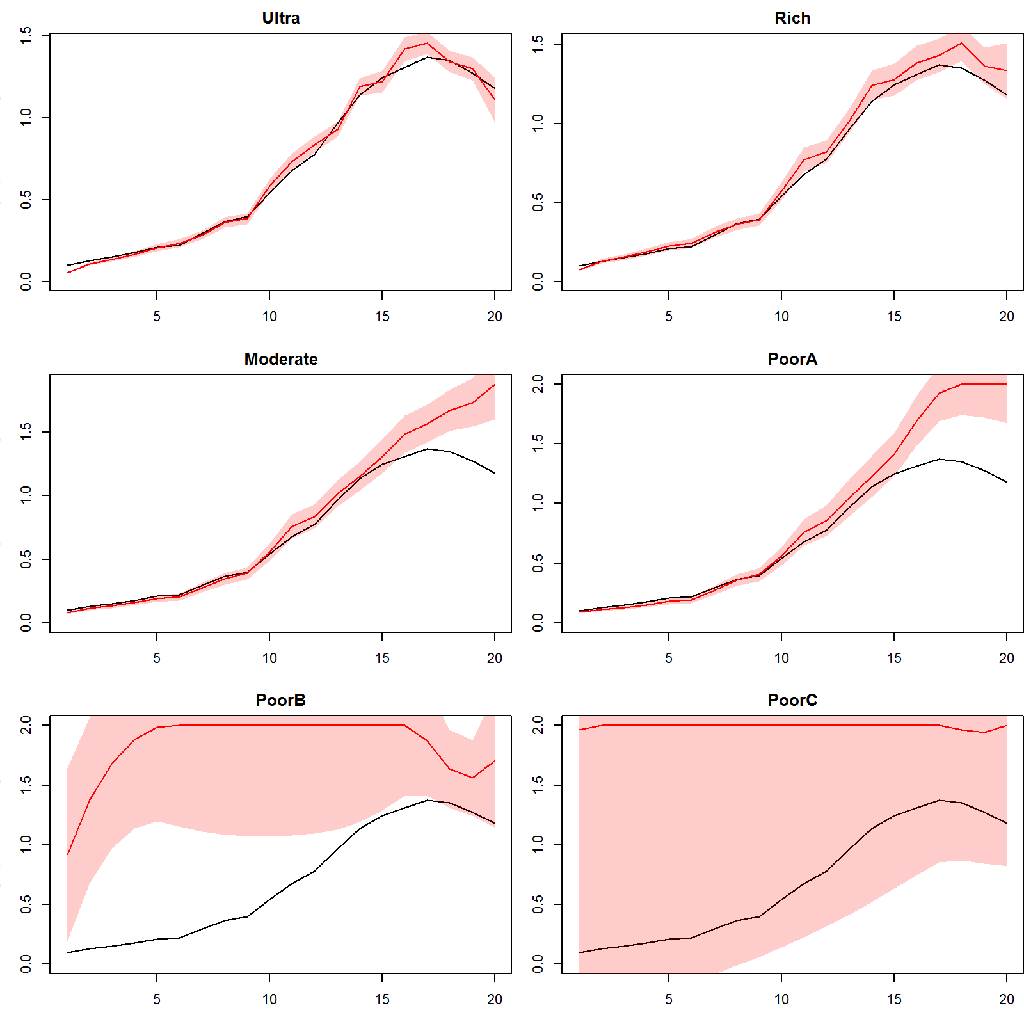
Model fits - Endogenous F, Constant R
Recruitment
Fishing Mortality
Ultra
Rich
Ultra
Rich
Moderate
Poor A
Moderate
Poor A
Poor B
Poor C
Poor B
Poor C

Slide 40
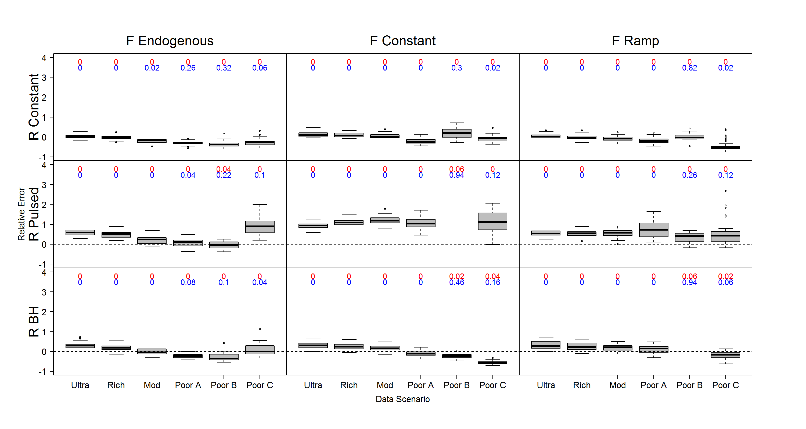
Relative error in SPR – fast-growing, 20 years data, σ_{R}=0.5
Notes:
50 iterations
Poor C would be just one year of length composition data, no catch or effort
Relative error for SPR, essentially depletion in the terminal year
Relatively good performance when F is constant and R is constant
All of these other scenarios – have poor performance for the other equilibrium based methods
When R is constant – start to get biases when we have drastically changing F over time for the data-poor scenario
Some bias for the data-poor scenarios when F is changing
Positive biases in this depletion parameter when R is pulsed – likely because recruitment started out high and estimated the median recruitment to be higher than it really was.

Slide 41
Relative error in SPR – fast-growing, 20 years data, σ_{R}=0.5

Slide 42
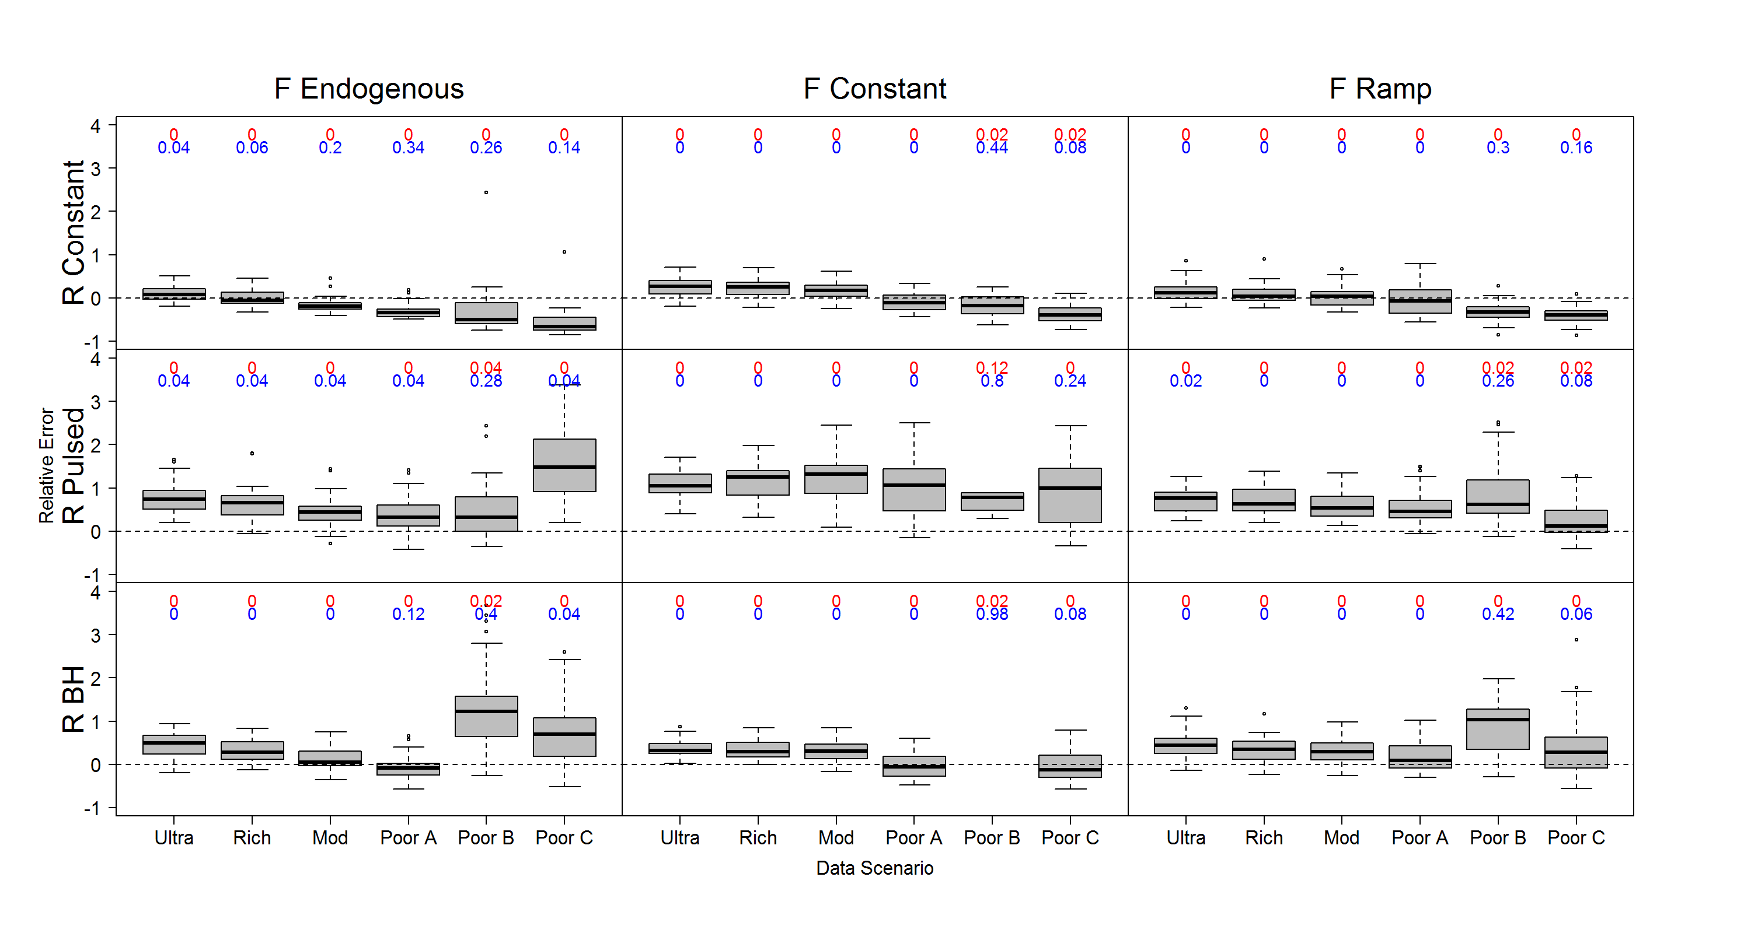
Relative error in SPR – fast-growing, 20 years data, σ_{R}=0.9

Slide 43
Relative error in SPR – fast-growing, 20 years data, σ_{R}=0.5

Slide 44
Relative error in SPR – fast-growing, 20 years data, σ_{R}=0.9

Slide 45
Alternative data scenario
Snapshot of length composition
Prior/penalty on catch time series and index based on local expert knowledge
(Variation on Poor C data scenario – which did not include any information on catch and effort index)

Slide 46
Next steps
Sensitivity analyses
Fixed parameters: growth curve, natural mortality, maturity
Parameter starting values: sigmaR, sigmaF, selectivity
Model structure
Set effective sample size appropriately
Number of vessels
Move away from multinomial
Monthly time step for coral reef fish
Notes:
Move away from multinomial (perhaps upon getting to know the data better)

Slide 47
Concluding thoughts
Sensitivity analysis required: ability to estimate terminal year depletion for data-poorest scenarios likely based on fixed parameter values
Potential as another option for coral reef fisheries where equilibrium is unlikely
Must be considered against equilibrium methods – is there a benefit to management from adding complexity?
Notes:
Situations with even less data than surplus production model → what is the role of data weighting in very data-limited situations?
Do the best with what we have

Slide 48
Discussion topics
Where to consider data weighting and conflict?
Length composition data
Effective sample size
Exclusion of data due to representativeness
Weight of expert insight

Slide 49

Thank you
Wildlife Conservation Society
SNAP Data-Limited Fisheries working group
NSF IGERT Program on Ocean Change
School of Aquatic and Fishery Sciences
Trevor Branch
Hilborn & Branch labs

Slide 50
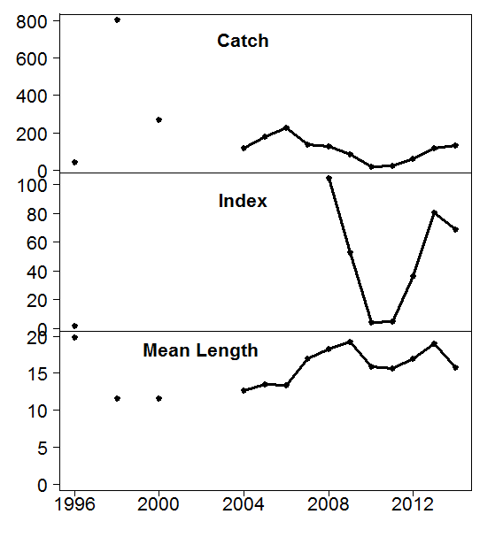
Kenyan coral reef fisheries
Lethrinus lentjan
1 of 3 species that represent 60% of the total catch
Evidence of growth and recruitment overfishing from equilibrium methods

