Slide 1

Effect of data weighting on mature male biomass estimate for Alaska golden king crab – a case study
M.S.M. Siddeek^{a*}, J. Zhengª, A.E. Punt^{b}, and D. Pengillyª
ªAlaska Department of Fish and Game, Juneau and Kodiak, Alaska
^{b}University of Washington, Seattle
Data conflict and weighting, likelihood functions, and process error
CAPAM Workshop , La Jolla, California 92037, USA
19-23 October 2015

Slide 2
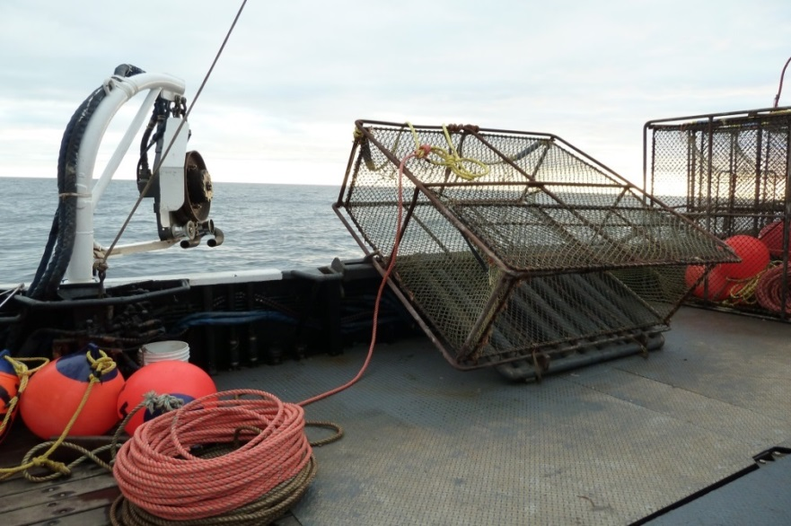
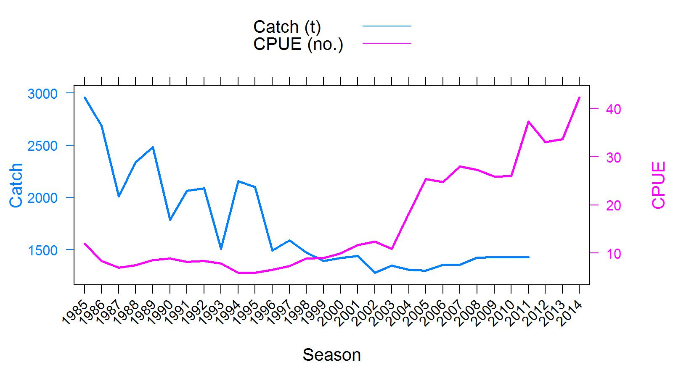
Overview of the eastern Aleutian Islands golden king crab fishery
Male-only deep water pot fishery producing 1.2 to 1.6 thousands metric tons of crab worth 5 to 11 million US $ annually.
Only 2 to 3 vessels operate since crab fishery rationalization in 2005.
Managed under ITQ constant harvest control rule.
CPUE has systematically increased since 1996.
No annual stock surveys.
ADFG
Catch (t) and CPUE (number of crabs per pot lift) of golden king crab in the eastern Aleutian Islands, 1985/86–2014/15 fisheries.

Slide 3
If there are data/model specification conflicts, what options are available?
We are faced with the problem of identifying whether the model issue is data conflicts, model misspecification, or both.
Assess whether their effects are severe on important management parameters. If not, can live with it!!
Our investigation is based on an integrated length-based model fitted by the likelihood method to eastern Aleutian Islands golden king crab data: pot fishery catch and bycatch, groundfish fishery bycatch, observer standardized CPUE, and tag release-recapture.
Terminal mature male biomass (≥ 121 mm CL, MMB) is the key to estimating TAC. Not knowing the actual problem area, we investigate the behavior of MMB under both data conflict and model misspecification.

Slide 4



Population dynamics
$$N_{t+1,j}= \sum_{i=1}^{j}{[N_{t,i}e^{−M}}−({\hat{C}}_{t,i}+{\hat{D}}_{t,i}+{\hat{Tr}}_{t,i})e^{\left(y_{t}−1\right)M}]X_{i,j}+R_{t+1,j}$$
${\hat{C}}_{t,i}$ = predicted retained catch, ${\hat{D}}_{t,i }$ = predicted discarded catch, ${\hat{T}}_{r_{t, i}}$ = predicted groundfish bycatch, $N_{t,i}$ = stock abundance; M= natural mortality; $y_{t}$ = elapsed time period from July 1 to mid point of the fishing period; $X_{i,j}$ = size transition matrix; $R_{t,j}$ = recruit; t = year; i and j = length-class indices.
Mature male biomass (MMB):
${MMB}_{t}= \sum_{j=mature size}^{n}{\{N_{j,t}e^{y^{′}M}−({\hat{C}}_{j,t}}+{\hat{D}}_{j,t}+{\hat{Tr}}_{j,t})e^{\left(y_{t}−y′\right)M}\}w_{j}$
y′
= elapsed time period from July 1 to next year Feb 15;
$$w_{j}$$
= weight at mid length of length-class j.

Slide 5
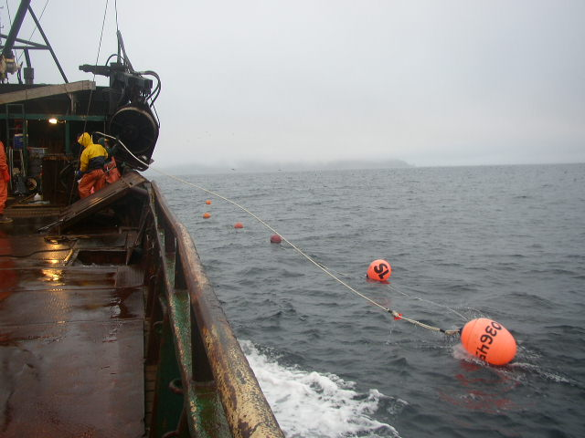
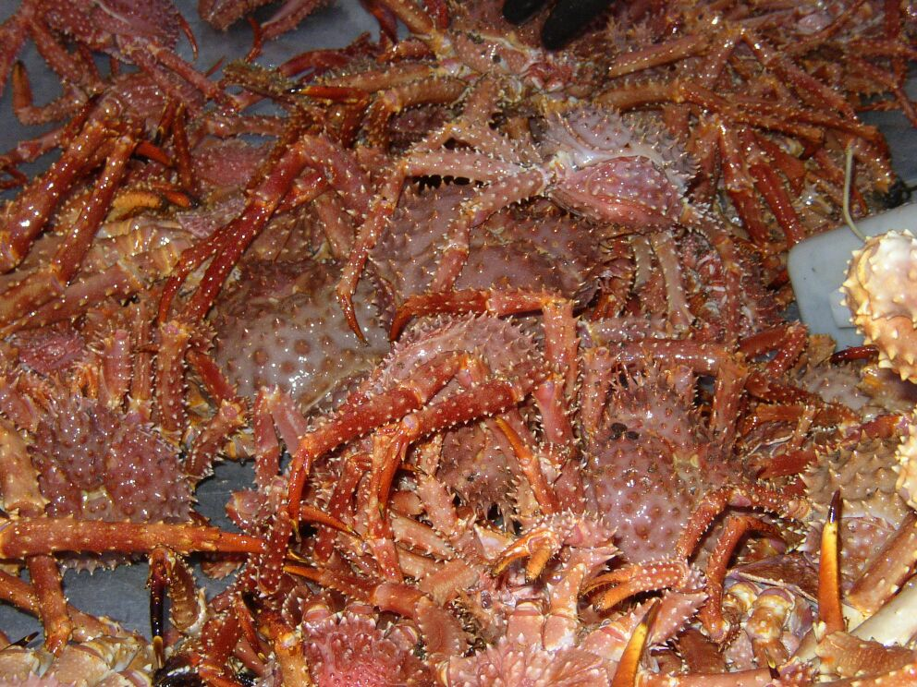

Optimization function
$$f= {LL}_{r}^{catch}+{LL}_{T}^{catch}+{LL}_{GD}^{catch}+ {LL}_{r}^{CPUE}+{LL}_{r}^{LF}+ {LL}_{T}^{LF}+{LL}_{GD}^{LF} + {LL}_{tag}+ P_{1}+P_{2}+ P_{3}+P_{4}+P_{5}$$
ADFG
ADFG

Slide 6
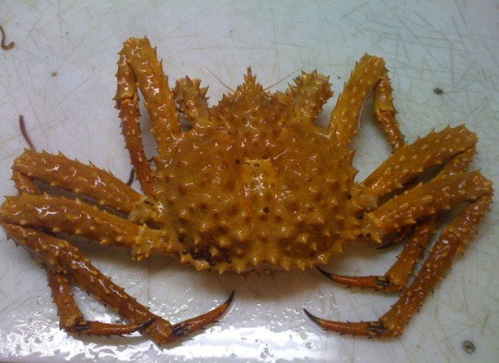




Negative log Likelihood components
Retained Catch:
${LL}_{r}^{catch}= λ_{r}\sum_{t}{\{ln(\sum_{j}{{\hat{C}}_{t,j}w_{j}+c)}}−ln(\sum_{j}{C_{t,j}w_{j}+c)\}^{2}}$
${LL}_{T}^{catch}= λ_{T}\sum_{t}{\{ln(\sum_{j}{{\hat{T}}_{t,j}w_{j}+c)}}−ln(\sum_{j}{T_{t,j}w_{j}+c)\}^{2}}$
${LL}_{GD}^{catch}= λ_{GD}\sum_{t}{\{ln(\sum_{j}{{\hat{Tr}}_{t,j}w_{j}+c)}}−ln(\sum_{j}{{Tr}_{t,j}w_{j}+c)\}^{2}}$
Total Catch:
Groundfish Discard:
CPUE:
${LL}_{r}^{CPUE}= \left\{0.5\sum_{t}{ln\left[2π\left(σ_{r,t}^{2}+ σ_{e}^{2}\right)\right]}+ \sum_{t}{\frac{{\left(ln{(CPUE}_{t}^{r}+c)− \hat{{ln(CPUE}_{t}^{r}+c)}\right)}^{2}}{2\left(σ_{r,t}^{2}+ σ_{e}^{2}\right)}}\right\}$
$$\hat{ {CPUE}_{t}^{r}} = q_{k}\sum_{j}{S_{j}^{T}}S_{j}^{r} \left(N_{t,j}−0.5\left[\hat{C_{t,j}}+ \hat{D_{t,j}}+\hat{{Tr}_{t,j}} \right]\right)e^{{−y}_{t}M}$$
ADFG
$$λ$$
= weights

Slide 7
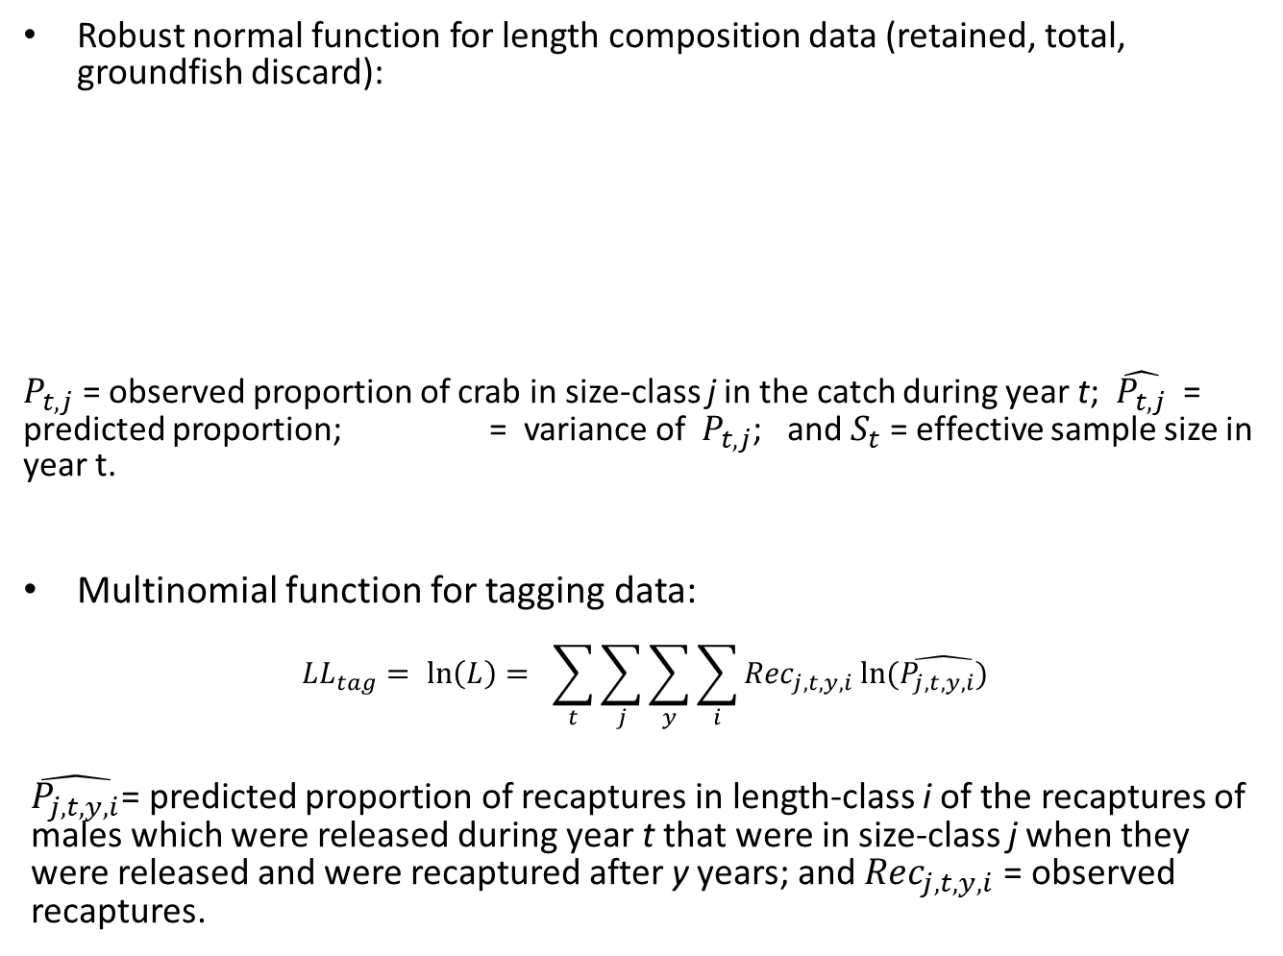

Negative log likelihood components
Robust normal function for length composition data (retained, total, groundfish discard):
$P_{t,j}$ = observed proportion of crab in size-class j in the catch during year t; $\hat{P_{t,j}}$ = predicted proportion; = variance of $P_{t,j}$; and $S_{t}$ = effective sample size in year t.
Multinomial function for tagging data:
$${LL}_{tag}= \ln\left(L\right)= \sum_{t}{\sum_{j}{\sum_{y}{\sum_{i}{{Rec}_{j,t,y,i}}ln⁡(\hat{P_{j,t,y,i})}}}}$$
$\hat{P_{j,t,y,i}}$= predicted proportion of recaptures in length-class i of the recaptures of males which were released during year t that were in size-class j when they were released and were recaptured after y years; and ${Rec}_{j,t,y,i}$ = observed recaptures.
$$σ_{}^{2}t,j$$

Slide 8

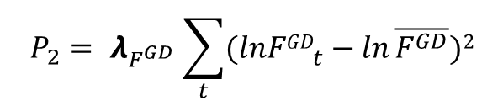

Negative log likelihood components
Penalty functions:
(a) pot fishing mortality:
(b) groundfish bycatch fishing mortality:
(c) Recruitment:
(d) average F about a fixed mean F:
(e) posfunction (ADMB):
ADFG
$$P_{2}= λ_{F^{GD }}\sum_{t}{(ln{FGD}_{t}^{}−ln}\overline{F^{GD}})2$$
$${ P}_{4}=λ_{Fmean}{(\overline{F}−k)}^{2}$$
$$P_{5}= λ_{posfn}∗fpen$$

Slide 9

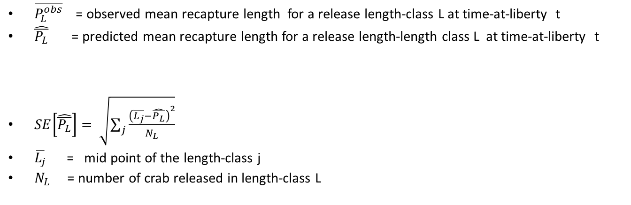
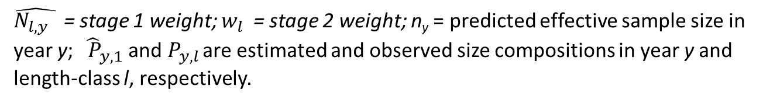
1. Tagging data weighting (Buckworth’s slide, Punt et al.)
$\overline{P_{L}^{obs}}$ = observed mean recapture length for a release length-class L at time-at-liberty t
$\hat{\overline{P_{L}}}$ = predicted mean recapture length for a release length-length class L at time-at-liberty t
$SE\left[\hat{\overline{P_{L}}}\right]= \sqrt{\sum_{j}{\frac{{\left(\overline{L_{j}}−\hat{\overline{P_{L}}}\right)}^{2}}{N_{L}}}}$
$\overline{L_{j}}$ = mid point of the length-class j
$N_{L}$ = number of crab released in length-class L
2. Stage-2 Length composition effective sample size (McAllister and Ianelli 1997)
$$\hat{N_{l,y}} w_{l}$$
(Notation of Francis 2011) =
$\hat{N_{l,y} }$ = stage 1 weight; $w_{l}$ = stage 2 weight; n_{y} = predicted effective sample size in year y; ${\hat{ P}}_{y,1}$ and $P_{y,l}$ are estimated and observed size compositions in year y and length-class l, respectively.

Slide 10
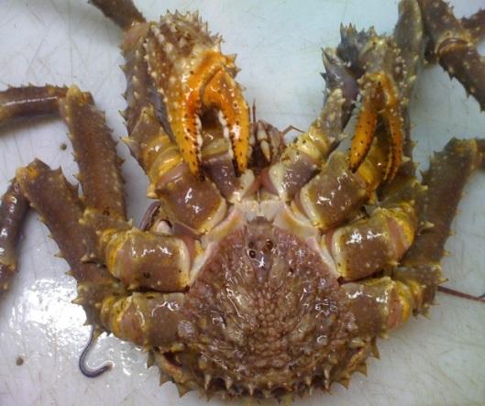
Tagging data and estimated weights
Total Release | 27131 | Number of Recoveries by Year
 | Year1 | 936
 | Year2 | 491
 | Year3 | 214
 | Year4 | 51
 | Year5 | 13
 | Year6 | 12
 | Overall % recovery | 6.33
Numbers of tag recaptures by time-at-large .
Estimated tagging data likelihood weights by time-at-large for the base model fit.
Time-at-large (yr) | Weights
1 | 0.49
2 | 0.20
3 | 0.38
4 | 1 (≥ 1, set at 1)
5 | 1 (≥ 1, set at 1)
6 | 1 (≥ 1, set at 1)
ADFG

Slide 11
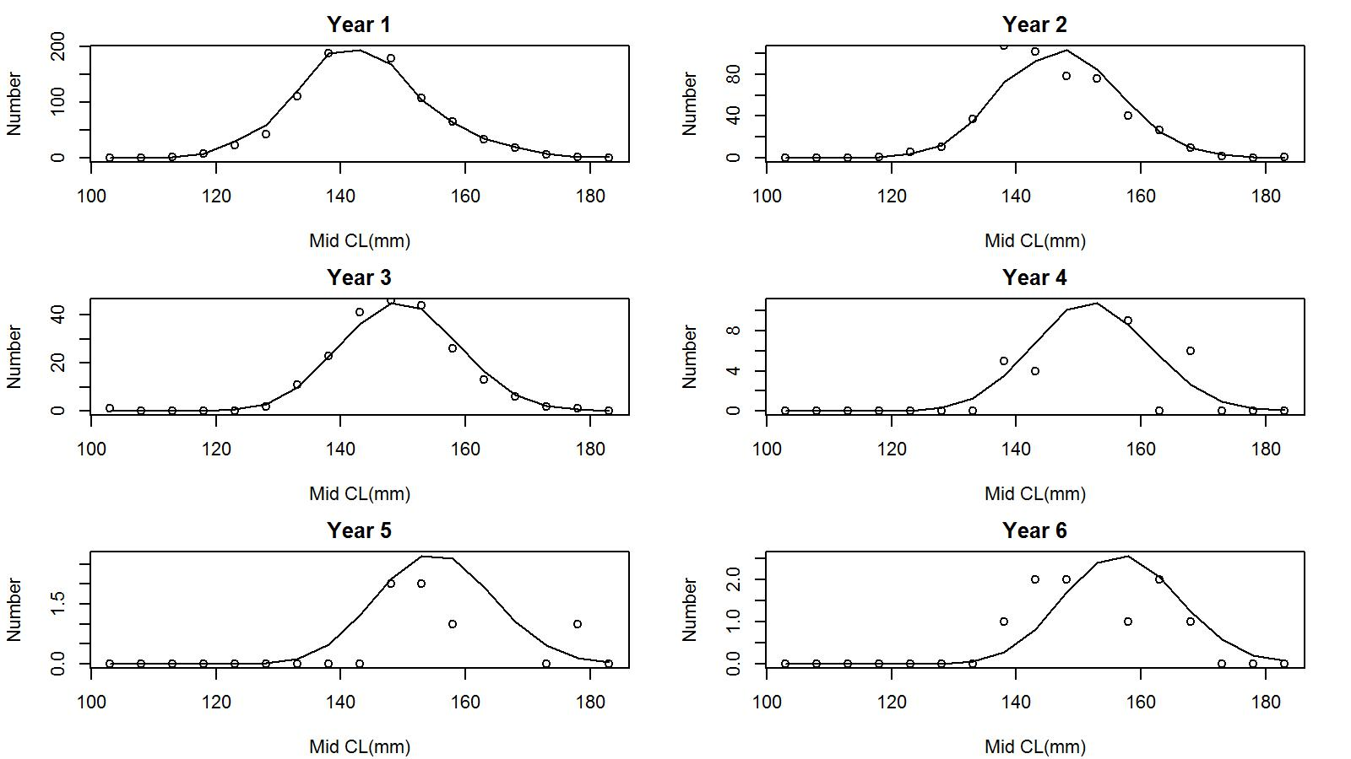
Base model output
Observed tag recaptures (open circle) vs. predicted tag recaptures (solid line) by length-class for years 1 to 6 recaptures.
Reasonably good fit to each year’s tag recoveries.

Slide 12
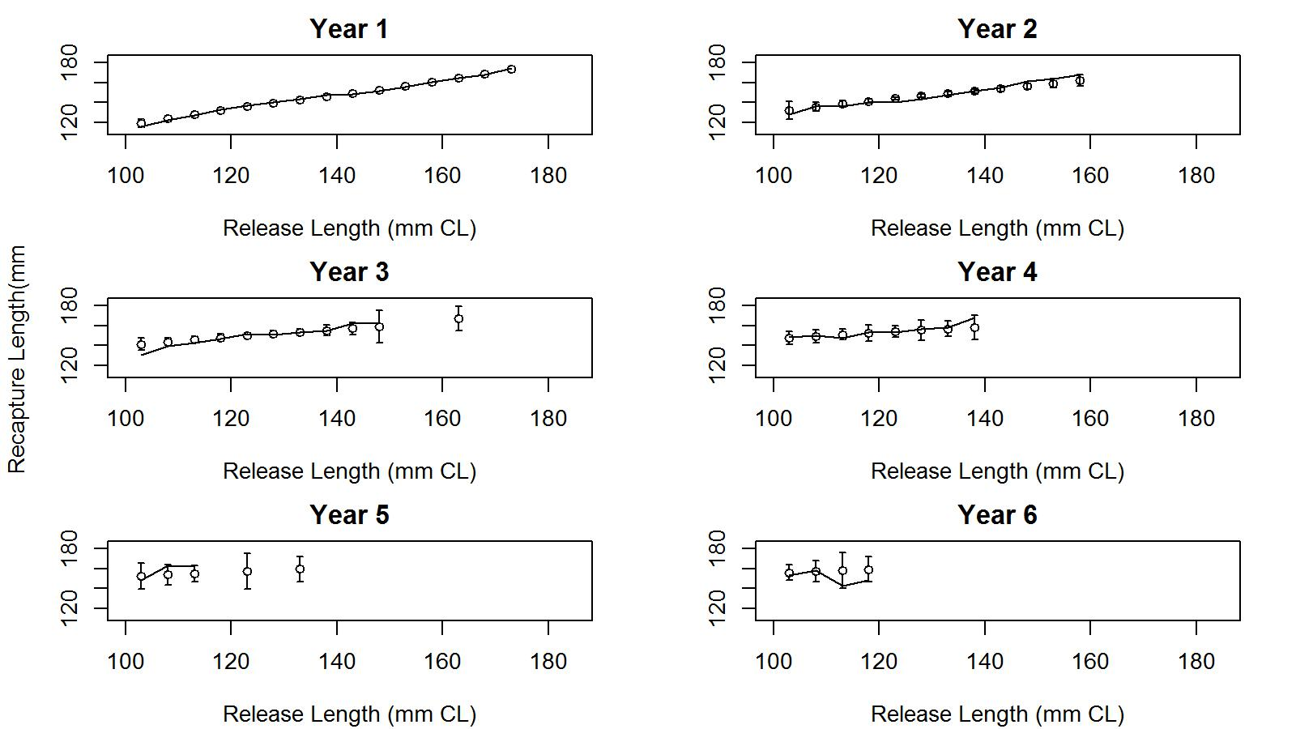
Base model output
Observed (open circle) and predicted (solid line) mean length (with two SE) of recaptures vs. release length for years 1 to 6 recaptures.
Reasonably good fit to each year’s recapture mean lengths.

Slide 13
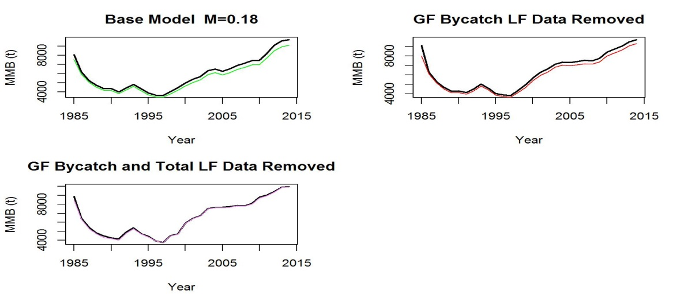
Misspecification of M (start with the base M)
MMB trends when tagging data are weighted (color) and non weighted (black) for M=0.18. Top left: base scenario; Top right: when groundfish bycatch LF data are removed; and bottom left: when groundfish bycatch and total LF data are removed.
Similar trends. Removal of groundfish and total LF data provides unbiased MMB.

Slide 14
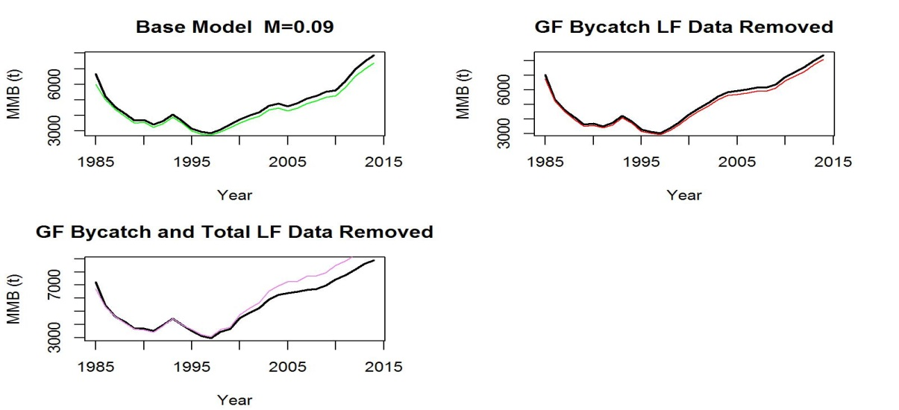
Misspecification of M (low M)
MMB trends when tagging data are weighted (color) and non weighted (black) for M=0.09. Top left: base scenario; Top right: when groundfish bycatch LF data are removed; and bottom left: when groundfish bycatch and total LF data are removed.
Similar trends. Removal of groundfish LF data provides almost same MMB.

Slide 15
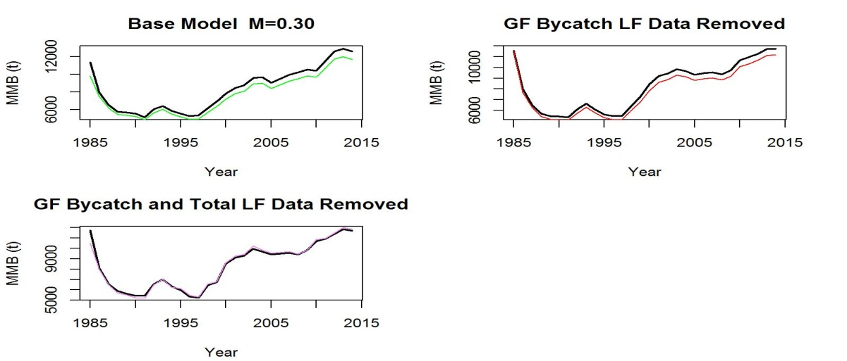
Misspecification of M (high M)
MMB trends when tagging data are weighted (color) and non weighted (black) for M=0.3. Top left: base scenario; Top right: when groundfish bycatch LF data are removed; and bottom left: when groundfish bycatch and total LF data are removed.
Similar trends. Removal of groundfish and total LF data provides unbiased MMB.

Slide 16
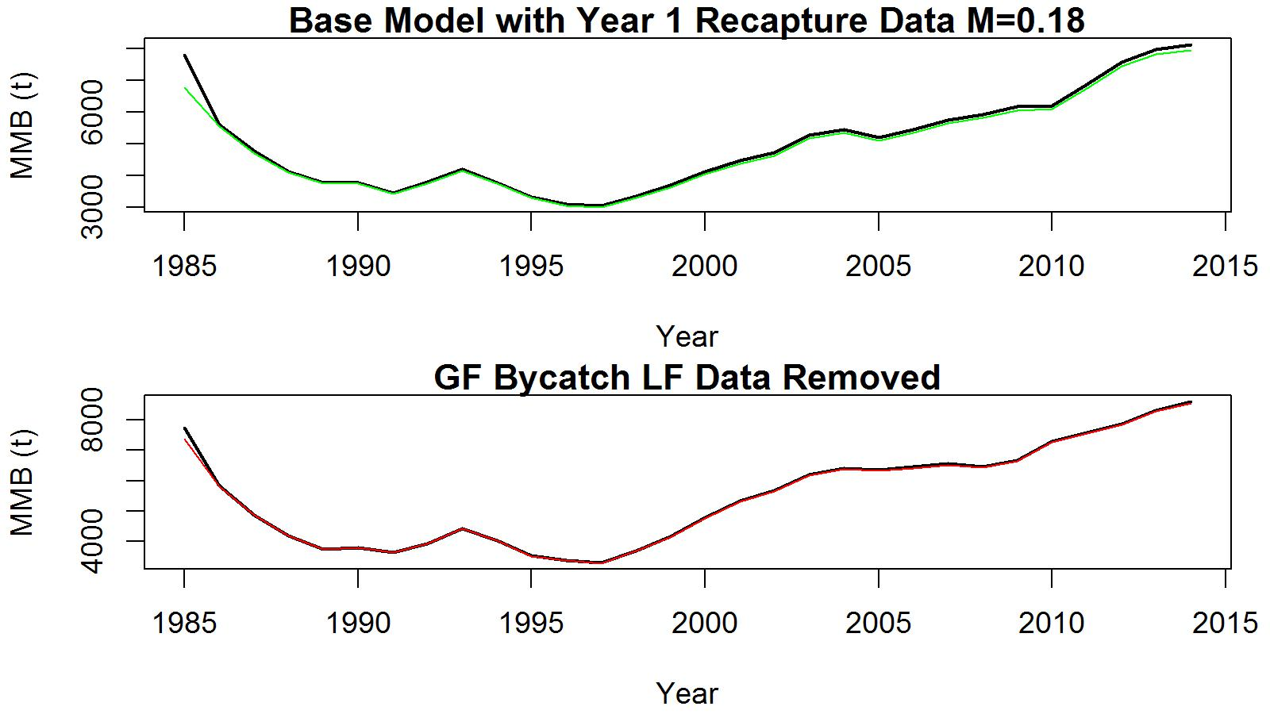
Subset of tag-recapture data: only the first year tag recapture data are considered
MMB trends when tagging data are weighted (color) and non weighted (black) at M = 0.18. Top: base model; bottom: when groundfish bycatch LF data are removed.
Hardly any difference when groundfish (GF) bycatch LF data are removed.

Slide 17
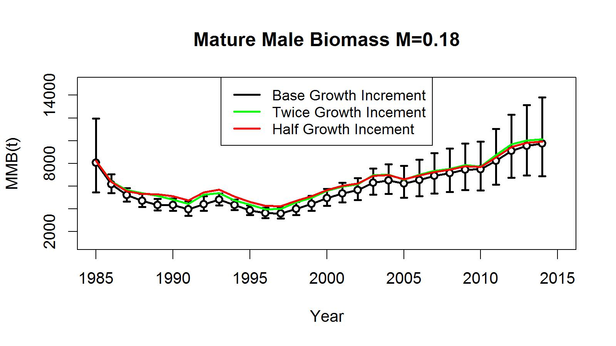
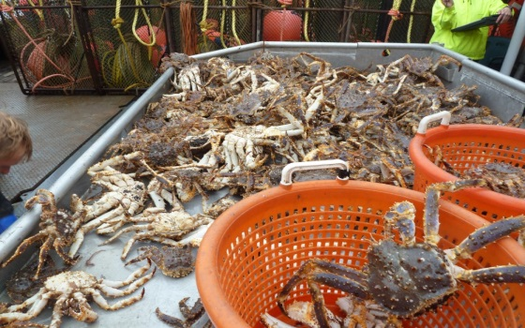
Misspecification of mean growth increment
MMB trends when tagging data are weighted (color) and non weighted (black) at M = 0.18. Error bars are two standard error confidence limits.
Trends are similar, but values are slightly higher when the mean growth increment is either increased or decreased.

Slide 18
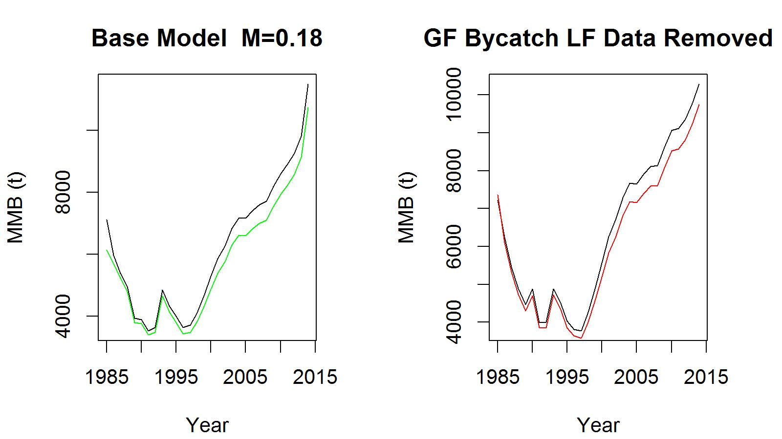
Applying stage-2 effective sample size calculation iteratively on length compositions and down weighting tagging data
MMB trends when tagging data are weighted (color) and non weighted (black) at M = 0.18. Left: base model; right: when groundfish bycatch LF data are removed.
No improvement between the base and groundfish bycatch LF removed scenarios’ results.
Stage-2 iteratively weighting LF sample sizes appears to be confounded with tagging data weighting.

Slide 19
Conclusions and question
We investigated the probable data conflict in association with model misspecification in a limited way by removing apparent inconsistent data, sub-setting tagging data, re-specifying natural mortality and growth increment, and re-estimating length composition effective sample sizes using stage-2 estimation procedure.
Down weighting of tagging data did not adversely affect the MMB trends and values for the eastern Aleutian Islands golden king crab. However, the western Aleutian Islands data provided a different outcome as Buckworth has shown earlier.
We did not investigate the tagging data down weighting effects when other likelihood weights - catch and bycatch biomasses, and penalty functions (not involving actual data) - are varied.
Tagging data down weighting suggests to omit groundfish bycatch and total size composition data to obtain unbiased MMB; but, removal of total catch LF will have adverse effects on total mortality and selectivity estimation.
Hence removal of groundfish LF data is an appropriate way to proceed with the assessment.
Question: Data weighting appears to be a trial and error science (or art). Can we formalize a better way to address conflicting data and model misspecification?

Slide 20

Acknowledgements
We thank Heather Fitch (ADFG) and Robert Foy (AFSC) for providing various fisheries data; and Vicki Vanek (ADFG) for providing tagging data. A number of suggestions made by the NPFMC Crab Plan Team vastly improved the length-based model.

