Slide 1

The current status of fisheries stock assessment
Mark Maunder
Inter-American Tropical Tuna Commission (IATTC)
Center for the Advancement of Population Assessment Methodology (CAPAM)

Slide 2
Outline
The World Conference on Stock Assessment Methods
Current uncertainties
Modeling temporal variation in catch composition data

Slide 3
The World Conference on Stock Assessment Methods
Workshop (15th-16th July 2013)
  Different models fit to real and simulated data
Conference (17th-19th July 2013)
  Key Challenges for Single Species Assessments
  Assessing Ecosystem Dynamics & Structure
  Spatial Complexity and Temporal Change
  Data Poor Approaches
Abstracts and presentations on line
  http://www.ices.dk/news-and-events/symposia/WCSAM-2013

Slide 4
Workshop: conclusions
Different models applied to the same data produce different results
Different models applied to data simulated by other models can perform poorly
Many assumptions differ among the models, so difficult to interpret results

Slide 5
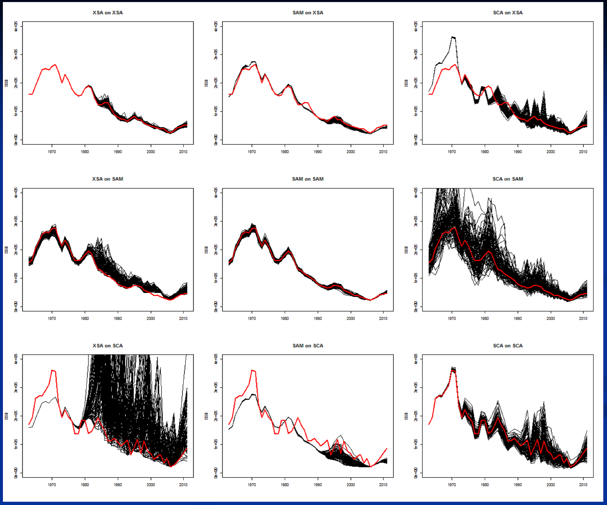
XSA
SAM
SCA
XSA
simulated
SAM
simulated
SCA
simulated
From Doug Butterworth and colleagues

Slide 6
Workshop analyses: selectivity assumptions
Extended survivors analysis (XSA)
  Age and year specific F
State-space assessment model (SAM)
  Random walk in F at age
Statistical catch-at-age analysis (SCA)
  Separable (constant selectivity) with three time blocks

Slide 8
Uncertainties
Stock-recruitment relationship
Natural Mortality
Growth
Selectivity
Catchability
Spatial distribution

Slide 9
Stock-recruitment relationship
Simulations studies show that estimates of the stock-recruitment relationship are usually Biased and imprecise
Highly influential on management quantities

Slide 10
Natural Mortality
Lack of direct information (tagging data)
Indirect methods (maximum age, life history relationships) are imprecise and probably biased
Estimate inside the stock assessment model
Highly influential on management quantities

Slide 11
Growth
More uncertain than generally considered
Asymptotic length particularly influential on fishing mortality and abundance estimates when using length composition data

Slide 12
Selectivity
Misspecification can cause biased estimates of management quantities
  Inflexible functional forms
  Time varying selectivity
Allowing flexible selectivity reduces information content of composition data

Slide 13
Catchability
Scales an index of abundance to absolute abundance
Usually unknown or more uncertainty than assumed

Slide 14
Spatial distribution
Temporal variation in fishery or stock spatial distribution can cause biases

Slide 15
Modeling temporal variation in catch composition data
Most stock assessments use catch-at-age or catch-at-length data
Composition data have too much influence on the results of integrated assessments

Slide 16
Why does composition data vary from year to year
Recruitment strength
Fishing mortality history
Sampling error
Temporal variability in selectivity
Other process variation
Spatial distribution of fleet and stock

Slide 17
Recruitment strength
Relative cohort strength is consistent from one year to the next
Estimate as model parameters

Slide 18
Fishing mortality history
High F = no old fish; Low F = many old fish
Changes slowly over time
Estimated in model from catch information

Slide 19
Sampling error
Different random sample different age composition
Important when sample size is low
Schooling by size reduces effective sample size
Estimate effective sample size by bootstrapping the sampling process

Slide 20
Temporal variability in selectivity
Gear changes
  Use selectivity time blocks when gear changes
Combining fisheries and changes in fishing effort among fisheries (e.g. VPA)
  Don’t combine fisheries or alternatively use time varying selectivity
Cohort targeting
  Model time varying or cohort specific selectivity

Slide 21
Growth
Temporal variation in growth may interact with length based selectivity
Use year specific growth parameters if available

Slide 22
Natural mortality
Most important for young ages due to predation
Temporal variation of young fish not vulnerable to the fishery accounted for in recruitment estimates
May be important for small sized species

Slide 23

Temporal variation in the spatial distribution of fleet or stock
May be a major contributor to variation in composition data
Can cause logistic contact selectivity to be dome shape at the stock assessment model level and change over time
Young
Young
Old
Old

Slide 24
Modeling temporal variation in catch composition data: summary
Account for recruitment as parameters in the model
Fishing mortality is estimated from catch information
Account for sampling error by bootstrapping the sampling process
Use annual estimates of growth if available
Determine if the model is robust to temporal variation in natural mortality and growth
Model multiple fisheries to account for differences among gears
Estimate the amount of selectivity temporal variation inside the model (state-space model) to account for spatial variation

Slide 25
Presentation summary
Different model assumptions (e.g. selectivity) can give different results
There is a lot of uncertainty about most population dynamics and fishing processes
Models need to account for temporal variability in selectivity

Slide 26
Conclusion
We either need to put a lot more focused effort into resolving the uncertainties
Or
Develop management strategies that are robust to the uncertainty

