Slide 1
What is the likelihood that your model is wrong? Generalized tests and corrections for overdispersion during model fitting and exploration
NWFSC (Seattle)
James Thorson, Kelli Johnson,
Richard Methot, and Ian Taylor
Oct. 20, 2015

Slide 2
Outline
Likelihoods and random processes
Surplus production model
Steps for real-world assessments
Standardizing compositional data for input sample size
Estimating effective sample size
Exploring process errors for overdispersed fleets
Plan moving forward
Probability of the model given data

Slide 3
Likelihoods
Likelihood: probability of the data given when
Many-to-one function
Inputs: parameters
Output: probability
Joint probability
$$p\left(X,Y\right)=p\left(X\right)p(Y)$$
Therefore log-probability and log-likelihood is additive
$$\log\left(p\left(X,Y\right)\right)=\log\left(p\left(X\right)\right)+log⁡(p\left(Y\right))$$

Slide 4
Likelihoods
Likelihood:
$$l\left(θ | D\right)=log⁡(p\left(D | θ,Model\right))$$
θ is the set of fixed parameters
D is the set of data
Model is the assumed model
Maximum likelihood estimation
$$\hat{θ}={argmax}_{θ}(l\left(θ | D\right))$$

Slide 5
Likelihoods
Often, there’s nuisance parameters!
Processes that vary over time, space, or among individuals
Can’t model as fixed effects
Number of new parameters grows with amount of data
$$X_{t+1}=f\left(X_{t}\right)+ε_{t}$$
$$y_{t}=X_{t}+δ_{t}$$
$$δ_{t}\sim N(0,{σ_{δ}}_{}^{2})$$
Where $\left|ε\right|→∞$ as $|y|→∞$
No way to get enough data to estimate each as fixed
Treat $ε$ as arising from a exchangeable random process
$$ε_{t}\sim N(0,{σ_{ε}}_{}^{2})$$
“State-space model”

Slide 6
Likelihoods
Random effects are “unobservable”
Meaning, we can’t get enough data to estimate them individually
Law of Total Probability
$$l\left(θ | D\right)=p\left(D | θ\right)=log⁡\left(\int_{ε}{p\left(D | θ,ε\right)p(ε|θ)}\right)$$
where θ are fixed effects
ε are random effects
$p\left(D | θ,ε\right)$ is the joint probability (easy to calculate!)
$p(ε|θ)$ is the probability of random effects
$l\left(θ | D\right)$ is the “marginal log-likelihood”

Slide 7
Likelihoods
Mixed-effects estimation
$$\hat{θ}={argmax}_{θ} (\log\left(\int_{ε}{p\left(D | θ,ε\right)p\left(ε | θ\right)}\right))$$
“Empirical Bayes” estimator
$$\hat{ε}={argmax}_{ε}(\log\left(p\left(D | \hat{θ},ε\right)p\left(ε | \hat{θ}\right)\right))$$
Interpretation
An unobservable is estimated using the distribution obtained by conditioning on all observables and integrating over all other unobservables
Searle et al. (2009)

Slide 8
Likelihoods
Say we want to predict a quantity $γ$:
$$γ=f(θ,ε)$$
Two types of prediction:
Sample
$$\hat{γ}=f(\hat{θ},\hat{ε})$$
Population
$$\hat{γ}=\int_{ε}{f(\hat{θ},ε)p(ε|\hat{θ})}$$
…and hierarchical models provide both very easily

Slide 9
Likelihoods
Implications
If you want to estimate fixed effects ….
… and there’s additional stochastic process that is unobservable…
… then you can estimate fixed-effects via a mixed-effects model!
Benefits
Generic approach to correlations, heteroskedasticity, and heterogeneity
(Fixes most violations in statistical models)

Slide 10
Likelihoods
Hierarchical models
Why would you make a hierarchy of parameters?
Stein’s paradox and shrinkage – Pooling parameters towards a mean will be more accurate on average
Biological intuition – Formulate models based on knowledge of constituent parts
Variance partitioning – Separate different sources of variability (e.g., measurement errors!)
More reading
Thorson, J.T., Minto, C., 2015. Mixed effects: a unifying framework for statistical modelling in fisheries biology. ICES J. Mar. Sci. J. Cons. 72, 1245–1256.
https://github.com/james-thorson/mixed-effects

Slide 11
Likelihoods
Overdispersion
Variation “in excess” of normal expectation
Two classic examples
Poisson process
If probability p of encountering an individual is low…
…and there are many individuals N…
… then you have a Poisson process
$$C\sim Poisson(pN)$$
$$Var\left(C\right)=pN$$
Multinomial process
If each individual has category b with probability p(b)…
… and the total number of individuals N in known…
… then you have a multinomial process
$$Cb\sim Multinomial(pb,N)$$
$$Var\left(Cb\right)=Npb(1−pb)$$
Data from a Poisson or multinomial process often have variance in excess of our expectation
We say they are “overdispersed”

Slide 12
Surplus production model
State-space surplus production model
$$B_{t+1}=\left(B_{t}−c_{t}\right)+\left(B_{t}−c_{t}\right)r\left(1−\frac{\left(B_{t}−c_{t}\right)}{K}\right)+εt$$
$$It=qB+δt+τt$$
$$ε_{t}\sim N(0,{σ_{ε}}_{}^{2})$$
$$δ_{t}\sim N(0,{σ_{δ}}_{}^{2})$$
$$τt\sim N\left(0,{σ_{τ,t}}_{}^{2}\right)$$
where I_{t} is an index of abundance
r is the maximum growth rate per capita
K is carrying capacity
q is catchability coefficient
${σ_{τ,t}}_{}^{2}$ is the estimated variance of the index of abundance

Slide 13
Surplus production model
Easy to re-parameterize
$$B_{t+1}=\left(B_{t}−c_{t}\right)+\left(B_{t}−c_{t}\right)r\left(1−\frac{\left(B_{t}−c_{t}\right)}{K}\right)+εt$$
$$It=qB+δt$$
$$ε_{t}\sim N(0,{σ_{ε}}_{}^{2})$$
$$δ_{t}\sim N(0,{σ_{δ}}_{}^{2}+{σ_{τ,t}}_{}^{2})$$
Two alternative models
Estimate overdispersion
${σ_{δ}}_{}^{2}$ as fixed effect
Ignore overdispersion
Assume ${σ_{δ}}_{}^{2}=0$

Slide 14
Surplus production model
Restrictions
Assume r is known
(Otherwise scale K is confounded with productivity r)
Programming techniques
Explicit-F parameterization
Treat exploitation rate as random effect, with variance fixed at low value (CV=0.01)
Code publicly available:
https://github.com/James-Thorson/state_space_production_model

Slide 15
Surplus production model
Estimating overdispersion
Neglecting overdispersion

Slide 16
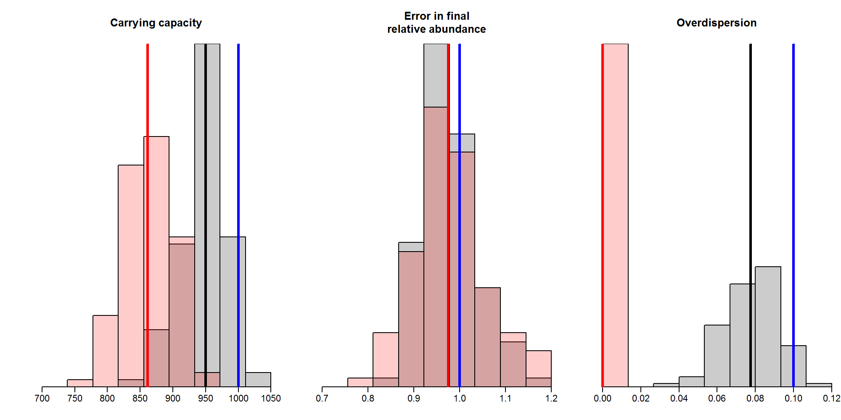
Surplus production model
Accounting for overdispersion improves parameter estimates (estimate, ignore, true)

Slide 17
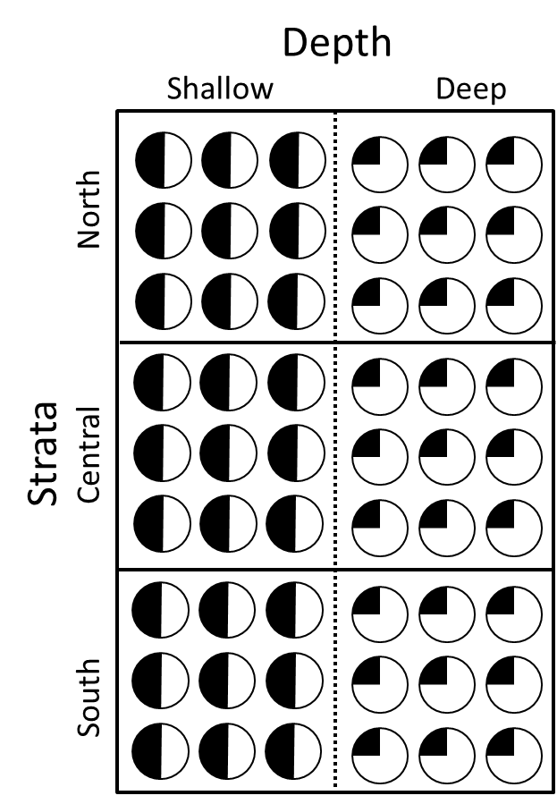
Step #1: Comp. standardization
Three sampling “Strata”: latitude
Difference in age-structure by depth
Thorson, J.T., 2014. Standardizing compositional data for stock assessment. ICES J. Mar. Sci. J. Cons. 71, 1117–1128.

Slide 18
Step #1: Comp. standardization
Generating overdispersed data
Equi-dispersed:
$$Cb\sim Multinomial(pb,N)$$
Where p_{b} is the probability of each bin (age)
N is the sample size
C_{b} is the sample
Overdispersed:
$$Cb\sim ω∙Multinomial(pb,N)$$
Where $ω$ is the magnitude of overdispersion
Cause:
Fish with similar size/age/sex school together (trawls)
Fish (scramble/contest) compete for access to food (hooks)

Slide 19
Step #1: Comp. standardization
Difference in age structure by depth
Dotted: inshore
Dashed: offshore
Solid: combined

Slide 20
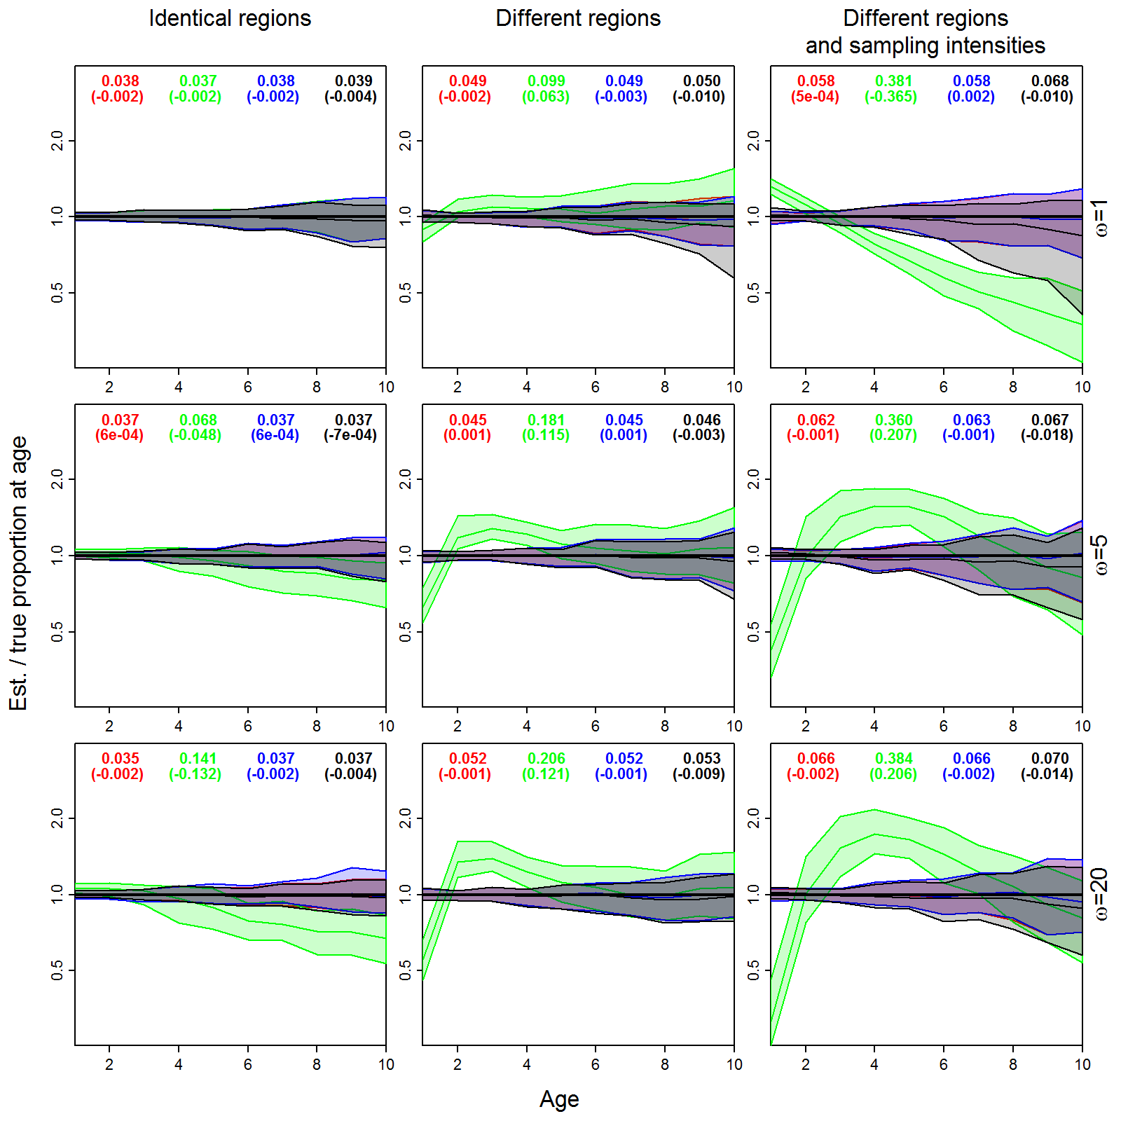
Step #1: Comp. standardization
Four estimators
Design-based
Dirichlet-multinomial
Normal approx.
Normal w/ process error
Performance for estimating proportion at age
Top of panel
RMSE, low is good
(bias), close to zero is good

Slide 21
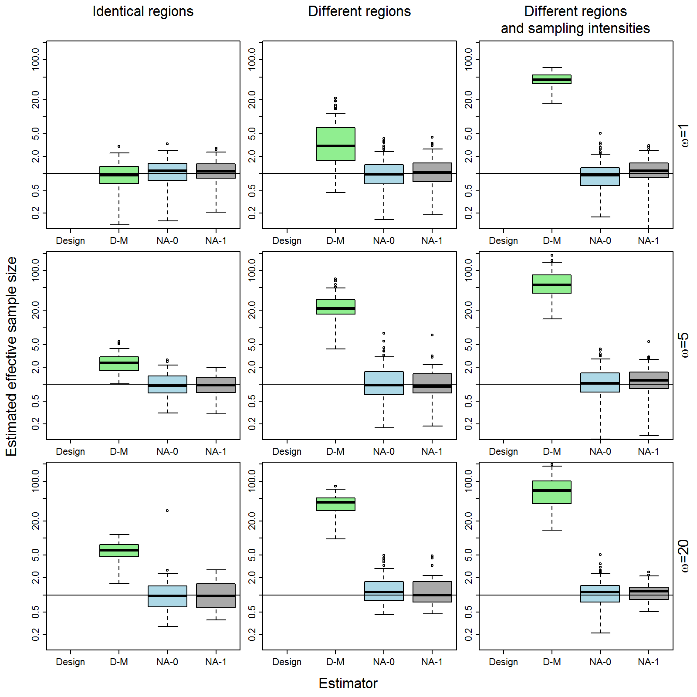
Step #1: Comp. standardization
Estimating overdispersion
Dirichlet-multinomial
Normal approx.
Normal w/ process error

Slide 22
Step #2: Estimating N_{effective}
Modify Stock Synthesis V3.3
target release date: Jan. 2016
New feature: Dirichlet-multinomial distribution
Turn-on for any fleet (fishery or survey)
Works for length/age comps
Should work for conditional age-at-length and length-at-age (but is not tested)
Allows mirroring (single parameter for multiple fleets)
Useful for spatially stratified models (e.g., Canary rockfish)

Slide 23
Step #2: Estimating N_{effective}
Generate data:
Using SS “bootstrap” simulator
Using simplified 2015 Pacific hake assessment
Generating overdispersed fishery age-comp data
$$Cb\sim ω∙Multinomial(pb,N)$$
Where $ω$ is the magnitude of overdispersion
Dirichlet-multinomial distribution
$$L\left(pb,β | πb,N\right)=\frac{Γ(N+1)}{\prod_{b=1}^{b}{Γ\left(Nπb+1\right)}}\frac{Γ(\hat{β})}{Γ(N+\hat{β})}\prod_{b=1}^{b_{max}}{\frac{Γ(π_{b}+βpb)}{Γ(βpb)}}$$
Where N is the sample size
$πb=Cb/N$ is the observed proportion in each bin b
p_{b} is the estimated proportion in each bin

Slide 24
Step #2: Estimating N_{effective}
Computing effective sample size:
Effective sample size ($N_{eff}$): sample size N of multinomial sample with the same variance
$$N_{eff}={\left(\frac{1}{N}+\frac{1}{β+1}\right)}^{−1}$$
Reparameterize:
$$β=θN$$
then
$$\frac{N_{eff}}{N}=θ$$
when N>>1 and $θ$<<1

Slide 25
Step #2: Estimating N_{effective}
Linear effective sample size
New parameter has similar action to iterative-reweighting factors
Therefore…
Compare its performance with McAllister-Ianelli iterative reweighting approach

Slide 26
Step #2: Estimating N_{effective}
Factorial design
Three levels of overdispersion
Three true sample sizes (N={25,100,400})
Conclusion
Dirichlet-multinomial estimates N_{eff} accurately
Small positive bias given high true sample size

Slide 27
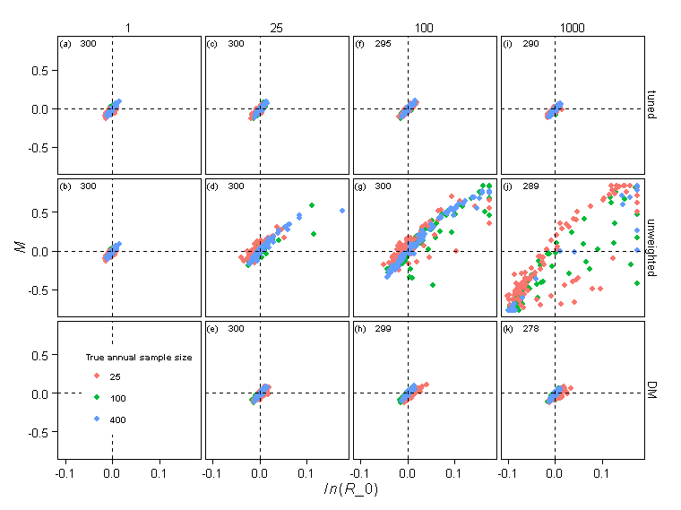
Step #2: Estimating N_{effective}
Performance for estimating parameters?
Works similarly to McAllister-Ianelli method
True overdispersion
Estimation method

Slide 28
Step #2: Estimating N_{effective}
Case study: pacific hake
Four models:
Unweighted, McAllister-Ianelli, Dirichlet-multinomial,
no fishery ages
Conclusion: Works similarly to McAllister-Ianelli

Slide 29
Step #2: Estimating N_{effective}
Benefits of internal estimation
Allows proper weighting during profiles and sensitivities
Profiles/sensitivities currently aren’t often tuned
Propagates uncertainty during standard errors and forecast intervals
Uncertainty in weighting currently not included in any confidence/credible intervals
Permits focus on other iterative model-fitting steps
Variance of process errors!

Slide 30
Step #3: Process errors
Many methods to estimate process errors in assessment models
Add a penalty and “wing it”
Just call it “penalized likelihood” and hope no one asks…
Eye-ball fit to data
Ad hoc tuning
First-order approximations
Statistically motivated tuning (G. Thompson, pers. comm.)
Sample variance plus estimation variance (Methot and Taylor 2014, CJFAS)
Clever model modifications
Empirical weight-at-age
Statistical methods
Laplace approximation (Thorson Hicks Methot 2014 ICESJMS)
Bayesian estimation (e.g., Mäntyniemi et al. 2013 CJFAS)

Slide 31
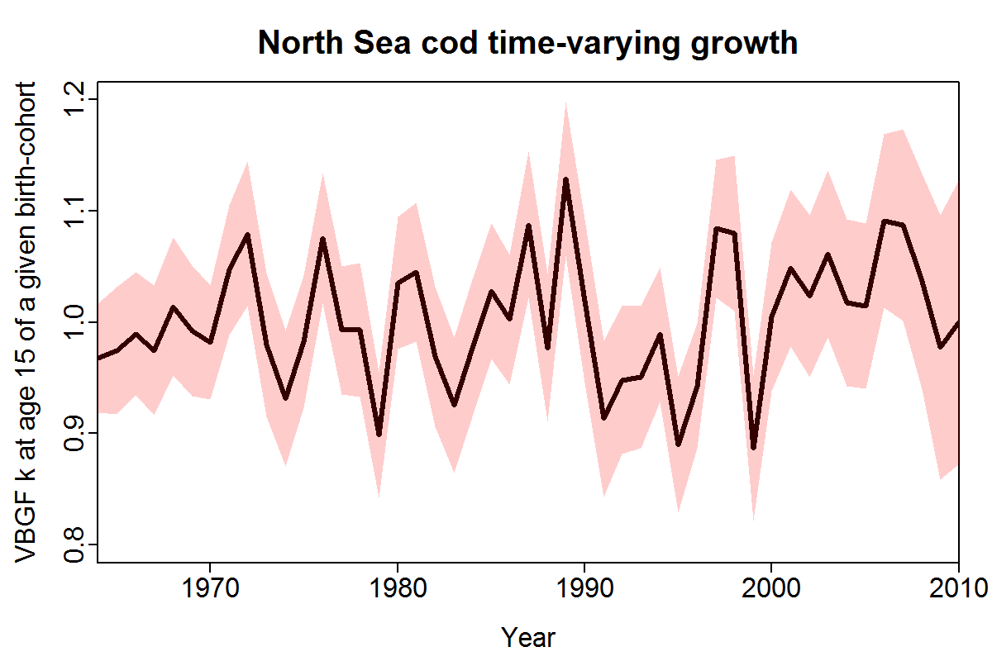
Step #3: Process errors
Laplace approximation
ADMB – very slow
Requires iterative re-fitting of model
TMB – fast and efficient
Requires rebuilding code

Slide 32
Step #3: Process errors
Template Model Builder
Permits faster estimation with more parameters
Fully spatial delay-difference model
Accounts for spatial variation in spawning biomass
Thorson, J.T., Ianelli, J., Munch, S., Ono, K., Spencer, P., In press. Spatial delay-difference modelling: a new approach to estimating spatial and temporal variation in recruitment and population abundance. Can. J. Fish. Aquat. Sci.

Slide 33
Step #3: Process errors
Clever model modifications
Empirical weight-at-age
Deals easily with time-varying growth
Doesn’t account for uncertainty
Statistical VPA (MacCall and Teo 2013 Fish Res)
Deals with time-varying selectivity
Not easy in most software packages
Empirical maturity and fecundity schedules
(I think this is still the norm most places…)

Slide 34
Plan moving forward
Three practical steps:
Estimate input sample sizes from the data
Account for overdispersion as a parameter
Account for correlations via process errors
Why not combine steps 2 and 3?

Slide 35
Plan moving forward
Why not combine Steps 2 and 3?
Structure of correlation in fishery models is very complicated!
Correlations among:
ages
lengths
sexes
fleets
There’s probably many ways to model correlations
Different methods account for some correlations but not others!
Francis (2014) account for correlations among lengths OR ages, but not simultaneously

Slide 36
Plan moving forward
Obvious approach to modelling correlations…
… is mixed effects!
Benefits
Retains focus on modelling the process
Doesn’t obfuscate correlations
Allows calculation of predicted compositions
Hard to calculate using methods that use ad hoc corrections for correlations
Keeps us working with mainstream statistics
Easier to work with ecologists
E.g., U-CARE and E-SURGE as diagnostic for overdispersion in tag-resighting models

Slide 37
Plan moving forward
Where can we start?
Make a list of unmodeled processes that generate correlations in compositional data
Recruitment variation (usually modeled explicitly)
Time-varying selectivity
(Actually caused by spatial variation in density and fishing rate)
Time-varying individual growth
Time- and age-varying natural mortality rates

Slide 38
Plan moving forward
What if there’s multiple processes that can account for correlations?
Multi-model inference
Model selection
Only valid if each constituent model is admissible
Model averaging / Ensemble modelling
Averaging results from multiple models
Multi-model decision theory
Averaging decision from each model, with weights derived for performance in that decision

Slide 39
Plan moving forward
Next steps
Methods and software for compositional standardization
Big black-box in most assessments I’ve seen!
Additional research regarding internal estimation of overdispersion
Does it affect estimates of uncertainty?
Does it affect profiles?
Improved algorithms and software for mixed-effect assessment models

Slide 40
Acknowledgements
Input on themes
Allan Hicks, Mark Maunder

