Slide 1

Estimating species interactions from multiple data sources: weighting solutions using a Bayesian multispecies production model
Robert Wildermuth
University of Massachusetts Dartmouth
School for Marine Science and Technology
CAPAM – SWFSC – Oct 11, 2015
Email: rwildermuth@umassd.edu

Slide 2
Outline
Ecosystem approaches in Northwest Atlantic
  MS-PROD
  MAR Gompertz approximation
Research questions and methods
  Incorporating disparate datasets in multispecies models
  Structural uncertainty and model inference
Future directions

Slide 3
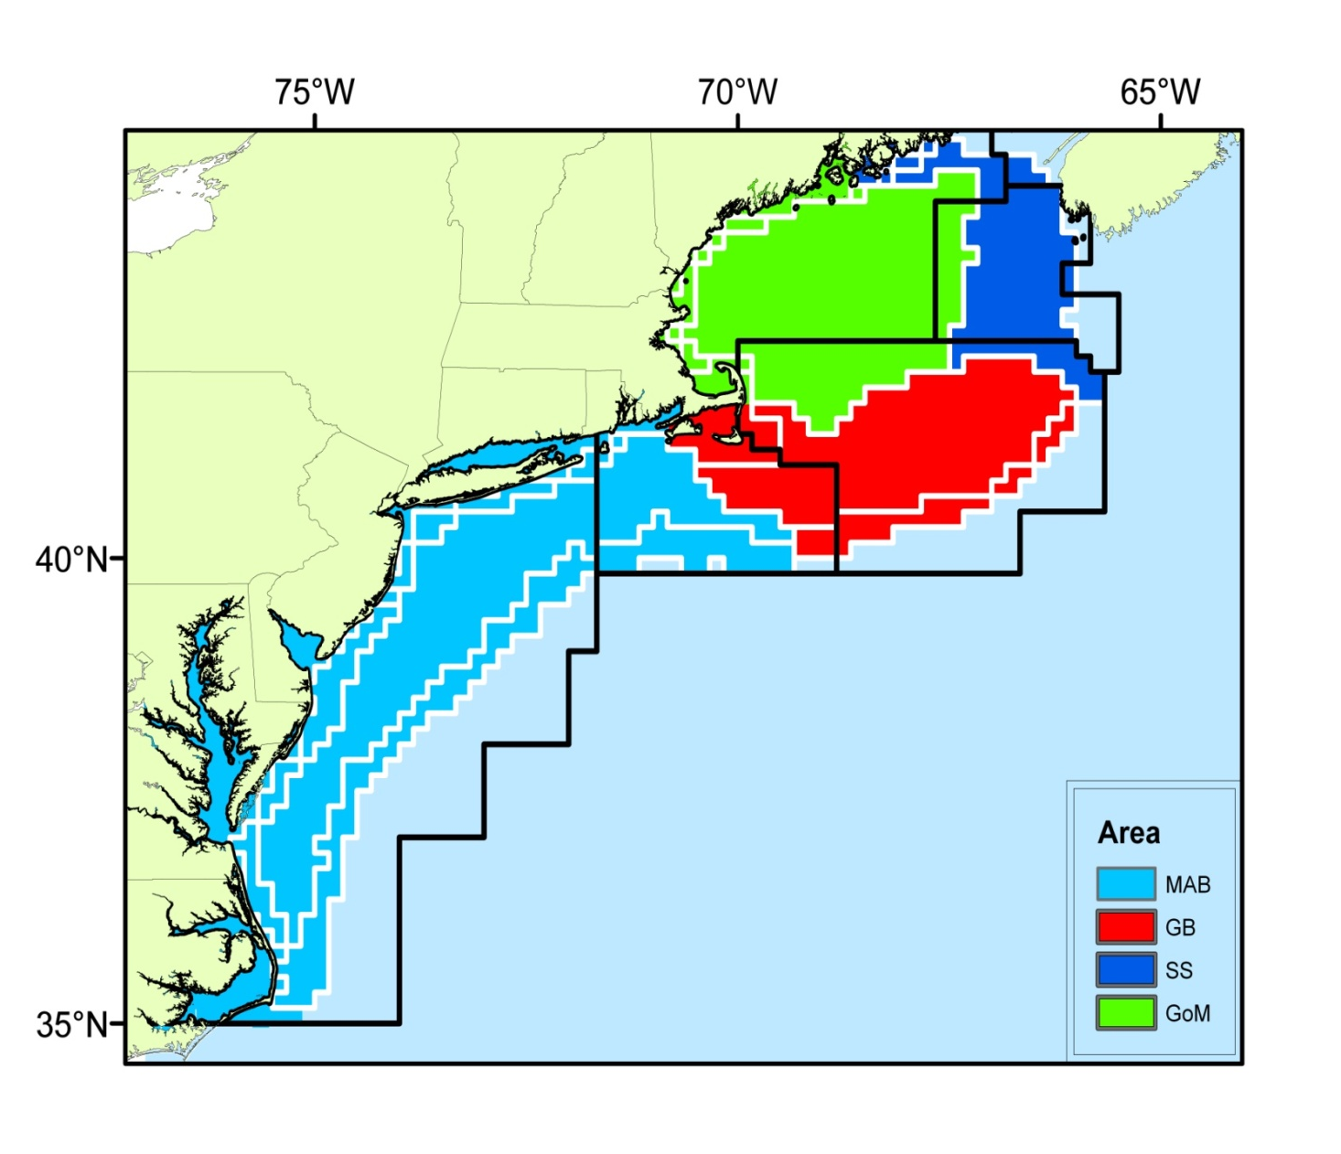
Georges Bank multispp assessment project
Goal: Harvest advice
Cod
Goosefish
Haddock
Yellowtail Fl
Dogfish
Winter Skate
Winter Fl
Herring
Silver Hake
Mackerel
Predation
Competition
Slide credit: S. Gaichas

Slide 4
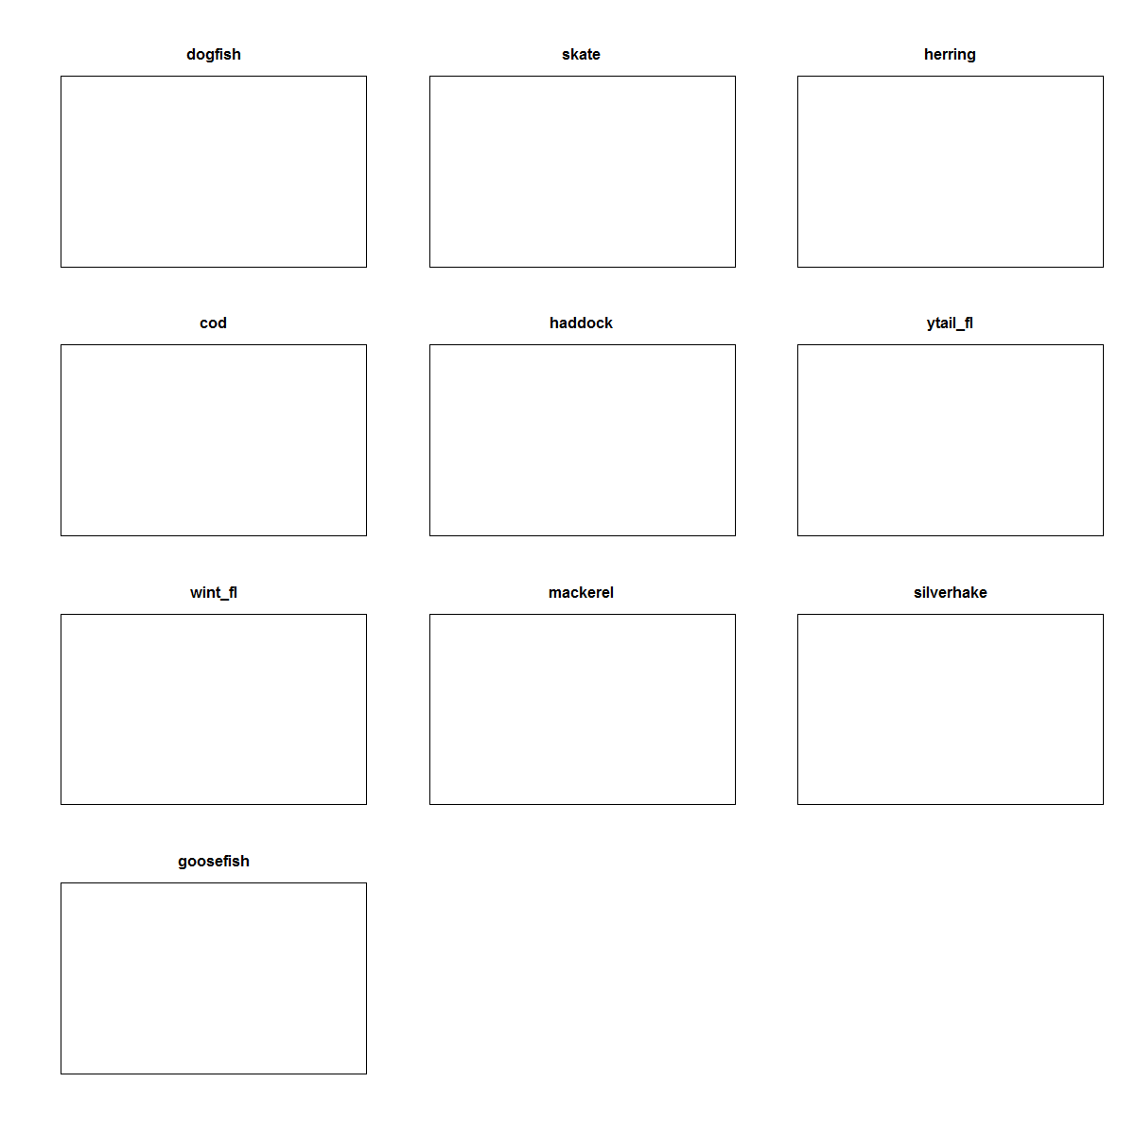
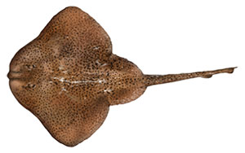
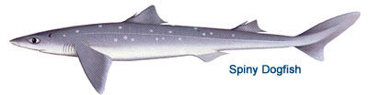
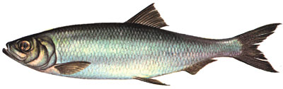
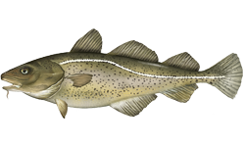
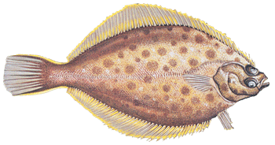
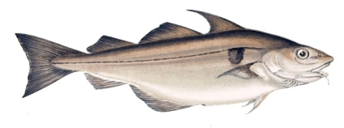
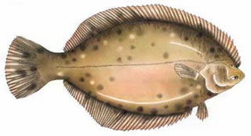
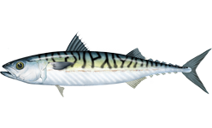
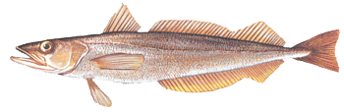
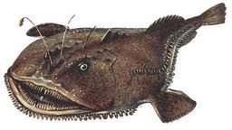
Possible species groupings
Full system
Taxonomic
Habitat
Taxonomic +
Feeding guild
Size based
Fleet based
Area based
…
Slide credit: S. Gaichas

Slide 5

Multispecies Production Model
MS-PROD (Gamble & Link 2009):
$$B_{i,t+1}=B_{i,t}+r_{i}B_{i,t}\left(1−\frac{B_{i,t}}{K_{i}}−\frac{\sum_{i≠j}{β_{ij}B_{j,t}}}{K_{σ}}\right)−B_{i,t}\sum_{p}{α_{ip}B_{p,t}}−H_{i,t}$$
Biologically explicit dynamics
Low data:parameter ratio → data hungry
Intrinsic growth
Competition coeff.
Harvest of sp i
Biomass of sp i
Biomass of sp j
Predation coeff.
Capacity of sp i
Biomass of pred p
Capacity of system

Slide 6

MAR Gompertz approximation
Linearized MS-PROD (after Gaichas et al. 2012):
$${lnB}_{i,t+1}=ln\left(B_{i,t}−H_{i,t}\right)+r_{i}+\sum_{j}^{n}{s_{ij}∗ln\left(B_{j,t}−H_{j,t}\right)}+ε_{i,t}$$
Less explicit
Approximates logistic growth well (Ives et al. 2003)
Fewer estimated parameters (higher data:parameter ratio)
Biomass of sp i
Harvest of sp j
Harvest of sp i
Interaction
coeff.
Biomass of sp j
Process error
Intrinsic growth

Slide 7
Q1: Informing the interaction matrix
Ecosystem-level datasets:
  Multispp catch records
  Multispp survey indices
Additional data:
  Taxonomic/phylogenetic groups
  Range overlap
  Isotopes
  Diet composition (overlap)
  Size distribution
Traditional efforts
*
*
Competition
*
*
Predation
* NOAA bottom trawl survey

Slide 8
Research questions
How to incorporate disparate data to inform the interaction matrix?
How does model structure influence inference?
Bayesian methods
Joint distributions
Hierarchical information “sharing”
Informative priors reflect knowledge of system

Slide 9

Q1: Informing the interaction matrix
Joint distributions:
$${lns}_{ij}∝ω_{s}f\left(size ratio\right)+ω_{d}f\left(diet\right)+ω_{r}f\left(range overlap\right)$$
Combines multiple probability distributions (proposed)
  $size ratio \sim ?(μ, σ^{2})$
  $diet comp. \sim Dirichlet(α)$
  $diet overlap \sim Beta(a,b)$
  $range overlap \sim Beta(c,d)$
Possible differential weighting of data ($ω_{i}$)

Slide 10






Q1: Informing the interaction matrix
$$μ$$
Hierarchical information sharing:
$$lns_{ij}∝P\left(data|θ_{g}\right)$$
Ex: Guild-level hyperparameter
$$θ_{g} \sim N(μ,σ_{g}^{2})$$
  Some possible guilds: taxonomy, size class, trophic level, spatial sub-units
$$σ_{g}^{2}$$
$$θ_{g}$$
$$y_{g(1)}$$
$$y_{g(2)}$$

Slide 11

Q1: Informing the interaction matrix
Informative priors:
$$lns_{ij}∝P\left(data|θ\right)P(φ)$$
Where $φ$ is determined by research hypotheses or from previous ecosystem analyses
BUT: priors influence fit of the model

Slide 12
Research questions
How to incorporate disparate data to inform the interaction matrix?
How does model structure influence inference?

Slide 13

Q2: Model structure
Gompertz community interaction matrix (S_{[sp*sp]}):
$$lnB\left(t+1\right)=lnB\left(t\right)+r+SlnB\left(t\right)−lnC(t)$$
Combines information on
  Intra- and inter-species competition
  Predation
Less intuitive estimation of elements
→ implicit assumptions about interactions

Slide 14

Q2: Model structure
More explicit structure:
$lnB\left(t+1\right)=lnB\left(t\right)+r+ClnB(t)+PlnB(t)$ $−lnC(t)$
Explicitly identifies competition (C_{[sp*sp]}) and predation (P_{[sp*sp]})
Each informed through different data
  All methods from Q1 possible!

Slide 15
Future directions
Incorporate diet composition, size class, and range overlap information in MS-PROD models
Compare model behavior and inference between various datasets and structures
Expand to larger Georges Bank community, including multiple trophic levels
  → Incorporate into Integrated Ecosystem Assessment for NE US Shelf

Slide 16
Acknowledgements
Collaborators:
UMass Dartmouth
  Gavin Fay
ICES WG on Northwest Atlantic Regional Seas
  Sarah Gaichas, Sean Lucey
NOAA Northeast Fisheries Science Center
  Rob Gamble, Jason Link
Funding:
SMAST, & Dept. Fisheries Oceanography
NOAA QUEST program
CINAR

Slide 17
Questions & Talking points
Intuition on informing models with disparate data (Q1)?
  Correlated data?
Candidate prior distributions? Link functions?
Email: rwildermuth@umassd.edu

