Slide 1



GROWTH: theory, estimation, and application in fishery stock assessment models
TOPIC A: Biological processes/ontogeny
Estimating individual growth variability in albacore (Thunnus alaunga) from the North Atlantic stock; aging for assessment purposes
V. Ortiz de Zárate ₁ and E. Babcock ₂
1 Instituto Español de Oceanografía, Spain , 2 Rosenstiel School of Marine & Atmospheric Science, UM

Slide 2

Albacore catch. North Atlantic stock. ICCAT 80% Surface gears (50-90 cm FL) – 20% LL (60-130 cm FL)
1950-2013

Slide 3

BACKGROUND GROWTH
Spines - vBertalanffy model. Linf 125; k 0,23; to -0.9892 → until 2010
Spines + tagging - vBertalanffy model. Linf 122; k 0,21; to -1.338 → used in 2013
Notes:
3

Slide 4
BACKGROUND SLICING
ICCAT 2013 - CAA North Atlantic Norte- 1975-2011
MFL & Kimura-Chikuni CAS analysis- Age 2, completed selected
Notes:
4

Slide 5
BACKGROUND CAA
Kimura-Chikuni
Algorithm used in
Length Analysis of CAS
Growth model based on Spines + Tagging,
Differences in Age groups estimates,
when adding more years
Notes:
5

Slide 6
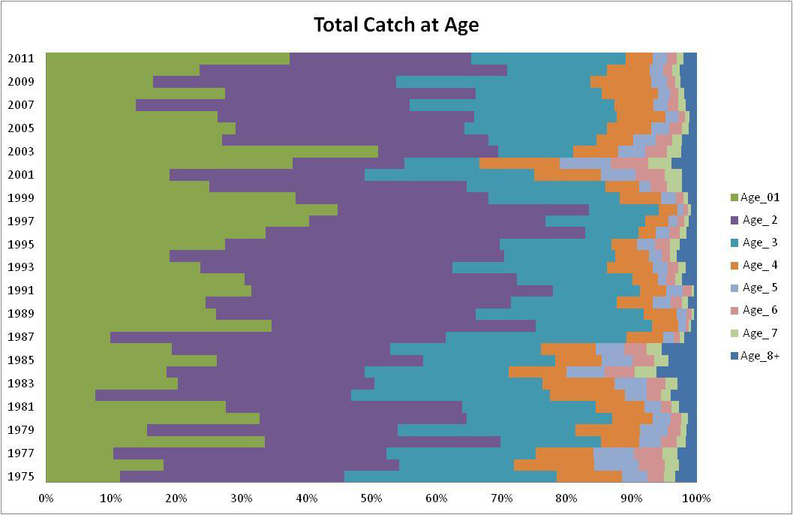
BACKGROUND CAA
Cach-at-age. North Atlantic albacore. 2013. Ages 1 to 4

Slide 7
BACKGROUND
CAS change annualy according to length composition sampled and raised by fleet.
CAS analysis yield CAA estimated with error.
Selectivity mainly based in 1- 4 years old albacore, changing annually.
Assessment driven by CAA
In the case of Albacore aging error is more important than sampling errors. Not easy to solve.
Notes:
7

Slide 8
OBJECTIVE PRESENT STUDY
Model individual variation in growth length based on individual life history derived from back-calculated length based on spine section reading of annual annulus. Growth trajectories each fish ends in measured length when captured
Notes:
8

Slide 9
MATERIAL & METHODS
AGING ALBACORE FIRST DORSAL SPINE SECTIONS
Two annuli per year in agreement with migratory behaviour (spring-summer/autumn-winter) at least up to 4-5 age group albacore (inmature)
Spawners > 5 age group , one annulus per year
Total 586 individual aged in 2011 fishing season : June to October. Sampled from baitboat and troll fleets catch.
Length range: 41 FL (cm) to 120 FL (cm) albacore fish
Fish born in June were age x.0, fish captured in July, August or September were age x.25, and fish captured October, November or December were age x.5, where x is the age in years inferred from the spine reading.
Notes:
9

Slide 10
MATERIAL & METHODS
Back-calculation fork length (cm) from spine diameter (mm)
FL(cm)
Geometric Mean Regression of fork length at capture on spines section diameter
Back-calculated lengths-at-age for each individual were derived using the formula of Ricker (1992).
LF annuli = [(LF capt-b/diamet capt)*Diamet annuli] +b
Spine section diameter (mm)
Notes:
10

Slide 11

MATERIAL & METHODS
Modelling growth: Nonlinear random effects model
Bayesian hierarchical model, with uninformative priors in all par
L∞ , K, t₀ , von Bertlanffy growth parameters from individual fish can be normally distributed random effects, with an estimated mean variance between individual fish
Use deviance information criterion (DIC) for model selection
Use p-value to test accuracy of model fit to data
Notes:
11

Slide 12
MATERIAL & METHODS
Treatments in the Modelling
To test for individual variation, only fish with 6 or more inferred lengths (n=25), to avoid bias in estimates of growth paremeters
For comparison between: including individual variation or cte growth, models were run also with:
-Fish with at least two inferred lengths (n=346)
-Fish with at least four inferred lengths (n=108)
To evaluate whether sample size in each category caused bias in the results. Model fitted to all measured lengths (n=578) and sub-sample in younger ages of 25 fish per age (n=155).
Notes:
12

Slide 13
RESULTS OF MODEL FIT
Individual variation | Δ_{DIC}
L∞,K,to | 75.87
L∞,K | 21.85
L∞ | 0.00
None | 186.58
Best model includes individual variation in L∞ only.
N= 25 fish with six or more estimated lengh by back-calculation

Slide 14
UNBALANCED SAMPLE SIZE
Notes:
14

Slide 15
UNBALANCED SAMPLE SIZE
Notes:
15

Slide 16
SUMMARY AND CONCLUSIONS
L∞ varies considerably among individual fish, not significant variation on K or to.
Fish tend to grow at around the same rate when they are young, they reach different asymptotic lengths
Unbalanced sample size across ages leads to an overestimate of L∞ and underestimate of K
Mean of L∞ in the hierarchical model is consistent with L∞ estimated without individual variation, or with measured data only
Notes:
16

Slide 17
SUMMARY AND CONCLUSIONS
Model fitted with individual variation in L∞
Notes:
17

Slide 18
WORK ON PROGRESS…
Incorporate 2012 observations into the growth modelling
analysis (n=920 observations)
Test the temporal variation in growth by incorporating more
years in the modelling.
Assess if growth parameters have changed over time for albacore in North Atlantic.
Notes:
18

Slide 19
FUTURE APPLICATION ALK´s
BB+TR = 50% of catch 1- 4 ages
Challenge : CAA from ALK´s ?
Notes:
19

Slide 20
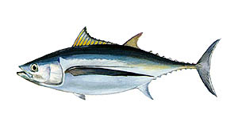
THANK YOU FOR YOUR ATTENTION

