Slide 1
Growth in Age-Structured Stock Assessment Models
R.I.C. Chris Francis
CAPAM Growth Workshop, La Jolla, November 3-7, 2014.

Slide 2
Age-structured vs Length-structured
Model type Population state at any time
age-structured number of fish in each age class
length-structured number of fish in each length class
Both types of model may also record fish numbers by sex, area, stock, ...
Important difference:
- age-structured models may know about length
- length-structured models don’t know about age

Slide 3
Eight Stock Assessment Programs
AMAK https://github.com/NMFS-toolbox/AMAK
ASAP Legault & Restrepo (1999)
BAM Craig (2012)
CASAL Bull et al. (2012)
Coleraine Hilborn et al. (2013)
iSCAM Martell (2014)
MFCL (Multifan-CL) Kleiber et al. (2013)
SS (Stock Synthesis) Methot & Wetzel (2013)

Slide 4
Two Approaches to Growth
1. Ignoring fish length
- growth information: matrices of mean-weight-at-age by year (separate matrices for catch, SSB, survey, etc)
- used by AMAK and ASAP
- reasonable for assessments without length data
2. Using fish length
Model relationships between
- length and weight (typically W = αL^{β})
- age and length – the growth model

Slide 5
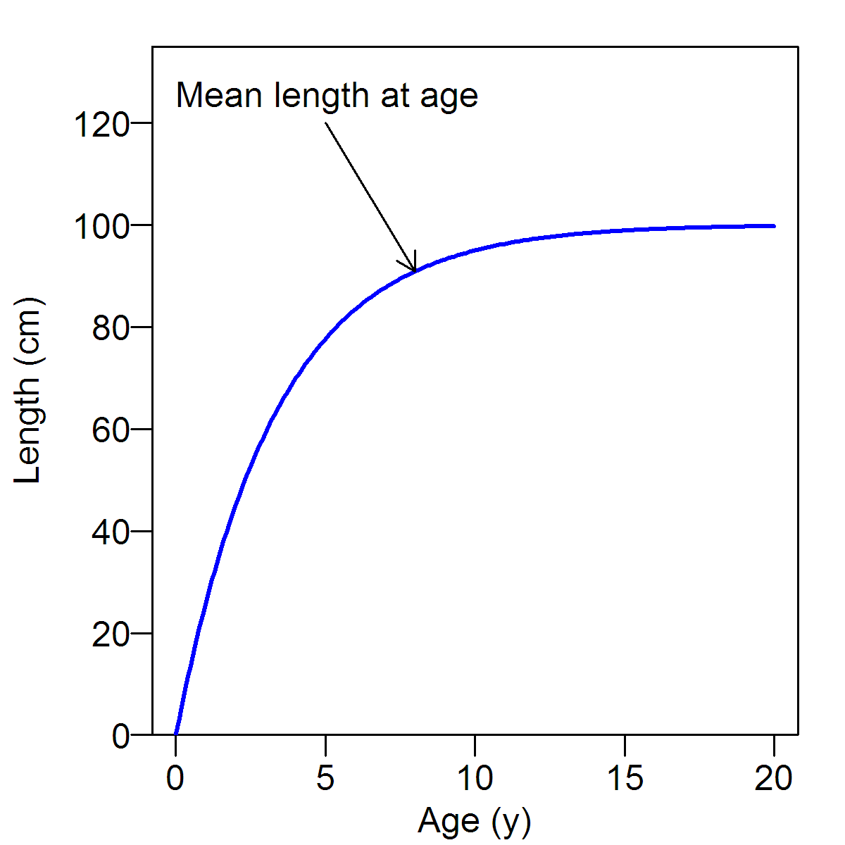
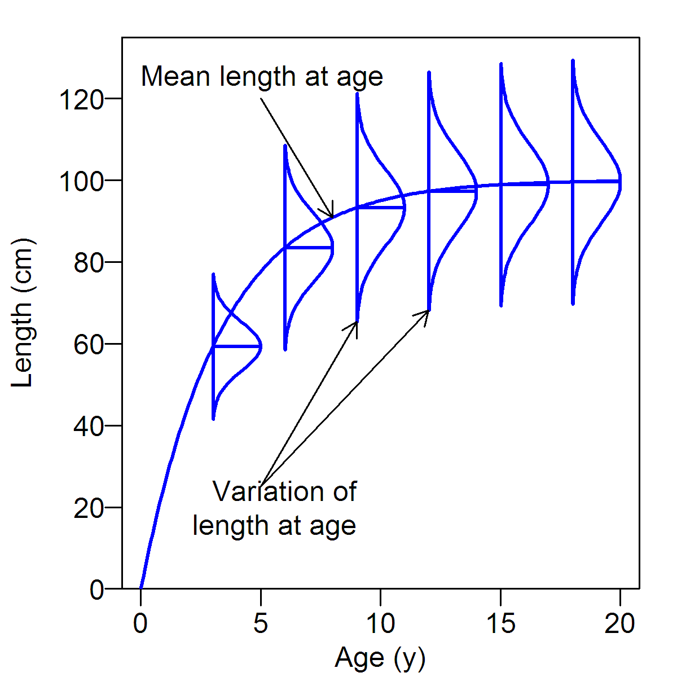
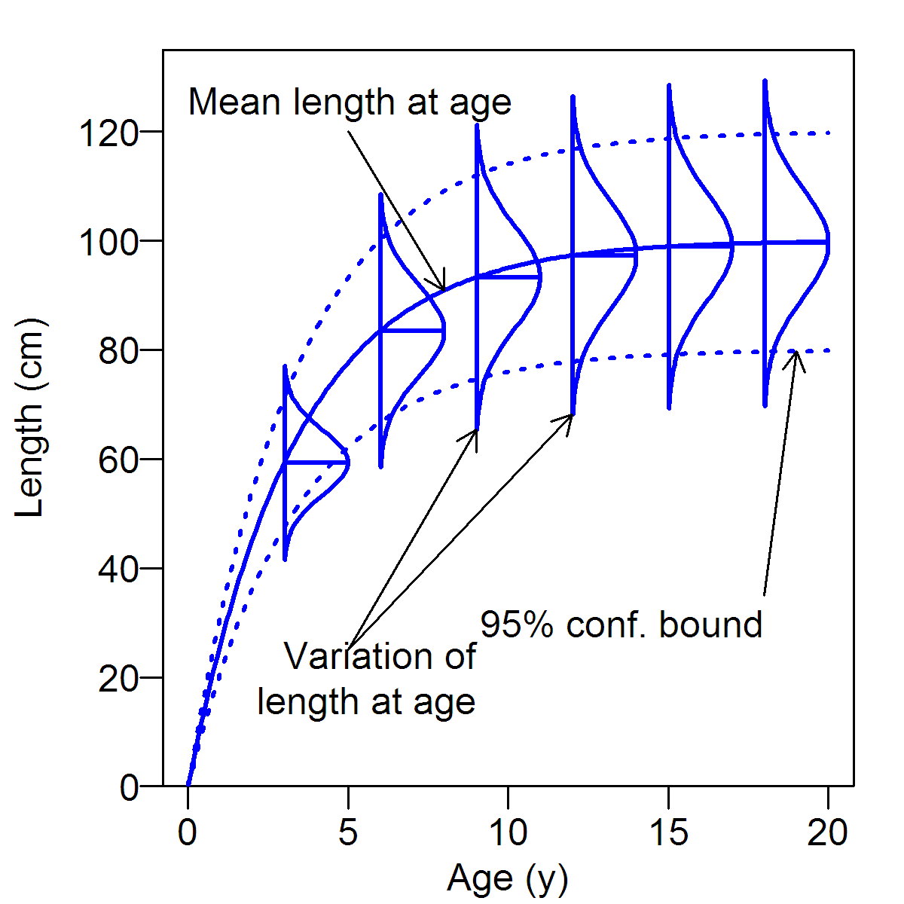
Elements of a Growth Model

Slide 6
Three Aspects of the Growth Model
Specification
Estimation
Function

Slide 7
Specification: 1. Mean length at age
Either
parametric (e.g., von Bertalanffy, Richards)
– can be estimated inside or outside the model
or
empirical (mean length at age by year)
– estimated outside the model
Extended parametric growth models
- separate parameters for some initial ages (MFCL)
- age-specific K (SS)

Slide 8
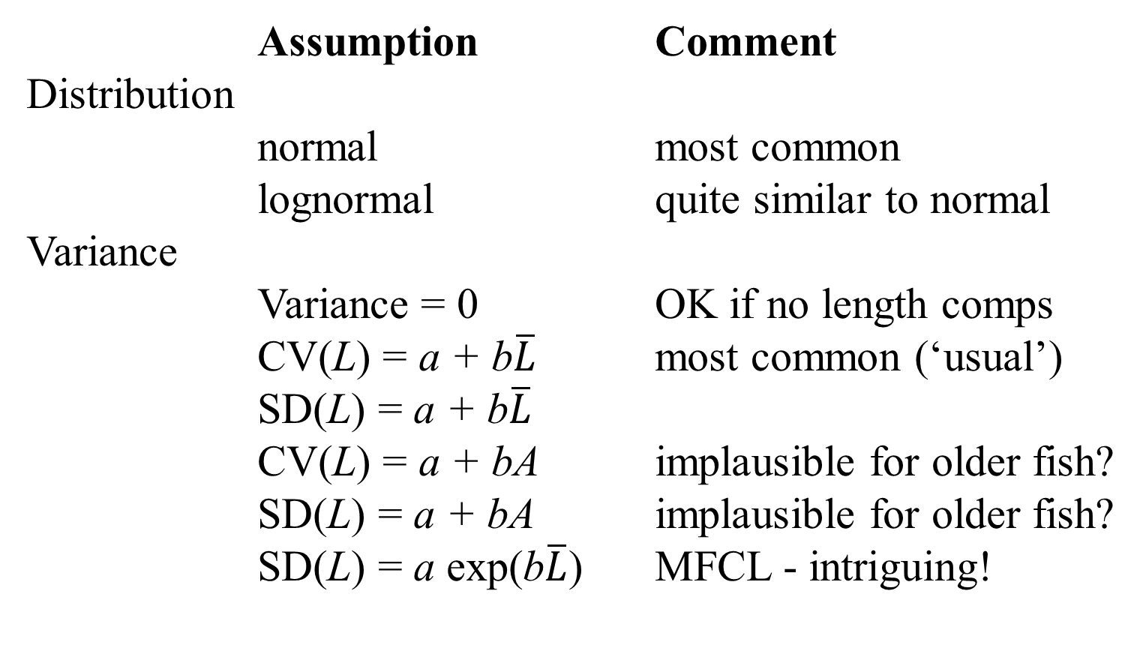
Specification: 2. Variation of length at age
Assumption Comment
Distribution
normal most common
lognormal quite similar to normal
Variance
Variance = 0 OK if no length comps
CV(L) = a + b$\overline{L}$ most common (‘usual’)
SD(L) = a + b$\overline{L}$
CV(L) = a + bA implausible for older fish?
SD(L) = a + bA implausible for older fish?
SD(L) = a exp(b$\overline{L}$) MFCL - intriguing!

Slide 9
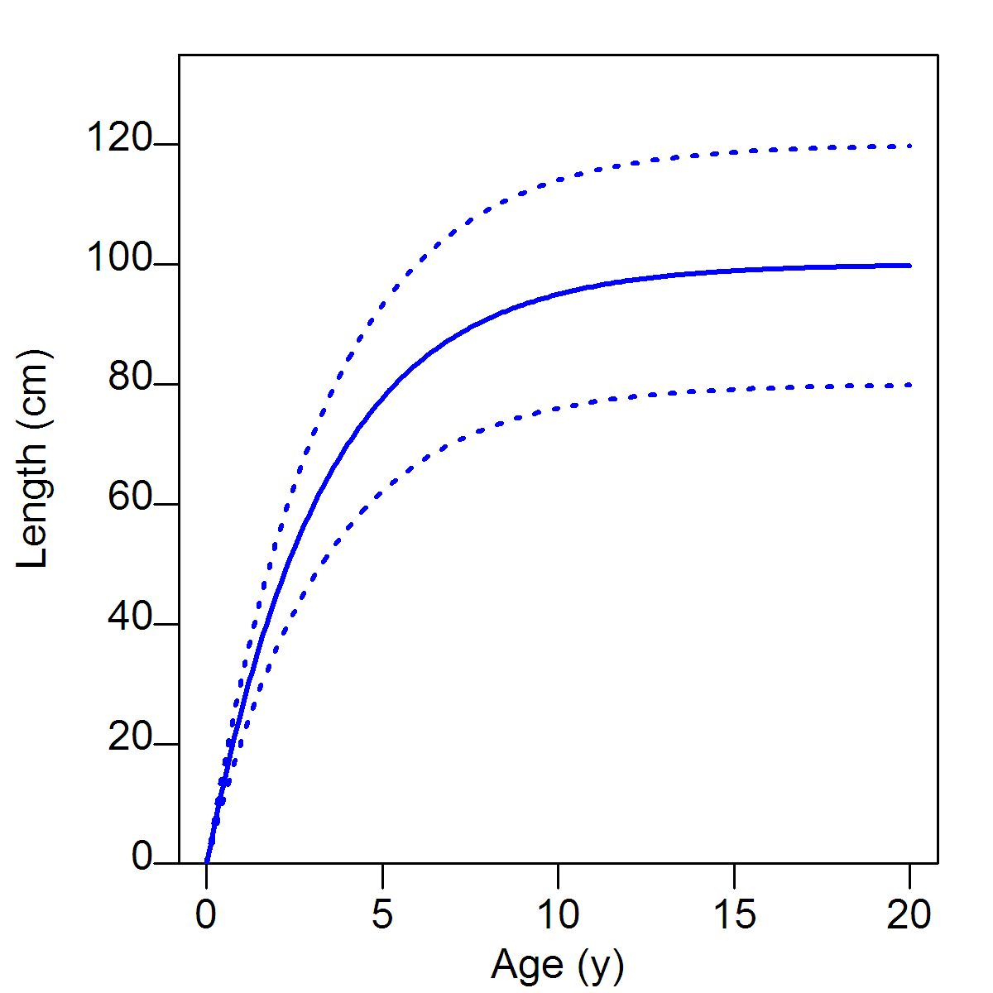
A slide for Terry Quinn

Slide 10
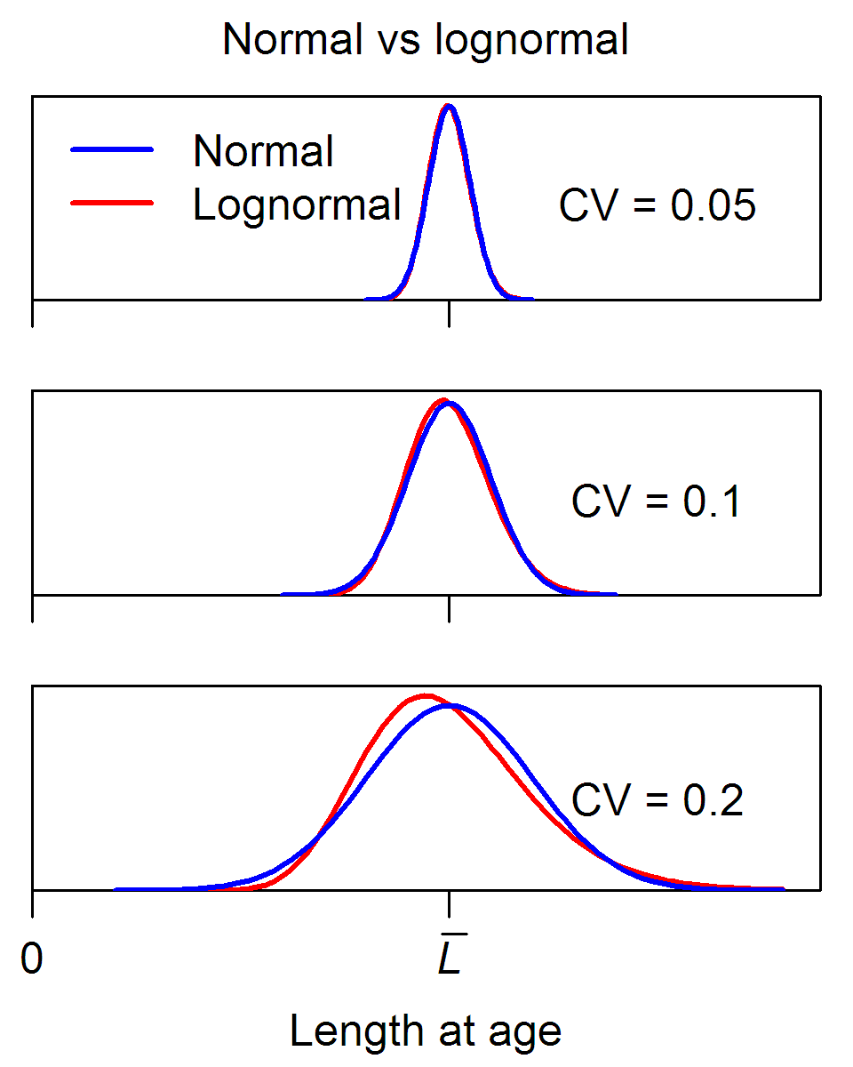
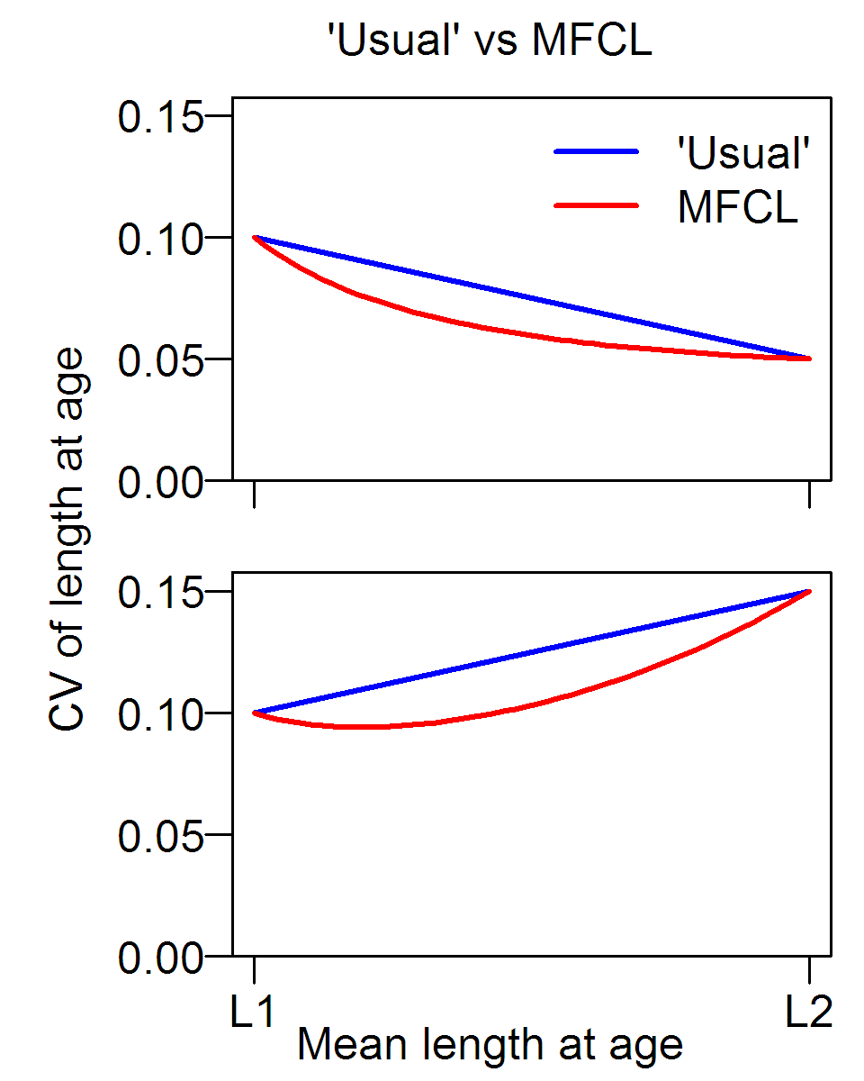
Two Comparisons of Variance Assumptions

Slide 11
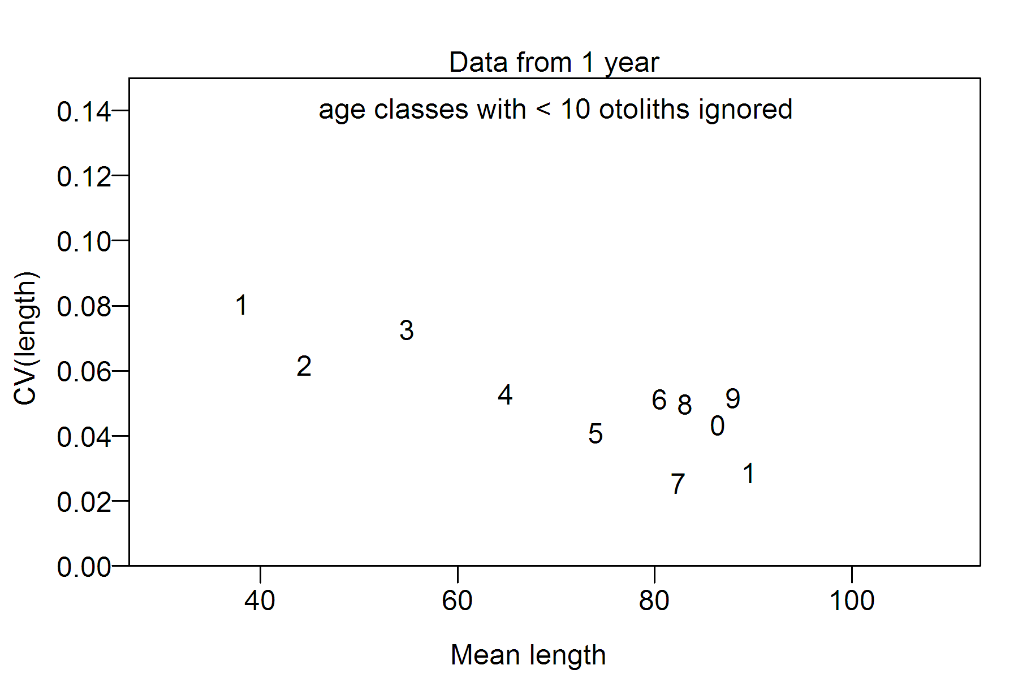
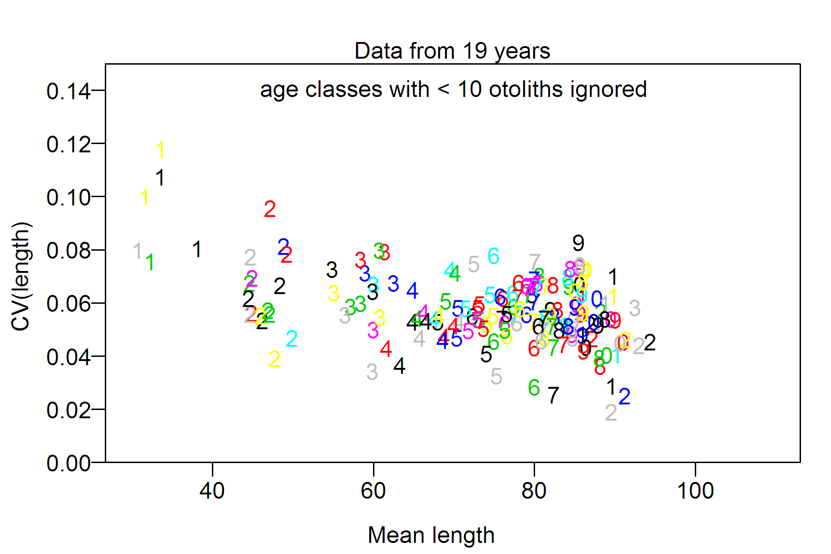
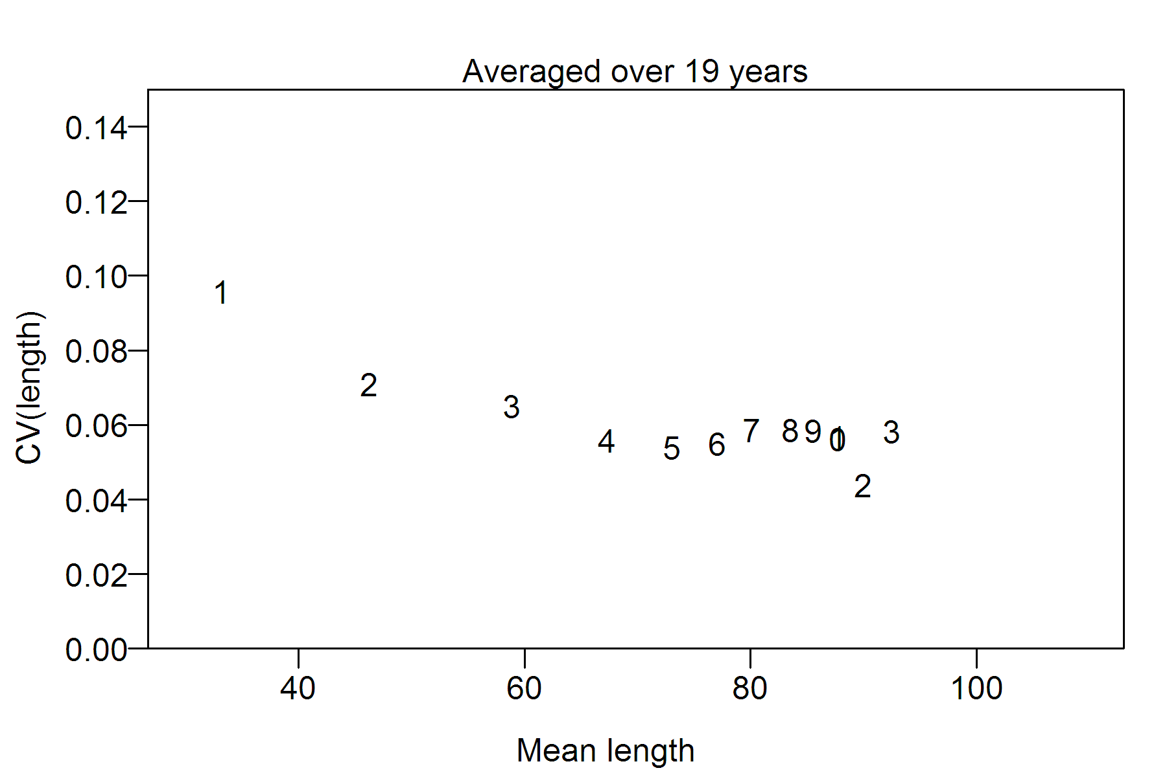
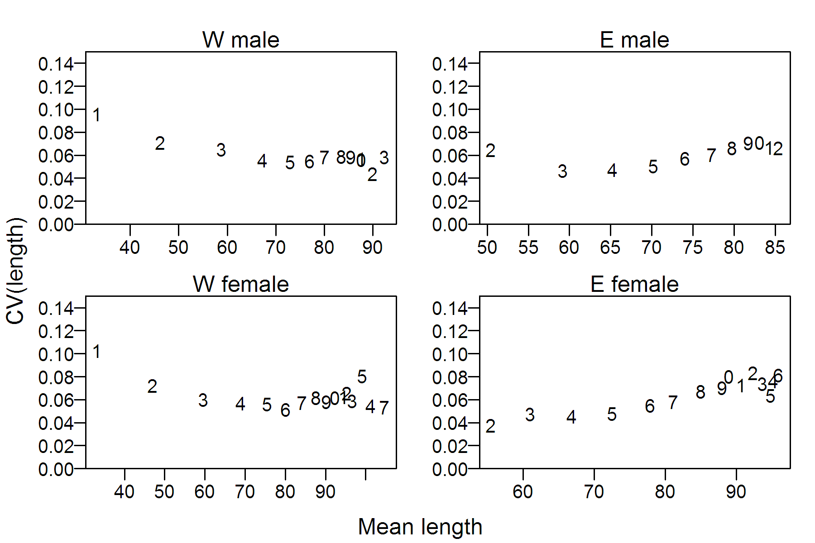
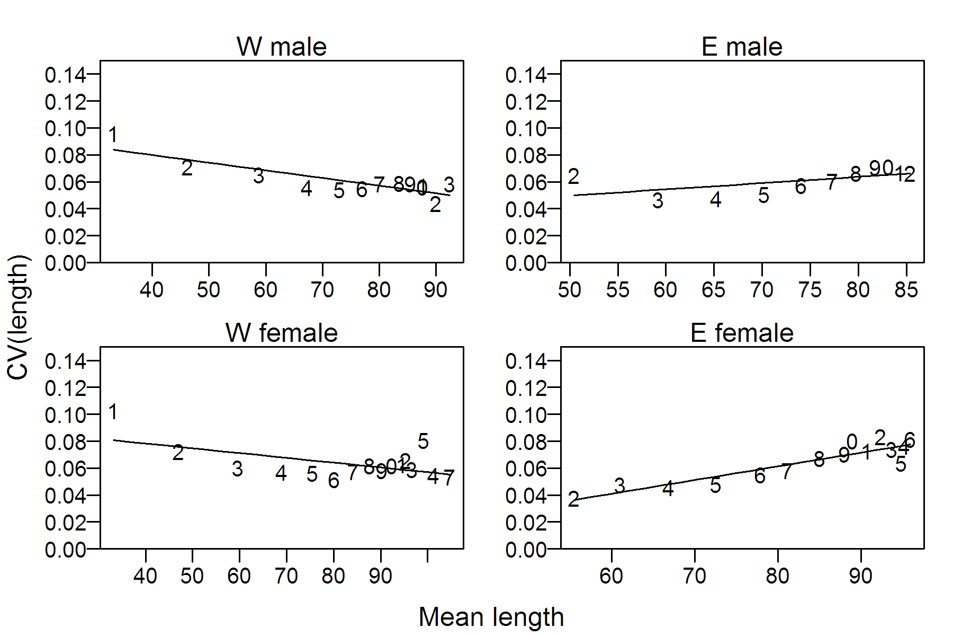
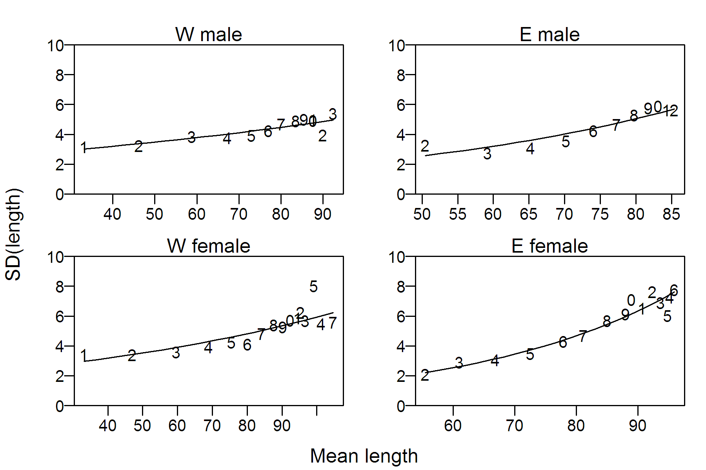
Variance assumptions: exploration with hoki data

Slide 12
Variation of Growth
Growth models may differ by
- sex (common)
- area & season of recruitment (SS) (‘growth morphs’)
- stock (CASAL)
- density (MFCL)
- time (SS)
- ‘phenotype’ (SS and CASAL) – see below

Slide 13
Estimation of Growth
The parameters of the growth model may be estimated
- outside the model, or
- inside the model
Which is best?
Historical trend is towards ‘inside’
(consistent with philosophy of integrated models)

Slide 14
Observations to Estimate Growth Parameters
1. age-length
- often used outside the model (treated as random at age)
- inside the model
- in SS (treated as random at length)
- in CASAL (several treatments)
2. length compositions
- outside the model with Multifan, etc
- inside the model (many programs)
3. tagging length increments
- inside the model (CASAL)
- problem of age- and length-based growth (Wednesday talk)

Slide 15
Functions of the growth model
1. To calculate biomass from numbers at age
age → length → weight
2. To convert length-based fishery selectivities to age-based
in order to remove the catch
3. To calculate likelihoods of length-related observations

Slide 16
Relevance of selectivity
All sampling methods are biased because
The size and age of fish caught depends on
- the gear used
- the time and place of fishing

Slide 17
Selectivity in stock assessment models
Each set of observations has an associated selectivity curve
- accounts for gear-based selectivity and fish distribution
Selectivities may be
- age-based (all models)
- length-based (many models)
- product of age- and length-based (SS)
Length-based often now deemed to be more realistic
- implies that age-length data are random at length
- biases growth curves estimated outside the model

Slide 18
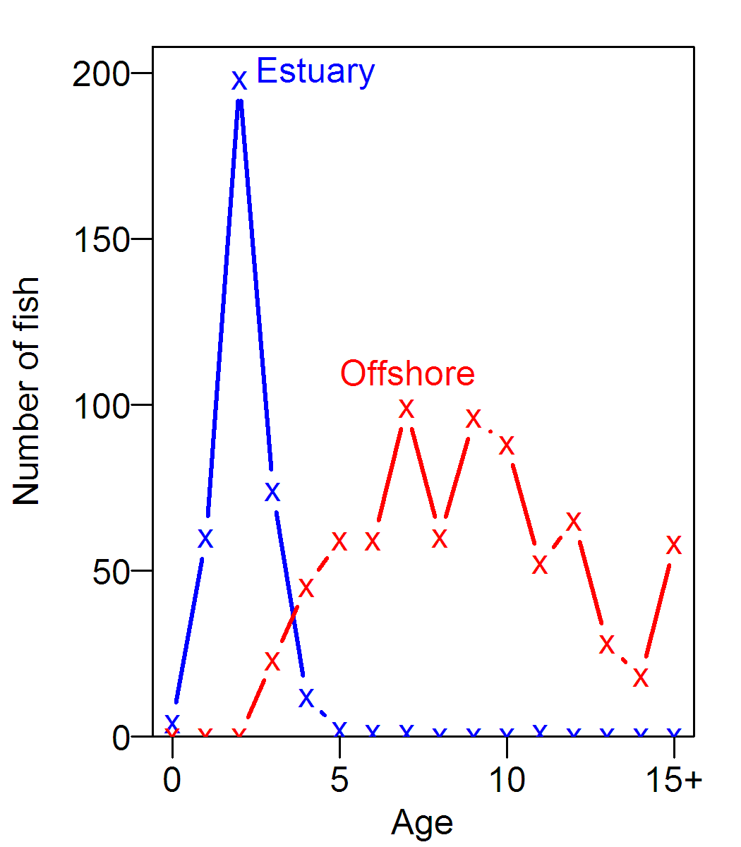
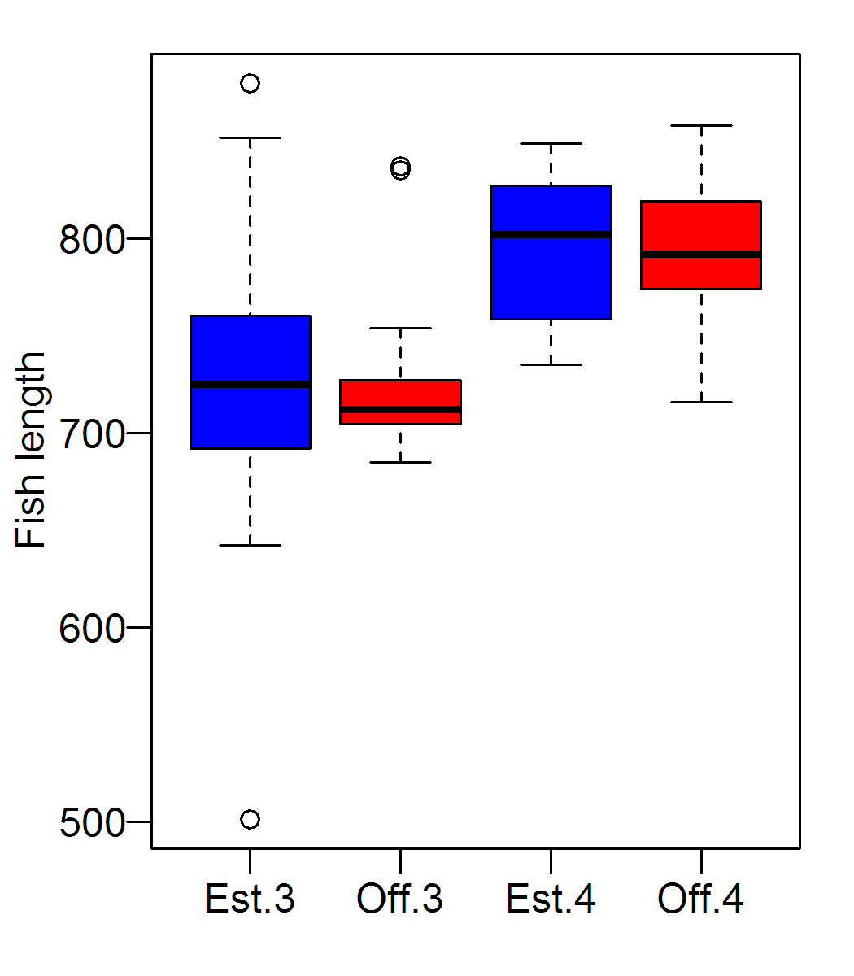
Ontogenetic Migration of Red Drum (data courtesy of Robert Muller)
Red drum migration is age-based
Migration at ages 3 & 4

Slide 19
Consequences
We should be cautious about the assumptions that
- selectivity is purely length-based
- age-length data should be treated as random at length
Age distributions of red drum of length 750-850 mm
2 3 4 5 6 7 8 9
ESTUARY 1 20 10 2 1 0 0 0
OFFSHORE 0 5 40 43 22 23 2 2

Slide 20
Growth variation by ‘phenotype’
Population divided into subpopulations, each with its own growth model
Terminology:
- sub-morphs (SS User Manual)
- platoons (Taylor & Methot, 2013 for SS)
- growth paths (CASAL)
Potential solution to a problem with length-based selectivity

Slide 21
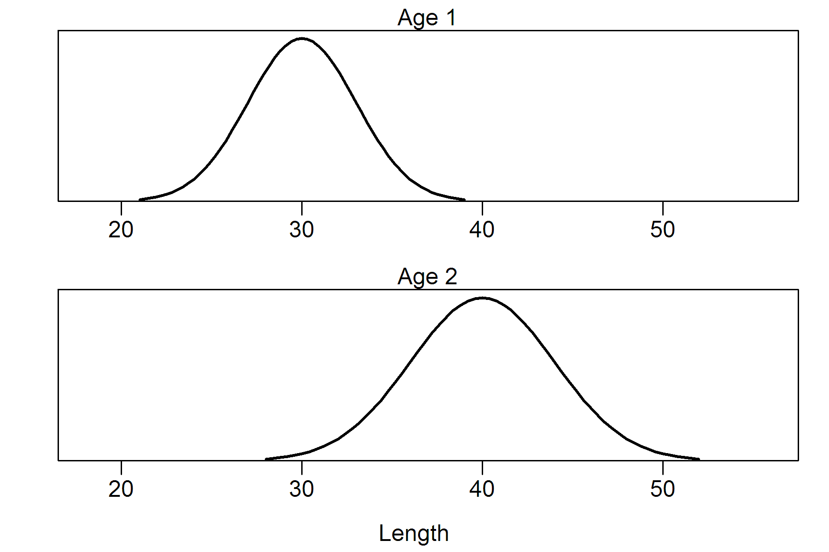
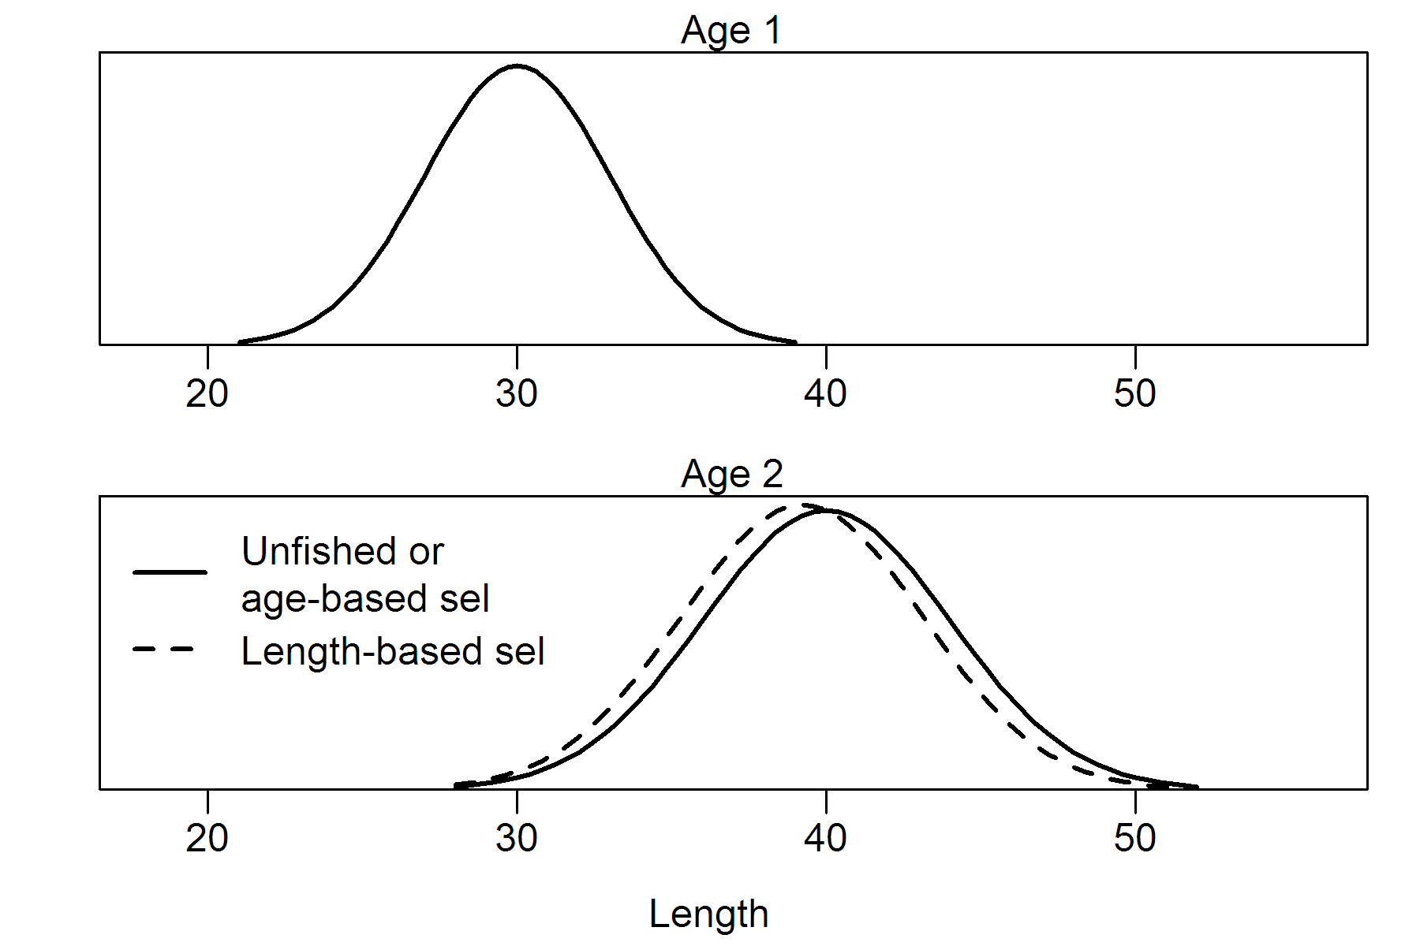
The Problem

Slide 22
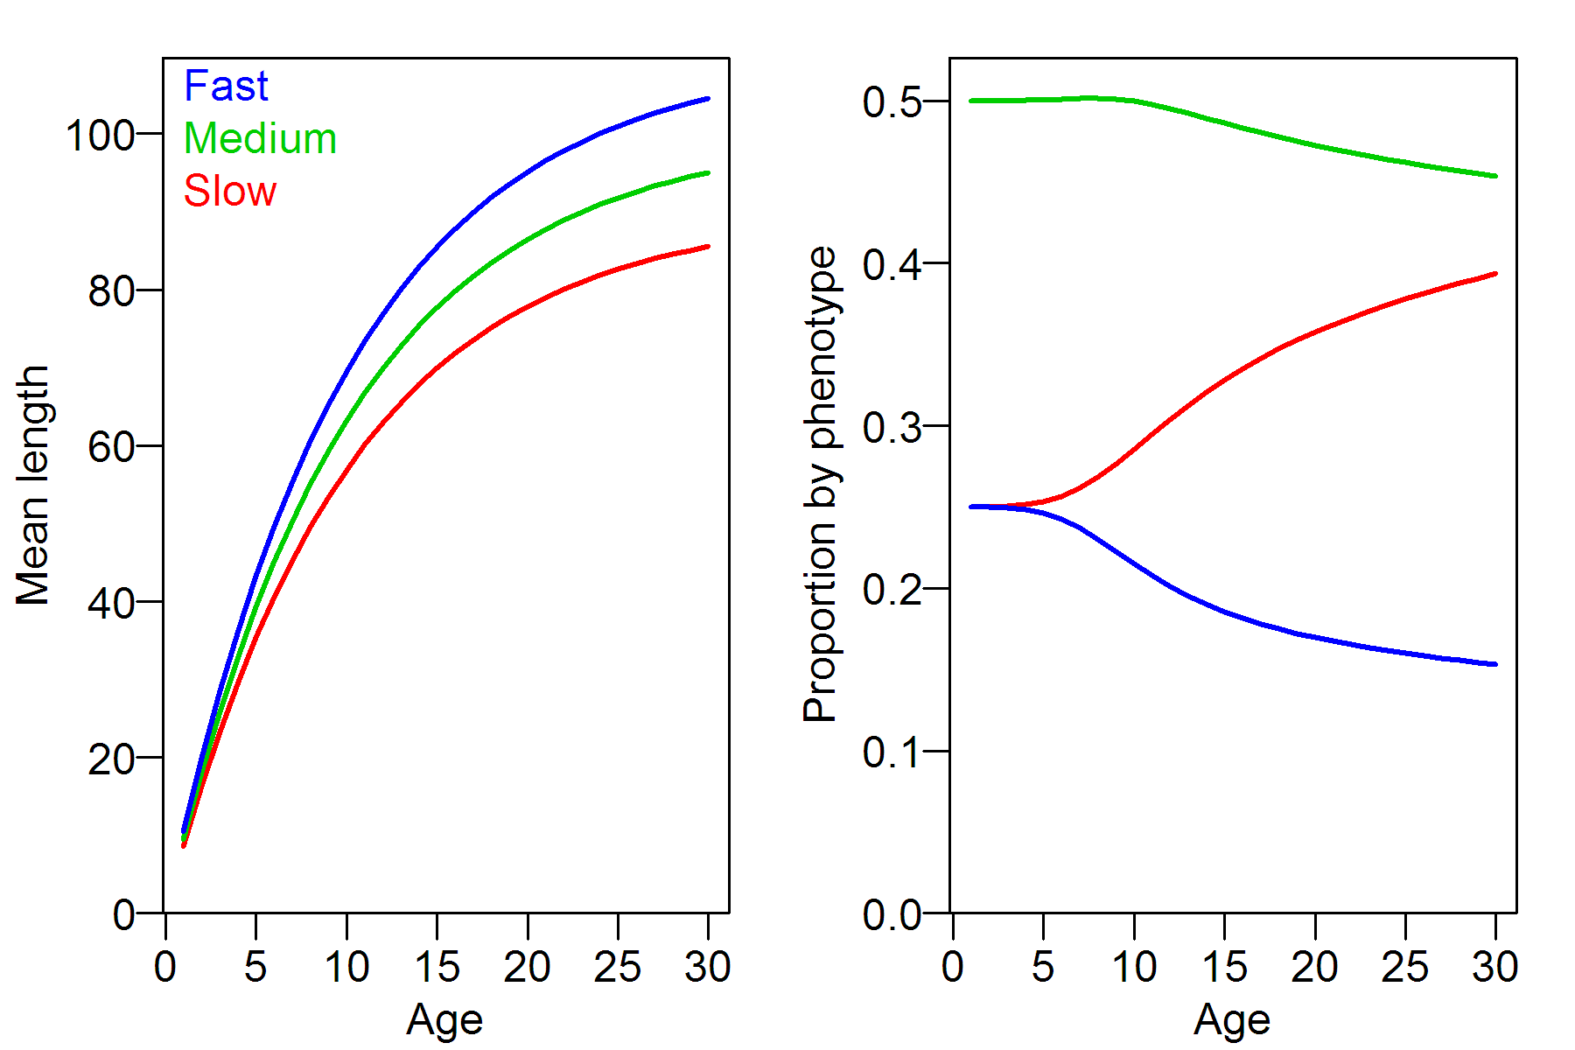
A 3-phenotype solution

Slide 23
Comments on phenotype growth
Seems like a good idea, but the jury’s still out
Potential weaknesses
- Assumes growth variation is genetic, rather than environmental
- Allows no genetic selection
- Ignores density-dependent growth
For more detail see Taylor & Methot (Can. J. Fish. Aquatic Sci. 142: 75-85, 2013)

Slide 24
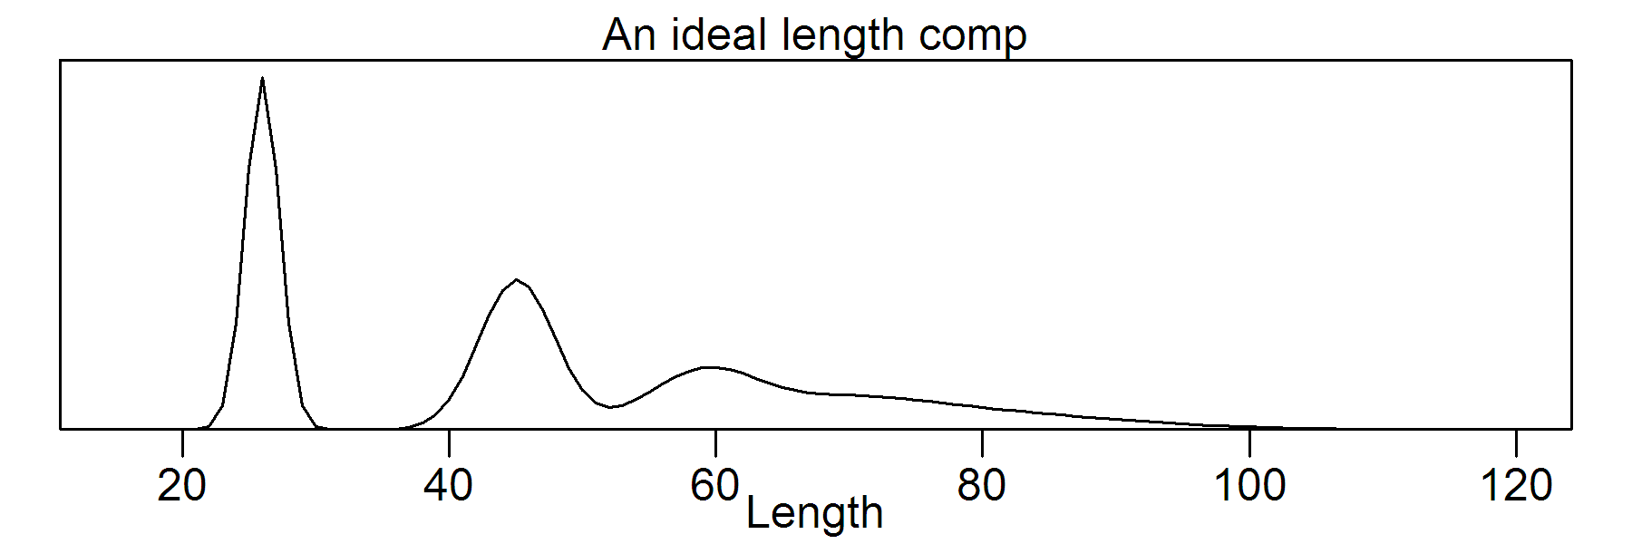
Inferring Growth from Length Comps
In practice
- modes for youngest age classes are often erratic
- many length comps are unimodal

Slide 25
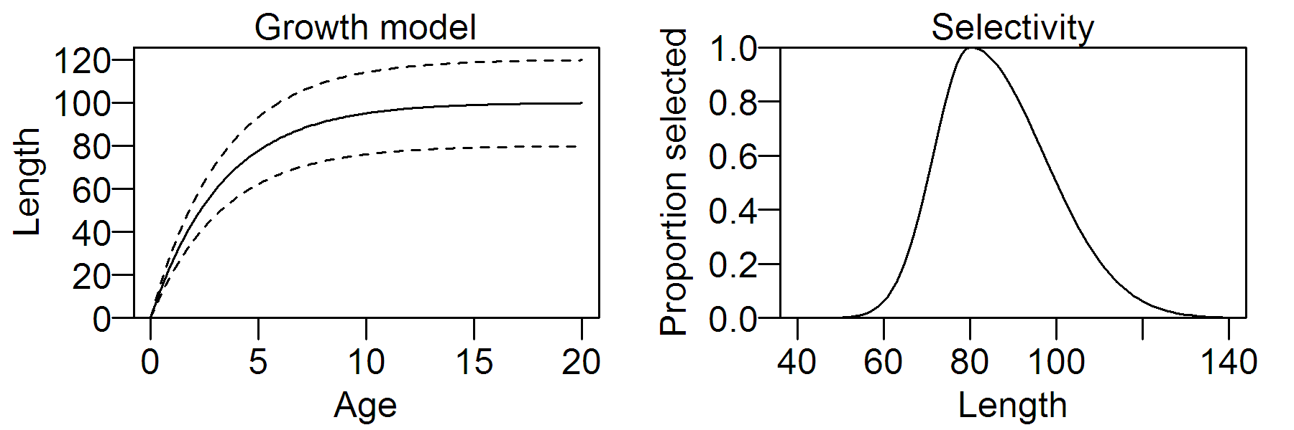
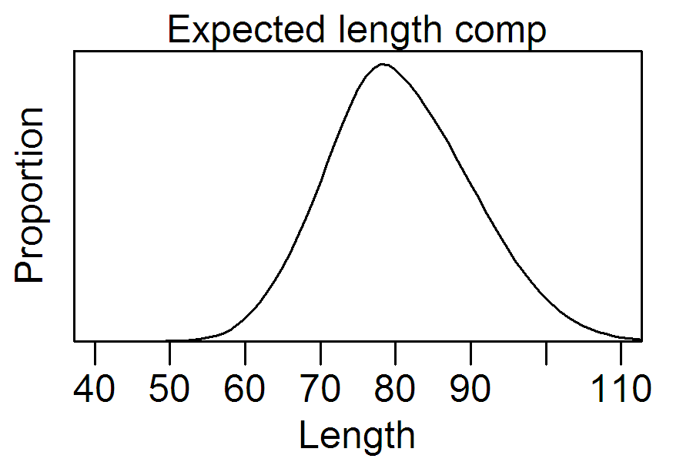
A unimodal length comp
M = F = 0.2

Slide 26
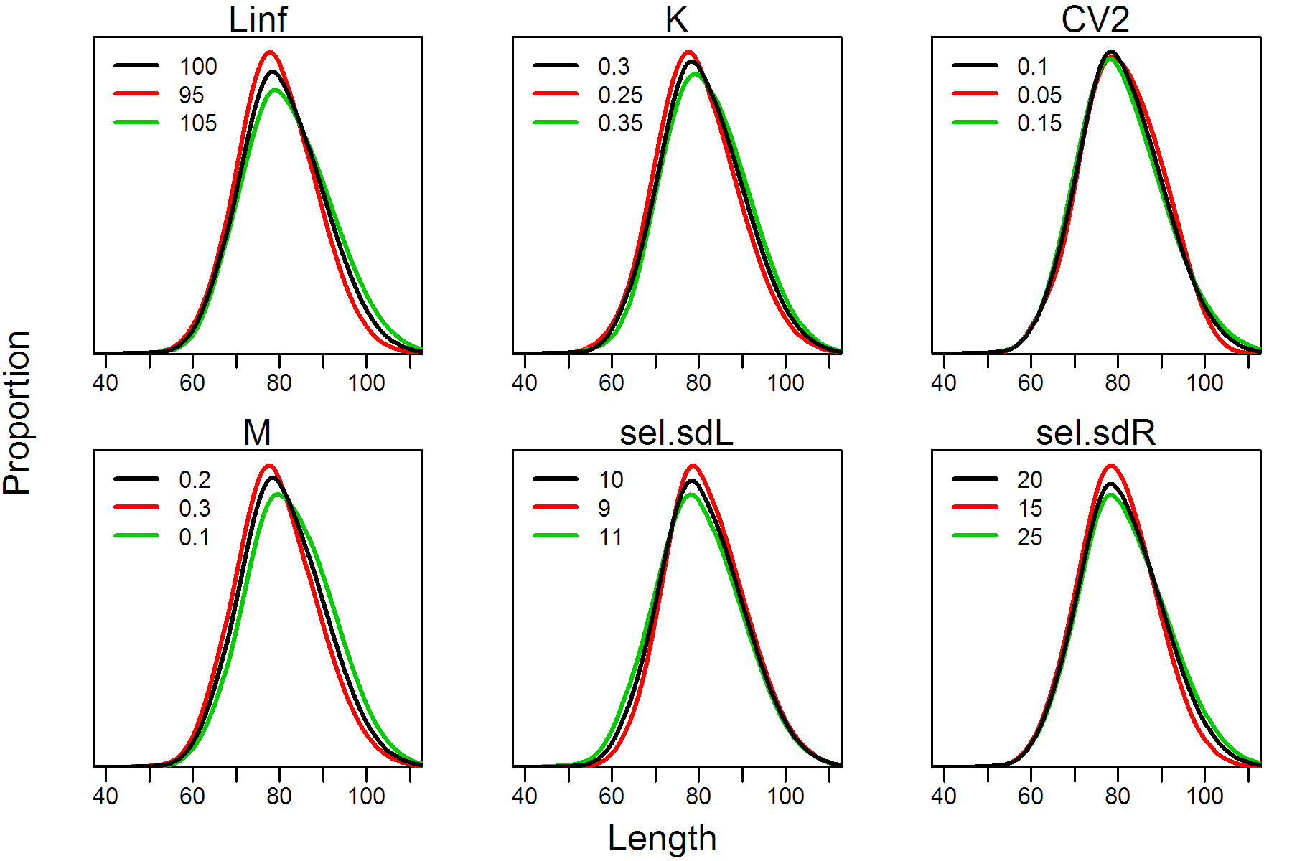
Sensitivity to Some Parameters

Slide 27
Use of Age-Length Keys (ALKs)
ALK – age-length data set, treated as random at length
Traditional approach
Outside model
- use ALKs to convert length
comps to age comps
- estimate growth pars
Inside model
- fix growth pars
- fit to age comps only
‘New’ approach (in SS)
Outside model
Inside model
- estimate growth pars
- fit to length comps and
ALKs

Slide 28
Pros and Cons of ‘New’ Approach
Pros
- more consistent with philosophy of integrated models
- should get better estimates of growth
- don't need complete ALKs
Con
- possible loss of information in fitting length comps
(because each expected length comp is calculated using the growth model, not the corresponding ALK)
Conclusion: be cautious about ‘new’ approach when growth varies by year

Slide 29
Guidelines for Choosing the Best (Growth) Model (including which parameters to estimate inside the model)
1. There are no fixed rules
2. Be guided by your data (including qualitative/anecdotal)
3. See what works (try alternative models)
4. Start simple & use Occam’s Razor

Slide 30
Evaluating Alternative (Growth) Models
Look for
- A visible improvement in goodness of fit
- A non-trivial change in stock status (e.g., SSB trajectory)
Don’t use AIC! (almost always favours more parameters)

