Slide 1
Can We Combine Age-Length and Tagging-Increment Data?
R.I.C. Chris Francis, Alex M. Aires-da-Silva,
Mark. N. Maunder, Kurt M. Schaefer
and Daniel W. Fuller
CAPAM Growth Workshop, La Jolla, November 3-7, 2014.

Slide 2
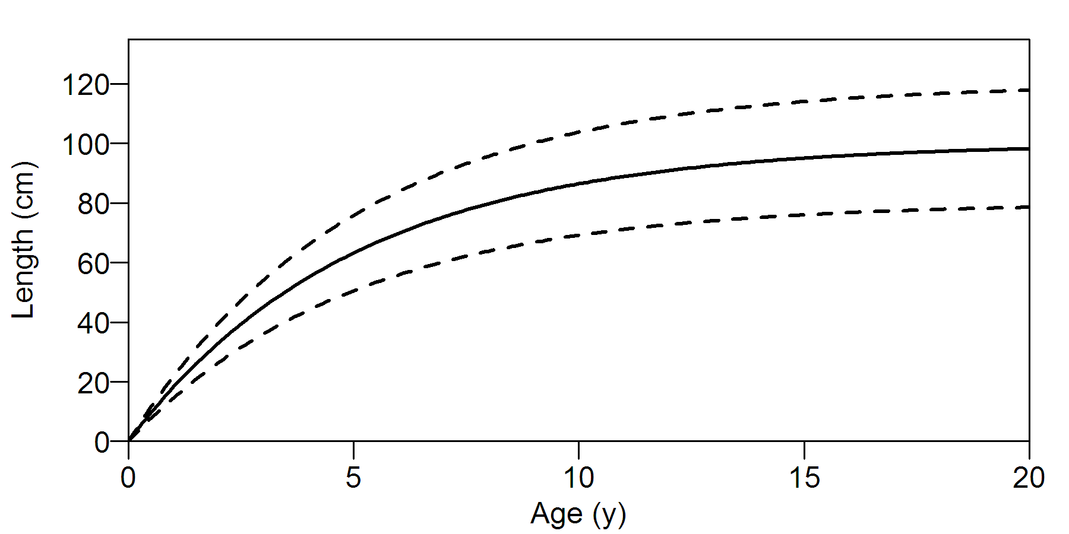
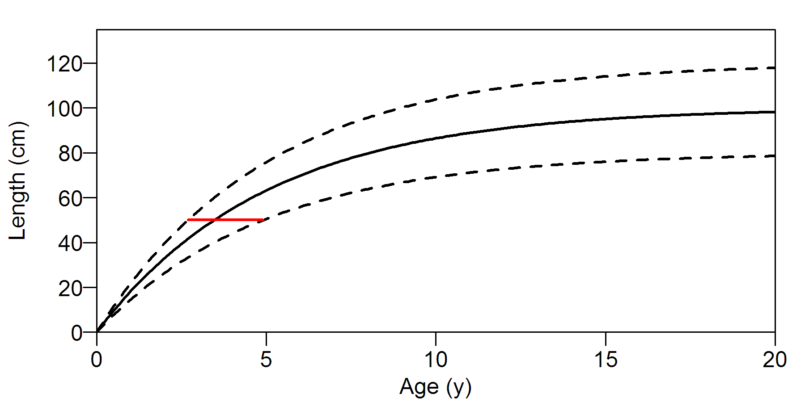
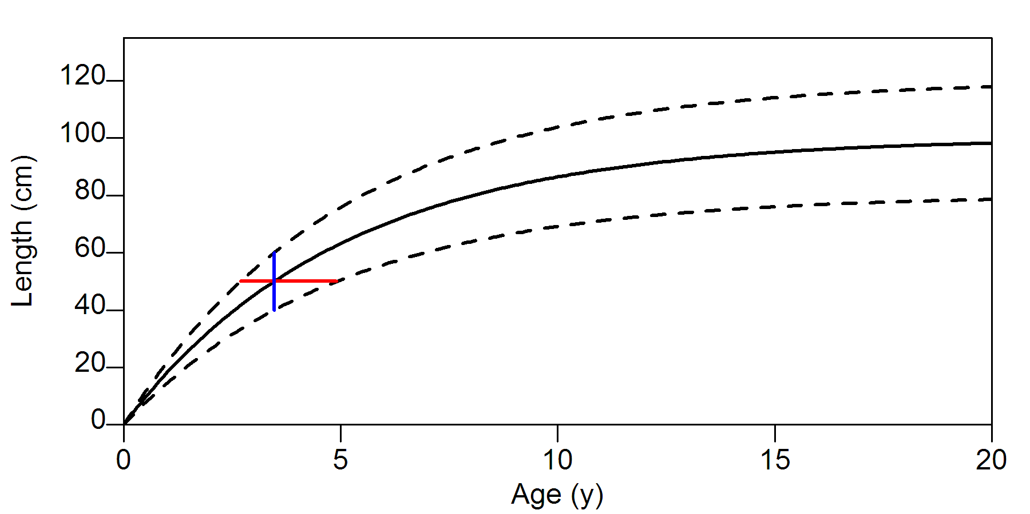
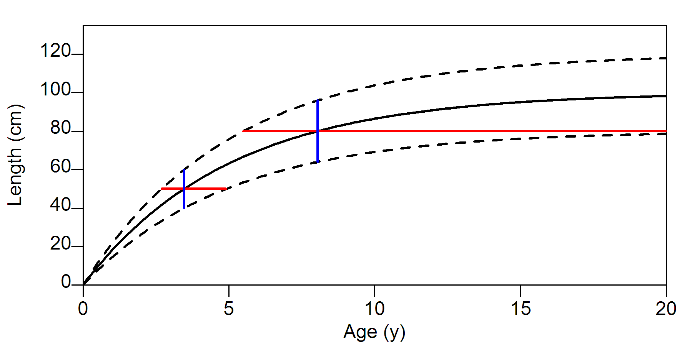
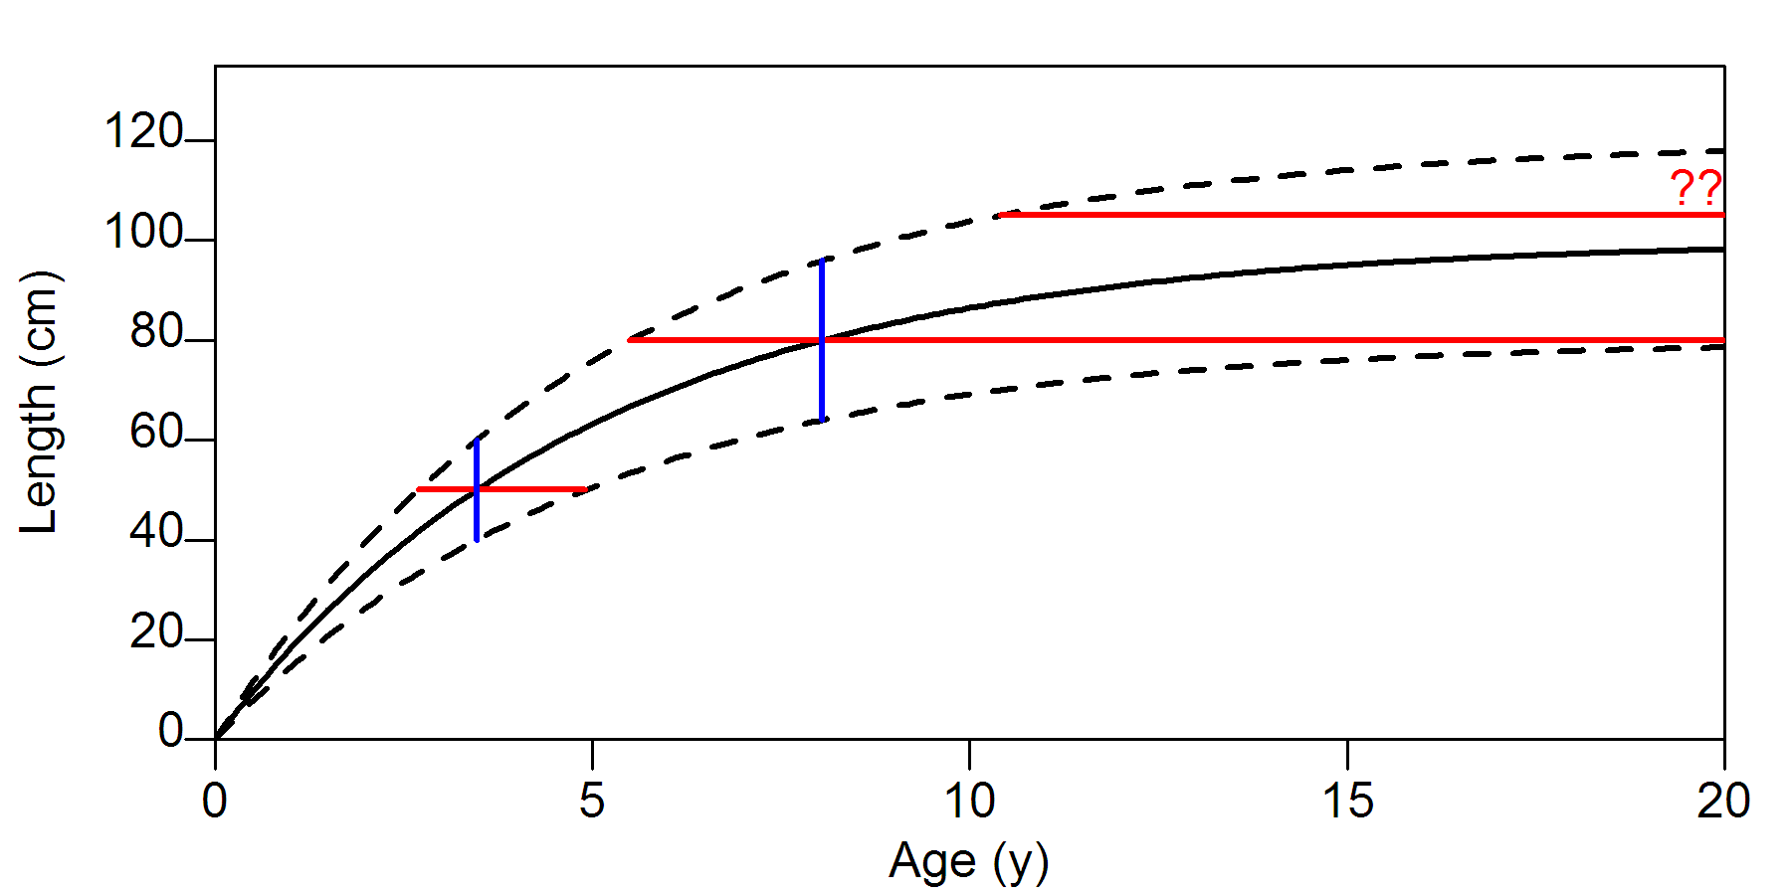
Francis (1988)* said No! (*CJFAS 45: 936-942)
Length-based growth (from tagging) and
age-based growth (from age-length data) are not comparable

Slide 3
A Recent Paper (in press, Fish. Res.)
Authors Aires-da-Silva, Maunder, Schaefer & Fuller (AMSF)
Title Improved growth estimates from integrated analysis of direct aging and tag–recapture data ...
Method A modification of the “LEP approach”

Slide 4
LEP Approach
Series of papers by Laslett, Eveson, and Polacheck
(especially CJFAS 61: 292-306, 2004)
1. Random-coefficients model of growth
- each fish grows according to a vonB curve with it’s own L∞, but with common values of K and t₀
2. Random-effects estimation
- for each tagged fish, L∞ and A [= A_{tagging} – t₀] are treated as random effects
(e.g., estimate μ_{L∞} , σ_{L∞})

Slide 5
Pros and cons of LEP
Pros
- makes tagging-growth age-based
- elegant mathematics
- sound statistics
Cons
- biologically implausible (growth deterministic; no response to environment)
- too computer-intensive for stock-assessment models
- fails Occam’s razor (sort of)

Slide 6
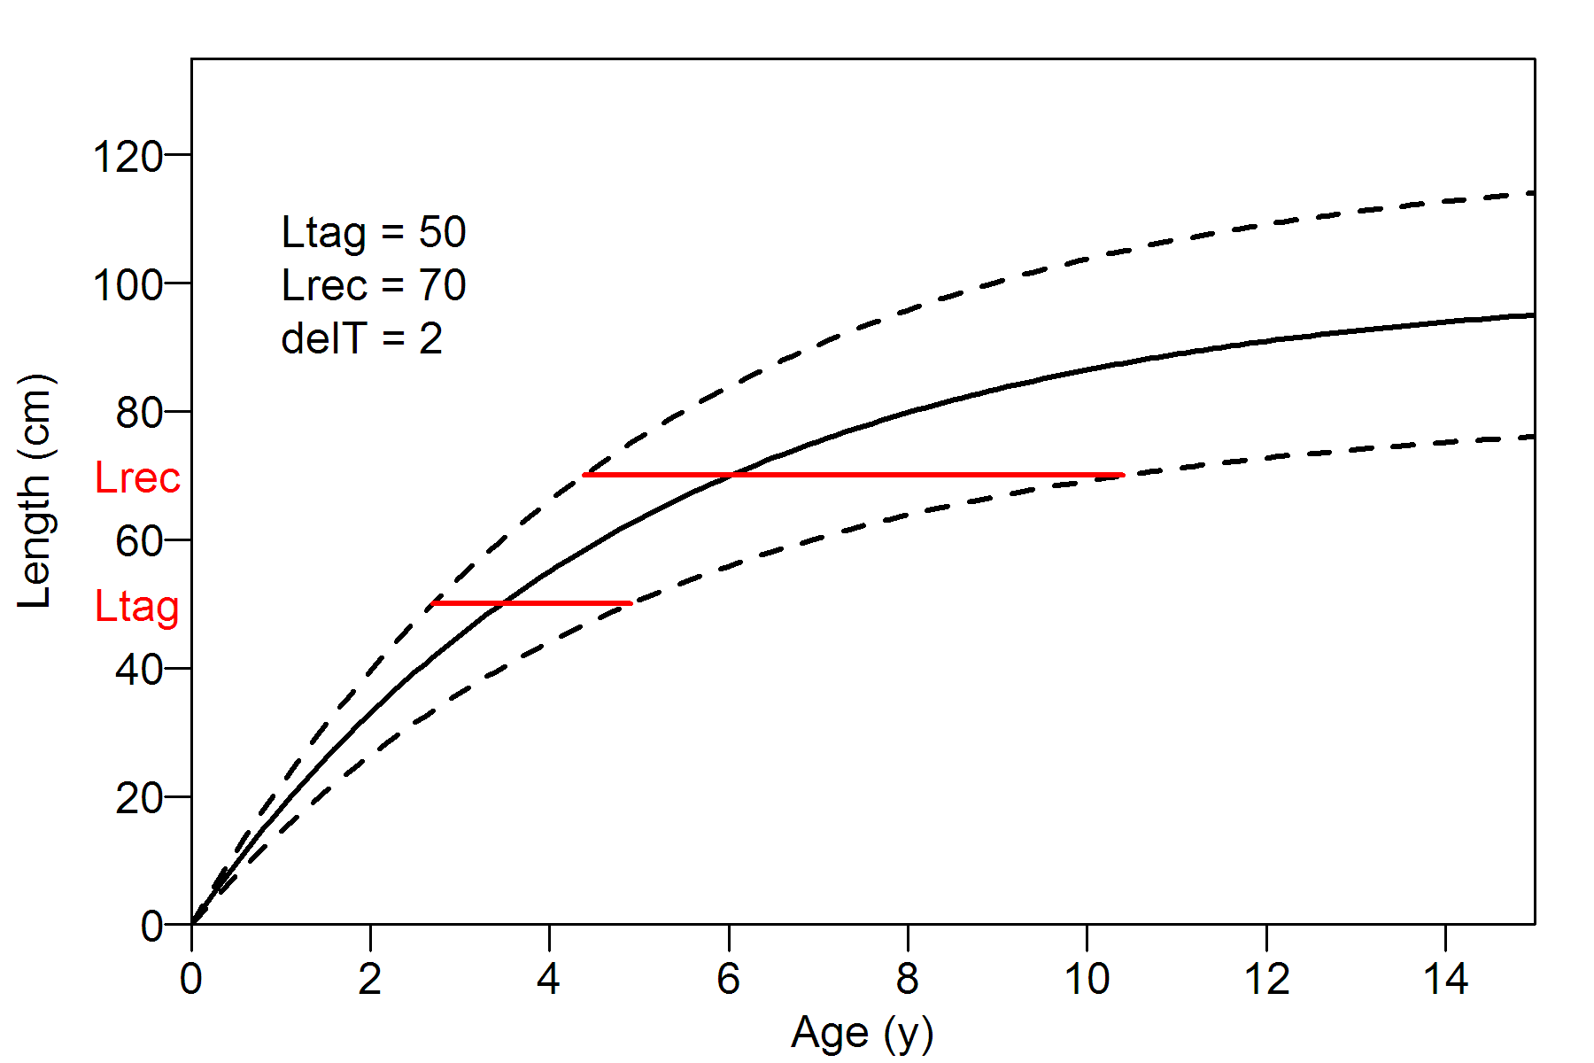
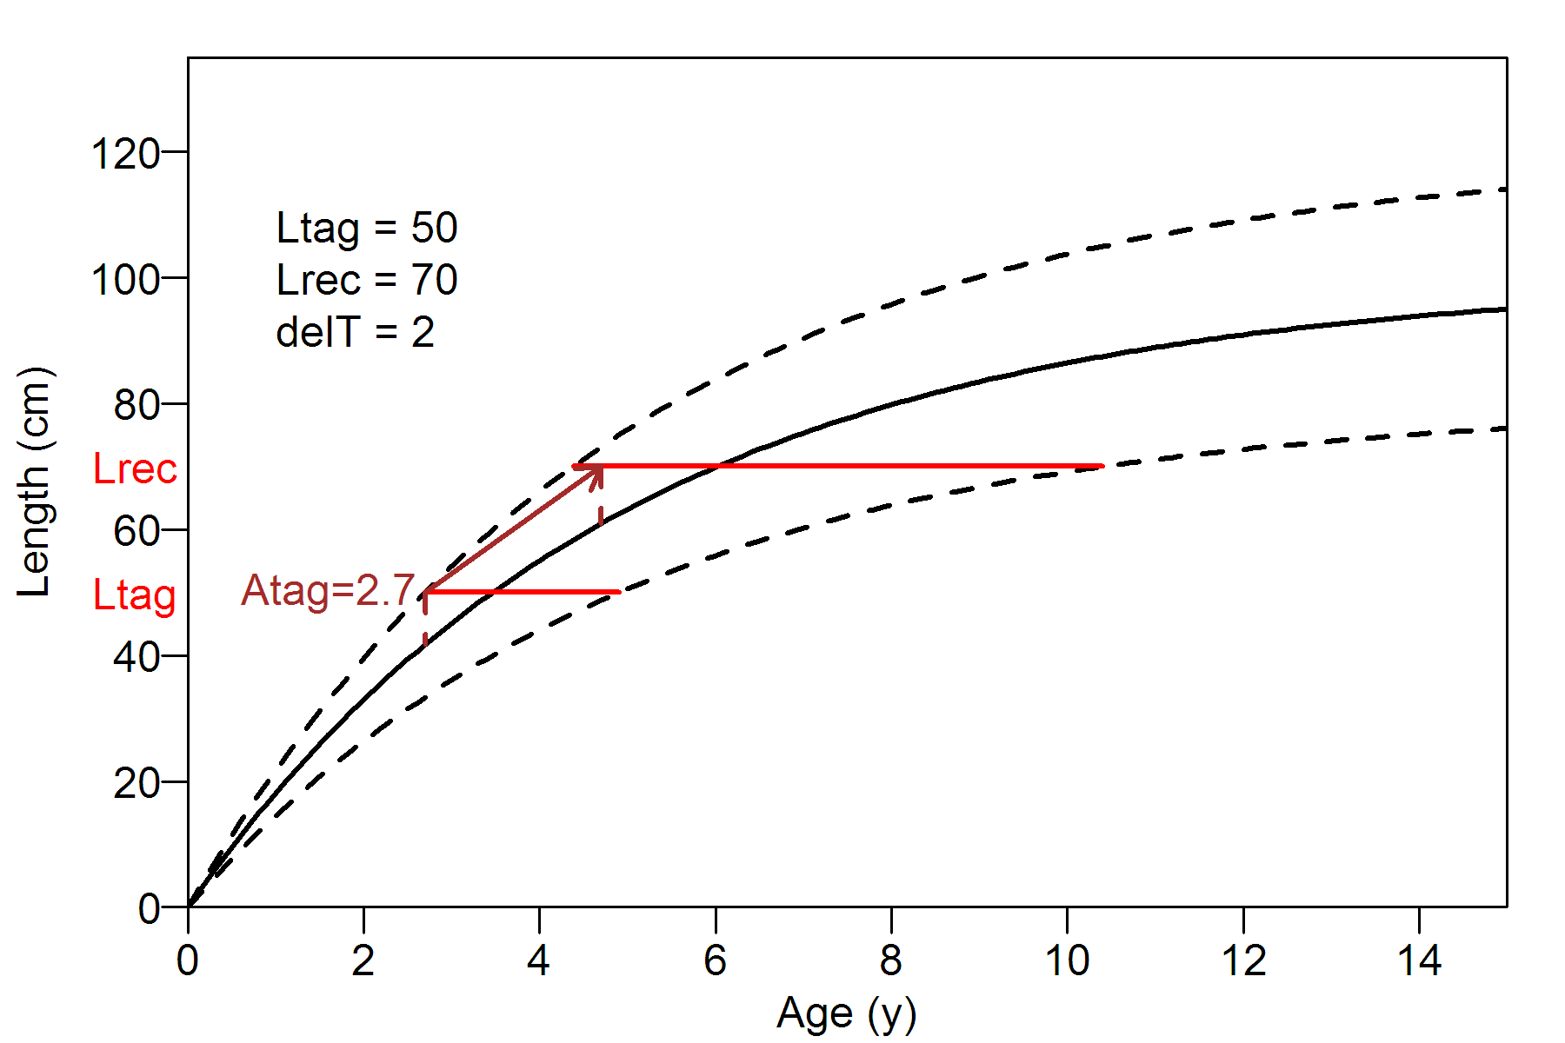
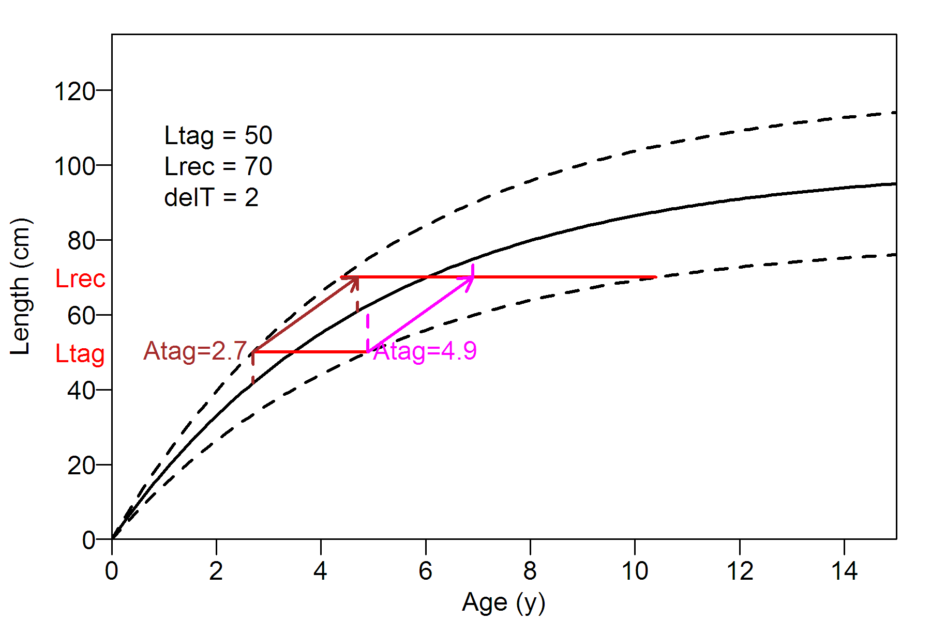
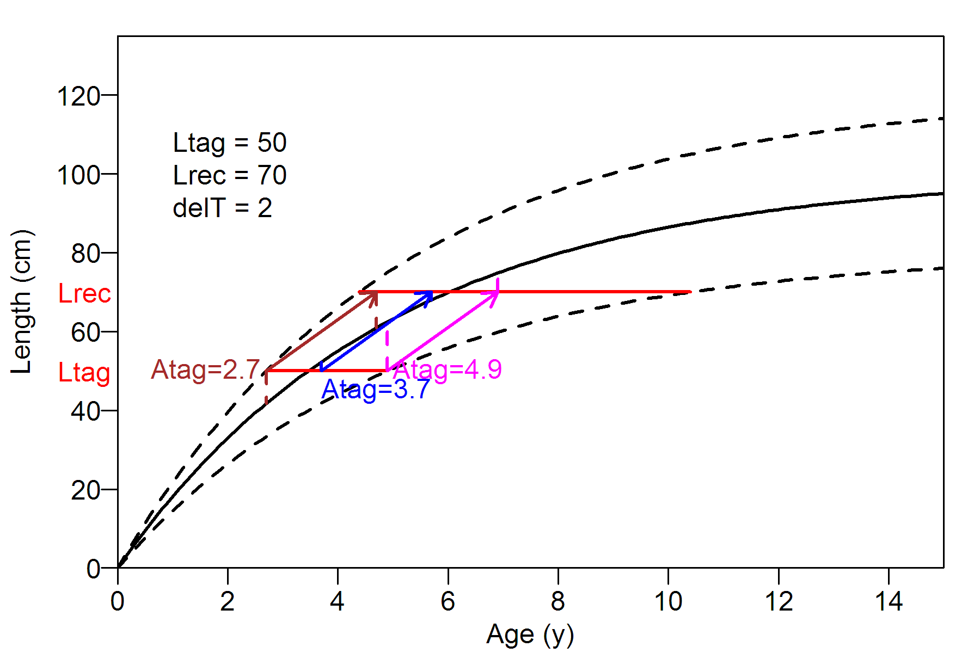
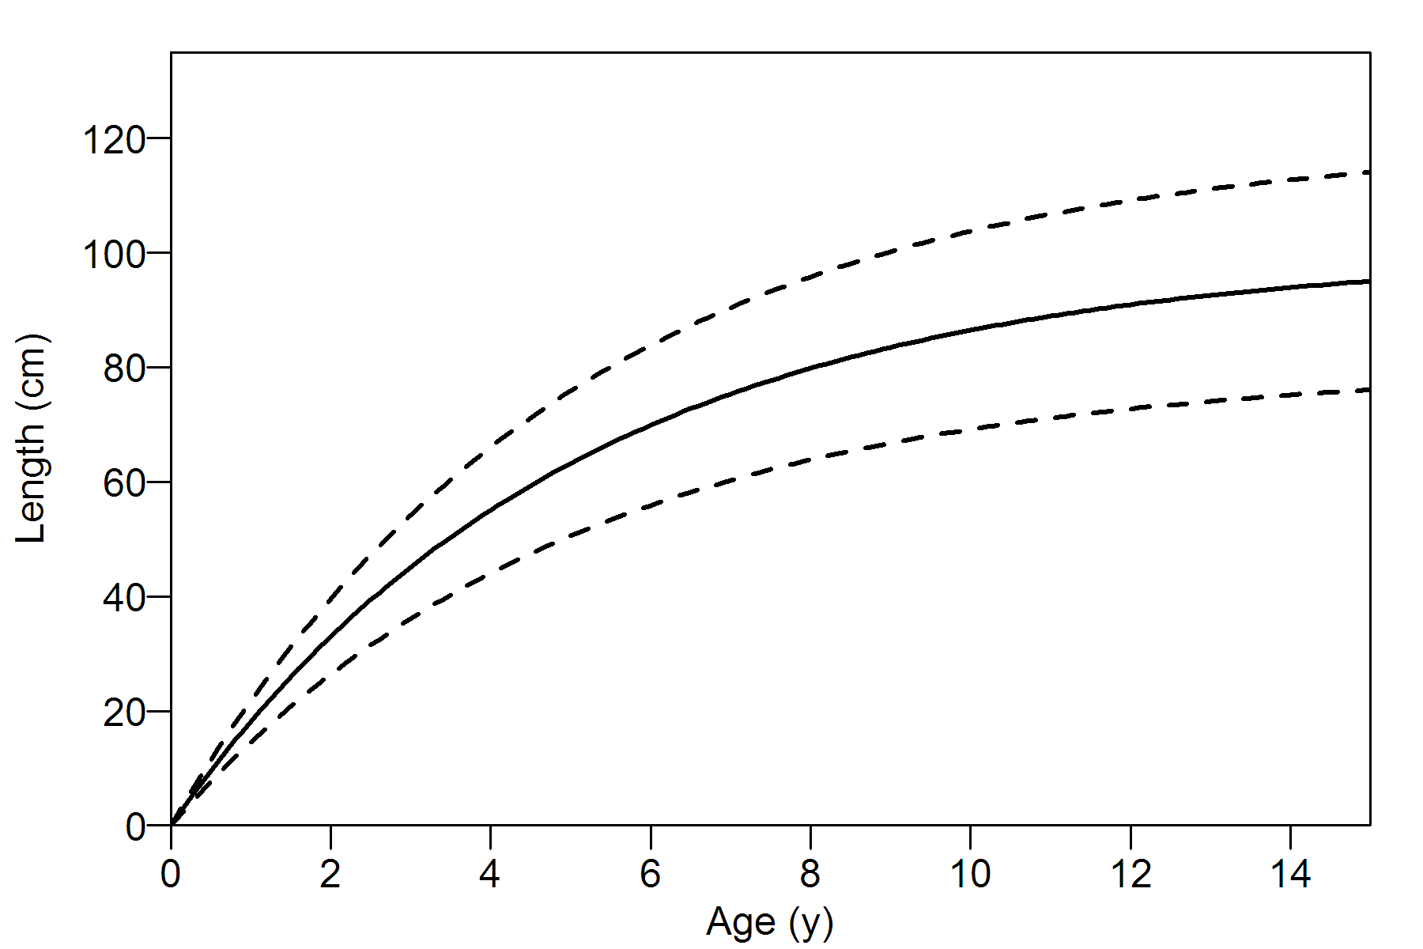
AMSF approach

Slide 7
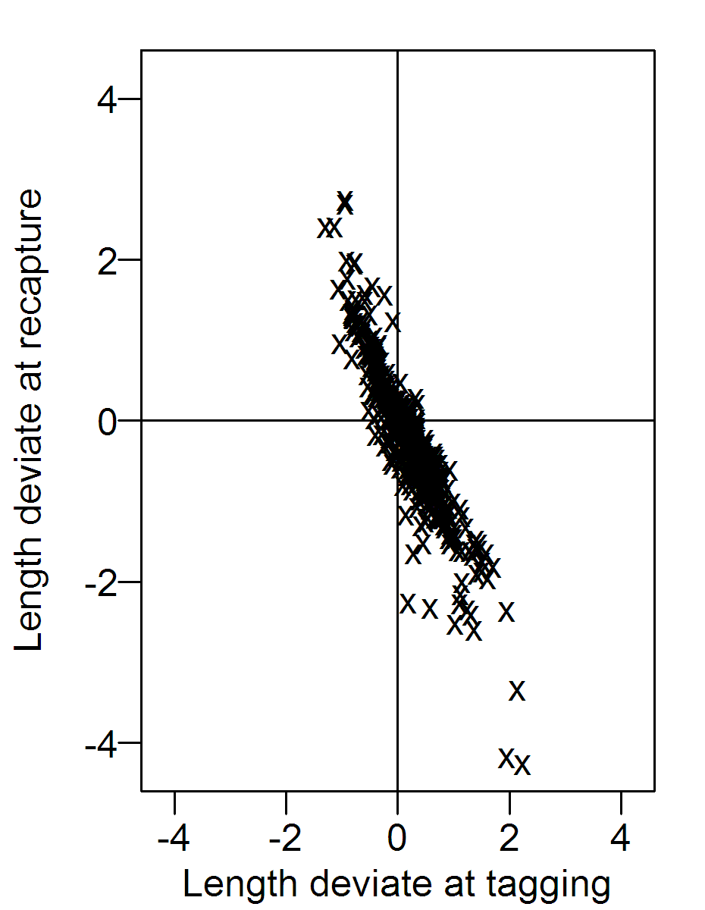
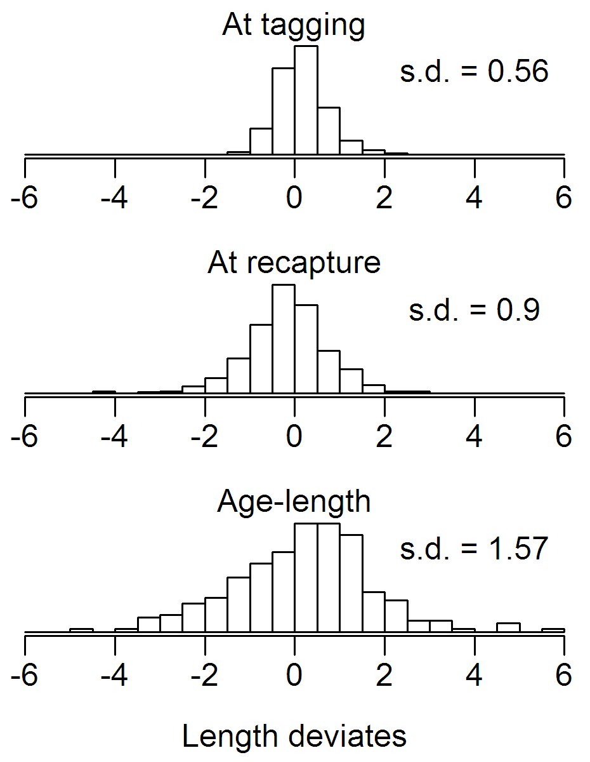
Problems with AMSF

Slide 8
Pros and cons of AMSF
Pros
- makes tagging-growth age-based (as for LEP)
- more plausible than LEP (no random coefficients)
- less computer-intensive (no random effects)
- consistent with usual assessment growth model
- much better growth curve for bigeye tuna
Cons
- implausible correlations between deviates
- growth variability underestimated

Slide 9
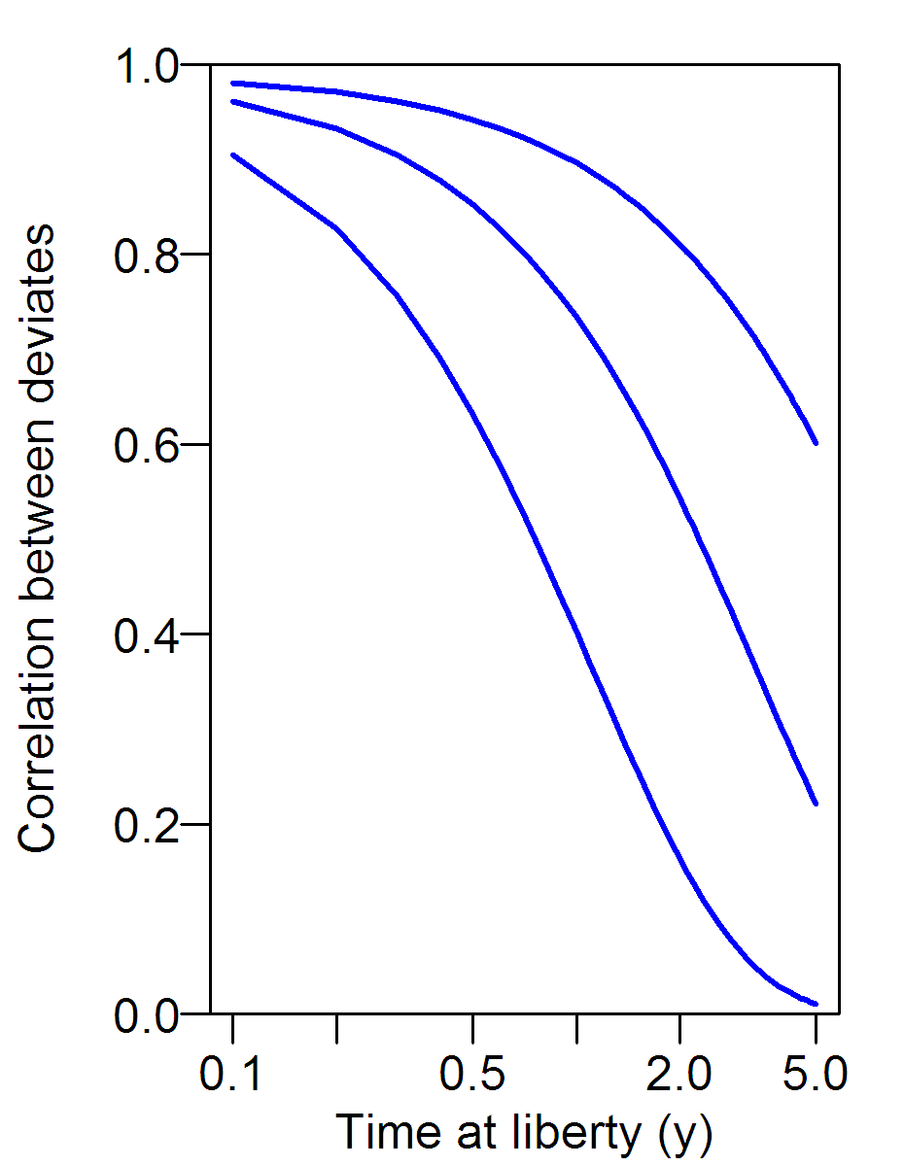
Can we fix these problems?
Problem: Tagging data contain no information about this correlation structure

Slide 10
Can’t reliably estimate age at tagging

Slide 11
Can We Combine Age-Length and Tagging-Increment Data?
1. Some progress has been made since 1988
2. Problem still not solved

