Slide 1
Estimating Growth Within Size-Structured Fishery Stock Assessments
(What is the State of the Art and What does the Future Look Like?)
André E Punt, Malcolm Haddon, and Richard Mcgarvey
5 November 2014; CAPAM Growth Workshop

Slide 2
Outline
Size-structured assessment models
Estimating size-transition matrices
  The measurement error approach
  The individual variability in parameters approach
Performance of methods
The state of the Art
The future!

Slide 3
Size-structured assessment models
The basic dynamics in size-structured assessments are modleled using the formula:
Numbers-at-length
Survival
Growth
Recruitment
Note: Growth is assumed to depend only on length (and not age) – but see later

Slide 4
Size-transition matrices (the basics)
Combined model
Moulting probability and growth increment
modelled separately

Slide 5
Constructing Size Transition Matrices
The size-transition matrix is ideally the integral over the sizes in the “from”
size-class and over those in the “to” size-class, i.e.:
Most applications ignore the first of these integrals for computational
ease and set the size for the “from” size-class to the mid-point of that
size-class.

Slide 6
Inside or outside the assessment-I?
Historically, size-transition matrices were estimated by fitting a model to tag-recapture data and then assuming that the matrix is known when conducting assessments:
  Johnston and Bergh (1992): Rock lobster off South Africa’s west coast
  Punt et al. (1997): Rock lobster off Tasmania
  Zheng et al (1998): Red king crab in the Bering Sea
  McGarvey et al. (2001): Rock lobster off South Australia
This under estimates uncertainty and the size-composition data may be inconsistent with the tagging data.

Slide 7
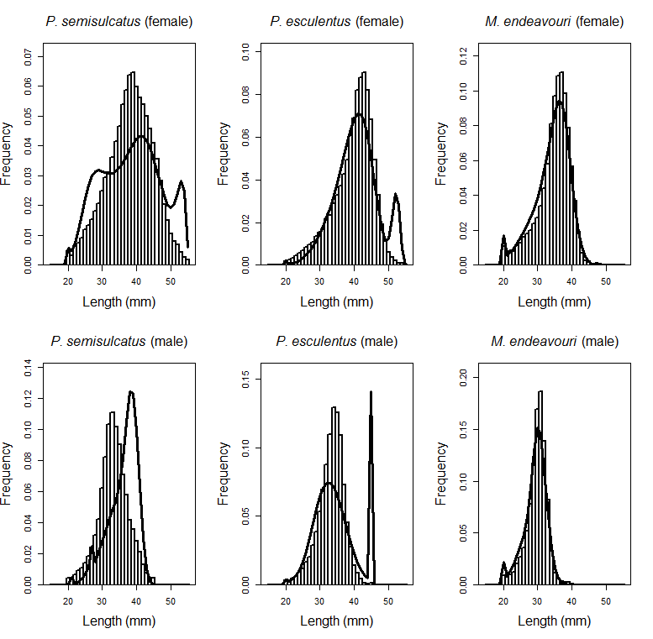
Inside or outside the assessment-II?
Fits to size-composition data when
growth is pre-specified based
on fits to tagging data.
Prawns is Australia’s northern prawn fishery
Punt et al. : ICES Journal of Marine Science (2012)

Slide 8
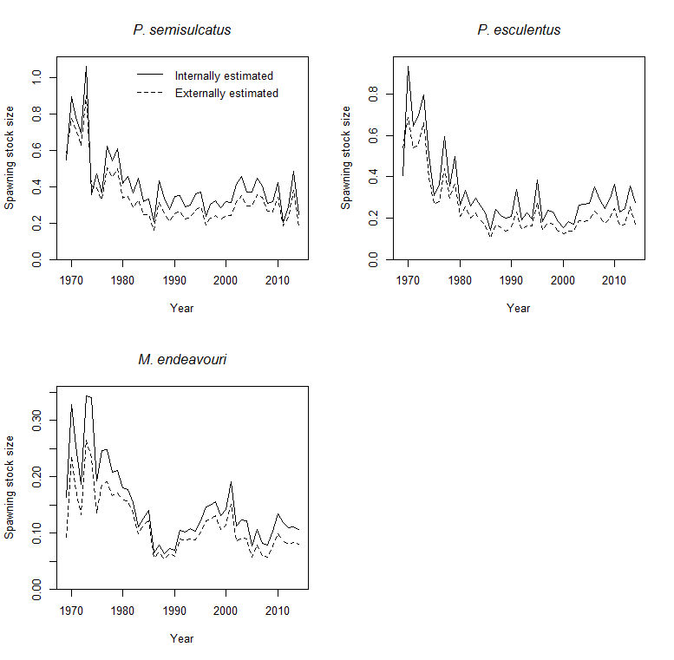
Inside or outside the assessment-III?
The results of the prawn
assessments are sensitive whether
growth is estimated inside or
outside the assessment.
Punt et al. : ICES Journal of Marine Science (2012)

Slide 9
Assessment of blacklip abalone
off the southwest of Tasmania

Slide 10
Estimating size- transition matrices

Slide 11
Measurement Error Approaches-I
If is the growth increment for i^{th} animal, is the length at release and
is the time at liberty, the likelihood function for the tag-recapture data is:
The function g can be one of many (normal, lognormal, gamma,,) and
the parameters determine (a) the expected growth increment and (b)
the variance of the growth increment.

Slide 12
Measurement Error Approaches-II
Abalone in New Zealand
Mean growth increment:
Variability in growth increment:
Fu, NZ FAR 2012

Slide 13
Measurement Error Approaches-III
The results from the previous approach need to be discretised before being included in an assessment. This can be overcome by assigning the release,
and recapture lengths and the times at liberty to the classes using the size-
classes and time-steps in the assessment.
The likelihood is then:
Discretised time at liberty
Discretised release and recapture
lengths

Slide 14
Observed and model-predicted size-
distributions of recaptures of rock lobsters
off Tasmania, Australia based on a model
which fitted the size-transition directly.
Punt et al. Marine and Freshwater Research, 1997

Slide 15
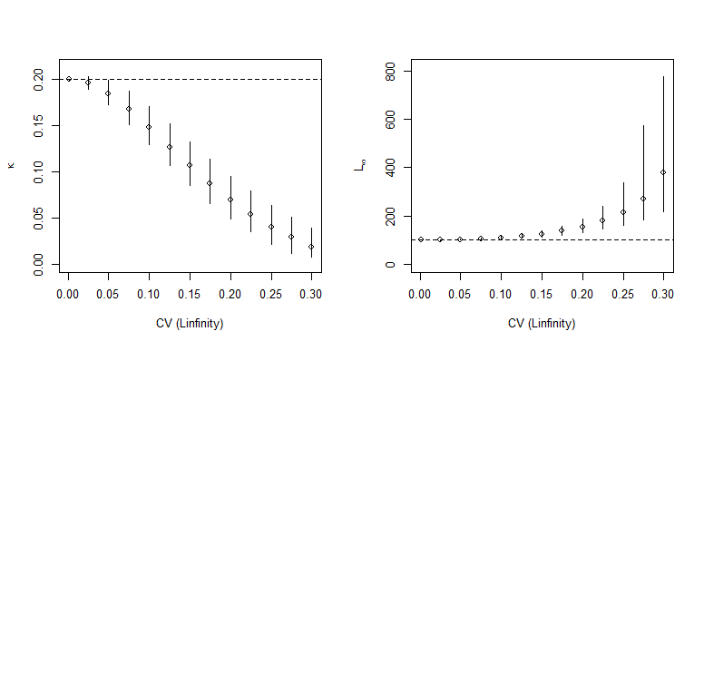
Measurement Error Approaches-IV
The Measurement Error
Approach is biased when
parameters vary among
individuals

Slide 16
Individual Variation in Growth Parameters-I
The likelihood function for this approach is derived by modelling the
probability distribution for the growth increment under the assumption that
one of the parameters of the growth curve varies among individuals.
For example is the asymptotic size varies among individuals:
Note that the distribution for the asymptotic size is constrained so that the
asymptotic size for the i^{th} animal is larger than L_{i}.

Slide 17
Individual Variation in Growth Parameters-II
Abalone off Victoria,
Australia. The asymptotic
length was assumed to
be gamma distributed.
Troynikov et al. Journal of ShellFish Research (1998)

Slide 18
Individual Variation in Growth Parameters-III
Another way to allow for individual variation in growth is to model the
joint distribution for the release and recapture lengths assuming that
both asymptotic size and age-at-tagging are random
Release and recapture
lengths
Jacobian

Slide 19
Individual Variation in Growth Parameters-IV
Male Peneaus semisulcatus
in Australia’s northern prawn fishery
Wang et al. CJFAS (1995)

Slide 20
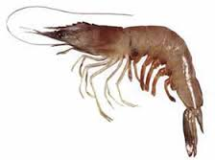

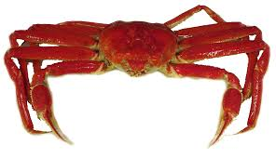
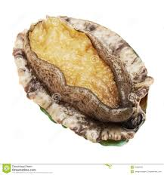

Synthesis of studies
Most assessments now
estimate growth internally
in the assessment
Few assessments allow for
time-varying growth
No assessments are based
on size-transition matrices
which allow for individual
variation in growth.
Growth is generally modelled
using the von Bertalanffy
growth curve (but some
assessments use the
Schnute model)

Slide 21
Sensitivity Analysis and
Simulation Studies

Slide 22
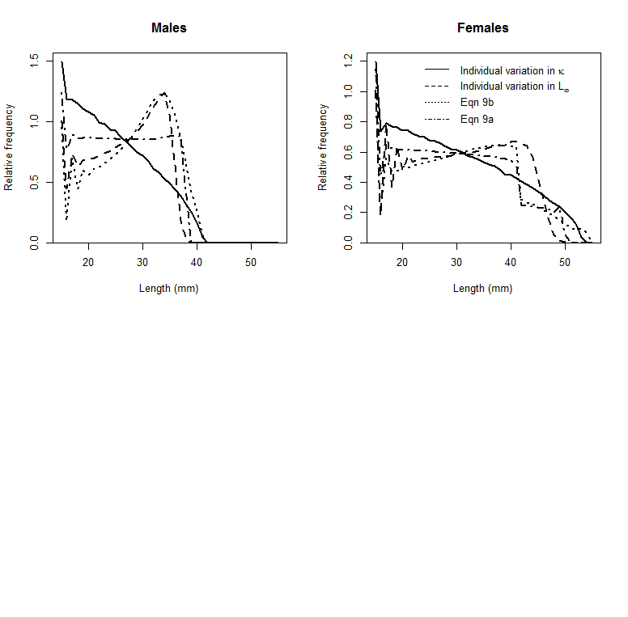
Sensitivity Analyses
Equilibrium size distributions
based on four approaches
Punt et al.: Marine and Freshwater Research 2009

Slide 23
Simulation Studies
Caveats before we start:
  Simulations are only as good as the operating model
    Most simulation studies assume that the likelihood function is known (as is M)
    Few simulation studies allow for over-dispersion.
  Avoid too many generalizations – most properties of estimators will be case-specific

Slide 24
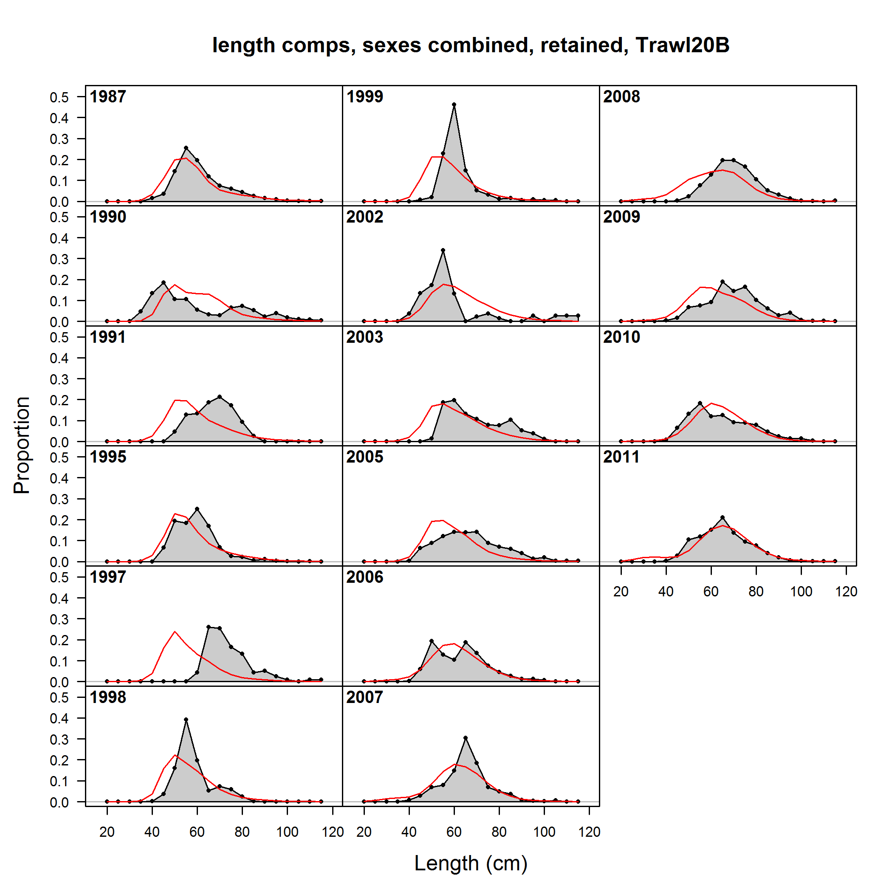
Overdispersal?
How often do the data generated in
simulation studies look like this?
How much does it matter?
The structure of most (perhaps all) operating
models is too simple and leads to simulated
data sets looking “too good”
Andre’s Turning Test: if you show someone 99
simulated data sets and the real data set,
could they pick it out?

Slide 25
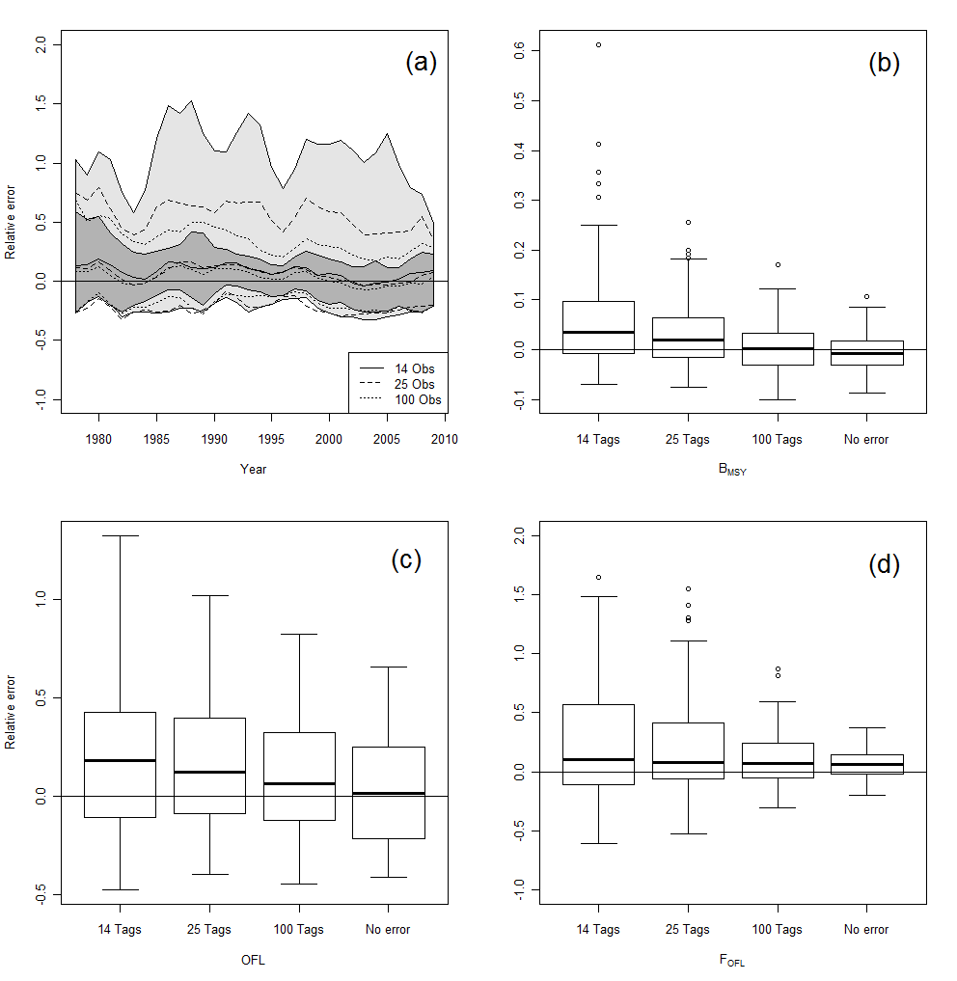
How Many Tags do we need?
Szuwalski & Punt: Fisheries Research (2012)

Slide 26
Operating model
Prawn-like fishery
L∞ and κ variable
Simulated time-at-liberty

Slide 27
Management Simulations
Few studies have examined the implications of error in the
size-transition matrix on the performance of management
strategies
Increasing growth over time -> lower probability of
achieving management goals
This can be addressed by regularly updating the size-
transition and allow for time-varying growth.

Slide 28
Recommendations and the Future

Slide 29
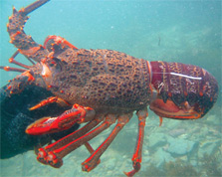
Key Recommendations-I
Estimation of size-transition matrices depends on data on tagging but:
  tags are seldom placed across the range of a stock;
  tags are seldom placed across the full range of sizes in the population; and
  tags are seldom assigned to allow the impact of factors such as habitat, depth to be quantified.
Basically, get the design right before you start!
http://www.doc.govt.nz/

Slide 30
Key Recommendations-II
Given that tagging studies are seldom designed with assessment in mind:
  Integrate growth estimation in the model
  Develop population models with multiple spatial strata to allow data to shared spatially.
Oh and improve tagging study design!

Slide 31

Key Recommendations-III
Data weighting matters!
Many methods are available to weight length and index data sets but little effort has been directed towards how to weight tagging data in
assessments.
http://rmsbunkerblog.wordpress.com/2011/08/30/what-is-weighting-data-in-market-research-a-few-cautions/

Slide 32
Key Recommendations-IV
Analysis methods which ignore individual variation in growth are biased! Key research steps are:
  Make methods which allow for individual variation in growth more broadly available (even if mathematically they are much more complicated)
  Integrate these methods in assessment packages.
  Conduct longitudinal studies to explore how parameters actually vary over (this will require extending current methods to include multiple recaptures).

Slide 33


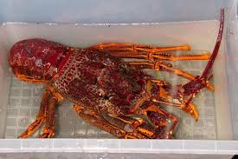


QUESTIONS??

