Slide 1
Time-Varying vs. Non-Time-Varying Growth in the Gulf of Mexico King Mackerel Stock Assessment: a Case Study
Southeast Fisheries Science Center
Jeff Isely, Michael Schirripa, John Walter and Matt Lauretta
SEFSC
J.J. Isely et al. | CAPAM Workshop | La Jolla, CA | November 3-7, 2014
Growth: theory, estimation, and application in fishery stock assessment models | Page 1

Slide 2
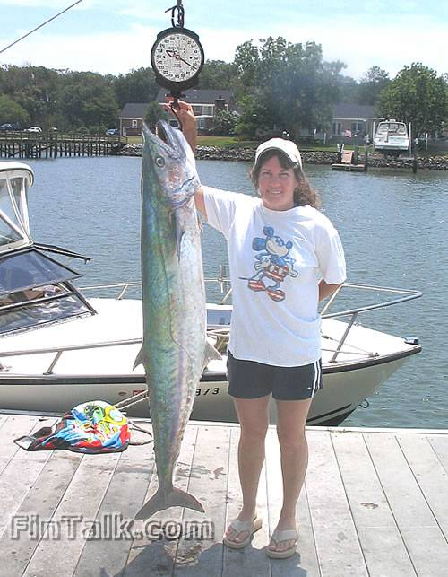

Slide 3
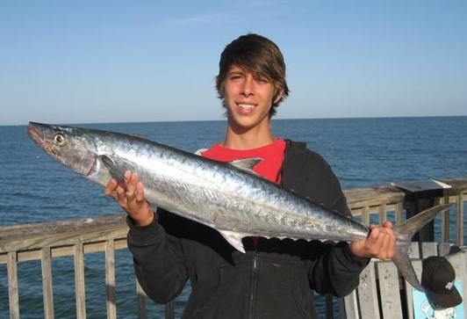

Slide 5
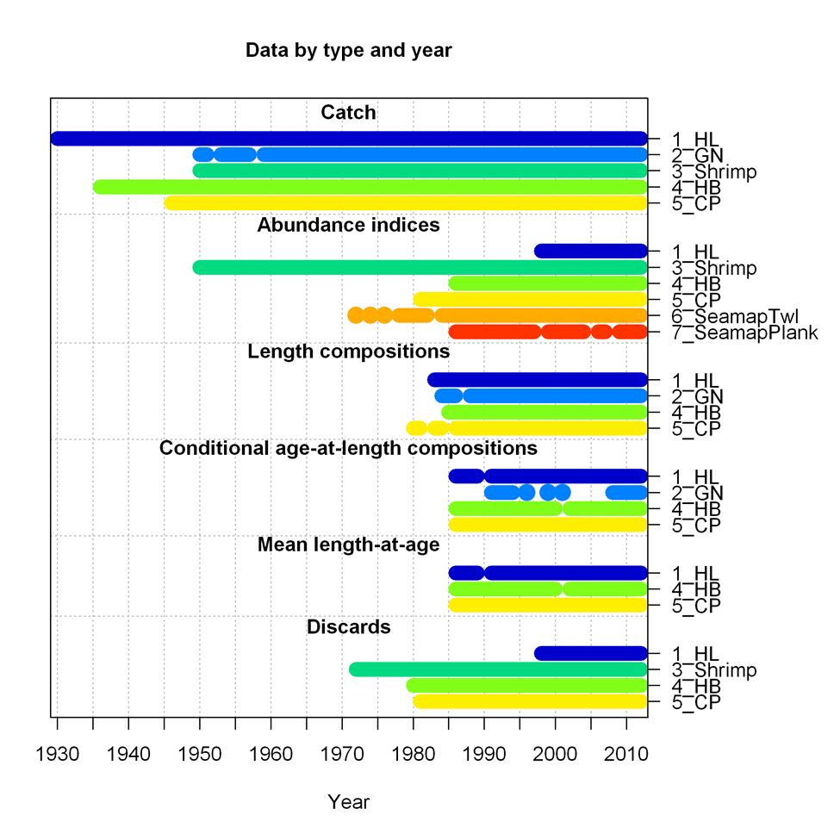

Slide 6
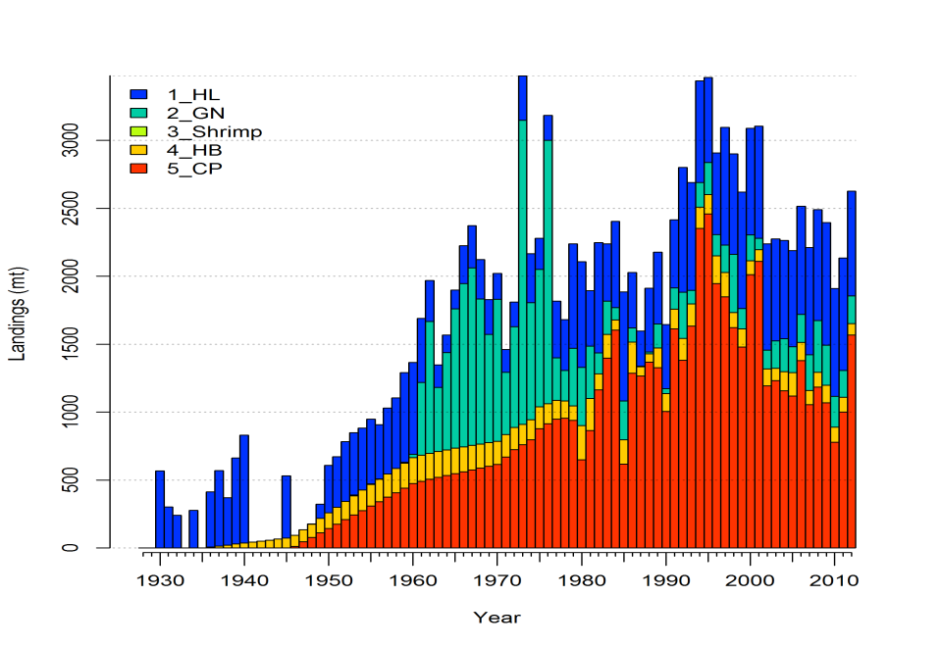
Landings

Slide 8
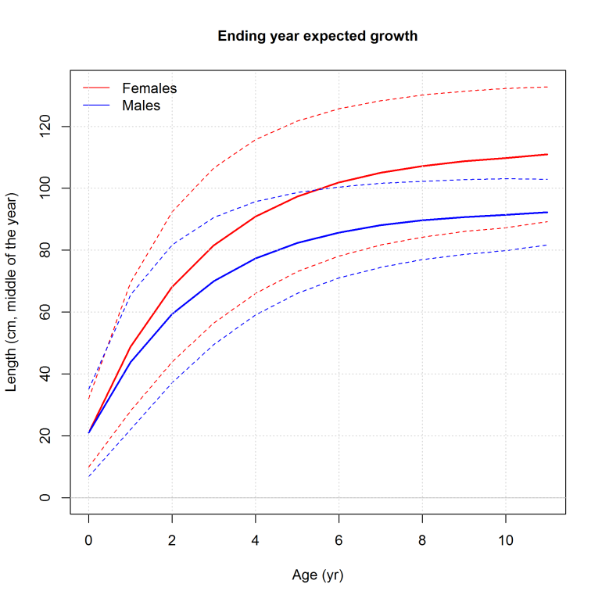

Slide 9
Investigative Model Configures
KMK_GOM_1: uses CPUE only with no length or age-at-length(AAL);
Two length bins (i.e. one big plus group)
Allows recruitment deviations;
Fixed sex-specific growth at Data Workshop values
KMK_GOM_2: start with #1
Add only lengths and selectivity
KMK_GOM_3: starts with #2
Adds Age at Length
Freely estimated constant (time invariant) growth (i.e. no informed priors)

Slide 10
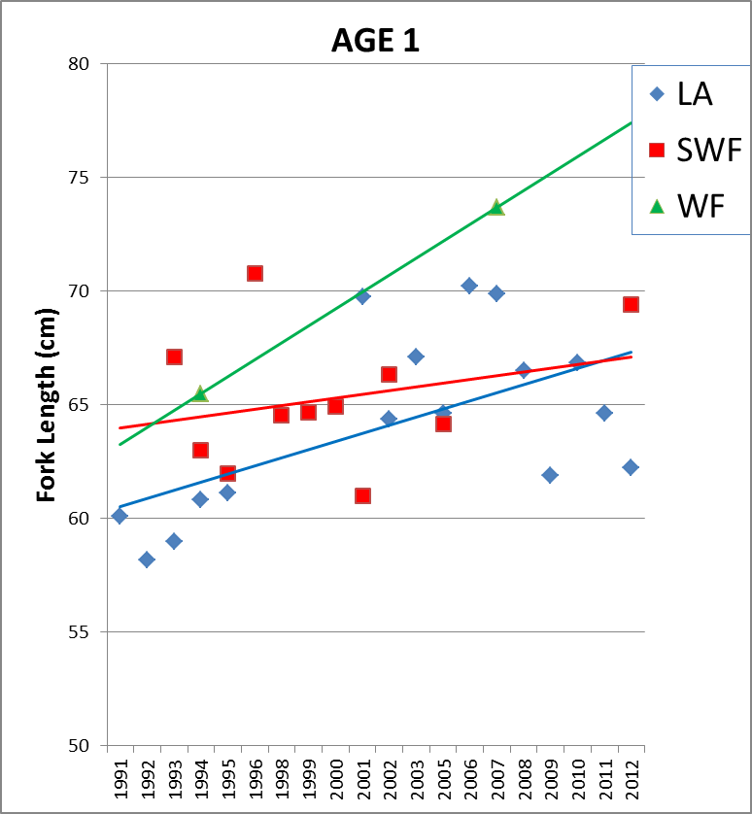
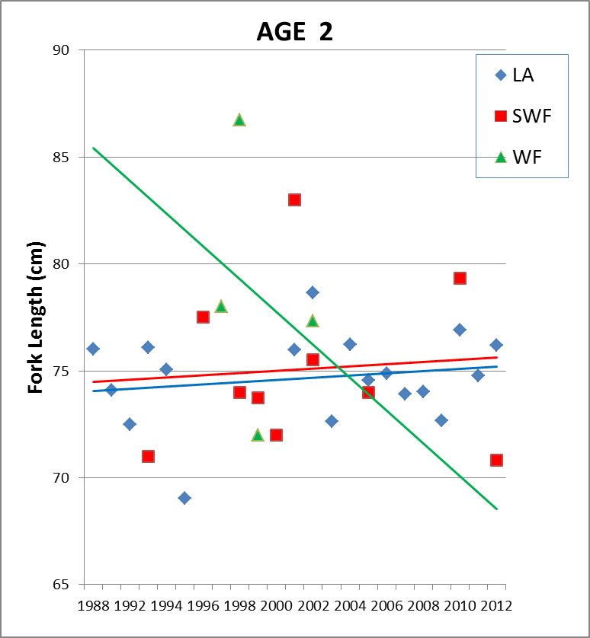
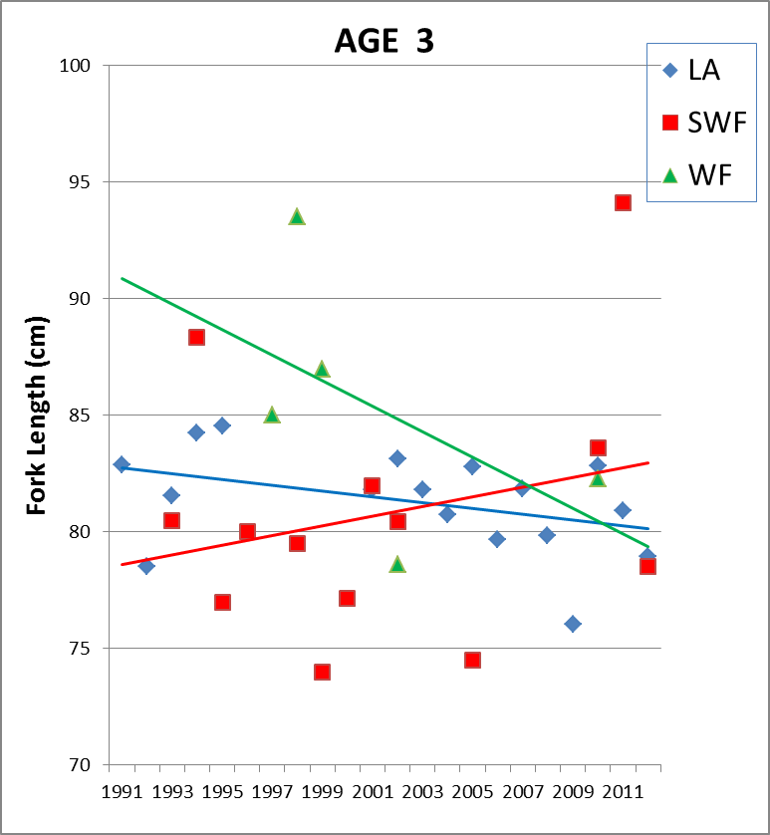
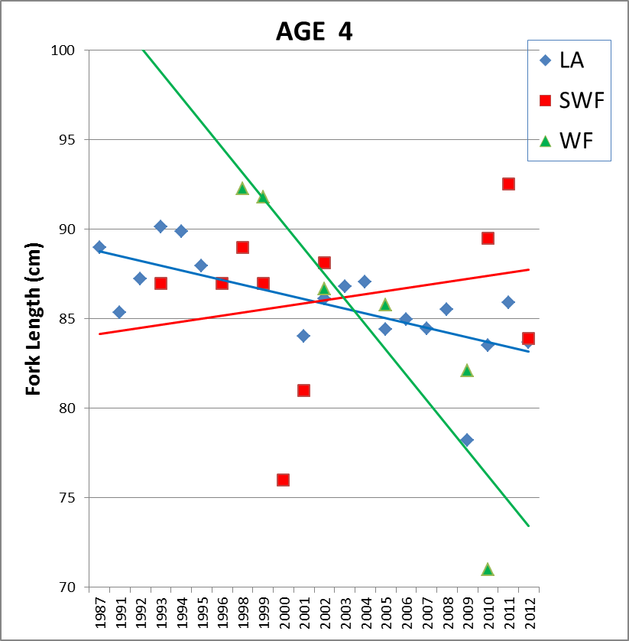
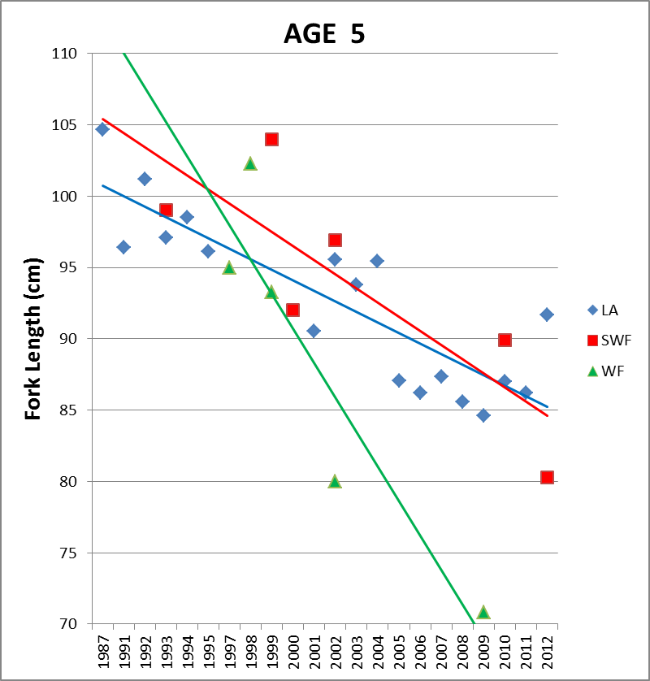
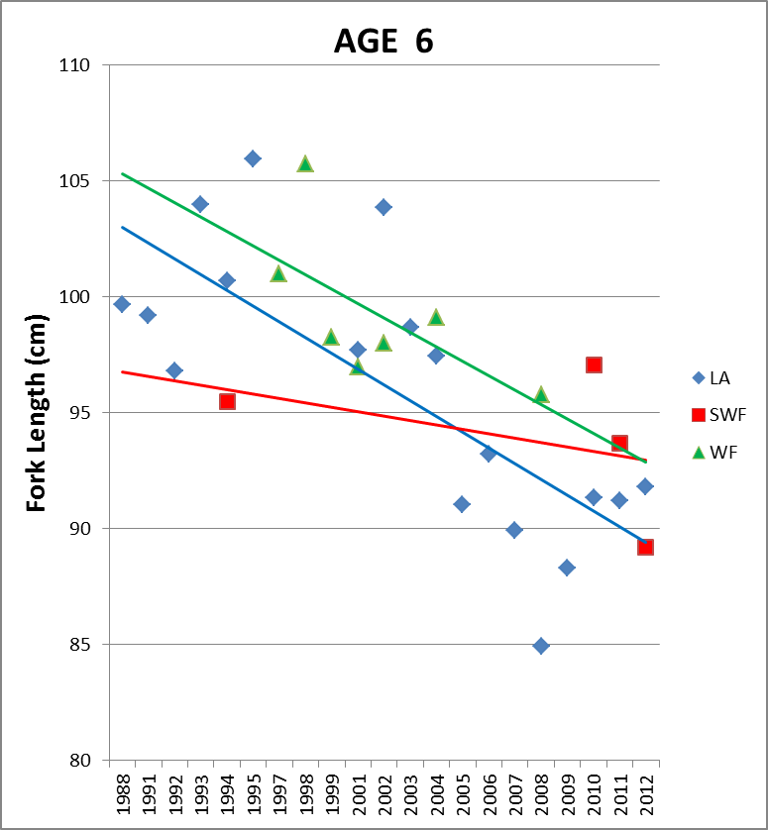
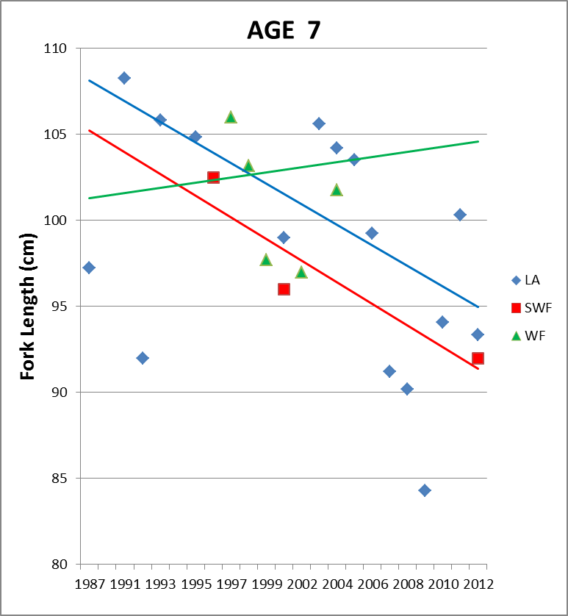
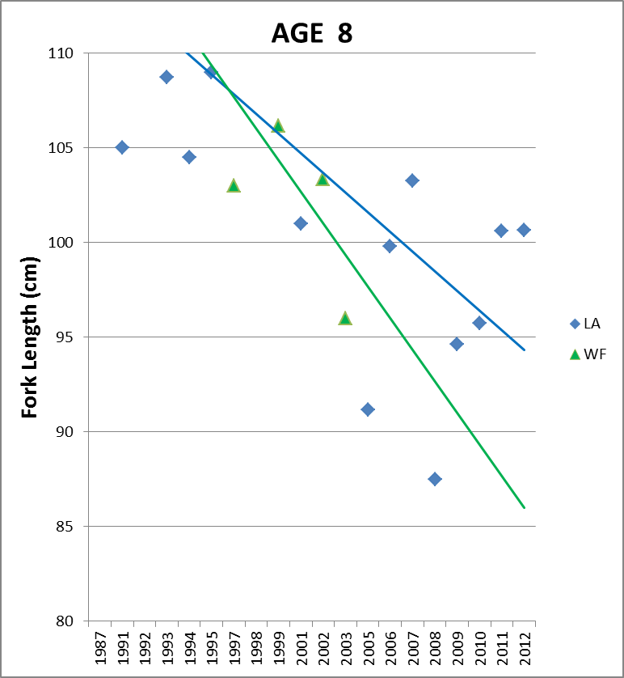
Females seems to be getting smaller over time

Slide 11
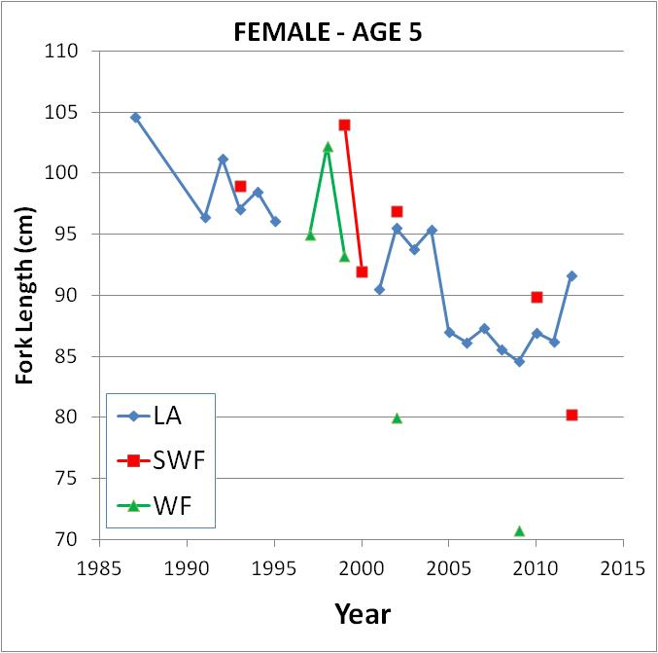
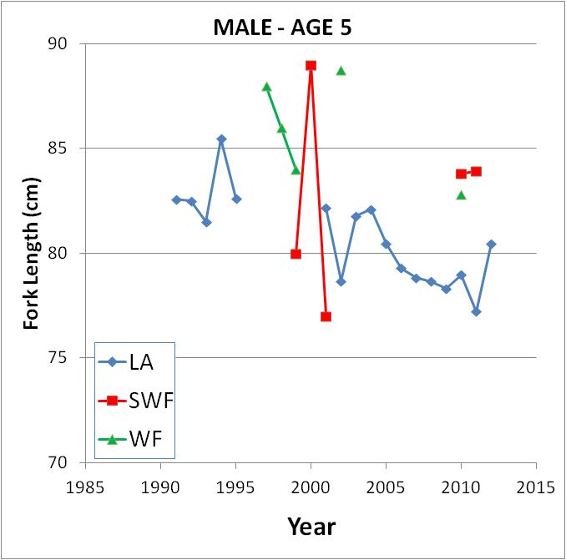
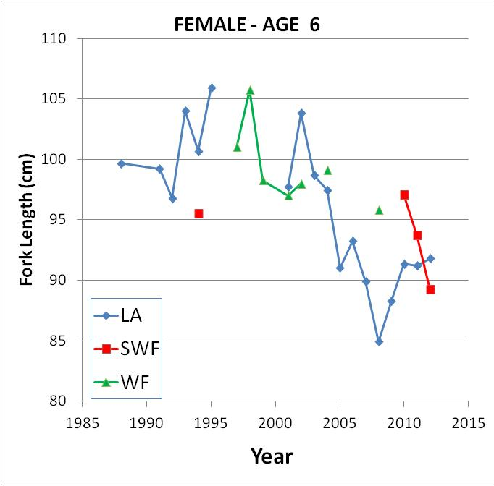
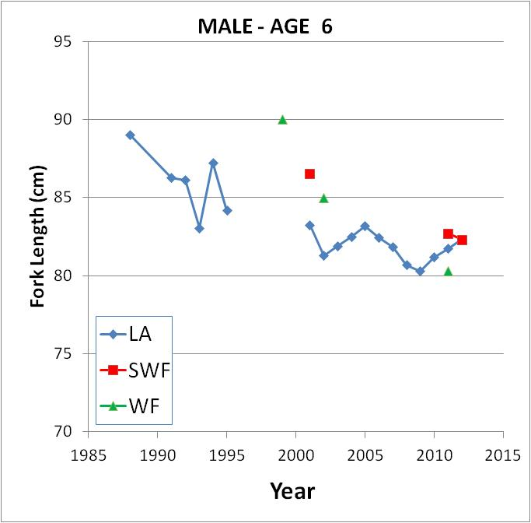

Slide 12
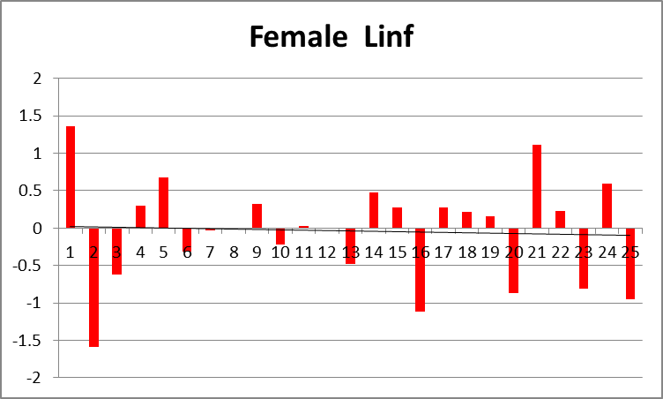
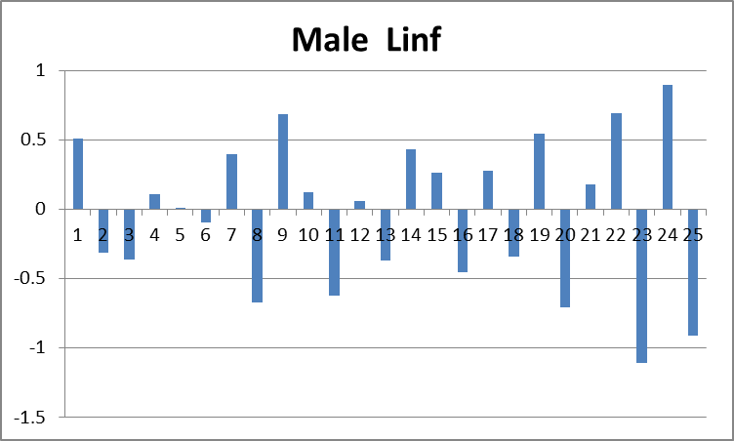
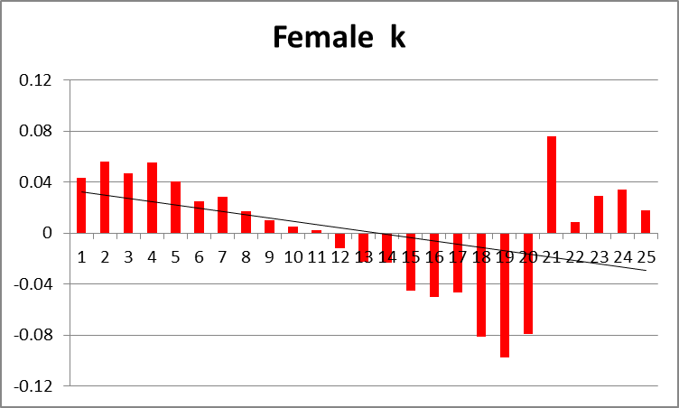
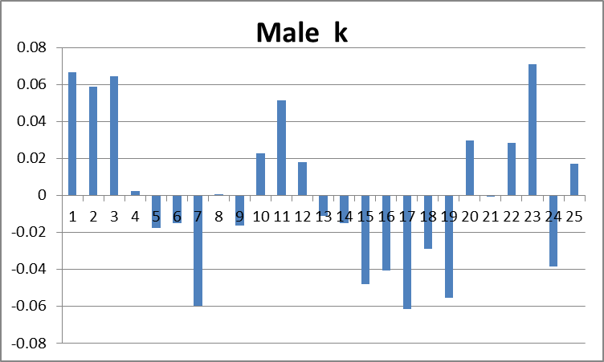
Additive random walk deviations in the growth parameters

Slide 13
Approaches to Model Selection
use numerical methods quantify the performance of the model fit to the data for each model
use more of a “deductive reasoning” approach: utilizing “if / then” logic to arrive at a “common sense” decision
Some combination of the two methods

Slide 14
Three Models for Consideration
Model_3: Ignore the observed changes in size-at-age and fits model to the data “as is” (null model).
Model_4: Use time varying growth to address the changes in observed size-at-age. Fixes the growth parameters at those estimated in in #3. Allows for annual deviations in male and female L∞ and k.
Model_5: Use time varying selectivity to address the changes in observed size-at-age. Fixes the growth parameters at those estimated in in #3. Allows for annual deviations in fleet-specific selectivites.

Slide 15
IF Model_3 is “more” correct THEN:
No pattern to the size-at-age over time
We would expect no significant improvement in the fit statistics if we vary growth
We would expect no significant improvement in the fit statistics if we vary selectivity

Slide 16
IF Model_4 is correct THEN:
we would expect to see a similar decrease in size-at-age for both male and females

Slide 17
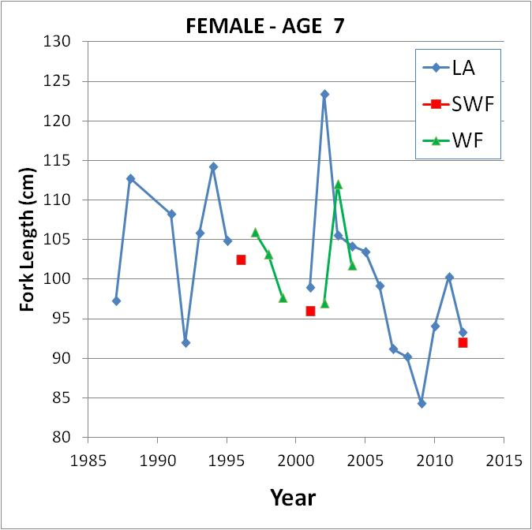
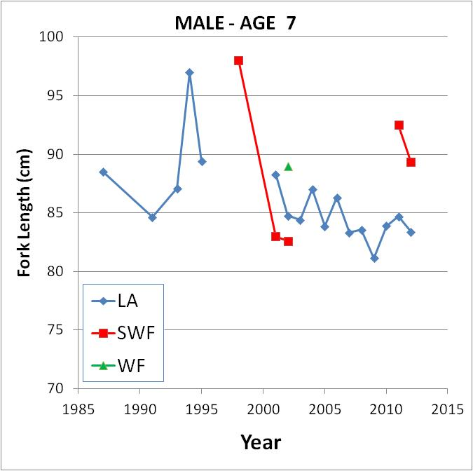
Both sexes show similar patterns

Slide 18
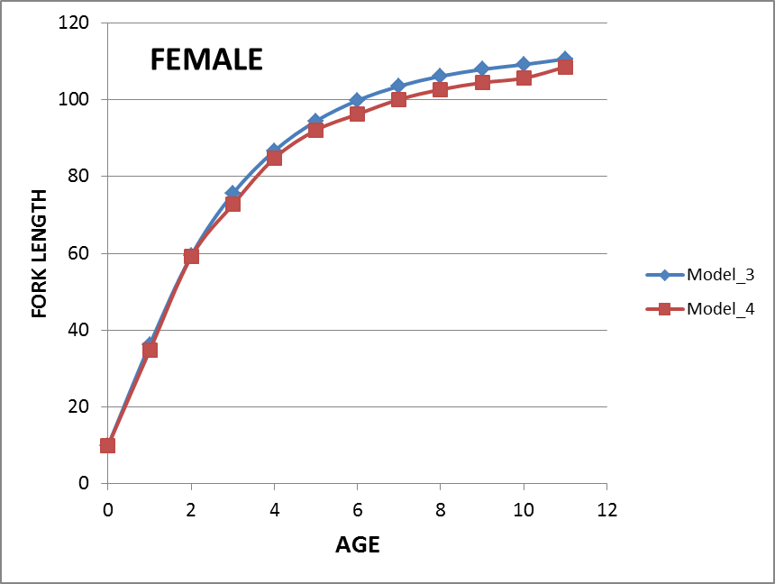
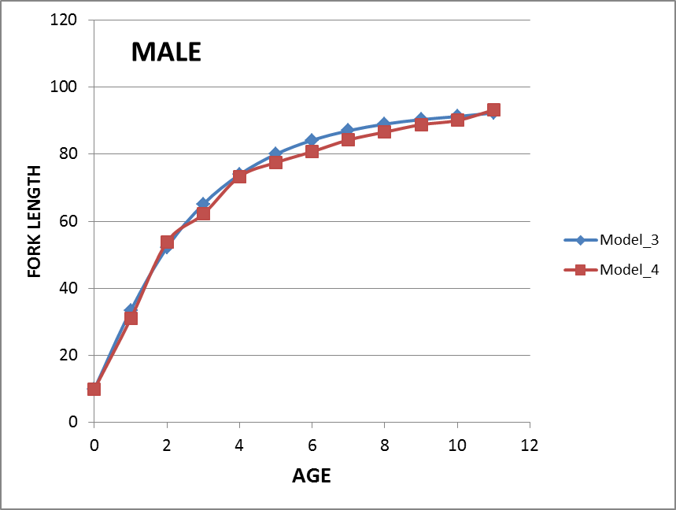
Resulting Growth Curves

Slide 19
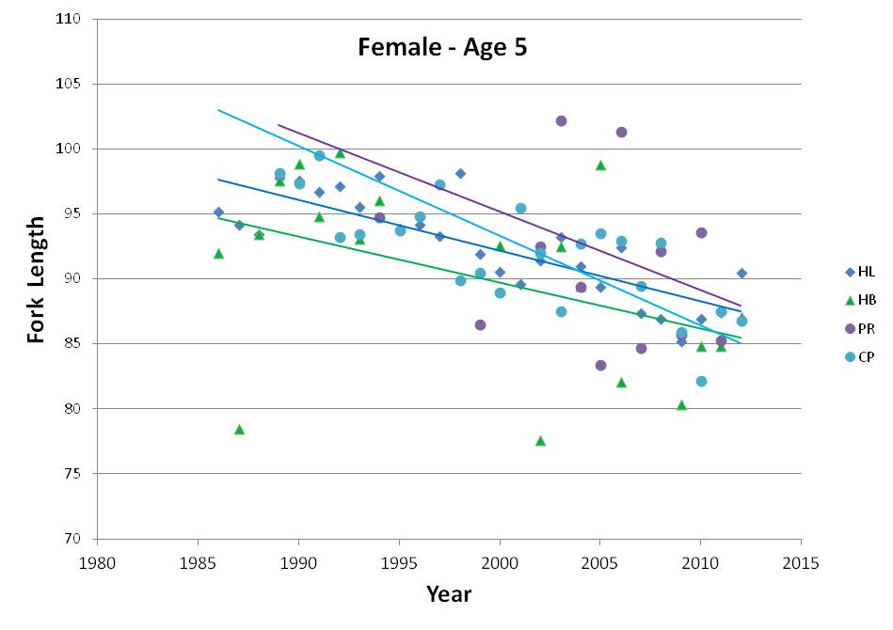
IF Model_5 is correct THEN we would need to believe that all gears changed selectivity at the same rate

Slide 20
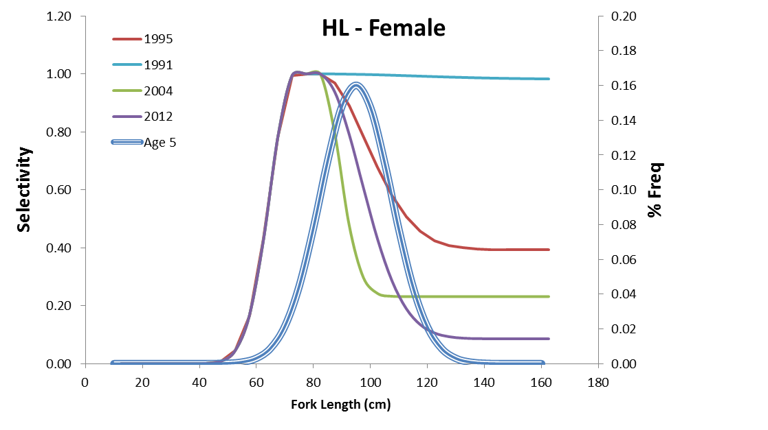

Slide 21
There IS a significant improvement in the model fit statistics for Models_4 & 5
** Although the LL maybe lower, it does not mean that the model is the most parsimonious

Slide 22
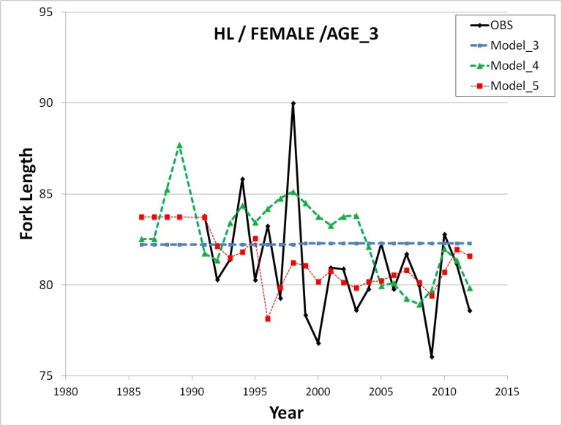
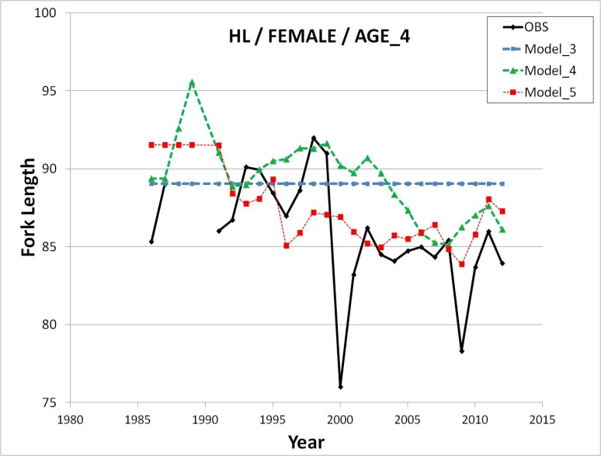
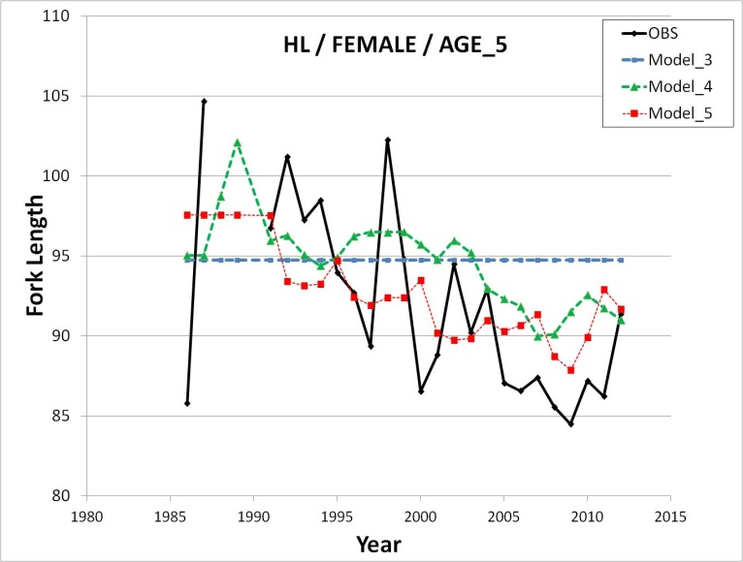
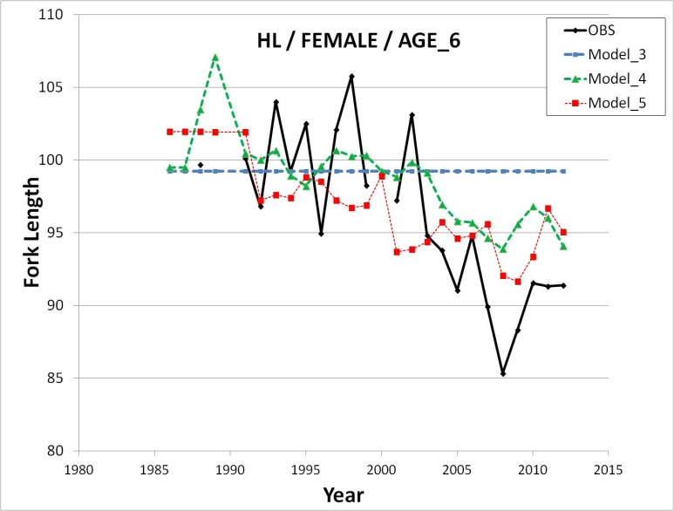
Both Model_4 and _5 fit better than _3

Slide 23
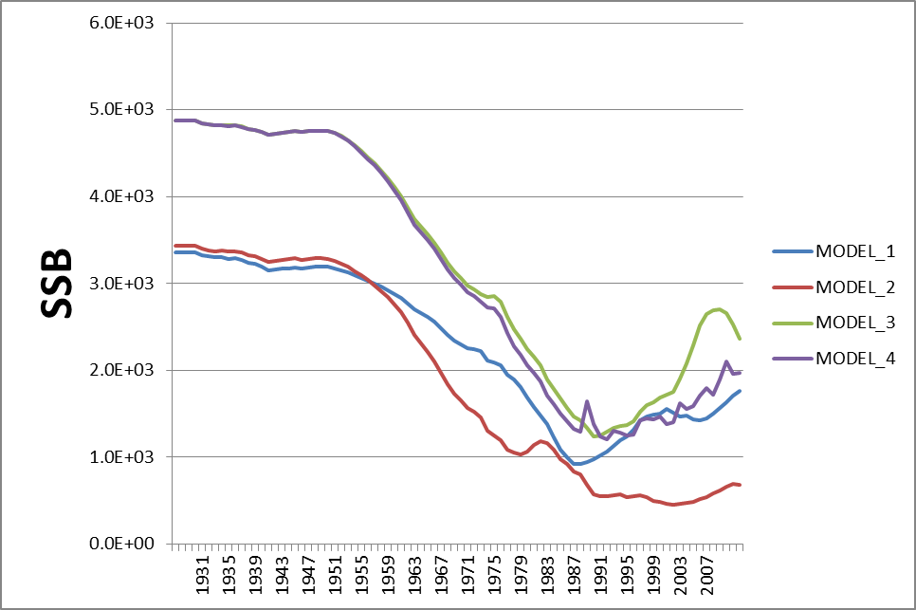
SSB for the four model configurations

Slide 24
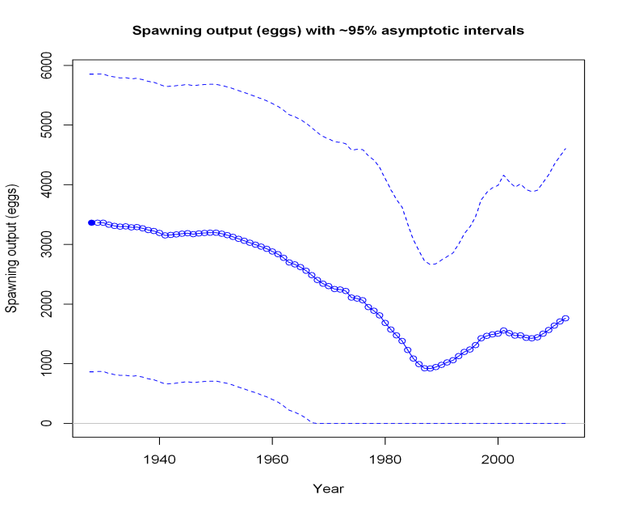
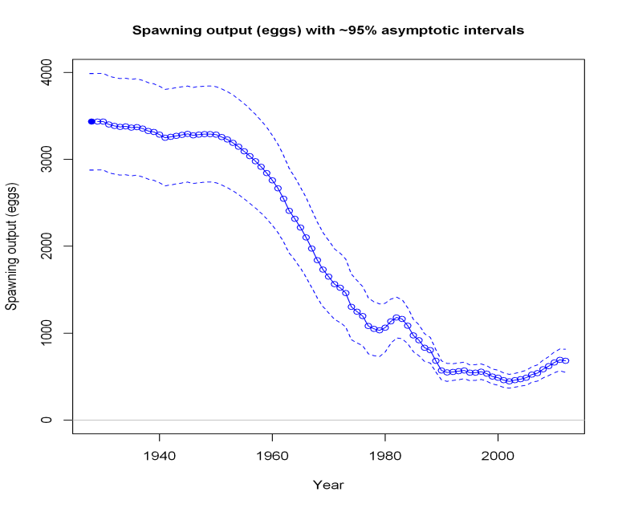
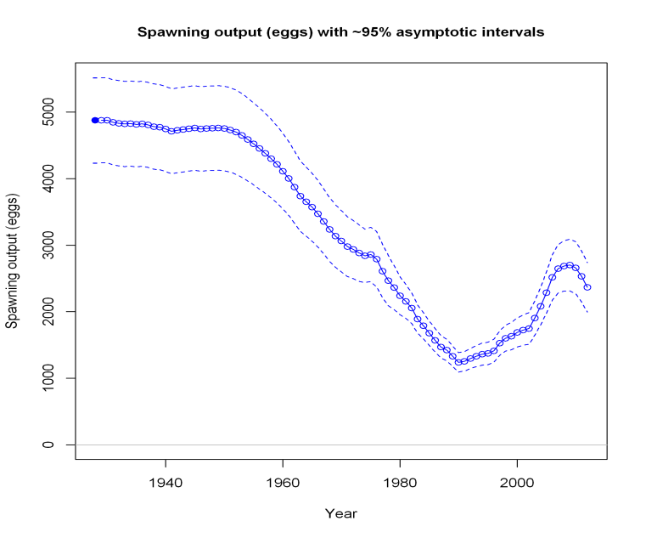
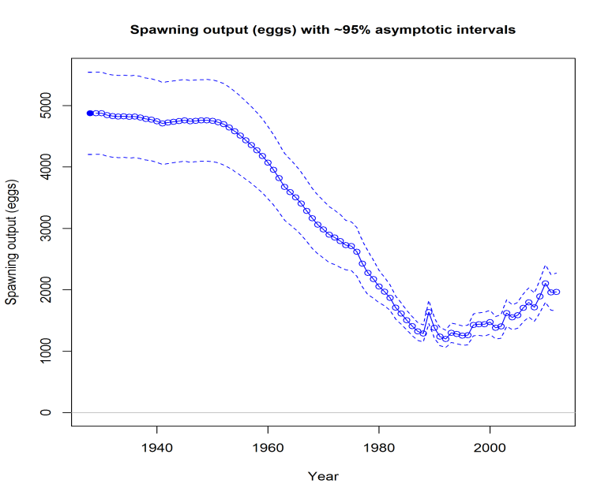
SSB trends are similar, certainty is not
Model_1
Model_2
Model_3
Model_4

Slide 25
Conclusions (Assessment Scientist)
Both of the alternative models (Model_4 & Model_5) explain the data better than the null model (Model_3) but requires the belief of unbiased length/age sampling. Cannot identify underlying ecological or environmental causes.
Model_4 accounted for the most variation in the data while using the fewest number of parameters to do so, but requires the belief that growth has decreased consistently and substantially in the past 25 years.
Model_5, while not requiring a change in growth, requires the belief that the selectivity for all gears changed in synchrony without a change in fishing methods.

Slide 26
Conclusions (review workshop)
Model_4: A 25-year decreasing trend in growth is unlikely.-Reject
Model_5: It is highly unlikely that selectivity for all gears changed simultaneously. -Reject
Model_3, Although not the best fit, requires the fewest assumptions and is consistent with our perception of the fishery. -Accept

Slide 27
Additional Conclusions (review workshop)
Weaknesses: The GOM KMK assessment model is not very stable. The data streams are lacking contrast and thus any real definitive signal related to stock status or stock productivity was not captured in the analysis.
Strengths: Despite the weaknesses, nearly every model configuration suggests that the stock size has been increasing since 1990 with no indication that the stock is currently being overfished or experiencing overfishing.
Recommendation: The current management strategy seems to be very effective at achieving stated goals and there is no evidence to suggest changes in the current quota would be beneficial.

Slide 28
Remaining issues to be resolved
Ageing method improvement: Has a change in ageing methods resulted in an increase in age at size?
Institutional Memory: Were historical tournament/quota samples included in the general recreational catch samples?
Coding/Identification issues: Are the small king mackerel in the historic Headboat samples really king mackerel? Were confiscated illegal catches included in the recreational samples?
Regulations: Has there been a change in gear configuration in the Rec and HL fisheries that would eliminate larger fish (e.g. circle hooks)?
Ecosystem-based assessment: Continue to investigate possible environmental and food-web changes in the GOM (FATE project).

Slide 29
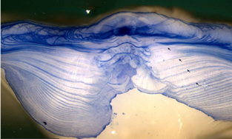

Slide 30
Remaining issues to be resolved
Ageing method improvement: Has a change in ageing methods resulted in an increase in age at size?
Institutional Memory: Were historical tournament/quota samples included in the general recreational catch samples?
Coding/Identification issues: Are the small king mackerel in the historic Headboat samples really king mackerel? Or were theyconfiscated illegal catches included in the recreational samples?
Regulations: Has there been a change in gear configuration in the Rec and HL fisheries that would eliminate larger fish (e.g. circle hooks)?
Ecosystem-based assessment: Continue to investigate possible environmental and food-web changes in the GOM (FATE project).

Slide 31
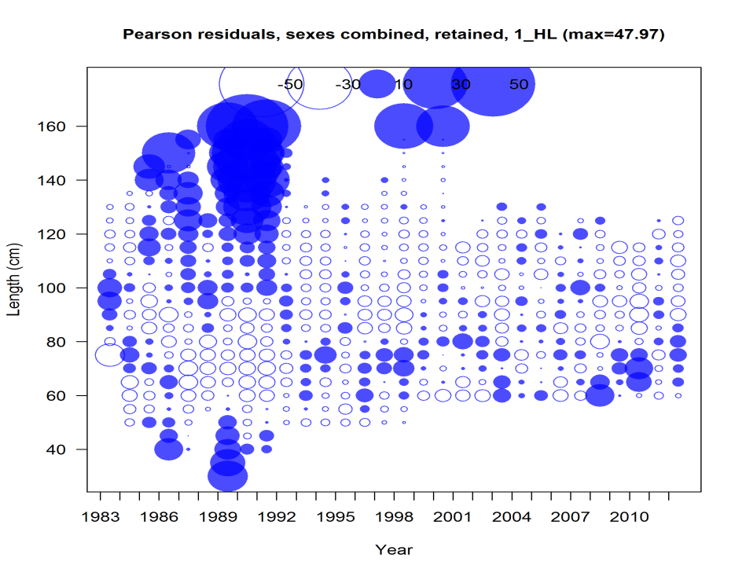

Slide 32
Remaining issues to be resolved
Ageing method improvement: Has a change in ageing methods resulted in an increase in age at size?
Institutional Memory: Were historical tournament/quota samples included in the general recreational catch samples?
Coding/Identification issues: Are the small king mackerel in the historic Headboat samples really king mackerel? Were confiscated illegal catches included in the recreational samples?
Regulations: Has there been a change in gear configuration in the Rec and HL fisheries that would eliminate larger fish (e.g. circle hooks)?
Ecosystem-based assessment: Continue to investigate possible environmental and food-web changes in the GOM (FATE project).

Slide 34
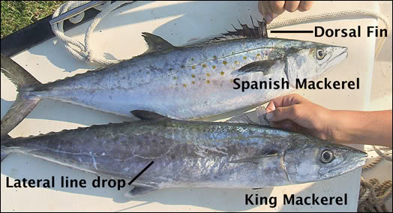

Slide 35
Remaining issues to be resolved
Ageing method improvement: Has a change in ageing methods resulted in an increase in age at size?
Institutional Memory: Were historical tournament/quota samples included in the general recreational catch samples?
Coding/Identification issues: Are the small king mackerel in the historic Headboat samples really king mackerel? Were confiscated illegal catches included in the recreational samples?
Regulations: Has there been a change in gear configuration in the Rec and HL fisheries that would eliminate larger fish (e.g. circle hooks)?
Ecosystem-based assessment: Continue to investigate possible environmental and food-web changes in the GOM (FATE project).

Slide 36
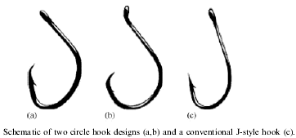

Slide 37
Remaining issues to be resolved
Ageing method improvement: Has a change in ageing methods resulted in an increase in age at size?
Institutional Memory: Were historical tournament/quota samples included in the general recreational catch samples?
Coding/Identification issues: Are the small king mackerel in the historic Headboat samples really king mackerel? Were confiscated illegal catches included in the recreational samples?
Regulations: Has there been a change in gear configuration in the Rec and HL fisheries that would eliminate larger fish (e.g. circle hooks)?
Ecosystem-based assessment: Continue to investigate possible environmental and food-web changes in the GOM (FATE project).

Slide 38

Questions?

Slide 39
Approaches to Model Selection
Can use numerical methods quantify the performance of the model fit to the data for each model?
Can use more of a deductive reasoning approach: utilizing “if / then” logic to arrive at a “common sense decision”?
Some combination of the two methods
(It’s critical to keep in mind that the data are likely biased to some degree (not perfect); one can favor the “right” model for the wrong reasons)

Slide 40
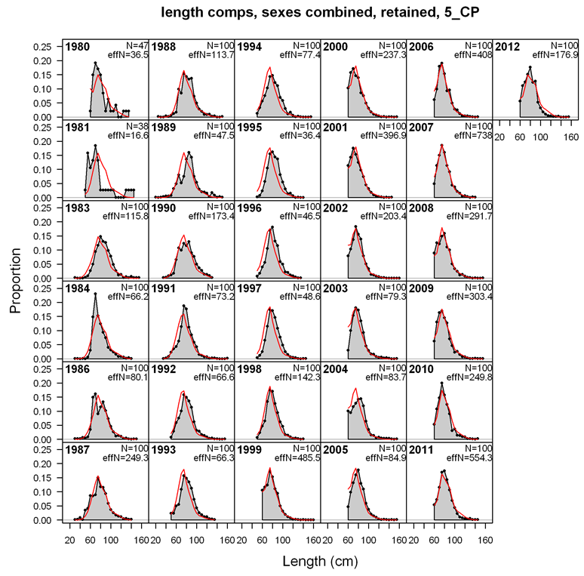
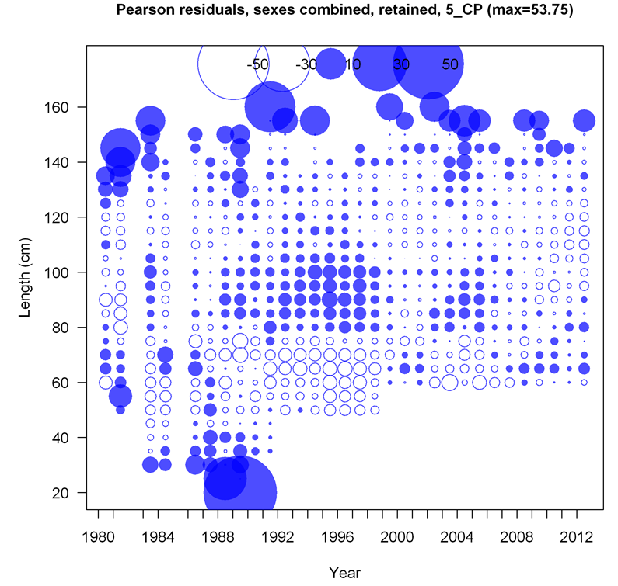
Figure 3.2.9. Observed and predicted length compositions of landings of GOM king mackerel in the recreational charter-private fleet (top). Observed (N) sample sizes and effective sample sizes (effN) estimated by SS are also reported. Pearson residuals for the length composition fit (bottom). Solid circles are positive residuals (i.e., observed greater than predicted) and open circles are negative residuals (i.e., predicted greater than observed).

Slide 41
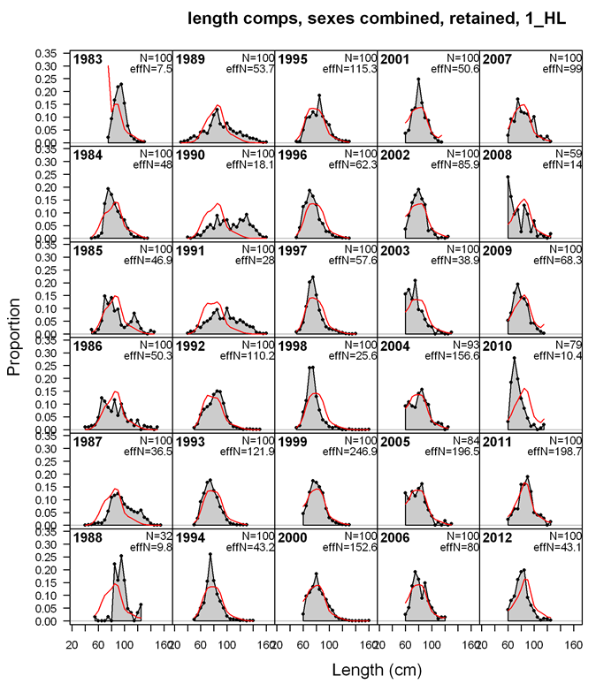
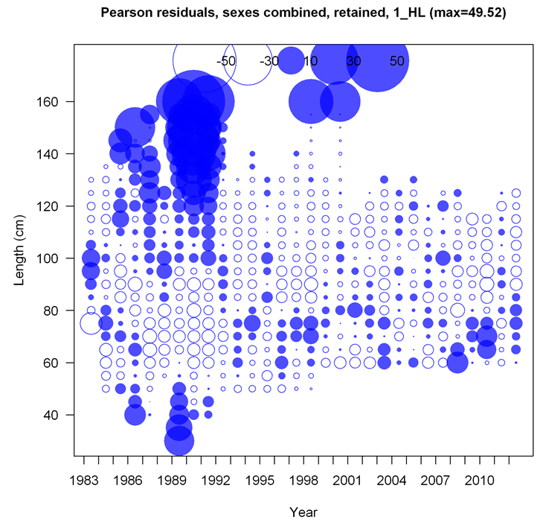
Figure 3.2.6. Observed and predicted length compositions of landings of GOM king mackerel in the commercial handline line fleet (top). Observed (N) sample sizes and effective sample sizes (effN) estimated by SS are also reported. Pearson residuals for the length composition fit (bottom). Solid circles are positive residuals (i.e., observed greater than predicted) and open circles are negative residuals (i.e., predicted greater than observed).

Slide 42
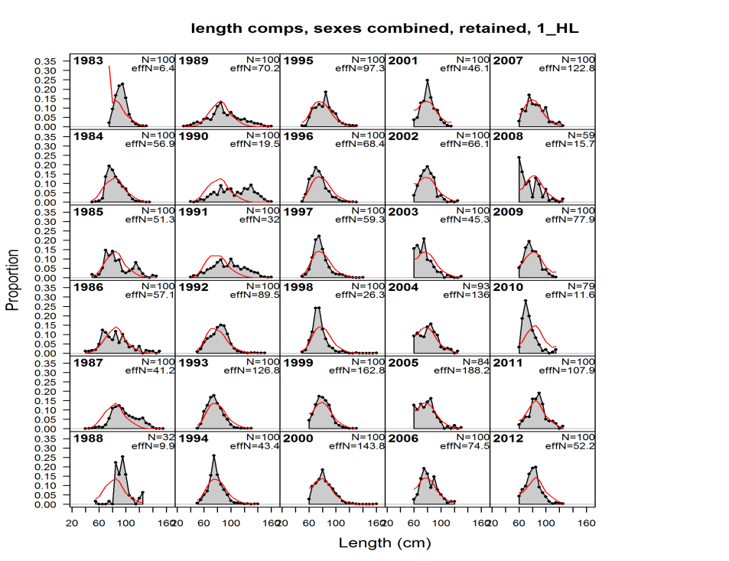
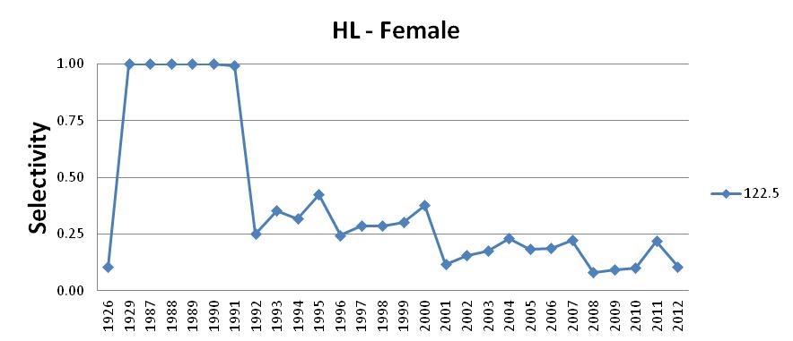

Slide 43
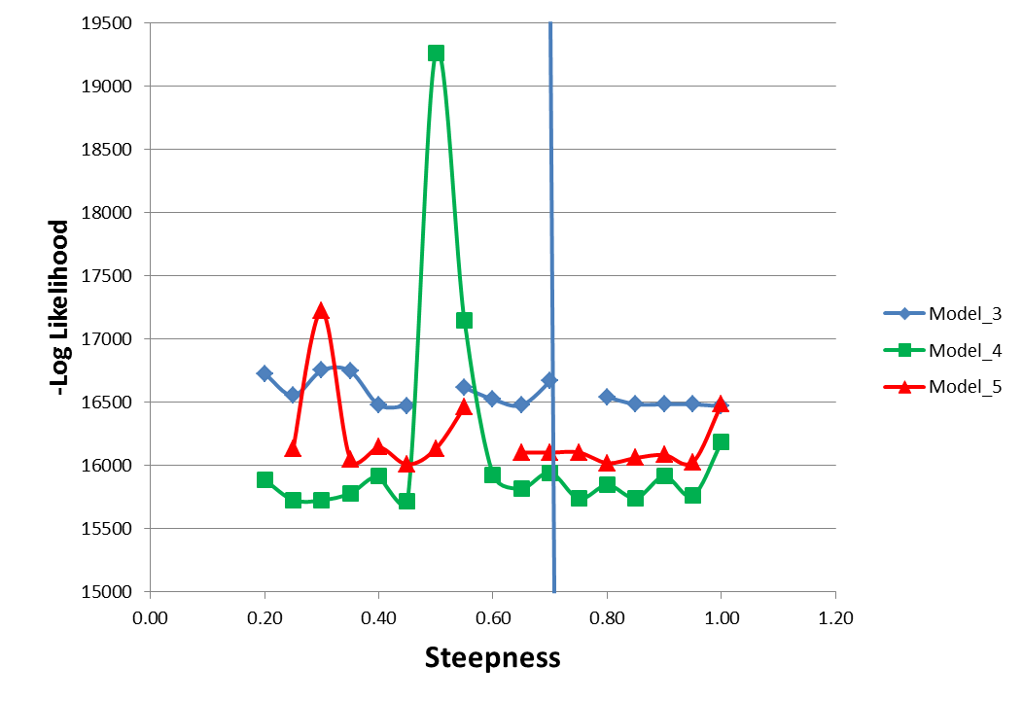
Profile on Steepness

Slide 45
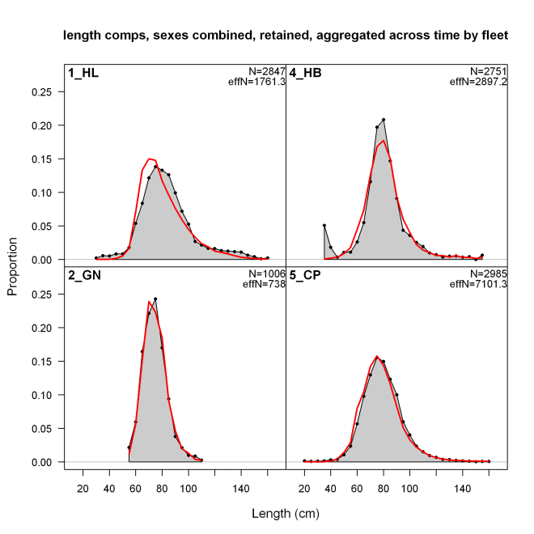
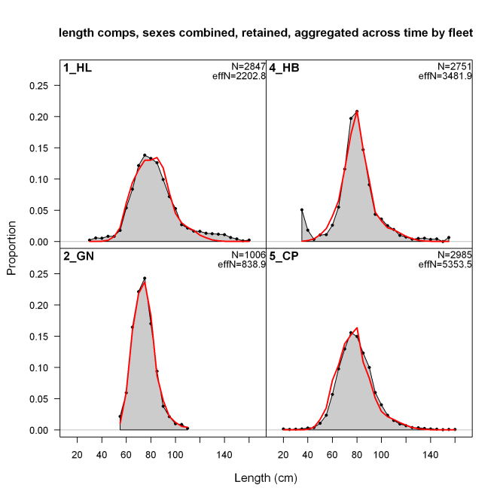

Fit to Lengths was improved with each successive model
Model_2
Model_3
Model_4

Slide 46
Fit to Lengths was improved with each successive model
Model_2
Model_3
Model_4

Slide 48
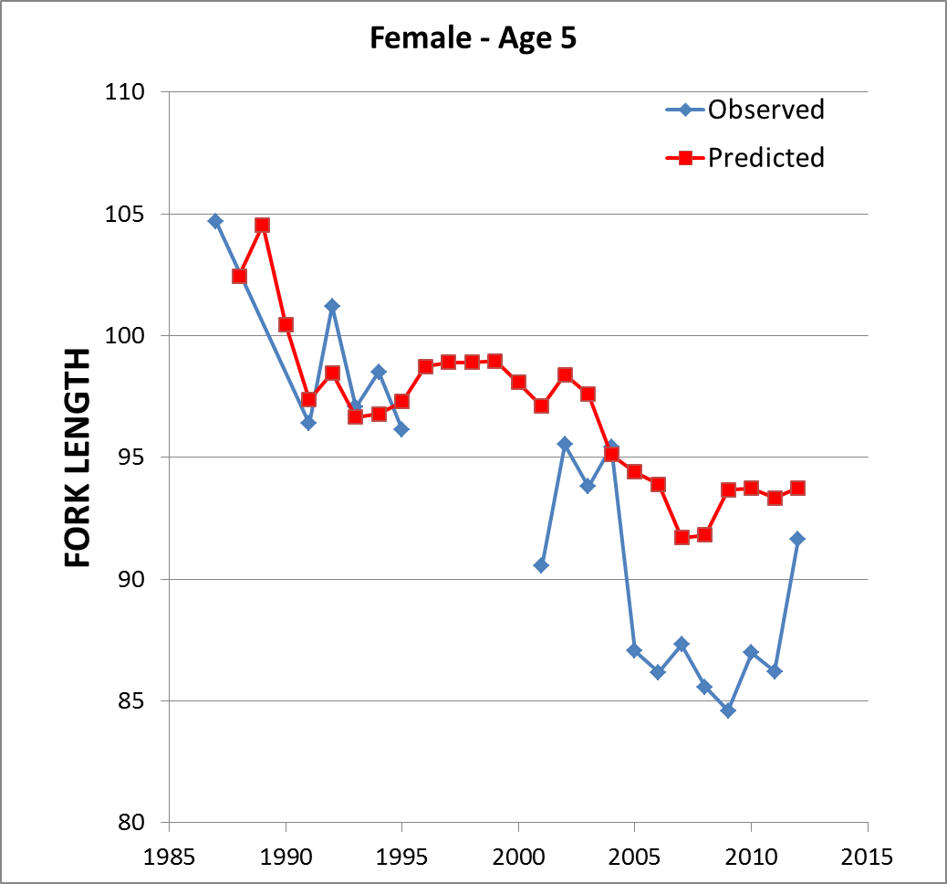

Fit to Observations

Slide 49
Model Configurations
The total fishery was parsed into 5 fleets
Commercial fisheries included handline (H&L), gillnet, and shrimp-fishery bycatch
Recreational fisheries included Headboat and Charter/Private
Surveys included Commercial H&L CPUE, Shrimp Effort, Headboat CPUE, SEAMAP Trawl Survey (age_1), and SEAMAP Larval Survey (SSB)

Slide 50



Landings

Slide 52

Life History Functions

Slide 53
Next Steps
Try constant growth with time varying selctivities

Slide 54
Additive random walk deviations in the growth parameters
parm’ (y) = parm (y-1) + dev(y)

Slide 55
Time varying growth adds 92 parameters but reduces LL by 769 units
Model_3
Model_4

Slide 56




Fits to HL CPUE
Model_1
Model_2
Model_3
Model_4

