Slide 1



Performance of a stock assessment model with misspecified time-varying growth
¹Yi-Jay Chang
²Brian Langseth
³Mark Maunder
¹Felipe Carvalho
1 – JIMAR, PIFSC, NOAA (JIMAR)
2 – PIFSC, NOAA
3 – IATTC
CAPAM, 3-7 Nov, 2014

Slide 2
Overview
Examples of time-varying growth in fish populations
Objectives of this study
Operating model (Individual-based model)
  Cohort-specific and year-specific time-varying growth
Stock assessment model
Results
  Cohort-specific K vs Linf
  Cohort-specific vs year-specific
  Comparison of time-varying methods
Discussion

Slide 3
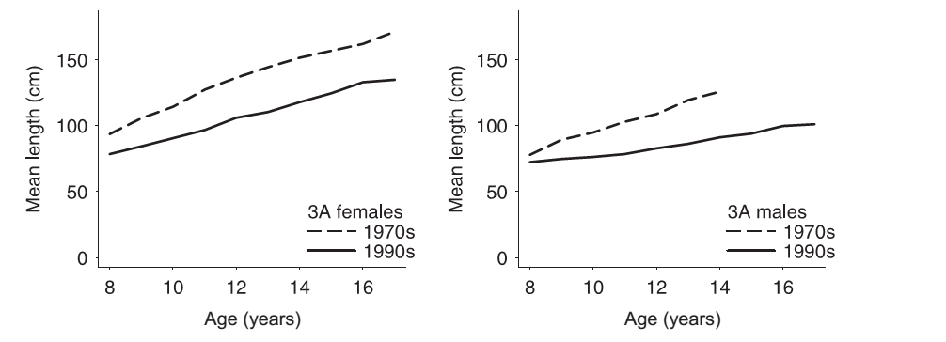
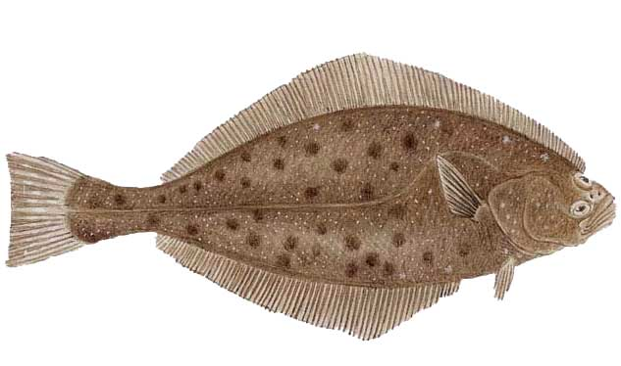
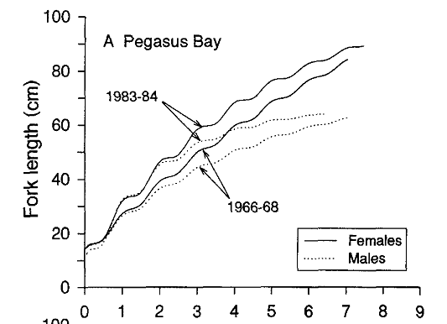
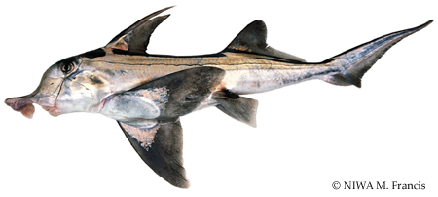
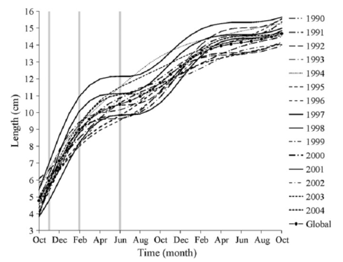
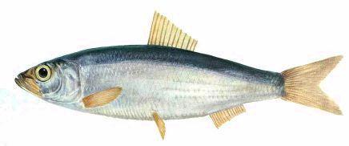
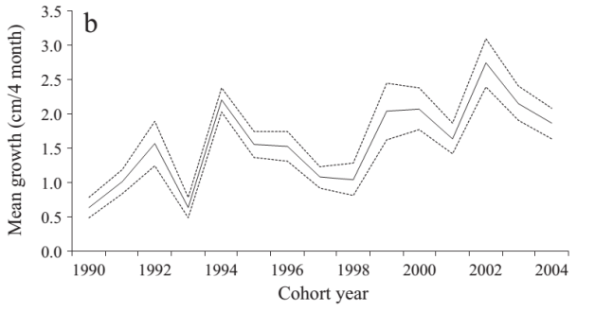
Examples of time-varying growth
Pacific halibut (Hippoglossus stenolepis)
Clark et al. (1999) CJAFS
Elephantfish (Callorhinchus milii)
Francis (1997)
NZ Mar Freshw Res
Common sardine (Strangomera bentincki)
Feltrim & Ernst (2010)
Fish Res
Notes:
Since the climate regime shift of 1976–1977 in the North Pacific, the individual growth of Pacific halibut (Hippoglossus stenolepis) has decreased dramatically in Alaska
The reason for the increases in growth rates between the 1960s and 1980s is not known, but may be related to variations in elephantfish biomass. The increase in elephantfish growth rate may therefore represent a density-dependent response to overfishing
Results showed a conspicuous inter-cohort variability in the mean length and growth rate at different life stages throughout the first year of life. Striking anomalies (positive and negative) were observed during the 97/98 ENSO (El Ni˜ no South Oscillation), but the mechanisms behind these dynamics are unknown.

Slide 4
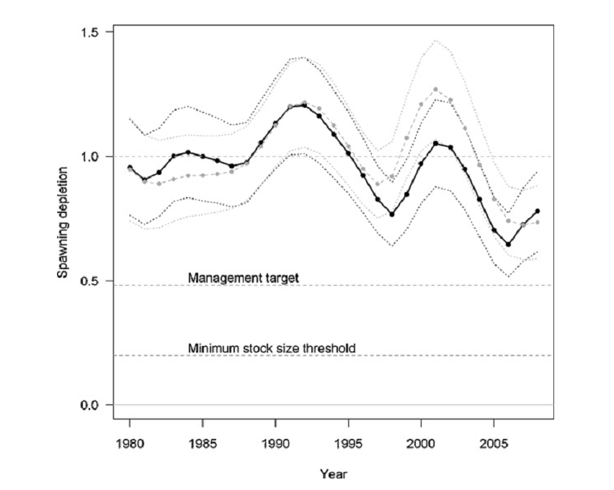
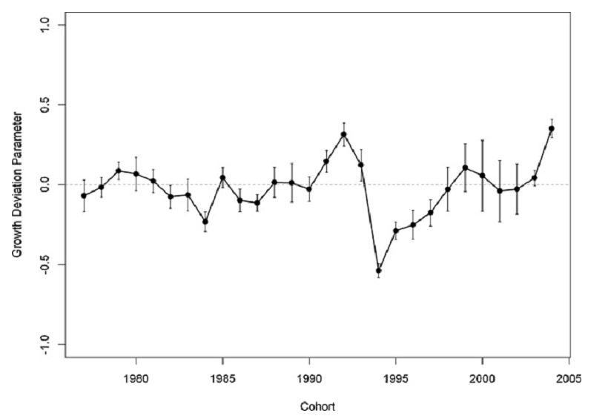
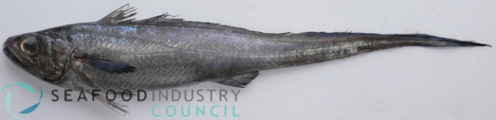
Impact of time-varying growth on stock assessment
Blue hake (grenadier), Macruronus novaezelandiae
Static growth
Time-varying growth
Further study should focus on comparing alternative methods for dealing with temporal variability in growth in stock assessment models by using simulation analyses.
Athol Whitten et al. (2013)
Fish Res
Notes:
Blue hake (grenadier) fishery in southern Australia and New Zealand.
Comparisons show that accounting for variable growth provides a better fit to time-series data and results in significant differences to key population estimates.

Slide 5

Objectives of this study
To develop an operating model (OM) to simulate population dynamics and possible time-varying growth of the swordfish in the North Pacific Ocean
To evaluate the performance of a stock assessment model with mis-specified time-varying growth by using simulation testing analysis
To explore the implications of various ways of handling time-varying growth in a stock assessment model

Slide 6
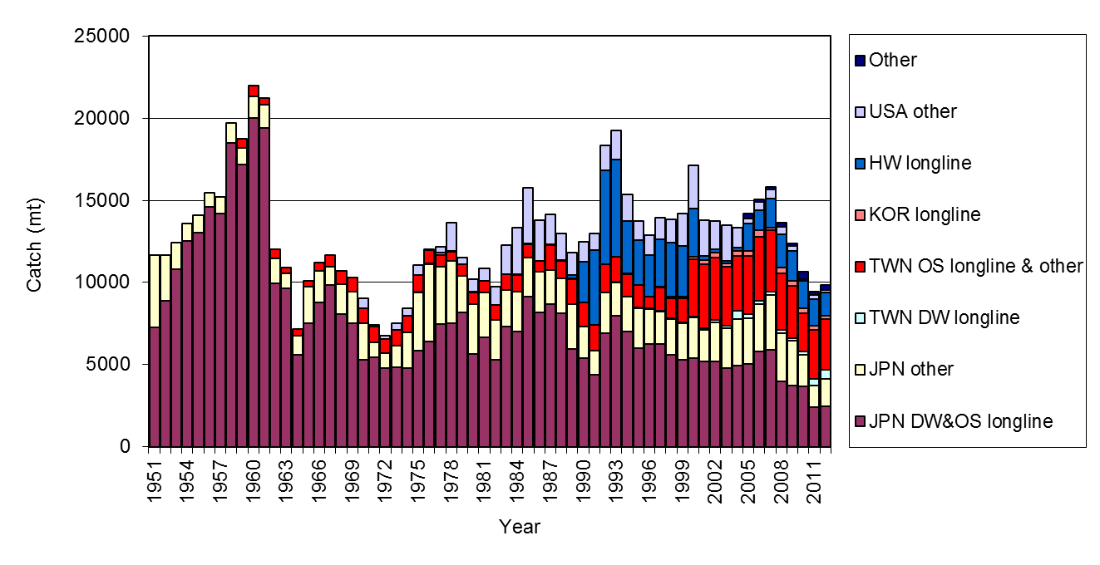

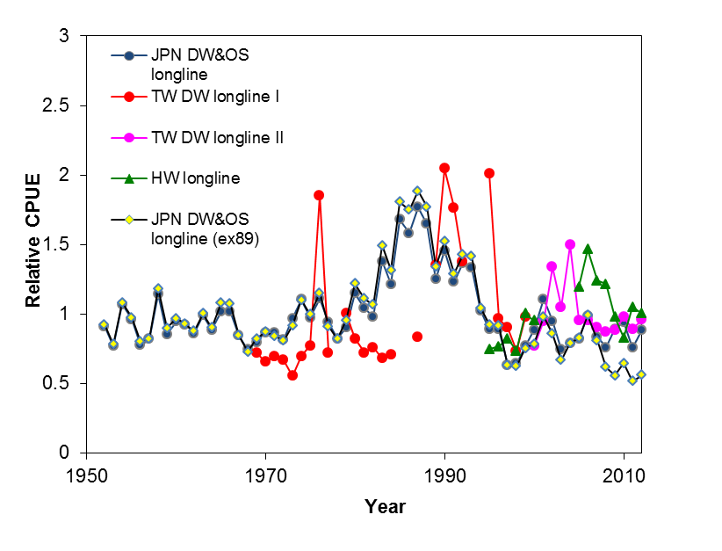
WCNPO Swordfish
Source:
Previous assessments
ISC (2009); ISC (2014)
SS3; Bayesian production model
Data used:
Catch
1951-2012 WCNPO SWO
CPUE indices:
Japan longline
TW longline
HW longline

Slide 7
Individual-based model
iPopSim
Individual-based Population Simulator
Population model:
N_{t+1} = N_{t} e^{-Z}
Individual-based model:
r₁ ~U(0,1); r₂ ~U(0,1)
If r₁ ≤ exp(Z(L_{i})), dies; survives
If r₂ ≤F(L_{i})/Z(L_{i}), fished; died naturally
End of year
Recruitment
Start of year
Bookkeeping
Die?
YES
Is it fished?
YES
Landing
NO
NO
Applications of IBM:
Chen et al. (2005) Maine lobster size‐structured stock assessment model
Kim et al. (2002) New Zealand abalone assessment model
Labelle (2005) yellowfin tuna MULTIFAN-CL
Time-varying
Growth
Die naturally
Bookkeeping
YES
More fish?
NO
Features:
Included the tagging module
Generates SS3.dat file
Modified from Chang et al. (2011)
CJFAS, 68: 122–136

Slide 8
Individual-based model - II
Single area, sex combined
Initialization
  40 years M only (1911-1950);
  62 years M+F (fishing period, 1951-2012)
Fishery
  One combined fleet, fixed q, logistic selectivity (size-based)
Life history parameters: maturity, length-weight (size-based)
Beverton-Holt SR relationship
Growth uncertainty
  Individual growth variability
  Time-varying growth variability

Slide 9
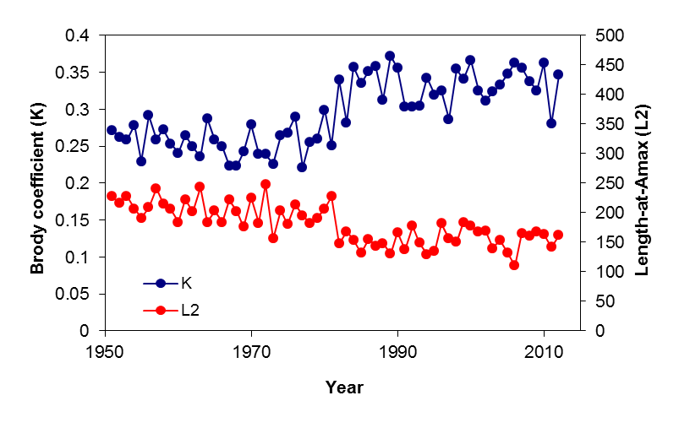
Time-varying growth scenarios in IBM
Period 1
Period 2
30% increase K
Linf
30% decrease Linf
Linf
y
Size
We modeled the time-varying K and Linf patterns for
Cohort-specific growth variability
Year-specific growth variability
age
c
time

Slide 10
Stock Synthesis estimation model
One fishery
Starts in 1951 (modeled as non-seasonal)
IBM’s Data for all years (1951-2012)
  Abundance index
  Length composition in fishery
  Age composition in fishery
Fixed, natural mortality, and steepness of the stock-recruitment relationship (h = 0.9)
Estimated parameters:
  Length at a₁ (L₁), Length at a₂ (L₂), K, CV_L₁, CV_L₂,
  R₀, Selectivity (SEL₅₀, SEL₉₅)

Slide 11
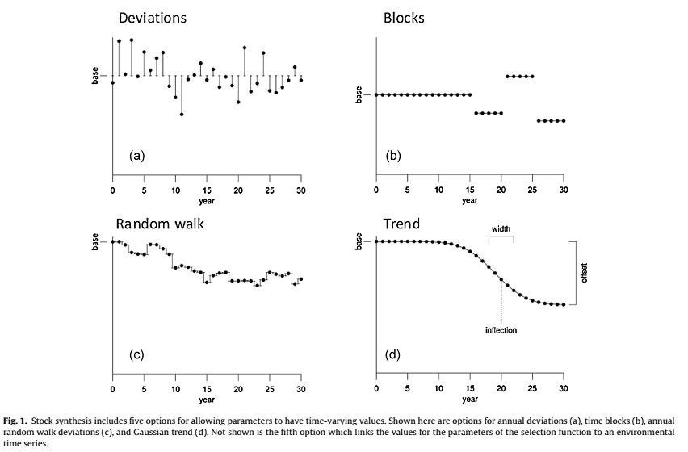
Stock Synthesis estimation model - II
Constant growth
Yearly multiplicative deviation
  Par’_{y}=par*e^{εy}
  1951-2012
Yearly random walk deviation
  Par’_{y}=Par’_{y-1}+ ε_{y}
  1951-2012
Cohort growth deviation
  L_{a+1,c} =L_{a,c}+∆L*e^{vc}
  1951-2005
Time blocks
  Par’ = blockpar
  Every 10 years block
  1951-1960; 1961-1970; 1971-1980; 1981-1990; 1991-2000, 2001-2012
Methot and Wetzel (2013)
Fish Res
6. Empirical weight-at-age
Taylor (Friday)
Notes:
The SS offers the advantage of allowing parameters that can vary through time, including annual- and/or cohort specific variability in growth

Slide 12
Simulation testing scenarios
Simulation scenario | Estimation model
Constant growth (base-level) | SS3_const
Time-varying K (Cohort) | SS3_const
 | SS3_mult_dev
 | SS3_ranwk
 | SS3_CGdev
 | SS3_Blocks
Time-varying K (Year) | 5 SS3 models
Time-varying Linf (Cohort) | 5 SS3 models
Time-varying Linf (Year) | 5 SS3 models
We compared:
SSB_{y}
Fy, SSBtyr, Ftyr, Weight-at-age (not shown in this presentation)

Slide 13
Result

Slide 14
Constant growth scenario
Comparison of time-series of SSB
by different estimation models
Cohort-specific time-varying K scenario
Cohort-specific time-varying Linf scenario

Slide 15
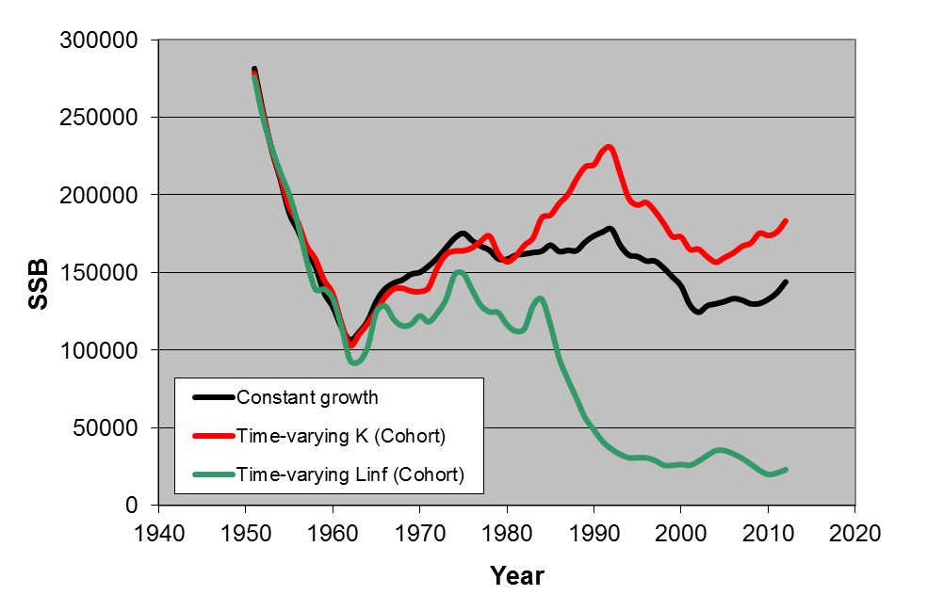
Time-varying K vs Time-varying Linf
(Kg)
Time-varying K
Time-varying Linf
(Cohort-specific)
(Cohort-specific)
Mean size EFL (cm)
1970
1970
Year
1990
1990
2010
age
2010

Slide 16
Model performance
Average absolute relative error
k is the number of years;
The E_{t} is the estimated value of SSB in year t;
T_{t} is the “true” SSB in year t;
Larger value -> higher estimation error

Slide 17
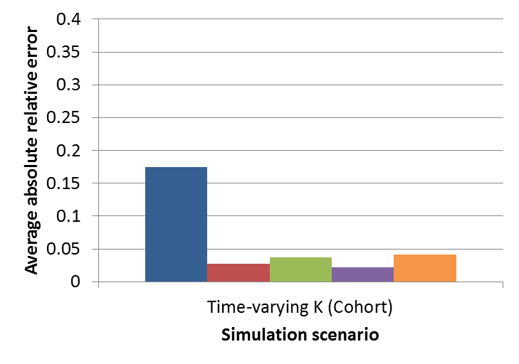
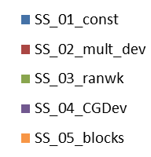
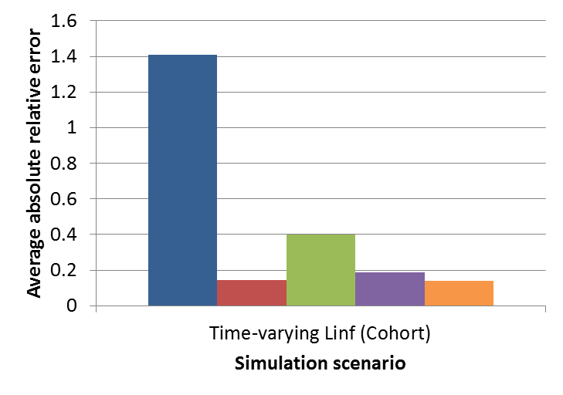
Estimation error of spawning stock biomass
SSB
SS3 estimation models:
Time-varying K
Base-level
(self-test error)
100%
SSB
Time-varying Linf

Slide 18
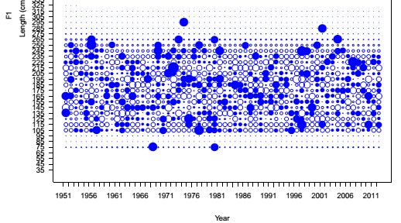
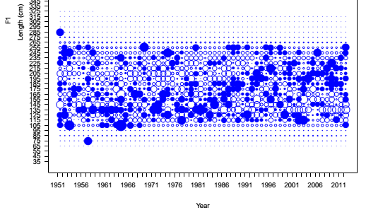
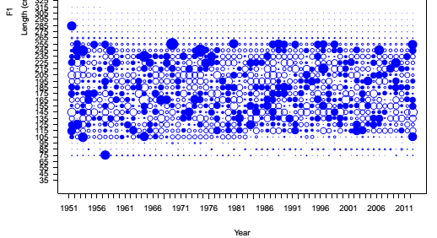
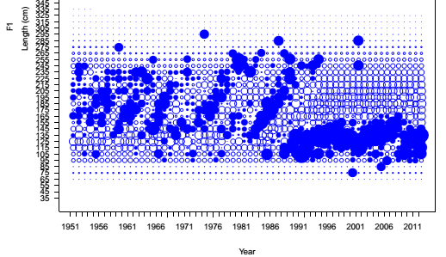
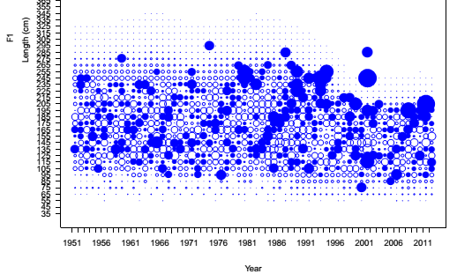
Simulation scenario
SS3 constant growth
Pearson residuals bubble plot
of size composition
SS3 constant growth
Constant growth
Base-level
SS3 constant growth
SS3 multiplicative dev in K
Time-varying K
(cohort-specific)
SS3 constant growth
SS3 multiplicative dev in Linf
Time-varying Linf
(cohort-specific)

Slide 19
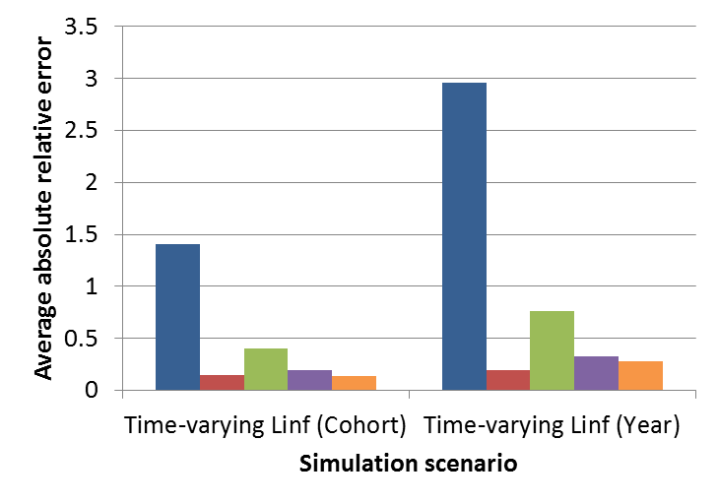
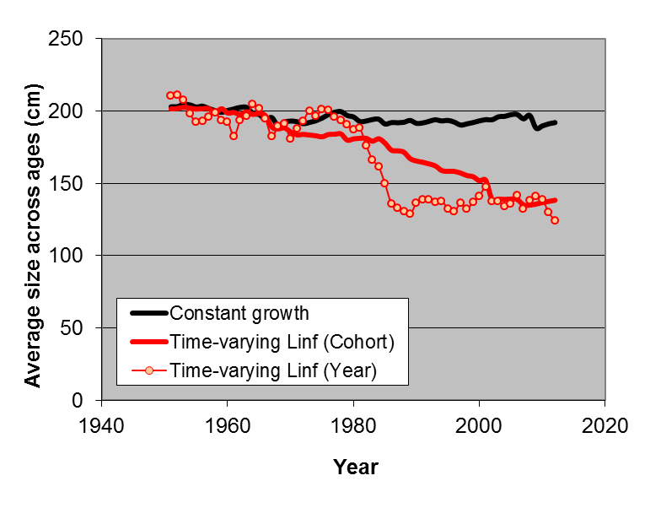
Cohort-specific vs Year-specific
time-varying growth
SS3 estimation models:
SSB
Base-level
100%
(Cohort-specific)
(Year-specific)
Mean size
1970
1970
Year
1990
1990
2010
Age
2010

Slide 20
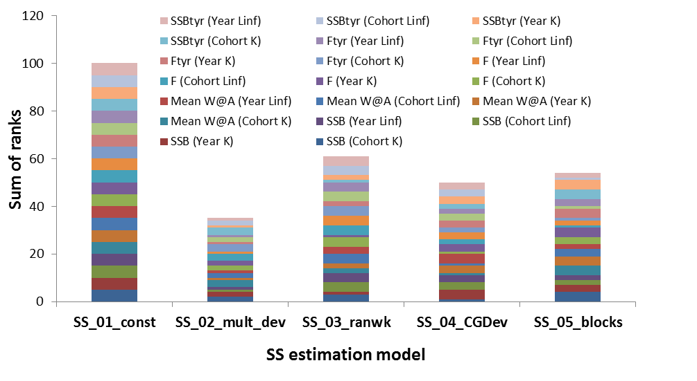
Which time-varying method is better?

Slide 21
Findings of the simulation study
Mis-specified time-varying growth can affect model output
  For example, estimation error in SSB
  Reason: time-varying growth -> mean size-at-age -> exploitable population (via selectivity) -> catch (young-big or old-small) -> population abundance, SSB (via L-Maturity & L-W functions) -> Recruitment -> … ->
Higher time-varying growth variation -> more complication in dynamics and data -> poor fits by stock assessment model -> higher estimation error
Time-varying Linf has a larger impact than time-varying K
  Big change in size scale across all ages
Year-specific time-varying growth has a larger impact than cohort-specific time-varying growth
  Year-specific has higher variations in mean size-at-age

Slide 22
Findings of the simulation study -II
Can we include time-varying growth in stock assessment?
  In our case, Yes!
    SSB RE 18% -> less 5% (time-varying K)
    SSB RE 150% -> 20% (time-varying Linf)
Default method for dealing with time-varying growth?
  Yearly multiplicative deviation and cohort growth deviation methods perform better
  Reason: greater flexibility to model the variation
Which one is worse?
  Constant growth; time blocks; random walk method (low flexibility)
Do the models with time-varying growth work well when true growth is constant?
  Yes! Reason: greater flexibility; more parameters
  Include it as a candidate run. Check model if it makes a difference.

Slide 23

Acknowledgments
CAPAM workshop conveners
ISC Billfish Working Group
Jon Brodziak
Rick Methot
Yong Chen
Hui-Hua Lee
Questions??

Slide 24
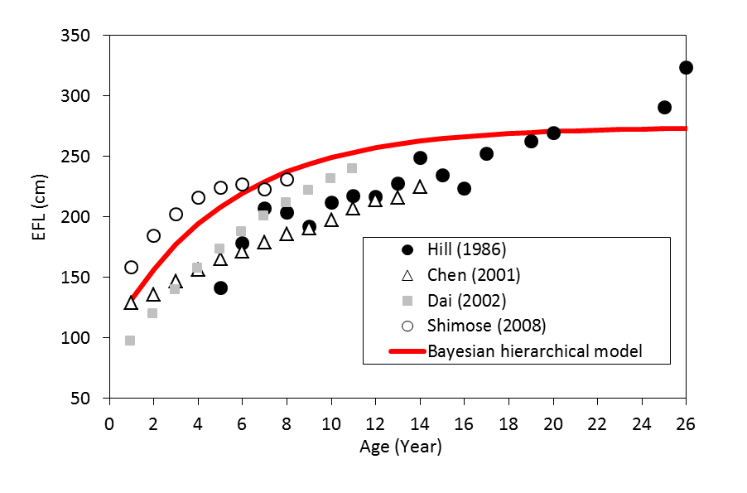
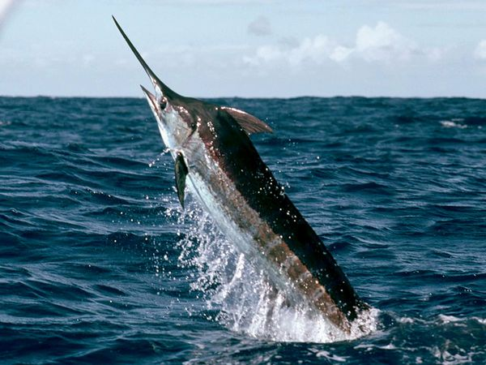
Examples of time-varying growth – II
Pelagic billfish
Pacific blue marlin
Chang et al. (2013)
ISC/13/BILLWG-1/02
Parameter | Posterior mean
μ∞ | 274.44
μ_{K} | 0.192
L_{∞,j} | 311; 241; 221; 309
K_{j} | 0.09; 0.32; 0.20; 0.11

Slide 25
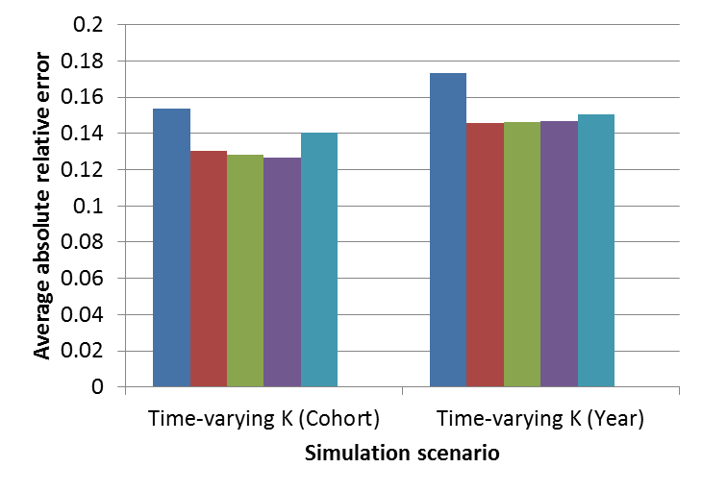
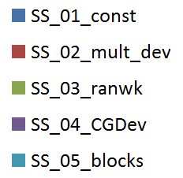
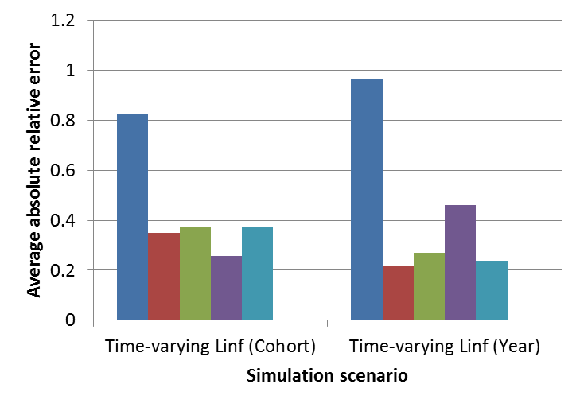
Weight
Estimation error of time-series of weight-at-age
Year
Base-level
Age
SS3 estimation models:
Time-varying K
100%
Base-level
Time-varying Linf

Slide 26
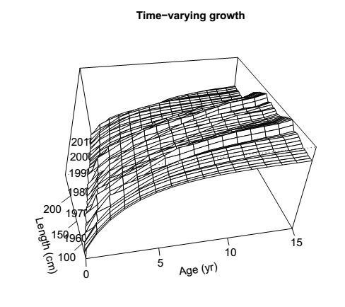
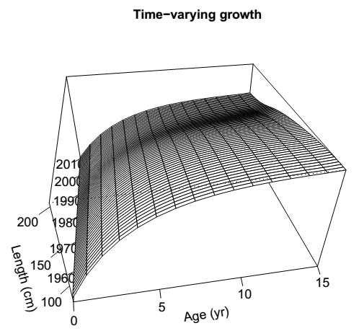
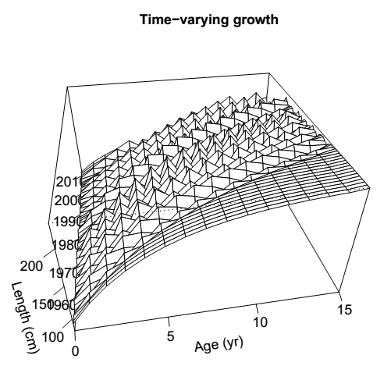
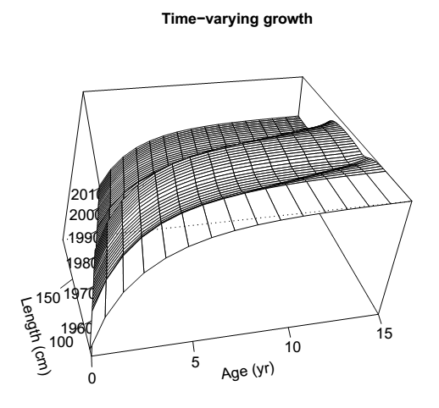
time-series of mean size-at-age
Mult_dev
Ranwk
CGDev
Blocks

Slide 27
Parameter (units) | IBM | Estimated in SS3
Natural mortality (yr⁻¹) | 0.25 | No
Reference age1 (yr) | 0 | No
Reference age2 (yr) | 15 | No
Length at a₁ (cm) | 62.69 | Yes
Length at a₂ (cm) | 216.72 | Yes
Growth rate (yr⁻¹) | 0.258 | Yes
IBM growth error CV; SS3 CV L₁ | 0.25; 0.01 | Yes
SS3 CV L₂ | 0.1 | Yes
Length-weight scaling | 1.35E-06 | No
Allometric factor | 3.4297 | No
Maturity slope | -0.1034 | No
Length-at-50% maturity (cm) | 143.68 | No
Log mean virgin recruitment | 1.09862 | Yes
Steepness | 0.9 | No
SigmaR | 0 | No
Logistic size-based selectivity, SEL₅₀ (cm) | 140 | Yes
Logistic size-based selectivity, SEL₉₅ (cm) | 160 | Yes
Catchability | 0.1 | No
CPUE observation error s.d. | 0.1 | No
Effective N in size comp. | 100 | No
Effective N in age comp. | 100 | No
Ageing error s.d. | 0.001 | No
Time-varying par. CV | 0.25 | No
Mortality
Growth
Other life
history
SR
relationship
Selectivity
Observation
error
Notes:
Add ss3 data fit and SS3 estimated model

Slide 28
Match up IBM with SS3
We compared:
Total mortality by age
Catch number-at-age
Population abundace-at-age
SSB
Growth curve
etc.
Notes:
Reseably well

Slide 29
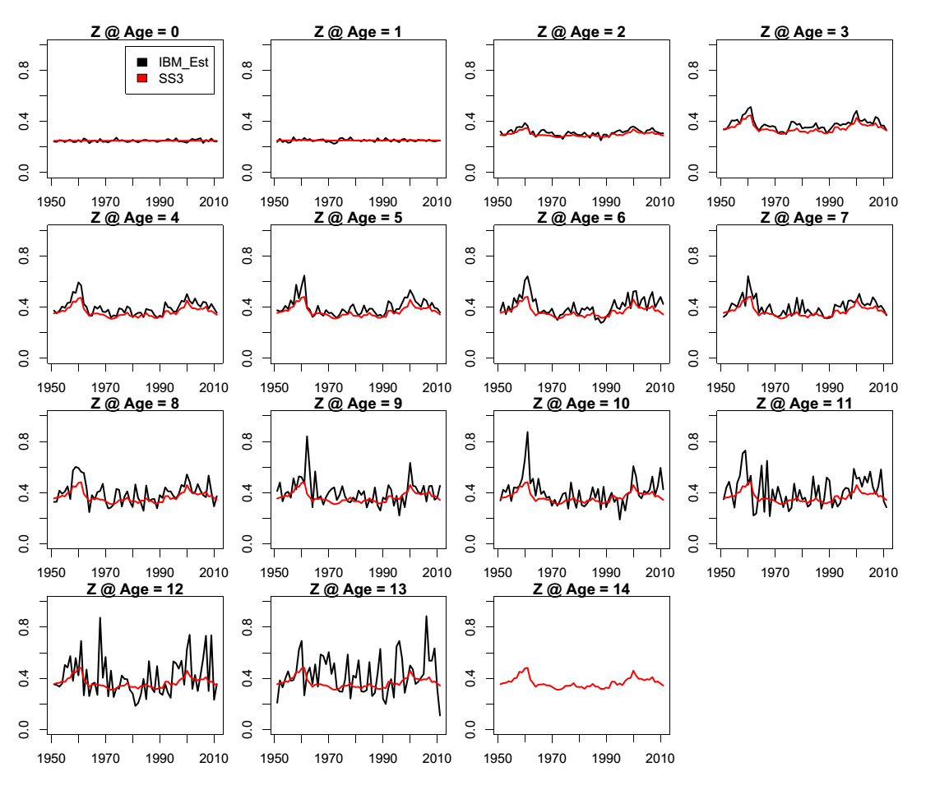
Total mortality of IBM and SS3

Slide 30
Discussion points
How does fish’s growth change through time?
What is the major impact of time-varying growth on population dynamics?
Can we include time-varying growth in stock assessment?
  How do we include time-varying growth in stock assessment?
What kind of data do we need for estimating time-varying growth?
  CPUE, Size composition, conditional age composition, tagging data
How many the above data do we need for estimating time-varying growth?
What is the relationship between time-varying growth and time-varying selectivity?
How does the time-varying growth affect the recruitment’s estimation?
What is the combined impact of both recruitment deviation and time-varying growth on population dynamics?

Slide 31
Stock assessment and model selection
Alternative hypotheses/models
Assessment data
Best model
Stock status
Spatial (Punt et al., 2000)
Sex-specific (Wang et al., 2005)
Time-varying mortality (Deroba & Schueller, 2013), selectivity (Martell & Stewart, 2014),
growth (Whitten et al., 2013), etc.
NRC, 1998
Issue:
The estimated quantities important for management can be sensitive to the model structure.
Consequences:
Overconfident inferences and decisions that may be more risky than expected.
Notes:
From Alex’s intro Alex’s

