Slide 1
Treating spatially varying growth in a spatially structured model with movement
Simon Nicol, John Hampton, and Shelton Harley
Secretariat of the Pacific Community

Slide 2
I just realized that my job is ridiculous ….
Simon Nicol, John Hampton, and Shelton Harley
Secretariat of the Pacific Community

Slide 3
Help!
Simon Nicol, John Hampton, and Shelton Harley
Secretariat of the Pacific Community

Slide 4
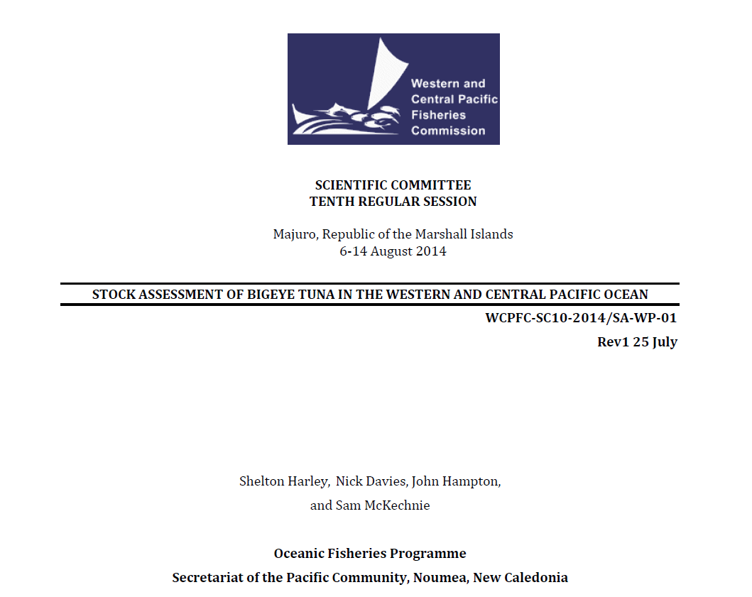
Bigeye tuna in the western Pacific

Slide 5
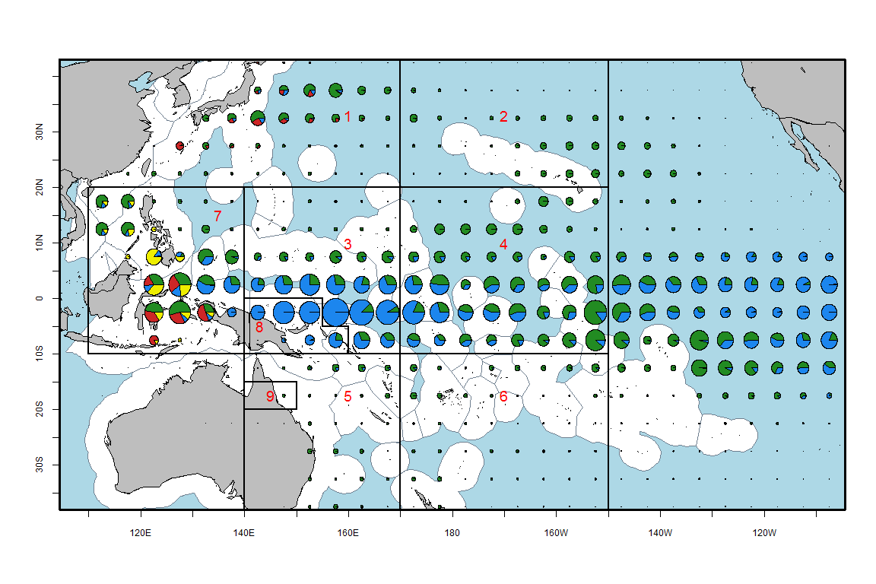
Bigeye catches across the Pacific

Slide 6
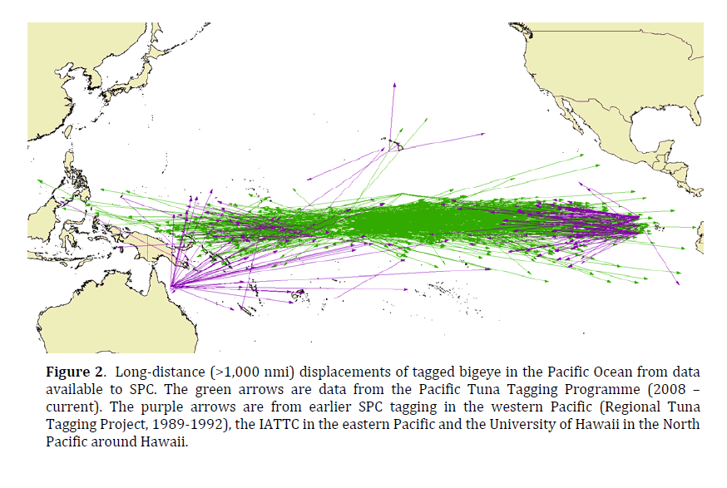

Slide 8
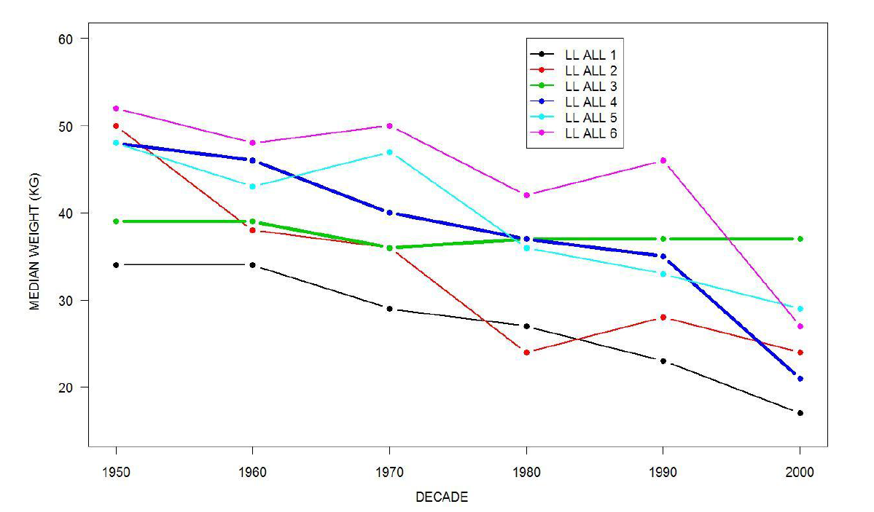

Slide 9
VBGF with offset at young ages

Slide 10
Model stability

Slide 11
Model stability

Slide 14
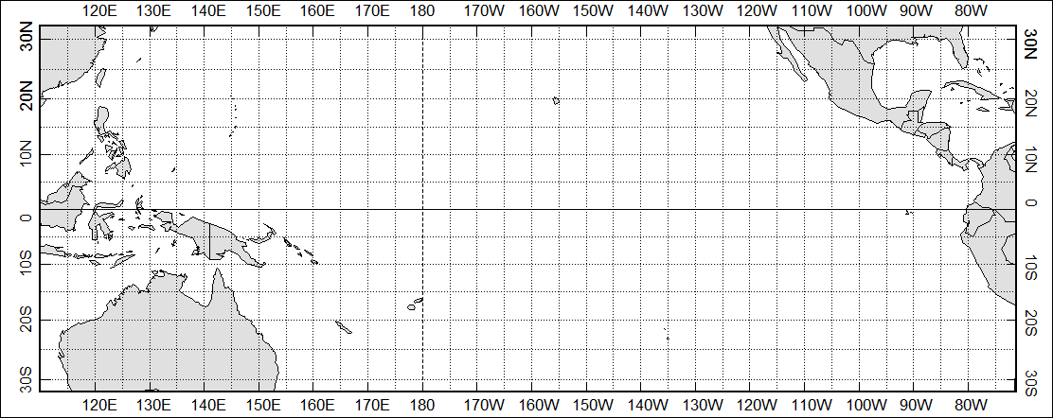
Key datasets – Age at Length
Sun et al. 2002
WCPFC Pilot
Farley et al. 2006
Lehodey et al. 1999
Leroy et al. 2001
Hampton et al. 2006
Schaefer and Fuller 2006

Slide 15
