Slide 1
Experimental estimation of snow crab catchability by the eastern Bering Sea bottom trawl survey
David Somerton
RACE Groundfish Assessment Program
Alaska Fisheries Science Center

Slide 2
Definition of terms
Sampling efficiency = sampled density / true density
Catchability = survey estimated pop / true pop
Q = max value of catchability

Slide 3
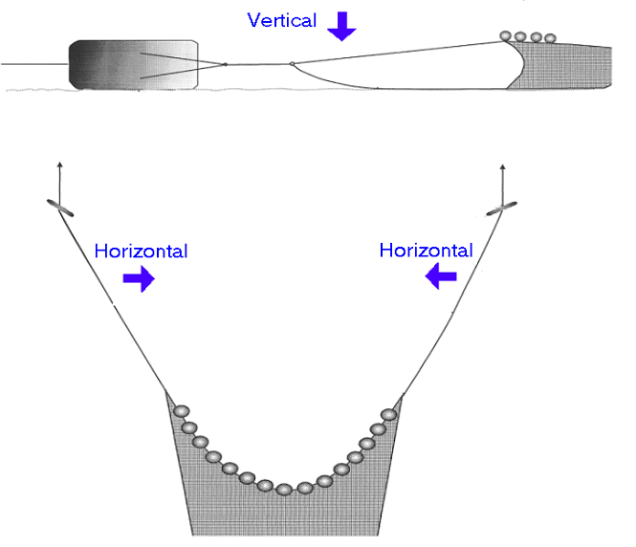
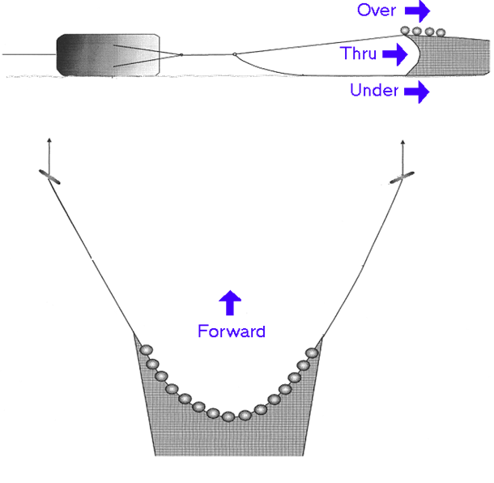
Sampling efficiency experiments

Slide 4
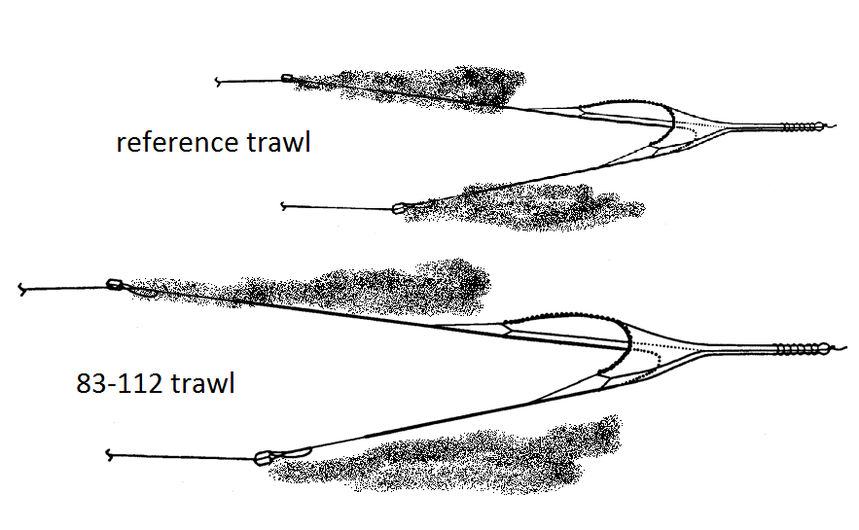
Sampling efficiency experiments

Slide 5
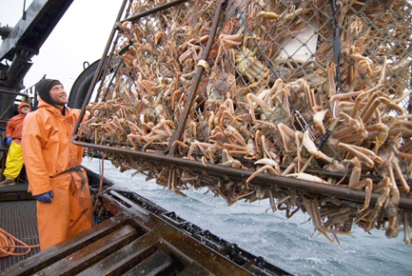
Example: Bering sea snow crab

Slide 6
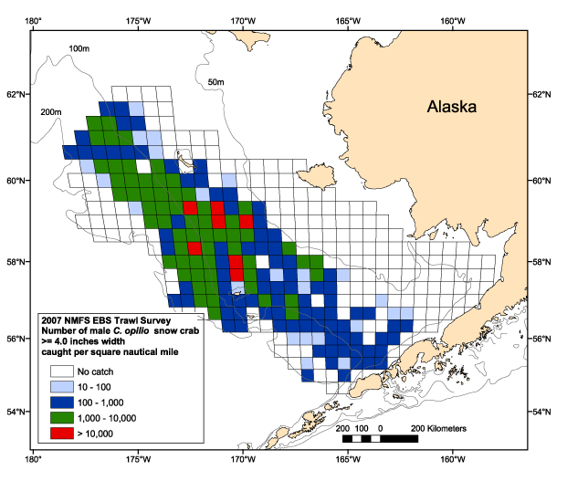
EBS bottom trawl survey

Slide 7
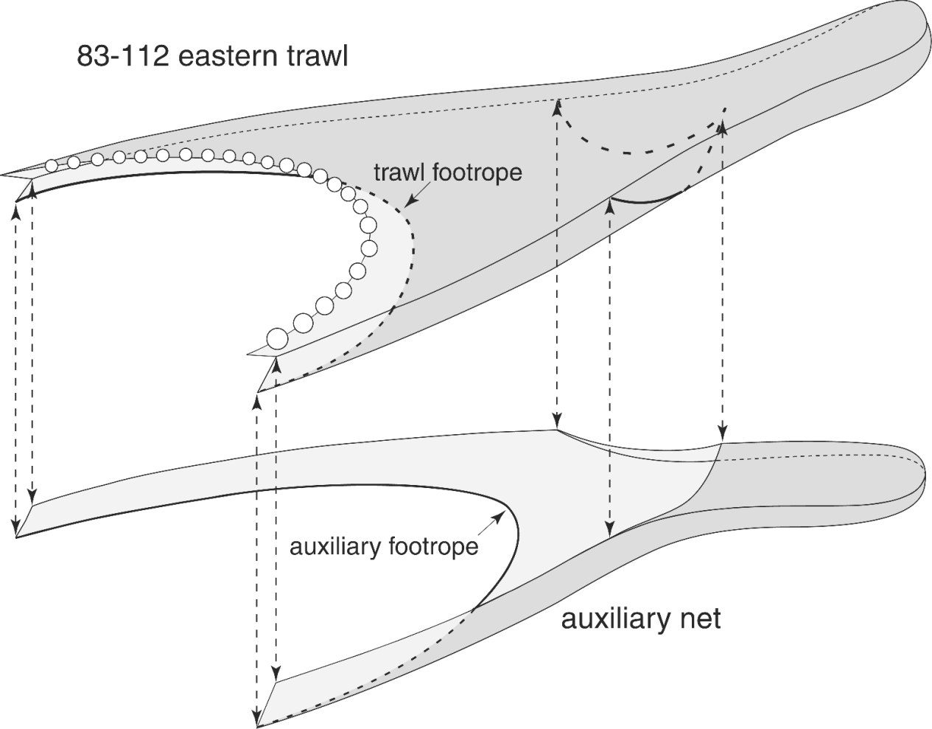
1998 Bottom Trawl Efficiency Study

Slide 8
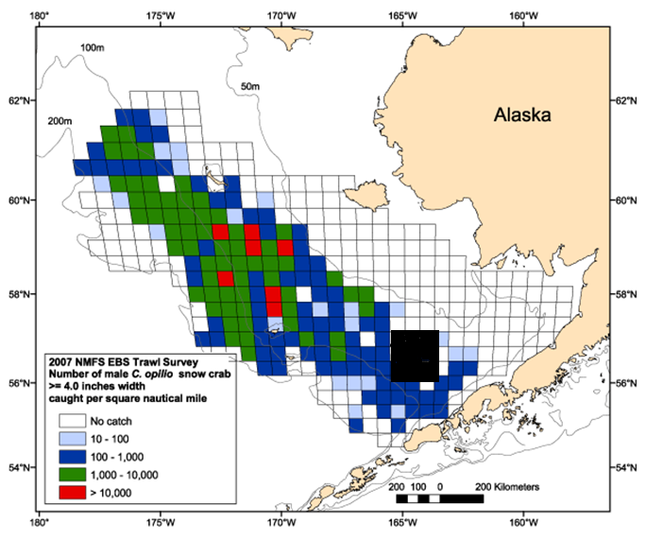
Experimental area

Slide 9
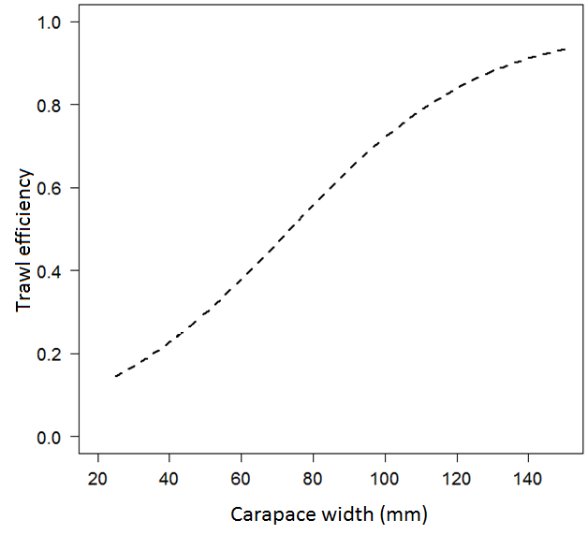

Slide 10
1. Subsequent trawl research using a bottom contact sensor showed footrope clearance increased in deep water and on a muddier bottom
2. Crab fisher organizations banded together to form the Bering Sea Fisheries Research Foundation to support crab stock assessment research.
3. Developed their own crab survey using a special purpose crab trawl.

Slide 11
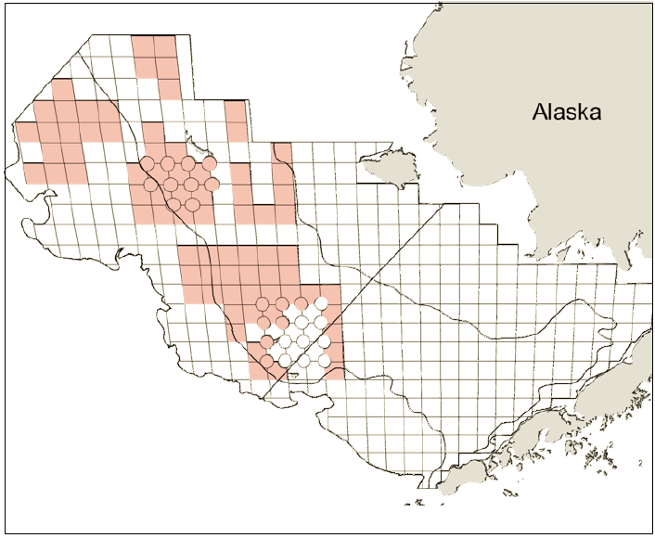
2010 SurveyTrawl Efficiency Study

Slide 12
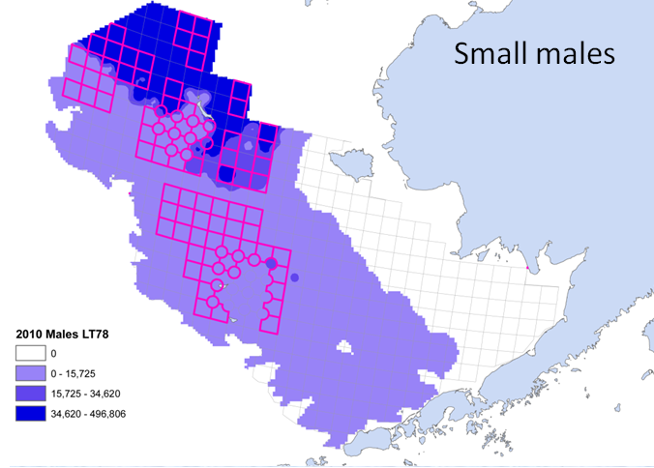
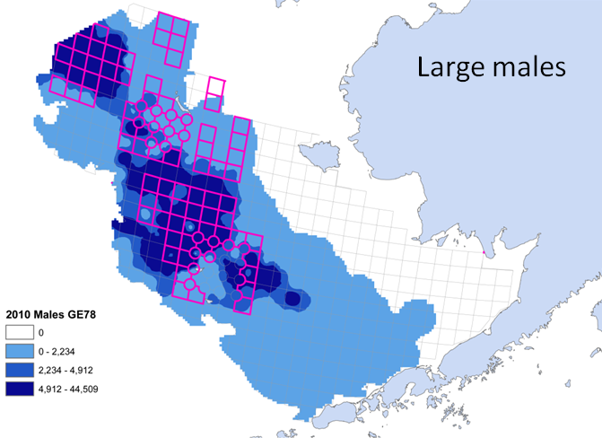
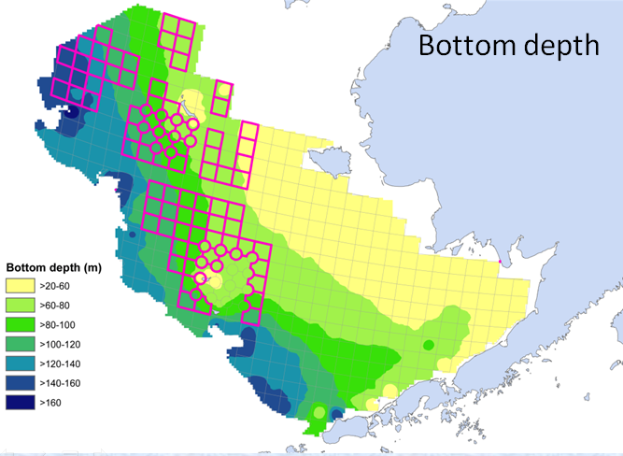
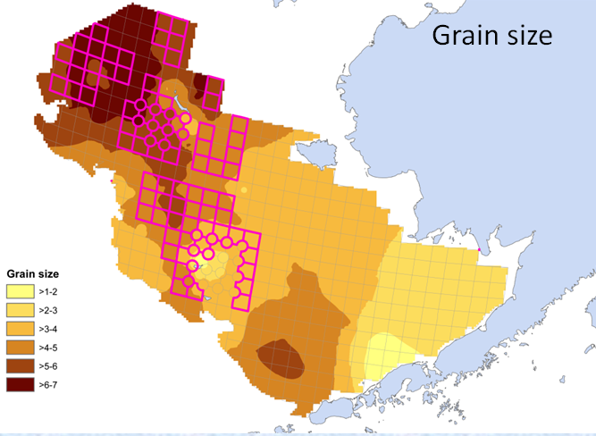
Notes:
12

Slide 13
Completed 92 side by side stations
Modeled trawl efficiency as smooth functions of width, depth, sediment

Slide 14
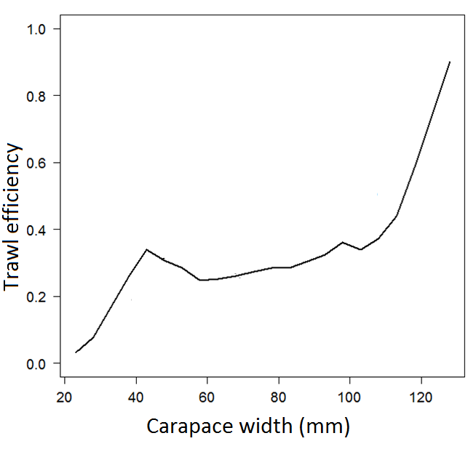

Slide 15
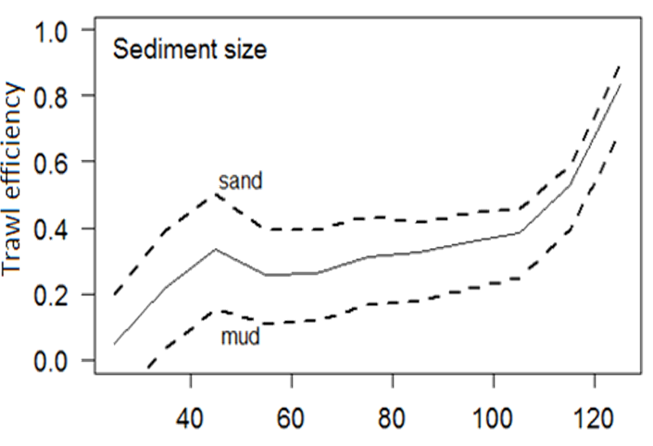
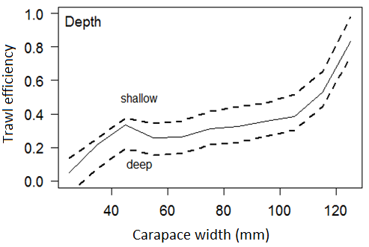

Slide 16
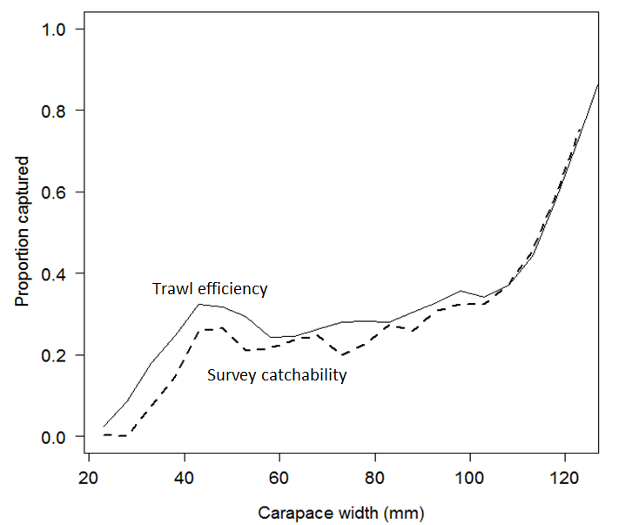

Slide 17
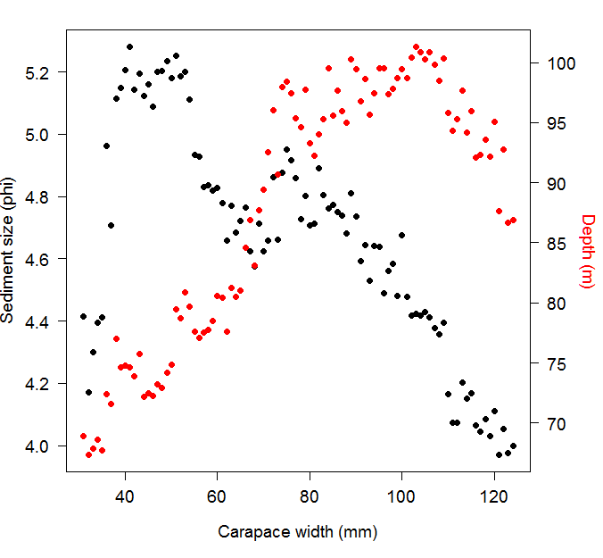

Slide 18
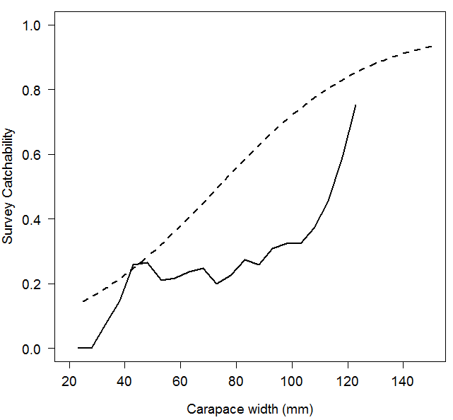

Slide 19
Conclusions
Survey catchability is likely to not be a logistic function of size.
Need to explore how to represent more complex shapes in SS models.
It is likely possible to estimate survey catchability for most survey gears that sample a measurable volume

