Slide 1

The length structure of bigeye tuna and yellowfin tuna catch at different depth layers and temperature ranges: an application to the longline fisheries in the waters near Gilbert Islands
Liming Song & Jialiang Yang
Shanghai Ocean University

Slide 2
INTRODUCTION
The significance of this study
The study status
Our goals

Slide 3

In the stock assessment on tunas and tuna like species, the fisheries scientists need more accurate data and model parameters.
Statistical catch-at-age analysis (Doubleday, 1976; Deriso et al., 1985) is a classical framework used for fisheries stock assessment (Hilborn and Walters, 1992).
The significance of this study

Slide 4
The spawner-recruitment relationship is often integrated into an age-structured, statistical catch-at-age/length model (Zhu et al., 2012).
Many catch-at-age analyses now integrate diverse auxiliary information (Fournier and Archibald, 1982).
The study status
Notes:
The S–R relationship is often integrated into an age-structured, statistical catch-at-age/length model to improve estimates of recruitment, other population parameters, and management quantities. But there is no agreed idea about whether there are differences in catch-at-length among each water layers or temperature ranges.
Although the tuna longline CPUEs were standardized by depth or temperature to adjust for the change in depth of longlines, the selectivity by depth or temperature was not changed in the stock assessment. Many catch-at-age analyses now integrate diverse auxiliary information, such as catch, effort, and the age or length compositions from the fishery and any surveys, and abundance indices.

Slide 5
Gerritsen et al. (2006) divided their data into three depth strata for north sea haddock (Melanogrammus aeglefinus) and the results showed that the shallow stratum was significantly different from the deeper strata, with higher probabilities for younger fish in the shallow stratum.
Stari et al. (2010) found significant differences between geographical areas, mature and immature fish, commercial and survey data, and fleets using different fishing gear for north sea haddock.

Slide 6
Although the tuna longline CPUEs were standardized by depth or temperature to adjust for the change in depth of longlines, the selectivity by depth or temperature was not changed in the stock assessment.
There is no conclusive evidence whether the length compositions are the same among water depth layers or temperature ranges for tunas and tuna-like species.
So, it is the priority to evaluate if the size selectivity by depth or temperature needs be considered in the stock assessment.

Slide 7

(1) if there are differences between the length structure of all samples and the length structure at different depth layers or temperature ranges for bigeye tuna and yellowfin tuna catch;
(2) if there is significant difference among the length structures of bigeye tuna and yellowfin tuna catch at different depth layers or temperature ranges;
(3) if the selectivity by depth or temperature needs be considered in the stock assessment.
Our goals

Slide 8


Materials
&Methods

Slide 9
Materials
1
2
Data collection
The survey vessels, areas, durations and fishing gears

Slide 10
Table 1 Vessels, longline gear specifications (one basket), operational characteristics, survey durations, and survey areas during 2009 and 2010
Year |  | 2009 | 2010
Name of vessel |  | Shenglianchen No.719 | Shengliangchen No.901
Vessel | Length (m) | 32.28 | 26.80
 | Engine power (kW) | 220.00 | 400.00
Mainline | Diameter (mm) | 3.6 | 3.6
 | Material | Mono Nylon | Mono Nylon
 | Length (km) | 110 | 110
Float | Diameter (mm) | 360 | 360
 | Material | Plastics (PVC) | Plastics (PVC)
Float line | Diameter (mm) | 4.2 | 5.0
 | Material | Multifilament Nylon | Multifilament Nylon
 | Length (m) | 20 | 30
Branch line | Length (m) | 18 | 18
 | Diameter (mm) | 1.2-3.0 | 1.2-3.0
 | Typeª | 1-16 | 1-16
Notes:
此培训完成后，受众能够做些什么? 简要描述受众将通过哪些方式从此演示文稿受益。

Slide 11
Table 1 (continue)
Year |  | 2009 | 2010
Name of vessel |  | Shenglianchen No.719 | Shenglianchen No.719
Hook | Ring Hook size | 35 | 35
 | Hooks between floats (HBF) | 21 or 25 | 21 or 25
 | Hook spacing (m) | 43.5 | 41.2
 | Circle Hook size | 17/0 | 17/0
Bait | Type | Blue mackerel scad/squid
 | Size (g) | 150 | 150
Operational | Vessel speed (deployment) (m s⁻¹) | 3.86 | 3.86
 | Line shooter speed (m s⁻¹) | 5.66 | 5.40
 | Time taken to shoot between hooks (s) | 8.0 | 8.0
 | Length of the mainline between floats (m) | 1177 | 1123
 | Sea-surface horizontal distance between floats (m) | 803 | 803
survey duration |  | Oct.- Dec. 2009 | Oct. 2010 –Jan. 2011
survey area |  | 6°00′N-2°00′S, 168°00′E- 178°00′E | 0°48′N-3°34′S, 169°00′E - 179°59′E

Slide 12
The survey areas

Slide 13
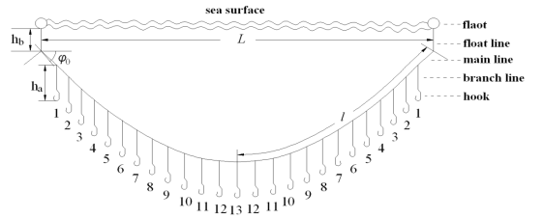
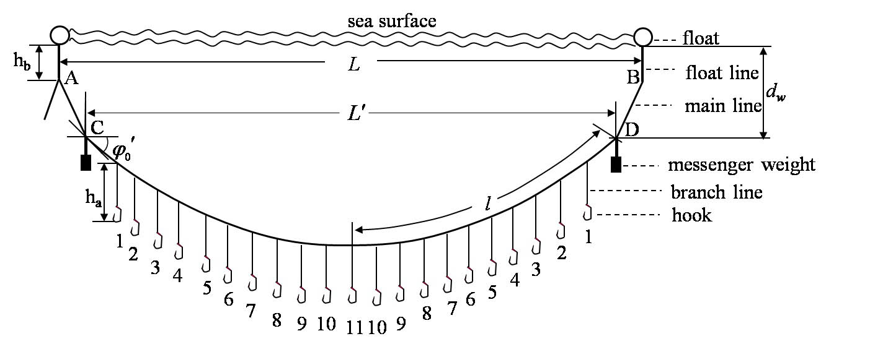
The survey fishing gears
The traditional fishing gear
The experimental fishing gear

Slide 14
    Data collection
operation parameters
the code of hook with which a fish was caught
number of hooked bigeye and yellowfin tuna per day
the fork length of bigeye and yellowfin tuna
the temperature vertical profile
the actual hook depth
three dimensional current profiles
Notes:
The data collected in the two survey were as follows: operation parameters (deployment position and time, course and speed, line shooter speed, number of HBF, time interval between two hooks, etc), the code of hook with which a fish was caught, number of hooked bigeye tuna and yellowfin tuna per day, and the fork length of bigeye tuna and yellowfin tuna measured by the tape. The temperature vertical profile in each site was also measured by XR-620 (RBR Co, Canada).The actual hook depth was measured by TDR2050, and the three dimensional current profiles were measured by Acoustic Doppler Current Profiler (ADCP, NOTREK Co, Norway). The deepest water column for which we measured was limited by the maximum length (= 450 m) of wires that were fixed to the instruments.

Slide 15
Methods
1
3
The evaluation on selectivity by depth and temperature
Analytical method of hook depth
2
The process of fisheries data

Slide 16
Analytical method of hook depth
The actual depths of traditional fishing gears were measured by TDRs and their theoretical hook depths were calculated by the catenary curve equation.
The predicted hook depths were calculated by the method of Song et al.(2010b).
The relationship models were developed by stepwise regression method.
We assumed that the hook depth was mainly affected by wind speed, wind direction, current shear, angle of attack, and the hook position code (Figs.2). For the experimental gear, we considered the weight of messenger weight as another factor.

Slide 17
For the traditional gear in 2009:
(11)
For the experimental gear in 2009:
(12)
For the traditional gear in 2010:
(13)
For the experimental gear in 2010:
(14)

Slide 18
The process of fisheries data
The data were assigned to four depth strata of 40 m each (40-80 m, 80-120 m …, and 160-200 m), and assigned to four temperature ranges of 1 ℃ each (25-26 ℃, 26-27 ℃, …, 28-29 ℃).
Frequency distributions were constructed by grouping lengths into 10-cm intervals.
Calculating the depth of hooked fish.
Calculating the temperature of hooked fish.
Calculating the frequency of length distribution of bigeye tuna and yellowfin tuna in each water layers and temperature ranges

Slide 19
The evaluation on selectivity of depth and temperature
A one-way analysis of variance (ANOVA) was used to test if there was significant difference between the length structure of all samples and the length structure at different depth layers or temperature ranges for bigeye tuna and yellowfin tuna catch, and to test if there was significant difference among the length structures of bigeye tuna and yellowfin tuna catch at different depth layers or temperature ranges.

Slide 20
Results
Notes:
每个主题使用一个节标题，以便清楚传达给观众。

Slide 21
  Fig. 3 The length structure of bigeye tuna in each water layer
Notes:
The length structure of bigeye tuna in each water layer and each temperature range in Gilbert Islands were obtained (Fig3, Fig4).

Slide 22
  Fig. 4 The length structure of bigeye tuna in each temperature range
Notes:
。

Slide 23
  Fig. 5 The length structure of yellowfin tuna in each water layer
Notes:
The length structure of yellowfin tuna in each water layer and each temperature range in Gilbert Islands were obtained (Fig5, and 6).

Slide 24
  Fig. 6 The length structure of yellowfin tuna in each temperature range
Notes:
。

Slide 25
Table 2. The p-value from ANOVA for length structure of bigeye tuna among each water depth layer
Depth layers (m) | 40-80 | 80-120 | 120-160 | 160-200
40-200M | 0.4917881 | 0.4624682 | 0.3601787 | 0.4148681
40-80M | - | 0.4543031 | 0.3678827 | 0.4229004
80-120M | - | - | 0.2811203 | 0.3786305
120-160M | - | - | - | 0.4430445
Notes:
There was no significant difference between the length structure of all samples and the length structure at different depth layers for bigeye tuna catch (p≥0.05) (Table 2). There was no significant difference among the length structures of bigeye tuna catch at different depth layers (p≥0.05) (Table 2).

Slide 26
Table 3.The p-value from ANOVA for length structure of bigeye tuna among each temperature range
Temperature ranges (℃) | 25-26 | 26-27 | 27-28 | 28-29
25-29 | 0.106239 | 0.4366206 | 0.3235321 | 0.4967402
25-26 | - | 0.1371469 | 0.0465955 | 0.107681
26-27 | - | - | 0.2689096 | 0.4398391
27-28 | - | - | - | 0.3206198
Notes:
There was no significant difference between the length structure of all samples and the length structure at different temperature ranges for bigeye tuna catch (p≥0.05) (Table 3). There was no significant difference among the length structures of bigeye tuna catch at different temperature ranges (p≥0.05), except the length structures of bigeye tuna catch between 25-26 ℃ and 27-28℃(p≤0.05).

Slide 27
Table 4.The p-value from ANOVA for length structure of yellowfin tuna among each water depth layer
Depth layers (m) | 40-80 | 80-120 | 120-160
40-160 | 0.4917881 | 0.4624682 | 0.3601787
40-80 | - | 0.4543031 | 0.3678827
80-120 | - | - | 0.2811203
Notes:
There was no significant difference between the length structure of all samples and the length structure at different depth for yellowfin tuna catch (p≥0.05) (Tables 4). There was no significant difference among the length structures of yellowfin tuna catch at different depth layers (p≥0.05) ranges (p≥0.05) (Tables 4).

Slide 28
Table 5.The p-value from ANOVA for length structure of yellowfin tuna among each temperature range
Temperature ranges (℃) | 26-27 | 27-28 | 28-29
26-29 | 0.4917881 | 0.4624682 | 0.3601787
26-27 | - | 0.4543031 | 0.3678827
27-28 | - | - | 0.2811203
Notes:
There was no significant difference between the length structure of all samples and the length structure at different temperature ranges for yellowfin tuna catch (p≥0.05) (Tables 5). There was no significant difference among the length structures of yellowfin tuna catch at different temperature ranges (p≥0.05) (Tables 5).

Slide 29
Discussion
  The reasons why there was no significant difference of the length structure of longline catch among almost all depth layers and temperature ranges
(1) The longline gear caught the adult bigeye tuna and yellowfin tuna.
(2)Fishing capacity (the number of hooks × the soak-times) during day was about twice as that during night.
(3) The juvenile fish are distributed on the sea surface and caught by purse seiner.
Notes:
The fishing depth of the deep longline was from 40 to 400 m (Song et al., 2009) and caught fewer juveniles (Dagorn, and Restrepo, 2011). The tagging study suggested that the adult yellowfin tuna experienced the vertical movement from sea surface to 270 m and the temperature from 11.1 to 27.9 ℃ in the day time (Brill et al. 1999). The adult bigeye tuna experienced the vertical movement from sea surface to 500 m and the temperature from 10.0 to 29.9 ℃ in the day time (Schaefer and Fuller, 2002; Musyl et al., 2003; Song et al., 2009).

Slide 30
  -The reasons why there was significant difference of the length structure of longline catch between 25-26 ℃and 27-28℃for bigeye tuna
The percentage of juvenile fish (40-100 cm) caught in temperature range of 27-28 ℃ and 25-26 ℃ was 57.1% and 22.8%, respectively.
Owing to the sampling bias, there was significant difference of the length structure of longline catch between 25-26 ℃ and 27-28℃ for bigeye tuna.

Slide 31
-The inference of this study
The selectivity of bigeye tuna and yellowfin tuna by depth or temperature does not need to be included in the assessment of these stocks when we use the longline data.

Slide 32
-Outlook
We should sample more fish to reveal the length structure difference by sex and water depth layer.
The sampling depth need to be much deep to cover all depth of the tuna habitat.
The similar study should be extent to the different fishing gear, hook size and sampling area.

Slide 33
Reference

Slide 34
Thank you for your attention!

