Slide 1
Influence of selectivity and size composition misfit on the scaling of population estimates and possible solutions: an example with north Pacific albacore
Steven L. H. Teo and Kevin R. Piner
Southwest Fisheries Science Center
CAPAM Selectivity Workshop
11-14 March

Slide 2
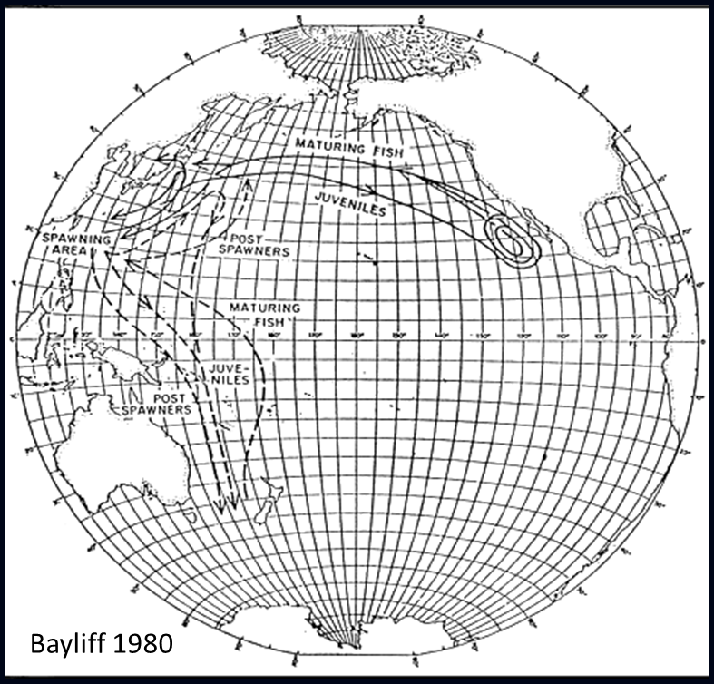
What is the Problem?
Highly migratory species move around a lot!
Regional fisheries
Many HMS assessments do not model movement due to lack of consistent tagging data
Assume well-mixed stock and differences in selex used as proxies for movements
But selex processes modeled as less variable in time and space than actual movements

Slide 3
What is the Problem?
May cause important misfit to size compositions
Influence recruitment and population scaling
Similar to mis-specified time-varying selex
In addition, mis-specified selex of one regional fishery can be strongly linked to selex of other fisheries catching

Slide 4
Albacore non-example
16 fleets, 8 fisheries dependent indices, and conditional age-at-length
Estimate growth
Spawning biomass scaled strongly with weighting of size composition data
Size composition weighted to 0.01
R0 vs Weighting plot
R0 profile plots

Slide 5
Albacore Piner Plots
Size composition weighting of 0.01

Slide 6
Albacore Piner Plots
Size composition weighting of 1.0

Slide 7
Plan B
Western Pacific
Eastern Pacific
7 fisheries
4 longline indices
1 age-0 index
Age 1-4
2 fisheries (1 selex)
3 purse seine indices
Age-based logistic selex
Age 1-5
Operating model based on Piner et al. 2009 SS model of Pacific bluefin tuna with 2 box annual movement (no tagging data)
Somewhat funky movement model
All fish move back to western Pacific after every year and no fish move to eastern Pacific after age 4
Created synthetic data set from the model (expected data without obs errors)

Slide 8
SS Estimation Model
Estimated dynamics using SS model with no movement
Compare different methods of dealing with the selectivity and misfit
Estimate EPO selex (with and without time blocks)
Fix selex with previous model run and don’t fit to lencomp data (with and without time blocks)
Downweight lencomp data
Annual time-varying selex
Calc average selex from annual time-varying selex and don’t fit to data (with and without time blocks)
Kitakado the EPO selex (with and without time blocks)
Kitakado the EPO selex with time-varying selex to help with convergence

Slide 9
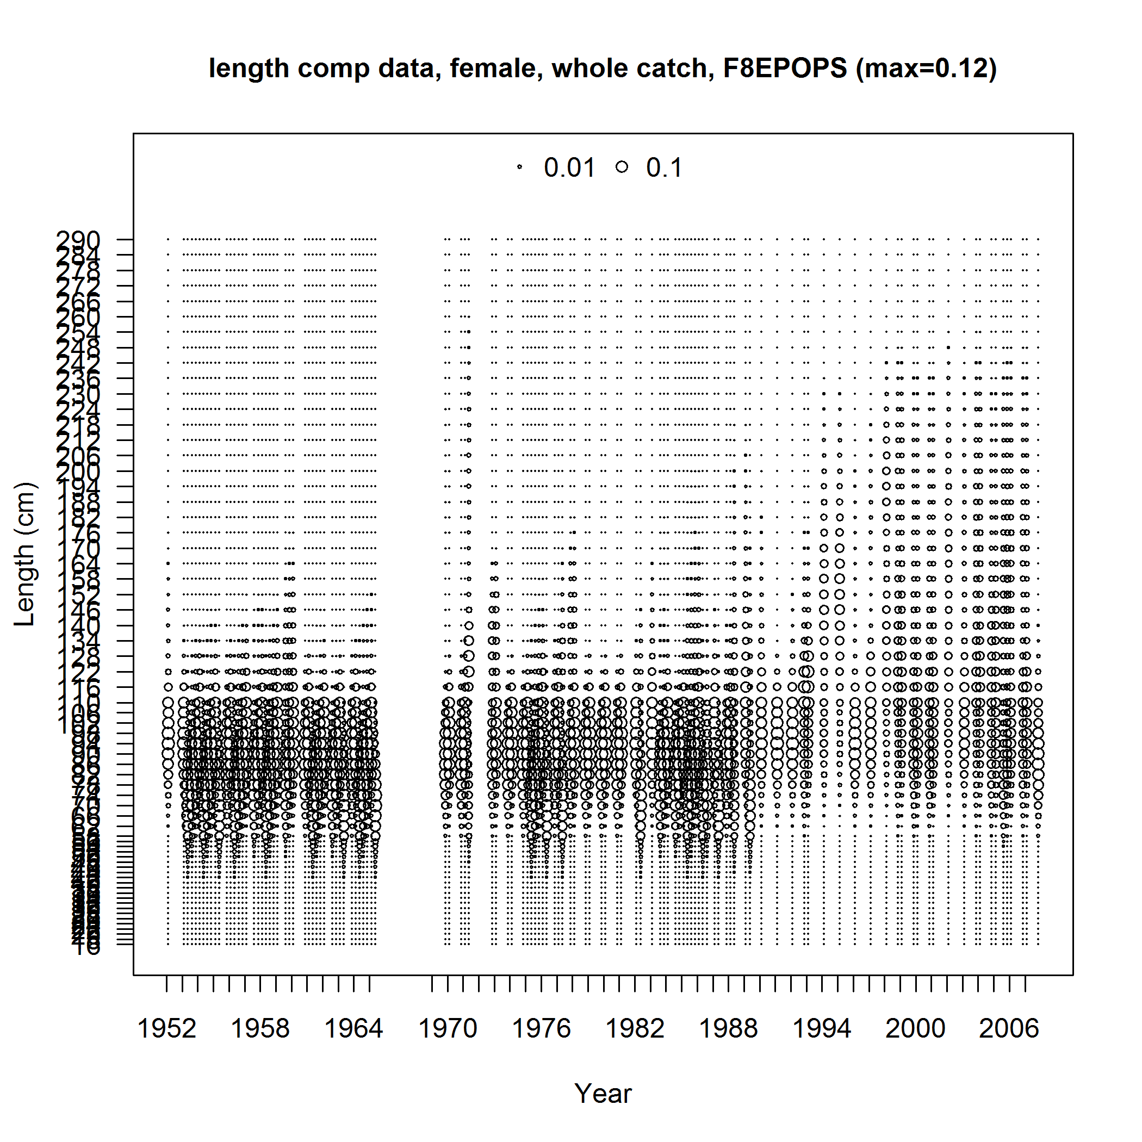
Eastern Pacific Size data

Slide 10
Selectivity of Eastern Pacific PS

Slide 11
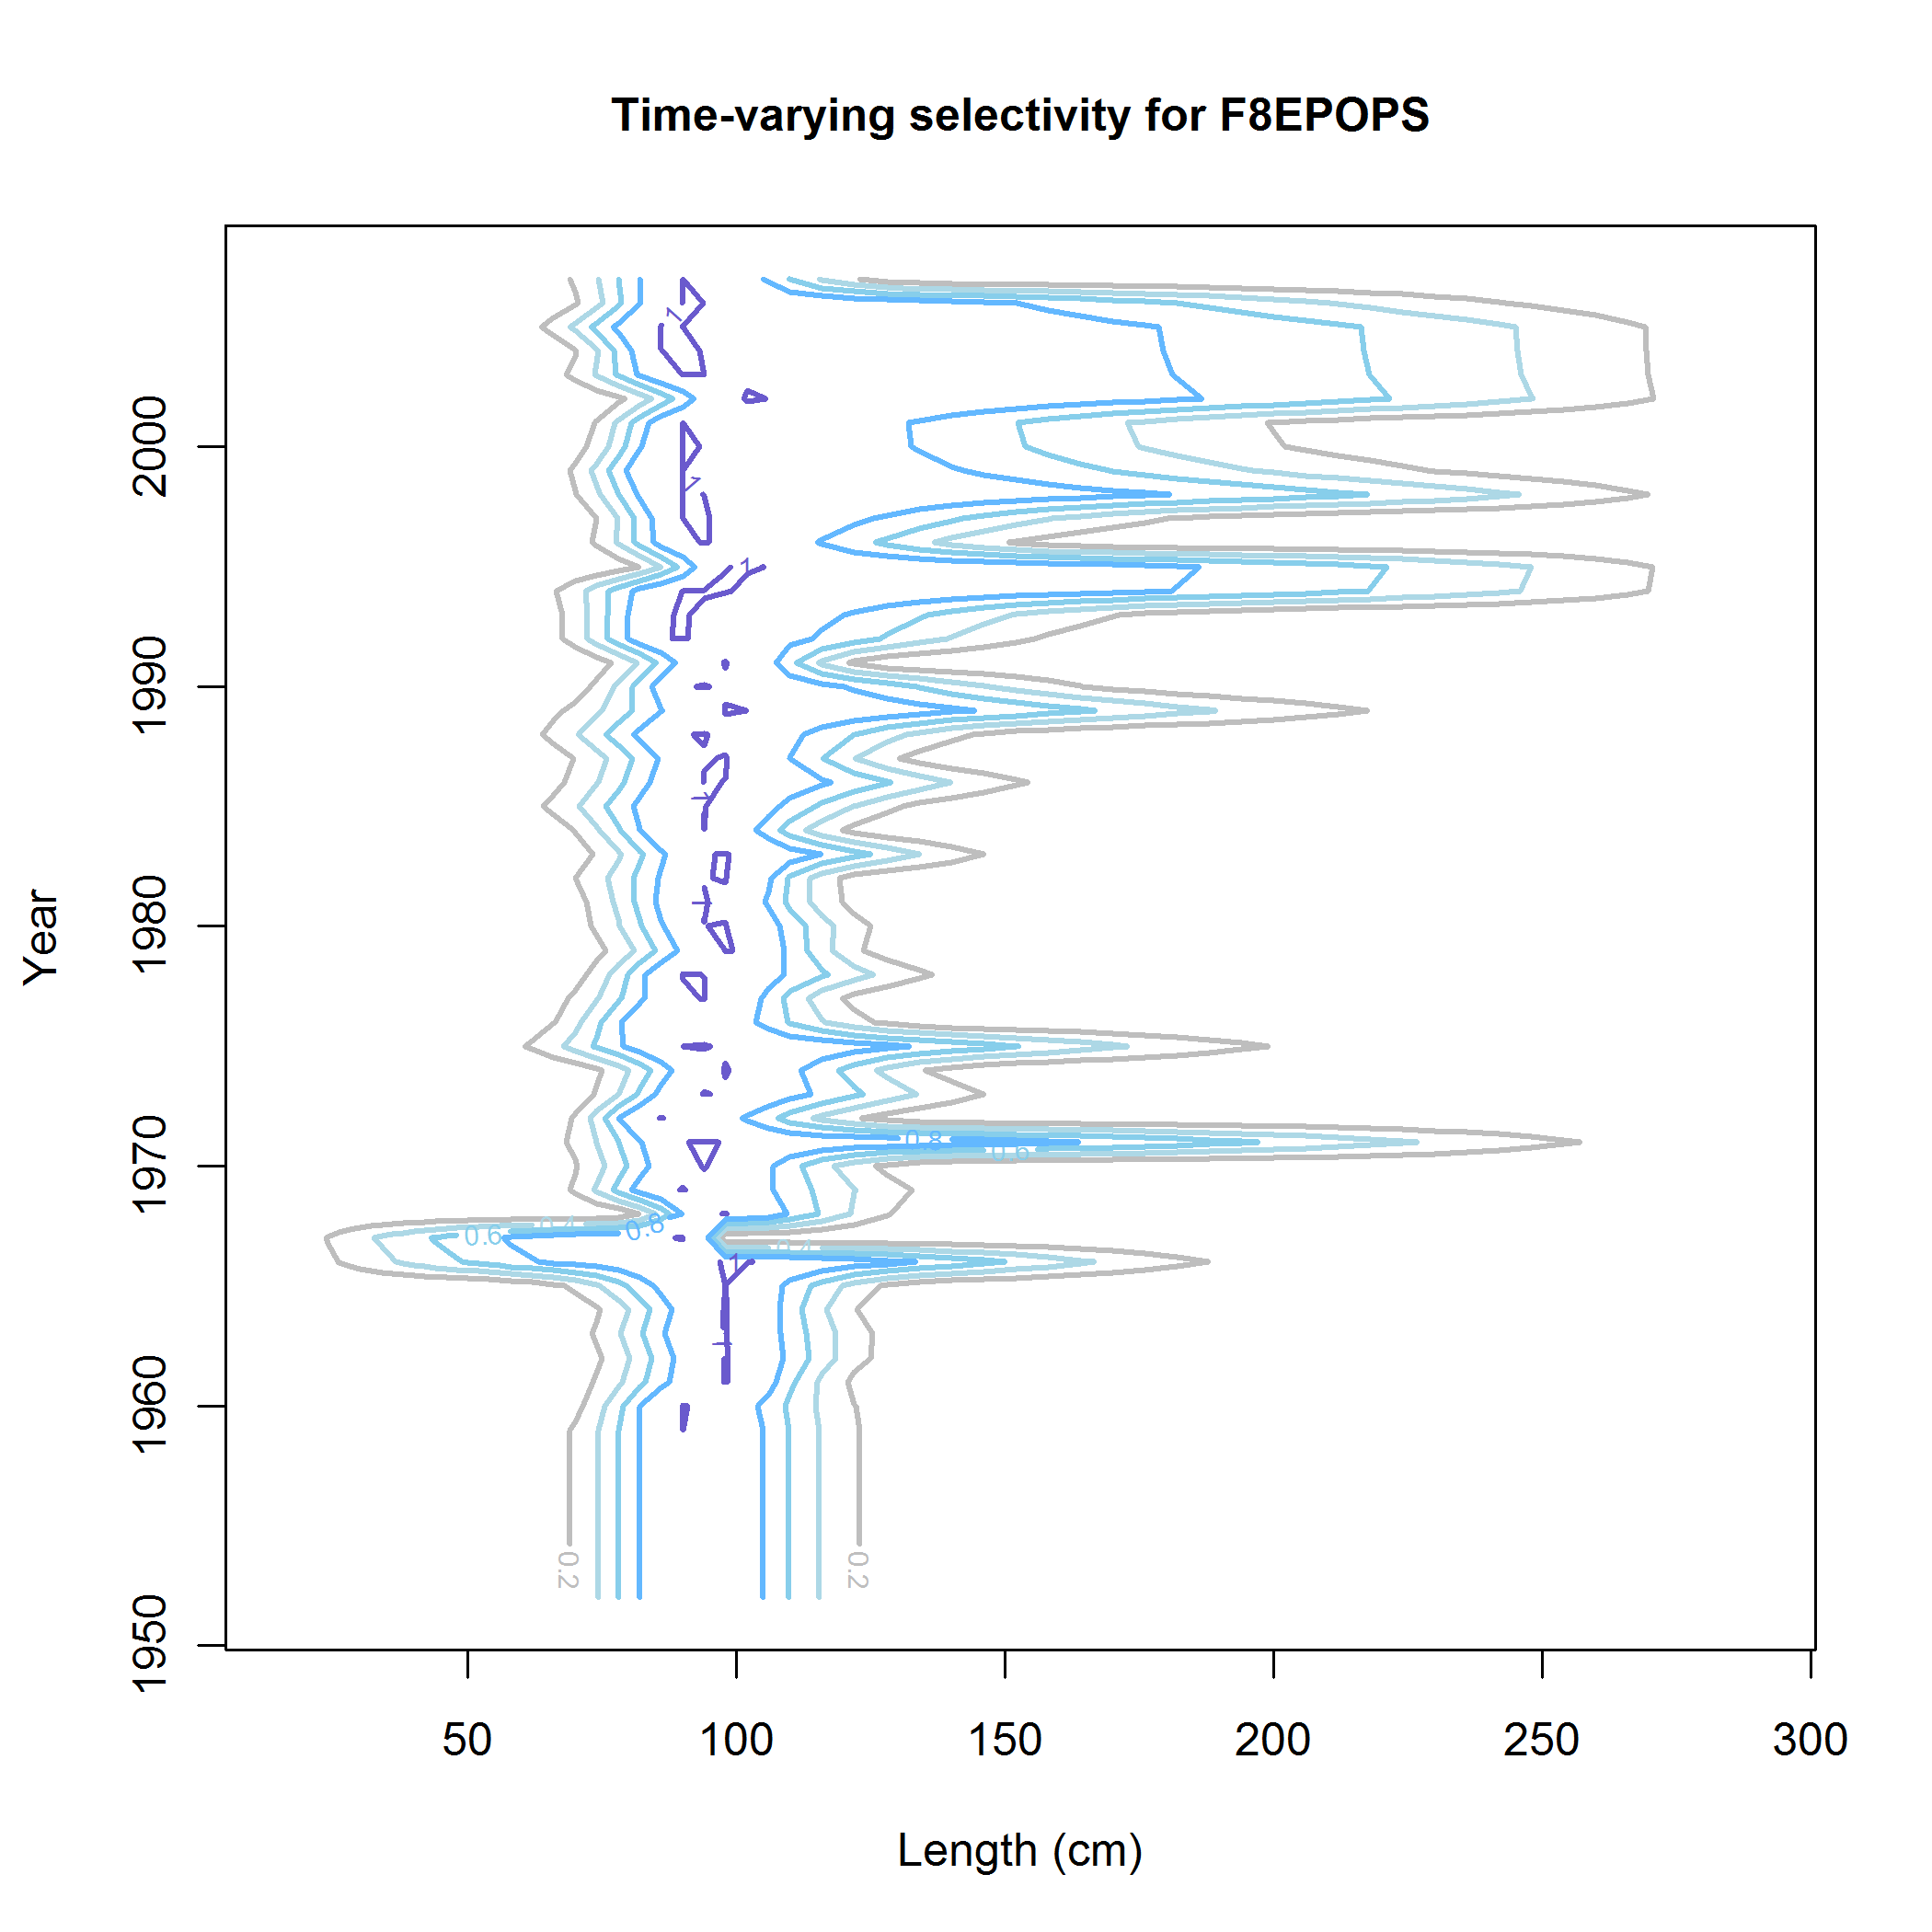
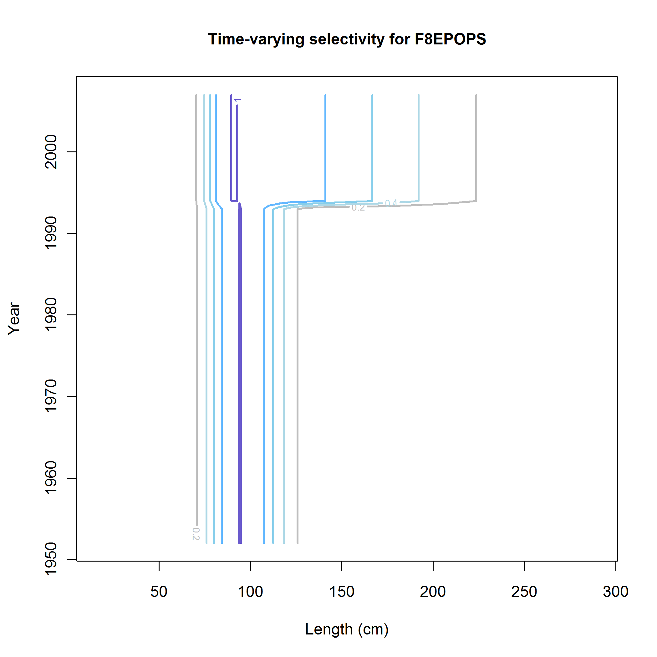
Time-Varying Selectivity

Slide 12
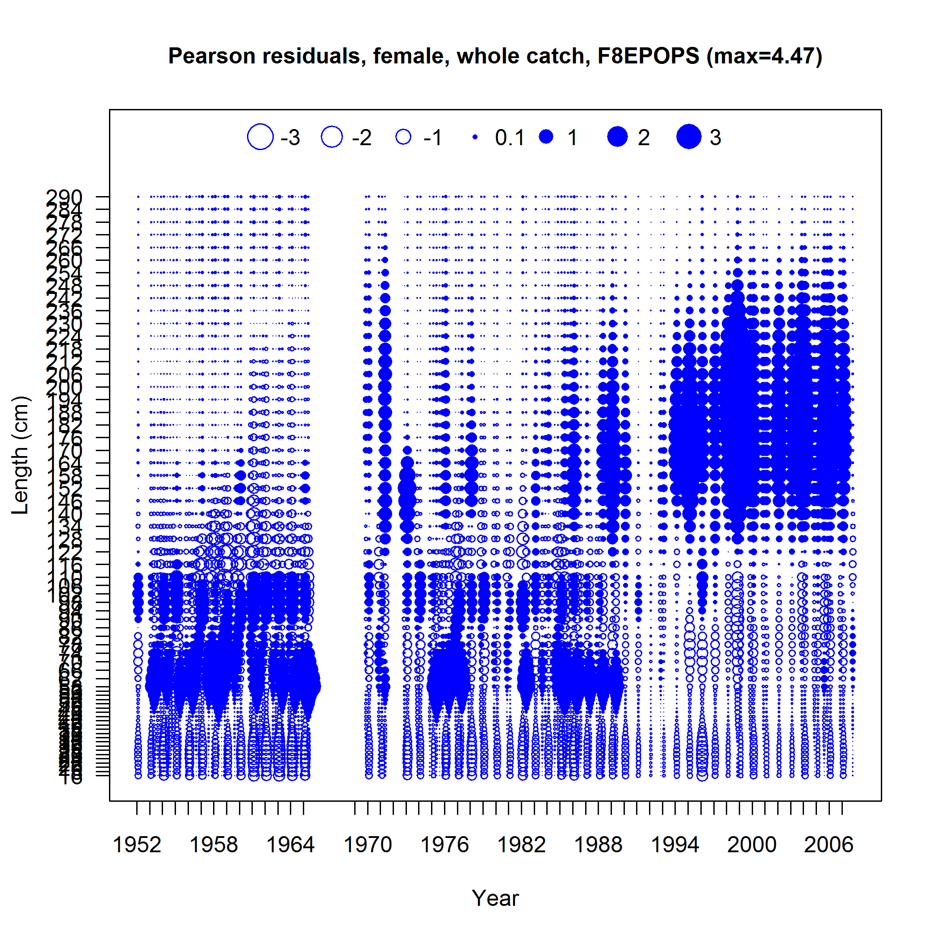
Eastern Pacific Size Comp Fits
Estimate selectivity with no time block

Slide 13
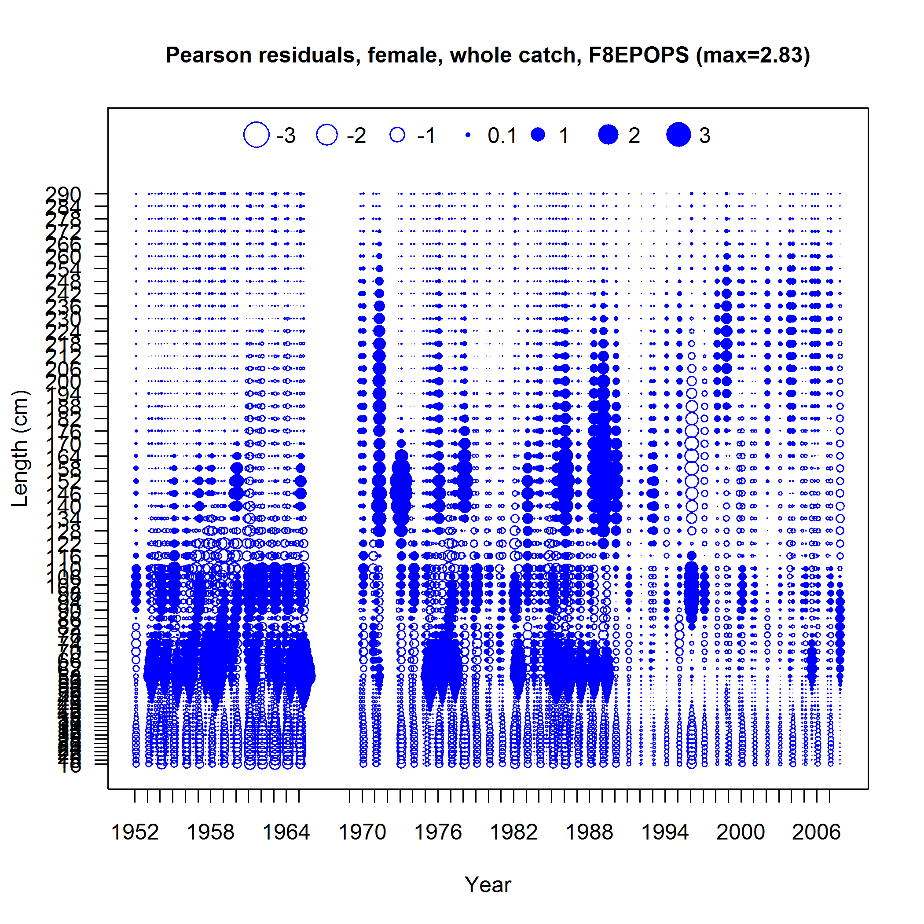
Eastern Pacific Size Comp Fits

Slide 14
Recruitment

Slide 15
Spawning Biomass

Slide 16
SSB with Timeblocks in Selectivity

Slide 17
SSB using Kitakado Method

Slide 18
Prelim Results & To Do List
See Felipe’s talk
R0 profile (aka Piner Plots) useful in understanding scaling influences in model
Do time-varying selex at least once to understand how selex might be changing – try non-parametric selex
Create a new synthetic data set with a simpler model (fewer fisheries & indices) with varying amounts of movement
Include observation and other process errors
How does that affect management?

Slide 20
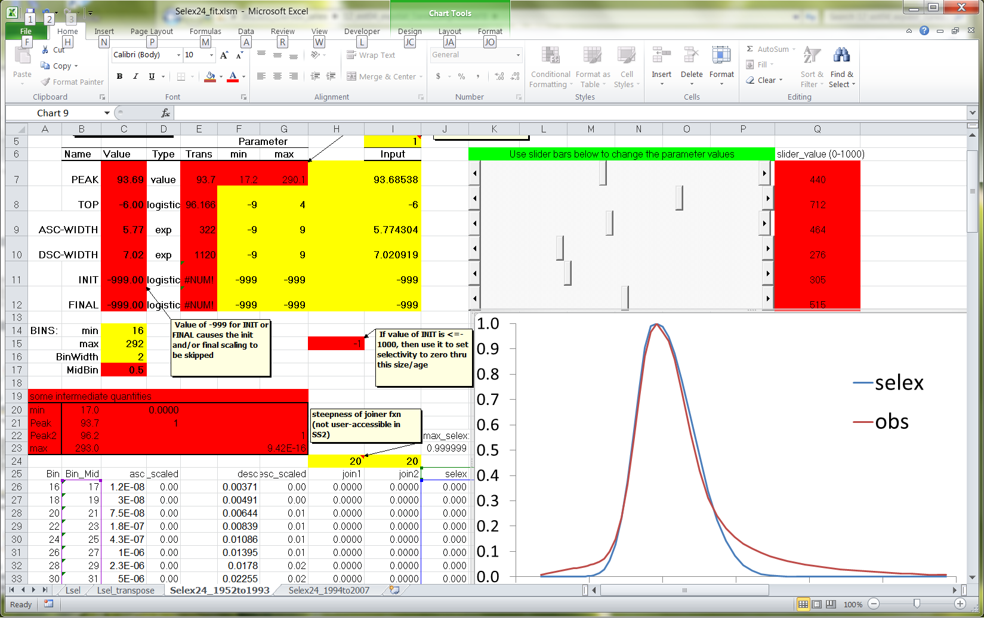
Averaging Blocks of Selectivity from Time-varying Selectivity
Fit time-varying selex model
Average the annual selex for wanted time blocks
Use selex24.xls and solver to get selex parms
Use parms in fixed selex for fishery and don’t fit to size comp data

