Slide 1

The effect of variable sampling efficiency on reliability of the observation error as a measure of uncertainty in abundance indices from scientific surveys.
Authors:
Stan Kotwicki and Kotaro Ono
We cannot solve our problems with the same thinking we used when we created them. (Albert Einstein)

Slide 2
Survey sampling efficiency
Sampling efficiency (q_{e}) = survey selectivity * catchability
Variable in time and space. Impossible to design surveys with constant q_{e},, because multiple factors are affecting it (e.g. variation in the geometry of the trawl, variation in fish behavior in response to the gear, variation in fish behavior in response to the environment, patchiness)
We may have to accept variable q_{e} and learn how to deal with it
Variability in q_{e} could be just random (unlikely) or have random and non-random components (i.e. depend on multiple variables; likely).
To date all studies of q_{e} show random component
Increased number of studies show q_{e} dependence on some variables
None of the studies show constant q_{e}

Slide 3
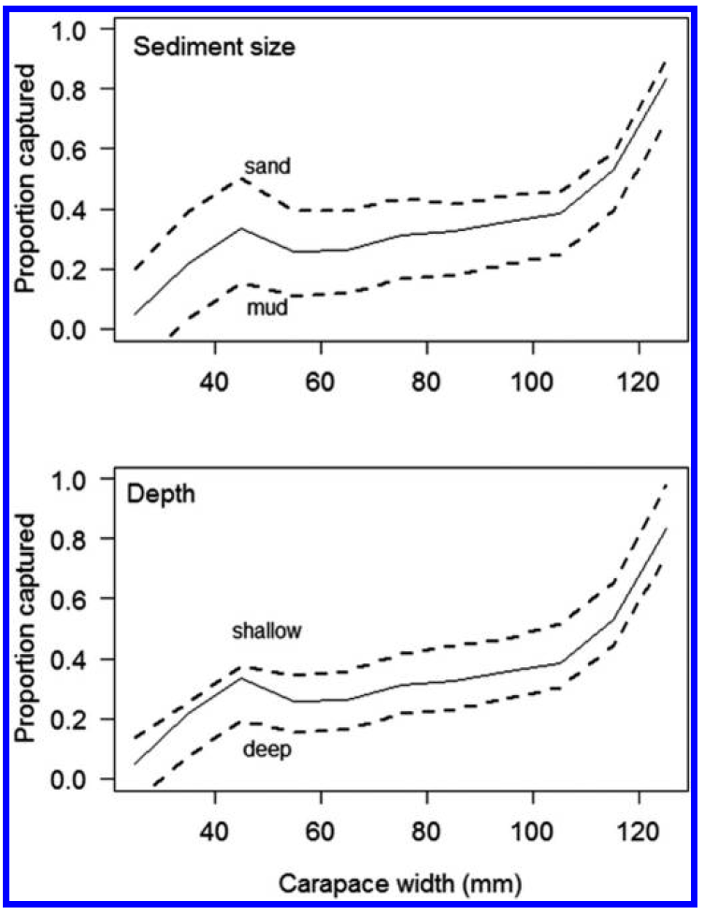
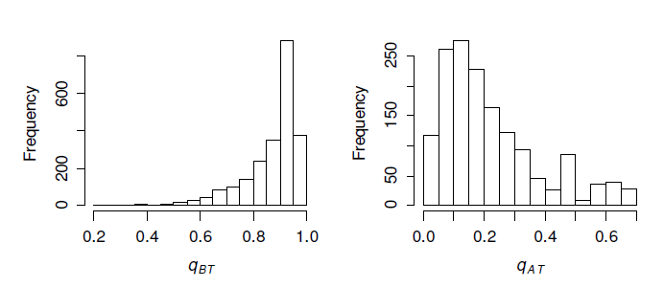
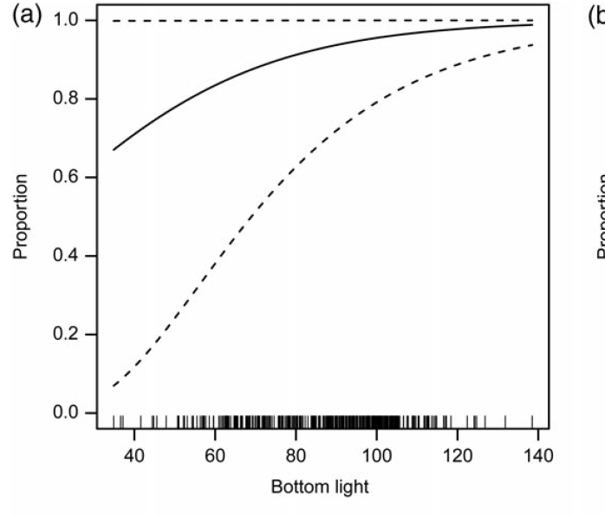
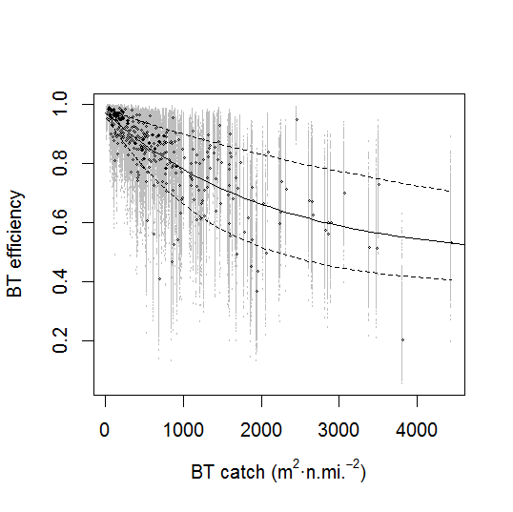
Examples
Snow crab
Pollock
Somerton, D.A., Weinberg, K.L. and Goodman, S.E. 2013 Catchability of snow crab (Chionoecetes opilio) by the eastern Bering Sea bottom trawl survey estimated using a catchcomparison experiment
Kotwicki, S, Horne, J. K., Punt, A. E., and Ianelli, J.N. 2015. Factors affecting the availability of walleye pollock to acoustic and bottom trawl survey gear. ICES J. Mar. Sci.
Notes:
Once we know these dependencies we can figure out …

Slide 4
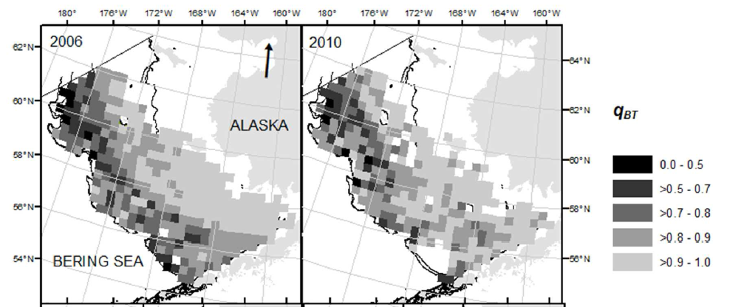


Spatial distribution of q_{e}
What exactly u and σ mean in this context?
What is effect on age composition data?
The formula to estimate variance for index of abundance from this survey does not exist.
Kotwicki, S, Ressler, P.H., Ianelli J. N., Punt, A. E., and Horne, J. K. In review. Combining data from bottom trawl and acoustic surveys to improve reliability of the abundance estimates. CJFAS.
Notes:
These formulas assume constant qe.
Does the variance really tell us how good the mean is?

Slide 5
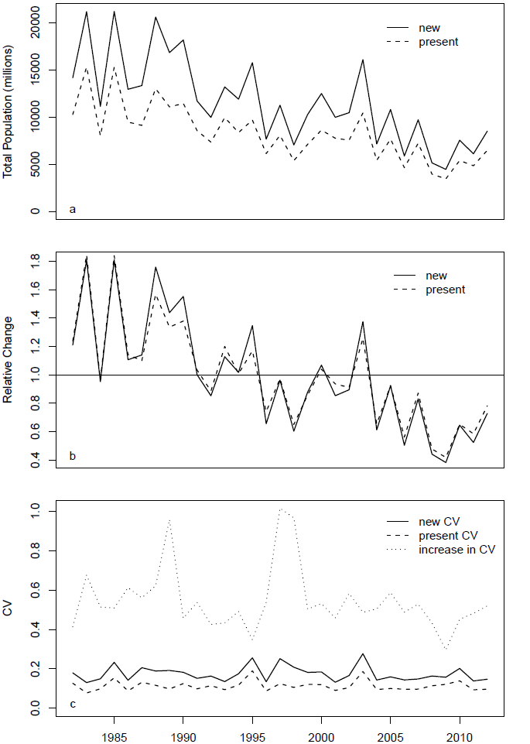
Relative weights can change
Kotwicki, S., Ianelli, J. N., and Punt, A. E. 2014. Correcting density-dependent effects in abundance estimates from bottom trawl surveys. ICES J. Mar. Sci. 71:1107-1116.
Notes:
Additional variance
Change weights across time series – ecological modeling, stock assessment
Ignoring this additional variance can cause bias in stock assessments

Slide 6
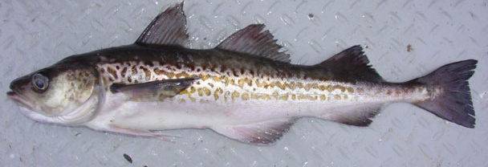
Simulating species distribution
Based on Pollock
Fit spatio-temporal model to survey data (Thorson et al. 2015, Ono et al. 2015)
Create map of predicted species distribution (MCMC)
Notes:
Spatio-temporal model = model that incorporates the spatio-temporal autocorrelation structure

Slide 7
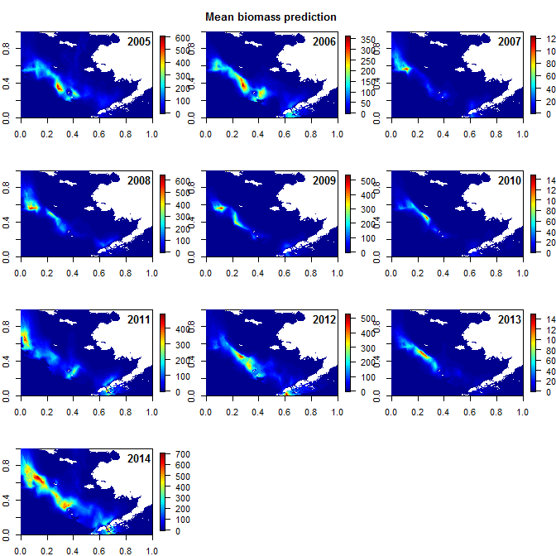

Slide 8

Simulating surveys
Assumed SRS design
376 samples over the survey area (u_{i})
q_{e} gamma distributted
Statistics:
Survey mean and variance
True mean and variance

Slide 9
Simulating surveys
Years | 2005 – 2014
Sampling efficiency (q_{e}) | 0.01, 0.05, 0.1, 0.2, 0.4, 0.6, 0.8, 1, 1.5, 2, 2.5, 3
Variance in q_{e} | 0.00001, 0.01, 0.1, 0.2, 0.4, 0.6, 0.8, 1, 2
Density dependent q_{e} (assuming q_{e} = 1 at low densities) | 1 (strong), 100, 500, 2000, 50000 (weak)

Slide 10
Deviation of survey mean from true mean
Biased mean for low q_{e} surveys,
For surveys with high q_{e} survey mean is unbiased
Increase in variance of the mean when q_{e} low

Slide 11
Survey CV
High variation in q_{e} - higher observation error.
Not much concern for surveys with high q_{e}.
Concern: High variation in q_{e} - increased variance in survey CV estimate.

Slide 12
Deviation of survey SD from true SD
Low q_{e} - SD biased low. High q_{e} - SD unbiased .
Increase in V(q_{e} ) – increase V(SD)
Notes:
Do the deviations of the cvs

Slide 13
CV of survey SD
Constant efficiency does not assure good precision of the SD estimate.
Increase in V(q_{e} ) – increase V(SD)
Notes:
Explain blue line.
Now we covered random component of V(q_{e} ),

Slide 14
Are these just spurious?

Slide 15
Density dependent q_{e}
Strong density dependence – survey CV biased low. Strong effects!
Density dependent q_{e} - hyperstable index, but appears highly precise.
Notes:
Start with the red line
Based on our present assessment of surveys we would consider surveys with strong DD as very good!
Hyperstable, hyperactive
Note that the effects are much larger compared to random q_{e} by comparing changes in red line with changes in box plots.

Slide 16
More on density dependent q_{e}
Not much has been done. 4 studies 5 species (all semipelagic), all show density dependent (hyperstable) q_{e} for bottom trawl.
Environmental effects on q_{e} most likely result in some form of density dependent q_{e} because environment affects both q_{e} and fish distribution. So environmentally induced variation in q_{e} will likely result in decrease in both accuracy and precision of survey variance estimates.

Slide 17
Sampling processes are not represented in the main structure of the stock assessment models (Maunder and Piner 2014) but they may be a major contributor to the total uncertainty of the mean, variance and age composition derived from scientific surveys.
State of the art survey design based variance estimators (SRS, Stratified, Cluster, geostatistical, etc) do not account for the variance in q_{e}., hence they maybe biased and imprecise.
It maybe advisable to redirect efforts from the design based variance estimates to estimates of total survey variance.
Reliability of survey derived abundance estimates should not be assessed using CV estimated from observation error alone
We still need to look into effect of variation in availability due to limited survey coverage.

Slide 18
What to do?
Account for the uncertainty in the observation error (weights) estimates in the stock assessments?
Estimate q_{e ,} and V(q_{e})
Incorporate sampling process into stock assessments?
Don’t diss the survey, but understand the implications of variable q_{e} on the statistics derived from survey data.

Slide 19
Questions for discussion
Knowing that SD estimates may be biased and uncertain is it still a good practice to weight indices of abundance using SD?
How to deal with uncertainty in the SD estimates, when this uncertainty can be estimated?
Is the adjusting variance for indices estimates a good practice? Does it inflate the variance of the index of abundance?

Slide 20
Thanks

Slide 21
How to evaluate surveys?
Observation error may not reflect completely total uncertainty of the index of abundance. Therefore using observation error (sampling variance) to weight indices may lead to biases in stock assessments.
Examples of possible sources of additional uncertainty in survey index:
Catchability variable in time and space due to environmental effects
Density dependent sampling efficiency
Survey does not encompass entire population
Correlation in age and length data

Slide 22
Maunder and Piner 2014
Temporal trends in catchability (e.g. Harley et al. 2001) in addition to uncertainty in mean catchability are particularly problematic, since they will bias estimates of depletion levels. Therefore, uncertainty in both the average level of catchability and the variation over time can contribute substantially to the uncertainty in stock assessment results and estimates of management quantities.
Process error is additional variability in the population (e.g. recruitment), fishing (e.g. selectivity), or sampling processes (e.g. survey catchability) that are not represented by the main structure of the model.
One example is the inflation of standard deviations for survey data because of temporal variability in catchability due to factors such as the environmental conditions. Another is the reduction in the effective sample size of composition data due to unmodelled correlation in the sampling process (i.e. many species school by size and repeated samples from a purse-seine set on a single school will be correlated).

Slide 23
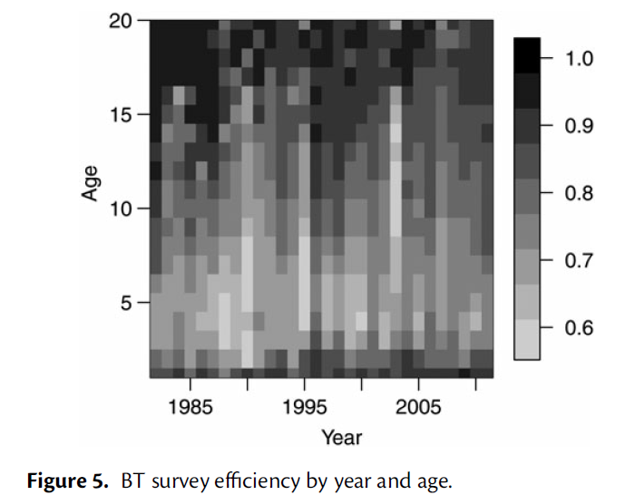
Effect on age composition
Kotwicki, S., Ianelli, J. N., and Punt, A. E. 2014. Correcting density-dependent effects in abundance estimates from bottom trawl surveys. ICES J. Mar. Sci. 71:1107-1116.

Slide 24
Main findings
Catchability of BT and acoustic surveys is variable in time and space.
Survey standardization not enough
Abundance estimates can be corrected for variable catchability but only if …
Only combined estimates provided reliable abundance estimate corrected for variable catchability
Methodology can be used for studies of vertical distribution of semipelagic species

Slide 25
Survey variance simply explained.
What is it?
Why is it important?
Where it comes from?
How to estimate it?

Slide 26
Mark Maunder guidance.
Don’t naively down-weight the data
  - Don’t naively weight the data using incorrect estimate of variance
Data recommendations: design surveys to have constant asymptotic selectivity, estimate q.
  - Estimating q is hard but usually possible.
  - Designing surveys to have constant asymptotic selectivity may be impossible
  - Design surveys to minimize variation in sampling efficiency

Slide 27
Can you see elephant now?

Slide 28
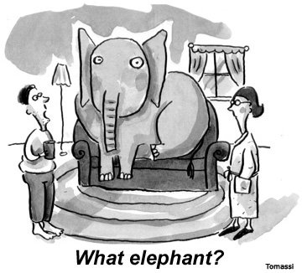

Slide 29
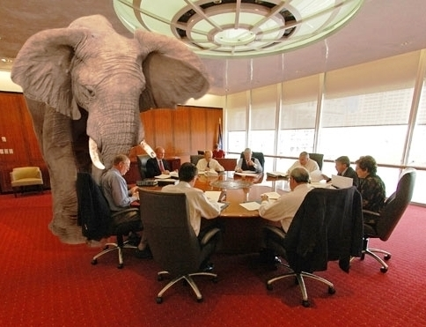
V(q_{e})
Is there an elephant in the room?
Notes:
These guys are busy trying to come up with better formulas for variance (geostats, cluster sampling, systematic etc.), but niether of these formulas will be correct if we ignore V(qe).
Too much effort put on the design based estimates of variannce, not enough effort on the total estimates of variannce.

