Slide 1
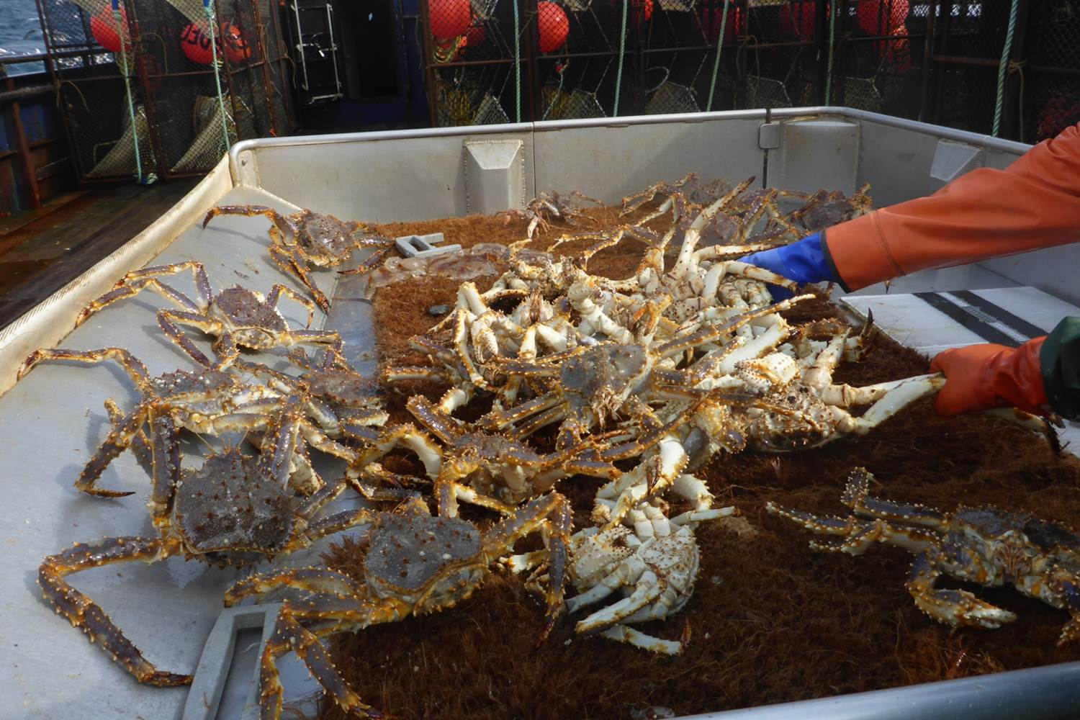
Survey Data Conflicts and Bias and Temporal Variation of Model Parameters of St. Matthew Island Blue King Crab
J. Zheng, D. Pengilly and V. A. Vanek
ADF&G, Juneau & Kodiak

Slide 2
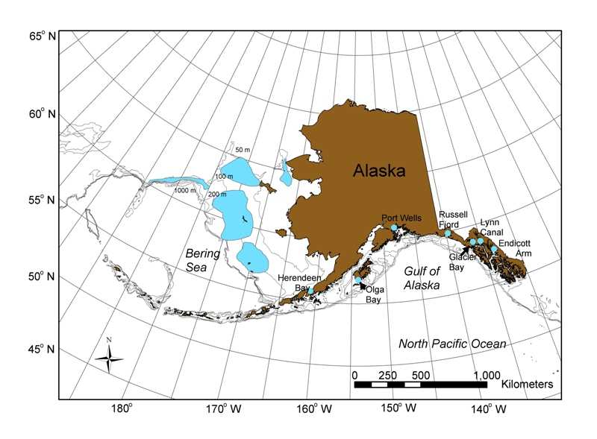
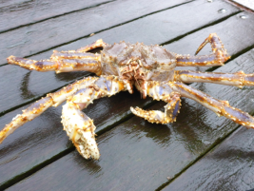
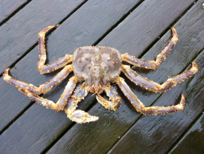
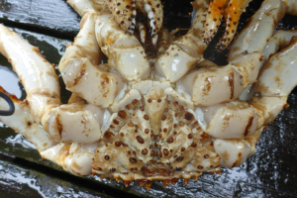
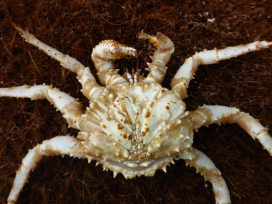
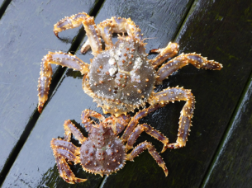
Distribution of blue king crab Paralithodes platypus in the Gulf of Alaska, Bering Sea, and Aleutian Islands waters. Shown in blue.
St. Matthew Is.

Slide 3
Basic Biology of SM Blue King Crab
Maximum age is about 20-25 years
Basic M = 0.18, based on 1% rule
Functional size at male maturity: 105 mm CL
Minimum size for commercial fishery: 120 mm CL
Mean growth increment per molt for mature males: 14.1 mm
Difficult to catch females during surveys, so model only males

Slide 4
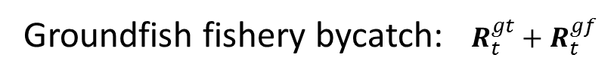

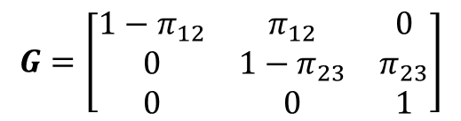
Three stage model (90-104, 105-119,120⁺mm):
N_{t} = [ N_{1,t}, N_{2,t}, N_{3,t} ]^{T}
$N_{t+1}=G{e^{−0.37M_{t}}({e^{−(0.63−τ_{t})M_{t}}(e}^{−τ_{t}M_{t}}N}_{t}−R_{t}^{df})−{(R}_{t}^{gt}+R_{t}^{gf}))+{N^{new}}_{t+1}$
Where M_{t} is natural mortality, $τ_{t}$ is time lag from survey to mid-point of pot fishing,
$$G=\left[\begin{matrix}{1−π}_{12} & π_{12} & 0 \\ 0 & 1−π_{23} & π_{23} \\ 0 & 0 & 1\end{matrix}\right]$$
Transition matrix:
Pot retained catch and bycatch:
$$R_{t}^{df}={H^{df}S}^{df}(1−e^{−F_{t}^{df}}){e^{−τ_{t}M}N}_{t}$$
Groundfish fishery bycatch: $R_{t}^{gt}+R_{t}^{gf}$
Recruitment:
N^{new}_{t+1} = [ N^{new} ₁,_{t+1}, 0 ,0 ]^{T}

Slide 5
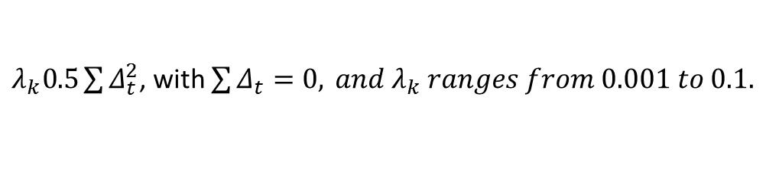
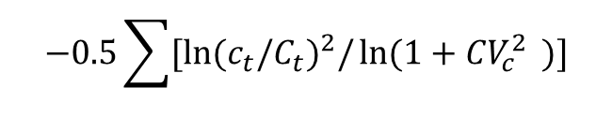
Loglikelihoods
1. Trawl survey biomass or pot survey CPUE:
CV_{t}=CV_{t,sur}.
When estimating additional CV:
CV_{t}=(CV_{t,sur}+CV_{est})
2. Retained catch or bycatch:
$$−0.5\sum{{{[ln⁡(c}_{t}/C_{t})}^{2}/}ln⁡(1+{{{CV}_{c}^{2}}_{ }}^{ })]$$
3. Stage compositions (p_{l,t,k}):
Effective sample sizes:
min(N, 0.5*observed values) for surveys,
min(N, 0.1*observed values) for fishery,
N=50 for trawl survey, 100 for pot survey,
25 for fishery (1978-1998) & 100 (2009-14)
4. Small penalties of deviations of ln(R_{t}) and ln(F_{t}):
$λ_{k}0.5\sum{Δ_{t}^{2}}$, with $\sum{Δ_{t}=0,}{ and λ}_{k} ranges from 0.001 to 0.1.$

Slide 6
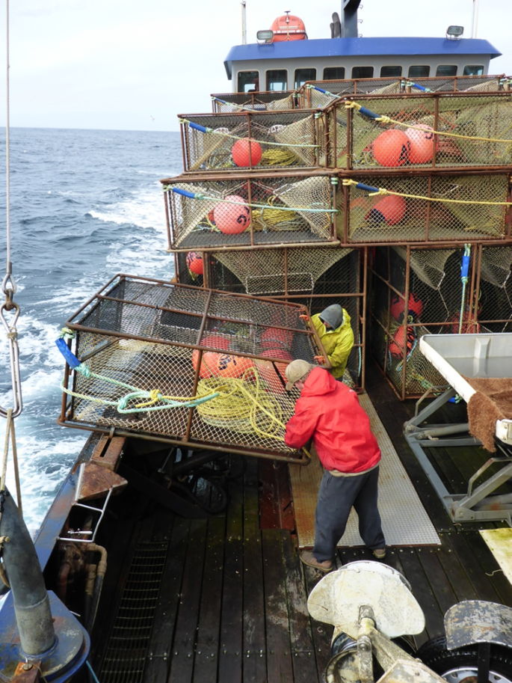
Data
Trawl survey: 1978-2015
Pot survey: Triennial pot survey 1995-2013 & 2015
Retained catch: 1978-98, 2009-2012 & 2014
Pot observer bycatch: 1990-98, 2009-2012 & 2014
Groundfish fisheries observer bycatch: 1992-2014

Slide 7
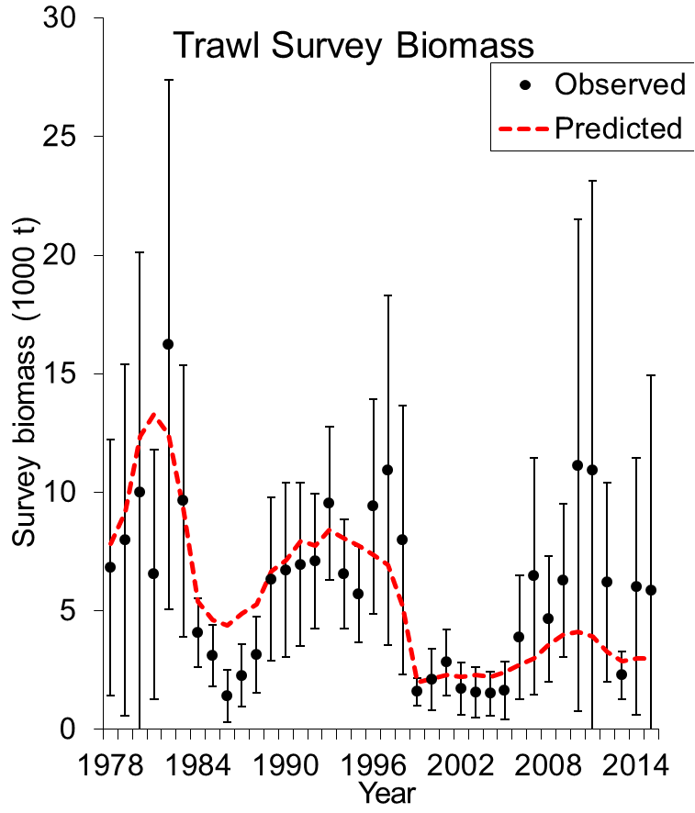
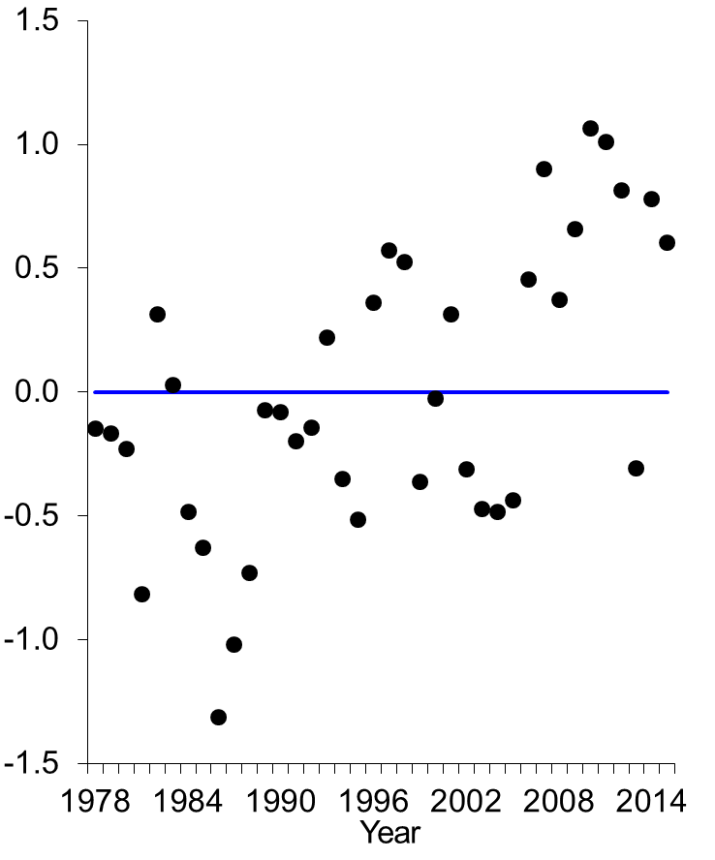
Scenario 1: constant survey selectivities over time
Residuals

Slide 8
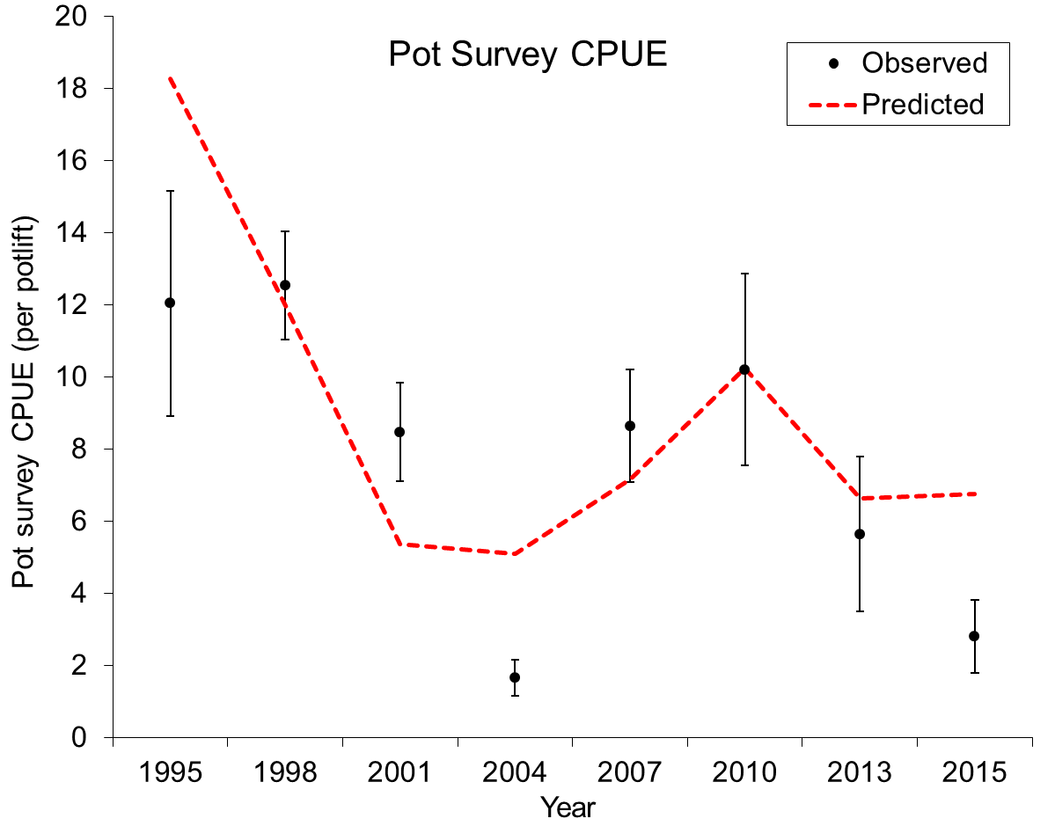
Scenario 1: constant survey selectivities over time

Slide 9
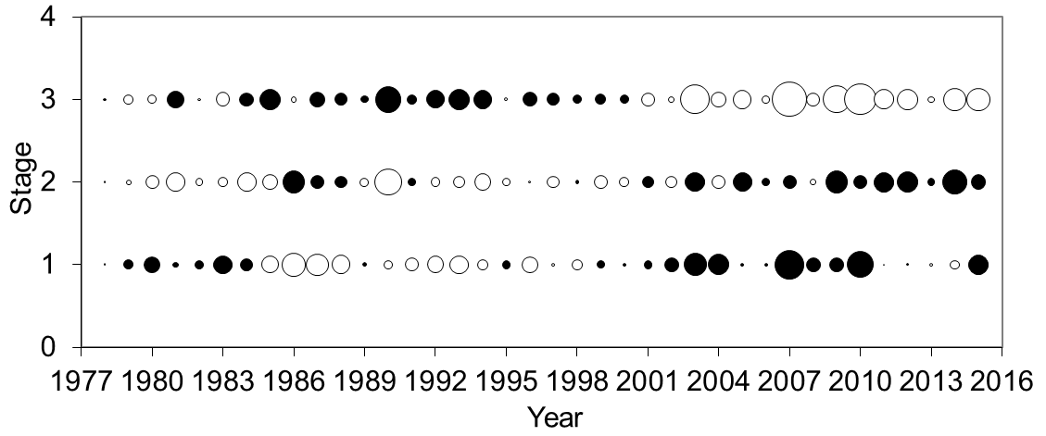
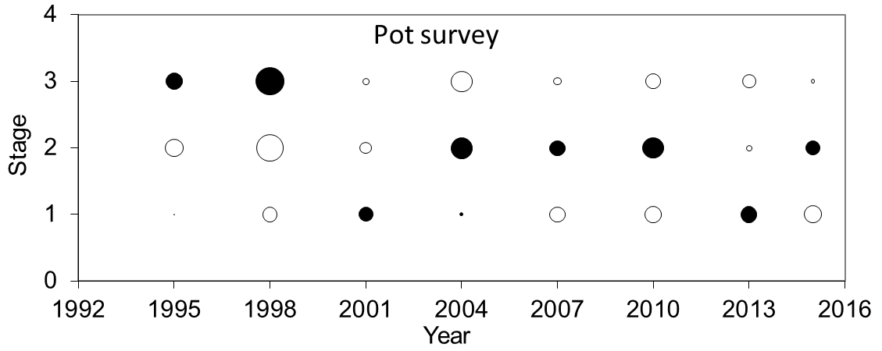
Scenario 1: constant survey selectivities over time:
Residuals of stage compositions (filled circles: observed higher than predicted)
Trawl survey

Slide 10
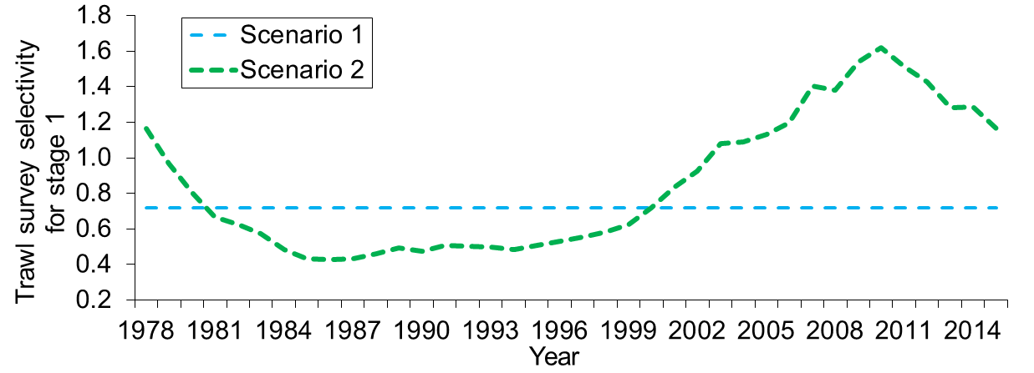
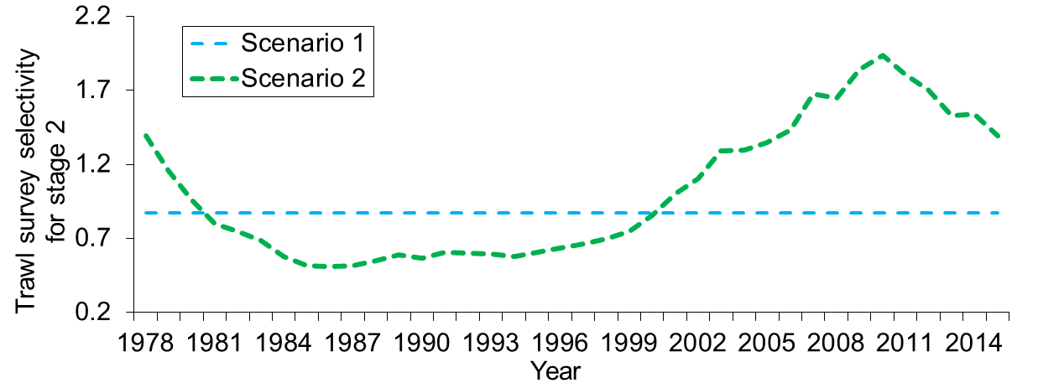
Scenario 2: Random walk to estimate trawl survey selectivities
Selectivity = 1 for stage 3. Solve temporal bias problems of stage comp.data

Slide 11
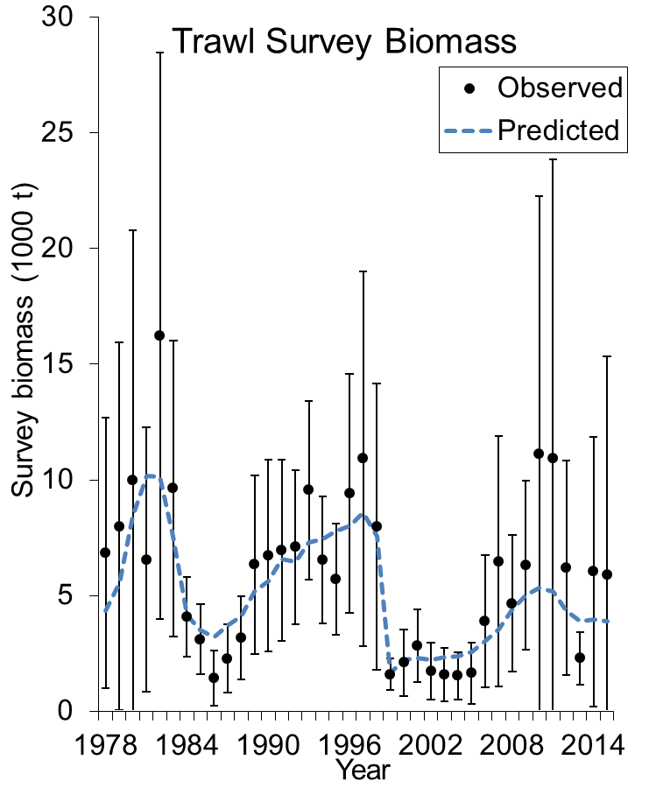
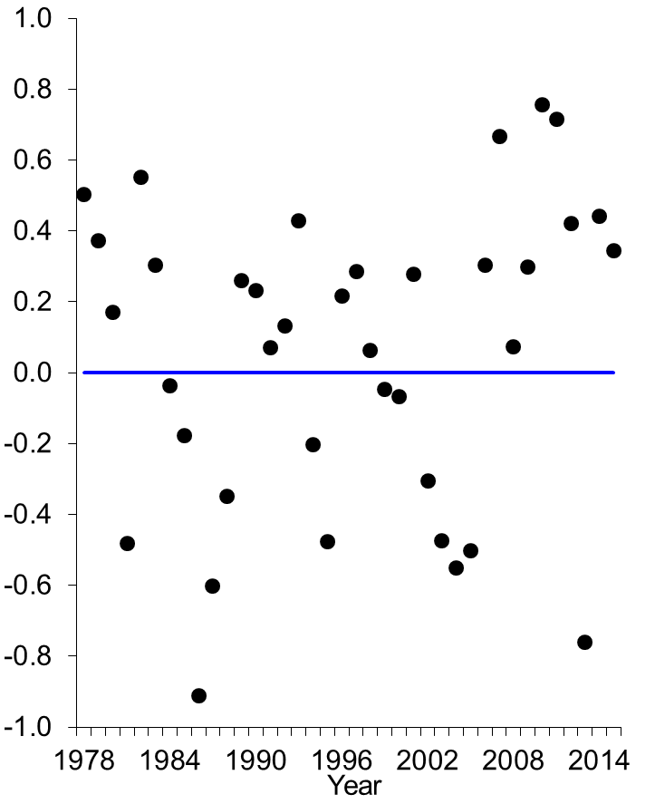
Scenario 3: Two time blocks (pre-2000 & after 1999) of survey selectivities and esti. additional survey biomass/cpue CVs
Residuals

Slide 12
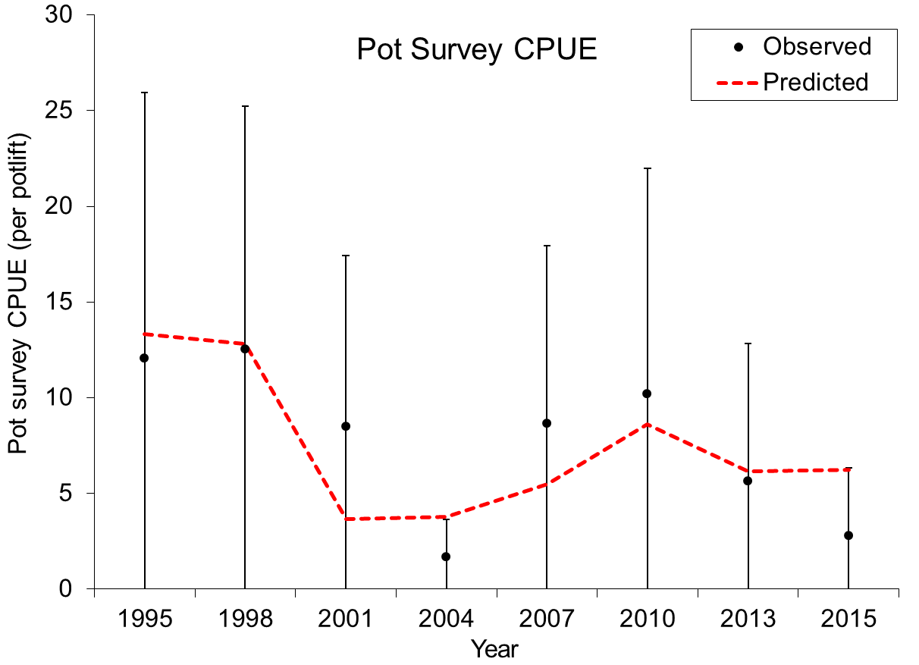
Scenario 3: Two time blocks (pre-2000 & after 1999) of survey selectivities and esti. additional survey biomass/cpue CVs

Slide 13
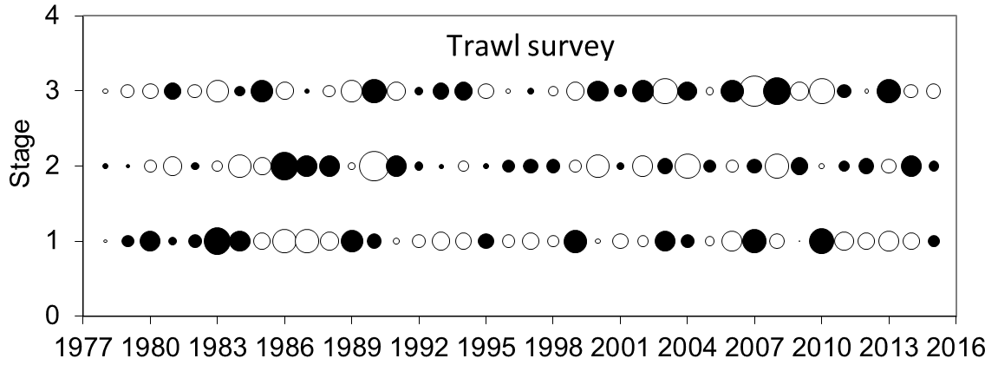
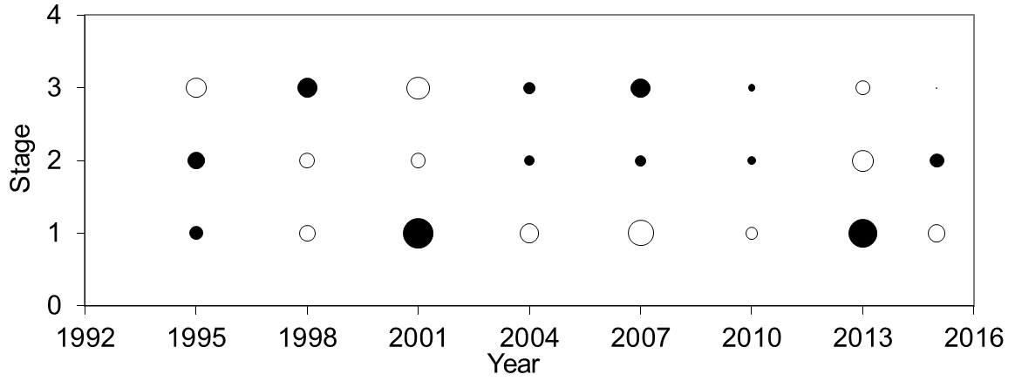
Scenario 3: Two time blocks (pre-2000 & after 1999) of survey selectivities and esti. additional survey biomass/cpue CVs:
Residuals of stage compositions
Pot survey

Slide 14
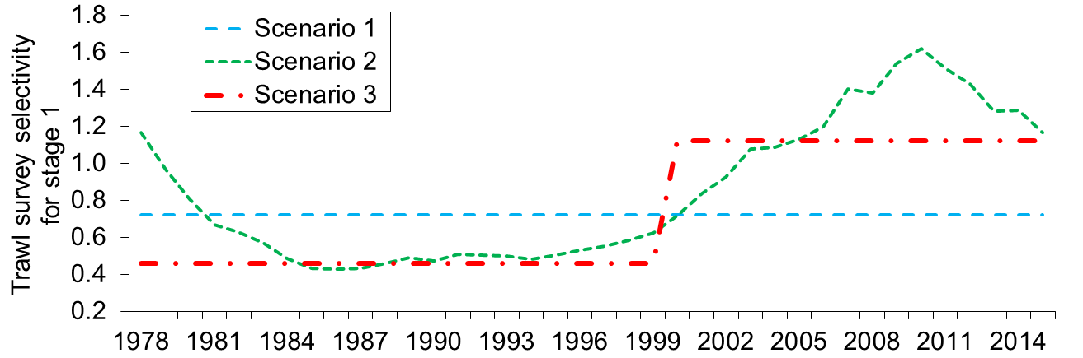
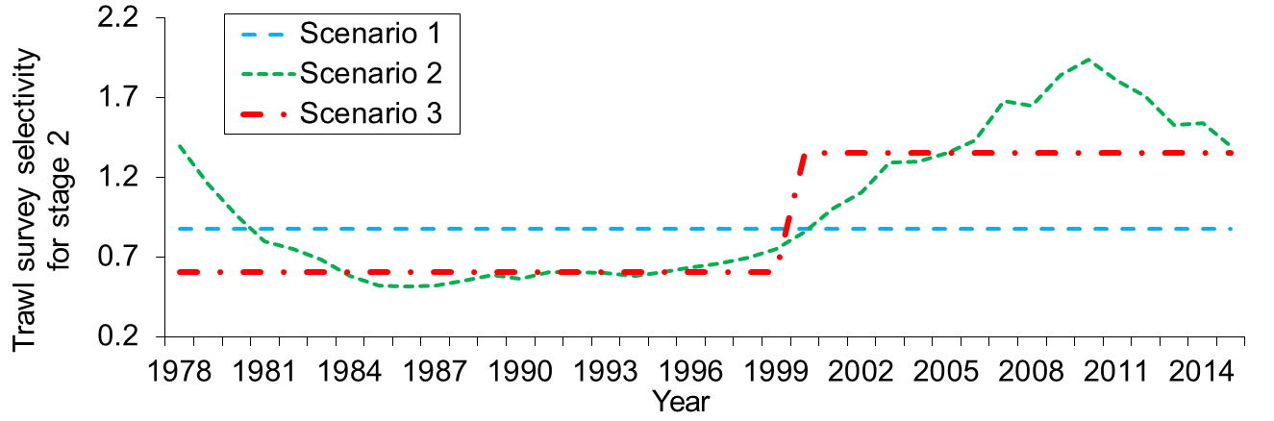
Scenario 3: Two time blocks (pre-2000 & after 1999) of survey selectivities and esti. additional survey biomass/cpue CVs

Slide 15
Trawl and Pot Survey Stations
R-24
Blue king crab are found primarily within the pot survey area and trawl station R-24

Slide 16
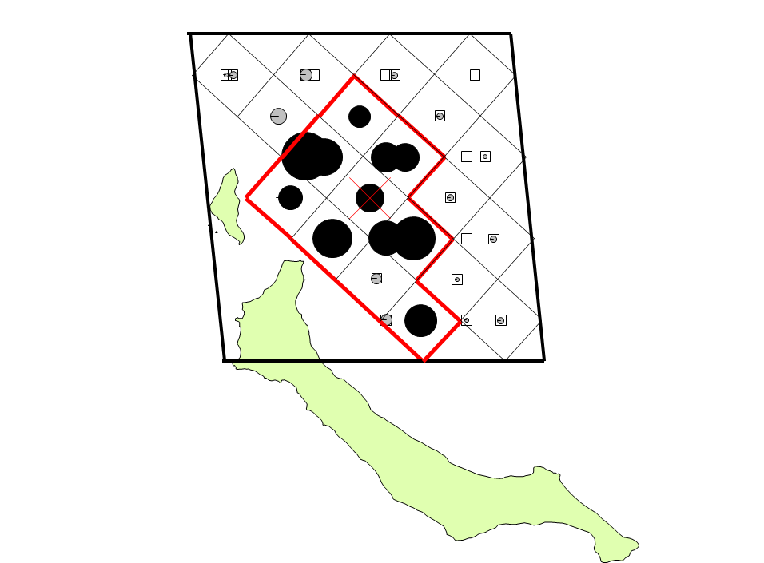
Pot survey CPUE in trawl station R-24 in 2013. High density area is a spatial area with CPUE > mean CPUE of the standard 84 pot survey stations within NMFS multi-tow area
Heavy red line is the identified “high density” area in R-24, 45% of water in 2013, and 35% in 2015, with 40% mean.
Trawl station R-24
With 30 pot stations in 2013 and 20 pot stations in 2015
Red X denotes center of trawl station R-24
Circles are proportional to pot station CPUE.
Pot survey CPUE in 2015 cannot be shown due to state law

Slide 17
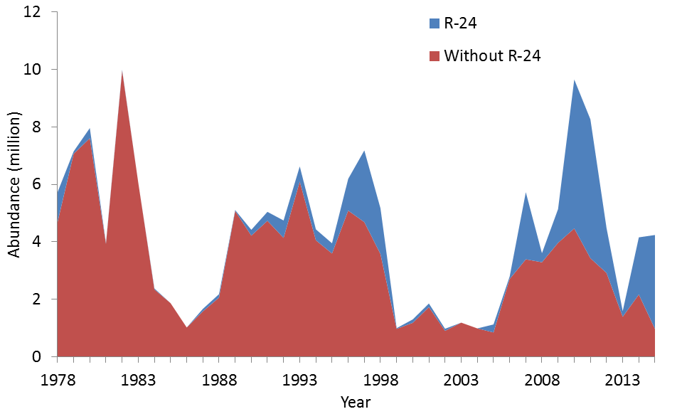
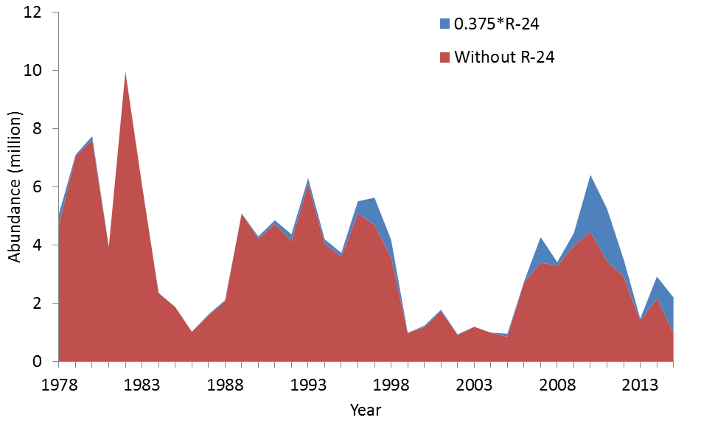
NMFS Trawl Area-
Swept Estimates
Scenarios 1, 2 & 3
NMFS Trawl Area-
Swept Estimates
Scenarios 4, 5 & 6

Slide 18
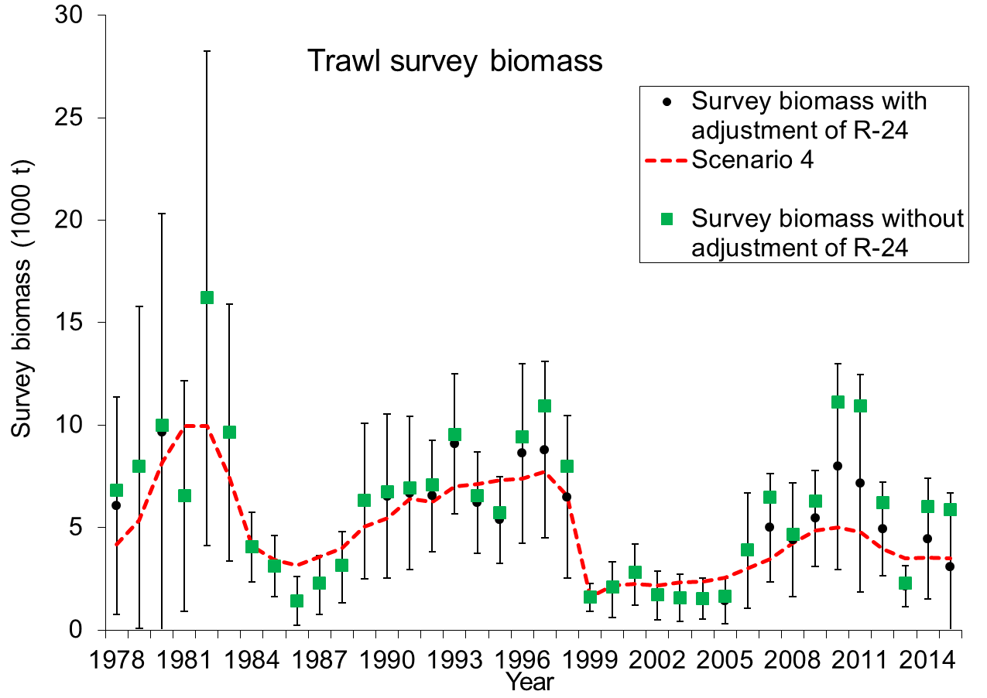
Scenario 4: Scenario 3 with trawl survey abundance adjustment in station R-24

Slide 19
Parameter Confounding
Many parameters are confounding in a length-based model. Changes in estimated survey selectivities could be the results of other parameter changes.
Scenario 5: Scenario 4 except for constant survey selectivities over time and estimating molting probability during 2000-2015.
Scenario 6: Scenario 4 except for increasing M from 0.18 to 0.36 during 2000-2015.

Slide 20
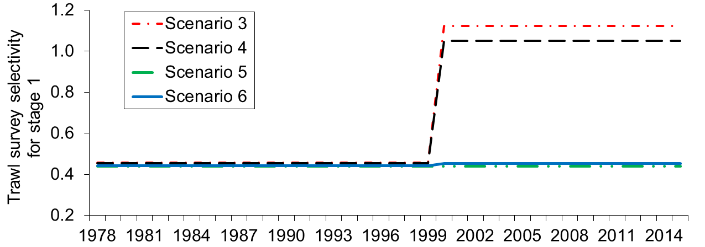
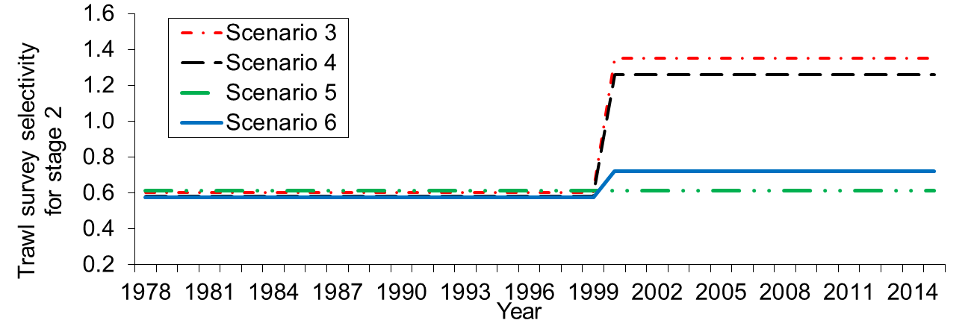
Scenario 5: Estimating molting probability during 2000-2015
Scenario 6: Increasing M from 0.18 to 0.36 during 2000-2015

Slide 21
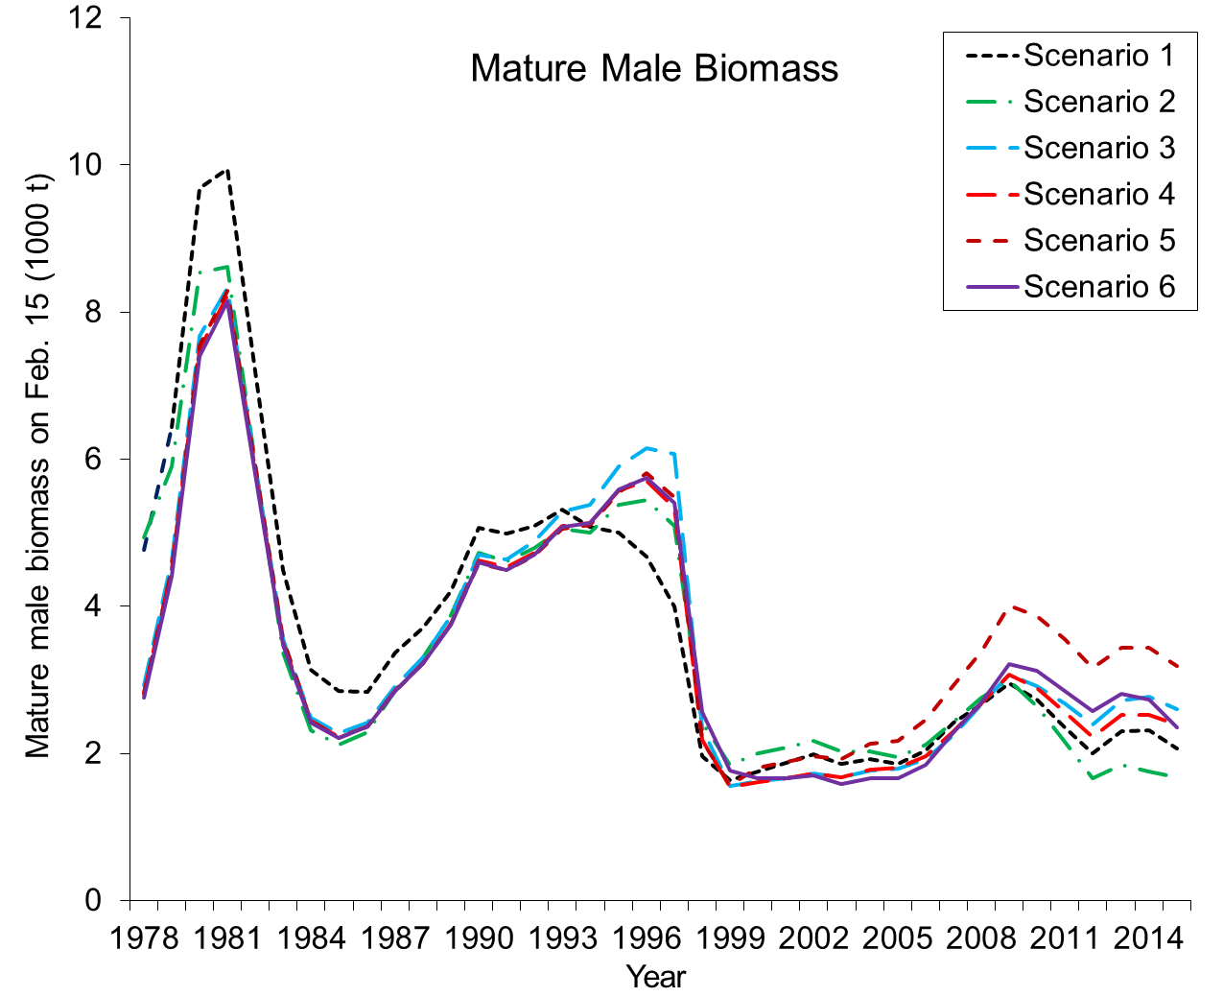

Slide 22
Summary
Changes in spatial distributions may be the reason for two survey data conflicts during recent years.
Adjustment of trawl survey abundance in station R-24 and estimating two additional survey biomass/CPUE CVs inside the model may have solved the data conflict problems.
Estimating survey selectivities in two time blocks eliminates the temporal residual biases of both survey biomass/CPUE and composition data.
Due to parameter confounding, estimated survey selectivity values depend on assumed M and molting probabilities. Differences of estimated survey selectivities between two time blocks may be due to change in spatial distributions, M, or molting probabilities.

Slide 23
Choice of Model Scenarios
1. Our preferred choice: Scenario 4:
(1) Best fit of the data,
(2) No bias,
(3) Relatively stable retrospective results,
(4) Reasonable adjustment of abundance in trawl survey station R-24,
(5) Reasonably to solve two survey data conflicts during recent
years.
2. Authorized decision: Scenario 1, further work on other scenarios.
3. What is your choice?

Slide 24
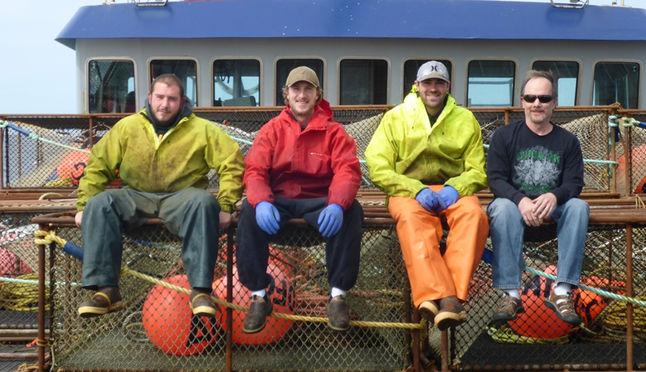
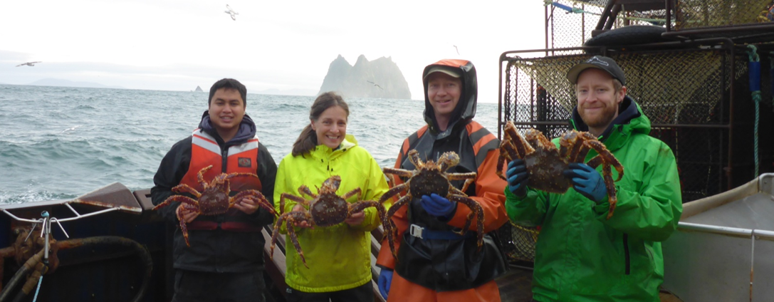
Thank you

